Slide 1


Omair Shafiq¹, Harold Boley², Derek Smith², Taylor Osmun²
¹Department of Computer Science, University of Calgary, Calgary, AB, Canada
²Institute for Information Technology, National Research Council, Canada
Fredericton, NB, Canada
PatientSupporter: A Social Semantic Web Portal for Virtual Support Groups
NRC Workshop

Slide 2
Part 1: PatientSupporter Foundation in
Profile Knowledge Base Interoperation
PatientSupporter Overview
Global and Local Knowledge Bases
Profile Interoperation Between Prolog-extending POSL & RDF-extending N3
  Interoperation Principles for
  Relational (POSL) and Networked (N3) Languages
  POSL ⬄ N3 Transformation
Injuries Partonomy
  Later seen in Part 2:
  A use case demo describes an online-interactive Patients community through the PatientSupporter system in Rule Responder

Slide 3
PatientSupporter Overview
PatientSupporter supports a patients community
that is online-interactive and rule-supported.
Each patient as participant of this community has the ability to:
  Create profiles about themselves, containing their preferences for injuries, healing stage, treatment level, possible collaboration times etc.
  Compare and collaborate with others in the community,
  to track progress and schedule group discussions for patients
Rules for patient profiles are
  Authored in rule languages such as POSL and N3
  Interoperated within the community using RuleML/XML

Slide 4
Global Knowledge Base
Contains knowledge relevant to everyone in the PatientSupporter community
Knowledge Areas:
  Participation check
    Checks preferred group size
  Age check
    Checks preferred age
  Good Duration check
    Checks preferred time duration w.r.t. start and end time
  Global Knowledge Base is available in POSL and N3

Slide 5
Local Knowledge Bases
Contains local knowledge specific to each patient in the PatientSupporter community
Knowledge Areas:
  ProfileID
    Unique identifier of patients
  Injury
    Injury partonomy
  Age
    Min Age and Max Age
  Group size
    Min and Max number of patients
  Category
    ‘In’ or ‘Out’ Patient
  Treatment Level
    Bandage, (Major or Medium or Minor) Operation, (Major or Medium or Minor) Medication or ChangeOfLifeStyle
  Healing Stage
    Fresh, Medium, Convalescent or Healed
  Start, End Time & Duration
    Year, Month, Day, Hour, Minute
  Channel
    Skype, MSN, Email etc.
  Gender
    Male or Female
  Contact
    Contact information
  Timezone
    All possible time zones
  MyDiscussion
    Derive patients’ individual injury preferences

Slide 6
Profile Interoperation (POSL & N3)
Support for both logic-relational (e.g., POSL) and
graph-networked (e.g., N3) knowledge representations
Users may write their profile in either language
Support for Prova, OO jDREW and Euler engines to execute
queries issued to POSL and N3 knowledge bases, respectively
Later seen in Part 2:
By using a RuleML subset as the exchange language and
Rule Responder as the platform, queries and answers
can be exchanged with all supported engines

Slide 7
POSL
POSL integrates positional and slotted knowledge
(e.g., Prolog’s positional and F-logic’s slotted knowledge)
PatientSupporter only uses positional POSL for logic-relational knowledge, displayed in a Prolog-like human-readable syntax
Positional relation descriptions (fact and query examples):
  Relation names (f):
    Each fact and rule head has a relation name
  Arguments (f):
    Constant arguments are strings or symbols, separated by commas (“,”)
  Variables (q):
    Variables can be named (“?” prefix) or anonymous (stand-alone “?”)
treatment(p0001,?Injury, ?Treatment).
treatment(p0001,?Injury, ?Treatment).
treatment(p0001,?Injury, ?Treatment).

Slide 8
Notation 3 (N3)
N3 is a compact, rule-extended version of RDF's XML syntax.
Writes triples (subject, property, object) as subject descriptions
PatientSupporter uses N3 for graph-networked readable knowledge
Slotted subject descriptions (fact and query examples):
  Subject names (f):
    Each fact / rule head has a subject name
  Variables (q):
    Can be named (“?” prefix ),
    or anonymous (stand-alone “?”)
  Arguments as property→object slots (f):
    Each argument must have
    a property (slot name):
    Each argument must also
    have an object (slot value):
“:” here denotes IRI of this local knowledge base
:treatment
rdf:type :Treatment;
:profileID :p0001;
:injury ?Injury;
:treatment ?Treatment.
:treatment
rdf:type :Treatment;
:profileID :p0001;
:injury ?Injury;
:treatment ?Treatment.
?treatment
rdf:type :Treatment;
:profileID :p0001;
:injury ?Injury;
:treatment ?.
:treatment
rdf:type :Treatment;
:profileID :p0001;
:injury ?Injury;
:treatment ?Treatment.

Slide 9
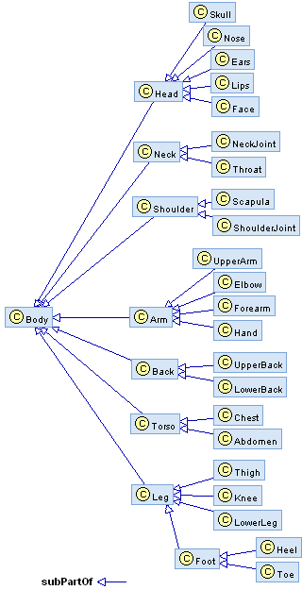
Partonomy
The PatientSupporter partonomy is organized as hierarchy of Injuries
Each of these contains different injuries (e.g., Leg and Head etc.)
Both representations use rdf:type, rdfs:Class and rdfs:subClassOf
Partonomy classes act as user-defined types to restrict rule variables
RDF (used by POSL)
<rdf:RDF
xmlns:rdf="http://www.w3.org/1999/02/22-rdf-syntax-ns#"
xmlns:rdfs="http://www.w3.org/2000/01/rdf-schema#">
<rdf:Description rdf:ID=“PatientSupporter">
<rdf:type rdf:resource="http://www.w3.org/2000/01/rdf-schema#Class"/>
</rdf:Description>
<rdf:Description rdf:ID=“Injury">
<rdf:type rdf:resource="http://www.w3.org/2000/01/rdf-schema#Class"/>
<rdfs:subClassOf rdf:resource="#PatientSupporter"/>
</rdf:Description>
<rdf:Description rdf:ID=“Leg">
<rdf:type rdf:resource="http://www.w3.org/2000/01/rdf-schema#Class"/>
<rdfs:subPartOf rdf:resource="#Injury"/>
</rdf:Description>
…

Slide 10
Part 2: PatientSupporter for an Online-Interactive Patients Community via Rule Responder
PatientSupporter as a Rule Responder
PatientSupporter Conceptual View
PatientSupporter Technical View
PatientSupporter Agent Implementation
Discussion Scenario: Example Queries with Live Demo
  Previously seen in Part 1:
  Foundation of PatientSupporter in profile knowledge base interoperation,
  which is assisted through transformation techniques

Slide 11
PatientSupporter as a Rule Responder
Rule Responder is an intelligent multi-agent infrastructure for collaborative teams and virtual communities
Rule Responder uses three kinds of agents:
  Organizational Agent (OA)
  Personal Agents (PAs)
    PAs extended to select relevant profiles of patients
  External Agents (EAs)
The PatientSupporter instantiation of Rule Responder employs the OA, PAs, and EAs for communication and query delegation
to support an online-interactive community of patients
  Similar to WellnessRules and SymposiumPlanner

Slide 12






Rule Responder
Conceptual View
EA: External Agent
Enquiry User
Injury₁
PA
Injury_{n}
PA
OA
m ...... 1
m ...... 1
Profile
Users
. . . . .
Profile
Users
m ...... 1
Injury₂
PA
Injury₃ PA
. . . . .
m ...... 1
Profile
Users
Virtual
Organization
Profile
Users

Slide 13
Rule Responder
Technical View
Organizational Agent
Browser (External Agent)
Rule Engine (Prova)
Knowledge Base
Web Browser
HTTP Web Form
Reaction RuleML Message
Reaction RuleML
Reaction RuleML
Patient PA instances
Enterprise
Service Bus
Rule Agent (OO jDREW)
…
Reaction RuleML
Rule Agent (OO jDREW)
Knowledge Base
Knowledge Base
Rule Agent (OO jDREW)
Knowledge Base
Reaction RuleML
Reaction RuleML
Reaction RuleML
Patient PA instances
Patient PA instances
Patient PA instances
Rule Agent (OO jDREW)
…
Rule Agent (OO jDREW)
…
Rule Agent (OO jDREW)
…
Rule Agent (OO jDREW)
Rule Agent (OO jDREW)
Rule Agent (OO jDREW)
Knowledge Base
Knowledge Base
Knowledge Base
Knowledge Base
Knowledge Base
Knowledge Base
Rule Agent (OO jDREW)
Rule Agent (OO jDREW)
Rule Agent (OO jDREW)
Knowledge Base
Knowledge Base
Knowledge Base

Slide 14
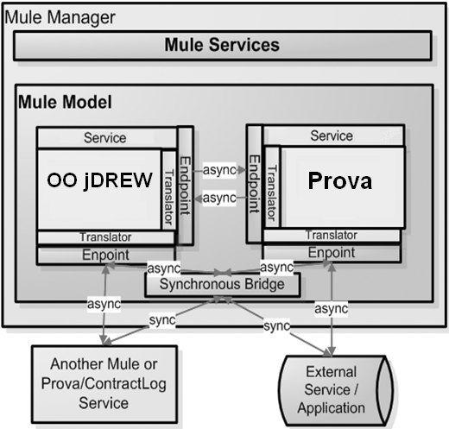
Communication using Mule Enterprise Service Bus
Mule ESB Open Source
Message Platform and distributed Object Broker
Event Driven Architecture (EDA)
> 30 Protocols (JMS, HTTP, SOAP …)
Synchronous and Asynchronous Communication
Message-driven Event Processing

Slide 15
PatientSupporter Architecture
Legend:
Data transfer via Mule
Data transfer from File
Possible data transfer from File
PatientSupporter Website (EA)
Prova Rulebase & Engine (OA)
Group Responsibility Matrix
Patient Injury PA₁
Patient Injury PA₂
Patient Injury PA₃
…
Patient Injury PA_{n}
Profile Responsibility Matrix
P0001 (Patient)
P0002 (Patient)
P0003 (Patient)
P0004 (Patient)
…
P000n (Patient)

Slide 16
Rule Responder Agents (EA, OA, PAs)
External Agent (EA):
  The PatientSupporter website (shown later)
Organizational Agent (OA):
  Contains a Prova knowledge base which is used for incoming queries: directs them to appropriate PAs via the Group Responsibility Matrix
Personal Agent with Profiles (PA):
  Consists of a Java servlet and − using the two embedded engines,
  OO jDREW and Euler − forwards the query to POSL and N3 profile knowledge bases, respectively
  It only has access to profiles which contain relevant information
  for its responsible injury by using the Profile Responsibility Matrix

Slide 17
Group and Profile Responsibility Matrix
Role assignment on two levels: Group Responsibility Matrix (GRM) and Profile Responsibility Matrix (PRM)
The GRM contains information about PA
injury responsibility, written as an OWL light ontology.
It defines which PA is best suited for different kinds of queries
The PRM contains information about PA profile responsibility and the format of each profile knowledge base:
<Injury>
<Leg>
<ResponsibleProfile name="p0001" format=”posl"/>
<ResponsibleProfile name="p0002" format=”n3"/>
<ResponsibleProfile name="p0003" format="posl"/>
</Leg>
. . .
</Injury>
PA_{Leg} :

Slide 18
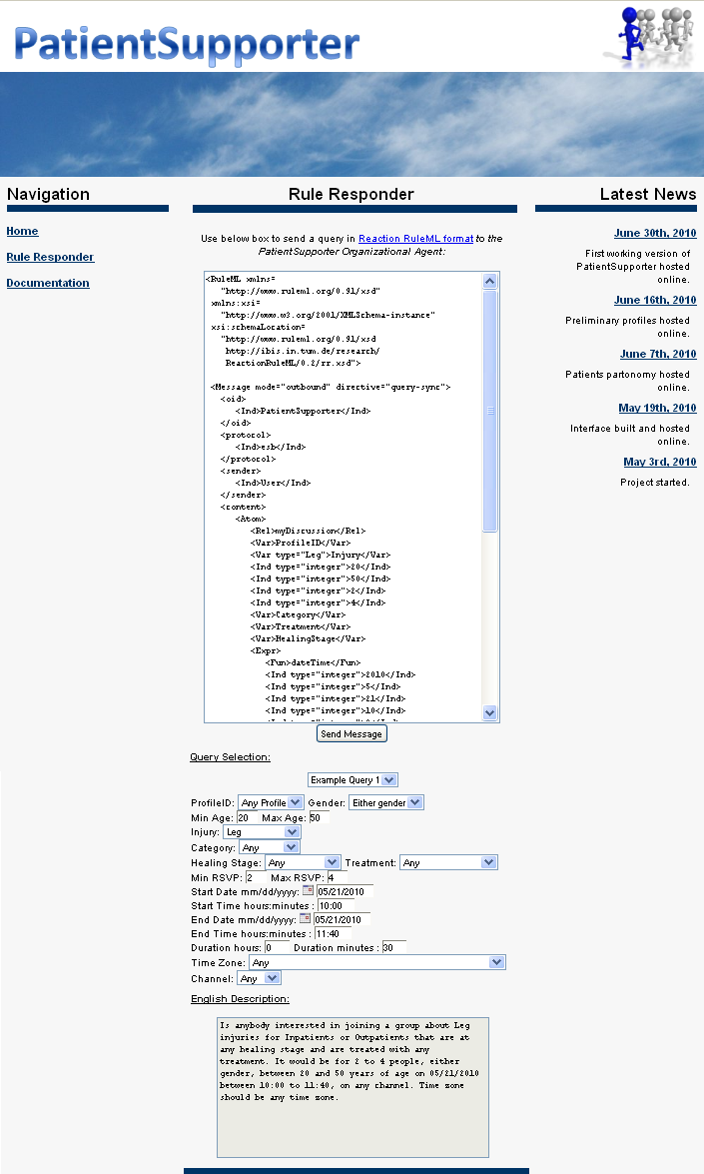
Website (EA)
EA is used to issue queries to the PatientSupporter OA
Query can be written manually or constructed by using the Javascript based GUI
Query is placed in the text box, in the RuleML format
The Send Message will issue the query to the OA
A new screen containing a list of answers in RuleML will be presented
Query examples are provided with their subsequent English descriptions. Can be modified to suit your query
  Online Demo:
  http://ruleml.org/PatientSupporter/RuleResponder.htm

Slide 19
Example Query 1
Paul issues Query 1
Green designates a relation name
...
<Atom>
<Rel>myDiscussion</Rel>
<Var>ProfileID</Var>
<Ind>Leg</Ind>
<Ind type="integer">20</Ind>
<Ind type="integer">75</Ind>
<Ind type="integer">2</Ind>
<Ind type="integer">5</Ind>
<Var>Category</Var>
<Var>Treatment</Var>
<Var>HealingStage</Var>
<Expr>
<Fun>dateTime</Fun>
<Var>StartYear</Var>
<Var>StartMonth</Var>
<Var>StartDay</Var>
<Var>StartHour</Var>
<Var>StartMinute</Var>
</Expr>
<Expr>
<Fun>dateTime</Fun>
...
</Expr>
<Expr>
<Fun>dateTime</Fun>
...
</Expr>
<Var>Channel</Var>
<Var>Contact</Var>
<Var>Gender</Var>
<Var>Timezone</Var>
</Atom>
...
English Description:
Is anybody interested in joining a group about Leg injuries
for any category (In or Out)
that are at any healing stage
and are treated with any treatment level.
It would be for 2 to 5 people,
either gender,
between 20 and 75 years of age
on any day between any time,
on any channel,
and any time zone?
Blue designates a constant.
More will get blue
as we progress
RuleML
Orange designates a variable

Slide 20
Example Query 1 – POSL & N3
RuleML
N3
...
<Atom>
<Rel>myDiscussion</Rel>
<Var>ProfileID</Var>
<Ind>Leg</Ind>
<Ind type="integer">20</Ind>
<Ind type="integer">75</Ind>
<Ind type="integer">2</Ind>
<Ind type="integer">5</Ind>
<Var>Category</Var>
<Var>Treatment</Var>
<Var>HealingStage</Var>
<Expr>
<Fun>dateTime</Fun>
<Var>StartYear</Var>
<Var>StartMonth</Var>
<Var>StartDay</Var>
<Var>StartHour</Var>
<Var>StartMinute</Var>
</Expr>
<Expr>
<Fun>dateTime</Fun>
...
</Expr>
<Expr>
<Fun>dateTime</Fun>
...
</Expr>
<Var>Channel</Var>
<Var>Contact</Var>
<Var>Gender</Var>
<Var>Timezone</Var>
</Atom>
...
_:myDiscussion
rdf:type :MyDiscussion;
:profileID ?ProfileID;
:injury :Leg;
:minAge 20;
:maxAge 75;
:minRSVP 2;
:maxRSVP 5;
:Category ?Category;
:Treatment ?Treatment;
:HealingStage ?Healing;
:startTime ?StartTime;
:endTime ?EndTime;
:duration ?Duration;
:channel ?Channel;
:contact ?Contact;
:timezone ?TimeZone.
POSL
myDiscussion(?ProfileID,Leg,20:integer,75:integer,2:integer,5:integer,?Category,
?Treatment,?HealingStage,
dateTime[?StartYear,? StartMonth,? StartDay,? StartHour,? StartMinute],
dateTime[?EndYear,? EndMonth,? EndDay,? EndHour,? EndMinute],
dateTime[?DurYear,?DurMonth,?DurDay,?DurHour,?DurMinute],
?Channel,?Contact,?Gender,?TimeZone) .

Slide 21
Conclusion
The PatientSupporter case study:
  Uses a global as well as distributed local knowledge bases
  to support profile interoperation and querying
  Demonstrates profile interoperation between logic-relational (e.g., POSL) and graph-networked (e.g., N3) knowledge representations
  Introduces an extended Rule Responder architecture,
  adding the profile level underneath the PAs
  Supports online-interactive communities of patients through
  the PatientSupporter in Rule Responder
  This system, described here, has been developed followed by WellnessRules and SymposiumPlanner

