Slide 1

Taylor Osmun
Institute for Information Technology
National Research Council, Canada
Fredericton, NB, Canada

Slide 2

WellnessRules Overview
WellnessRules + Rule Responder
PA & OA components of WellnessRules
WellnessRules Ontology in N3
Sample WellnessRules usage through N3 & Euler
  Sample Query
  Sample Result
  MyActivity Rule

Slide 3

WellnessRules goal is to create an online-interactive wellness community. This community would have the ability to:
  Create profiles about themselves containing their preferences for activities and nutrition, their event days, and their fitness levels.
  Collaborate with others in the community to schedule group wellness events.
  Track other participant’s progress and relate it to their own.
Rules about wellness opportunities are created by participants in rule languages such as Prolog and N3, and translated within a wellness community using RuleML/XML.

Slide 4

Rule Responder is an intelligent multi-agent infrastructure for collaborative teams and virtual communities.
Each Rule Responder instantiation uses three different kinds of agents:
  Organizational Agent (OA)
  Personal Agents (PAs)
  External Agents (EAs)
WellnessRules uses the OA, PAs, and EAs to create an online-interactive wellness community.

Slide 5

Contains all global knowledge in the WellnessRules knowledge base.
Knowledge Areas:
  Season
    Defines timeframe of the seasons.
  Forecast
    Describes the weather forecast within timeframes.
  Meetup
    Contains activity meet up locations for maps.

Slide 6

Contains local knowledge which is unique to each participant in the WellnessRules community.
Knowledge Areas:
  Calendar
    Used for event planning. Allows for sharing of calendars between profiles.
  Map
    Links to Meetup locations. Allows for sharing of maps between profiles.
  Fitness
    Defines expected fitness level for specific a period of time.
    (scale of 1-10)
  Event
    Possible/Planned/Performing/Past
  MyActivity
    Define user’s individual activity preferences

Slide 7

@prefix : <wellnessRules#>.
@prefix rdf: <http://www.w3.org/1999/02/22-rdf-syntax-ns#>.
@prefix rdfs: <http://www.w3.org/2000/01/rdf-schema#>.
:Wellness rdf:type rdfs:Class.
:Activity rdf:type rdfs:Class;
rdfs:subClassOf :Wellness.
:Walking rdf:type rdfs:Class;
rdfs:subClassOf :Activity.
:Running rdf:type rdfs:Class;
rdfs:subClassOf :Activity.
:Swimming rdf:type rdfs:Class;
rdfs:subClassOf :Activity.
:Skating rdf:type rdfs:Class;
rdfs:subClassOf :Activity.
:Yoga rdf:type rdfs:Class;
rdfs:subClassOf :Activity.
:Hiking rdf:type rdfs:Class;
rdfs:subClassOf :Activity.
:Baseball rdf:type rdfs:Class;
rdfs:subClassOf :Activity.
The WellnessRules ontology is broken into two topics, Activity, and Nutrition.
Each of these contain multiple sub-topics (i.e. Running).
Our N3 representation uses rdf:type and rdfs:subClassOf

Slide 8

The following slides contain:
  Sample Query
  Sample Result
  MyActivity Rule
The prefix ‘:’ represents the WellnessRules knowledge base:
There are 3 things to look for:
  Query Constants – User’s preferences, ‘passed in’ to the rule and conclusion.
  Variables – The variables that are ‘transported’ from premise to conclusion.
  Profile Constraints – Profile’s preferences, used in the MyActivity rule.
@prefix : <wellnessRules#>.

Slide 9

Asks the WellnessRules system if the user ‘p0001’ is interested in going for an indoor run during the given times.
Query Constants:
  :MyActivity
  :p0001
  :Running
  :in
  “2009-06-15T10:15:00”
  “2009-06-15T11:15:00”
### Query
@prefix : <wellnessRules#>.
@prefix rdf: <http://www.w3.org/1999/02/22-rdf-syntax-ns#>.
_:myActivity
rdf:type :MyActivity;
:profileID :p0001;
:activity :Running;
:inOut :in;
:minRSVP ?MinRSVP;
:maxRSVP ?MaxRSVP;
:startTime "2009-06-15T10:15:00";
:endTime "2009-06-15T11:15:00";
:location ?Place;
:duration ?Duration;
:fitnessLevel ?FitnessLevel.

Slide 10

rdf:type
p0001 is interested in running indoors within this timeframe.
Variables:
  1
  2
  :joesGym
  “P10M”
  5
_:sk46
a :MyActivity;
:profileID :p0001;
:activity :Running;
:inOut :in;
:minRSVP 1;
:maxRSVP 2;
:startTime "2009-06-15T10:15:00”;
:endTime "2009-06-15T11:15:00”;
:location :joesGym;
:duration "P10M”;
:fitnessLevel 5.
Datetime format for 10 minutes

Slide 11

A rule consists of a
subgraph {... } of premises,
an ‘implies’ arrow =>
and a
subgraph {... } for the
conclusion.
We will develop a rule, showing its premises in three parts, followed by its conclusion.
Premise
{
…
}
=>
{
...
}.
Implies
Conclusion

Slide 12

{?calendar
rdf:type :Calendar;
:profileID :p0001;
:calendarID ?CalendarID.
?event
rdf:type :Event;
:calendarID ?CalendarID;
:aspect :Running;
:tense :possible;
:startTime ?StartTime;
:endTime ?EndTime.
?season
rdf:type :Season;
:startTime ?StartTime;
:value :summer.
?forecast
rdf:type :Forecast;
:startTime ?StartTime;
:aspect :temperature;
:value ?Temp.
?Temp math:notLessThan 30.
… }
Using global and local facts, the season and temperature are retrieved.
Profile Constraints:
  Has a possible event
  Season = Summer
  Temperature >= 30
Users may be using another participant’s calendar

Slide 13

{ …
?participation
rdf:type :Participation;
:profileID :p0001;
:activity :run;
:inOut :in;
:min ?MinRSVP;
:max ?MaxRSVP.
?map
rdf:type :Map;
:profileID :p0001;
:mapID ?MapID.
?meetup
rdf:type :Meetup;
:mapID ?MapID;
:activity :run;
:inOut :in;
:location ?Place.
… }
Using global and local facts, the min/max RSVP, and location of the event is determined.
Profile Constraints:
  Has a possible event
  Season = Summer
  Temperature >= 30

Slide 14

{ …
?level
rdf:type :Level;
:profileID :p0001;
:activity :run;
:inOut :in;
:location ?Place;
:duration ?Duration;
:fitnessLevel ?FitnessLevel.
?fitness
rdf:type :Fitness;
:profileID :p0001;
:startTime ?StartTime;
:expectedFitness ?ExpectedFitness.
?ExpectedFitness math:notLessThan ?FitnessLevel.
}
Using local facts, the level of the activity, and the user’s preferred level are checked.
Profile Constraints:
  Has a possible event
  Season = Summer
  Temperature >= 30
  Expected Fitness >= Required Fitness

Slide 15

The three key components, Query Constants, Variables, and Profile Constraints, along with other facts in the knowledge base, will be used to fill this premise. This will generate the previously seen result.
There can be many answers to a single query.
Premise:
{ … }
=>
{
_:myActivity
rdf:type :MyActivity;
:profileID :p0001;
:activity :Running;
:inOut :in;
:minRSVP ?MinRSVP;
:maxRSVP ?MaxRSVP;
:startTime ?StartTime;
:endTime ?EndTime;
:location ?Place;
:duration ?Duration;
:fitnessLevel ?FitnessLevel.
}.
Result:
:MyActivity;
:p0001;
:Running;
:in;
1;
2;
"2009-06-15T10:15:00”;
"2009-06-15T11:15:00”;
:joesGym;
"P10M”;
5.

Slide 16


Query Constants:
  :MyActivity
  :p0001
  :Running
  :in
  “2009-06-10T10:15:00”
  “2009-06-10T11:15:00”
…
rdf:type :MyActivity;
:profileID :p0001;
:activity :Running;
:inOut :in;
:startTime "2009-06-15T10:15:00";
:endTime "2009-06-15T11:15:00";
…
?event
…
:tense :possible;
…
Variables:
  1
  2
  :joesGym
  “P10M”
  5
…
:minRSVP 1;
:maxRSVP 2;
:location :joesGym;
:duration "P10M”;
:fitnessLevel 5.
…
?season
…
:value :summer.
?Temp math:notLessThan 30.
?ExpectedFitness math:notLessThan ?FitnessLevel.

Slide 17

WellnessRules Overview and Rule Responder
Local and Global components of WellnessRules
WellnessRules Ontology in N3
Sample WellnessRules usage through N3 & Euler
  Query Constants
  Variables
  Profile Constraints
Coming up:
  Euler Eye Installation, Demo,
  and Deep Taxonomy Benchmark

Slide 18

Taylor Osmun
Institute for Information Technology
National Research Council, Canada
Fredericton, NB, Canada

Slide 19

Three test cases:
  Linear Relationship
  Single Additional Option
  Two Additional Options
Timed via Java JRE 1.6.0_13, using Euler Eye 5.1.3
Timings are taken for increasing number of triples.
100, 1 000, 10 000, and 20 000.
Final values are plotted in MATLAB and equation is estimated.

Slide 20

Uses a single fact:
Query is issued so that it must traverse all possible answers:
Using this format for relations. Each rule counts as a triple.
Produces the result:
…
:Test rdf:type :A1
…
{?X rdf:type :A1} => {?X rdf:type :B1}.
{?X rdf:type :B1} => {?X rdf:type :C1}.
{?X rdf:type :C1} => {?X rdf:type :D1}.
{?X rdf:type :D1} => {?X rdf:type :E1}.
…
{?X rdf:type :Y1} => {?X rdf:type :A2}.
Z is skipped so as to return to the beginning of the alphabet, within 24 characters.
…
_:Subject rdf:type :A2.
...
:Test a :A2.
rdf:type

Slide 21

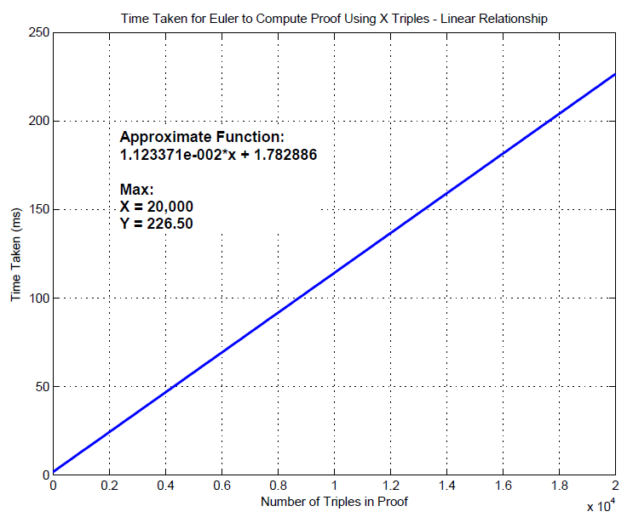
Note the linear growth of the time taken, as more triples (linear rules) are added.

Slide 22

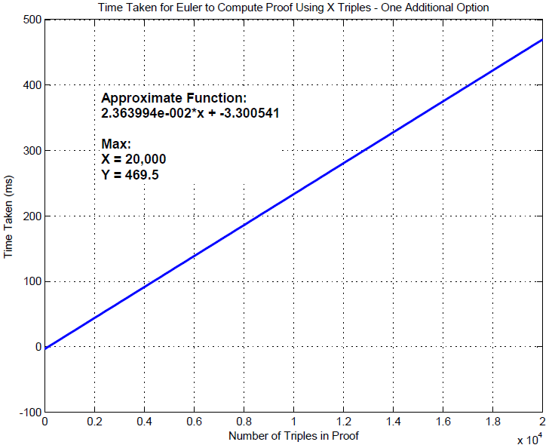
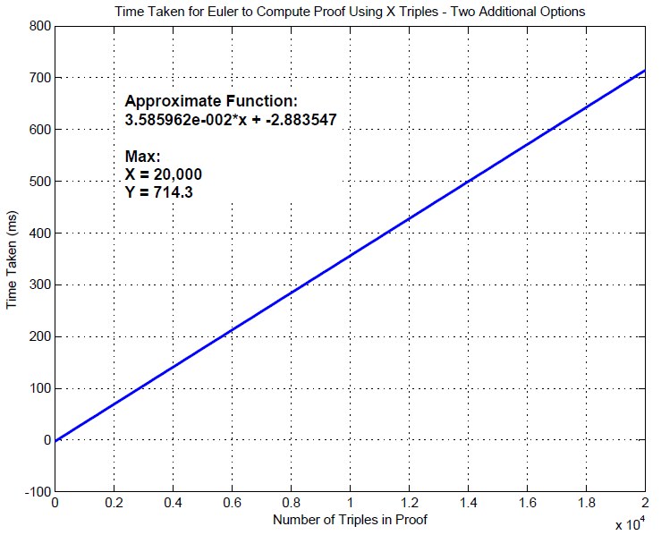
Single additional option:
Two additional options:
…
{?X rdf:type :A1} => {?X rdf:type :B1}.
{?X rdf:type :A1} => {?X rdf:type :Node1}.
{?X rdf:type :B1} => {?X rdf:type :C1}.
{?X rdf:type :B1} => {?X rdf:type :Node2}.
…
…
{?X rdf:type :A1} => {?X rdf:type :B1}.
{?X rdf:type :A1} => {?X rdf:type :Node1}.
{?X rdf:type :A1} => {?X rdf:type :Node2}.
{?X rdf:type :B1} => {?X rdf:type :C1}.
{?X rdf:type :B1} => {?X rdf:type :Node3}.
{?X rdf:type :B1} => {?X rdf:type :Node4}.
…

Slide 23

Regardless of the number of additional options, the growth of the function will still be linear.
Change in magnitude:
  Linear Relationship @ 20,000:
    2,265 sec
  One Additional Option @ 20,000:
    4,695 sec
  Two Additional Options @ 20,000:
    7,143 sec
But again, a linear pattern is observed.
Therefore, Euler EYE is extremely efficient with regards to overall time, as well as increasing complexity of the knowledge base.

Slide 24

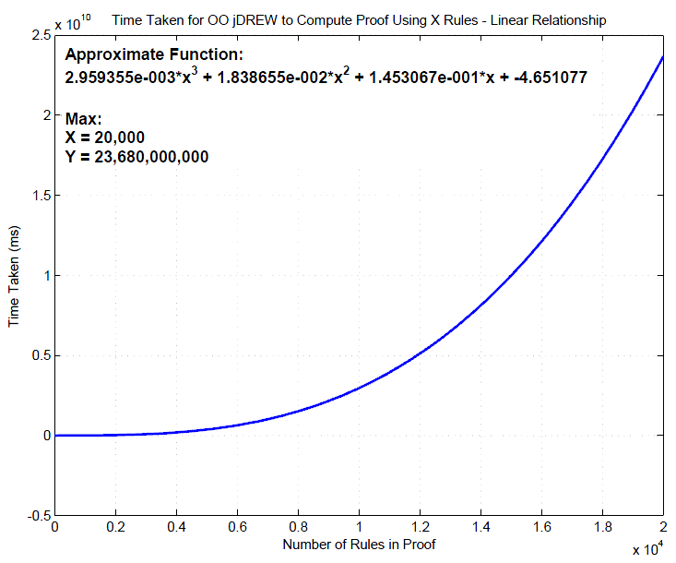
Euler Eye Results:
Linear Relationship @ 20,000
  2,265 sec = 37.75 min
OO jDREW Results:
Linear Relationship @ 20,000
  2.3*10^14ms = 750 years

Slide 25

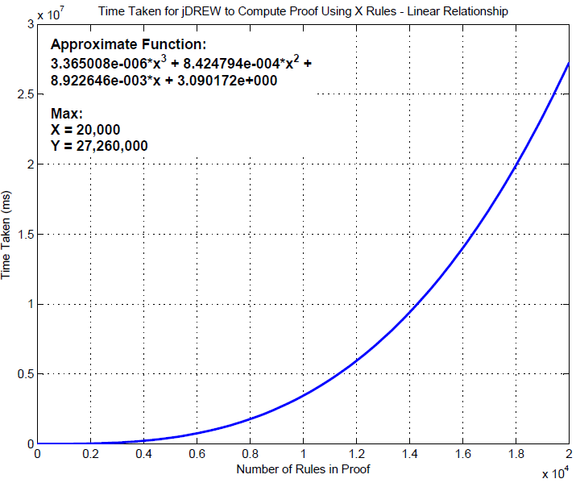
Euler Eye Results:
Linear Relationship @ 20,000
  2,265 sec = 37.75 min
jDREW Results:
Linear Relationship @ 20,000
  2.7*10^11 = 316 days
  (OO jDREW = 750 years)

Slide 26
Euler EYE was set up for use in Eclipse.
Small demo using WellnessRules was shown.
Using the three test cases, benchmarking results were analyzed for Euler EYE
These results were then compared to OO jDREW and jDREW, respectively.

Slide 27

Euler:
  http://www.agfa.com/w3c/euler/
Semantic Web Tutorial Using N3:
  http://www.w3.org/2000/10/swap/doc/
WellnessRules – Rule Responder:
  http://ruleml.org/WellnessRules/RuleResponder/

