Slide 1
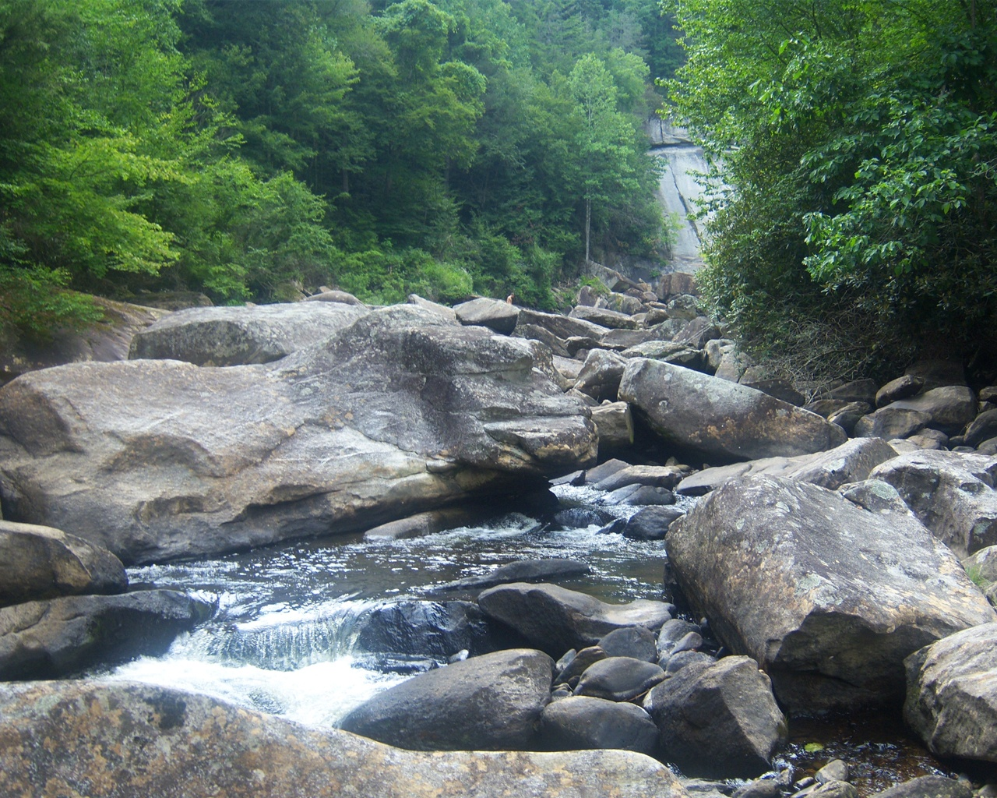
WellnessRules2: Supporting Social Semantic Wellness Communities with Rule Responder
Harold Boley, Taylor Osmun, Derek Smith
Institute for Information Technology, National Research Council, Canada
Fredericton, NB, Canada
2nd Atlantic Workshop on Semantics and Services (AWoSS 2)
Moncton, NB , Canada, Nov. 10, 2010

Slide 2
WellnessRules − Idea and Implementations
The Social Web (Web 2.0) meets
the Semantic Web (ontologies and rules)
in a Social Semantic Web (Web 3.0):
People advertise their semantic profiles
to socialize with others in wellness groups
Implemented in WellnessRules & WellnessRules2

Slide 3

WellnessRules Overview
WellnessRules supports a wellness community
that is online-interactive and rule-supported.
Each participant of this community has the ability to:
  Create profiles about themselves, containing their preferences for activities and nutrition, their event times, and their fitness levels
  Compare and collaborate with others in the community,
  to track progress and schedule group events
Rules about wellness opportunities are
  authored in rule languages such as POSL and N3
  interoperated within the community using RuleML/XML

Slide 4
Global Knowledge Base
Contains knowledge relevant to everyone in the WellnessRules community
Knowledge Areas:
  Season
    Defines timeframe of the seasons
  Forecast
    Describes the weather forecast within timeframes
  Meetup
    Contains activity meetup locations for maps
  Global Knowledge Base is available in POSL and N3

Slide 5
Local Knowledge Bases
Contains local knowledge specific to each participant in the WellnessRules community
Knowledge Areas:
  Calendar
    Used for event planning. Allows for sharing of calendars between profiles
  Map
    Links to meetup locations. Allows for sharing of maps between profiles
  Fitness
    Defines expected fitness level for a specific period of time (scale of 1-10)
  Event
    Possible/Planned/Performing/Past
  MyActivity
    Derive participants’ individual activity preferences

Slide 6
Local MyActivity Sample Rule (in POSL)
− Centered on Participant p0001as First Argument
myActivity(p0001,Running,out,?MinRSVP,?MaxRSVP,?StartTime,?EndTime,?Place,?Duration,?Level)
:-
calendar(p0001,?Calendar),
event(?Calendar,?:Running,possible,?StartTime,?EndTime),
participation(p0001,run,out,?MinRSVP,?MaxRSVP),
season(?StartTime,summer),
forecast(?StartTime,sky,?Weather),
notEqual(?Weather,raining),
map(p0001,?Map),
meetup(?Map,run,out,?Place),
level(p0001,run,out,?Place,?Duration,?Level),
fitness(p0001,?StartTime,?ExpectedFitness),
greaterThanOrEqual(?ExpectedFitness,?Level),
goodDuration(?Duration,?StartTime,?EndTime).
Orange designates a profile
preference
Based on this rule the following are p0001’s preferences for Running outdoors:
  The number of participants must be within the minimum and maximum
  The season must be summer
  It must not be raining outside
  p0001’s fitness level is greater than or equal to the required fitness level

Slide 7
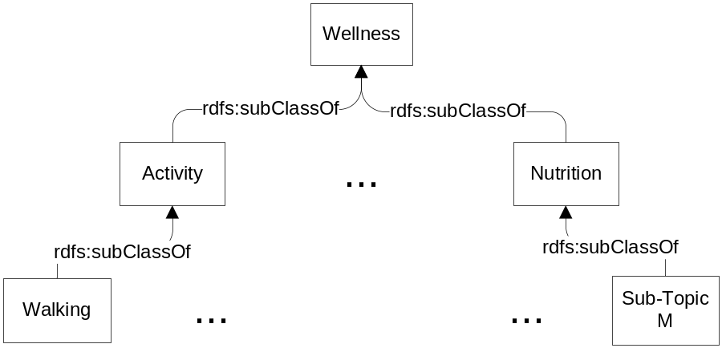
Taxonomy
The WellnessRules taxonomy is broken into two topics: Activity and Nutrition
Each of these contains multiple subtopics (e.g., Walking and Running)
Both representations use rdf:type, rdfs:Class and rdfs:subClassOf
Taxonomy classes act as user-defined types to restrict rule variables
RDF (used by POSL)
N3
<rdf:RDF
xmlns:rdf="http://www.w3.org/1999/02/22-rdf-syntax-ns#"
xmlns:rdfs="http://www.w3.org/2000/01/rdf-schema#">
<rdf:Description rdf:ID="Wellness">
<rdf:type rdf:resource="http://www.w3.org/2000/01/rdf-schema#Class"/>
</rdf:Description>
<rdf:Description rdf:ID="Activity">
<rdf:type rdf:resource="http://www.w3.org/2000/01/rdf-schema#Class"/>
<rdfs:subClassOf rdf:resource="#Wellness"/>
</rdf:Description>
<rdf:Description rdf:ID="Walking">
<rdf:type rdf:resource="http://www.w3.org/2000/01/rdf-schema#Class"/>
<rdfs:subClassOf rdf:resource="#Activity"/>
</rdf:Description>
…
@prefix : <wellnessRules#>.
@prefix rdf: <http://www.w3.org/1999/02/22-rdf-syntax-ns#>.
@prefix rdfs: <http://www.w3.org/2000/01/rdf-schema#>.
:Wellness rdf:type rdfs:Class.
:Activity rdf:type rdfs:Class;
rdfs:subClassOf :Wellness.
:Walking rdf:type rdfs:Class;
rdfs:subClassOf :Activity.
…
⬄

Slide 8
WellnessRules as a Rule Responder
Rule Responder is an intelligent multi-agent infrastructure for collaborative teams and virtual communities
Rule Responder uses three kinds of agents:
  Organizational Agent (OA)
  Personal Agents (PAs)
    PAs extended to select relevant profiles of participants
  External Agents (EAs)
The WellnessRules instantiation of Rule Responder employs the OA, PAs, and EAs for communication and query delegation
to support an online-interactive wellness community
  Similar to SymposiumPlanner

Slide 9
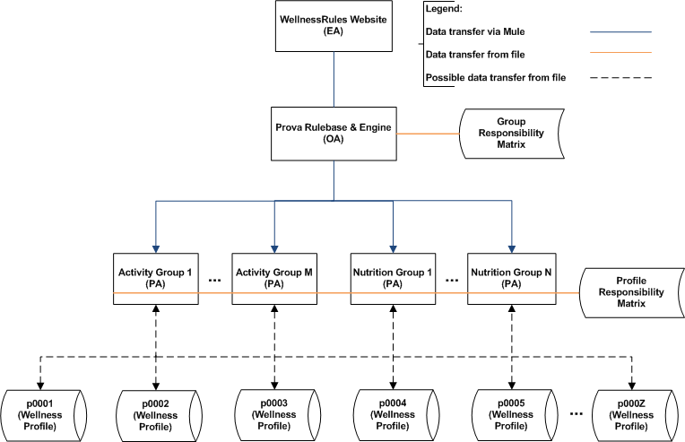
WellnessRules Architecture

Slide 10
Rule Responder Agents (OA, PAs, EAs)
External Agent (EA):
  The WellnessRules website (shown later)
Organizational Agent (OA):
  Contains a Prova knowledge base which is used for incoming queries: directs them to appropriate PAs via the Group Responsibility Matrix
Personal Agent with Profiles (PA):
  Consists of a Java servlet and − using the two embedded engines,
  OO jDREW and Euler − forwards the query to POSL and N3 profile knowledge bases, respectively
  It only has access to profiles which contain relevant information
  for its responsible activity by using the Profile Responsibility Matrix

Slide 11
Group and Profile Responsibility Matrix
Role assignment on two levels: Group Responsibility Matrix (GRM) and Profile Responsibility Matrix (PRM)
The GRM contains information about PA
wellness responsibility, written as an OWL light ontology.
It defines which PA is best suited for different kinds of queries
The PRM contains information about PA profile responsibility and the format of each profile knowledge base:
<Activity>
<Walking>
<ResponsibleProfile name="p0001" format=”posl"/>
<ResponsibleProfile name="p0002" format=”n3"/>
<ResponsibleProfile name="p0003" format="posl"/>
</Walking>
. . .
</Activity>
PA_{Walking} :

Slide 12
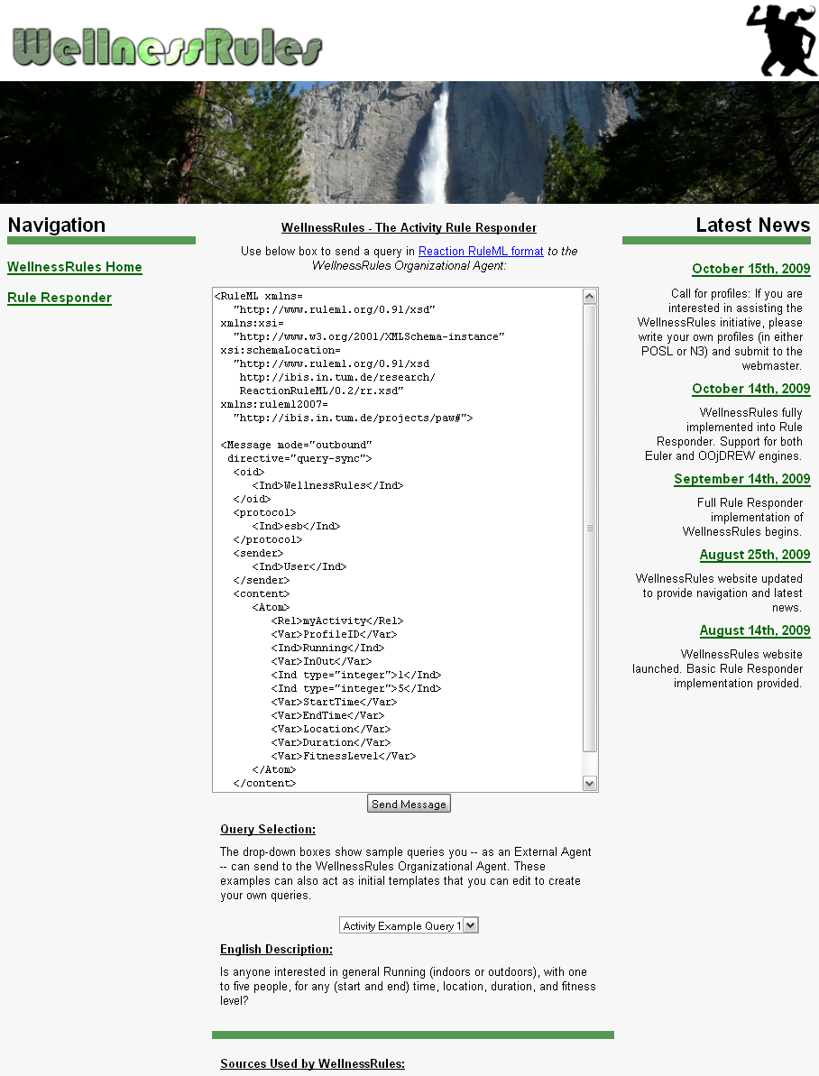
Website (EA)
EA used to issue queries to the WellnessRules OA
Query is placed in the text box, in RuleML format
The Send Message will issue the query to the OA
A new screen containing a list of answers in RuleML will be presented
Query examples are provided with their subsequent English descriptions. Can be modified to suit your query
  Online Demo:
  http://www.ruleml.org/WellnessRules/RuleResponder

Slide 13
Activity Scenario: Structured English
Introduction:
In this scenario a participant of WellnessRules (Peter) uses the system to find one or more partners for Running some time in the near future
Query 1:
Peter first asks the community if anyone at all is interested in running with 2 to 6 people. Assessing the answer to this, he finds that there are far too many candidates on the list, and decides to narrow down his question
Query 2:
He feels that he will continue to have a fitness level of 5 for Running, and so asks a refined question wanting only Level-5 activities. In the answer list he notices p0001 (John), who is someone he has previously performed cycling with. (He finds John's fitness level of 5 for running surprising, as he did not realize he was also a good Runner)
Query 3:
Now he wishes to run with John (perhaps in a race?) and so targets p0001, and that he prefers Joe's Gym as the location. Peter now receives a single, final answer on the list, from which he takes the type of running, time, and duration, to contact John for scheduling this event

Slide 14
Example Query 1
Peter would like to go for a run at some point in time.
He poses the following question:
Green designates a relation name
...
<Atom>
<Rel>myActivity</Rel>
<Var>ProfileID</Var>
<Ind>Running</Ind>
<Var>InOut</Var>
<Ind type="integer">2</Ind>
<Ind type="integer">6</Ind>
<Var>StartTime</Var>
<Var>EndTime</Var>
<Var>Location</Var>
<Var>Duration</Var>
<Var>FitnessLevel</Var>
</Atom>
...
English Description:
Is anyone interested in
general Running
(indoors or outdoors),
with 2
to 6 people,
for any (start
and end) time,
location,
duration,
and fitness level?
Blue designates a constant.
More will get blue
as we progress
RuleML
Orange designates a variable

Slide 15
Example Query 1 – POSL & N3
RuleML
N3
...
<Atom>
<Rel>myActivity</Rel>
<Var>ProfileID</Var>
<Ind>Running</Ind>
<Var>InOut</Var>
<Ind type="integer”>2</Ind>
<Ind type="integer”>6</Ind>
<Var>StartTime</Var>
<Var>EndTime</Var>
<Var>Location</Var>
<Var>Duration</Var>
<Var>FitnessLevel</Var>
</Atom>
...
_:myActivity
rdf:type :MyActivity;
:profileID ?ProfileID;
:activity :Running;
:inOut ?InOut;
:minRSVP 2;
:maxRSVP 6;
:startTime ?StartTime;
:endTime ?EndTime;
:location ?Location;
:duration ?Duration;
:fitnessLevel ?FitnessLevel.
POSL
myActivity(?ProfileID,Running,?InOut,2:integer,6:integer,
?StartTime,?EndTime,?Location,?Duration,?FitnessLevel).

Slide 16
Example Query 2
Peter feels that he will continue to have a fitness level of 5 for Running. He poses the following question:
...
<Atom>
<Rel>myActivity</Rel>
<Var>ProfileID</Var>
<Ind>Running</Ind>
<Var>InOut</Var>
<Ind type="integer">2</Ind>
<Ind type="integer">6</Ind>
<Var>StartTime</Var>
<Var>EndTime</Var>
<Var>Location</Var>
<Var>Duration</Var>
<Ind type="integer">5</Ind>
</Atom>
...
English Description:
Is anyone interested in
general Running
(indoors or outdoors),
with 2
to 6 people,
for any (start
and end) time,
location,
and duration,
at a fitness level of 5?
RuleML

Slide 17
Example Query 3
Now he wishes to run with John, and so addresses p0001, and that he prefers Joe's Gym as the location. He poses the following question:
...
<Atom>
<Rel>myActivity</Rel>
<Ind>p0001</Ind>
<Ind>Running</Ind>
<Var>InOut</Var>
<Ind type="integer">2</Ind>
<Ind type="integer">6</Ind>
<Var>StartTime</Var>
<Var>EndTime</Var>
<Ind>joesGym</Var>
<Var>Duration</Var>
<Ind type="integer">5</Ind>
</Atom>
...
English Description:
Is p0001 interested in
general Running
(indoors or outdoors),
with 2
to 6 people,
for any (start
and end) time,
at Joe’s Gym,
for any duration,
at a fitness level of 5?
RuleML

Slide 18
Answer to Query 3
WellnessRules will return the answer seen below. This gives Peter all of the information he needs to contact John about scheduling this event.
...
<Atom>
<Rel>myActivity</Rel>
<Ind>p0001</Ind>
<Ind>Running</Ind>
<Ind>in</Ind>
<Ind type="integer">2</Ind>
<Ind type="integer">6</Ind>
<Ind>2009-06-15T10:15:00</Ind>
<Ind>2009-06-15T11:15:00</Ind>
<Ind>joesGym</Ind>
<Ind>P60M</Ind>
<Ind type="integer">5</Ind>
</Atom>
...
English Description:
p0001 is interested
in Running
Indoors,
with 2
to 6 people,
between 10:15AM and 11:15AM
on June 15th, 2009,
at Joe's Gym,
for 60 minutes,
at a fitness level of 5.
RuleML

Slide 19
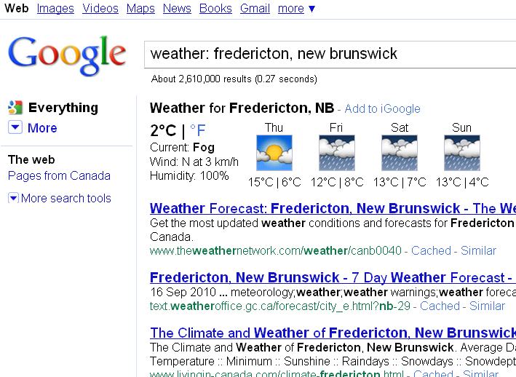
Google Weather – GUI & XML
Google provides a GUI result when you query weather via a Google search. However, an XML API format is also available
We will use Thursday, October 14th, 2010 as an example:
GUI
XML
...
<forecast_conditions>
<day_of_week data="Thu"/>
<low data="42"/>
<high data="59"/>
<icon data="/ig/images/weather/
partly_cloudy.gif"/>
<condition data="Partly Cloudy"/>
</forecast_conditions>
...
Converted to Celsius during post-processing
Used in the taxonomy of weather conditions
  Google Weather In XML for Fredericton, NB:
  http://www.google.com/ig/api?weather=Fredericton,NB

Slide 20
Google Weather – POSL & N3
WellnessRules2 takes this XML representation, converting it to POSL and N3, with similar interoperation methods as seen previously
N3
:forecast_109
rdf:type :Forecast;
:location "Fredericton, NB";
:dateTime [rdf:type :DateTime;
:year 2010;
:month 10;
:day 14;
:hour ?Hour;
:minute ?Minute];
:lowTemp 5;
:highTemp 15;
:avgTemp 10;
:conditions :PartlyCloudy.
XML
...
<forecast_conditions>
<day_of_week data="Thu"/>
<low data="42"/>
<high data="59"/>
<icon data="/ig/images/weather/
partly_cloudy.gif"/>
<condition data="Partly Cloudy"/>
</forecast_conditions>
...
POSL
forecast("Fredericton,NB",
dateTime[2010:integer,10:integer,14:integer,
?Hour:integer,?Minute:integer],
5:integer,15:integer,10:integer,?:PartlyCloudy).

Slide 21
Google Calendar – Current Work
Current Project will provide an extension to WellnessRules2, which: automatically imports participants’ events from their Google Calendar and synchronizes event facts with the rest of their profiles
Methodology
Increment 1: Servlet to retrieve participants’ Google Calendar event information and display this information
Increment 2: Translator that maps event information to the N3 and POSL formats
Increment 3: Editor to update a participant’s profile

Slide 22
Conclusion
The WellnessRules case study:
  Uses a global as well as distributed local knowledge bases
  to support profile interoperation and querying
  Demonstrates profile interoperation between
  logic-relational (e.g., POSL) and graph-networked (e.g., N3) knowledge representations
  Introduces an extended Rule Responder architecture,
  adding the profile level underneath the PAs
  Supports online-interactive wellness communities via the online WellnessRules/WellnessRules2 ActivityPlanners in Rule Responder
  This system, described here, was also complemented by a NutritionPlanner and by a PatientSupporter
  More instantiations upcoming, e.g. a Personal Learning Responder

