Slide 1

The RuleML 0.87 Release
UML Model, Validation Stability, and Abridged Syntax
David Hirtle
Co-op student, NRC IIT e-Business
August 12, 2004

Slide 2
Overview
Introduction
  example
RuleML 0.87
  background
  UML model
  type/role distinction
  slot changes
  stripe-skipping
  validation stability
  demo
Future Work

Slide 3
Introduction
rules are essential for the Semantic Web
  derivation rules (implicational-inference)
  reaction rules (event-condition-action)
  transformation rules (functional-equational)
rule interchange is important for e-Business
Rule Markup Initiative’s goal is a canonical language (RuleML) for interoperable rule markup
  XSLT translators to other SW languages, e.g. RDF
collaborating with W3C and other standards bodies

Slide 4
Introduction – Example
''The discount for a customer buying a product is 5 percent
if the customer is premium and the product is regular.''
<Imp>
<head>
<Atom>
<opr><Rel>discount</Rel></opr>
<Var>customer</Var>
<Var>product</Var>
<Ind>5.0 percent</Ind>
</Atom>
</head>
<body>
<And>
<Atom>
<opr><Rel>premium</Rel></opr>
<Var>customer</Var>
</Atom>
<Atom>
<opr><Rel>regular</Rel></opr>
<Var>product</Var>
</Atom>
</And>
</body>
</Imp>
Imp
head
body
Atom
And
opr
Atom
Atom
discount
customer
product
5 percent
Rel
Var
Var
Ind
opr
opr
premium
customer
regular
product
Rel
Var
Rel
Var

Slide 5
RuleML 0.87
release announced today
full specification: www.ruleml.org/0.87
  XML Schemas: www.ruleml.org/0.87/xsd
  Examples: www.ruleml.org/0.87/exa
  Stylesheet: www.ruleml.org/0.87/xslt
highlights
  UML model for system of sublanguages
  new type/role tag distinction
  slot changes
  “stripe-skipping” syntax
  validation stability

Slide 6
RuleML 0.87 - Background
transition from DTDs to XML Schema was problematic
  many issues were resolved
  then remodularization in 0.85 revealed a new one…
W3C XML Schema expressiveness gap
  cannot extend ranges by decreasing lowerbound
  impossible to go from binary to “zero or more” arguments
    e.g. from binary datalog sublanguage to regular datalog

Slide 7
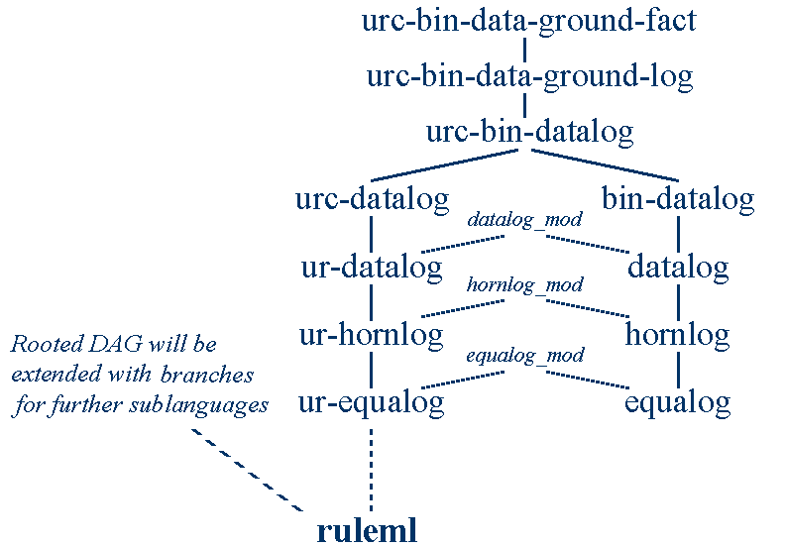
(version 0.85)
[www.ruleml.org/0.85/dtd/Inheritance_diagram.gif]

Slide 8
RuleML 0.87 – Background cont’d
transition from DTDs to XML Schema was problematic
  many issues were resolved
  then remodularization in 0.85 revealed a new one…
W3C XML Schema expressiveness gap
  cannot extend ranges by decreasing lowerbound
  impossible to go from binary to “zero or more”
    e.g. from binary datalog sublanguage to regular datalog
evaluated three alternative versions of modularization
  see www.ruleml.org/modularization for details
  the “winner” was further refined and represented in UML

Slide 9
RuleML 0.87 - UML Model
graphical conventions:
  rectangle - schema drivers (actual sublanguages)
  oval - elementary modules
  UML-like aggregation arrows
    e.g. datalog is part of hornlog
  UML-like inheritance arrows
    e.g. bindatalog is a datalog
element and attribute definitions grouped into modules
  not intended to be directly validated against
  allow others to “borrow” specific parts of RuleML
top-down expressiveness ordering

Slide 10
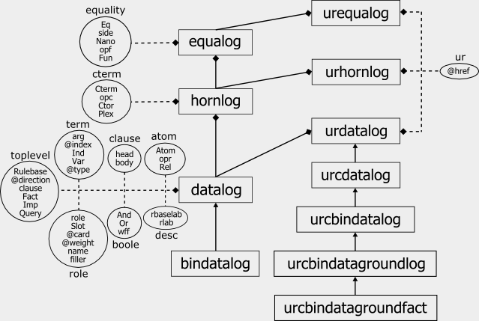
(uml model)
[www.ruleml.org/modularization/ruleml_m12n_uml.png]

Slide 11
RuleML 0.87 - Type/Role Distinction
role tags distinguished with “_” prefix since 0.8
  e.g. role tags: _head, _opr
    type tags: imp, var
now switching to Java-style case convention
  role tags begin with lowercase letter e.g. head, opr
  type tags begin with uppercase letter e.g. Imp, Var
XSLT stylesheet automatically upgrades 0.86 to 0.87
  see comparison of input and output files using HTMLDiff

Slide 12
RuleML 0.87 - Slot Changes
to accommodate F-logic…
  slot names as subelements, not attributes
    e.g. <slot name=“instrument"><Ind>bass</Ind></slot>
becomes
<slot><Ind>instrument</Ind><Ind>bass</Ind></slot>
  variables and complex terms as slot names
    e.g. <slot><Var>Property</Var><Ind>bass</Ind></slot>
    (Property can be bound to instrument or fish)
slot evolves from a role to a type
  so with new naming convention:
<Slot><Var>Property</Var><Ind>bass</Ind></Slot>

Slide 13
RuleML 0.87 - Stripe-Skipping
alternating type/role tags called “striped syntax”
  e.g. <Imp><head><Atom><opr><Rel>
result is quite verbose
  but important for compatibility with OO modeling and RDF
“Stripe-Skipping” to the rescue
  cf. RuleML 0.8 and Sandro Hawke, W3C: StripeSkipping
  role tags become optional (can be “reconstructed” anyway)
  result is (combinable) compact and expanded forms

Slide 14
RuleML 0.87 - Stripe-Skipping (2)
Compact:
<Imp>
<head>
<Atom>
<Rel>discount</Rel>
<Var>customer</Var>
<Var>product</Var>
<Ind>5.0 percent</Ind>
</Atom>
</head>
<body>
<And>
<Atom>
<Rel>premium</Rel>
<Var>customer</Var>
</Atom>
<Atom>
<Rel>regular</Rel>
<Var>product</Var>
</Atom>
</And>
</body>
</Imp>
Expanded:
<Imp>
<head>
<Atom>
<opr><Rel>discount</Rel></opr>
<arg index="1"><Var>customer</Var></arg>
<arg index="2"><Var>product</Var></arg>
<arg index="3"><Ind>5.0 percent</Ind></arg>
</Atom>
</head>
<body>
<And>
<Atom>
<opr><Rel>premium</Rel></opr>
<arg index="1"><Var>customer</Var></arg>
</Atom>
<Atom>
<opr><Rel>regular</Rel></opr>
<arg index="1"><Var>product</Var></arg>
</Atom>
</And>
</body>
</Imp>

Slide 15
RuleML 0.87 - Validation Stability
emphasized in 0.86 and 0.87, but …
XML Schema spec is complex and difficult to implement
  current tools (e.g. validators) can be misleading
    “I suspect it is true that there is no single schema processor which correctly enforces all the constraints defined in the schema specification. ... Certainly the fact that it gets through XML Spy (or any other product) is no proof of validity…”
  Michael Kay, xmlschema-dev@w3.org mailing list
modularity of RuleML XSDs adds to the challenge
  discovered (and reported) issues with several tools, e.g. XML Spy
  useful as a benchmark for finding validator bugs

Slide 16
RuleML 0.87 - Validation Stability (2)
determining if RuleML XSDs are valid is not trivial
our approach: use a variety of validators
  W3C XML Schema Validator (XSV) (stable, free, online)
  Altova XML Spy
  Saxon-SA
  Microsoft XML Core Services (MSXML)
  Xerces2 Java Parser (Xerces-J)
see www.ruleml.org/0.87/#Validation for full results
via Stylus Studio

Slide 17
RuleML 0.87 - Demo
W3C XML Schema Validator (XSV)

Slide 18
Steering Committee
presented to RuleML Steering Committee during teleconference
  Monday, August 9, 2004 1:00pm ADT
Committee members:
  Asaf Adi (IL)
  Harold Boley (CA)
  Mike Dean (USA)
  Andreas Eberhart (DE)
  Benjamin Grosof (USA)
  Michael Kifer (USA)
  Steve Ross-Talbot (UK)
  Bruce Spencer (CA)
  Said Tabet (USA)
  Gerd Wagner (NL)
work was approved

Slide 19
Future Work
fully compact and fully expanded role tag normal forms
  possible XSLT between these and earlier “mixed” form
first-order logic extensions
reaction rules, transformation rules
abstract syntax
glossary of terms
guarded Horn Logic
  suggested by Wolfgang Nejdl, U Hannover
CLP (Corteous Logic Programs) overrides facts
  work by Benjamin Grosof, MIT

Slide 20
Questions/Comments?

