Slide 1

WellnessRules: The Activity Rule Responder
Taylor Osmun
Harold Boley
Benjamin Craig
Institute for Information Technology
National Research Council, Canada
Fredericton, NB, Canda
RuleML-2009 Challenge
Las Vegas, Nevada
November 5-7, 2009

Slide 2
Outline
WellnessRules Overview
WellnessRules as a Rule Responder
WellnessRules Architecture
WellnessRules Agent Implementation & Role Assignment Matrix
Activity Scenario: Example Queries with Live Demo
Proof of Interoperation

Slide 3

WellnessRules Overview
WellnessRules supports an online-interactive
wellness community.
This rule-supported community has the ability to:
  Create profiles about themselves containing their preferences for activities and nutrition, their event days, and their fitness levels
  Compare and collaborate with others in the community to track progress and schedule group wellness events
Rules about wellness opportunities are
  created by participants in rule languages such as Prolog and N3
  interoperated within a wellness community using RuleML/XML

Slide 4
WellnessRules as a Rule Responder
Rule Responder is an intelligent multi-agent infrastructure for collaborative teams and virtual communities
Each Rule Responder instantiation uses
three different kinds of agents:
  Organizational Agent (OA)
  Personal Agents (PAs)
    PAs also select relevant profiles of participants
  External Agents (EAs)
WellnessRules uses the OA, PAs, and EAs
for communication and query delegation to create an online-interactive wellness community

Slide 5
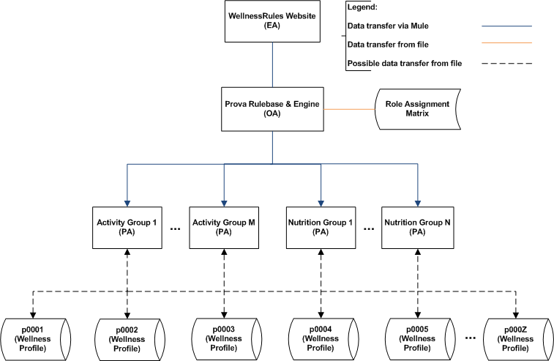
WellnessRules Architecture

Slide 6
Rule Responder Agents (OA,PAs,EAs)
External Agent (EA):
  The WellnessRules website (shown later)
Organizational Agent (OA):
  Contains a Prova knowledge base which is used to handle the incoming queries and direct them to appropriate PAs using the Role Assignment Matrix
Personal Agent with Profiles (PA):
  Consists of a Java servlet, and using the two embedded engines, OO jDREW and Euler, forwards the query to POSL and N3 Profile knowledge bases, respectively
  It only has access to Profiles which contain relevant information for its responsible activity by using the Role Assignment Matrix

Slide 7
Role Assignment Matrix
Composed of the Activity Responsibility Matrix (ARM) and Profile Responsibility Matrix (PRM)
The ARM contains information about PA Activity responsibility, written as an OWL light ontology.
It defines which PA is best suited for certain queries
The PRM contains information about PA Profile responsibility, as well of the format of each Profile knowledge base

Slide 8
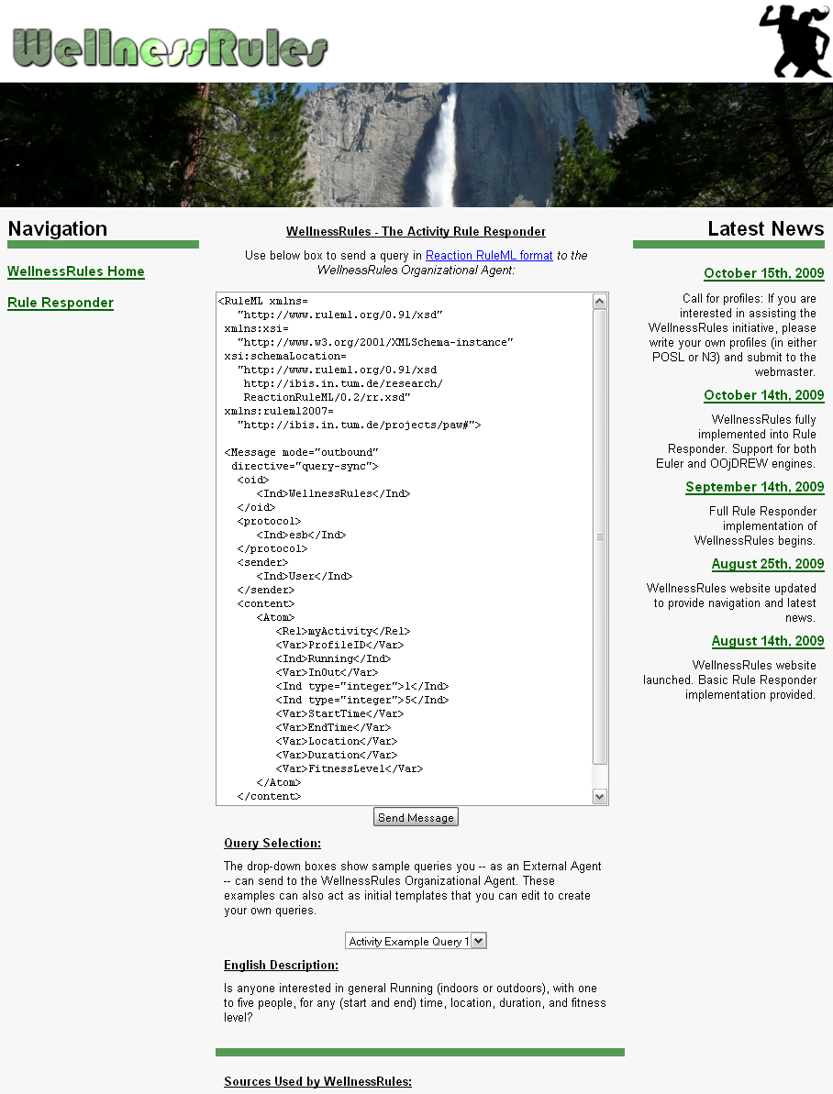
WR Website (EA)
Used to issue queries to the WellnessRules OA
Query is placed in the text box, in RuleML format
The Send Message will issue the query to the OA
A new screen containing a list of answers in RuleML will be presented
Query examples are provided with their subsequent English descriptions. Can be modified to suit your query

Slide 9
Activity Scenario: Structured English
Introduction:
In this scenario a participant of WellnessRules, Peter, uses the system to find one or more partners for Running some time in the near future
Query 1:
Peter first asks the community if anyone at all is interested in running with two to six people. Assessing the answer to this, he finds that there are far too many possibilities on the list and decides to narrow down his question
Query 2:
He feels that he will continue to have a fitness level of 5 for Running, and so asks a refined question wanting only Level-5 activities. In the answer list he notices p0001 (John), who is someone he has previously performed cycling with. He finds John's fitness level of 5 for running surprising, as he did not realize he was also a good Runner
Query 3:
Now he wishes to run with John (perhaps in a race?) and so specifies p0001 and that he prefers Joe's Gym as the location. Peter now receives a single, final answer on the list, from which he takes the type of running, time, and duration, to contact John for scheduling this event

Slide 10
Example Query 1
Peter would like to go for a run at some point in time.
He poses the following question:
Green designates a relation name
...
<Atom>
<Rel>myActivity</Rel>
<Var>ProfileID</Var>
<Ind>Running</Ind>
<Var>InOut</Var>
<Ind type="integer">2</Ind>
<Ind type="integer">6</Ind>
<Var>StartTime</Var>
<Var>EndTime</Var>
<Var>Location</Var>
<Var>Duration</Var>
<Var>FitnessLevel</Var>
</Atom>
...
English Description:
Is anyone interested in
general Running
(indoors or outdoors),
with two
to six people,
for any (start
and end) time,
location,
duration,
and fitness level?
Blue designates a constant.
More will get blue
as we progress.
Orange designates a variable

Slide 11
Example Query 1 – POSL & N3
RuleML
N3
...
<Atom>
<Rel>myActivity</Rel>
<Var>ProfileID</Var>
<Ind>Running</Ind>
<Var>InOut</Var>
<Ind type="integer”>2</Ind>
<Ind type="integer”>6</Ind>
<Var>StartTime</Var>
<Var>EndTime</Var>
<Var>Location</Var>
<Var>Duration</Var>
<Var>FitnessLevel</Var>
</Atom>
...
_:myActivity
rdf:type :MyActivity;
:profileID ?ProfileID;
:activity :Running;
:inOut ?InOut;
:minRSVP 2;
:maxRSVP 6;
:startTime ?StartTime;
:endTime ?EndTime;
:location ?Location;
:duration ?Duration;
:fitnessLevel ?FitnessLevel.
POSL
myActivity(?ProfileID,Running,?InOut,2:integer,6:integer,
?StartTime,?EndTime,?Location,?Duration,?FitnessLevel).

Slide 12
Example Query 2
Peter feels that he will continue to have a fitness level of 5 for Running.
He poses the following question:
...
<Atom>
<Rel>myActivity</Rel>
<Var>ProfileID</Var>
<Ind>Running</Ind>
<Var>InOut</Var>
<Ind type="integer">2</Ind>
<Ind type="integer">6</Ind>
<Var>StartTime</Var>
<Var>EndTime</Var>
<Var>Location</Var>
<Var>Duration</Var>
<Ind type="integer">5</Ind>
</Atom>
...
English Description:
Is anyone interested in
general Running
(indoors or outdoors),
with two
to six people,
for any (start
and end) time,
location,
and duration,
at a fitness level of 5?

Slide 13
Example Query 3
Now he wishes to run with John, and so specifies p0001 and that he prefers Joe's Gym as the location. He poses the following question:
...
<Atom>
<Rel>myActivity</Rel>
<Ind>p0001</Ind>
<Ind>Running</Ind>
<Var>InOut</Var>
<Ind type="integer">2</Ind>
<Ind type="integer">6</Ind>
<Var>StartTime</Var>
<Var>EndTime</Var>
<Ind>joesGym</Var>
<Var>Duration</Var>
<Ind type="integer">5</Ind>
</Atom>
...
English Description:
Is p0001 interested in
general Running
(indoors or outdoors),
with two
to six people,
for any (start
and end) time,
at Joe’s Gym,
for any duration,
at a fitness level of 5?

Slide 14
Answer to Query 3
WellnessRules has returned the answer seen below. This gives Peter all of the information he needs to contact John about scheduling this event.
...
<Atom>
<Rel>myActivity</Rel>
<Ind>p0001</Ind>
<Ind>Running</Ind>
<Ind>in</Ind>
<Ind type="integer">2</Ind>
<Ind type="integer">6</Ind>
<Ind>2009-06-15T10:15:00</Ind>
<Ind>2009-06-15T11:15:00</Ind>
<Ind>joesGym</Ind>
<Ind>P60M</Ind>
<Ind type="integer">5</Ind>
</Atom>
...
English Description:
p0001 is interested
in Running
Indoors,
with two
to six people,
between 10:15AM and 11:15AM
on June 15th, 2009,
at Joe's Gym,
for 60 minutes,
at a fitness level of 5.

Slide 15
Profile Responsibility Matrix (PRM)
According to the PRM, p0001 has a format of N3
Since p0001 is also available in POSL, we can change the format
<WellnessRules>
<Activity>
<Walking>
<ResponsibleProfile name="p0001" format=”n3"/>
<ResponsibleProfile name="p0002" format="posl"/>
<ResponsibleProfile name="p0003" format="posl"/>
</Walking>
<Running>
<ResponsibleProfile name="p0001" format=”n3"/>
<ResponsibleProfile name="p0002" format="posl"/>
<ResponsibleProfile name="p0003" format="posl"/>
</Running>
...
</Activity>
</WellnessRules>
<WellnessRules>
<Activity>
<Walking>
<ResponsibleProfile name="p0001" format=”posl"/>
<ResponsibleProfile name="p0002" format="posl"/>
<ResponsibleProfile name="p0003" format="posl"/>
</Walking>
<Running>
<ResponsibleProfile name="p0001" format=”posl"/>
<ResponsibleProfile name="p0002" format="posl"/>
<ResponsibleProfile name="p0003" format="posl"/>
</Running>
...
</Activity>
</WellnessRules>

Slide 16
Wrap Up
The WellnessRules case study:
  Creates an online-interactive wellness community
  through the WellnessRules Rule Responder system
  Creates a new Rule Responder architecture,
  adding the Profile level underneath the PAs
  In our next presentation:
  Provides Profile interoperation through transformation techniques in the context of WellnessRules between these knowledge representation formats

