Slide 1
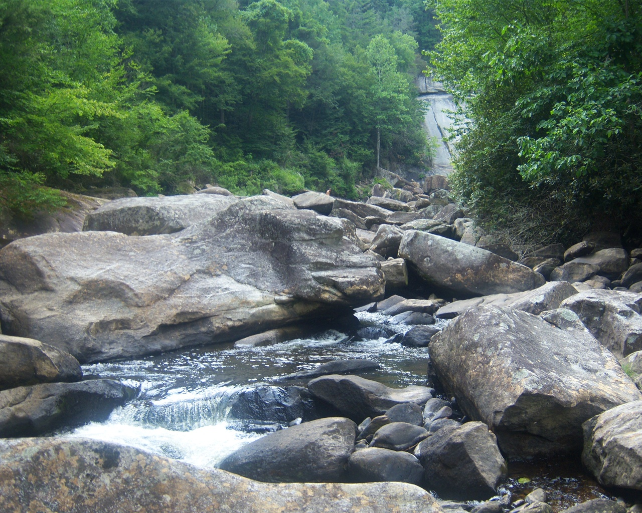
Wellness-Rules: A Web 3.0 Case Study in
RuleML-Based Prolog-N3 Profile Interoperation
Harold Boley
Taylor Osmun
Benjamin Craig
Institute for Information Technology
National Research Council, Canada
Fredericton, NB, Canda
RuleML-2009 Challenge
Las Vegas, Nevada
November 5-7, 2009

Slide 2
Outline
WellnessRules Overview
Profile Interoperation (POSL ⬄ N3)
Relational (POSL) and Graph (N3)
Language & Interoperation Overviews
Global and Local Knowledge Bases
POSL ⬄ N3 Transformation
Taxonomy

Slide 3

WellnessRules Overview
WellnessRules supports an online-interactive
wellness community.
This rule-supported community has the ability to:
  Create profiles about themselves containing their preferences for activities and nutrition, their event days, and their fitness levels
  Compare and collaborate with others in the community to track progress and schedule group wellness events
Rules about wellness opportunities are
  created by participants in rule languages such as Prolog and N3
  interoperated within a wellness community using RuleML/XML

Slide 4
Profile Interoperation (POSL ⬄ N3)
Support for both logic-relational (e.g., POSL) and
graph-oriented (e.g., N3) knowledge representations
Users may write their profile in either language
Support for OO jDREW and Euler engines to execute queries issued to POSL and N3 knowledge bases, respectively
Previously seen in the demo:
By using a RuleML subset as interchange language and
Rule Responder as interchange platform, queries are applied to all supported engines, with answers returned in RuleML

Slide 5
POSL
POSL integrates positional and slotted knowledge for humans
(e.g.: Prolog’s positional and F-logic’s slotted knowledge)
WellnessRules uses positional POSL for logic-relational knowledge, displayed in a Prolog-like syntax
Positional Notations:
  Relation names:
    Each fact or rule has a relation name
  Values:
    Values can be upper or lower case, separated by a comma (,)
  Variables:
    Can be named (prefix “?”), or anonymous (stand-alone “?”)
season(?StartTime,summer).
season(?StartTime,summer).
season(?StartTime,?).

Slide 6
Notation 3 – N3
A language which is a compact and readable alternative to RDF's XML syntax. Uses RDF triples (subject, property, object) to represent knowledge
WellnessRules uses N3 for graph-oriented knowledge
Slotted Notations:
  Subject names:
    Each fact or rule has a subject name
  Variables:
    Can be named (prefix “?”),
    or anonymous (stand-alone “?”)
  Values (property-object pairs):
    Each value must have a property (slot name):
    Each value must also
    have an object (slot value):
‘:’ here denotes a local knowledge base
:season_1
rdf:type :Season;
:startTime ?StartTime;
:period :summer.
:season_1
rdf:type :Season;
:startTime ?StartTime;
:period :summer.
:season_1
rdf:type :Season;
:startTime ?StartTime;
:period ?.
:season_1
rdf:type :Season;
:startTime ?StartTime;
:period :summer.

Slide 7
Global Knowledge Base
Contains knowledge that is relevant to everyone in the WellnessRules community
Knowledge Areas:
  Season
    Defines timeframe of the seasons
  Forecast
    Describes the weather forecast within timeframes
  Meetup
    Contains activity meet up locations for maps

Slide 8
Local Knowledge Base
Contains local knowledge that is specific to each participant in the WellnessRules community
Knowledge Areas:
  Calendar
    Used for event planning. Allows for sharing of calendars between profiles
  Map
    Links to Meetup locations. Allows for sharing of maps between profiles
  Fitness
    Defines expected fitness level for specific a period of time (scale of 1-10)
  Event
    Possible/Planned/Performing/Past
  MyActivity
    Derive participant’s individual activity preferences

Slide 9
Example MyActivity Rule - POSL
myActivity(p0001,Running,out,?MinRSVP,?MaxRSVP,?StartTime,?EndTime,?Place,?Duration,?Level)
:-
calendar(p0001,?Calendar),
event(?Calendar,?:Running,possible,?StartTime,?EndTime),
participation(p0001,run,out,?MinRSVP,?MaxRSVP),
season(?StartTime,summer),
forecast(?StartTime,sky,?Weather),
notEqual(?Weather,raining),
map(p0001,?Map),
meetup(?Map,run,out,?Place),
level(p0001,run,out,?Place,?Duration,?Level),
fitness(p0001,?StartTime,?ExpectedFitness),
greaterThanOrEqual(?ExpectedFitness,?Level),
goodDuration(?Duration,?StartTime,?EndTime).
Based on this rule the following are p0001’s preferences for Running outdoors:
  The number of participants must be within the minimum and maximum
  The season must be summer
  It must not be raining outside
  p0001’s fitness level is greater than or equal to the required fitness level

Slide 10
POSL ⬄ N3 Transformation-1
N3 requires the use of subjects for naming relationships.
The subject name uses the relation name followed by “_#” where ‘#’ is the iteration number
Each corresponding N3 rule’s ‘relation name’ is defined via rdf:type and the uppercase version of the name
In positional POSL slot names are not needed. Therefore, slot names (properties) must be created for N3, while the slot variables (variable objects) use the same variable names as POSL
:season_1
rdf:type :Season;
:startTime ?StartTime;
:period ?Season.
POSL
⬄
N3
season(?StartTime,?Season).
⬄
:season_1
rdf:type :Season;
:startTime ?StartTime;
:period ?Season.
POSL
season(?StartTime,?Season).
N3

Slide 11
POSL ⬄ N3 Transformation-2
Rules are represented and handled differently.
OO jDREW (using POSL) is essentially
a top-down (:-) reasoner.
Euler (using N3) is a bottom-up reasoner (=>):
Assumes previous slide
(Transformation-1)
{
...
?forecast
rdf:type :Forecast;
:startTime ?StartTime;
:aspect :sky;
:value ?Weather.
?Weather log:notEqualTo :raining.
...
}
=>
{
_:myActivity
rdf:type :MyActivity;
:profileID :p0001;
:activity :Running;
:inOut :in;
:minRSVP ?MinRSVP;
:maxRSVP ?MaxRSVP;
:startTime ?StartTime;
:endTime ?EndTime;
:location ?Place;
:duration ?Duration;
:fitnessLevel ?FitnessLevel.
}.
myActivity(p0001,Running,in,?MinRSVP,?MaxRSVP,
?StartTime,?EndTime,?Place,?Duration,?Level)
:-
...
forecast(?StartTime,sky,?Weather),
notEqual(?Weather,raining),
...
.
N3
POSL
⬄

Slide 12
POSL ⬄ N3 Transformation-3
The POSL handling of negation as failure (NAF) is via a built-in:
N3 does not have a built-in to handle NAF. Therefore, NAF is encoded by a
e:findall searching for an empty list
POSL has built-in math operations. N3 uses package-prefixed math operations.
naf( event(?Calendar, ?:Running, past, ?StartTimeYDay, ?EndTimeYDay)),
POSL
?NAF e:findall
(?event
{?event
rdf:type :Event;
:calendarID ?CalendarID;
:aspect :Running;
:tense :past;
:startTime ?StartTimeYDay;
:endTime ?EndTimeYDay.}
() ).
N3
POSL
⬄
N3
greaterThanOrEqual(?ExpectedFitness,?Level),
?ExpectedFitness math:notLessThan ?FitnessLevel.

Slide 13
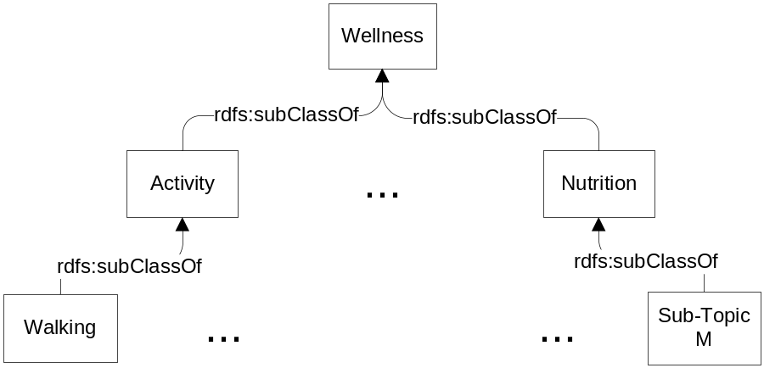
Taxonomy
The WellnessRules taxonomy is broken into two topics: Activity and Nutrition
Each of these contains multiple sub-topics (e.g. Walking or Running)
Both representations use rdf:type, rdfs:Class and rdfs:subClassOf
Taxonomy classes function as user-defined types to restrict rule variables
RDF (used by POSL)
N3
<rdf:RDF
xmlns:rdf="http://www.w3.org/1999/02/22-rdf-syntax-ns#"
xmlns:rdfs="http://www.w3.org/2000/01/rdf-schema#">
<rdf:Description rdf:ID="Wellness">
<rdf:type rdf:resource="http://www.w3.org/2000/01/rdf-schema#Class"/>
</rdf:Description>
<rdf:Description rdf:ID="Activity">
<rdf:type rdf:resource="http://www.w3.org/2000/01/rdf-schema#Class"/>
<rdfs:subClassOf rdf:resource="#Wellness"/>
</rdf:Description>
<rdf:Description rdf:ID="Walking">
<rdf:type rdf:resource="http://www.w3.org/2000/01/rdf-schema#Class"/>
<rdfs:subClassOf rdf:resource="#Activity"/>
</rdf:Description>
…
@prefix : <wellnessRules#>.
@prefix rdf: <http://www.w3.org/1999/02/22-rdf-syntax-ns#>.
@prefix rdfs: <http://www.w3.org/2000/01/rdf-schema#>.
:Wellness rdf:type rdfs:Class.
:Activity rdf:type rdfs:Class;
rdfs:subClassOf :Wellness.
:Walking rdf:type rdfs:Class;
rdfs:subClassOf :Activity.
…
⬄

Slide 14
Wrap Up
The WellnessRules case study:
  Demonstrates profile interoperation between both
  logic-relational (e.g., POSL) and graph-oriented (e.g., N3) knowledge representations
  Provides transformation techniques in the context of WellnessRules between these knowledge representation formats
  Previously seen in the demo:
  With an exciting use case, creates an
  online-interactive wellness community through the WellnessRules Rule Responder system

