Slide 1
Expert Querying and Redirection with Rule Responder
FEWS-2007, 12 Nov 2007
Harold Boley¹, Adrian Paschke²
¹ National Research Council of Canada
University of New Brunswick, Canada
² Bioinformatics, BIOTEC Center,
Technical University Dresden, Germany

Slide 2
Introduction
Earlier expert finding (discovery) focus:
Static expert description using
agent-centric metadata profiles
The current focus:
Dynamic expert interaction using
agent-communication infrastructure
Rules employed for semi-automated
  decision support
  delegation/coordination
  negotiation flow
  reaction logic

Slide 3
Introduction
Research builds on our previous work in
  AgentMatcher: Similarity match-making of weighted trees describing (learning) objects
  FindXpRT (Find an eXpert via Rules and Taxonomies): (RDF or RuleML) FOAF facts and (RuleML) FOAF rules as well as (RDFS) classes for expert finding
  Rule Responder: Extending Semantic Web towards a Pragmatic Web infrastructure for distributed
  rule-based human-computer collaboration

Slide 4
RuleML FOAF
Previous system ― RDF FOAF:
Person-centric metadata facts only
FindXpRT contribution ― RuleML FOAF:
Person-centric metadata rules added
  Enables XML-based
    Rule Formalization
    Rule Interchange
    Rule Execution
  Can derive new FOAF facts
  Can often be ‘normalized’ into RDF FOAF

Slide 5
RuleML FOAF: Rules
Make implicit properties and relationships explicit:
\
watchMovie(Peter,?X) :- recommendMovie(Firefly,?X).
Constitute person-centric metadata properties conditional on the time, place, …:
\
phonePreference(Peter,office) :- time(9-12) OR time(13-17).
phonePreference(Peter,cell) :- time(12-13) OR time(17-18).
phonePreference(Peter,home) :- time(18-21).
phonePreference(Peter,voicemail) :- time(21-9).

Slide 6
Current Scenario
An entity that seeks expertise in some area,
hence called the (expertise) consumer
consults
Another entity that mediates, or directly offers, expertise, hence called the (expertise) provider
Both consumers and providers of expertise can
be individuals, organizations, or software systems
Interested in systems as expertise providers for individuals/organizations as expertise consumers
Based on Semantic (FOAF) & Pragmatic (Agent) Web

Slide 7
Expertise Providers
Can be
Expert finders
  Systems that find experts who then solve problems
or
Problem solvers
  Systems that directly solve problems
The same system can be an expert finder and a problem solver:
Duality of expert finding and problem solving

Slide 8
Continuum Between Extremes of
Pure Expert Finding and Pure Problem Solving (1)
In its pure form, expert finding uses a description of human expertise, skills, and traits to search for a matching expert by
  Broadcasting the description to candidates, comparing it to candidates' self-descriptive
  (FOAF or SIOC) profiles, or
  Via a match-maker that mediates between both
Once an expert is engaged by an organization,
he or she starts with problem (analysis and) solving

Slide 9
Continuum Between Extremes of
Pure Expert Finding and Pure Problem Solving (2)
When a consumer performs expert finding,
this is part of problem solving in broad sense:
An expert is sought  e.g. by advertising a generalized problem description  to solve temporary or continuing problems of the consumer
If the problems can be solved via ‘outsourcing’, the found expert(s) can perform problem solving remotely

Slide 10
Continuum Between Extremes of
Pure Expert Finding and Pure Problem Solving (3)
In some cases, not even the identity of individuals within a team of remote experts will need to be revealed.
A remote team that solves problems of a consumer can become increasingly ‘virtual’:
The focus can shift to communication protocols between the problem solving provider and the consumer
The experts no longer need to form a fixed team or consist of human experts only:
Problem-solving systems can perform some of the tasks
The internal structure of the providing system need not be known to the consumer

Slide 11
Continuum Between Extremes of
Pure Expert Finding and Pure Problem Solving (4)
If, for all problems, the consumer has to deal with only one provider without being revealed the expert(s) or system(s) behind it,
the provider turns into a pure problem solver

Slide 12
Interplay Between Expert Finding and
Problem Solving
Even if a consumer primarily plans to engage an expert, their decision on, say, hiring him or her for a job may be (partially) based on his or her performance when solving a trial problem as part of the selection process
Conversely, even if a consumer primarily plans to get a problem solved, their trust in a proposed solution may be (partially) based on the reputation of the expert(s) involved in problem solving

Slide 13
Problem Solving Specialized to Query Answering
Some problems themselves consist in answering a query, and various other problems, X, are basically solved when the query “How to solve problem X?” is answered
Therefore, and since query answering is more amenable to current software systems than, say, sensor/effector-intensive problem solving, we will focus on the important special case where problem solving equals query answering

Slide 14
Overlap of Expert Finding and Query Answering (1)
A specific query is normally posed to directly receive an answer from a given expert
(it is too narrow to define an area of expertise)
A general query is normally posed to find an expert in the whole area of expertise it defines
(it is too broad to lend itself to a direct answer)
A typical query can result in both a (partial) answer and a (partial) identification of the expert(s) involved in finding it

Slide 15
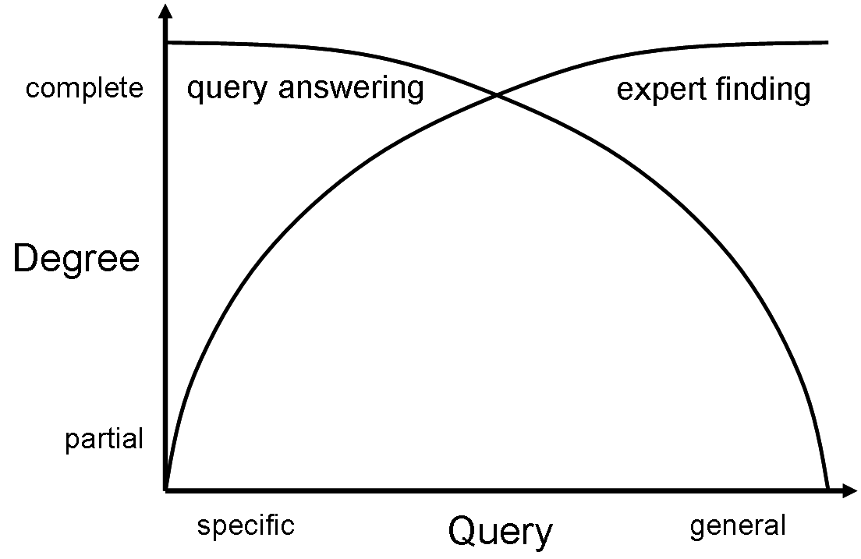
Overlap of Expert Finding and Query Answering (2)
Horizontal axis: specificity/generality of queries
Vertical axis: degree to which queries are answered by a given expert
degree to which queries are used to find experts

Slide 16
Expert Redirection as
Expert Referral or Expert Delegation
Expert referral: provider refers consumer to other providers inside or outside his/her organization
Expert delegation: provider delegates query to such providers, maybe without telling the consumer

Slide 17
Expert Chaining (1)
Redirection of an expertise consumer C from an expertise provider Pj to the ‘next best’ provider Pj+1 can be stored statically on the profile of Pj, e.g. using the renowned foaf:knows property
Can also be computed dynamically by Pj, e.g. based on the knowledge Pj has gained so far about the query of consumer C and the partial answer Pj may have given to C
Combinations of static and dynamic redirections are also possible

Slide 18
Expert Chaining (2)
Leads to chaining, e.g. a redirection path
P1, P2, ..., Pj, Pj+1, ..., Pn
In more general case becomes a redirection tree
  with branches from a provider P to k other providers, who
    besides performing own referrals and/or ‘downward’ delegations
  give partial answers ‘upward’ to P for answer integration
In most general case, the redirection tree becomes a general redirection graph, where providers perform networking

Slide 19
Find an Expert with Referrals
Lucy
Julia
Offers Expertise: Pop Music
Seeks Expertise: Logic Programming
Rating Threshold: 4.5
Degree Threshold: 1
… … … … … …
Offers Expertise: Logic Programming
Seeks Expertise: Pop Music
Overall Rating: 4.5
Status: Busy
… … … … … …
Hart
foaf:knows
Offers Expertise: Logic Programming
Seeks Expertise: Pop Music
Overall Rating: 4.0
… … … … … …
FindXpRT(Lucy, ?CSXpRT, ?ReferredXpRT,
PopMusic, LogicProgramming, 4.5:Real, ?RatingSought, 1:Integer)

Slide 20
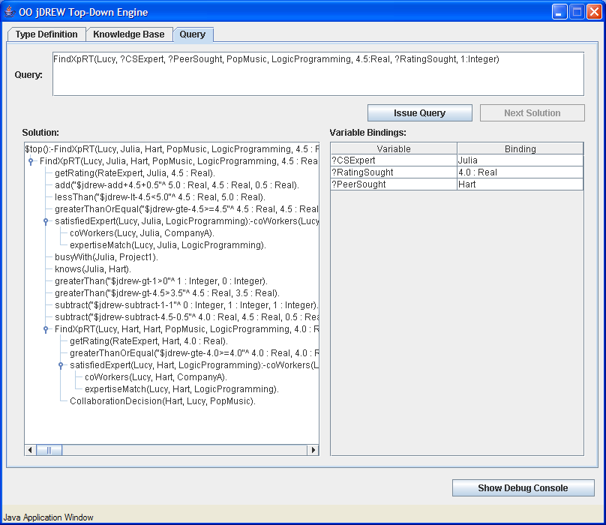

Slide 21
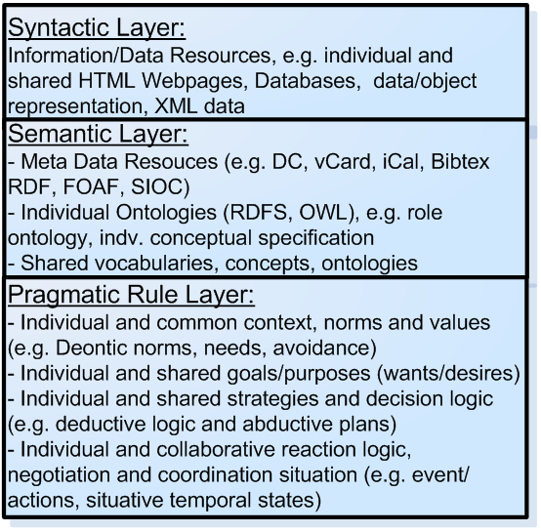
Towards a Pragmatic Web
Explicit Meta-data
  vCard, PICS, Dublin Core, RDF, IEEE LOM (Learning Objects Metadata), Micro Formats, FOAF, SIOC …
Ontologies
  RDFS, OWL Lite|DL|Full
Logic and Inference
  e.g. Logic Programming Rule/Inference Engines
Software Agents and Web Services
  FIPA, Semantic Web Services, RBSLA, …

Slide 22
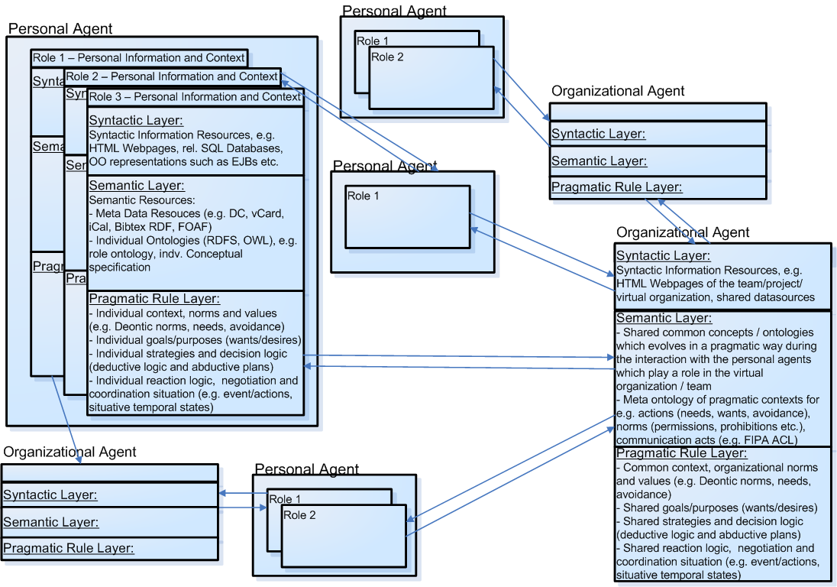
Pragmatic Web with Two Kinds of Collaborative Agents
Interaction

Slide 23
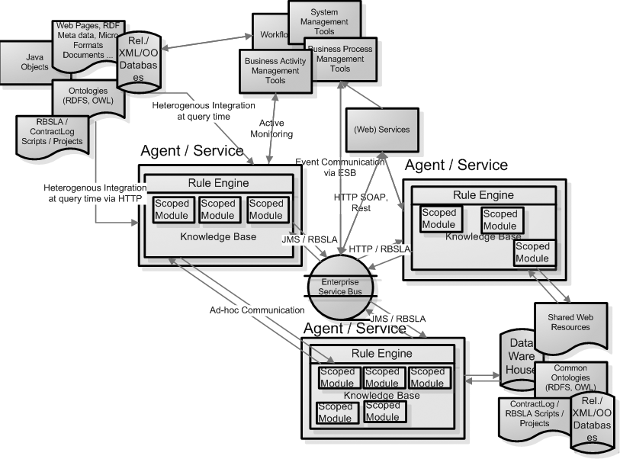
Pragmatic Agent Web
Rule Responder Project:
http://www.responder.ruleml.org/

Slide 24
Benefits of Rule-Based Decision and
Reaction Logic
Compact declarative representation of rules
  Clear semantics
  Global rules which might apply in several contexts (reusability)
  Separation of contract rules from the application code
  Extensibility of the rule base (without changing the interpreter)
Efficient, generic interpreters (rule engines) for automated rule chaining and execution of reaction rules
Automated conflict detection of rule conflicts
  Traceable and verifiable results
  Integrity constraints are possible
  Automated conflict resolution by rule prioritization
Rules play an important role to automatically transform contextual data,
derive new conclusions and decisions from existing knowledge and behaviourally act according to changed conditions or occurred events

Slide 25
Rule Responder Architecture (MDA)
Computational independent model (CIM) with rules, processes, conversational flows (e.g. in a natural or visual language)
Platform independent model (PIM) which represents the rules, events and ontologies in a common (standardized) interchange format (e.g. a markup language)
Platform specific model (PSM) which encodes the rule statements in the language of a specific execution environment (e.g. a rule engine / inference service or compiled code)

Slide 26

General Syntax for Reaction Rules
(Reaction RuleML 0.2)
<Rule style="active" evaluation="strong">
<label> <!-- metadata --> </label>
<scope> <!-- scope --> </scope>
<qualification> <!-- qualifications --> </qualification>
<oid> <!-- object identifier --> </oid>
<on> <!-- event --> </on>
<if> <!-- condition --> </if>
<then> <!-- conclusion --> </then>
<do> <!-- action --> </do>
<after> <!-- postcondition --> </after>
<else> <!-- else conclusion --> </else>
<elseDo> <!-- else/alternative action --> </elseDo>
<elseAfter> <!-- else postcondition --> </elseAfter>
</Rule>

Slide 27
Messages in Reaction RuleML
<Message mode="outbound" directive="ACL:inform">
<oid> <!-- conversation ID--> </oid>
<protocol> <!-- transport protocol --> </protocol>
<sender> <!-- sender agent/service --> </sender>
<content> <!-- message payload --> </content>
</Message>
@mode = inbound|outbound – attribute defining the type of a message
@directive – attribute defining the pragmatic context of the message, e.g. one or more FIPA ACL performatives, KQML, OWL-QL, Standard Deontic Logic norms, …
< oid > – the conversation id used to distinguish multiple conversations and conversation states
< protocol > – a transport protocol such as HTTP, JMS, SOAP, Jade, Enterprise Service Bus (ESB) ...
< sender >< receiver > – the sender/receiver agent/service of the message
< content > – message payload transporting a RuleML / Reaction RuleML query, answer or rule base

Slide 28
Example: Request / Query
...
<Message mode="outbound" directive="ACL:query-ref">
<oid> <Ind>RuleML-2007</Ind> </oid>
<protocol> <Ind>esb</Ind> </protocol>
<sender> <Ind>User</Ind> </sender>
<content>
<Atom>
<Rel>getContact</Rel>
<Ind>Website</Ind>
<Var>Contact</Var>
</Atom>
</content>
</Message>
...
Message is local to the conversation state (oid) and pragmatic context (directive)
FIPA ACL directive

Slide 29
Example: Response / Answer
<Message …>
...
<content>
<Atom>
<Rel>getContact</Rel>
<Ind>Website</Ind>
<Expr>
<Fun>person</Fun>
<Ind>Adrian Paschke</Ind>
<Ind>Program Co-Chair RuleML-2007</Ind>
<Ind>Technical University Munich</Ind>
<Ind>paschke@in.tum.de</Ind>
<Ind>+49 89 289 17504</Ind>
</Expr>
</Atom>
</content>
...
</Message>

Slide 30
Enterprise Service Bus
Communication Middleware
+
Service Object Broker

Slide 31
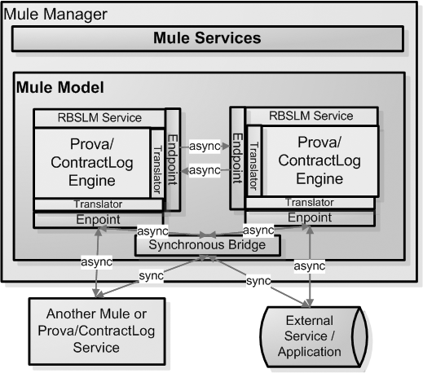
Mule Enterprise Service Bus
Mule ESB Open Source
Message Platform and distributed Object Broker
Staged Event Driven Architecture (SEDA)
> 30 Protocols (JMS, HTTP, SOAP …)
Synchronous and Asynchronous Communication
Complex Message-driven Event Processing (CEP)

Slide 32
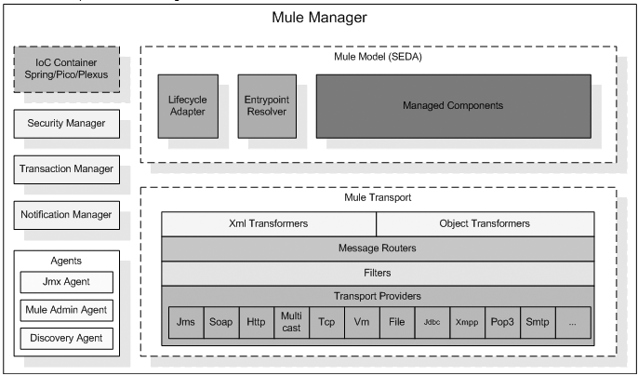
Mule Enterprise Service Bus

Slide 33
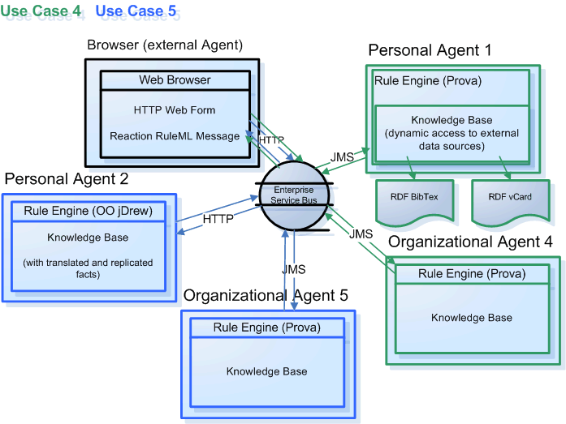
Use Case: Expert Finding (1)

Slide 34
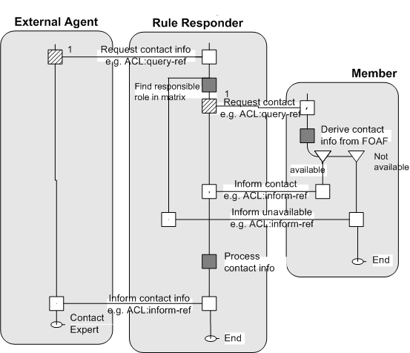
Use Case: Expert Finding (2)
Expert

Slide 35
Advanced Performatives
Query Answering: Should the query be answered directly, only be used for expert finding, or both?
Expert Identification: Do experts answering a query inside or outside the provider's organization need to be identified to the consumer?
Query Confidentiality: Must the query be treated as confidential inside or outside the provider's organization?
Expert Referral: Should the provider refer the consumer to other providers inside or outside his/her organization if no (complete) answer can be found (the consumer himself/herself would then need to contact that next provider, perhaps showing them the referral message from the previous provider)?
Expert Delegation: Is the provider entitled to delegate the query (perhaps anonymized?) to other providers inside or outside his/her organization?
Delegation Chains: Should delegation be stopped after a maximum length of delegation chains is reached (special cases: no delegation, 1-step delegation)?
Query Decomposition: Should the provider decompose the query into subqueries if it cannot be answered or delegated as a whole?
Answer Returning: Should providers to whom a (sub)query was delegated return answers to the delegating provider, to the consumer, or to both?
Answer Integration: Should the provider integrate answers returned to it for subqueries or just collect them and hand them back unchanged to the consumer?

Slide 36
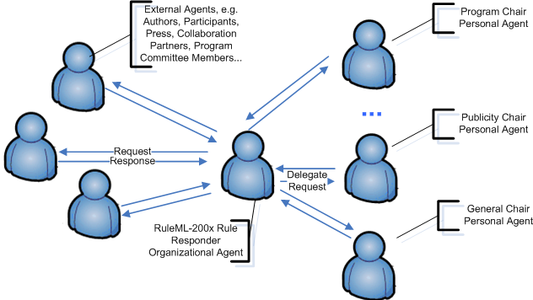
Use Case: Symposium Question-Answering
(by its Virtual Organization)

Slide 37
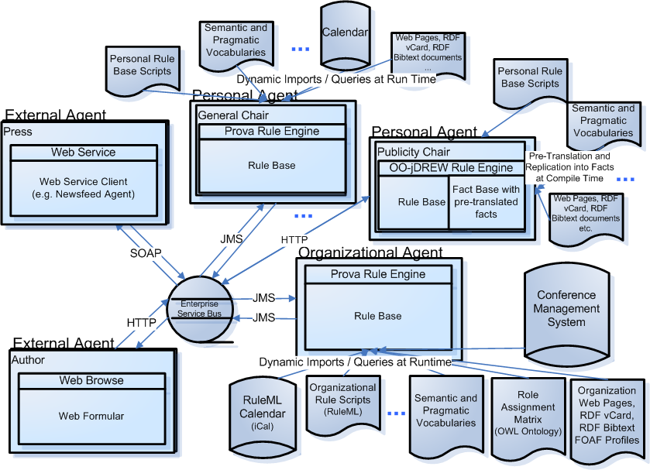

Slide 38
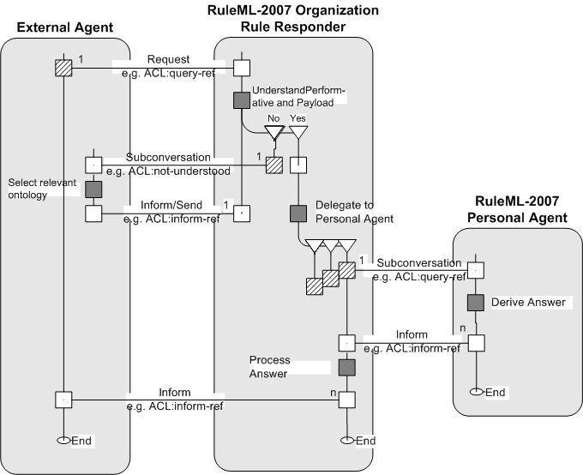
Use Case: Symposium Question-Answering
(by its Virtual Organization)

Slide 39
Example: Request Registration Fee (1)
Query from External Agent (e.g. Web form)
<RuleML ...>
<Message mode="outbound" directive="query">
...
<content>
<Atom> <Rel>computeFee</Rel>
<Ind>Peter Pan</Ind>
<Var>Fee</Var>
</Atom>
</content>
</Message>
</RuleML>
Delegation Logic of Organizational Agent (Prova)
fee(Phase,Fee):-
% look-up responsible agent
assigned(Agent,
ruleml2007_Submission, ruleml2007_responsible),
% query permission from responsible agent
sendMsg(XID,esb,Agent, "query", fee(Phase,Fee)),
% receive answers multiple times
rcvMult(XID,esb,Agent,"answer", fee(Phase,Fee)).

Slide 40
Example: Request Registration Fee (2)
Rule of Program Chair Agent: (Prova)
computeFee(Participant,Fee,T):- holdsAt(open(RegistrationPhase),T), fee(RegistrationPhase,BasicFee),
sendMsg(XID,esb,ruleml2007_PublicityChair,query, registrationDiscount(Participant,BasicFee,1,Discount,Cost)),
rcvMsg(XID,esb,ruleml2007_PublicityChair,answer,
registrationDiscount(Participant,BasicFee,1,Discount,Cost)),
Fee = Cost - (Cost * Discount).
fee(earlyRegistration,currency_Dollar:500).
fee(regularRegistration,currency_Dollar:600).
Rule of Publicity Chair Agent: (OO jDREW)
%This rule is used to calculate the discount of registration if % the organization is a collaboration partner. registrationDiscount(?Organization:collaborationPartner,?RegistrationCost:real,?NumberOfRegistrations:integer,?IndividualDiscountCost:real,?TotalCost:real) :-
multiply(?IndividualDiscountCost:real,
?RegistrationCost:real, 0.9:real),
multiply(?TotalCost:real,
?NumberOfRegistrations:integer,
?IndividualDiscountCost:real).

Slide 41
Conclusions (1)
Explained duality of expert finding and
query answering, and introduced new approach to both
Rule Responder was employed as the
Web-based communication infrastructure for expert querying and redirection
As our use case, we discussed the organization of the RuleML-2007 Symposium

Slide 42
Conclusions (2)
Future work includes
Formal foundations of expert finding
(e.g., expert and conversation id's as
π-calculus channel names)
Refinement of the system of performatives supporting Rule Responder expert finding
Further development of Reaction RuleML for serializing the required event and rule types
Continuation of the RuleML-2007 use case and exploration of similar ones

