Slide 1


A RuleML Study on Integrating
Geographical and Health Information
S. Gao, D. Mioc, H. Boley, F. Anton, X. Yi

Slide 2
Outline
Introduction
Objective
Methodology
Implementation and Result
Conclusion

Slide 3
Introduction
Semantic Web improves machine understanding of
Web-based information
Ontologies and rules in Semantic Web
Given the growing number of diseases, health information
integration and retrieval becomes very important
Appropriate systems are needed to query and map health
information for eliminating the impact of disease outbreaks

Slide 4
Challenges
Health data are stored in heterogeneous ways
Health data representation

Slide 5
Objectives
Create an ontology for spatial, temporal and
thematic health data query
Generate logic rules for semantic query
Support roll-up health data and visualization.

Slide 6
Methodology – Data description
New Brunswick Lung Association
Data
  NB_PATIENTINCIDENT
  NB_PROVINCE
  NB_HEALTH_REGION
  NB_CENSUS_DIVISION
  NB_PC3

Slide 7
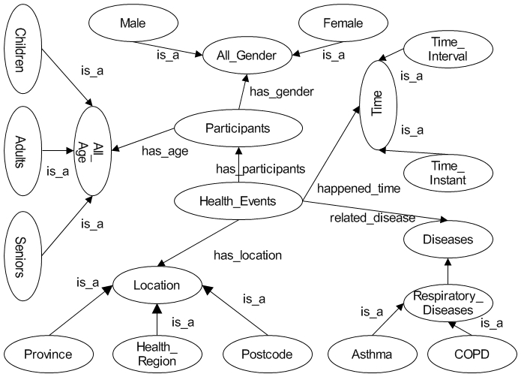
Methodology – Ontology design

Slide 8
Methodology–Knowledge representation
RuleML - de facto open language standard for Web
rules
Use RuleML to transcribe and refine our ontology as a knowledge base, consisting of facts and rules

Slide 9

Implementation - Architecture
Reasoning Engine (OOJDREW)
Database
Facts
Rules
Ontology
Mapping
Engine
(Geotools)
Server
Files
Data
User
Interface
Request
Client

Slide 10
Implementation – Facts
Location facts
inside(place1->E1V;place2->Health_Region_7).
…
Patient incident facts generated from the health information.
event(id->306947;
  disease->COPD;
  postcode->E1V;
  age->61:Integer;
  gender->Male).
…

Slide 11
Implementation – Facts
Disease facts
subclass(disease1->COPD; disease2->Respiratory_Disease).
…
Age facts
agerange(agetype->adults;age1->18:Integer;age2->64:Integer).
…

Slide 12
Implementation – Rules
Location relation rules
inside_closure(place1->?placeA;place2->?placeB) :-
  inside(place1->?placeA;place2->?placeB).
inside_closure(place1->?placeA;place2->?placeC) :-
  inside(place1->?placeA;place2->?placeB),
  inside(place1->?placeB;place2->?placeC).
Age rule
age(agetype->?agetype;agen->?agex:Integer) :-
  agerange(agetype->?agetype;
    age1->?age1:Integer;
    age2->?age2:Integer),
  greaterThanOrEqual(?agex:Integer,?age1:Integer),
  lessThanOrEqual (?agex:Integer,?age2:Integer).

Slide 13
Implementation – Rules
Disease relation rules
subclass_closure(disease1->?diseaseA;disease2->?diseaseA).
subclass_closure(disease1->?diseaseA;
      disease2->?diseaseC) :-
  subclass(disease1->?diseaseA;disease2->?diseaseB),
  subclass(disease1->?diseaseB;disease2->?diseaseC).

Slide 14
Implementation – Rules
Disease_locator rule
disease_locator(id->?id;
  location->?location;
  disease->?disease;
  agetype->?agetype;
  gender->?gender) :-
  event(id->?id;
  postcode->?postcode;
  disease->?kindofdisease;
  age->?ageofid:Integer;
  gender->?gender!?),
  age(agetype->?agetype;agen->?ageofid:Integer),
  inside_closure(place1->?postcode;place2->?location),
  subclass_closure(disease1->?kindofdisease;
  disease2->?disease).

Slide 15
Implementation – Roll-up data
Determine health event location relationships with administrative boundaries
Use spatial operations

Slide 16
Implementation – Development kits
OOjDREW
A deductive reasoning engine for the POSL and RuleML, written in Java.
Geotools
An open source Java code library which provides
standards compliant methods for the manipulation of
geospatial data.

Slide 17
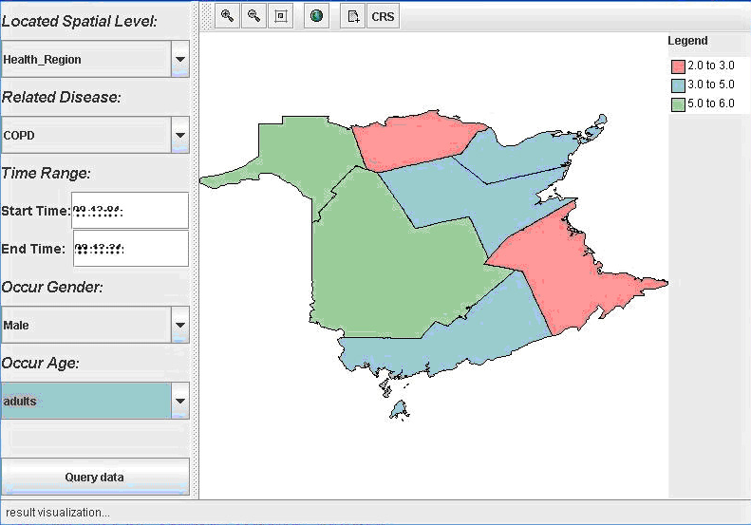
Result
health region level, COPD, male, and adults

Slide 18
Conclusion
Designed an ontology to explore semantic query
of health information
Integrated rules in semantic reasoning of spatial
and thematic factors.
Supported health data roll-up and visualization
Future work will be on the optimization of spatial,
temporal and thematic reasoning.

