Slide 1
The RuleML Family of Web Rule Languages
PPSWR’06, Budva, Montenegro, 10 June 2006
Revised, RuleML’06, Athens, GA, 11 Nov. 2006
Shortened, Vienna, SWT Course, 17 Nov. 2008
Harold Boley
University of New Brunswick, Canada
National Research Council of Canada

Slide 2
Introduction
Rules are central to the Semantic Web
Rule interchange in an open format
is important for e-Business
RuleML is the de facto open language
standard for rule interchange/markup
Collaborating with W3C (RIF), OMG (PRR, SBVR), OASIS, DARPA-DAML, EU-REWERSE, and other standards/gov'nt bodies

Slide 3
RuleML Enables ...
modelling
markup
translation
interchange
execution
publication
archiving
UML
RDF
XML
ASCII
Rule
in

Slide 4
RuleML Identifies ...
Expressive sublanguages
  for Web rules
  started with
    Derivation rules: extend SQL views
    Reaction rules: extend SQL triggers
  to empower their subcommunities

Slide 5
RuleML Specifies ...
Derivation rules via XML Schema:
  All sublanguages: (OO) RuleML 0.91
  First Order Logic: FOL RuleML 0.91
  With Ontology language: SWRL 0.7
    A Semantic Web Rule Language
    Combining OWL (W3C) and RuleML
  With Web Services language: SWSL 0.9
Translators in & out (e.g. Jess) via XSLT

Slide 6
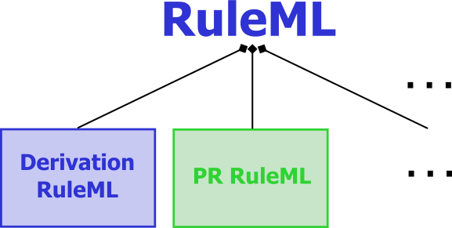
Modular Schemas
“RuleML is a family of sublanguages
whose root allows access to
the language as a whole and
whose members allow to identify
customized subsets of the language.”
. . .
RuleML: Rule Markup Language
  RuleML derivation rules (shown here) and production rules defined in XML Schema Definition (XSD)
  Each XSD of the family corresponds to the
  expressive class of a specific RuleML sublanguage
The most recent schema specification of RuleML is always available at http://www.ruleml.org/spec
Current release: RuleML 0.91
Previews: http://wiki.ruleml.org/XSD_Workplan

Slide 7
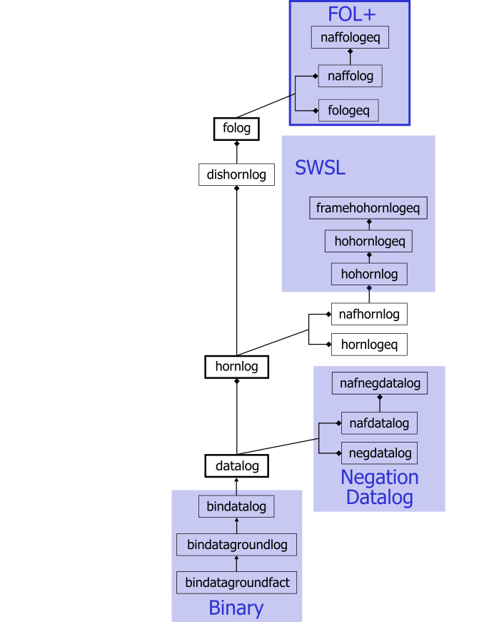
Schema Modularization
XSD URIs identify expressive classes
  Receivers of a rulebase can validate applicability of tools
  (such as Datalog vs. Hornlog interpreters)
  Associated with semantic classes
  (such as function-free vs. function-containing Herbrand models)
Modularization (Official Model)
  Aggregation:
  e.g., Datalog part of Hornlog
  Generalization:
  e.g., Bindatalog is a Datalog

Slide 8
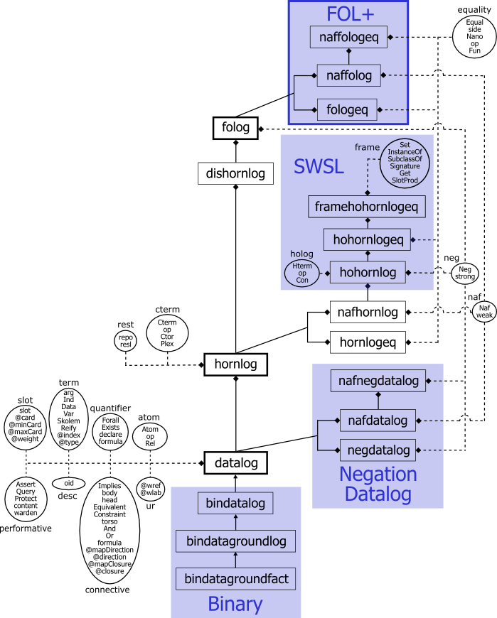
Rectangles are sublanguages
  Inheritance between schemas
Ovals are auxiliary modules
  Elementary, including only
  element and/or attribute definitions
  Become part of sublanguages
E.g., in http://www.ruleml.org/
0.91/xsd/hornlog.xsd
<xs:redefine
schemaLocation=
"datalog.xsd">
<xs:include
schemaLocation=
"modules/cterm_module.xsd"/>

Slide 9
Bring Datalog to the Semantic Web
Start with n-ary relations (not binary properties)
Keep Variable typing optional (reuse RDFS’
subClassOf taxonomies as sort lattices)
Allow signature declarations of arities and types
Employ function-free facts as well as Horn rules (rather than 1st: RDF descriptions; 2nd: RDF rules)
Use function-free Herbrand model semantics
(querying stays decidable)
Provide three syntactic levels:
  User-oriented: Prolog-like, but with “?”-variables
  Abstract: MOF/UML diagrams
  XML serialization: Datalog RuleML

Slide 10
Business Rule: Positional
''The discount for a customer buying a product is 5 percent
if the customer is premium and the product is regular.''
<Implies>
<head>
<Atom>
<Rel>discount</Rel>
<Var>customer</Var>
<Var>product</Var>
<Ind>5.0</Ind>
</Atom>
</head>
<body>
<And>
<Atom>
<Rel>premium</Rel>
<Var>customer</Var>
</Atom>
<Atom>
<Rel>regular</Rel>
<Var>product</Var>
</Atom>
</And>
</body>
</Implies>
Implies
head
body
Atom
And
Atom
Atom
discount
customer
product
5.0
Rel
Var
Var
Ind
premium
customer
regular
product
Rel
Var
Rel
Var

Slide 11
Extend Datalog for the Semantic Web (I)
Allow slots as name->filler pairs in Atoms
(cf. F-logic’s methods and RDF’s properties)
Extend optional types and signatures for slots
Add optional object identifiers (oids) to atoms
Separate Data literals from Individual constants

Slide 12
Business Rule: Slotted (for OO)
''The discount for a customer buying a product is 5 percent
if the customer is premium and the product is regular.''
<Implies>
<head>
<Atom>
<Rel>discount</Rel>
<slot><Ind>buyer</Ind><Var>customer</Var></slot>
<slot><Ind>item</Ind><Var>product</Var></slot>
<slot><Ind>rebate</Ind><Data>5.0</Data></slot>
</Atom>
</head>
<body>
<And>
<Atom>
<Rel>premium</Rel>
<Var>customer</Var>
</Atom>
<Atom>
<Rel>regular</Rel>
<Var>product</Var>
</Atom>
</And>
</body>
</Implies>
Implies
head
body
Atom
And
item
rebate
buyer
Atom
Atom
discount
customer
product
5.0
Rel
Var
Var
Data
premium
customer
regular
product
Rel
Var
Rel
Var

Slide 13
Extend Datalog for the Semantic Web (II)
Permit IRI webizing for Data (XML Schema Part 2), Individuals (RDF’s resources), Relations,
slot names, types (RDFS’ classes), and
oids (RDF’s about)
Introduce Module (scope) construct for clauses
(cf. RDF’s named graphs)
Add scoped-default (Naf), strong (Neg), scoped-default-of-strong negation (unscoped: cf. ERDF)
Integrate with Description Logics
  Homogeneous (SWRL, Datalog RuleML + OWL-DL)
  Hybrid (AL-log, Datalog^{DL}, DL+log, ...)

Slide 14
Bring Horn Logic to the Semantic Web
Augment Datalog with uninterpreted Functions
and their Expressions; also for extended Datalog
Augment Datalog’s Herbrand model semantics with such Functions (querying becomes undecidable)
Extend Datalog syntaxes
  XML Schema of Hornlog RuleML inherits and augments XML Schema of Datalog RuleML
Add Equality and interpreted Functions (XML serialization: attribute in="yes")
Reuse XQuery/XPath functions and operators as built-ins

Slide 15
Specify a First-Order Logic Web Language
Layer on top of either
  Disjunctive Datalog: Or in the head generalizing Datalog
  Disjunctive Horn Logic: Or in head of near-Horn clauses
Alternatively, layer on top of either
  Disjunctive Datalog with restricted strong Negation
  Disjunctive Horn Logic with restricted strong Neg
Permit unrestricted Or, And, strong Neg, and quantifiers Forall and Exists to obtain FOL
Use semantics of classical FOL model theory
Extend Hornlog RuleML syntax to FOL RuleML

Slide 16
Approach Production and Reaction Rules
Share Condition (C) part with earlier languages as proposed for the RIF Condition Language
Develop Action (A) part of Production Rules via a taxonomy of actions on KBs (Assert, Retract, ...), on local or remote hosts, or on the surroundings
Develop Event (E) part of Reaction Rules via a corresponding taxonomy
Create CA and ECA families bottom-up and map to relevant languages for Semantic Web Services
Serialized: <Reaction> E C A </Reaction>
See http://ibis.in.tum.de/research/ReactionRuleML TG

Slide 17
Bidirectional Interpreters in Java
Two varieties of reasoning engines
  Top-Down: backward chaining
  Bottom-Up: forward chaining
jDREW: Java Deductive Reasoning Engine
for the Web includes both TD and BU http://www.jdrew.org
OO jDREW: Object-Oriented extension to jDREW http://www.jdrew.org/oojdrew
Java Web Start online demo available at http://www.jdrew.org/oojdrew/demo.html

Slide 18
OO jDREW Slots
Normalized atoms and complex terms
  oids (object identifier)
  Positional parameters (in their original order)
  Positional rest terms
  Slotted parameters (in the order encountered)
  Slotted rest terms
Efficient unification algorithm
  Linear O(m+n): instead of O(m*n)
    No need for positional order
    Slots internally sorted
  Steps:
    Scan two lists of parameters
      Matching up roles and positions for positional parameters
      Unifying those parameters
    Add unmatched roles to list of rest terms
    Generate dynamically a Plex (RuleML’s closest equivalent to a list)
    for a collection of rest terms

Slide 19
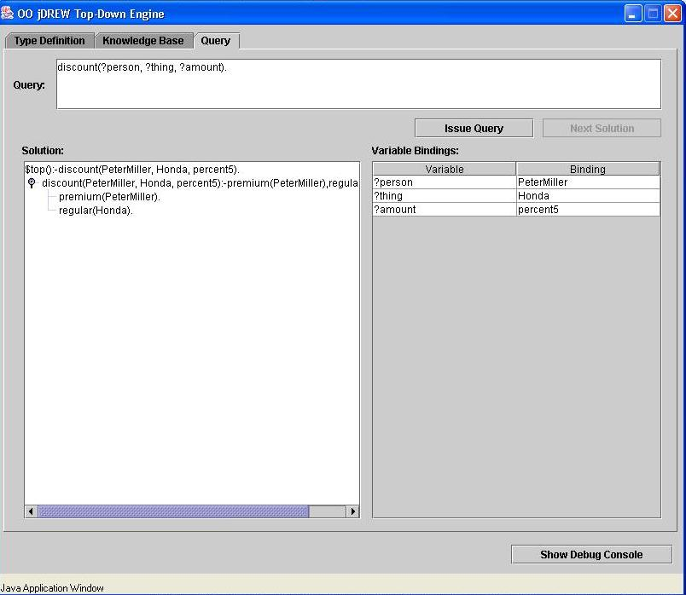
positional
POSL
syntax
discount(?customer,?product,percent5)
:- premium(?customer), regular(?product).
premium(PeterMiller).
regular(Honda).

Slide 20
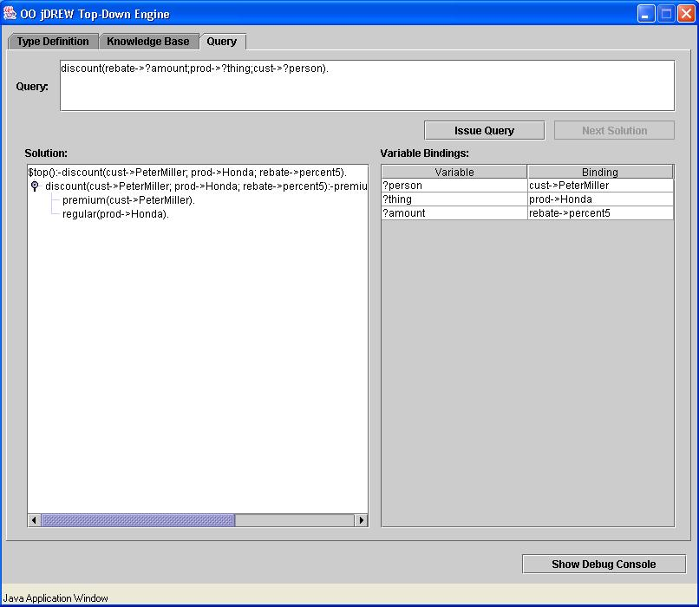
slotted
POSL
syntax
discount(cust->?customer;prod->?product;rebate->percent5)
:- premium(cust->?customer), regular(prod->?product).
premium(cust->PeterMiller).
regular(prod->Honda).

Slide 21
OO jDREW Types
Order-sorted type system
  RDF Schema: lightweight taxonomies of the Semantic Web
  To specify a partial order for a set of classes in RDFS
Advantages
  Having the appropriate types specified for the parameters
  To restrict the search space
  Faster and more robust system than when reducing types to unary predicate calls in the body
Limitations
  Only modeling the taxonomic relationships between classes
  Not modeling properties with domain and range restrictions

Slide 22
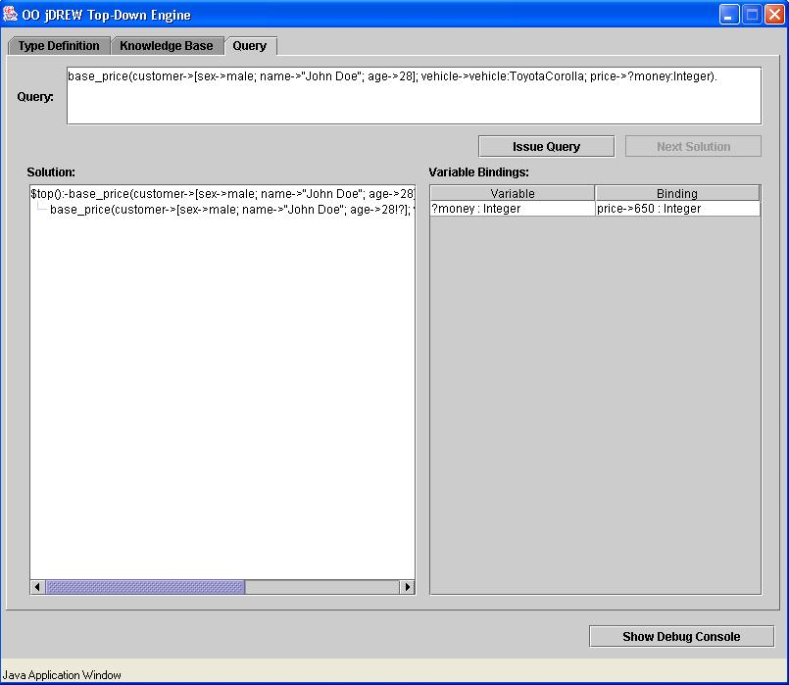
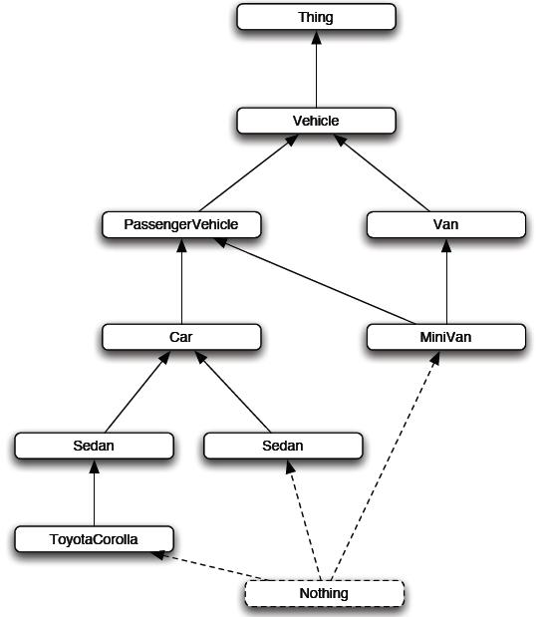
base_price(customer->[sex->male;!?];
vehicle->:Car;
price->650:Integer).
base_price(customer->[sex->male;!?];
vehicle->:Van;
price->725:Integer).

Slide 23
Conclusions
RuleML is modular family, whose root allows to access the language as a whole and whose members allow customized subsets
New members joining, e.g. Fuzzy RuleML
Concrete & abstract syntax of RuleML
  Specified by modular XSD (shown here) & MOF
Formal semantics of OO Hornlog RuleML
  Implemented by OO jDREW BU & TD
Interoperability/Interchange of/with RuleML
  Realized by translators, primarily via XSLT

