Slide 1
The RuleML Family of Web Rule Languages
PPSWR’06, Budva, Montenegro, 10 June 2006
Revised, RuleML’06, Athens, GA, 11 Nov. 2006
Harold Boley
University of New Brunswick, Canada
National Research Council of Canada

Slide 2
Introduction
Rules are central to the Semantic Web
Rule interchange in an open format
is important for e-Business
RuleML is the de facto open language
standard for rule interchange/markup
Collaborating with W3C (RIF), OMG (PRR, SBVR), OASIS, DARPA-DAML, EU-REWERSE, and other standards/gov'nt bodies

Slide 3
RuleML Enables ...
modelling
markup
translation
interchange
execution
publication
archiving
UML
RDF
XML
ASCII
Rule
in

Slide 4
RuleML Identifies ...
Expressive sublanguages
  for Web rules
  started with
    Derivation rules: extend SQL views
    Reaction rules: extend SQL triggers
  to empower their subcommunities

Slide 5
RuleML Specifies ...
Derivation rules via XML Schema:
  All sublanguages: (OO) RuleML 0.91
  First Order Logic: FOL RuleML 0.91
  With Ontology language: SWRL 0.7
    A Semantic Web Rule Language
    Combining OWL (W3C) and RuleML
  With Web Services language: SWSL 0.9
Translators in & out (e.g. Jess) via XSLT

Slide 6
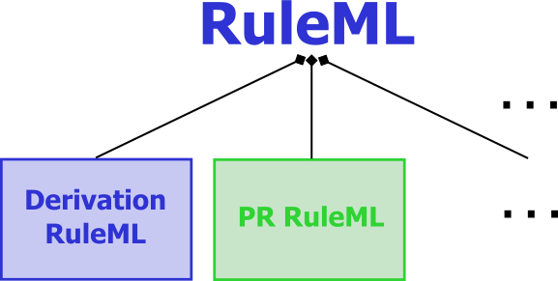
Modular Schemas
“RuleML is a family of sublanguages
whose root allows access to
the language as a whole and
whose members allow to identify
customized subsets of the language.”
. . .
RuleML: Rule Markup Language
  RuleML derivation rules (shown here) and production rules defined in XML Schema Definition (XSD)
  Each XSD of the family corresponds to the
  expressive class of a specific RuleML sublanguage
The most recent schema specification of RuleML is always available at http://www.ruleml.org/spec
Current release: RuleML 0.91
Previews: http://wiki.ruleml.org/XSD_Workplan

Slide 7
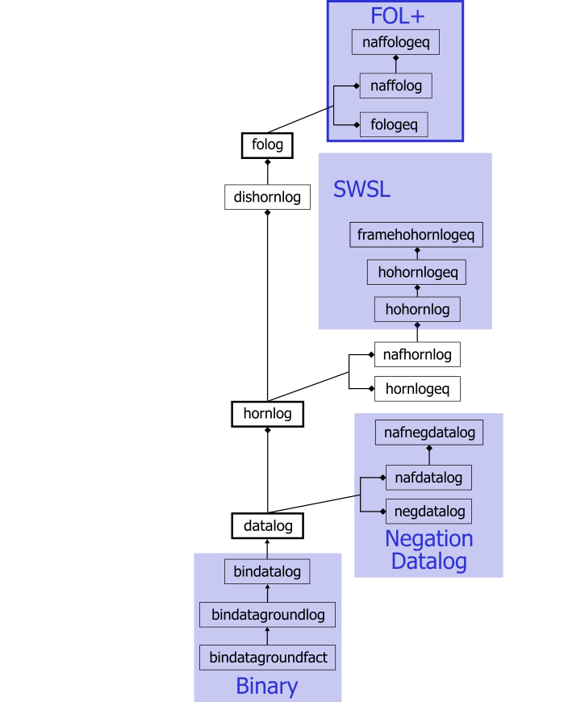
Schema Modularization
XSD URIs identify expressive classes
  Receivers of a rulebase can validate applicability of tools
  (such as Datalog vs. Hornlog interpreters)
  Associated with semantic classes
  (such as function-free vs. function-containing Herbrand models)
Modularization (Official Model)
  Aggregation:
  e.g., Datalog part of Hornlog
  Generalization:
  e.g., Bindatalog is a Datalog

Slide 8
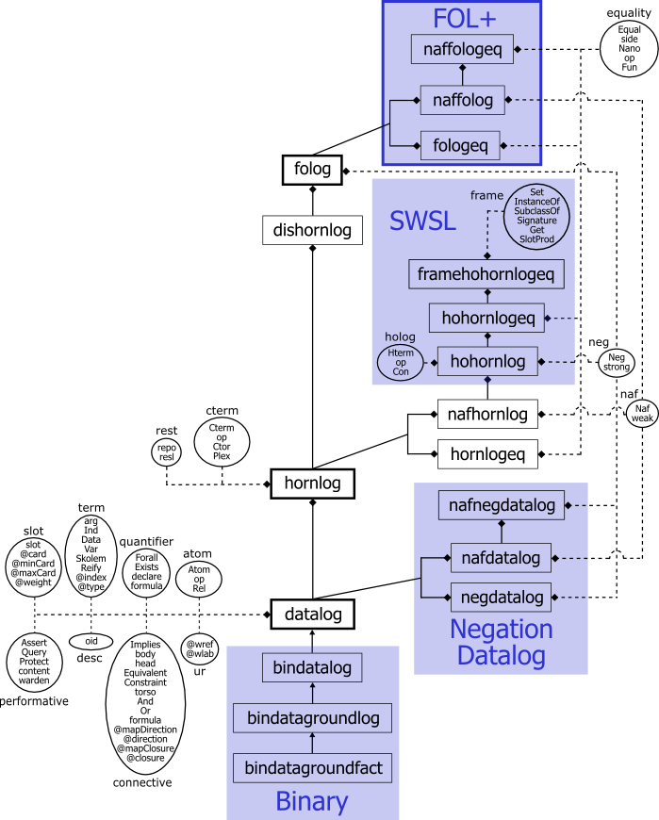
Rectangles are sublanguages
  Inheritance between schemas
Ovals are auxiliary modules
  Elementary, including only
  element and/or attribute definitions
  Become part of sublanguages
E.g., in http://www.ruleml.org/
0.91/xsd/hornlog.xsd
<xs:redefine
schemaLocation=
"datalog.xsd">
<xs:include
schemaLocation=
"modules/cterm_module.xsd"/>

Slide 9
Bring Datalog to the Semantic Web
Start with n-ary relations (not binary properties)
Keep Variable typing optional (reuse RDFS’
subClassOf taxonomies as sort lattices)
Allow signature declarations of arities and types
Employ function-free facts as well as Horn rules (rather than 1st: RDF descriptions; 2nd: RDF rules)
Use function-free Herbrand model semantics
(querying stays decidable)
Provide three syntactic levels:
  User-oriented: Prolog-like, but with “?”-variables
  Abstract: MOF/UML diagrams
  XML serialization: Datalog RuleML

Slide 10
Business Rule: Positional
''The discount for a customer buying a product is 5 percent
if the customer is premium and the product is regular.''
<Implies>
<head>
<Atom>
<Rel>discount</Rel>
<Var>customer</Var>
<Var>product</Var>
<Ind>5.0</Ind>
</Atom>
</head>
<body>
<And>
<Atom>
<Rel>premium</Rel>
<Var>customer</Var>
</Atom>
<Atom>
<Rel>regular</Rel>
<Var>product</Var>
</Atom>
</And>
</body>
</Implies>
Implies
head
body
Atom
And
Atom
Atom
discount
customer
product
5.0
Rel
Var
Var
Ind
premium
customer
regular
product
Rel
Var
Rel
Var

Slide 11
Extend Datalog for the Semantic Web (I)
Allow slots as name->filler pairs in Atoms
(cf. F-logic’s methods and RDF’s properties)
Extend optional types and signatures for slots
Add optional object identifiers (oids) to atoms
Separate Data literals from Individual constants

Slide 12
Business Rule: Slotted (for OO)
''The discount for a customer buying a product is 5 percent
if the customer is premium and the product is regular.''
<Implies>
<head>
<Atom>
<Rel>discount</Rel>
<slot><Ind>buyer</Ind><Var>customer</Var></slot>
<slot><Ind>item</Ind><Var>product</Var></slot>
<slot><Ind>rebate</Ind><Data>5.0</Data></slot>
</Atom>
</head>
<body>
<And>
<Atom>
<Rel>premium</Rel>
<Var>customer</Var>
</Atom>
<Atom>
<Rel>regular</Rel>
<Var>product</Var>
</Atom>
</And>
</body>
</Implies>
Implies
head
body
Atom
And
item
rebate
buyer
Atom
Atom
discount
customer
product
5.0
Rel
Var
Var
Data
premium
customer
regular
product
Rel
Var
Rel
Var

Slide 13
Extend Datalog for the Semantic Web (II)
Permit IRI webizing for Data (XML Schema Part 2), Individuals (RDF’s resources), Relations,
slot names, types (RDFS’ classes), and
oids (RDF’s about)
Introduce Module (scope) construct for clauses
(cf. RDF’s named graphs)
Add scoped-default (Naf), strong (Neg), scoped-default-of-strong negation (unscoped: cf. ERDF)
Integrate with Description Logics
  Homogeneous (SWRL, Datalog RuleML + OWL-DL)
  Hybrid (AL-log, Datalog^{DL}, DL+log, ...)

Slide 14
Bring Horn Logic to the Semantic Web
Augment Datalog with uninterpreted Functions
and their Expressions; also for extended Datalog
Augment Datalog’s Herbrand model semantics with such Functions (querying becomes undecidable)
Extend Datalog syntaxes
  XML Schema of Hornlog RuleML inherits and augments XML Schema of Datalog RuleML
Add Equality and interpreted Functions (XML serialization: attribute in="yes")
Reuse XQuery/XPath functions and operators as built-ins

Slide 15
Specify a First-Order Logic Web Language
Layer on top of either
  Disjunctive Datalog: Or in the head generalizing Datalog
  Disjunctive Horn Logic: Or in head of near-Horn clauses
Alternatively, layer on top of either
  Disjunctive Datalog with restricted strong Negation
  Disjunctive Horn Logic with restricted strong Neg
Permit unrestricted Or, And, strong Neg, and quantifiers Forall and Exists to obtain FOL
Use semantics of classical FOL model theory
Extend Hornlog RuleML syntax to FOL RuleML

Slide 16
Equality for Functions
Functional programming (FP) plays increasing
Web role: MathML, XSLT, XQuery
Functional RuleML employs orthogonal notions freely combinable with Relational RuleML
Also solves a Relational RuleML issue, where the following ‘child-of-parent’ elements are separated:
  Constructor (Ctor) of a complex term (Cterm)
  User-defined function (Fun) of a call (Nano)
Proceed to a logic with equality

Slide 17
Function Interpretedness (I)
Different notions of ‘function’ in LP and FP:
LP: Uninterpreted functions denote unspecified values when applied to arguments, not using function definitions
FP: Interpreted functions compute specified returned values when applied to arguments, using function definitions
E.g.: first-born: Man × Woman → Human
  Uninterpreted: first-born(John, Mary) denotes first-born
  Interpreted: using first-born(John, Mary) = Jory, so the application returns Jory

Slide 18
Function Interpretedness (II)
Uninterpreted <Ctor> vs. interpreted <Fun>
functions now distinguished with attribute values:
<Fun in="no"> vs. <Fun in="yes">
Function applications with Cterm vs. Nano
then uniformly become Expressions
Two versions of example marked up as follows
(where "u" stands for "no" or "yes"):
<Expr>
<Fun in="u">first-born</Fun>
<Ind>John</Ind>
<Ind>Mary</Ind>
</Expr>

Slide 19
Unconditional Equations
Modified <Equal> element permits both
symmetric and oriented equations
E.g.: first-born(John, Mary) = Jory
can now be marked up thus:
<Equal oriented="yes">
<lhs>
<Expr>
<Fun in="yes">first-born</Fun>
<Ind>John</Ind>
<Ind>Mary</Ind>
</Expr>
</lhs>
<rhs>
<Ind>Jory</Ind>
</rhs>
</Equal>

Slide 20
Conditional Equations
Use <Equal> as the conclusion of an <Implies>,
whose condition may employ other equations
E.g.: ?B = birth-year(?P) ⇒ age(?P) = subtract(this-year(),?B)
<Implies>
<Equal oriented="no">
<Var>B</Var>
<Expr>
<Fun in="yes">birth-year</Fun>
<Var>P</Var>
</Expr>
</Equal>
<Equal oriented="yes">
<Expr>
<Fun in="yes">age</Fun>
<Var>P</Var>
</Expr>
<Expr>
<Fun in="yes">subtract</Fun>
<Expr>
<Fun in="yes">this-year</Fun>
</Expr>
<Var>B</Var>
</Expr>
</Equal>
</Implies>

Slide 21
Accommodate SWSL-Rules
HiLog: Higher-order Variables, Constants, and Hterms (complex terms and atomic formulas at the same time)
Equal: As in Horn Logic with (unoriented) Equality
Frames:
  Value molecules: Atoms with an oid, an optional Rel class, and zero or more name->filler instance slots
  Signature molecules: name=>filler class slots, which
  can have {min:max} cardinality constraints
Reification: A formula (e.g., a rule) embedded in a Reify element is treated (e.g., unified) as a term
Skolems: Unnamed, represent new individual constants (like RDF's blank nodes); otherwise, uniquely named ones

Slide 22
HiLog Examples: Hterms (I)
First-order terms: f(a,?X)
<Hterm>
<op><Con>f</Con></op>
<Con>a</Con>
<Var>X</Var>
</Hterm>
Variables over function symbols: ?X(a,?Y)
<Hterm>
<op><Var>X</Var></op>
<Con>a</Con>
<Var>Y</Var>
</Hterm>

Slide 23
HiLog Examples: Hterms (II)
Parameterized function symbols: f(?X,a)(b,?X(c))
<Hterm>
<op>
<Hterm>
<op><Con>f</Con></op>
<Var>X</Var>
<Con>a</Con>
</Hterm>
</op>
<Con>b</Con>
<Hterm>
<op><Var>X</Var></op>
<Con>c</Con>
</Hterm>
</Hterm>

Slide 24
Equality Example
Equality :=: in rule head: f(a,?X):=:g(?Y,b) :- p(?X,?Y).
<Implies>
<head>
<Equal>
<Hterm>
<op><Con>f</Con></op>
<Con>a</Con>
<Var>X</Var>
</Hterm>
<Hterm>
<op><Con>g</Con></op>
<Var>Y</Var>
<Con>b</Con>
</Hterm>
</Equal>
</head>
<body>
<Hterm>
<op><Con>p</Con></op>
<Var>X</Var>
<Var>Y</Var>
</Hterm>
</body>
</Implies>

Slide 25
Frame Example: Value Molecule
Parameterized-name->filler slot: o[f(a,b) -> 3]
<Atom>
<oid><Con>o</Con></oid>
<slot>
<Hterm>
<op><Con>f</Con></op>
<Con>a</Con>
<Con>b</Con>
</Hterm>
<Con>3</Con>
</slot>
</Atom>

Slide 26
Reification Example: Reified Rule
$Rule as slot filler: john[believes -> ${p(?X) implies q(?X)}].
<Hterm>
<oid>john</oid>
<slot>
<Con>believes</Con>
<Reify>
<Implies>
<body>
<Hterm>
<op><Con>p</Con></op>
<Var>X</Var>
</Hterm>
</body>
<head>
<Hterm>
<op><Con>q</Con></op>
<Var>X</Var>
</Hterm>
</head>
</Implies>
</Reify>
</slot>
</Hterm>

Slide 27
Skolem Examples (I):
Named Skolem: holds(a,_#1) and between(1,_#1,5).
<And>
<Hterm>
<op><Con>holds</Con></op>
<Con>a</Con>
<Skolem>1</Skolem>
</Hterm>
<Hterm>
<op><Con>between</Con></op>
<Con>1</Con>
<Skolem>1</Skolem>
<Con>5</Con>
</Hterm>
</And>

Slide 28
Skolem Examples (II):
Unamed Skolem: holds(a,_#) and between(1,_#,5).
<And>
<Hterm>
<op><Con>holds</Con></op>
<Con>a</Con>
<Skolem/>
</Hterm>
<Hterm>
<op><Con>between</Con></op>
<Con>1</Con>
<Skolem/>
<Con>5</Con>
</Hterm>
</And>

Slide 29
Proceed towards Modal Logics
Modal operators generically viewed as special Relations at least one of whose arguments is a proposition represented as an Atom with an uninterpreted Relation (including another modal operator, but not an arbitrary formula)
  Alethic necessary () and possible ()
  Deontic must and may (e.g., in business rules)
  Open for temporal (e.g., when planning/diagnosing reactive rules), epistemic (e.g., in authentication rules), and further modal operators
Towards a unified framework for multi-modal logic based on Kripke-style possible worlds semantics

Slide 30
Modal Examples: Alethic Operator
Necessity:  prime(1)
<Atom>
<Rel modal="yes">necessary</Rel>
<Atom>
<Rel in="no">prime</Rel>
<Data>1</Data>
</Atom>
</Atom>

Slide 31
Modal Examples: Epistemic Operator
Knowledge: knows(Mary,material(moon,rock))
<Atom>
<Rel modal="yes">knows</Rel>
<Ind>Mary</Ind>
<Atom>
<Rel in="no">material</Rel>
<Ind>moon</Ind>
<Ind>rock</Ind>
</Atom>
</Atom>

Slide 32
Modal Examples: Epistemic Reasoning
Veridicality axiom: Knows_{Agent} proposition → proposition
Knows_{Mary} material(moon,rock) → material(moon,rock)
Serialization in previous slide
→
<Atom>
<Rel in="yes">material</Rel> <!-- "yes" is default -->
<Ind>moon</Ind>
<Ind>rock</Ind>
</Atom>

Slide 33
Modal Examples: Nested Operators
Knowledge of Necessity: knows(Mary, prime(1))
<Atom>
<Rel modal="yes">knows</Rel>
<Ind>Mary</Ind>
<Atom>
<Rel modal="yes" in="no">necessary</Rel>
<Atom>
<Rel in="no">prime</Rel>
<Data>1</Data>
</Atom>
</Atom>
</Atom>

Slide 34
Protect Knowledge Bases by Integrity Constraints
A knowledge base KB is a formula in any of our logic languages
An integrity constraint IC is also a formula in any
of our logic languages, which may be chosen independently from KB
KB obeys IC
iff
KB entails IC
(Reiter 1984, 1987)
  Entailment notion of 1987 uses epistemic modal operator
Serialization: <Entails> KB IC </ Entails>

Slide 35
Integrity Constraint Example: Rule with ∃-Head
Adapted from (Reiter 1987):
IC = {(∀x)emp(x)⇒(∃y)ssn(x,y)}
KB₁ = {emp(Mary)} KB₁ violates IC
KB₂ = {emp(Mary), ssn(Mary,1223)} KB₂ obeys IC
<Entails> KB_{i} IC </Entails>
KB₁:
<Atom>
<Rel>emp</Rel>
<Ind>Mary</Ind>
</Atom>
KB₂:
<Rulebase>
<Atom>
<Rel>emp</Rel>
<Ind>Mary</Ind>
</Atom>
<Atom>
<Rel>ssn</Rel>
<Ind>Mary</Ind>
<Data>1223</Data>
</Atom>
</Rulebase>
IC:
<Forall>
<Var>x</Var>
<Implies>
<Atom>
<Rel>emp</Rel>
<Var>x</Var>
</Atom>
<Exists>
<Var>y</Var>
<Atom>
<Rel>ssn</Rel>
<Var>x</Var>
<Var>y</Var>
</Atom>
</Exists>
</Implies>
</Forall>

Slide 36
Approach Production and Reaction Rules
Share Condition (C) part with earlier languages as proposed for the RIF Condition Language
Develop Action (A) part of Production Rules via a taxonomy of actions on KBs (Assert, Retract, ...), on local or remote hosts, or on the surroundings
Develop Event (E) part of Reaction Rules via a corresponding taxonomy
Create CA and ECA families bottom-up and map to relevant languages for Semantic Web Services
Serialized: <Reaction> E C A </Reaction>
See http://ibis.in.tum.de/research/ReactionRuleML TG

Slide 37
RDF Rules
RDF-like Rules: Important RuleML sublanguage
  Datalog: Relational databases augmented by views
  RDF Properties: Slots permit non-positional, keyed arguments
  RDF URIs/IRIs: Anchors provide object identity via webzing through URIs/IRIs
    oids: Can be Individuals, Variables, etc.
    iris: Now used for both RDF’s about and resource
  RDF Blank Nodes: F-logic/Flora-2 Skolem-constant approach
    E.g., Skolem generator ‘_’ becomes <Skolem/>

Slide 38
<Implies>
<body>
<And>
<Atom>
<oid><Var>x</Var></oid>
<Rel>product</Rel>
<slot><Ind iri=":price"/><Var>y</Var></slot>
<slot><Ind iri=":weight"/><Var>z</Var></slot>
</Atom>
<Atom>
<Rel iri="swrlb:greaterThan"/><Var>y</Var><Data>200</Data>
</Atom>
<Atom>
<Rel iri="swrlb:lessThan"/><Var>z</Var><Data>50</Data>
</Atom>
</And>
</body>
<head>
<Atom>
<oid><Var>x</Var></oid>
<Rel>product</Rel>
<slot><Ind iri=":shipping"/><Data>0</Data></slot>
</Atom>
</head>
</Implies>
“For a product whose price is greater than 200 and
whose weight is less than 50, no shipping is billed.”

Slide 39
Bidirectional Interpreters in Java
Two varieties of reasoning engines
  Top-Down: backward chaining
  Bottom-Up: forward chaining
jDREW: Java Deductive Reasoning Engine
for the Web includes both TD and BU http://www.jdrew.org
OO jDREW: Object-Oriented extension to jDREW http://www.jdrew.org/oojdrew
Java Web Start online demo available at http://www.jdrew.org/oojdrew/demo.html

Slide 40
OO jDREW Slots
Normalized atoms and complex terms
  oids (object identifier)
  Positional parameters (in their original order)
  Positional rest terms
  Slotted parameters (in the order encountered)
  Slotted rest terms
Efficient unification algorithm
  Linear O(m+n): instead of O(m*n)
    No need for positional order
    Slots internally sorted
  Steps:
    Scan two lists of parameters
      Matching up roles and positions for positional parameters
      Unifying those parameters
    Add unmatched roles to list of rest terms
    Generate dynamically a Plex (RuleML’s closest equivalent to a list)
    for a collection of rest terms

Slide 41
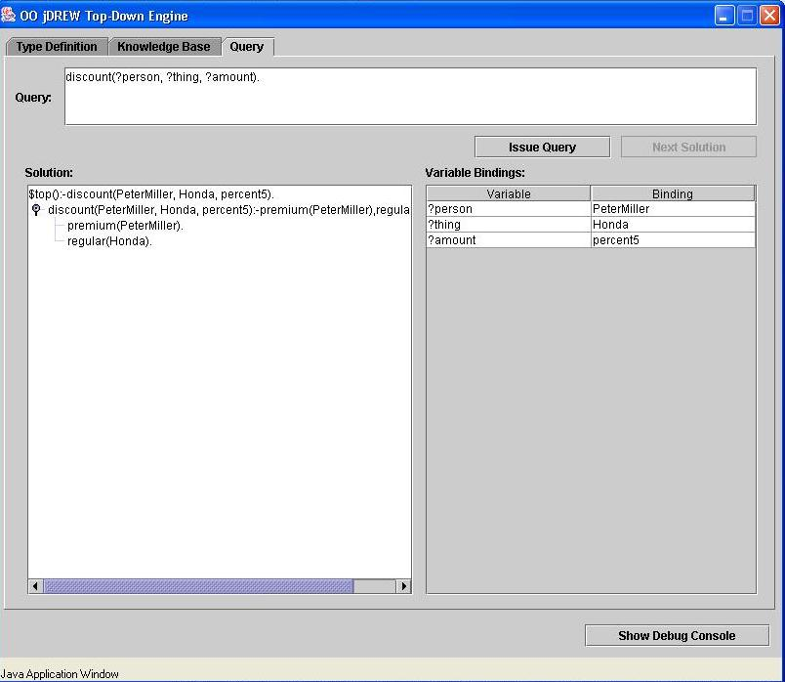
positional
POSL
syntax
discount(?customer,?product,percent5)
:- premium(?customer), regular(?product).
premium(PeterMiller).
regular(Honda).

Slide 42
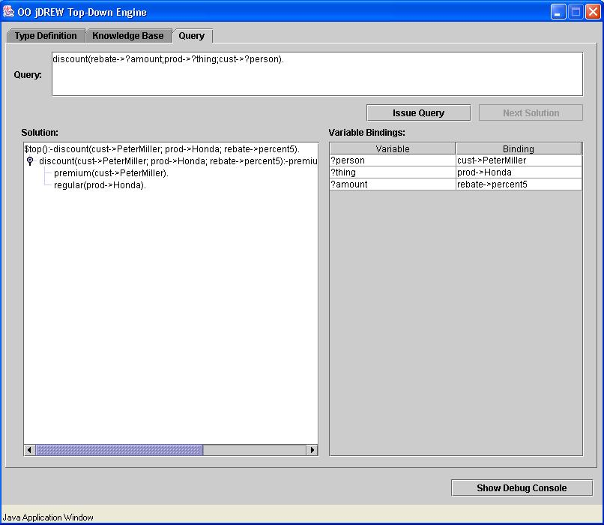
slotted
POSL
syntax
discount(cust->?customer;prod->?product;rebate->percent5)
:- premium(cust->?customer), regular(prod->?product).
premium(cust->PeterMiller).
regular(prod->Honda).

Slide 43
OO jDREW Types
Order-sorted type system
  RDF Schema: lightweight taxonomies of the Semantic Web
  To specify a partial order for a set of classes in RDFS
Advantages
  Having the appropriate types specified for the parameters
  To restrict the search space
  Faster and more robust system than when reducing types to unary predicate calls in the body
Limitations
  Only modeling the taxonomic relationships between classes
  Not modeling properties with domain and range restrictions

Slide 44
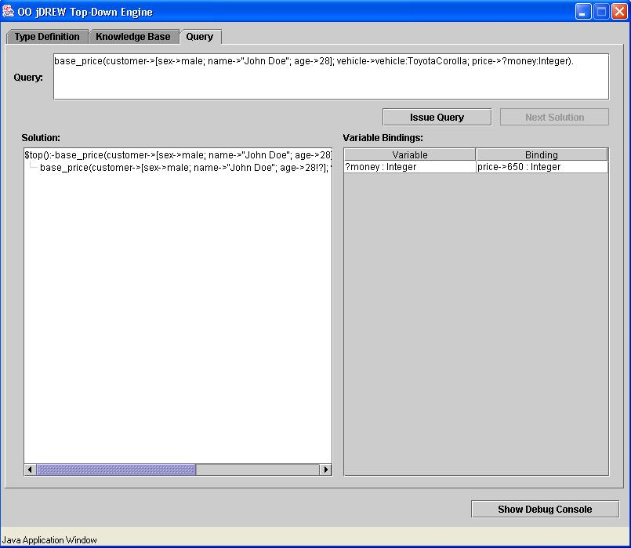
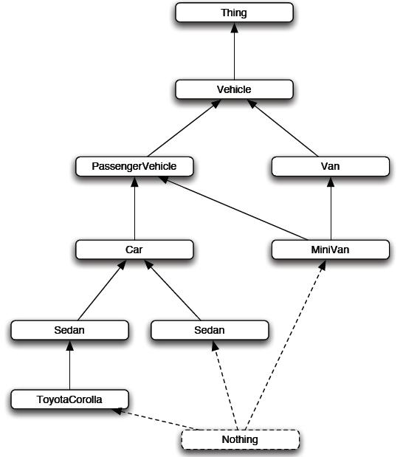
base_price(customer->[sex->male;!?];
vehicle->:Car;
price->650:Integer).
base_price(customer->[sex->male;!?];
vehicle->:Van;
price->725:Integer).

Slide 45
OO jDREW OIDs
<Atom>
<oid><Ind>mary-12</Ind></oid>
<Rel>keep</Rel>
<Ind>Mary</Ind>
<Var>object</Var>
</Atom>
oid: Object Identifier
Currently: symbolic names
  In <Atom> & <Implies>
Planned: iri attribute
E.g., give name to fact
keep(Mary, ?object).
<Atom>
<oid><Ind iri=“http://mkb.ca”/></oid>
<Rel>keep</Rel>
<Ind>Mary</Ind>
<Var>object</Var>
</Atom>
<Atom>
<oid><Var>object</Var></oid>
<Rel>keep</Rel>
<Ind>Mary</Ind>
<Var>object</Var>
</Atom>

Slide 46
Conclusions
RuleML is modular family, whose root allows to access the language as a whole and whose members allow customized subsets
New members joining, e.g. Fuzzy RuleML
Concrete & abstract syntax of RuleML
  Specified by modular XSD (shown here) & MOF
Formal semantics of OO Hornlog RuleML
  Implemented by OO jDREW BU & TD
Interoperability/Interchange of/with RuleML
  Realized by translators, primarily via XSLT

