Slide 1
ECA-LP/ECA-RuleML
09-21-2006
IBIS, TU München
+49 89 289 17504
http://ibis.in.tum.de
ECA-LP / ECA-RuleML: A Homogeneous ECA Logic Programming Language
Agenda
ECA-LP Syntax
ECA-LP Semantics
Update Actions
Complex Event / Action Algebra
ECA-RuleML
Event Notification / Event Messaging
Discussion
Adrian Paschke (TUM)
RuleML Reactive Rules, Telephone Conference, 09-21-2006

Slide 2
Event Condition Action Logic Programming Language (ECA-LP) – Syntax (1)
ECA-LP Core Syntax: Extended (T)ECA(P)(EL) Rules
eca(Time,Event,Condition,Action,Post-Condition,Else).
Optional Time Part
  Interval validity period of rule, e.g. “from 1-1-2005 to 10-3-2006”
  Periodical monitoring schedules, e.g. “ from 9 a.m. to 12 p.m. every 10 seconds”
  Absolute time events, e.g. “at 25-2-2006 at 9:00 a.m.”
  Relative event, e.g. “ 5 minutes after event X”
Post-Condition
  Cuts and counters might be set to prevent backtracking of variable bindings
  Post conditional test, e.g. test integrity constraints, test special predefined test case etc.
  If Post-condition test fails, then rollback (internal) update transactions (actions)
Else
  Defines alternative action (exception) in case the normal execution sequence fails
  Leads to a more compact syntax:
  “On event and condition do action 1 else do action 2”

Slide 3
Event Condition Action Logic Programming Language (ECA-LP) – Syntax (2)
Homogeneous Representation with Derivation Rules
ECA rule: eca (
1 everyMinute(), % time
2 detect(request(Customer, FlightDestination),T), % event
3 find(FlightDestination,Flight), % condition
4 book(Customer, Flight), ! , % action
5 notify(Customer, bookedUp(FlightDestination) ). % else
Derivation Rules:
6 Time: everyMinute() :- sysTime(T), interval(timespan(0,0,1,0),T).
7 Event: detect(request(Customer, FlightDestination),T):-
8 occurs(request(Customer,FlightDestination),T),
9 consume(request(Customer,FlightDestination)).
10 Condition: find(Destination,Flight) :-
11 on_exception(java.sql.SQLException,on_db_exception()),
12 dbopen("flights",DB),
13 sql_select(DB,”flights”, [flight, Flight], [where, “dest=Destination”]).
14 Action: book(Cust, Flight) :-
15 flight.BookingSystem.book(Flight, Cust),
16 notify(Cust, flightBooked(Flight)).
17 Post-Condition
18 Else notify(Customer, Message):-
19 sendMessage(Customer, Message).

Slide 4
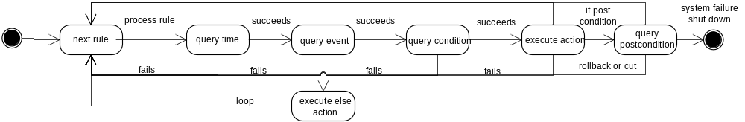
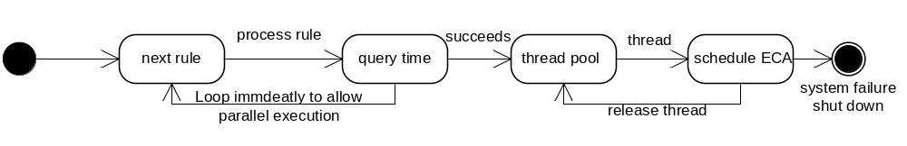
ECA-LP Procedural Semantics
Goal-driven Backward-Reasoning
  ECA rules are meta interpreted
  Active forward-directed operational semantics of ECA paradigm is simulated via queries
ECA interpreter provides general Wrapper interface on query API
Parallel execution via multi-threading
  safeguarded by Event/Action Context, Event Calculus States and Integrity Constraints
Implements Typed Variable Unification, Backtracking, Procedural Attachments

Slide 5


Dynamic ID-based Updates
Declarative Semantics
  Inherits semantics and properties from underlying inference system
  Global definition of ECA rules
  Parallel execution of ECA rules
Labeled, Unitized Logic
  Clauses are labeled with ID (rule name)
  Bundled to clause sets (modules) with module ID
Dynamic Logic
  Updates: Add / Remove / Change extensional and intensional knowledge
  Transition to new knowledge state: or
  Transition: <P,E,U> → <P’,U,U’>
Transactional Updates
  Safeguarded by Integrity Constraints / Test Cases
  Transition into hypothetical / pending state: P → P^{hypo}
  If test fails rollback P’=P else commit P’=P^{hypo}

Slide 6
Complex Events / Actions
Different Event / Action Definitions
  Active Database
    Complex Event Algebra: Transient complex event occurrences ~ detection time of terminating event
  Event Notification Systems
    Sequence of event messages (following a protocol)
  KR Event / Action Logics
    Formalized axioms to represent happened or planned non-transient events
    Temporal reasoning over effects of events / actions
Interval-based Event Calculus
  Classical Event Calculus
    Example:
      initiates(stopService,serviceUnavailable,T)
      terminates(startService,serviceUnavailable,T)
      happens(stopService,t1); happens(startService,t5)
      holdsAt(serviceUnavailable,t3)? → true
      holdsAt(serviceUnavailable,t7)? → false
  Interval-based Event Calculus
    Event interval: [E1,E2], E1 = Initiator, E2 = Terminator
    Time interval: [T1,T2]
    Examples:
    occurs(e1,[t1,t1]). occurs(e2,[t2,t2])
    holdsInterval([e1,e2],[t1,t2])?
stopService
startService
t1
t3 ?
t5
t7 ?

Slide 7
Complex KR Event / Action Algebra
Event / Action Algebra based on Interval-based Event Calculus
(A;B;C) ≡ detect(e,[T1,T3]) :- holdsInterval([a,b],[T1,T2],[a,b,c]), holdsInterval([b,c],[T2,T3],[a,b,c]),
[T1,T2]<=[T2,T3].
Meta Program for Algebra Operators
  Sequence, conjunction, or, xor, concurrent, neg, any, aperiodic
detect(e,T):- event(sequence(a,b),T), % detection condition for the event e
update(eis(e), "occurs(e,_0).“, [T]), % add e with key eis(e)
consume(eis(a)), consume(eis(b)).% consume all a and b events
Transient events: occurs(E,T) vs. Non-Transient Events: happens(E,T)
Consume: Remove transient events from event instance sequence (managed by ID)

Slide 8
SLA Scenario with States, Right and Obligations
Service Level Agreement
Schedule | Time | Availability | Response Time
Prime | 8 a.m. -18 p.m. | 98%[99%]100% ; pinged every 10s | 4 sec.; pinged every 10s
Standard | 18 p.m. -8 a.m. | 95%[97%]99%; pinged every min. | 10[14]16 sec.; pinged every min.
Maintenance | 0 a.m.- 4 a.m.* | 20%[50%]80%;pinged every 10 min | No monitoring
Price | Base | Bonus | Malus
Prime | p_{prime} | p_{prime} + (x_{high}-x_{median}) *p_{bonus} % | p_{prime} - (x_{median}-x_{low}) *p_{malus} %
Standard | p_{standard} | p_{standard} + (x_{high}-x_{median}) *p_{bonus} % | p_{standard} - (x_{median}-x_{low}) *p_{malus} %
Maintenance | p_{maintenance} | p_{maintenance}+ (x_{high}-x_{median}) *p_{bonus} % | p_{maintenance} - (x_{median}-x_{low}) *p_{malus} %
Level | Role | Time-to-Repair (TTR) | Rights / Obligations
1 | Process Manager | 10 Min. | Start / Stop Service
2 | Quality Manager | Max. Time-to-Repair (MTTR) | Change Service Levels to max values
3 | Control Committee | No Limit | All rights

Slide 9
Formalization (1)
…
ECA rule: “If the ping on the service fails and not maintenance then trigger escalation level 1 and notify process manager, else if ping succeeds and service is down then update with restart information and inform responsible role about restart".
1 eca( schedule(T,S), not(available(S)), not(maintenance(S)), escalate(S),_, restart(S)). % ECA rule
2 available(S) :- WebService.ping(S). % ping service
3 maintenance(S) :- sysTime(T), holdsAt(maintenance(S),T).
4 escalate(S) :- sysTime(T),
5 not(holdsAt(unavailable(S),T)), % escalate only once
6 update(“outages”,”happens(outage(_0),_1).”,[S,T]), % add outage event
7 role(R), notify (R, unavailable(S)). % notify
8 restart(S) :-
9 sysTime(T), holdsAt(unavailable(S),T),
10 update(“outages”,”happens(restart(_0),_1).”,[S,T]), % add restart event
11 role(R), notify(R,restart(S)). % update + notify
..
% initiate escalation level 1 if outage event happens
12 terminates(outage(S),escl_lvl(0),T).
13 initiates(outage(S),escl_lvl(1),T).
…

Slide 10
Formalization (2)
…
% define time-to-repair deadline and trigger escalation level 2 if deadline is elapsed
1 time_to_repair(tdeadline). % relative time to repair value (fact)
2 trajectory(escl_lvl(1),T1,deadline,T2,(T2 - T1)) . % deadline function (countdown)
3 derivedEvent(elapsed).
4 happens(elapsed,T) :- time_to_repair(TTR), valueAt(deadline,T, TTR).
5 terminates(elapsed, escl_lvl(1),T). % terminate escalation level 1
6 initiates(elapsed, escl_lvl(2),T). % initiate escalation level 2
…
% terminate escalation level 1/2/3 if servicing is started
7 initiates(startServicing(S),escl_lvl(0),T). terminates(startServicing(S), escl_lvl(1),T). terminates(startServicing(S), escl_lvl(2),T). terminates(startServicing(S),escl_lvl(3),T).
…

Slide 11
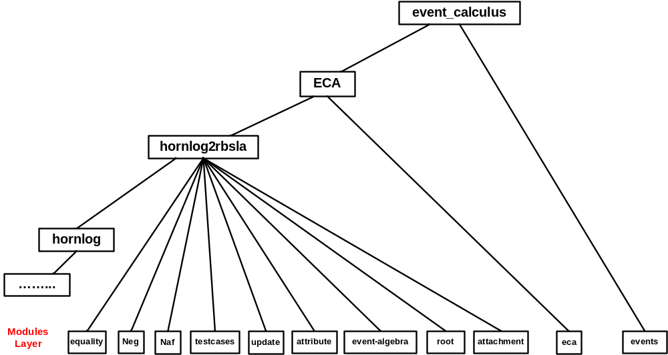
ECA-RuleML
Serialization Syntax for ECA Rules and Event / Action Algebra
    URL: http://ibis.in.tum.de/staff/paschke/rbsla/rbsla-ruleml.htm
Based on RuleML 0.9

Slide 12
ECA-RuleML Example
<ECA>
<time>
<Cterm>
<op><Ctor>everySecond</Ctor></op> <arg><Var>T</Var></arg>
</Cterm>
</time>
<event>
<Sequence>
<operator> <Concurrent>
<event>
<Ind>a</Ind>
<Ind>b</Ind>
</event>
</Concurrent> </operator>
<event> <Ind>c</Ind> </event>
</Sequence>
</event>
<condition>
<HoldsAt>
<fluent>
<Cterm>
<op><Ctor>state</Ctor></op>
<arg><Var type=“java.lang.Integer”>1</Var></arg>
</Cterm>
</fluent>
</HoldsAt>
</condition>
<action>
<Assert>
<oid><Ind>state1</Ind></oid>
<formula><Happens>
<event><Ind>ab</Ind></event>
<time><Var>T</Var></time>
</Happens></formula>
</Assert>
</action>
</ECA>

Slide 13
Event Notification / Messaging Style
Prova Agent Architecture: Event Notification / Messaging (Alex Kozlenkov)
  Core concept: Serial Horn Rules
    combination of updates and conditional body literals (see transaction logics)
  Communication / Protocol oriented reaction patterns
  Message reception and variety of outbound / inbound communication actions
  Distinguish conversations and protocol states
    Built-in management of correlation, conversation ids, session ids
Combination of
  Global ECA Rules (active database ECA paradigm)
  Event Notification / Messaging
  KR Event / Action Logics (Event Calculus)
  General denominator: “Extended Logic Programming”
  Promises to combine benefits and overcome drawbacks in each domain
  Questions:
    Homogeneous syntax?
    Heterogeneous approach?
    Minimal extensions to common logic programming vs. extensive built-ins?
    Reuse standard LP inference engines (Prolog derivates) – What about procedural attachments?

Slide 14
Discussion
Pros
  Homogeneously represent ECA rules with derivation rules, integrity rules, defeasible rules etc.
  Compact ECA syntax, but nevertheless full expressiveness of logic programming
  KR event / action formalisms such as Event Calculus, Situation Calculus
  Light-weight ECA interpreter as add-on to arbitrary LP inference systems
    Forward-directed production rule systems can use ECA terms as final matching constraints
  Adopts procedural and declarative semantics of logic programming
    Additional semantics needed to safeguard updates and parallel execution in dynamic LPs (e.g. test cases / integrity constraints)
  Enables active event processing via procedural attachments (e.g. ping service) or passive event processing (query facts/event data)
  Reusability of global rules
  Event context represented by variables might be derived by more or less complex (derivation) rule sets
  Dynamic changes with update actions safeguarded by integrity constraints
  Traceability and verifiability of conclusions resp. reactions due to formal semantics
  Different event/action definitions due to typed logic, e.g. simple test value, complex term/function, Object-oriented (Java) class
  Supports short and long-term perspective with transient, non-transient and planned events
Cons
  Trade-off between expressiveness and complexity
  Procedural problems such as event storms, non-terminating event answers (Internet), side effects are out of the scope of the logical formalisms and need procedural treatment, e.g. termination of processing threads, event queues.
  Event Notification / Messaging not directly supported by global ECA rules – Conversation ID /State needs to be managed
  Extra effort needed to safeguard parallel execution with update actions, e.g. by Event Calculus states and integrity constraints
➔ ECA-LP suitable for higher-level behavioral logic which amounts for formal reasoning and predictability / traceability of triggered actions and concluded results.

Slide 15
Thanks
Questions / Discussion ?

