Slide 1

TRANSLATOR:
A TRANSlator from LAnguage TO Rules
David Hirtle
David R. Cheriton School of Computer Science
University of Waterloo
(Work done at the University of New Brunswick)
October 13, 2006

Slide 2

Outline
Introduction
Translating Language to Rules
Attempto Controlled English
Discourse Representation Structures
Rule Markup Language
Future Work
Conclusion

Slide 3
Introduction
Semantic Web still not widely used
  Focus: machine-readable (meta)data
    facts, rules and ontologies
  Problem: only experts can contribute
    formal standards like RDF and OWL
    (and soon RIF) are difficult to learn
    need to lower the barrier to entry

Slide 4
Example: Semantic Web rule
Every student gets a discount of 15 percent.
<Implies>
<body>
<Atom>
<Rel>student</Rel>
<Var>customer</Var>
</Atom>
</body>
<head>
<Atom>
<Rel>discount</Rel>
<Var>customer</Var>
<Data>15%</Data>
</Atom>
</head>
</Implies>

Slide 5
Our Approach
Provide a user-friendly format
  why not English?
    easy
    familiar
    expressive
    but ambiguous
  “controlled English” avoids ambiguity
    formal, yet natural

Slide 6
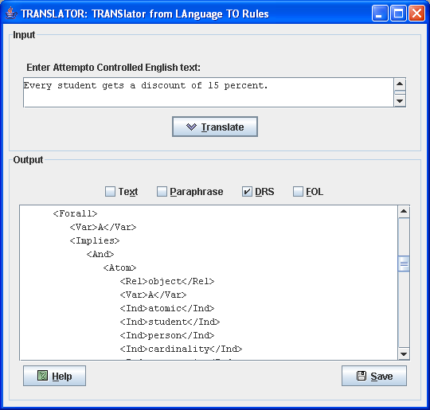
TRANSLATOR
Java Web Start

Slide 7
Step 1: Input
TRANSLATOR
ACE
GUI
DRS
DRS
Parser
DRS
grammar
RuleML, …
RuleML
query
(ACE + params)
DRS,
…
JavaCC
APE
webservice

Slide 8
Attempto Controlled English (1)
Looks like English
  Every honest student who does not procrastinate receives a good mark and easily passes the course.
Actually a formal language, like RDF
  tractable subset of English
    all ACE sentences are English, but not
    vice versa
  unambiguously translatable into logic

Slide 9
Attempto Controlled English (2)
Strategies for handling ambiguity:
  exclude imprecise phrasings
    Students hate annoying professors.
  interpretation rules
    The student brings a friend who is an alumnus and receives a discount.
      Who receives the discount?
        in ACE, student does (by default)
        repeat relative pronoun for other interpretation
        The student brings a friend who is an alumnus and who receives a discount.

Slide 10
Attempto Controlled English (3)
How can rules be expressed?
  in natural language, many different forms
    e.g., Everyone is mortal.
    All humanity is mortal.
    Every human being is mortal.
    For each person the person is mortal.
    If there is a member of the human race
    then he/she is mortal.
  all above are valid ACE
  further embellishment
    negation, relative clauses, etc.

Slide 11
Attempto Controlled English (4)
What can’t yet be easily expressed?
  “infix” implication
    The student is happy if there is no class.
    but TRANSLATOR supports it
      just swap condition(s) and conclusion(s)
        result: If there is no class then the student is happy.
  production and reaction rules
    involve actions
      If a student is caught cheating then send a report to
      the registrar’s office.
    require imperative mood (not yet in ACE)

Slide 12
Step 2: Query APE for DRS
TRANSLATOR
ACE
GUI
DRS
DRS
Parser
DRS
grammar
RuleML, …
RuleML
query
(ACE + params)
DRS,
…
JavaCC
APE
webservice

Slide 13
Discourse Representation Structures
Output by Attempto Parsing Engine (APE)
Syntactic variant of first-order logic
  facilitates translation to RuleML
Basis is Discourse Representation Theory
  formal way to handle contextual meaning across multiple sentences
  developed by Hans Kamp (1981)
APE uses extended “flat” notation
  e.g., student(X) → object(X,…,student,…)

Slide 14
(ACE)
Every honest student who does not procrastinate
receives a good mark and easily passes the course.
[]
[A]
object(A, atomic, student, person, cardinality, count_unit, eq, 1)-1
property(A, honest)-1
NOT
[B]
predicate(B, unspecified, procrastinate, A)-1
=>
[C, D, E, F]
object(C, atomic, mark, object, cardinality, count_unit, eq, 1)-1
property(C, good)-1
predicate(D, unspecified, receive, A, C)-1
predicate(E, unspecified, pass, A, F)-1
modifier(E, manner, none, easily)-1
object(F, atomic, course, object, cardinality, count_unit, eq, 1)-1
(DRS)

Slide 15
Step 3: Parse DRS
TRANSLATOR
ACE
GUI
DRS
DRS
Parser
DRS
grammar
RuleML, …
RuleML
query
(ACE + params)
DRS,
…
JavaCC
APE
webservice

Slide 16
Step 4: Map to RuleML
TRANSLATOR
ACE
GUI
DRS
DRS
Parser
DRS
grammar
RuleML, …
RuleML
query
(ACE + params)
DRS,
…
JavaCC
APE
webservice

Slide 17
DRS-to-RuleML Mapping
Performed “on-the-fly” by actions (Java code) embedded in DRS grammar
Direct
  preserves extended notation
  uses positional RuleML syntax
Explicit
  e.g., quantifers: <Forall>, <Exists>
Reversible
  enables future rules → English extension

Slide 18
Every honest student who does not procrastinate
receives a good mark and easily passes the course.
(ACE)
…
<Forall>
<Var>A</Var>
<Implies>
<And>
<Atom><Rel>object</Rel>…<Ind>student</Ind>…</Atom>
<Atom><Rel>property</Rel>…<Ind>honest</Ind></Atom>
<Neg>
<Exists>
<Var>B</Var>
<Atom><Rel>predicate</Rel>…<Ind>procrastinate</Ind> …
</Exists>
</Neg>
</And>
<Exists>
<Var>C</Var><Var>D</Var><Var>E</Var><Var>F</Var>
<And>
<Atom><Rel>object</Rel>…<Ind>mark</Ind>…</Atom>
<Atom><Rel>property</Rel>…<Ind>good</Ind></Atom>
<Atom><Rel>predicate</Rel>…<Ind>receive</Ind>…</Atom>
<Atom><Rel>predicate</Rel>…<Ind>pass</Ind>…</Atom>
<Atom><Rel>modifier</Rel>…<Ind>easily</Ind></Atom>
<Atom><Rel>object</Rel>…<Ind>course</Ind>…</Atom>
</And>
</Exists>
</Implies>
</Forall>
…
[]
[A]
object(A, … student, …)
property(A, honest)
NOT
[B]
predicate(B, … procrastinate, A)
=>
[C, D, E, F]
object(C, … mark, …)
property(C, good)
predicate(D, … receive, A, C)
predicate(E, … pass, A, F)
modifier(E, manner, … easily)
object(F, … course, …)
(DRS)
(RuleML)

Slide 19
Rule Markup Language (1)
Goal is interoperable rule markup
  XSLT translators to other Semantic Web languages
Family of “sublanguages”
  modular XML Schemas
  each represents well-known rule system
  TRANSLATOR uses First-Order Logic sublanguage

Slide 20
Rule Markup Language (2)
Why use RuleML?
  ease of interchange (XML)
  compatibility with RDF, OWL and SWRL
    also major input to W3C’s upcoming RIF
  availability of tools
    OO jDREW, Mandarax, NxBRE, …
  wide variety of features
    negation-as-failure, data types, weights, etc.

Slide 21
Step 5: Display results
TRANSLATOR
ACE
GUI
DRS
DRS
Parser
DRS
grammar
RuleML, …
RuleML
query
(ACE + params)
DRS,
…
JavaCC
APE
webservice

Slide 22
Future Work
Support new extensions in ACE 5
  modality
    If a student procrastinates and an assignment's due date
    is near then the student must work quickly.
    If the student misses the due date then he can only beg
    the professor for an extension.
  negation as failure and passive voice
    If a transaction is not recorded by the bank then it is
    not provable that the transaction happens.
Investigate adding option for “non-flat” notation
Extend TRANSLATOR to be bidirectional
(also capable of “verbalizing” rules)

Slide 23
Conclusion
TRANSLATOR allows non-experts
to write facts and rules for the
Semantic Web
  critical factor in success of original Web?
Automated mapping from controlled English input to formal representation
  ACE → DRS → RuleML
Ongoing development by Attempto team

Slide 24
For more information
dhirtle@cs.uwaterloo.ca
http://www.ruleml.org/translator
(includes Java Web Start demo)
http://www.ifi.unizh.ch/attempto/tools

