Slide 1

TRANSLATOR:
A TRANSlator from LAnguage TO Rules
David Hirtle
Faculty of Computer Science
University of New Brunswick
March 24, 2006

Slide 2

Outline
Introduction
Input: Attempto Controlled English
Translation
Output: Rule Markup Language
Future Work
Conclusion

Slide 3
Introduction
Semantic Web
  machine understandability
  standards: RDF, OWL … RIF
  hasn’t quite caught on
    barrier to entry too high?
    Users are expected to work with tools or rule
    languages which are transformed to and from
    this format.
    - RIF Working Group Charter
1

Slide 4
Introduction
“people axis”
  vast majority are non-experts
  user-friendly format needed
    natural language, e.g., English
      easy
      familiar
      expressive
      ambiguous
    controlled natural language to the rescue
      formal, yet natural
2

Slide 5
Introduction
TRANSLATOR
  translates (controlled) English sentences
  into a formal representation for the
  Semantic Web
    input: Attempto Controlled English (ACE)
    output: Rule Markup Language (RuleML)
  Java (Web Start)
  uses Prolog-based APE web service
3

Slide 6
Attempto
research project for past 10+ years
  Dept. of Informatics, University of Zurich
  still highly active
    EU Network of Excellence REWERSE
ACE, APE, RACE (Reasoning in ACE)
more information
  http://www.ifi.unizh.ch/attempto
4

Slide 7
Attempto Controlled English
seems like English
actually a formal language, like RDF
  tractable subset of English
    all ACE sentences are English, but not
    vice versa
  unambiguously translatable into logic
5

Slide 8
Attempto Controlled English
handling ambiguity
  exclude imprecise phrasings
    e.g., Students hate annoying professors.
  interpretation rules
    e.g., The student brings a friend who is an alumnus and receives a discount.
      Who receives the discount?
        in ACE, student does (by default)
        repeat relative pronoun for other interpretation
        i.e., The student brings a friend who is an alumnus and who receives a discount.
6

Slide 9
Attempto Controlled English
what kind of rules can be expressed?
  what is a rule?
    facts
      e.g., John is human.
        Prolog representation: human(John).
    rules
      e.g., All humans are mortal.
        Prolog: mortal(X) :- human(X).
        “X is mortal if X is human”
      allows inferring new facts
        e.g., mortal(John).
7

Slide 10
Attempto Controlled English
what kind of rules can be expressed?
  in natural language, many different forms
    e.g., Everyone is mortal.
    All humanity is mortal.
    Every human being is mortal.
    For each person the person is mortal.
    If there is a member of the human race
    then he/she is mortal.
  all above are valid ACE
  further embellishment
    negation, relative clauses, etc.
8

Slide 11
Attempto Controlled English
what kind of rules can be expressed?
  not “infix” implication
    e.g., The student is happy if there is no class.
    but, TRANSLATOR supports it
      swap condition(s) and conclusion(s) before
      sending to APE
        result: If there is no class then the student is happy.
  mostly derivation rules
    not yet reaction rules, integrity constraints, etc.
    same with RuleML
9

Slide 12
Discourse Representation Structures
basis: Discourse Representation Theory
  formal method of dealing with contextual meaning across multiple sentences
  Hans Kamp (1981)
DRS is syntactic variant of first-order logic
APE outputs extended form of DRS
  e.g., relations as arguments
required for translation to RuleML
10

Slide 13
Every honest student who does not procrastinate
receives a good mark and easily passes the course.
(ACE)
[]
[A, B]
object(A, student, person)-1
quantity(A, cardinality, count_unit, B, eq, 1)-1
structure(A, atomic)-1
property(A, honest)-1
NOT
[C]
predicate(C, unspecified, procrastinate, A)-1
=>
[D, E, F, G, H, I]
structure(H, atomic)-1
quantity(H, cardinality, count_unit, I, eq, 1)-1
object(H, course, object)-1
object(D, mark, object)-1
quantity(D, cardinality, count_unit, E, eq, 1)-1
structure(D, atomic)-1
property(D, good)-1
predicate(F, unspecified, receive, A, D)-1
predicate(G, unspecified, pass, A, H)-1
modifier(G, manner, none, easily)-1
(DRS)
11

Slide 14
Translation
accept ACE input from user
preprocess
  “Y if X” → “if X then Y”; add “.” if necessary
send query (input) to APE web service
  threaded GUI remains responsive
retrieve and parse result from APE
traverse DRS to build RuleML/XML
  simplified by JavaCC (open source tool)
display (user configurable) results
12

Slide 15
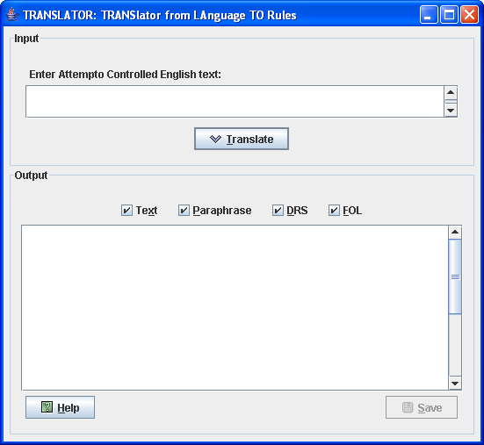
Translation
http://www.ruleml.org/translator/translator.jnlp
13

Slide 16
Translation
DRS-RuleML mapping
  direct
    preserve “augmented” logic
    RuleML syntax
      positional (not “slotted”)
      compact (“role-skipped”) form
  explicit
    e.g., quantifers: <Forall>, <Exists>
      existential unless in the body of an implication
  reversible
    no loss of information
      later: RuleML → ACE
14

Slide 17
Every honest student who does not procrastinate
receives a good mark and easily passes the course.
(ACE)
…
<Forall>
<Var>A</Var> …
<Implies>
<And> …
<Atom><Rel>object</Rel>…<Ind>student</Ind>…</Atom>
<Atom><Rel>property</Rel>…<Ind>honest</Ind></Atom>
<Neg>
<Exists>
<Var>C</Var>
<Atom><Rel>predicate</Rel>…<Ind>procrastinate</Ind> …
</Exists>
</Neg>
</And>
<Exists>
<Var>D</Var>…<Var>F</Var><Var>G</Var><Var>H</Var> …
<And> …
<Atom><Rel>object</Rel>…<Ind>course</Ind>…</Atom>
<Atom><Rel>object</Rel>…<Ind>mark</Ind>…</Atom>
<Atom><Rel>property</Rel>…<Ind>good</Ind></Atom>
<Atom><Rel>predicate</Rel>…<Ind>receive</Ind>…</Atom>
<Atom><Rel>predicate</Rel>…<Ind>pass</Ind>…</Atom>
<Atom><Rel>modifier</Rel>…<Ind>easily</Ind></Atom>
</And>
</Exists>
</Implies>
</Forall>
…
[]
[A …]
…
object(A, student, person)
property(A, honest)
NOT
[C]
predicate(C, … procrastinate, A)
=>
[D, … F, G, H …]
…
object(H, course, object)
object(D, mark, object)
property(D, good)
predicate(F, … receive, A, D)
predicate(G, … pass, A, H)
modifier(G, manner, … easily)
(DRS)
(RuleML)
15

Slide 18
Rule Markup Language
international initiative since 2000
  now developed at NRC-IIT, e-Business
canonical language for interoperable rule markup
  XSLT translators to other Semantic Web languages
collaboration with standards bodies
  W3C, OMG, OASIS
more information
  http://www.ruleml.org
16

Slide 19
Rule Markup Language
family of sublanguages
  realized with modular XML Schemas
    current version: 0.9
  each represents well-known rule system
    accommodate diverse needs of users
    e.g., datalog, hornlog
    TRANSLATOR uses folog (first-order logic)
      FOL RuleML
17

Slide 20
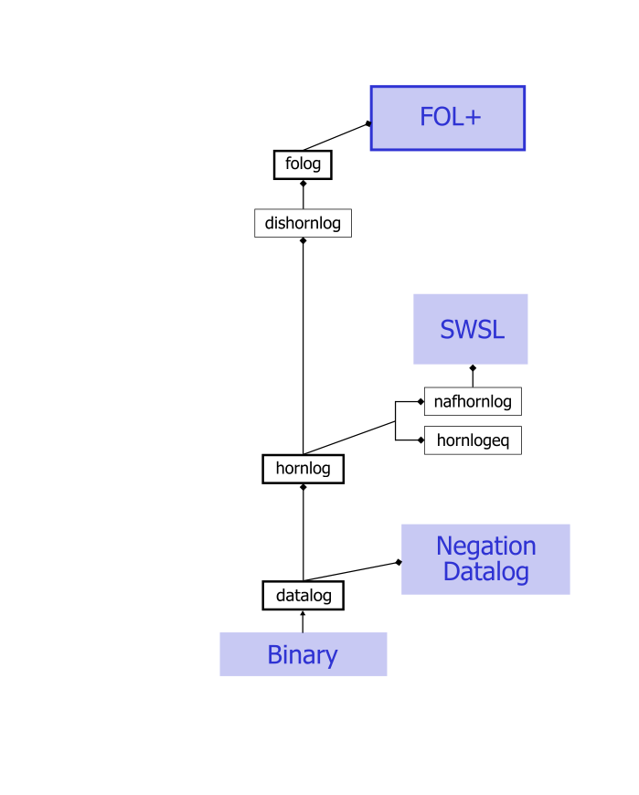
Rule Markup Lang uage
http://www.ruleml.org/modularization
18

Slide 21
Rule Markup Language
advantages
  interchange (XML)
  compatibility with RDF, OWL and SWRL
    also major input to W3C’s upcoming RIF
  tools
    engines
      OO jDREW, Mandarax, NxBRE…
    XSLT translators
  features
    negation-as-failure, data types, weights, etc.
19

Slide 22
Future Work
query support
  <Query> vs. <Assert> currently undecidable
    DRS of “Does the man enter a card?”
    same as that of “The man enters a card.”
verbalization
  RuleML → DRS
  DRS → ACE with DRACE tool
Attempto
  negation-as-failure, modality, …
20

Slide 23
Conclusion
TRANSLATOR allows anyone to write facts and rules in formal representation for use on the Semantic Web
  critical factor in success of original Web?
ACE → DRS → RuleML
future collaboration with Attempto team
21

Slide 24
http://www.ruleml.org/translator
http://www.ifi.unizh.ch/attempto/tools

