Slide 1
Optimized, Bottom-Up Semantic Web Reasoning based on OWL2 RL in Resource-Constrained Settings
William Van Woensel

Slide 2
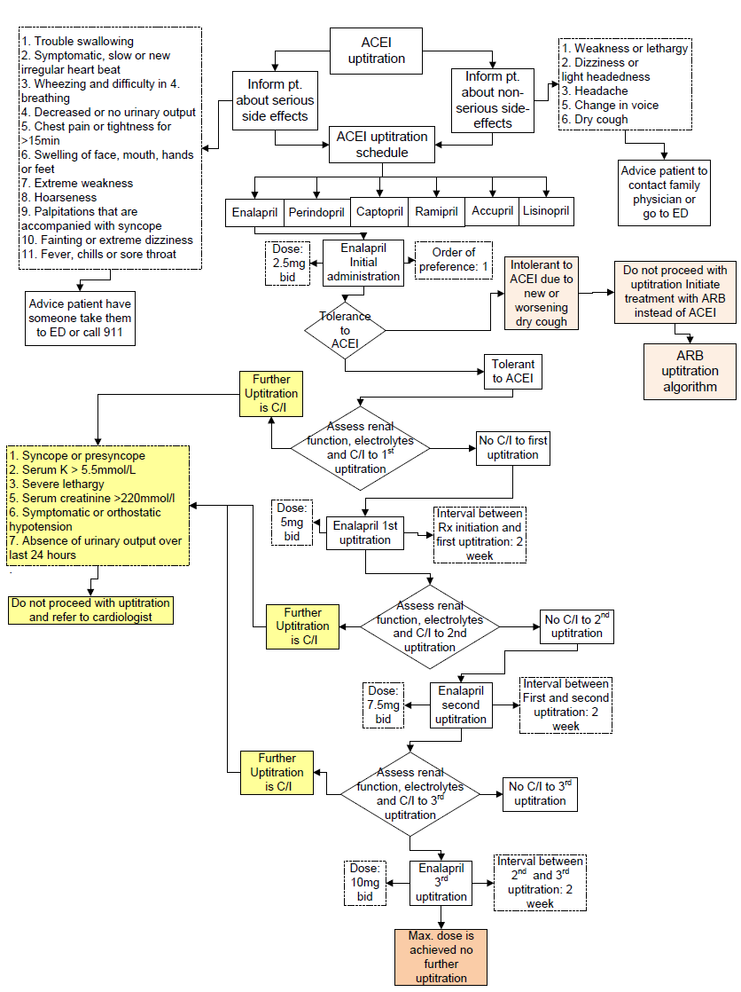
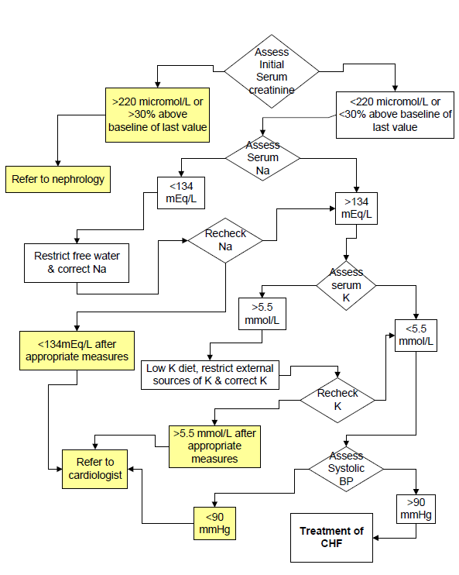
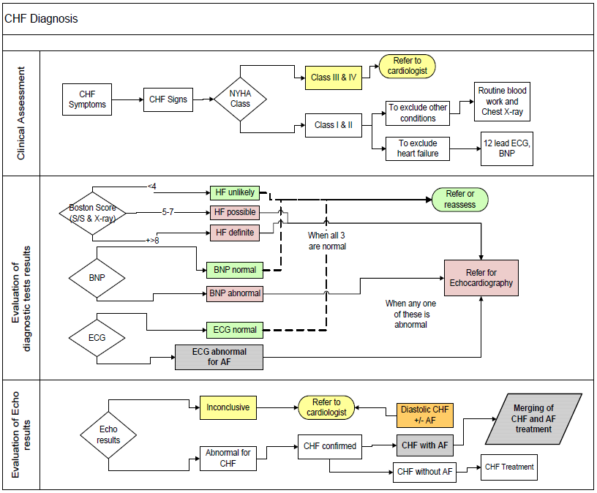
Context
Clinical Practice Guidelines (CPG)
Disease-specific, evidence-based recommendations
Standard for decision making on diagnosis, prognosis and treatment
Context-sensitive care recommendations
Clinical workflow of relevant clinical activities
ACEI upitration [1]
Pre-treatment assessment and
correction of electrolytes [1]
Algorithm for diagnosis of heart failure [1]

Slide 3
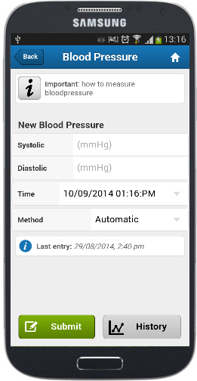
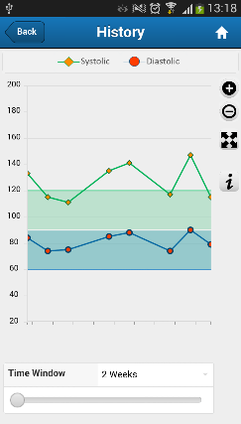

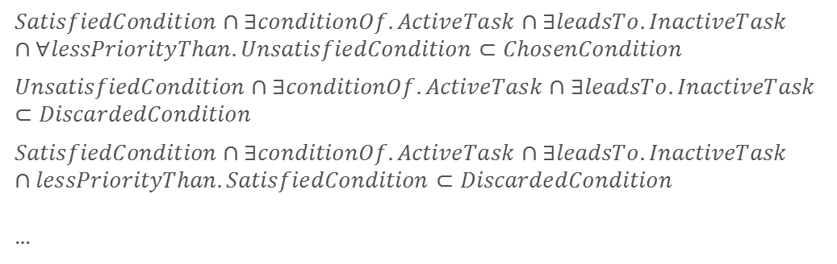
Context (2)
Clinical Decision Support Systems (CDSS)
Automated systems that incorporate computerized CPG
Pro-actively guide physician through decision processes
Decision Logic (OWL2 DL), IF-THEN (SWRL) rules, .. Canadian Community Health Survey (2014):
Chronic illnesses affect ca. 40% of Canadians
With multi-morbidity of ca. 15%
Increase self-sufficiency and quality of life
Reduce healthcare costs
Mobile patient diaries
Self-collect health data at any time and place
Using Bluetooth measurement devices (e.g., IBGStar, OneTouch, Withings, iHealth)
Increase mobility of chronic patients
Up-to-date health profile
No delays in supplying health-critical info
Switch [2, 3]:
$$SatisfiedCondition∩∃conditionOf.ActiveTask∩∃leadsTo.InactiveTask∩∀lessPriorityThan.UnsatisfiedCondition⊂ChosenCondition$$
$$UnsatisfiedCondition∩∃conditionOf.ActiveTask∩∃leadsTo.InactiveTask⊂DiscardedCondition$$
$$SatisfiedCondition∩∃conditionOf.ActiveTask∩∃leadsTo.InactiveTask∩lessPriorityThan.SatisfiedCondition⊂DiscardedCondition$$
…
Class hierarchy of CPG-DKO [2, 3]

Slide 4
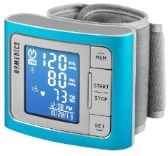
Context (2)
Clinical Decision Support Systems (CDSS)
Automated systems that incorporate computerized CPG
Pro-actively guide physician through decision processes
Involve patients in their own long-term care
Canadian Community Health Survey (2014):
Chronic illnesses affect ca. 40% of Canadians
With multi-morbidity of ca. 15%
Increase self-sufficiency and quality of life
Reduce healthcare costs
Mobile patient diaries
IMPACT-AF project
Self-collect health data at any time and place
Using Bluetooth measurement devices (e.g., IBGStar, OneTouch, Withings, iHealth)
Increase mobility of chronic patients
Up-to-date health profile
No delays in supplying health-critical info

Slide 5
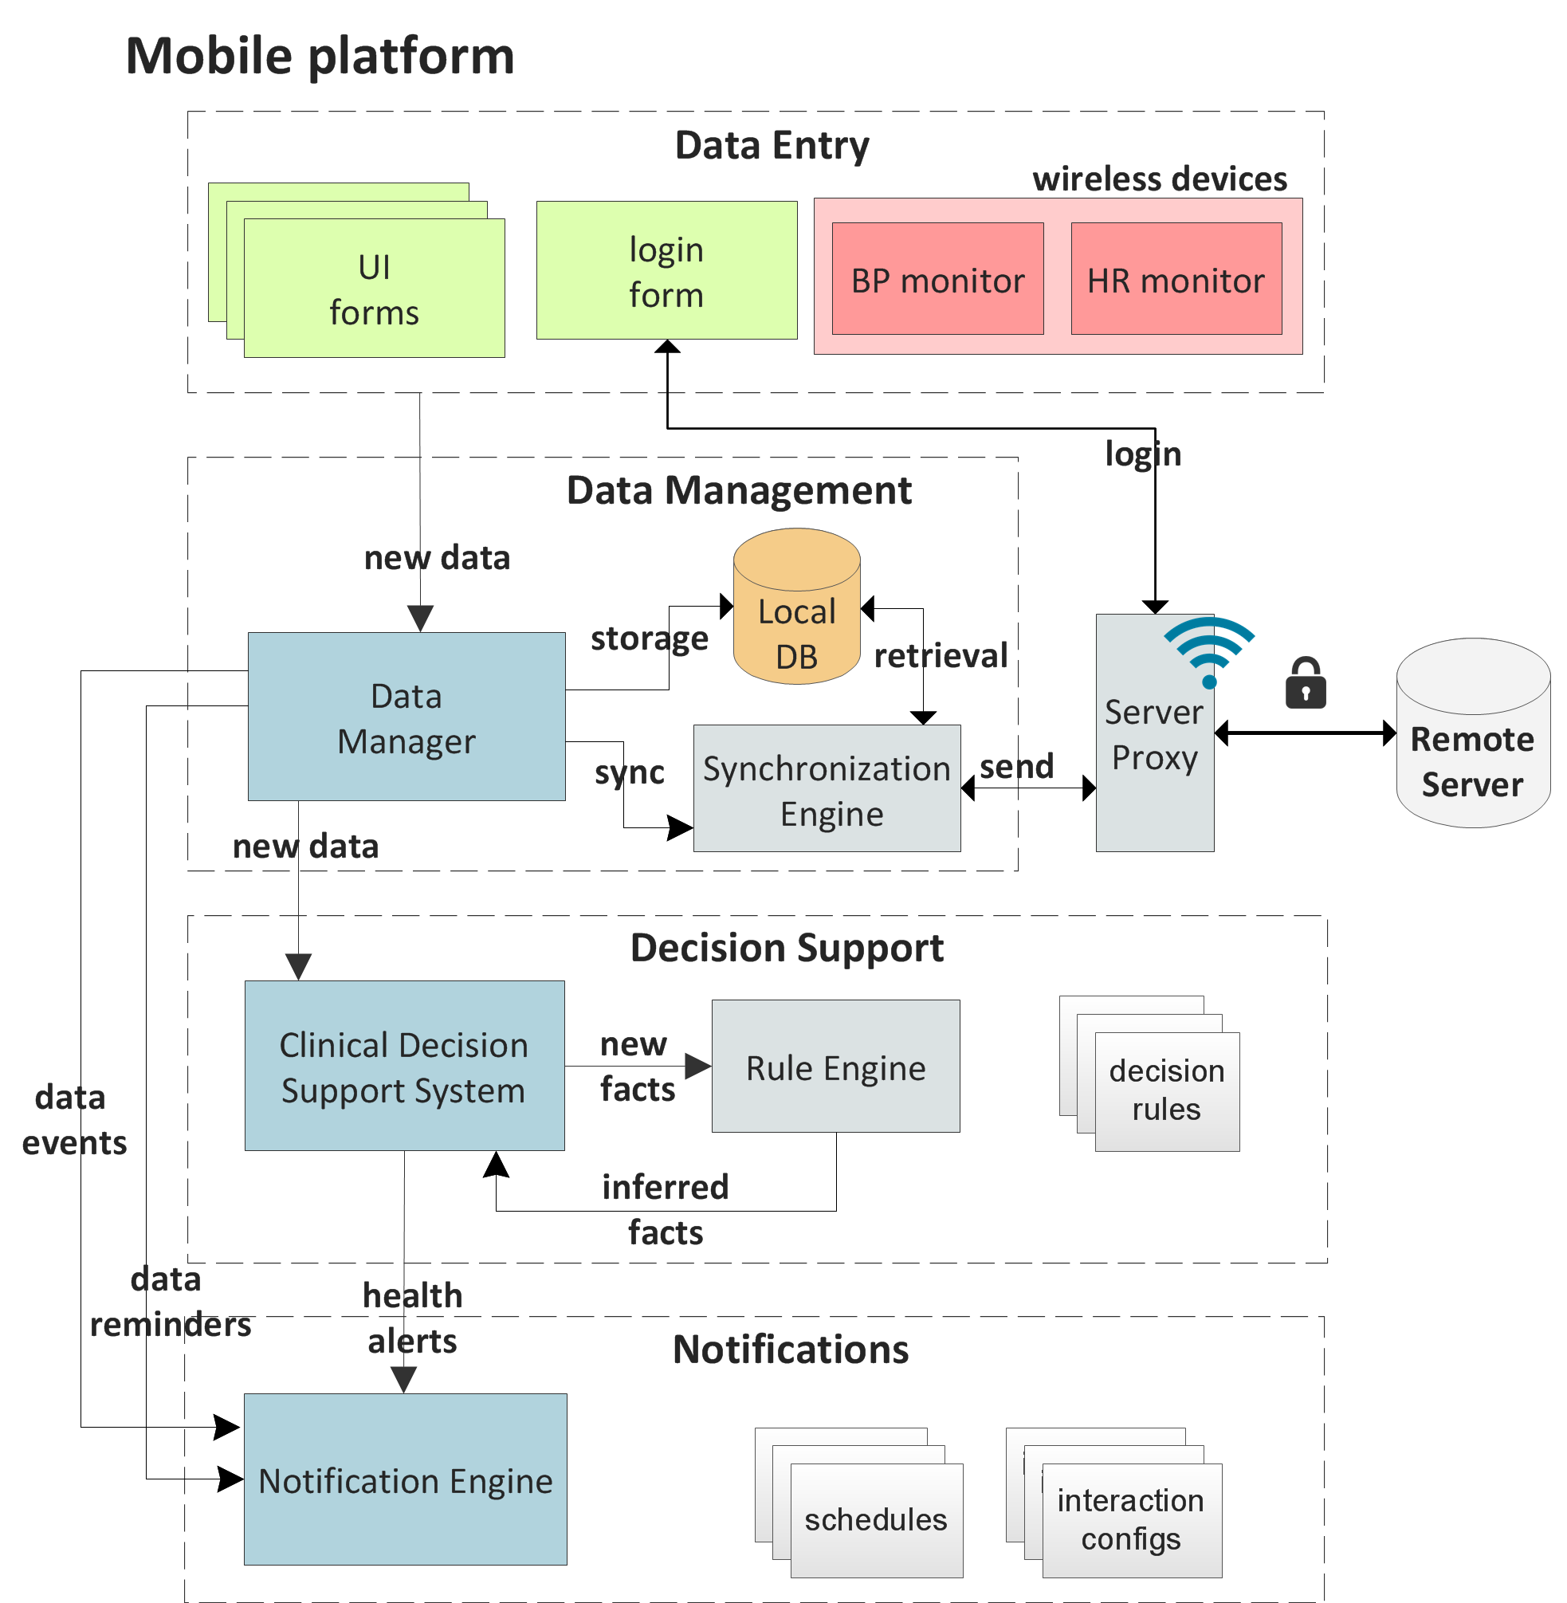
Context (3)
Requirements:
Connectivity
Cope with short/long-term disconnections (lack of WiFi, 3G)
Should not limit mobile patient diary usage
Response latency
Slow / lacking connectivity may occur frequently
Server = single point of failure
Solutions:
Offline data entry (BP, HR, ..)
Synchronize with online EMR when connectivity is restored
Local Clinical Decision Support System
Independent of connectivity
Enables timely health alerts
Distributed setup
Local: lightweight, time-sensitive reasoning is deployed locally
Remote: heavyweight processes are delegated to the server

Slide 6
Context (4)
Ontology-based (OWL) reasoning
OWL2 DL: too resource-intensive on mobile systems
Recent empirical work by Bobed et al. [4]:
PC outperforms Android by 1,5 – 150
Larger number of out-of-memory errors
Most mobile approaches are rule-based
E.g., OWL2 RL or custom entailment
OWL2 RL
Suitable W3C OWL2 profile
Allows scalable reasoning without sacrificing too much expressivity
Adjust reasoning complexity to suit scenario & resources
Choose rule subsets based on task & overhead
Enhance any rule-based task with semantic features
I.e., include OWL2 RL (subset) into ruleset
Such as computerized, rule-based CPG in CDSS
Notes:
Galaxy Nexus (Android 4.2.1, 1.2 GHz dualcore, 1 GB RAM, released in 2011, in the following denoted as A1)
Galaxy 655 Tab 2 7.0 (Android 4.1.2, 1 GHz dual-core, 1 GB RAM, released in 2012, denoted A2)

Slide 7
1) Optimizing the OWL2 RL ruleset
Multi-stage OWL2 RL ruleset selection
Stable vs. volatile ontology
Conformant
Equivalent OWL2 RL ruleset
Removing logically equivalent rules
Replace 2+ specific rules with more general rules & axioms
Removing “stand-alone” schema inference rules
Purpose- and reference-based subsets
Purpose: inferencing vs. validation
Reference: instances vs. schema
Remove inefficient rules
Leave out rules with large performance impact
E.g., #eq-ref infers each resource is equivalent to itself
Domain-based ruleset selection
I.e., leave out rules not needed by ontology & dataset
Forward-chaining algorithm (Tai et al. [8])
Non-conformant
Stable
Notes:
Removing logically equivalent rules: i.e., rules of which the results are covered by other rule(s)
Some of these break conformance with OWL2 RL axiomatization:

Slide 8
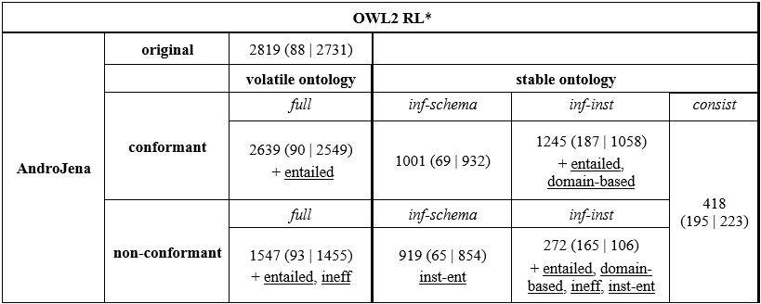
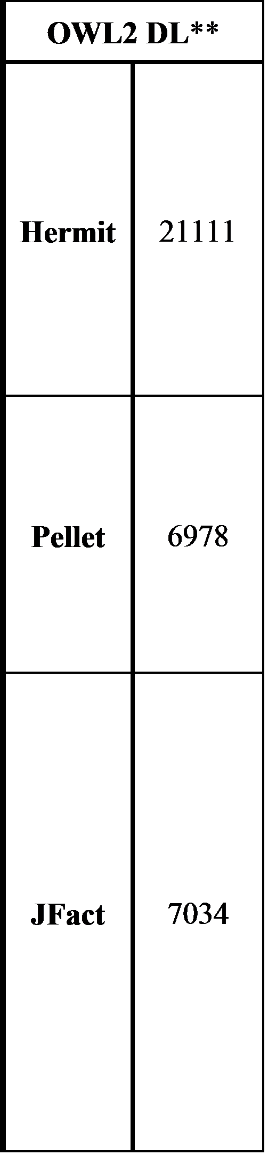
1) Optimizing the OWL2 RL ruleset: Evaluation
Notes:
Conformant – Volatile : ca. 94% (-6%)
Conformant – Stable (inf-inst): ca. 44% (-56%)
Non-conformant – Volatile: ca. 55% (-45%)
Non-conformant – Stable (inf-inst): ca. 10% (-90%)

Slide 9
1) Optimizing the OWL2 RL ruleset: Future work
Rule instantiation [7, 9, 10]
Materialize schema inferences in ontology
Instantiate each instance rule with schema terms
Increase rule selectivity
Reduce # of joins
Requires a “stable” ontology
Domain-specific rulesets
Large impact on performance
Currently, does not support “volatile” ontologies
Ruleset needs to be re-calculated on ontology changes
Avg. ca. 291ms (PC), 4183ms (mobile)
Deploy on mobile device, integrate with reasoner?

Slide 10
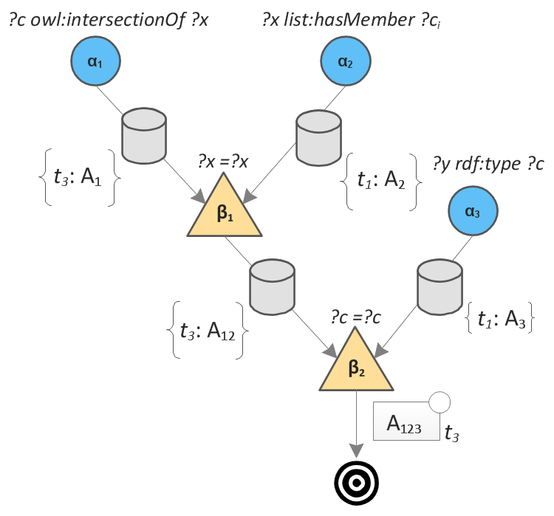
2) RETE Strategies for Resource-Constrained Settings
RETE Algorithm
Well-known solution to implement production rule systems
Rule premise = alpha node
Alpha memory: keeps matched facts
Join = beta node
Beta memory: keeps join results
Useful in dynamic environments, due to its incremental nature
Known for trading memory for performance
Alpha memories will overlap depending on premise selectivity
Many SW applications already involve an RDF store for query access
Collection of alpha memories duplicate RDF store
Many rules will not be needed for domain
But, still consume computing & memory resources in RETE
Tailor RETE networks during execution
In light of dynamic & incremental situations

Slide 11
2) RETE Strategies for Resource-Constrained Settings (2)
Dataset-mask memory strategy
Keep alpha memories as masks on the RDF store
Query RDF store using joining token & rule premise as constraint
Hybrid version: dataset-mask vs. regular memory, based on premise selectivity
Dynamic tailoring of RETE networks
Avoid redundant join attempts [11]
Unlink alpha memory from its beta node in case join attempts are useless
Avoid redundant token matches
Pause alpha nodes in case they are unlinked from each rule
Requires separate RDF store for synchronizing alpha memory upon resume
Join-utility heuristics
Determine utility of join attempts
Empty sibling memory
In case alpha (i <= 2) or beta (i > 2) memory is empty, no joins are possible [10]
Lower failed alpha nodes
Pointless to attempt joins in case a failed alpha node occurs lower down
Notes:
Pause alpha nodes: assumes that standard-practice optimizations, such as re-using alpha nodes, are applied
(Heuristics: avoid false negatives (i.e., join attempts were indeed useful))

Slide 12
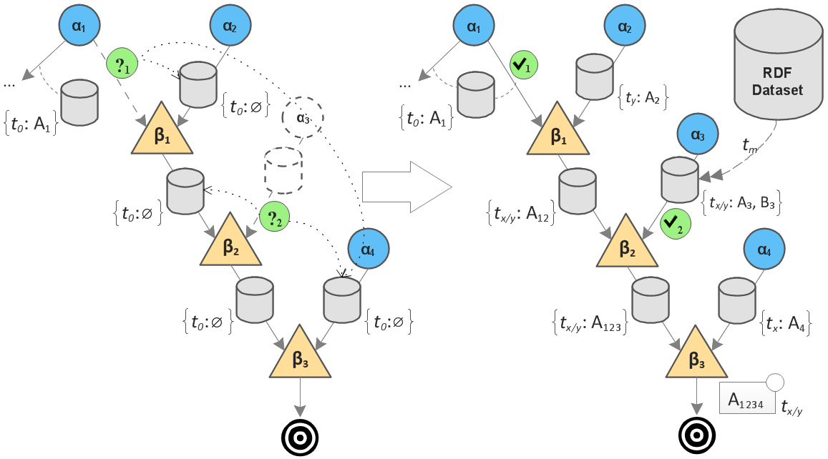
Dynamic tailoring of RETE networks
Responsiveness to Incremental Reasoning Scenarios
Notes:
The rule failed at time t₀
Both join-utility heuristics hold for non-failed alpha nodes α₁ and α₃: i.e., their sibling memories are empty, and a lower-down alpha node (node α₄) has failed
As a result, their memories were unlinked from the related beta nodes. Further, the α₃ node memory is paused, since it is unlinked from each related rule.
Triggers (?_{i}) are installed that listen for when the applicable heuristics no longer hold.
At time $t_{x}$, a new token A₄ matches node α₄ (satisfying heuristic (2))
At time $t_{y}$, an incoming token A₂ is matched to the previously failed node α₂ (satisfying heuristic (1)).
So, trigger ?₁ will be activated at time $t_{y}$, re-linking the α₁ memory to beta node β₁. This results in the joined token A₁₂ activating the ?₂ trigger, since the sibling memory of α₃ is no longer empty, similarly re-linking the memory, and resuming node α₃ (since it is now become relevant again)
Finally, this results in a complete inference A₁₂₃₄ for the rule.

Slide 13
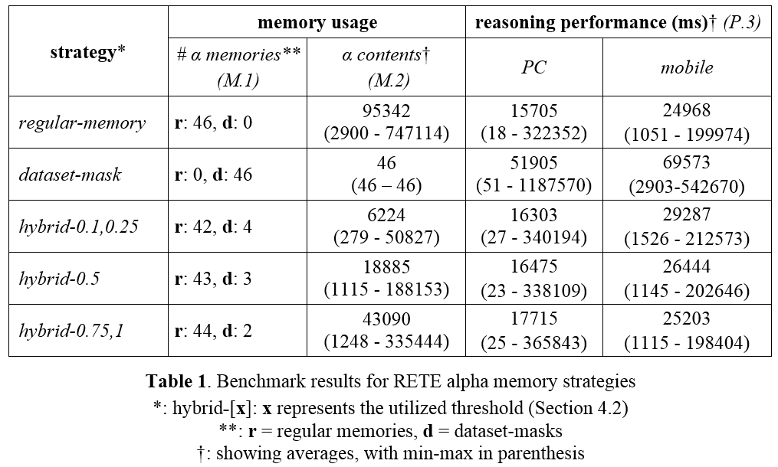
Dataset-mask: Evaluation (1)
Notes:
Memory savings for dataset-mask are tremendous: only 0,05% of tokens are needed
(each dataset-mask memory keeps a mask that counts as a token)
But, reasoning times are significantly increased, by factors of avg. ca. 3,3 and 2,8 for PC and mobile
(note that performance times for PC and mobile are not directly comparable, since, as mobile benchmarks are executed on a subset of the PC ontologies)

Slide 14
Dataset-mask: Evaluation (2)
What if SW scenario does not include an RDF store?
Introduce RDF store as shared alpha memory pool
Updated memory reductions:
Dataset-mask: avg. ca. -55%
Hybrid-0.1,0.25: avg. ca. -27%
Hybrid-0.5: avg. ca. -9%
Hybrid-0.75,1: avg. ca. +1%
RDF store update operations:
PC: avg. ca. +0,67s
Mobile: avg. ca. +1s

Slide 15
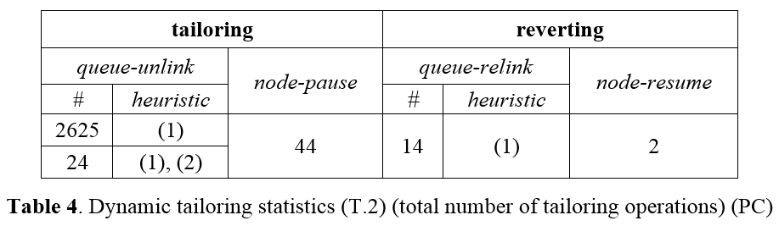
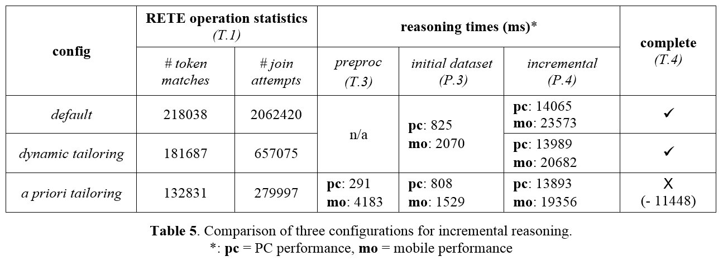
Dynamic RETE tailoring: Evaluation
Notes:
large majority of unlinking operations is due to heuristic (1), i.e., empty sibling memory
(upon closer inspection, the premise “?x ?p ?x” only occurs in unsuccessful OWL2 RL rules for each ontology
so, its related alpha node is unlinked from each rule and paused each time
a second node “?y rdf:type ?ci” was paused twice, and resumed twice.)
overhead of individual tailoring operations is negligible, with the collective overhead (i.e., total time) not exceeding 50ms on PC and 80ms on mobile
RETE operation statistics column indicates the impact of dynamic tailoring on the number of RETE operations
(regarding the alpha node for premise “?x ?p ?x”, the system will attempt to match every single incoming token to it)
by pausing this node for each ontology (and twice another node) ..)
the number of attempted token matches is decreased by avg. ca. -17% (-36351 operations)
the number of join attempts is greatly decreased, by avg. ca. -68% (-1405345 operations)
a priori network tailoring further decreases the number of RETE operations:
avg. ca. -39% (-85207 operations) for attempted token matches
avg. ca -86% (!) (-1782423 operations) for join attempts
however, this comes at the expense of losing reasoning completeness when faced with incremental scenarios
also, it requires a naïve reasoning algorithm to be performed beforehand, which also yields a non-trivial overhead (preproc column)
reasoning times column shows the overall performance for initial (initial dataset column) and subsequent (incremental column) reasoning cycles
performance impact is much higher on the mobile platform than on PC, reflecting the reduced processing capabilities.
in fact, performance improvements on PC are virtually negligible
dynamic tailoring in incremental reasoning optimizes performance by avg. ca. -76ms (-0.5%) on PC and -2,9s (-12,3%) on mobile.
a priori tailoring in incremental reasoning reduces reasoning times by avg. ca. -172ms (1,2%) on PC and -4,2s (-17,9%) on mobile
but, requires a non-trivial pre-processing step (especially on mobile)
if we don’t include the pre-processing step, a priori tailoring thus yields the highest increase in performance, but at the expense of reasoning completeness
we observed that this strategy resulted in loss of a total of 11448 inferences for 5 ontologies
further, its pre-processing step involves a one-time overhead that is non-trivial on PC (avg. ca. 291ms) and a quite large overhead on mobile (avg. ca. 4,2s)
this strategy seems mostly useful for non-incremental reasoning on a series of similar datasets, each utilizing similar terms and data patterns
whereas dynamic tailoring deals with arbitrary incremental scenarios, guaranteeing reasoning completeness

Slide 16
2) RETE Strategies for Resource-Constrained Settings: Future work (in progress)
Currently: mostly based on OWL2 RL ruleset in clinical decision support
Also, benchmarks done using OWL2 RL ruleset
Additional benchmarks needed for other rulesets
More advanced heuristics to determine join utility
Eager vs. lazy algorithm
More fine-grained memory strategy
Alpha memories will often subsume other memories
E.g., subsumed (virtual) alpha memories access their subsuming, concrete alpha memory behind-the-scenes (comparable to dataset-mask but with a smaller query access overhead)
Dynamic hybrid memory strategies
Switch between regular and dataset-mask memories based on evolving selectivities
Notes:
OWL2 RL ruleset: some of its rules including overly general wildcard premises (i.e., “?x ?p ?y”)
for other rulesets with more concrete premises, utilizing dataset-mask memories will likely lead to smaller memory reductions
also, seeing how overly general rule premises match many more tokens, memory unlinking and node pausing will also have a smaller performance impact

Slide 17
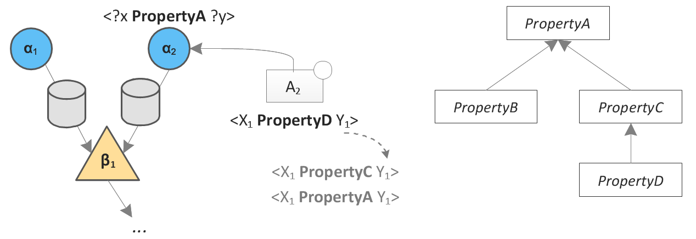
2) RETE Strategies for Resource-Constrained Settings: Future work (in progress) (2)
Virtual materialization of OWL2 semantics in match & join operations
Consider OWL2 semantics when matching & joining tokens
Avoid explicit materialization, which takes up memory

Slide 18
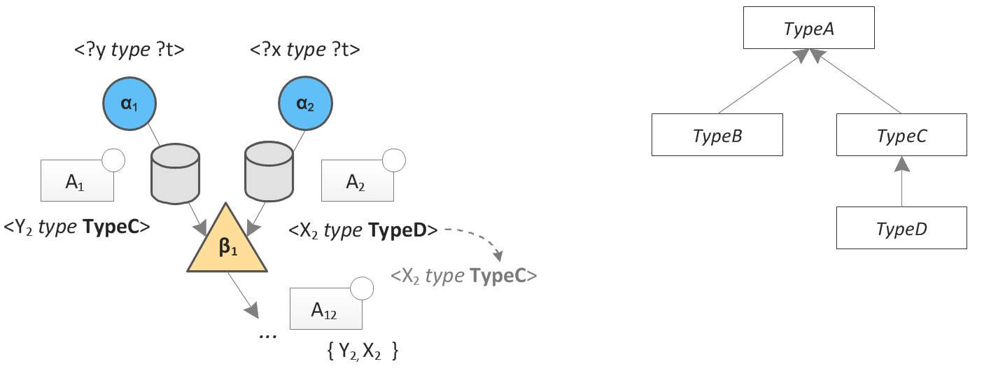
2) RETE Strategies for Resource-Constrained Settings: Future work (in progress) (2)
Virtual materialization of OWL2 semantics in match & join operations
Consider OWL2 semantics when matching & joining tokens
Avoid explicit materialization, which takes up memory

Slide 19
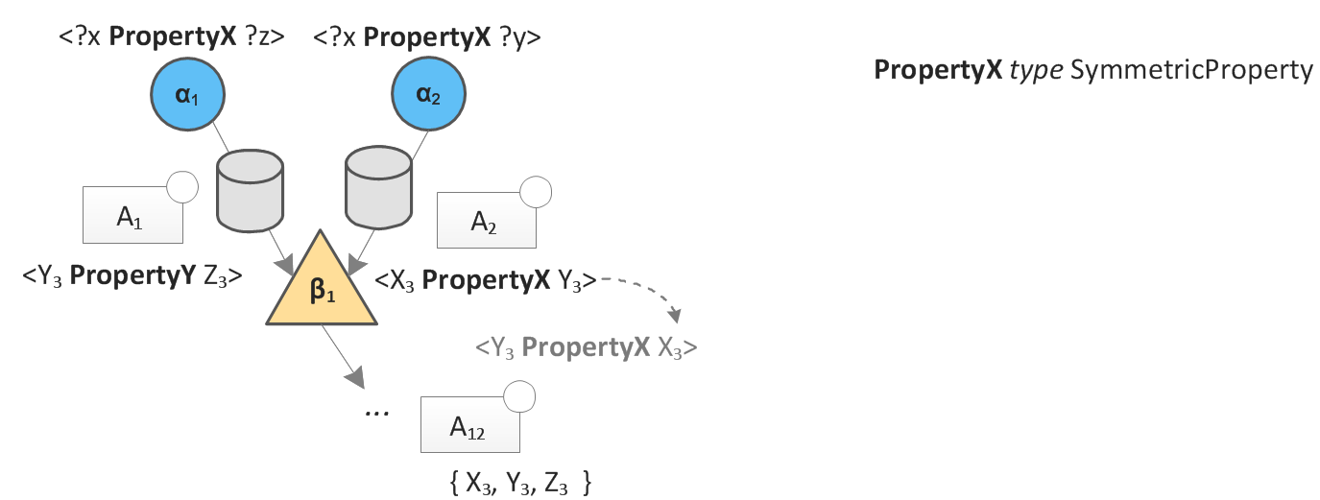
2) RETE Strategies for Resource-Constrained Settings: Future work (in progress) (2)
Virtual materialization of OWL2 semantics in match & join operations
Consider OWL2 semantics when matching & joining tokens
Avoid explicit materialization, which takes up memory

Slide 20
Questions?
E-mail: william.van.woensel@gmail.com

Slide 21
References
[1] S. Abidi. PhD Thesis, 2010.
[2] B. Jafarpour. PhD Thesis, 2010.
[3] B. Jafarpour, S. S. R. Abidi, S. R. Abidi. Exploiting Semantic Web Technologies to Develop OWL-Based Clinical Practice Guideline Execution Engines. IEEE J. Biomed. Heal. Informatics, 2014.
[4] C. Bobed, R. Yus, F. Bobillo, E. Mena. Semantic reasoning on mobile devices: Do androids dream of efficient reasoners? Web Semantics: Science, Services and Agents on the World Wide Web, 35:167–183, December 2015.
[5] S. Ali and S. Kiefer. “microOR --- A Micro OWL DL Reasoner for Ambient Intelligent Devices. In Proceedings of the 4th International Conference on Advances in Grid and Pervasive Computing, 2009, pp. 305–316.
[6] T. Kim, I. Park, S. J. Hyun, D. Lee. MiRE4OWL: Mobile Rule Engine for OWL. In Proceedings of the 2010 IEEE 34th Annual Computer Software and Applications Conference Workshops, 2010, pp. 317–322.
[7] B. Motik, I. Horrocks, S. M. Kim. Delta-reasoner: A Semantic Web Reasoner for an Intelligent Mobile Platform. In Proceedings of the 21st International Conference Companion on World Wide Web, 2012, pp. 63–72.
[8] W. Tai, J. Keeney, D. O’Sullivan. Resource-constrained reasoning using a reasoner composition approach. Semant. Web, vol. 6 (1), pp. 35–59, 2015
[9] J. Bak, M. Nowak, C. Jedrzejek. RuQAR: Reasoning Framework for OWL 2 RL Ontologies. In The Semantic Web: ESWC 2014 Satellite Events, Anissaras, Crete, Greece, May 25-29, 2014, 2014, vol. 8798, pp. 195–198.
[10] G. Meditskos N. Bassiliades. DLEJena: A Practical Forward-chaining OWL 2 RL Reasoner Combining Jena and Pellet. Web Semant., vol. 8, no. 1, pp. 89–94, Mar. 2010.
[11] R.B. Doorenbos. Combining Left and Right Unlinking for Matching a Large Number of Learned Rules. In Hayes-Roth, B. and Korf, R.E. (eds.) Proceedings of the 12th National Conference on Artificial Intelligence, Seattle, WA, USA, July 31 - August 4, 1994, Volume 1. pp. 451–458.

