Slide 1


Harold Boley¹, Omair Shafiq², Derek Smith³, Taylor Osmun³
¹Institute for Information Technology, National Research Council Canada,
Fredericton, NB, Canada
²Department of Computer Science, University of Calgary,
Calgary, AB, Canada
³Faculty of Computer Science, University of New Brunswick, Canada,
Fredericton, NB, Canada
Keynote at
The 3rd Canadian Semantic Web Symposium (CSWS2011)
The Social Semantic Subweb of
Virtual Patient Support Groups
Vancouver, British Columbia, Canada, August 5, 2011
(Update: September 17, 2011)

Slide 2
PatientSupporter − Idea and Implementation
The Social Web (Web 2.0) meets
the Semantic Web (ontologies and rules)
in a Social Semantic Web (Web 3.0):
Patients advertise their semantic profiles
to socialize with others in support groups
Implemented in initial PatientSupporter prototype

Slide 3
Part 1: PatientSupporter Foundation in
Profile Knowledge Base Interoperation
PatientSupporter Overview
Ontologies & Rules, Global & Local Knowledge Bases
Local Knowledge Base (Profile) Interoperation between
Prolog-extending POSL & RDF-extending N3
  Interoperation Principles for
  Relational (POSL) and Networked (N3) Languages
  POSL ⬄ N3 Transformation
Injuries Partonomy
  Later seen in Part 2:
  A use case demo describes an online-interactive Patients community through the PatientSupporter system in Rule Responder

Slide 4
PatientSupporter Overview
PatientSupporter supports a patient community
that is online-interactive and rule-based
Each patient as participant of this community
has ability to:
  Create profiles about themselves, containing their preferences for injuries, healing stage, treatment level, possible collaboration times, etc.
  Compare and collaborate with others in the community,
  to track progress and schedule group discussions
Rules for patient profiles are
  Authored in rule languages such as POSL and N3
  Interoperated within the community using RuleML/XML

Slide 5
Knowledge Bases
Ontologies − Global
  Group Responsibility Matrix (see later)
  Body Partonomy (see later)
    Structures sports injuries as commonsense ontology of affected body parts
Rules (including Facts) − Global and Local
  See below

Slide 6
Global Rule Base
Contains knowledge relevant to everyone in the PatientSupporter community
Knowledge Areas:
  participation
    Ensures that a patient’s preferred group size interval is within a requested group size interval
  ageCheck
    Ensures that a patient’s age is within a requested age interval
  goodDuration
    Ensures that a patient’s preferred call duration is within a requested start and end time

Slide 7
Local Rule Bases (Profiles)
Contain local knowledge specific to each patient in the PatientSupporter community
Knowledge Areas:
  age
    Own age
  groupSize
    Preferred group sizes for injuries
  category
    ‘In’ or ‘Out’ patient
  treatment
    Bandage, (Major or Medium or Minor) Operation, (Major or Medium or Minor) Medication or ChangeOfLifeStyle
  healingStage
    Fresh, Medium, Convalescent or Healed
  duration
    Preferred call duration
  gender
    Male or Female
  communication
    Channel and Contact names
  timezone
    Own time zone
  MyDiscussion
    Derive patients’ discussion preferences

Slide 8
Local MyDiscussion Sample Rule (in POSL)
− Centered on Participant p0004 as First Argument
myDiscussion(p0004,Injury:Toe,?MinAge,?MaxAge,?MinRSVP,?MaxRSVP,?Category,?Treatment,?HealingStage,
dateTime[?StartYear,?StartMonth,?StartDay,?StartHour,?StartMinute],
dateTime[?EndYear,?EndMonth,?EndDay,?EndHour,?EndMinute],
dateTime[?DurYear,?DurMonth,?DurDay,?DurHour,?DurMinute],
MSN,?Contact,?Gender,?TimeZone)
:-
ageCheck(p0004,?MinAge,?MaxAge,?Age),
participation(p0004,?Injury,?MinRSVP,?MaxRSVP),
communication(p0004,MSN,?Contact),
event(p0004,?Injury,Possible,
dateTime[?StartYear,?StartMonth,?StartDay,?StartHour,?StartMinute],
dateTime[?EndYear,?EndMonth,?EndDay,?EndHour,?EndMinute]),
duration(p0004,?Injury,dateTime[?DurYear,?DurMonth,?DurDay,?DurHour,?DurMinute]),
goodDuration(p0004,?Injury,
dateTime[?DurYear,?DurMonth,?DurDay,?DurHour,?DurMinute],
dateTime[?StartYear,?StartMonth,?StartDay,?StartHour,?StartMinute],
dateTime[?EndYear,?EndMonth,?EndDay,?EndHour,?EndMinute]),
category(p0004,?Category),
treatment(p0004,?Injury,?Treatment),
healingStage(p0004,?Injury,?HealingStage),
gender(p0004,?Gender),
timeZone(p0004,?TimeZone).
Orange
designates a profile
preference / fact

Slide 9
Local MyDiscussion Profile Facts (in POSL)
− Centered on Participant p0004 as First Argument
age(p0004,27:integer).
groupSize(p0004,?:Toe,2:integer,10:integer).
duration(p0004,?:Toe,dateTime[0:integer,0:integer,0:integer,0:integer,30:integer]).
category(p0004,Out).
treatment(p0004,?:Toe,MinorOperation).
healingStage(p0004,?:Toe,Medium).
communication(p0004,MSN,Sam24).
gender(p0004,Male).
timeZone(p0004,-400:integer).

Slide 10
Profile Interoperation (POSL & N3)
Support for both logic-relational (e.g., POSL) and
graph-networked (e.g., N3) knowledge representations
Users may write their profile in either language
Support for Prova, OO jDREW, and Euler engines to execute
queries issued to POSL and N3 knowledge bases, respectively
Later seen in Part 2:
By using a RuleML subset as the exchange language and
Rule Responder as the platform, queries and answers
can be exchanged with all supported engines

Slide 11
POSL
POSL integrates positional and slotted knowledge
(e.g., Prolog’s positional and F-logic’s slotted knowledge)
PatientSupporter only uses positional POSL for logic-relational knowledge, displayed in a Prolog-like human-readable syntax
Positional relation descriptions (fact and query examples):
  Relation names (f):
    Each fact and rule head has a relation name
  Arguments (f):
    Constant arguments are strings or symbols, separated by commas (“,”)
  Variables (q):
    Variables can be named (“?” prefix) or anonymous (stand-alone “?”)
treatment(p0001,Toe,Bandage).
treatment(p0001,Toe,Bandage).
treatment(p0001,?, ?Treatment)

Slide 12
Notation 3 (N3)
N3 is a compact, rule-extended version of RDF's XML syntax.
Writes triples (subject, property, object) as subject descriptions
PatientSupporter uses N3 for graph-networked knowledge
Slotted subject descriptions (fact and query examples):
  Subject names (f):
    Each fact / rule head has a subject name
  Variables (q):
    Can be anonymous (stand-alone “?”)
    or named (“?” prefix )
  Arguments as property→object slots (f):
    Each argument must have
    a property (slot name):
    Each argument must also have
    an object (slot value):
“:” here denotes IRI of this local knowledge base
:treatment_1
rdf:type :Treatment;
:profileID :p0001;
:injury :Toe;
:treatment :Bandage.
:treatment_1
rdf:type :Treatment;
:profileID :p0001;
:injury :Toe;
:treatment :Bandage.
?treatment
rdf:type :Treatment;
:profileID :p0001;
:injury ?;
:treatment ?Treatment.
:treatment_1
rdf:type :Treatment;
:profileID :p0001;
:injury :Toe;
:treatment :Bandage.

Slide 13
POSL ⬄ N3 Transformation (Atoms)
Transformations are bi-directional; harder left-right reading focused here
N3 uses subjects to provide named instances/relationships.
The subject name is the “:”-prefixed relation “:name” extended by “_i”, where “i” is an instance counter. A “?”-prefixed variable can stand for a subject name
A POSL relation name becomes defined in an N3 rule head via an rdf:type property using the “:”-prefixed, uppercased version of the “:Name”
Starting with positional POSL, slot names (properties) can be generated
and stored in signatures for reuse; variables and constants as
slot values (objects) employ the same names as in POSL
?treatment
rdf:type :Treatment;
:profileID :p0001;
:injury ?;
:treatment ?Treatment.
POSL
⬄
N3
treatment(p0001,?, ?Treatment)
?treatment
rdf:type :Treatment;
:profileID :p0001;
:injury ?;
:treatment ?Treatment.
POSL
⬄
N3
treatment(p0001,?, ?Treatment)

Slide 14
POSL ⬄ N3 Transformation (Rules)
{
...
?treatment
rdf:type :Treatment;
:profileID :p0004;
:injury :Toe;
:treatmentType ?Treatment.
?healingStage
rdf:type :HealingStage;
... .
...
}
=>
{
_:myDiscussion
rdf:type :MyDiscussion;
:profileID :p0004;
:injury :Toe;
... ;
:treatment ?Treatment;
:healingStage ?Stage;
... .
}.
Rule transformation builds on
atom transformation
OO jDREW (using POSL) typically
does top-down (:-) reasoning;
Euler (using N3) always
does bottom-up (=>) reasoning:
‘conclude ... from ---’ becomes ‘if --- then ...’
:-
=>
myDiscussion(p0004,Injury:Toe,
...,
?Treatment,?HealingStage,
...,
)
:-
...,
treatment(p0004,Injury:Toe,?Treatment),
healingStage(...),
....
POSL
⬄
N3

Slide 15
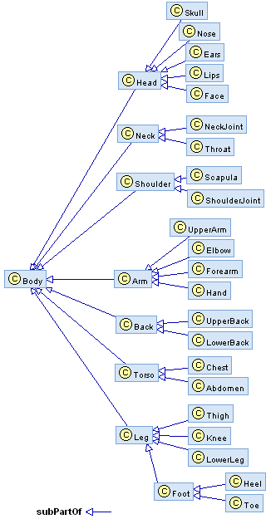
Body Partonomy
The PatientSupporter partonomy is organized as hierarchy of body parts
Each of these corresponds to an injury (e.g., Leg, Foot, Toe, etc.)
Mapped to a taxonomy, using rdf:type, rdfs:Class, and rdfs:subClassOf
Taxonomy classes act as user-defined types to restrict rule variables
RDF (used by POSL, equivalent to a version in N3)
<rdf:RDF
xmlns:rdf="http://www.w3.org/1999/02/22-rdf-syntax-ns#"
xmlns:rdfs="http://www.w3.org/2000/01/rdf-schema#">
<rdf:Description rdf:ID=“Body">
<rdf:type rdf:resource="http://www.w3.org/2000/01/rdf-schema#Class"/>
</rdf:Description>
<rdf:Description rdf:ID=“Leg">
<rdf:type rdf:resource="http://www.w3.org/2000/01/rdf-schema#Class"/>
<rdfs:subClassOf rdf:resource="#Body"/>
</rdf:Description>
…

Slide 16
Part 2: PatientSupporter for an Online-Interactive Patient Community via Rule Responder
PatientSupporter as a Rule Responder
PatientSupporter Conceptual View
PatientSupporter Technical View
PatientSupporter Agent Implementation
Discussion Scenario: Example Queries with Live Demo
  Previously seen in Part 1:
  Foundation of PatientSupporter in profile knowledge base interoperation,
  which is assisted through transformation techniques

Slide 17
PatientSupporter as a Rule Responder
Rule Responder is an intelligent multi-agent infrastructure for collaborative teams and virtual communities
Rule Responder uses three kinds of agents:
  Organizational Agent (OA)
  Personal Agents (PAs)
    PAs extended to select relevant profiles of patients
  External Agents (EAs)
The PatientSupporter instantiation of Rule Responder employs the OA, PAs, and EAs for communication and query delegation
to support an online-interactive community of patients
  Similar to WellnessRules2, WellnessRules, and SymposiumPlanner

Slide 18






Rule Responder
Conceptual View
EA: External Agent
Enquiry User
Injury₁
PA
Injury_{n}
PA
OA
m ...... 1
m ...... 1
Profile
Users
. . . . .
Profile
Users
m ...... 1
Injury₂
PA
Injury₃ PA
. . . . .
m ...... 1
Profile
Users
Virtual
Organization
Profile
Users

Slide 19
Rule Responder
Technical View
Organizational Agent
Browser (External Agent)
Rule Engine (Prova)
Knowledge Base
Web Browser
HTTP Web Form
Reaction RuleML Message
Reaction RuleML
Reaction RuleML
Patient PA instances
Enterprise
Service Bus
Rule Agent (OO jDREW)
…
Reaction RuleML
Rule Agent (OO jDREW)
Knowledge Base
Knowledge Base
Rule Agent (OO jDREW)
Knowledge Base
Reaction RuleML
Reaction RuleML
Reaction RuleML
Patient PA instances
Patient PA instances
Patient PA instances
Rule Agent (OO jDREW)
…
Rule Agent (OO jDREW)
…
Rule Agent (OO jDREW)
…
Rule Agent (OO jDREW)
Rule Agent (OO jDREW)
Rule Agent (OO jDREW)
Knowledge Base
Knowledge Base
Knowledge Base
Knowledge Base
Knowledge Base
Knowledge Base
Rule Agent (OO jDREW)
Rule Agent (OO jDREW)
Rule Agent (OO jDREW)
Knowledge Base
Knowledge Base
Knowledge Base

Slide 20
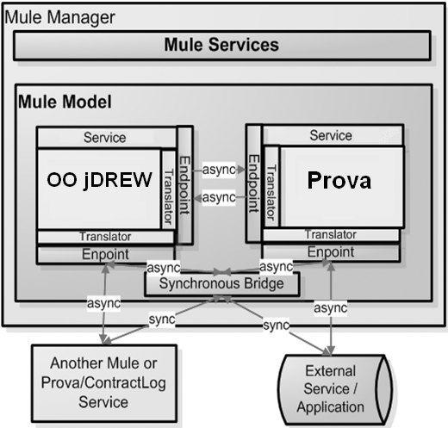
Communication using Mule Enterprise Service Bus
Mule ESB Open Source
Message Platform and distributed Object Broker
Event Driven Architecture (EDA)
Around 50 Protocols (JMS, HTTP, SOAP …)
Synchronous and Asynchronous Communication
Message Driven Event Processing

Slide 21
PatientSupporter Architecture
Legend:
Data transfer via Mule
Data transfer from File
Possible data transfer from File
PatientSupporter Website (EA)
Prova Rulebase & Engine (OA)
Group Responsibility Matrix
Patient Group PA₁
Patient Group PA₂
Patient Group PA₃
…
Patient Group PA_{n}
Profile Responsibility Matrix
P0001 (Patient)
P0002 (Patient)
P0003 (Patient)
P0004 (Patient)
…
P000n (Patient)

Slide 22
Rule Responder Agents (EA, OA, PAs)
External Agent (EA):
  The PatientSupporter website (shown later)
Organizational Agent (OA):
  Contains a Prova knowledge base which is used for incoming queries: directs them to appropriate PAs via the Group Responsibility Matrix
Personal Agent with Profiles (PA):
  Consists of a Java servlet and − using the two embedded engines,
  OO jDREW and Euler − forwards the query to POSL and N3 profile knowledge bases, respectively
  It only has access to profiles which contain relevant information
  for its responsible injury by using the Profile Responsibility Matrix

Slide 23
Group and Profile Responsibility Matrix
Role assignment on two levels: Group Responsibility Matrix (GRM) and Profile Responsibility Matrix (PRM)
The GRM contains information about PA
injury responsibility, written as an OWL light ontology.
It defines which PA is best suited for different kinds of queries
The PRM contains information about PA profile responsibility and the format of each profile knowledge base:
<Injury>
<Leg>
<ResponsibleProfile name="p0001" format=”posl"/>
<ResponsibleProfile name="p0002" format=”n3"/>
<ResponsibleProfile name="p0003" format="posl"/>
</Leg>
. . .
</Injury>
PA_{Leg} :

Slide 24
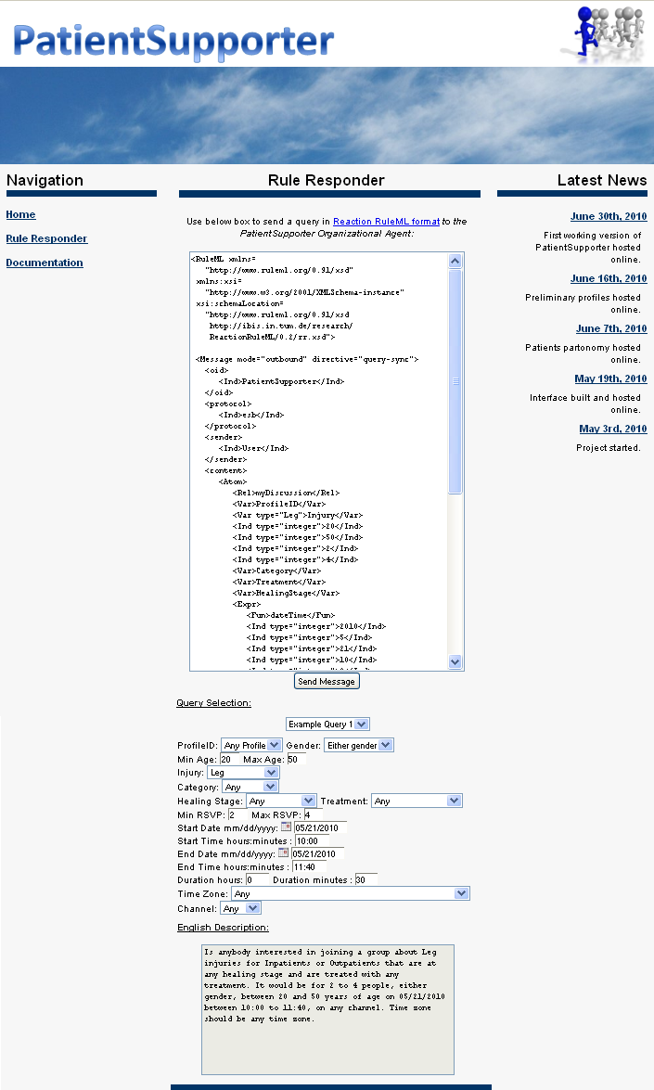
Website (EA)
EA is used to issue queries to the PatientSupporter OA
Query can be written manually or constructed by using the Javascript based GUI
Query is placed in the text box, in the RuleML format
The Send Message will issue the query to the OA
A new screen containing a list of answers in RuleML will be presented
Query examples are provided with their subsequent English descriptions. Can be modified to suit your query
  Online Demo:
  http://ruleml.org/PatientSupporter/RuleResponder

Slide 25
Discussion Group Formation Scenario: Query Refinement
Introduction:
In this scenario a participant of PatientSupporter (Paul) uses the system to find one or more partners for a Discussion on his and others’ Toe injuries
Query 1:
Paul first asks the community if some are interested in discussing Leg injuries with 2 to 10 people. Assessing the answers to this, he finds that there are too many candidates on the list, and decides to narrow down his question
Query 2:
Paul fixes the date and limits possible times, which helps to reduce the numbers, but he still gets too many answers. While these constraints may be ‘hard’ for him (in this week), he should be aware that he may thereby decrease body-part recall (see Queries 3-4)
Query 3:
Now he decides to further descend into the body partonomy, asking about Foot injuries (keeping the constraints of Query 2). The answer volume seems fine, but he now wants maximum body-part precision
Query 4:
So, finally he focuses on Toe injuries. Paul now receives a single answer,
from which he takes the contact name, Sam24, for agreeing on an MSN call

Slide 26
Example Query 1
Paul poses query about Leg,
age, partici-pation, and call
dura-tion
...
<Atom>
<Rel>myDiscussion</Rel>
<Var>ProfileID</Var>
<Var type="Leg">Injury</Var>
<Ind type="integer">20</Ind>
<Ind type="integer">50</Ind>
<Ind type="integer">2</Ind>
<Ind type="integer">10</Ind>
<Var>Category</Var>
<Var>Treatment</Var>
<Var>HealingStage</Var>
<Expr><Fun>dateTime</Fun>...</Expr>
<Expr><Fun>dateTime</Fun>...</Expr>
<Expr>
<Fun>dateTime</Fun>
<Ind type="integer">0</Ind>
<Ind type="integer">0</Ind>
<Ind type="integer">0</Ind>
<Ind type="integer">0</Ind>
<Ind type="integer">30</Ind>
</Expr>
<Var>Channel</Var>
<Var>Contact</Var>
<Var>Gender</Var>
<Var>TimeZone</Var>
</Atom>
...
Green designates a relation name
English Description:
Is anybody interested in joining a
group about Leg injuries,
between 20 and 50 years of age,
for 2 to 10 people,
for any category (In or Out)
that are treated with any
treatment at any healing stage?
It would be on any date
between any (start and end) times,
for ... 0 hours and 30 minutes,
on any channel, with any contact,
gender, and time zone.
Blue designates a constant.
More will get blue
shortly
RuleML
Yellow designates a variable

Slide 27
Example Query 1 – POSL & N3
...
<Atom>
<Rel>myDiscussion</Rel>
<Var>ProfileID</Var>
<Var type="Leg">Injury</Var>
<Ind type="integer">20</Ind>
<Ind type="integer">50</Ind>
<Ind type="integer">2</Ind>
<Ind type="integer">10</Ind>
<Var>Category</Var>
<Var>Treatment</Var>
<Var>HealingStage</Var>
<Expr><Fun>dateTime</Fun>...</Expr>
<Expr><Fun>dateTime</Fun>...</Expr>
<Expr>
<Fun>dateTime</Fun>
<Ind type="integer">0</Ind>
<Ind type="integer">0</Ind>
<Ind type="integer">0</Ind>
<Ind type="integer">0</Ind>
<Ind type="integer">30</Ind>
</Expr>
<Var>Channel</Var>
<Var>Contact</Var>
<Var>Gender</Var>
<Var>TimeZone</Var>
</Atom>
...
RuleML
N3
_:myDiscussion
rdf:type :MyDiscussion;
:profileID ?ProfileID;
:injury Injury:Leg;
:minAge 20;
:maxAge 50;
:minRSVP 2;
:maxRSVP 10;
:category ?Category;
:treatment ?Treatment;
:healingStage ?Healing;
:startTime ?StartTime;
:endTime ?EndTime;
:duration [rdf:type :DateTime;
:year 0;
:month 0;
:day 0;
:hour 0;
:minute 30];
:channel ?Channel;
:contact ?Contact;
:timezone ?TimeZone.
POSL
myDiscussion(?ProfileID,Leg,20:integer,50:integer,2:integer,10:integer,?Category,
?Treatment,?HealingStage,
dateTime[?StartYear,?StartMonth,?StartDay,?StartHour,?StartMinute],
dateTime[?EndYear,?EndMonth,?EndDay,?EndHour,?EndMinute],
dateTime[0:integer,0:integer,0:integer,0:integer,30:integer],
?Channel,?Contact,?Gender,?TimeZone) .

Slide 28
Example Query 2
...
<Atom>
<Rel>myDiscussion</Rel>
<Var>ProfileID</Var>
<Var type="Leg">Injury</Var>
<Ind type="integer">20</Ind>
<Ind type="integer">50</Ind>
<Ind type="integer">2</Ind>
<Ind type="integer">10</Ind>
<Var>Category</Var>
<Var>Treatment</Var>
<Var>HealingStage</Var>
<Expr>
<Fun>dateTime</Fun>
<Ind type="integer">2010</Ind>
<Ind type="integer">5</Ind>
<Ind type="integer">21</Ind>
<Ind type="integer">10</Ind>
<Ind type="integer">0</Ind>
</Expr>
<Expr>
<Fun>dateTime</Fun>
...
<Ind type="integer">11</Ind>
<Ind type="integer">40</Ind>
</Expr>
<Expr>
<Fun>dateTime</Fun>
...
<Ind type="integer">30</Ind>
</Expr>
<Var>Channel</Var>
<Var>Contact</Var>
<Var>Gender</Var>
<Ind type="integer">-400</Ind>
</Atom>
...
Paul fixes date
and limits times, giving time zone
English Description:
Is anybody interested in joining a
group about Leg injuries,
between 20 and 50 years of age,
for 2 to 10 people,
for any category (In or Out)
that are treated with any
treatment at any healing stage?
It would be on 05/21/2010 between 10:00 and 11:40,
for ... 0 hours and 30 minutes,
on any channel, with any contact
and gender, and on GMT -4:00.
RuleML

Slide 29
Example Query 3
...
<Atom>
<Rel>myDiscussion</Rel>
<Var>ProfileID</Var>
<Var type="Foot">Injury</Var>
<Ind type="integer">20</Ind>
<Ind type="integer">50</Ind>
<Ind type="integer">2</Ind>
<Ind type="integer">10</Ind>
<Var>Category</Var>
<Var>Treatment</Var>
<Var>HealingStage</Var>
<Expr>
<Fun>dateTime</Fun>
<Ind type="integer">2010</Ind>
<Ind type="integer">5</Ind>
<Ind type="integer">21</Ind>
<Ind type="integer">10</Ind>
<Ind type="integer">0</Ind>
</Expr>
<Expr>
<Fun>dateTime</Fun>
...
<Ind type="integer">11</Ind>
<Ind type="integer">40</Ind>
</Expr>
<Expr>
<Fun>dateTime</Fun>
...
<Ind type="integer">30</Ind>
</Expr>
<Var>Channel</Var>
<Var>Contact</Var>
<Var>Gender</Var>
<Ind type="integer">-400</Ind>
</Atom>
...
Paul focuses on Foot as part of Leg
English Description:
Is anybody interested in joining a
group about Foot injuries,
between 20 and 50 years of age,
for 2 to 10 people,
for any category (In or Out)
that are treated with any
treatment at any healing stage?
It would be on 05/21/2010 between 10:00 and 11:40,
for ... 0 hours and 30 minutes,
on any channel, with any contact
and gender, and on GMT -4:00.
RuleML

Slide 30
Example Query 4
...
<Atom>
<Rel>myDiscussion</Rel>
<Var>ProfileID</Var>
<Var type="Toe">Injury</Var>
<Ind type="integer">20</Ind>
<Ind type="integer">50</Ind>
<Ind type="integer">2</Ind>
<Ind type="integer">10</Ind>
<Var>Category</Var>
<Var>Treatment</Var>
<Var>HealingStage</Var>
<Expr>
<Fun>dateTime</Fun>
<Ind type="integer">2010</Ind>
<Ind type="integer">5</Ind>
<Ind type="integer">21</Ind>
<Ind type="integer">10</Ind>
<Ind type="integer">0</Ind>
</Expr>
<Expr>
<Fun>dateTime</Fun>
...
<Ind type="integer">11</Ind>
<Ind type="integer">40</Ind>
</Expr>
<Expr>
<Fun>dateTime</Fun>
...
<Ind type="integer">30</Ind>
</Expr>
<Var>Channel</Var>
<Var>Contact</Var>
<Var>Gender</Var>
<Ind type="integer">-400</Ind>
</Atom>
...
Paul focuses on Toe as part of Foot
English Description:
Is anybody interested in joining a
group about Toe injuries,
between 20 and 50 years of age,
for 2 to 10 people,
for any category (In or Out)
that are treated with any
treatment at any healing stage?
It would be on 05/21/2010 between 10:00 and 11:40,
for ... 0 hours and 30 minutes,
on any channel, with any contact
and gender, and on GMT -4:00.
RuleML

Slide 31
Answer to Query 4
Paul gets precise answer
...
<Atom>
<Rel>myDiscussion</Rel>
<Ind>p0004</Ind>
<Var type="Toe">Injury</Var>
<Ind type="integer">20</Ind>
<Ind type="integer">50</Ind>
<Ind type="integer">2</Ind>
<Ind type="integer">10</Ind>
<Ind>Out</Ind>
<Ind>MinorOperation</Ind>
<Ind>Medium</Ind>
...
<Ind>MSN</Ind>
<Ind>Sam24</Ind>
<Ind>Male</Ind>
<Ind type="integer">-400</Ind>
</Atom>
...
English Description:
p0004 is interested in joining a
group about Toe injuries,
between 20 and 50 years of age,
for 2 to 10 people,
as an Out patient
that was treated with a
Minor Operation at Medium healing stage.
It would be on ...,
channel MSN, with contact name Sam24, gender Male, and on GMT -4:00.
RuleML

Slide 32
Conclusion
The PatientSupporter case study:
  Uses a global as well as distributed local knowledge bases
  to support profile interoperation and querying
  Demonstrates profile interoperation between logic-relational (e.g., POSL) and graph-networked (e.g., N3) knowledge representations
  Employs an extended Rule Responder architecture,
  containing the profile level underneath the PAs
  Supports online-interactive communities of patients
  guided by a body partonomy mapped to a taxonomy
  This Rule Responder version thus ontologizes the architecture of earlier instantiations WellnessRules (2) and SymposiumPlanner

