Slide 1
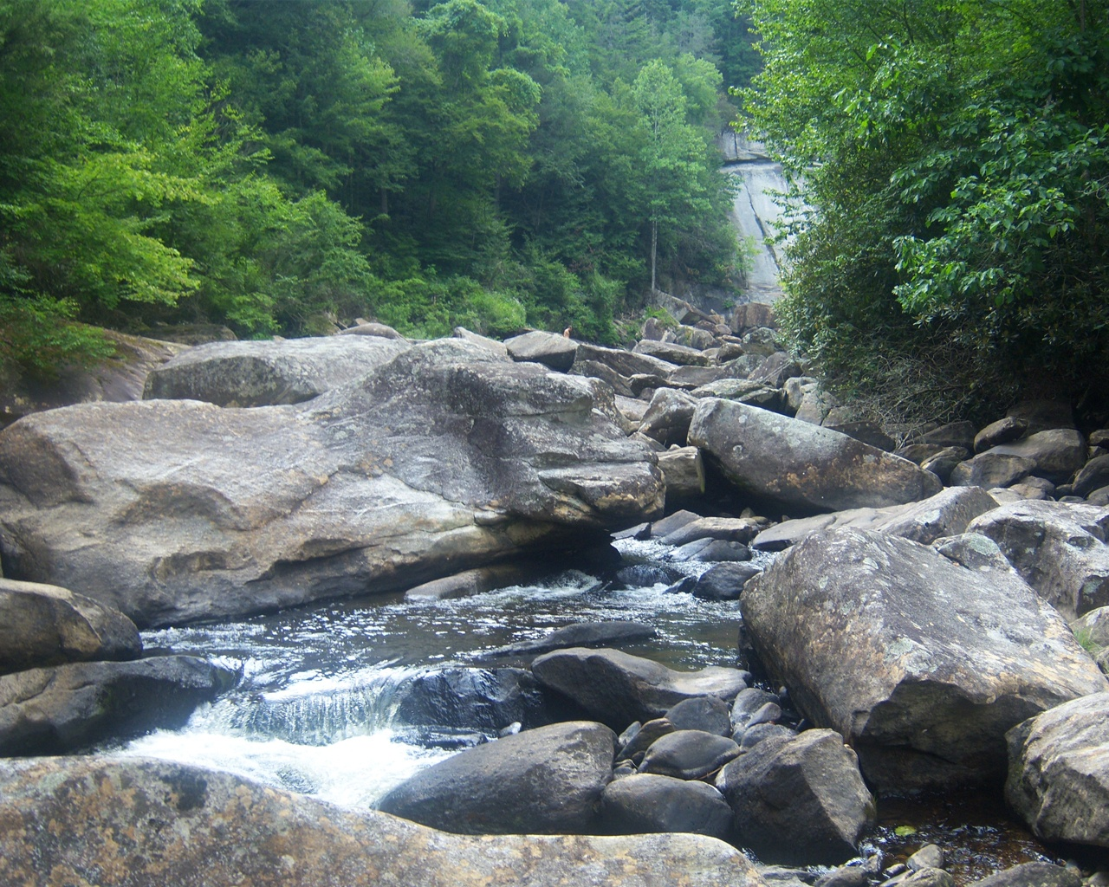
Social Semantic Rule Sharing and Querying
in Wellness Communities
Harold Boley, Taylor Osmun, Benjamin Craig
Institute for Information Technology, National Research Council, Canada
Fredericton, NB, Canada
4th Annual Asian Semantic Web Conference, Shanghai, China, Dec. 7-9, 2009

Slide 2

Part 1: WellnessRules Foundation in
Profile Knowledge Base Interoperation
WellnessRules Overview
Global and Local Knowledge Bases
Profile Interoperation (POSL & N3)
  Interoperation of
  Relational (POSL) and Graph (N3) Languages
  POSL ⬄ N3 Transformation
Taxonomy
  Later seen in Part 2:
  A use case demo describes an online-interactive wellness community through the WellnessRules system in Rule Responder

Slide 3
WellnessRules Overview
WellnessRules supports a wellness community
that is online-interactive and rule-supported.
Each participant of this community has the ability to:
  Create profiles about themselves, containing their preferences for activities and nutrition, their event times, and their fitness levels
  Compare and collaborate with others in the community,
  to track progress and schedule group events
Rules about wellness opportunities are
  authored in rule languages such as Prolog and N3
  interoperated within the community using RuleML/XML

Slide 4
Global Knowledge Base
Contains knowledge relevant to everyone in the WellnessRules community
Knowledge Areas:
  Season
    Defines timeframe of the seasons
  Forecast
    Describes the weather forecast within timeframes
  Meetup
    Contains activity meetup locations for maps
  Global Knowledge Base is available in POSL and N3

Slide 5
Local Knowledge Base
Contains local knowledge specific to each participant in the WellnessRules community
Knowledge Areas:
  Calendar
    Used for event planning. Allows for sharing of calendars between profiles
  Map
    Links to meetup locations. Allows for sharing of maps between profiles
  Fitness
    Defines expected fitness level for a specific period of time (scale of 1-10)
  Event
    Possible/Planned/Performing/Past
  MyActivity
    Derive participants’ individual activity preferences

Slide 6
Local MyActivity Sample Rule (in POSL)
myActivity(p0001,Running,out,?MinRSVP,?MaxRSVP,?StartTime,?EndTime,?Place,?Duration,?Level)
:-
calendar(p0001,?Calendar),
event(?Calendar,?:Running,possible,?StartTime,?EndTime),
participation(p0001,run,out,?MinRSVP,?MaxRSVP),
season(?StartTime,summer),
forecast(?StartTime,sky,?Weather),
notEqual(?Weather,raining),
map(p0001,?Map),
meetup(?Map,run,out,?Place),
level(p0001,run,out,?Place,?Duration,?Level),
fitness(p0001,?StartTime,?ExpectedFitness),
greaterThanOrEqual(?ExpectedFitness,?Level),
goodDuration(?Duration,?StartTime,?EndTime).
Orange designates a profile
preference
Based on this rule the following are p0001’s preferences for Running outdoors:
  The number of participants must be within the minimum and maximum
  The season must be summer
  It must not be raining outside
  p0001’s fitness level is greater than or equal to the required fitness level

Slide 7
Profile Interoperation (POSL & N3)
Support for both logic-relational (e.g., POSL) and
graph-oriented (e.g., N3) knowledge representations
Users may write their profile in either language
Support for OO jDREW and Euler engines to execute
queries issued to POSL and N3 knowledge bases, respectively
Later seen in Part 2:
By using a RuleML subset as the exchange language and
Rule Responder as the platform, queries and answers
can be exchanged with all supported engines

Slide 8
POSL
POSL integrates positional and slotted knowledge for humans
(e.g., Prolog’s positional and F-logic’s slotted knowledge)
WellnessRules only uses positional POSL for logic-relational knowledge, displayed in a Prolog-like syntax
Positional Notations:
  Relation names:
    Each fact and rule head has a relation name
  Arguments:
    Arguments can be upper or lower case, separated by commas (“,”)
  Variables:
    Can be named (“?” prefix) or anonymous (stand-alone “?”)
season(?StartTime,summer).
season(?StartTime,summer).
season(?StartTime,?).

Slide 9
Notation 3 – N3
N3 is a compact and readable version of RDF's XML syntax.
Uses triples (subject, property, object) to represent knowledge
WellnessRules uses N3 for graph-oriented knowledge
Slotted Notations:
  Subject names:
    Each fact / rule head has a subject name
  Variables:
    Can be named (“?” prefix ),
    or anonymous (stand-alone “?”)
  Arguments (property-object pairs):
    Each argument must have
    a property (slot name):
    Each argument must also
    have an object (slot value):
“:” here denotes a local knowledge base
:season_1
rdf:type :Season;
:startTime ?StartTime;
:period :summer.
:season_1
rdf:type :Season;
:startTime ?StartTime;
:period :summer.
:season_1
rdf:type :Season;
:startTime ?StartTime;
:period ?.
:season_1
rdf:type :Season;
:startTime ?StartTime;
:period :summer.

Slide 10
POSL ⬄ N3 Transformation (Atoms)
Transformations are bi-directional; harder left-right reading focused here
N3 requires the use of subjects for naming relationships.
The subject name is the “:”-prefixed relation “:name” extended by “_i”,
where “i” is an instance counter
A POSL relation name becomes defined in an N3 rule head via an rdf:type property using the “:”-prefixed, uppercased version of the “:Name”
Starting with positional POSL, slot names (properties)
must be generated for N3, while variables and constants as
slot values (objects) use the same names as in POSL
:season_1
rdf:type :Season;
:startTime ?StartTime;
:period ?Season.
POSL
⬄
N3
season(?StartTime,?Season).
⬄
:season_1
rdf:type :Season;
:startTime ?StartTime;
:period ?Season.
POSL
season(?StartTime,?Season).
N3

Slide 11
POSL ⬄ N3 Transformation (Rules)
Rule transformation builds on
atom transformation
OO jDREW (using POSL) typically
does top-down (:-) reasoning;
Euler (using N3) always
does bottom-up (=>) reasoning:
‘conclude ... from ...’ becomes ‘if ... then ...’
{
...
?forecast
rdf:type :Forecast;
:startTime ?StartTime;
:aspect :sky;
:value ?Weather.
?Weather log:notEqualTo :raining.
...
}
=>
{
_:myActivity
rdf:type :MyActivity;
:profileID :p0001;
:activity :Running;
:inOut :in;
:minRSVP ?MinRSVP;
:maxRSVP ?MaxRSVP;
:startTime ?StartTime;
:endTime ?EndTime;
:location ?Place;
:duration ?Duration;
:fitnessLevel ?FitnessLevel.
}.
myActivity(p0001,Running,in,?MinRSVP,?MaxRSVP,
?StartTime,?EndTime,?Place,?Duration,?Level)
:-
...
forecast(?StartTime,sky,?Weather),
notEqual(?Weather,raining),
...
.
POSL
⬄
N3

Slide 12
POSL ⬄ N3 Transformation
(naf and built-ins)
The POSL handling of negation as failure (naf) is via a primitive:
Euler’s N3 doesn’t recommend the naf primitive.
Instead, naf is encoded by an e:findall expecting an empty solution list ()
POSL has built-in math operations.
N3 uses package-prefixed math operations
naf( event(?Calendar, ?:Running, past, ?StartTimePast, ?EndTimePast))
POSL
?NAF e:findall
(?event
{?event
rdf:type :Event;
:calendarID ?CalendarID;
:aspect :Running;
:tense :past;
:startTime ?StartTimePast;
:endTime ?EndTimePast.}
() )
N3
POSL
N3
⬄
greaterThanOrEqual(?ExpectedFitness,?Level),
?ExpectedFitness math:notLessThan ?FitnessLevel.

Slide 13
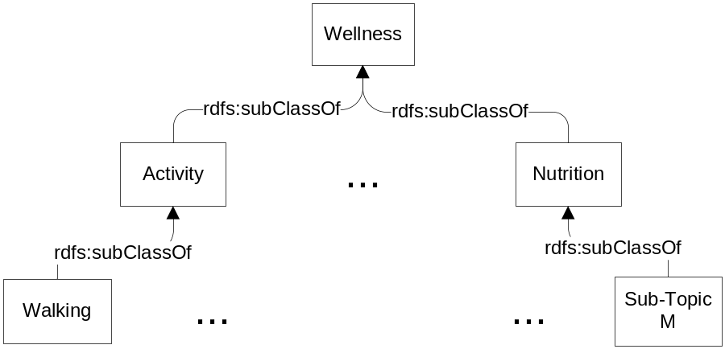
Taxonomy
The WellnessRules taxonomy is broken into two topics: Activity and Nutrition
Each of these contains multiple subtopics (e.g., Walking or Running)
Both representations use rdf:type, rdfs:Class and rdfs:subClassOf
Taxonomy classes act as user-defined types to restrict rule variables
RDF (used by POSL)
N3
<rdf:RDF
xmlns:rdf="http://www.w3.org/1999/02/22-rdf-syntax-ns#"
xmlns:rdfs="http://www.w3.org/2000/01/rdf-schema#">
<rdf:Description rdf:ID="Wellness">
<rdf:type rdf:resource="http://www.w3.org/2000/01/rdf-schema#Class"/>
</rdf:Description>
<rdf:Description rdf:ID="Activity">
<rdf:type rdf:resource="http://www.w3.org/2000/01/rdf-schema#Class"/>
<rdfs:subClassOf rdf:resource="#Wellness"/>
</rdf:Description>
<rdf:Description rdf:ID="Walking">
<rdf:type rdf:resource="http://www.w3.org/2000/01/rdf-schema#Class"/>
<rdfs:subClassOf rdf:resource="#Activity"/>
</rdf:Description>
…
@prefix : <wellnessRules#>.
@prefix rdf: <http://www.w3.org/1999/02/22-rdf-syntax-ns#>.
@prefix rdfs: <http://www.w3.org/2000/01/rdf-schema#>.
:Wellness rdf:type rdfs:Class.
:Activity rdf:type rdfs:Class;
rdfs:subClassOf :Wellness.
:Walking rdf:type rdfs:Class;
rdfs:subClassOf :Activity.
…
⬄

Slide 14
Part 2: WellnessRules for an Online-Interactive Wellness Community via Rule Responder
WellnessRules as a Rule Responder
WellnessRules Architecture
WellnessRules Agent Implementation
and Role Assignment Matrix
Activity Scenario: Example Queries with Live Demo
  Previously seen in Part 1:
  Foundation of WellnessRules in profile knowledge base interoperation,
  which is assisted through transformation techniques

Slide 15
WellnessRules as a Rule Responder
Rule Responder is an intelligent multi-agent infrastructure for collaborative teams and virtual communities
Rule Responder uses three kinds of agents:
  Organizational Agent (OA)
  Personal Agents (PAs)
    PAs extended to select relevant profiles of participants
  External Agents (EAs)
The WellnessRules instantiation of Rule Responder
(similar to SymposiumPlanner) employs the OA, PAs, and EAs
for communication and query delegation to support
an online-interactive wellness community

Slide 16
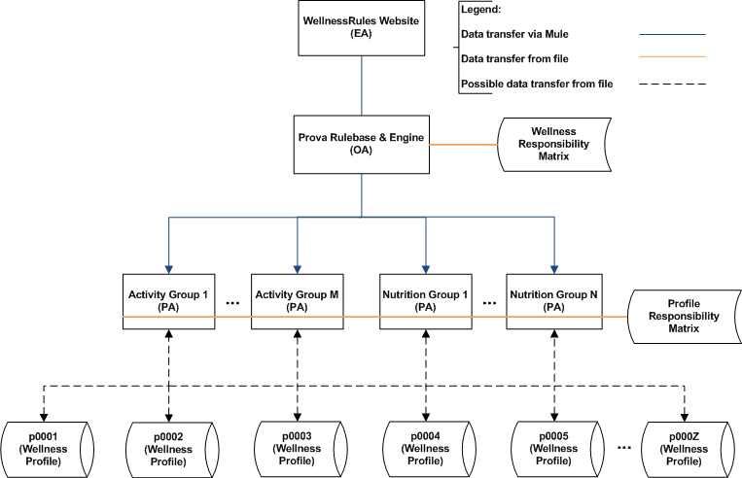
WellnessRules Architecture

Slide 17
Rule Responder Agents (OA, PAs, EAs)
External Agent (EA):
  The WellnessRules website (shown later)
Organizational Agent (OA):
  Contains a Prova knowledge base which is used for incoming queries: directs them to appropriate PAs via the Wellness Responsibility Matrix
Personal Agent with Profiles (PA):
  Consists of a Java servlet and − using the two embedded engines,
  OO jDREW and Euler − forwards the query to POSL and N3 profile knowledge bases, respectively
  It only has access to profiles which contain relevant information
  for its responsible activity by using the Profile Responsibility Matrix

Slide 18
Role Assignment Matrix
Composed of the Wellness Responsibility Matrix (WRM) and Profile Responsibility Matrix (PRM)
The WRM contains information about PA
wellness responsibility, written as an OWL light ontology.
It defines which PA is best suited for different kinds of queries
The PRM contains information about PA profile responsibility and the format of each profile knowledge base:
<Activity>
<Walking>
<ResponsibleProfile name="p0001" format=”posl"/>
<ResponsibleProfile name="p0002" format=”n3"/>
<ResponsibleProfile name="p0003" format="posl"/>
</Walking>
. . .
</Activity>

Slide 19
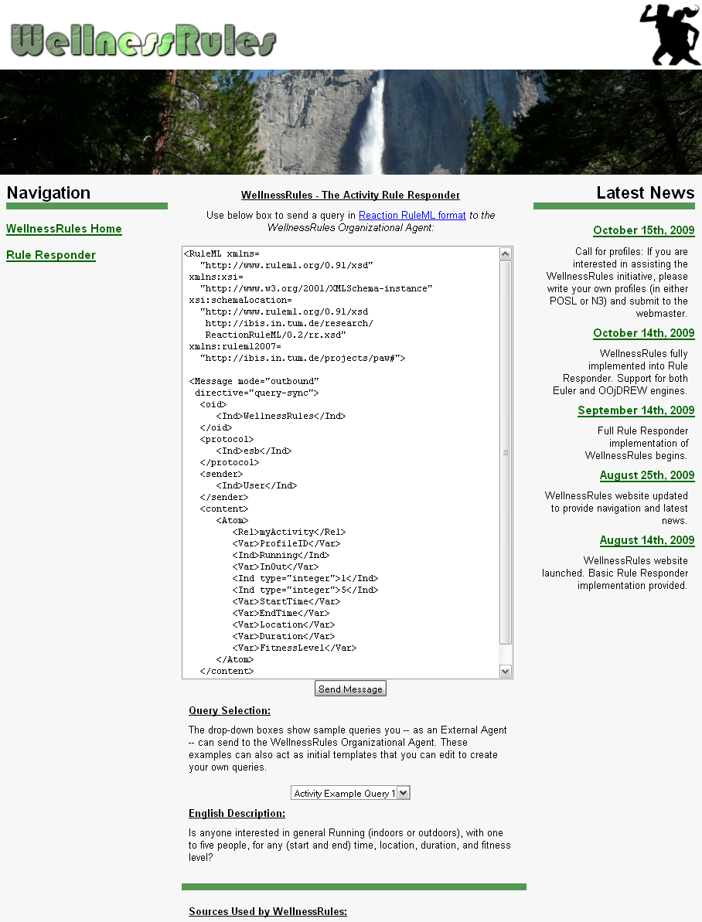
Website (EA)
Used to issue queries to the WellnessRules OA
Query is placed in the text box, in RuleML format
The Send Message will issue the query to the OA
A new screen containing a list of answers in RuleML will be presented
Query examples are provided with their subsequent English descriptions. Can be modified to suit your query
  Online Demo:
  http://www.ruleml.org/WellnessRules/RuleResponder

Slide 20
Activity Scenario: Structured English
Introduction:
In this scenario a participant of WellnessRules (Peter) uses the system to find one or more partners for Running some time in the near future
Query 1:
Peter first asks the community if anyone at all is interested in running with 2 to 6 people. Assessing the answer to this, he finds that there are far too many candidates on the list, and decides to narrow down his question
Query 2:
He feels that he will continue to have a fitness level of 5 for Running, and so asks a refined question wanting only Level-5 activities. In the answer list he notices p0001 (John), who is someone he has previously performed cycling with. (He finds John's fitness level of 5 for running surprising, as he did not realize he was also a good Runner)
Query 3:
Now he wishes to run with John (perhaps in a race?) and so targets p0001, and that he prefers Joe's Gym as the location. Peter now receives a single, final answer on the list, from which he takes the type of running, time, and duration, to contact John for scheduling this event

Slide 21
Example Query 1
Peter would like to go for a run at some point in time.
He poses the following question:
Green designates a relation name
...
<Atom>
<Rel>myActivity</Rel>
<Var>ProfileID</Var>
<Ind>Running</Ind>
<Var>InOut</Var>
<Ind type="integer">2</Ind>
<Ind type="integer">6</Ind>
<Var>StartTime</Var>
<Var>EndTime</Var>
<Var>Location</Var>
<Var>Duration</Var>
<Var>FitnessLevel</Var>
</Atom>
...
English Description:
Is anyone interested in
general Running
(indoors or outdoors),
with 2
to 6 people,
for any (start
and end) time,
location,
duration,
and fitness level?
Blue designates a constant.
More will get blue
as we progress
RuleML
Orange designates a variable

Slide 22
Example Query 1 – POSL & N3
RuleML
N3
...
<Atom>
<Rel>myActivity</Rel>
<Var>ProfileID</Var>
<Ind>Running</Ind>
<Var>InOut</Var>
<Ind type="integer”>2</Ind>
<Ind type="integer”>6</Ind>
<Var>StartTime</Var>
<Var>EndTime</Var>
<Var>Location</Var>
<Var>Duration</Var>
<Var>FitnessLevel</Var>
</Atom>
...
_:myActivity
rdf:type :MyActivity;
:profileID ?ProfileID;
:activity :Running;
:inOut ?InOut;
:minRSVP 2;
:maxRSVP 6;
:startTime ?StartTime;
:endTime ?EndTime;
:location ?Location;
:duration ?Duration;
:fitnessLevel ?FitnessLevel.
POSL
myActivity(?ProfileID,Running,?InOut,2:integer,6:integer,
?StartTime,?EndTime,?Location,?Duration,?FitnessLevel).

Slide 23
Example Query 2
Peter feels that he will continue to have a fitness level of 5 for Running. He poses the following question:
...
<Atom>
<Rel>myActivity</Rel>
<Var>ProfileID</Var>
<Ind>Running</Ind>
<Var>InOut</Var>
<Ind type="integer">2</Ind>
<Ind type="integer">6</Ind>
<Var>StartTime</Var>
<Var>EndTime</Var>
<Var>Location</Var>
<Var>Duration</Var>
<Ind type="integer">5</Ind>
</Atom>
...
English Description:
Is anyone interested in
general Running
(indoors or outdoors),
with 2
to 6 people,
for any (start
and end) time,
location,
and duration,
at a fitness level of 5?
RuleML

Slide 24
Example Query 3
Now he wishes to run with John, and so addresses p0001, and that he prefers Joe's Gym as the location. He poses the following question:
...
<Atom>
<Rel>myActivity</Rel>
<Ind>p0001</Ind>
<Ind>Running</Ind>
<Var>InOut</Var>
<Ind type="integer">2</Ind>
<Ind type="integer">6</Ind>
<Var>StartTime</Var>
<Var>EndTime</Var>
<Ind>joesGym</Var>
<Var>Duration</Var>
<Ind type="integer">5</Ind>
</Atom>
...
English Description:
Is p0001 interested in
general Running
(indoors or outdoors),
with 2
to 6 people,
for any (start
and end) time,
at Joe’s Gym,
for any duration,
at a fitness level of 5?
RuleML

Slide 25
Answer to Query 3
WellnessRules will return the answer seen below. This gives Peter all of the information he needs to contact John about scheduling this event.
...
<Atom>
<Rel>myActivity</Rel>
<Ind>p0001</Ind>
<Ind>Running</Ind>
<Ind>in</Ind>
<Ind type="integer">2</Ind>
<Ind type="integer">6</Ind>
<Ind>2009-06-15T10:15:00</Ind>
<Ind>2009-06-15T11:15:00</Ind>
<Ind>joesGym</Ind>
<Ind>P60M</Ind>
<Ind type="integer">5</Ind>
</Atom>
...
English Description:
p0001 is interested
in Running
Indoors,
with 2
to 6 people,
between 10:15AM and 11:15AM
on June 15th, 2009,
at Joe's Gym,
for 60 minutes,
at a fitness level of 5.
RuleML

Slide 26
Conclusion
The WellnessRules case study:
  Uses a global as well as distributed local knowledge bases
  to support profile interoperation and querying
  Demonstrates profile interoperation between
  logic-relational (e.g., POSL) and graph-oriented (e.g., N3) knowledge representations
  Introduces an extended Rule Responder architecture,
  adding the profile level underneath the PAs
  Supports an online-interactive wellness community
  through the WellnessRules system in Rule Responder

Slide 27
Example of Interoperation
According to the PRM, p0001’s profile has a format of POSL:
Since p0001’s profile is transformable to N3, the format can be, too:
<WellnessRules>
<Activity>
<Walking>
<ResponsibleProfile name="p0001" format=”posl"/>
<ResponsibleProfile name="p0002" format=”n3"/>
<ResponsibleProfile name="p0003" format="posl"/>
</Walking>
<Running>
<ResponsibleProfile name="p0001" format=”posl"/>
<ResponsibleProfile name="p0002" format=”n3"/>
<ResponsibleProfile name="p0003" format="posl"/>
</Running>
...
</Activity>
</WellnessRules>
<WellnessRules>
<Activity>
<Walking>
<ResponsibleProfile name="p0001" format=”n3"/>
<ResponsibleProfile name="p0002" format=”n3"/>
<ResponsibleProfile name="p0003" format="posl"/>
</Walking>
<Running>
<ResponsibleProfile name="p0001" format=”n3"/>
<ResponsibleProfile name="p0002" format=”n3"/>
<ResponsibleProfile name="p0003" format="posl"/>
</Running>
...
</Activity>
</WellnessRules>

