Slide 1

Deploying a Distributed Symposium
Planner Through Rule Responder
Harold Boley
Benjamin Craig
Institute for Information Technology
National Research Council, Canada
Fredericton, NB, Canada
RuleML-2008 Challenge
Orlando Florida
October 30-31, 2008

Slide 2
Outline
Rule Responder Overview
Symposium Planner Use Case
  Agents
    Personal / Organizational / External
  Rule Engines (for Realizing Agents)
    Prova
    OO jDREW
  Communication Middleware (for Connecting Agents)
    Mule ESB
    Reaction RuleML Messages
Online Demo
Conclusion

Slide 3
Overview of Rule Responder
Rule Responder is an experimental
multi-agent system for collaborative teams and virtual communities on the Web
Supports rule-based collaboration between the distributed members of such a virtual organization
Members of each virtual organization are assisted by semi-automated rule-based agents, which use rules to describe the decision and behavioral logic
Implemented on top of a Mule-based
Service Oriented Architecture (SOA)
Notes:
Why rules are important -> to implement the decision logic

Slide 4
Use Case: Symposium Planner
RuleML-20xy Symposia
  An organizational agent acts as the single point of entry to assist with the symposium:
    Currently, query answering about the symposium
    Ultimately, preparing and running the symposium
  Personal agents have supported symposium chairs since 2007 (deployed as Q&A in 2008)
    General Chair, Program Chair, Panel Chair, Publicity Chair, etc.

Slide 5
Organizational Agents
An organizational agent represents goals and strategies shared by each member of the organization
It contains rule sets that describe the policies, regulations, opportunities, etc. of its organization

Slide 6
Personal Agents
A personal agent assists a single person
of an organization, (semi-autonomously) acting on his/her behalf
Can be thought as delegating routine work to an assistant

Slide 7
External Agents
External agents exchange messages with (the public interface of) organizational agents, asking queries, receiving answers, or interchanging complete rule sets
End users, as external agents, employ a Web (HTTP) interface of Rule Responder (currently an API-like browser interface)
Support for simultaneous external agents: Currently, end users (B2C)
Ultimately, other organizations (B2B)

Slide 8
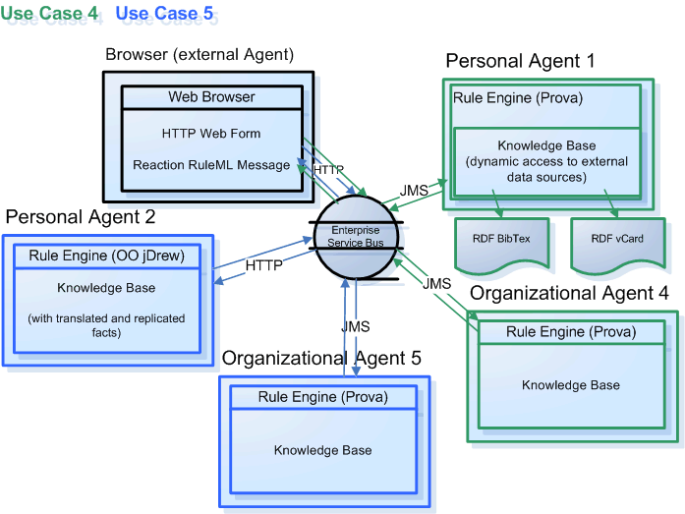
Infrastructure - Overview

Slide 9
Reaction RuleML
Reaction RuleML is a branch of the RuleML family that supports actions and events
When two agents need to communicate, each others’ Reaction RuleML messages are sent through the ESB
Carries RuleML queries, answers, and rule bases to/from agents

Slide 10
Rule Engines
Prova: Prolog + Java
OO jDREW: Object Oriented
java Deductive Reasoning Engine for the Web

Slide 11
Prova
Prova is mainly used to realize the organizational agents of Rule Responder
It implements Reaction RuleML for agent interaction (event-condition-action rules)

Slide 12
OO jDREW
OO jDREW is used to realize the
personal agents of Rule Responder
It implements Hornlog RuleML for agent reasoning (Horn logic rules)
Supports rules in two formats:
  POSL: Positional Slotted presentation syntax
  RuleML: XML interchange syntax
  (can be generated from POSL)

Slide 13
Communication Middleware
Mule Enterprise Service Bus (ESB)
  Mule* is used to create communication end points at each personal and organizational agent of Rule Responder
  Mule supports various transport protocols
  (e.g. HTTP, JMS, SOAP)
  Rule Responder currently uses HTTP and JMS as transport protocols
  * Mule – The open source SOA infrastructure: http://mulesource.com

Slide 14
Online Use Case Demo
Rule Responder:
http://responder.ruleml.org
RuleML-2007/RuleML-2008 Symposia:
http://ibis.in.tum.de/projects/paw/ruleml-2007
http://ibis.in.tum.de/projects/paw/ruleml-2008
Personal agents:
Supporting all Chairs
Organizational agent:
Supporting Symposium as a whole
Online

Slide 15
Sample Message to Organizational Agent
<RuleML xmlns="http://www.ruleml.org/0.91/xsd"
xmlns:xsi="http://www.w3.org/2001/XMLSchema-instance"
xsi:schemaLocation="http://www.ruleml.org/0.91/xsd
http://ibis.in.tum.de/research/ReactionRuleML/0.2/rr.xsd"
xmlns:ruleml2007="http://ibis.in.tum.de/projects/paw#">
<Message mode="outbound" directive="query-sync">
<oid>
<Ind>RuleML-2008</Ind>
</oid>
<protocol>
<Ind>esb</Ind>
</protocol>
<sender>
<Ind>User</Ind>
</sender>
<content>
<Atom>
<Rel>getContact</Rel>
<Ind>ruleml2008_PanelChair</Ind>
<Ind>update</Ind>
<Var>Contact</Var>
</Atom>
</content>
</Message>
</RuleML>
Online
http://www.ruleml.org/RuleML-2008/RuleResponder
Query Selection: Panel Chair Contact
Notes:
Explain what the message means OID, protocol, sender

Slide 16
Architecture - Execution

Slide 17
Architecture - Execution

Slide 18
Architecture - Execution

Slide 19
Architecture - Execution

Slide 20
Architecture - Execution

Slide 21
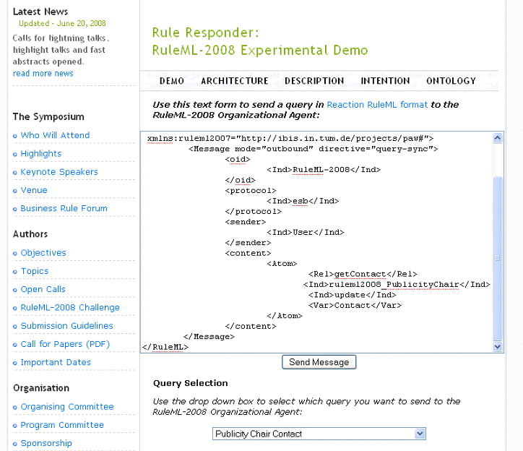

Slide 22
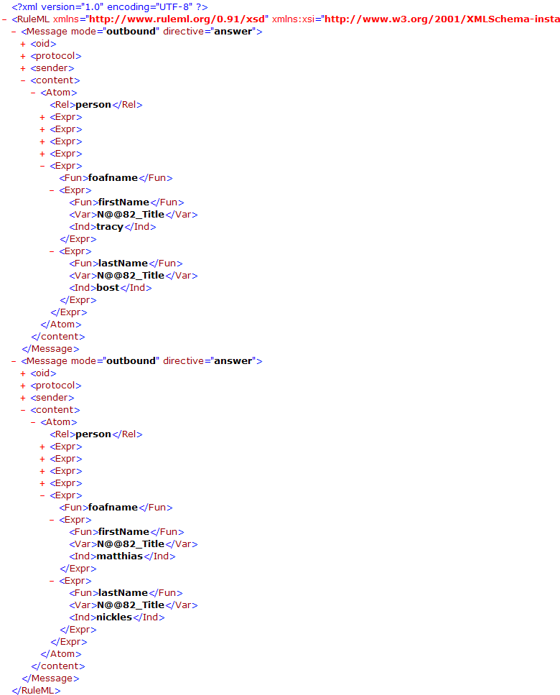
Notes:
Response

Slide 23
Sample Message to Publicity Chair Agent (I)
<content>
<Atom>
<Rel>sponsor</Rel>
<Expr>
<Fun>contact</Fun>
<Ind>Mark</Ind>
<Ind>JBoss</Ind>
</Expr>
<Ind type="integer">500</Ind>
<Expr>
<Fun>results</Fun>
<Var>Level</Var>
<Var>Benefits</Var>
<Var>DeadlineResults</Var>
</Expr>
<Expr>
<Fun>performative</Fun>
<Var>Action</Var>
</Expr>
</Atom>
</content>
Online
http://www.ruleml.org/RuleML-2008/RuleResponder
Query Selection: Publicity Chair Sponsoring
Notes:
Query

Slide 24
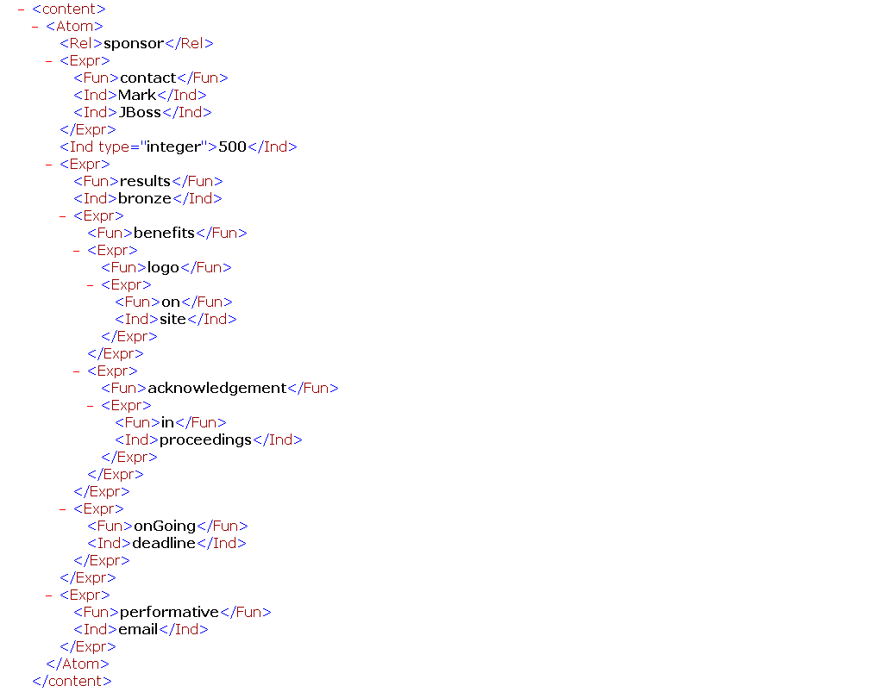
Notes:
Reponse

Slide 25
Sample Message to Publicity Chair Agent (II)
<content>
<Atom>
<Rel>sponsor</Rel>
<Expr>
<Fun>contact</Fun>
<Ind>Mary</Ind>
<Ind>Super</Ind>
</Expr>
<Ind type="integer">5000</Ind>
<Expr>
<Fun>results</Fun>
<Var>Level</Var>
<Var>Benefits</Var>
<Var>DeadlineResults</Var>
</Expr>
<Expr>
<Fun>performative</Fun>
<Var>Action</Var>
</Expr>
</Atom>
</content>
Online
http://www.ruleml.org/RuleML-2008/RuleResponder
Query Selection: Publicity Chair Sponsoring (edit)
Notes:
Query

Slide 26
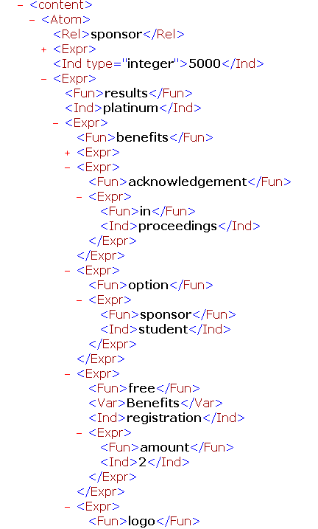
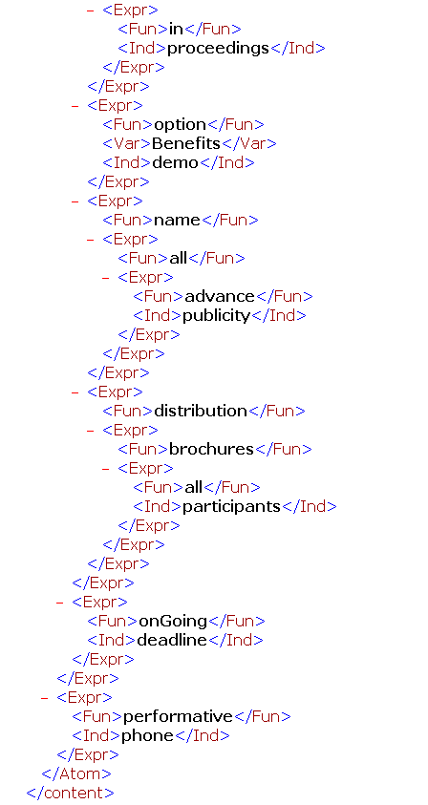

Slide 27
Conclusion
Rule Responder was implemented & tested for various use cases (http://responder.ruleml.org) and deployed for RuleML-2008 Q&A
Its organizational agents delegate external queries to topic-assigned personal agents
It couples rule engines OO jDREW & Prova via Mule middleware and RuleML 0.91 XML interchange format

