Slide 1
Are Your Rules Online?
Four Web Rule Essentials
RuleML-2007, 25-26 Oct 2007
Harold Boley
National Research Council of Canada
University of New Brunswick, Canada

Slide 2
Introduction
Web rules permit novel Web sites
  with machine-interpretable rule representations
  for automated reasoning
Research builds on our previous work in
  Web rule foundations (e.g., POSL, Datalog^{DL}, ALC^{u}_{P})
  Standards (e.g., RuleML, SWRL, RIF)
  Engines (e.g., OO jDREW)
  Use cases (e.g., AgentMatcher, FindXpRT,
  Rule Responder, Ontology Integration)

Slide 3
Objective
Devise complementary techniques of
  rule representation & reasoning
for
  Business Rules
  the Semantic Web
  Web Services
  other Web (and Web 2.0) areas

Slide 4
Four Principal Web Rule Issues
Previous research led to following four principal Web rule issues used here as starting points ...

Slide 5
I1: Formal Knowledge as Content or Metadata
Web increasingly has ‘Semantic Subwebs’ containing knowledge documents (knowledge bases, schemas, etc.)
Formal knowledge representation can act as
  content that is queried and retrieved in its own right
  metadata that helps to retrieve other formal or informal content
  a combination of both

Slide 6
I2: Global Inconsistency vs. Local Consistency
Open Web as well as closed ‘intranets’ contain knowledge documents:
  Open Web knowledge in expressively rich representations is typically inconsistent
  Closed intranet knowledge is typically paraconsistent, i.e. the documents
  in each intranet are maintained to be
  (locally) consistent, although the intranet union may be (globally) inconsistent
→

Slide 7
I2: Global Inconsistency vs. Local Consistency (Cont’d)
While classical 2-valued logic
  cannot be directly used for
  open Web reasoning
  it can be exploited locally for
  closed intranet reasoning
Locality of documents creates
an implicit module notion
Locality can also be achieved via
an explicit module construct

Slide 8
I3: Rule Layering on Top of RDF?
Trade-off between representation expressiveness and reasoning tractability
→ Scalability of reasoning to the open Web is still unresolved for higher expressive classes
→ Representation layering on top of quite inexpressive languages:
RDF is W3C's fundamental knowledge layer, although its XML syntax is somewhat complicated, and its semantics is rather complicated

Slide 9
I3: Rule Layering on Top of RDF? (Cont’d)
Yet, simple RDF statements without blank nodes in assertions, queried without property variables, are a candidate for the least expressive (binary-)fact layer: Use RuleML & RIF’s slotted syntax (F-logic semantics)
Binary Datalog rules, similar to relational views over 2-column tables, can then be added to derive new facts from conjunctions of other facts, much like relational joins
Finally, an irreflexive subClassOf fragment of RDF Schema can be employed to define order-sorted types for constants and rule variables

Slide 10
I4: Web Standards Compatibility / Webizing
Web rules layered on, and side-by-side with, other Web languages
→ Represent rules so that compatibility with relevant Web standards (e.g., XML, RDF, OWL) is preserved
Selecting Web standards can be hard, e.g. which, if any,
query and transformation languages should be included
(e.g., XQuery, XSLT, SPARQL, OWL-QL)
Levels and degrees of compatibility with each selected language need to be determined
→ Focus on what is unique to Web languages, namely
‘webizing’, basically permitting Web rule language to use
URIs for global constants, in ways compatible with URIs
in existing (Semantic) Web languages

Slide 11
Four Essentials of Web Rules
To address issues I1-I4, we will consider four corresponding essentials of Web rules, E1-E4
Taken together, the Web rule essentials will constitute a diamond-like system, , with URIs (E4) at the bottom, modules (E2) and assertional-terminological layers (E3) on the same level in the middle, and a Controlled English Wiki (E1) at the top
E
1
2
3
4

Slide 12
Rule Wiki
E
1
2
3
Modules
4
Layers
URI access/naming

Slide 13
E1: Combining Logic Rules with Controlled English
Combine formal and informal knowledge in a Rule Wiki, where clauses (here, rules and facts)
are given dual representations, in natural language (e.g., English) and in logic
Formal parts can be taken as code
(or as metadata) for the informal parts,
and the informal parts as documentation
(or as content) for the formal parts

Slide 14
E1: Combining Logic Rules with Controlled English (Cont’d)
This combination is analogous to Knuth’s Literate Programming and to Javadoc
Supported by tools mapping Controlled English into rules and back
  English-to-rule tools based on Attempto: TRANSLATOR, and AceRules
  Related tools have also been developed for AceWiki and “Semantics of Business Vocabulary and Business Rules” (SBVR)

Slide 15
E1: Rule(ML) Wiki
Classical Wiki permits authoring of informal-knowledge documents using natural-language-enriching markup simpler than (but mapped to) HTML
Extending this concept, a Rule Wiki permits formal-knowledge authoring using logic-language-enriching markup simpler than (but mapped to) XML, combining this with informal-knowledge authoring
Formal-knowledge language can employ a human-readable syntax such as POSL, integrating the Prolog and F-logic syntaxes

Slide 16
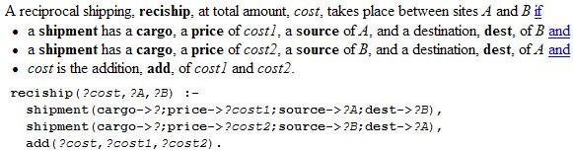
E1: Rule(ML) Wiki (Cont’d)

Slide 17
Rule Wiki
E
1
2
3
Modules
4
Layers
URI access/naming

Slide 18
E2: A Distributed Rule Module Construct
Beneficial to represent distributed knowledge via a module construct,
  supporting local consistency
  reducing the search space of scoped
  (module-restricted) queries
  permitting scoped negation as failure
  (over closed worlds)
Such Web modules may be
  written and used ‘in place' or
  defined at one place (URL) and accessed from other places
The semantics of modules should not depend on any needed URL-dereferencing

Slide 19
E2: Modules in RuleML
RuleML 0.91 embeds modules (Rulebases) into an Entails element, which serves to prove whether a query or module is entailed by another module
Can be extended to nested (cycle-free) inheritance system of modules
We only need a simplified kind of module inheritance, since by default we don’t assume Prolog-like textual order in a module's set of assertional (fact and rule)
or terminological (subclass-ontological) clauses
→ Don’t need to merge clauses but can just
take their union

Slide 20
E2: Module Example: loyalty
{
discount(?customer,?product,percent[5]) :-
premium(?customer),
regular(?product).
discount(?customer,?product,percent[10]) :-
premium(?customer),
luxury(?product).
}

Slide 21
E2: Module Example: legality
{
-discount(?customer,?product1,?percent) :-
payment(?customer,?product2,?amount,?method,?time),
fraudulent(?customer,?method,?time).
-discount(?customer,?product1,?percent) :-
delivery(?customer,?product2,?amount,date[?y1,?m1,?d1]),
payment(?customer,?product2,?amount,?method,date[?y2,?m2,?d2]),
datediff(days[?delta],date[?y2,?m2,?d2],date[?y1,?m1,?d1]),
greaterThan(?delta,45).
}
Using “-” prefix as POSL syntax for RuleML’s (strong) Neg(ation) element

Slide 22
E2: Module Prioritization: legality vs. loyalty
Example modules locally consistent, but their union is inconsistent:
According to first rule of loyalty module, premium customers
would be granted 5 percent discount for a regular product, but,
according to the first rule of legality module, would be denied
discount on any product if they used a fraudulent payment method
on a product
To deal with this, prioritization (cf. Courteous Logic Programs
and Defeasible Logic) can be employed on the module level to let
all rules of the legality module override all loyalty rules

Slide 23
E2: Module-Scoped Queries  Example Based on Local Modules: customer and product
{
discount(?customer,?product,percent[5]) :-
customer |- premium(?customer),
product |- regular(?product).
discount(?customer,?product,percent[10]) :-
customer |- premium(?customer),
product |- luxury(?product).
}
Using “|-” infix as POSL syntax for RuleML’s Entails element

Slide 24
Rule Wiki
E
1
2
3
Modules
4
Layers
URI access/naming

Slide 25
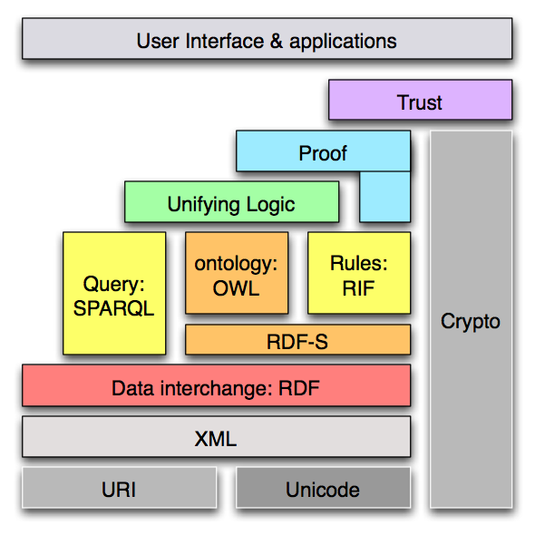
E3: Assertional-Terminological Expressiveness
Layering  Zooming into the ‘Cake’
Tim Berners-Lee 2006:

Slide 26
E3: Assertional-Terminological Expressiveness
Layering
Various efforts towards dual expressiveness layering of assertional and terminological knowledge as well as their blends
Assertional bottom layer usually consists of Datalog (function-free) assertions, perhaps restricted to unary/binary predicates
Terminological bottom layer can employ irreflexive version of RDF Schema's subClassOf, which can later be extended towards the ρΔΦ fragment of RDF

Slide 27
E3: Assertional-Terminological Expressiveness 
Bottom Layers
Bottom layers can be blended through a
hybrid combination: ρDF classes used as types for Datalog constants and variables, and subClassOf defined with order-sorted semantics
or
homogeneous integration: ρDF classes used as unary predicates in the body of Datalog rules, and subClassOf defined as special rules with Herbrand-model semantics

Slide 28
E3: Assertional-Terminological Expressiveness 
Higher Layers
Higher layers can develop
Datalog into Horn and FOL (First-Order Logic) assertions
ρDF into ALC and SHIQ terminologies with classes and properties
appropriate blends, e.g. as advancements of our hybrid Datalog^{DL} or homogeneous ALC^{u}_{P}
Assertional layers can move even beyond FOL,
including towards higher-order and modal logics,
as started as part of the RuleML family

Slide 29
E3: Layering Example: Vehicle Registration
Assertions:
Terminology:
registration(?V:Van,CAD[?R:Decimal]) :-
emission(?V,CO2[?E]),
weight(?V,kg[?W]),
emiweight(CAD[?R],CO2[?E],kg[?W]).
registration(?V:Car,CAD[?R:Decimal]) :-
emission(?V,CO2[?E]),
speed(?V,kmh[?S]),
emispeed(CAD[?R],CO2[?E],kmh[?S]).
Vehicle > Van
Vehicle > PassengerVehicle
Van > MiniVan
PassengerVehicle > MiniVan
PassengerVehicle > Car
s
Vehicle
s
s
Van
s = rdfs:subClassOf
s
PassengerVehicle
s
MiniVan
s
Car

Slide 30
Rule Wiki
E
1
2
3
Modules
4
Layers
URI access/naming

Slide 31
E4: URIs for Access or Naming
There have been attempts to differentiate the Web notion of URIs into two subnotions:
  URLs (Uniform Resource Locators), for access
  URNs (Uniform Resource Names), for naming
In the context of Web knowledge representation, three central URI uses are emerging, given here in the order of further needed research

Slide 32
E4: URIs for Access, Naming, or Both (1)
A URI can be used URL/access-style, for module import,
where it is an error if dereferencing the URI does not yield
a knowledge base valid with respect to the expected
representation language
Example: The loyalty module can be imported into
the current rulebase using URL/access-style URI
http://modeg.org#loyalty

Slide 33
E4: URIs for Access, Naming, or Both (2a)
A URI can be used URN/naming-style, as the identifier
of an individual constant in the representation language,
where URI dereferencing is not part of the formal
knowledge representation. Dereferencing as part of the
metadata about the informal knowledge representation
retrieves ‘homepage’ of the individual
Example: The URI http://en.wikipedia.org/wiki/Pluto can
be used URN/naming-style to refer to celestial body originally
considered a planet (URI in angular brackets, <. . . >):
planet(<http://en.wikipedia.org/wiki/Pluto>,AD[?year]) :-
lessThanOrEqual(1930,?year),
lessThanOrEqual(?year,2006).

Slide 34
E4: URIs for Access, Naming, or Both (2b)
As part of formal rule knowledge, Pluto URI is
used only for naming.
Rule can also be employed as metadata about
informal knowledge via (‘semantic search engine’)
queries like
planet(?which, AD[2005])
since one of its solutions is
?which = <http://en.wikipedia.org/wiki/Pluto>
whose dereferencing (‘clicking’) will then retrieve
Pluto's Wikipedia entry

Slide 35
E4: URIs for Access, Naming, or Both (3)
A URI can be used naming-style, as identifier of a class,
property, relation, or function, and at the same time
access-style, where dereferencing yields knowledge base
formally defining that identifier (perhaps partially only,
as for an RDF Schema knowledge base just giving the
superclasses of a class)
Example: for certain formal purposes a URI like
http://termeg.org#MiniVan is needed just to provide
a name; for other formal purposes, also to provide a total or
partial definition found by using that same URI for access
(say, the partial definition of being rdfs:subClassOf both
http://termeg.org#Van and
http://termeg.org#PassengerVehicle)

Slide 36
Conclusions (1)
E
1
Essentials in are variously interrelated
For instance,
  a Rule Wiki for assertional knowledge (E1)
  can be extended with
  terminological knowledge (E3),
  both of which
  can be kept in distributed modules (E2)
  accessed by URIs (E4)
2
3
4

Slide 37
Conclusions (2)
The four essentials can be transferred to (re)active rules for knowledge update, which have been increasingly studied in Web languages such as Reaction RuleML and Prova
These rules have extra event and action parts:
  Can also be combined with Controlled English (E1),
  Modules are even more important here, for containing
  action side-effects (E2)
  Terminologies can be directly added to formalize
  both event and action vocabularies (E3)
  All kinds of URIs are also crucial for
  (re)active Web rules and Web Services (E4)

