Slide 1
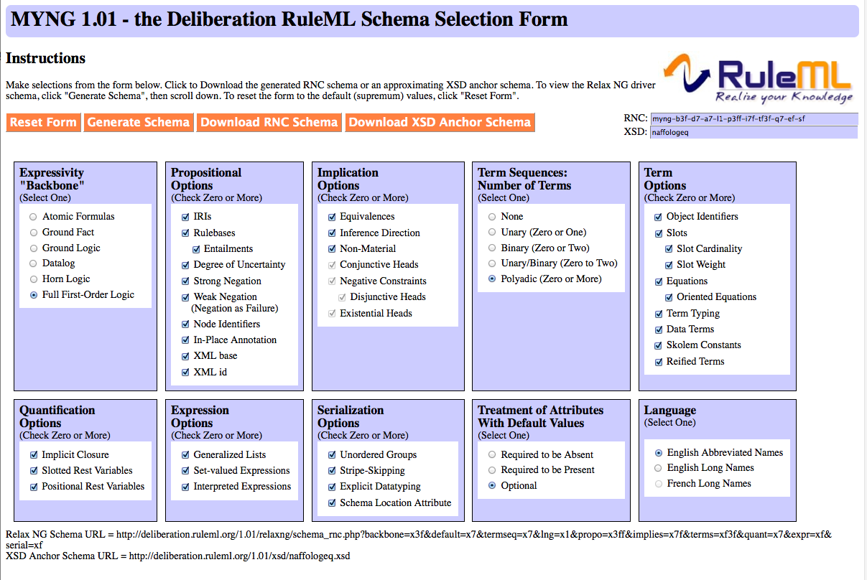
MYNG GUI Starting View
Supremum Deliberation RuleML

Slide 2
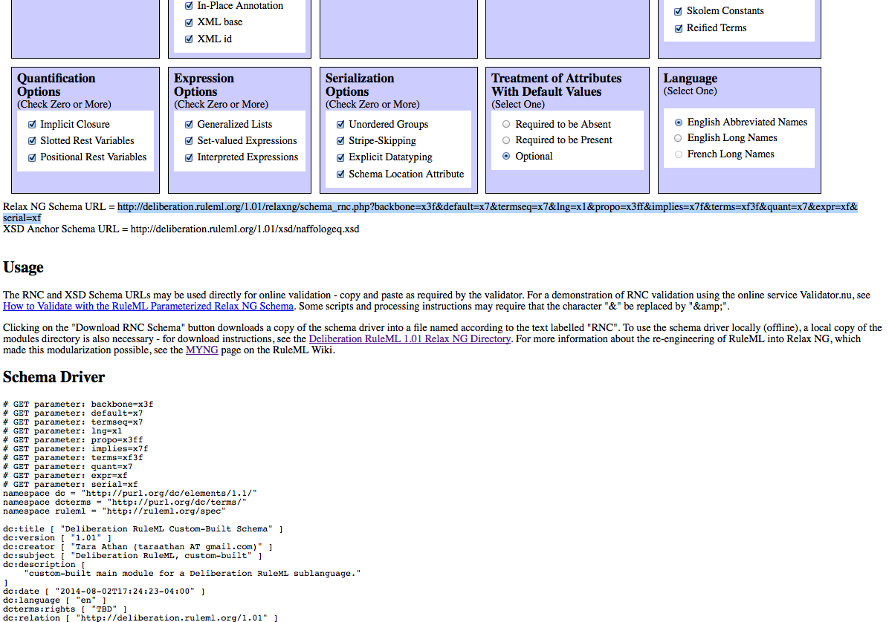
Scroll Down in the MYNG GUI
Usage and Schema Driver

Slide 3
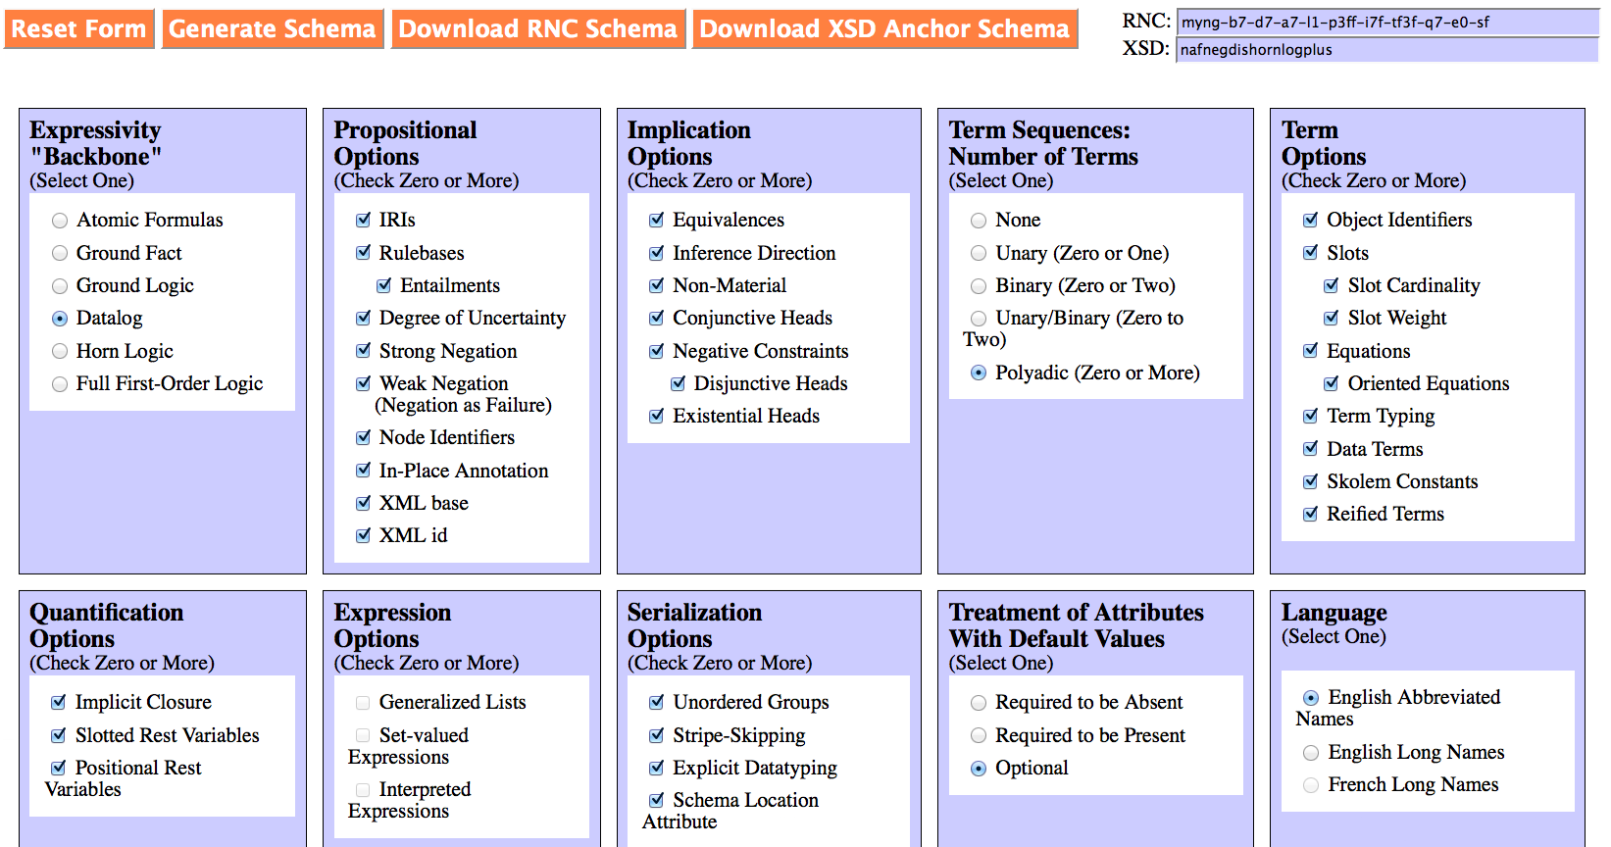
Selection of Expressivity
Datalog

Slide 4
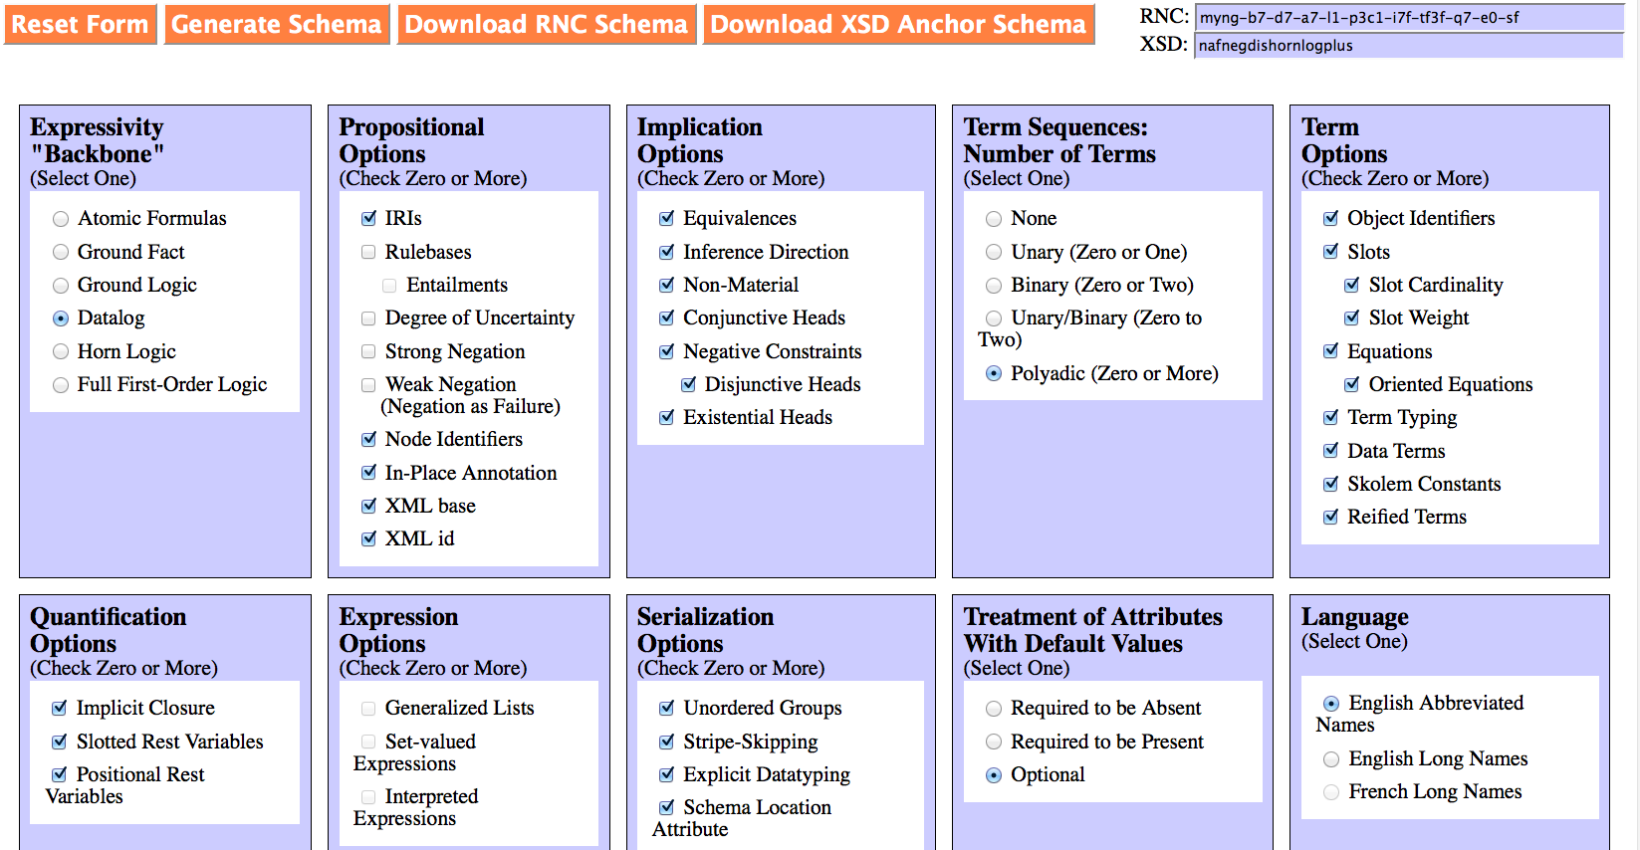
Selection of Propositional Options
No Rulebases, Fuzzy Logic or Negations

Slide 5

Selection of Implication Options
No Equivalences

Slide 6

Selection of Term Options
No Object Identifiers, or Slots

Slide 7
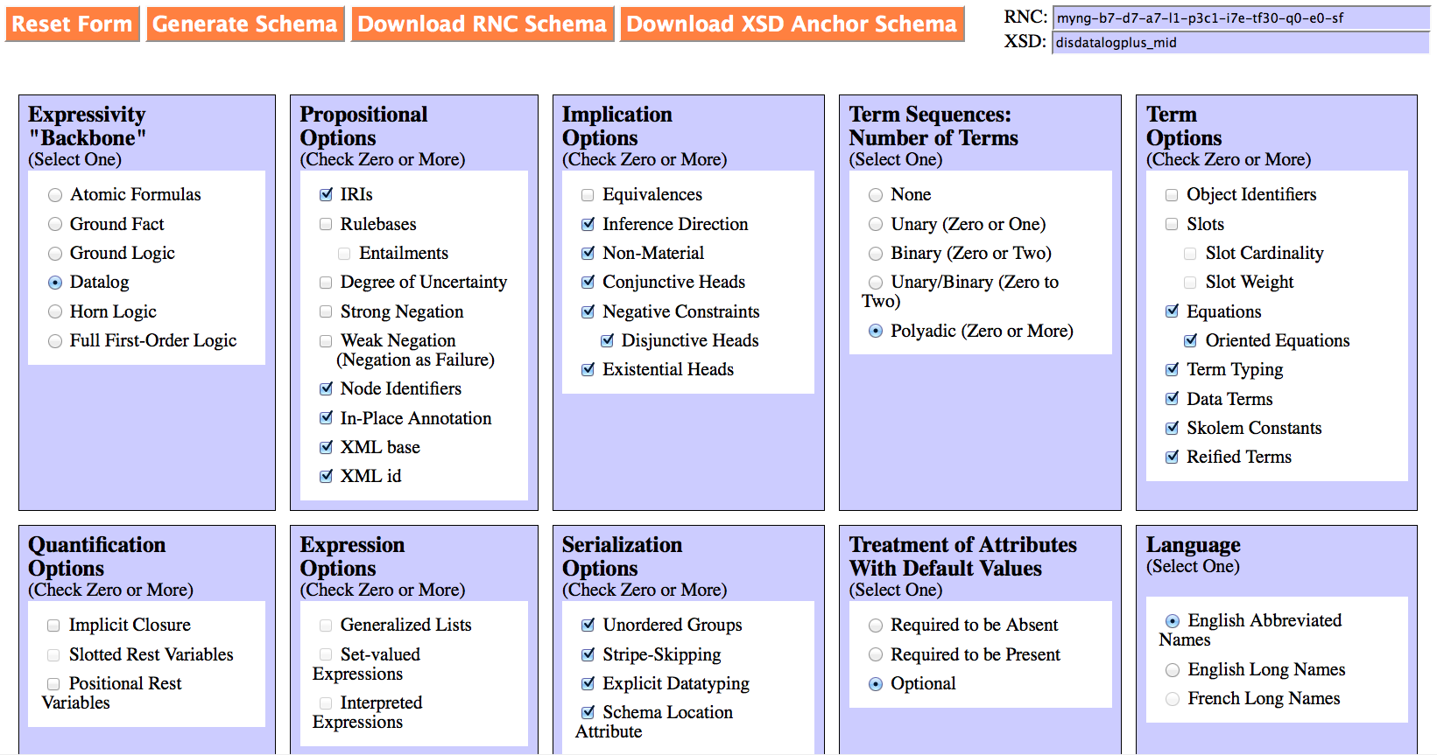
Selection of Quantification Options
No Implicit Closure, Rest Variables

Slide 8
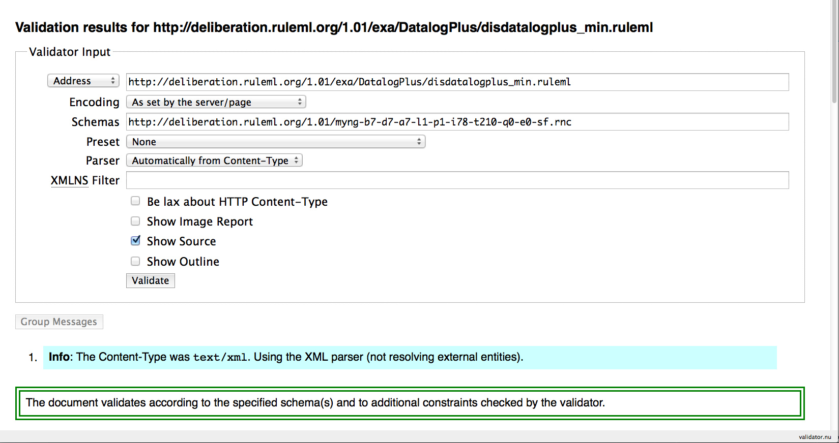
Using Validator.nu
Validation of disdatalogplus_min.ruleml

