Slide 1

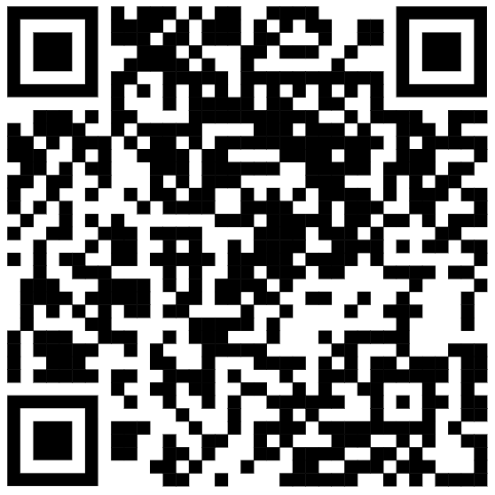
Welcome to BioNetGen
@ SIAMLS26!
SPEAKERS:
Jim Faeder PhD
Laura Strube PhD
Alex DiBiasi
Achyudhan Kutuva
Follow along on the GitHub!

Slide 2
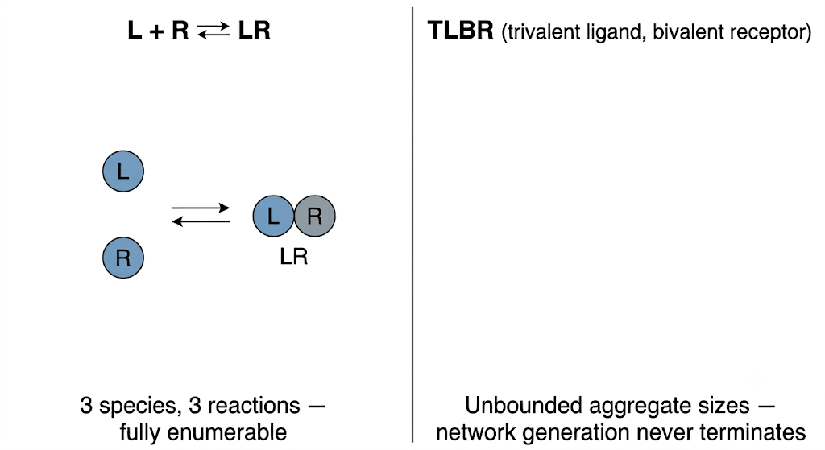
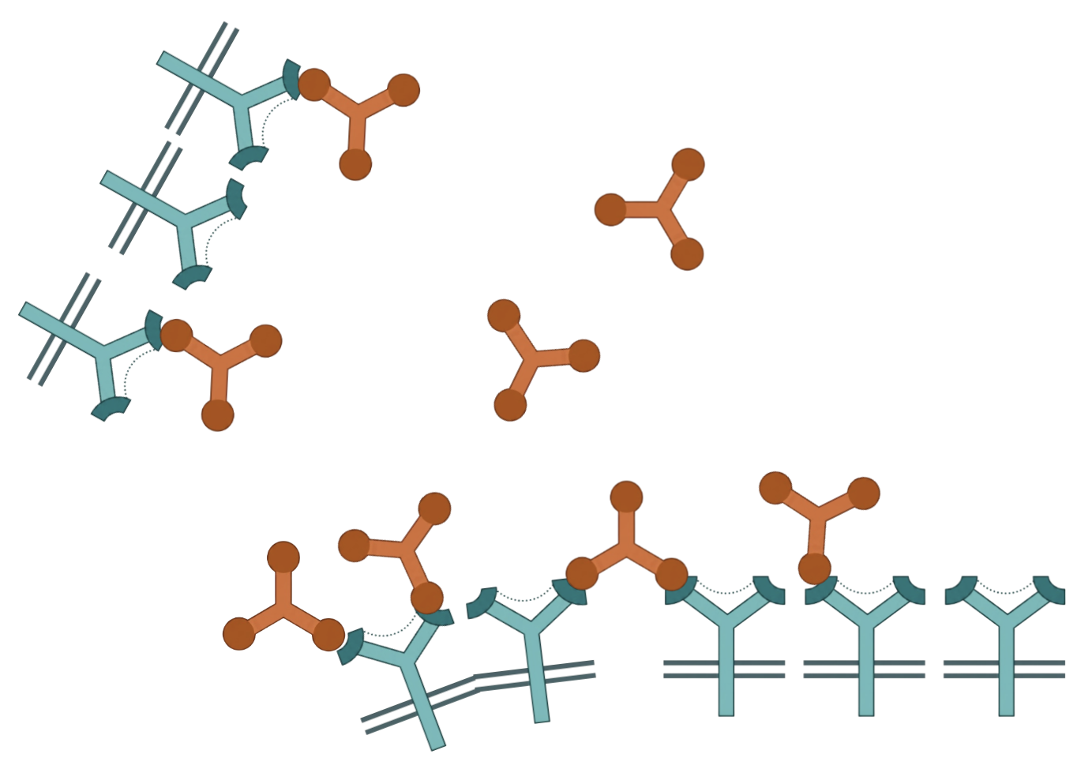
Bivalency turns a 3-reaction network into an unbounded one

Slide 3
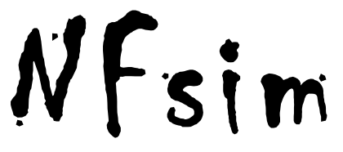
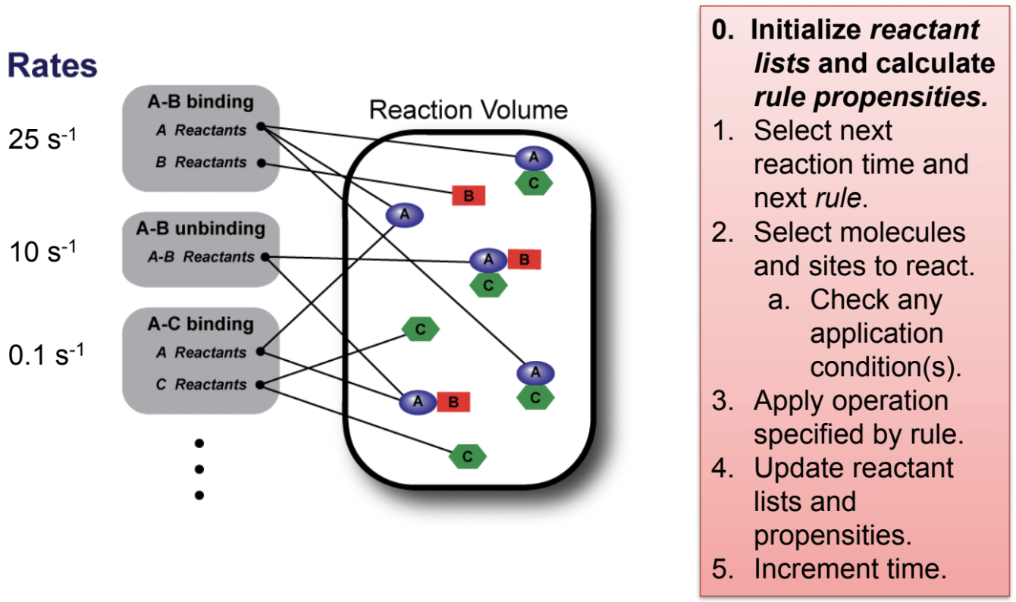
NFsim sidesteps network generation by tracking species on the fly
Sneddon, Faeder & Emonet, Nat. Methods 8, 177–183 (2011)

Slide 4
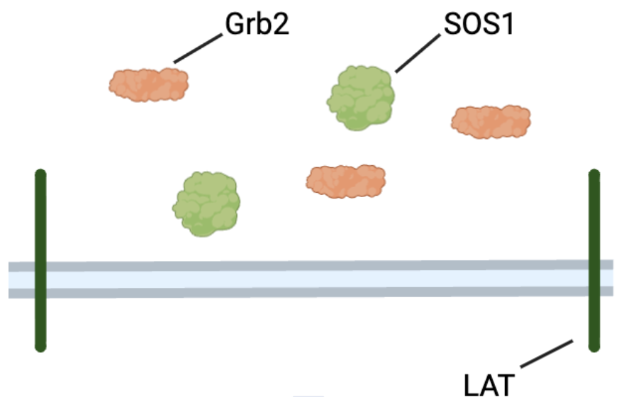
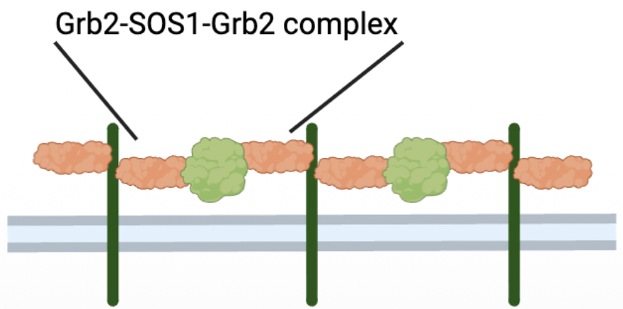
LAT, Grb2, and SOS crosslink into combinatorially many aggregate states
T-cell
Nag, Monine, Faeder & Goldstein, Biophys. J. 96(7), 2604–2623 (2009)

Slide 5
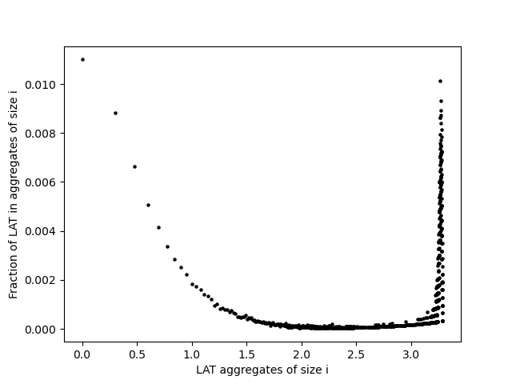
NFsim species file can extract cluster sizes for LAT complex

Slide 6

Modeling every ribosome collision makes a fixed network impossible at any mRNA length
Bottorff, Park, Geballe & Subramaniam, PLoS Genet. 18(10): e1010460 (2022)

Slide 7
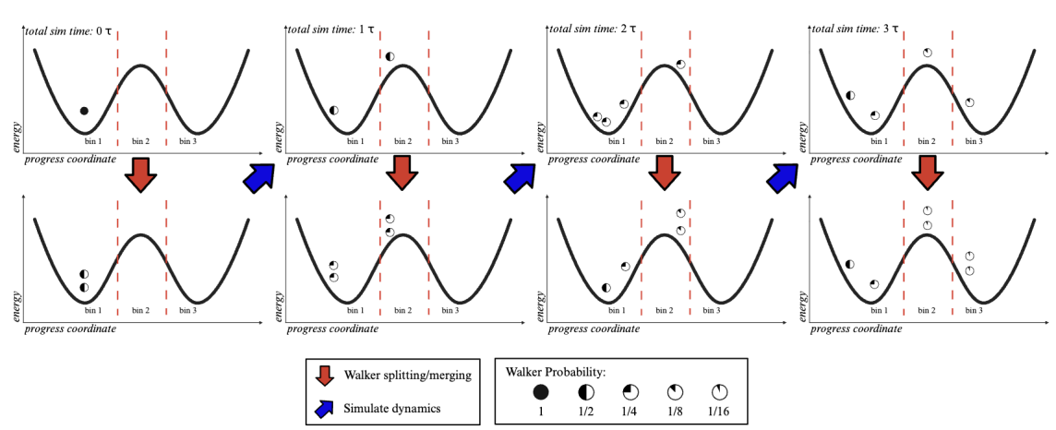


WEBNG runs weighted ensemble of BioNetGen models
RULE BASED MODEL
CONSTRUCTION
RARE EVENT SAMPLING
BioNetGen
WESTPA
Adapted from Donovan, Sedgewick, Faeder & Zuckerman, J. Chem. Phys. 139, 115105 (2013)

