Slide 1
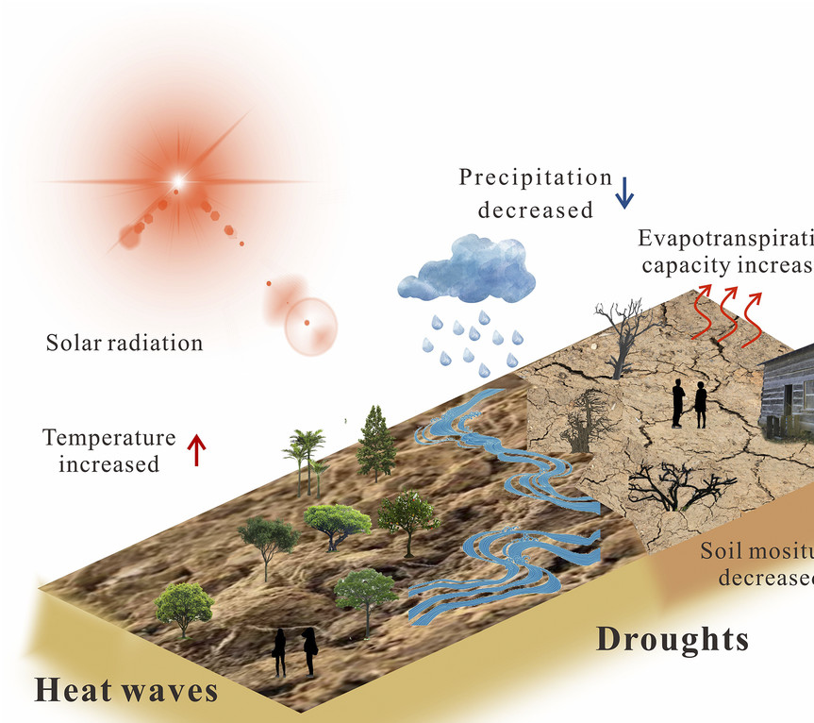
Interactive Visualization of Global
Heatwaves and Drought Patterns
Jegadit Sakthi Saravanan Client: Prof. Akintomide A. Akinsanola, PhD (Earth & Environmental Sciences, UIC) Course: CS 529 - Visual Data Science | Oct 2025

Slide 2



Problem and motivation
2
Understanding long-term patterns is very difficult from raw data.
Current visualizations are static, global, & hard to interpret regionally.
Limited interactive tools focused on global climate trends.

Slide 3
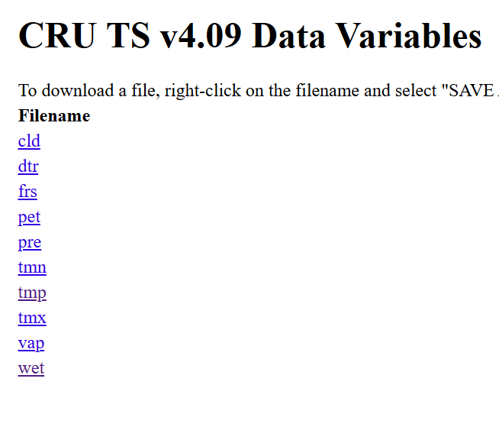
Data and Processing
3
Data: - CRU TS v4.09 (Temp., 1950 - present)
CRU Dataset (Drought anomaly, global)
Processed data from the client
Tech Stack: - D3.js (Interactive visualization)
- JS / HTML / NetCDF / CSV data
- Python (data preprocessing)

Slide 4
Client Requirements and Project Goals
4
Overall, the tool must allow filtering, comparison, and export; helping researchers explore climate extremes intuitively.
The client wants a web based(deployable) interactive system that visualizes Global heatwave trends from 1950 to the present at a country level.
Clicking on any country should reveal its temperature trend over time.
Should also integrate global drought data to analyze intensity, variability, and correlations with heatwaves.
1
2

Slide 5
Thank you
5

Slide 6
Appendix 1: Deliverables: Timeline
6
Timeline & Next Steps
Weeks 1-2: Data collection & preprocessing
Weeks 3-4: D3 map + spiral prototype
Week 5: Global drought integration
Week 6: Refinement & probe analysis
Week 7: Final presentation & report

Slide 7
Appendix 2: Visualization Design
7
Interactive Map: Hover → intensity color; Click → spiral view.
Spiral Chart: Shows yearly temp rise from 1950–present.
Global Drought Map: Displays deviation intensity overlay.
Expected Impact:
Help researchers explore spatial-temporal climate patterns.

