Slide 1

“Remit Management System”
Project Member:
Name :Rulson Joshi
Rollno : 24
Department of ICT, Mega National College

Slide 2
Introduction
This project aims at serving individuals who need to send money internationally by digitizing the remittance process.
It mainly focuses on facilitating secure cross-border fund transfers.
This system will make the overall billing system easy, comfortable and effective for consumers.
It offers real-time currency conversion and live exchange rate updates for better transfer decisions.
This system will make the overall money transfer experience fast, transparent and convenient for users.
Department of Computer Application, Mega National College

Slide 3
Objectives
The Objectives of this project are
To automate the process of international money transfers.
To maintain accurate records of beneficiaries and their bank details for seamless transactions.
To reduce manual errors and improve the accuracy of fund transfers.
To make cross-border remittance management faster, simpler and more organized.
Department of Computer Application, Mega National College

Slide 4
Scope of Project
The Scope of the project is :
It provides a secure platform for real-time currency conversion and exchange rate tracking.
The application supports multiple recipients, allowing users to manage several beneficiaries for recurring transfers.
The project can be used by individuals and businesses for managing international money transfers between Australia and Nepal.
Department of Computer Application, Mega National College

Slide 5
Tools Used
Frontend (Mobile App): Flutter (Dart)
Backend : PHP
Database: MySQL
Development Environment: Visual Studio Code, Android Studio, X-Code
Department of Computer Application, Mega National College

Slide 6
Methodology(Agile Model )
Work is done in small sprints
First, basic features like user registration, login and PIN setup are developed and tested.
In the next sprints, features like recipient management, currency conversion and money transfer are added gradually.
Each increment is tested and improved before adding the next feature.
Department of Computer Application, Mega National College

Slide 7
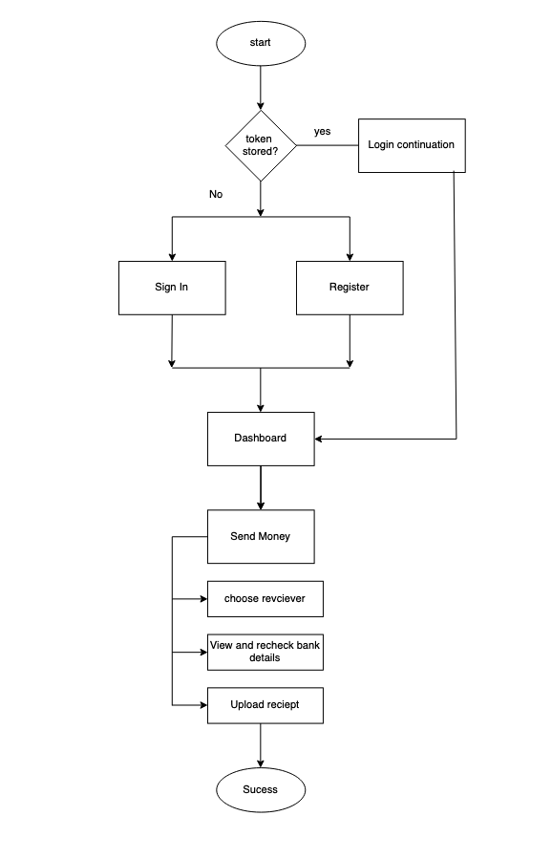
Methodology(Flow Chart)
Department of Computer Application, Mega National College

Slide 8
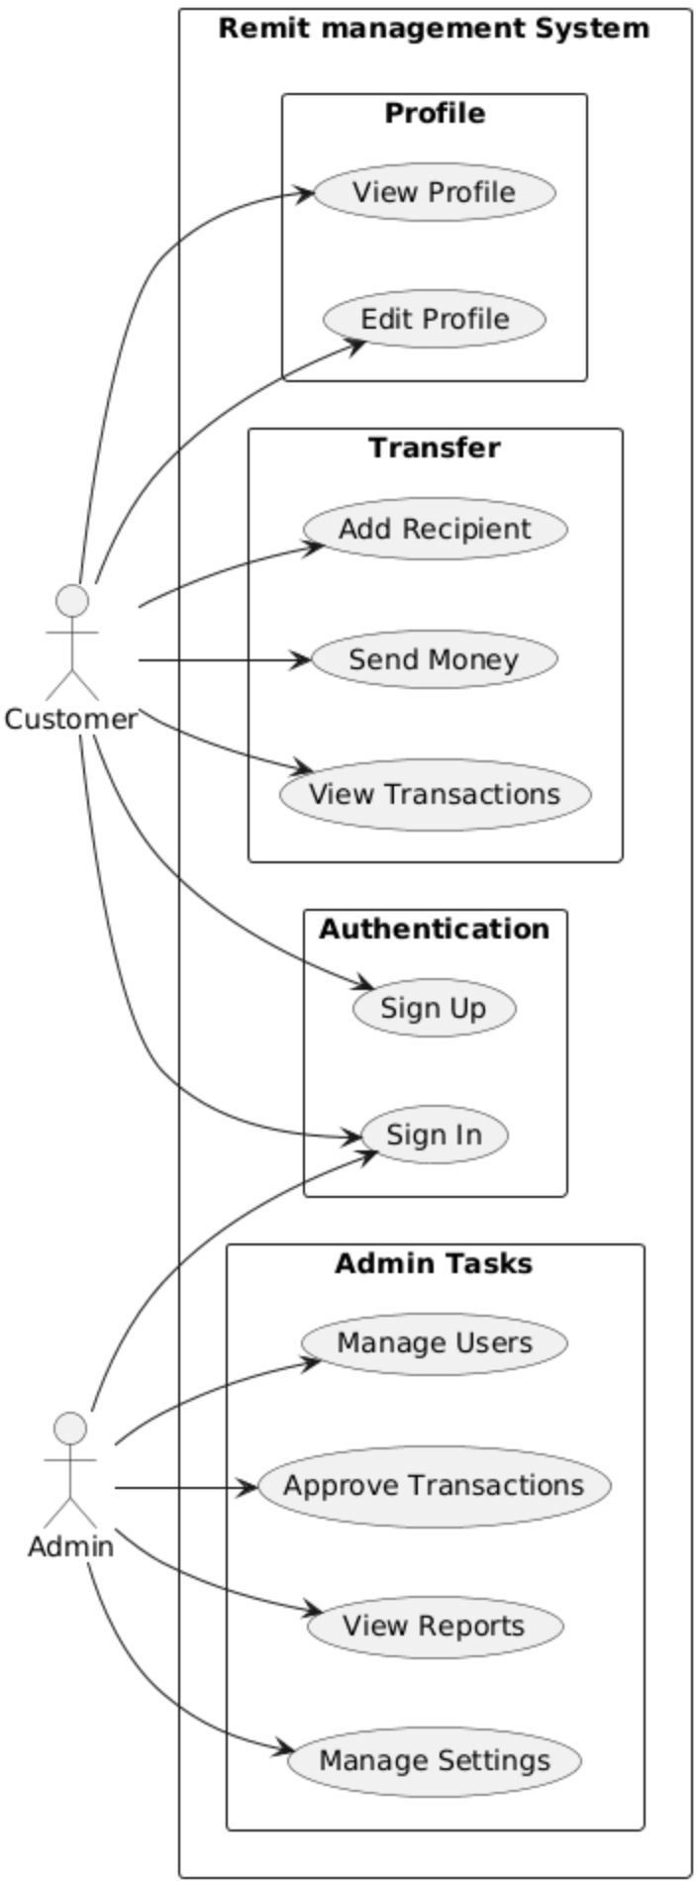
Methodology(Use Case)
Department of Computer Application, Mega National College

Slide 9
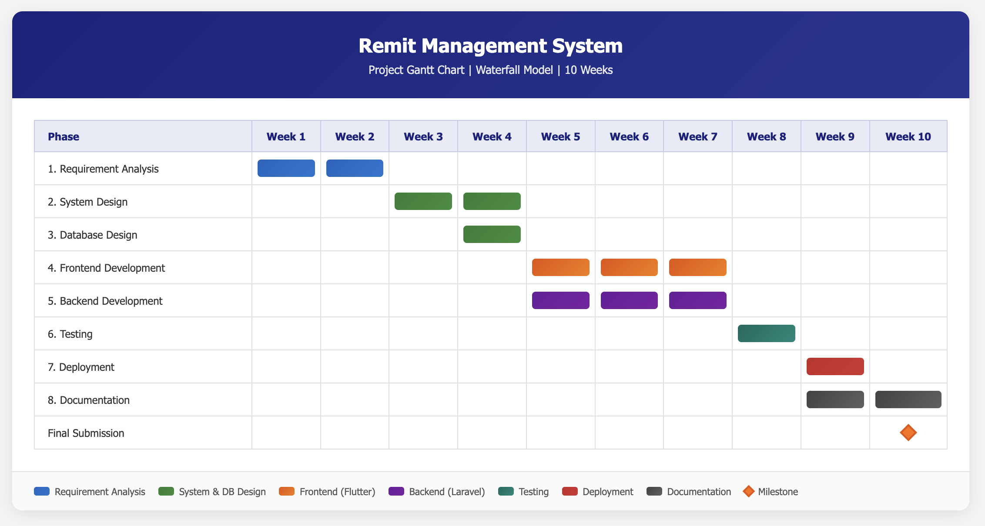
Project Timeline
Gantt Chart of the project
Department of Computer Application, Mega National College

Slide 10
Expected Outcome
The expected outcome of this project is the development of a secure, cross-platform mobile application for managing international money transfers. Users can register, verify their accounts, manage beneficiaries and initiate transfers through a simple 4-step process. The system provides real-time currency conversion, live exchange rates and transparent fee calculations. Users can track their transaction history and view detailed receipts in real time. The project demonstrates the practical application of software development, API integration, database management and testing skills acquired during the BCA program.
Department of Computer Application, Mega National College

Slide 11
References
1 Elmasri, R., & Navathe, S. B. (2016). Fundamentals of Database Systems (7th ed.). Pearson.
2 Fioravanti, M. (2020). Flutter Complete Reference: Learn Dart, Widgets, App Development and Publish to Stores. Leanpub
Department of Computer Application, Mega National College

Slide 12
Thankyou
Department of Computer Application, Mega National College

