Slide 1
Heroin overdose prediction for Mesa
APP designed for Naloxone Distribution
Rui Jiang, Jingyi Cai
MUSA 508

Slide 2
Opioid Overdose Background
01
Opioid-involved overdose claimed the lives of 90 Americans per day in 2015, rising to a staggering 137 per day in 2019
02
Due to the difficulty of monitoring the continually evolving illicit drug supply and rapidly changing overdose risk environment, proactive interventions focused at the community level.
03
These including naloxone distribution, street outreach, expansion of opioid use disorder (OUD) treatment services, and provision of mobile and low-threshold OUD treatment, have become more important than ever

Slide 3
Naloxone
Naloxone is a medicine that rapidly reverses an opioid overdose.
Families with loved ones who struggle with opioid addiction should have naloxone nearby; ask their family member to carry it; and let friends know where it is. People should still call 911 immediately in the event of an overdose.
Naloxone is being used more by police officers, emergency medical technicians, and non-emergency first responders than before. In most states, people who are at risk or who know someone at risk for an opioid overdose can be trained on how to give naloxone.

Slide 4
APP: Naloxone Distribution Project (NDP) Helper
Public Health Officials
notice the possibility of a shortage of naloxone as a prevention resource for each provider (based on the prediction).
They could edit the page for each provider for offering more details.
Residents
check the provider near them by navigating the map to their area.
They could then contact the provider directly by phone to arrange a free naloxone pick-up.
They could request more Naloxone on the app.

Slide 5
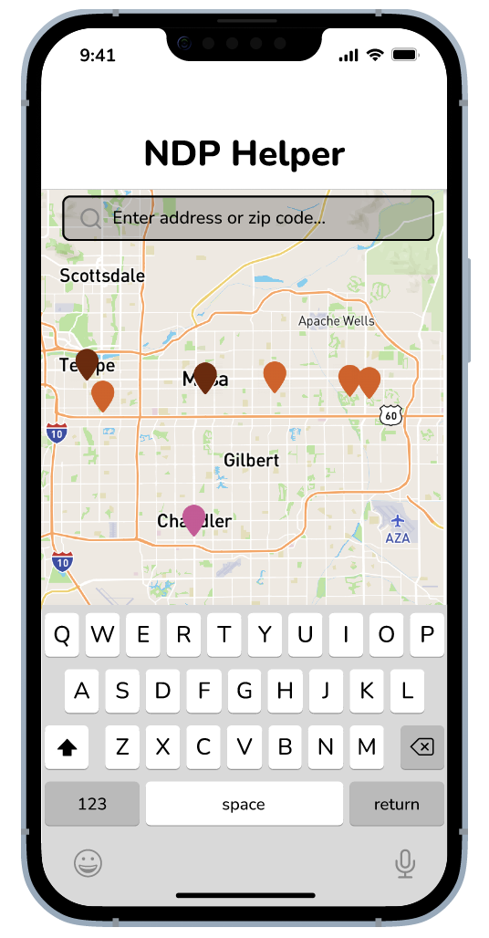
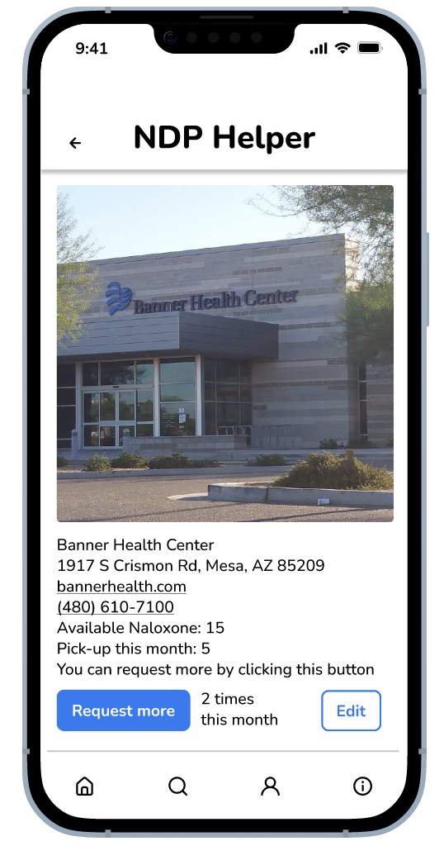
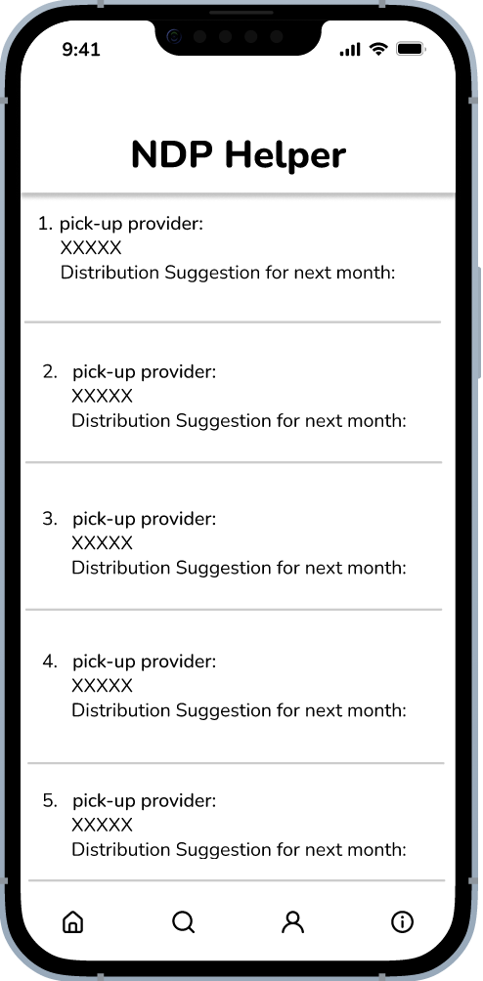
User: Public Health Officials

Slide 6
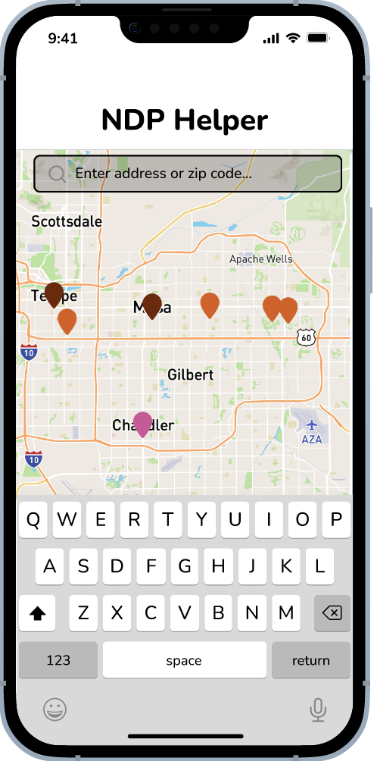
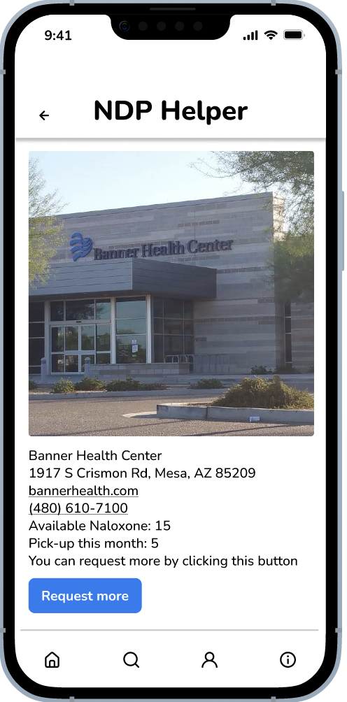
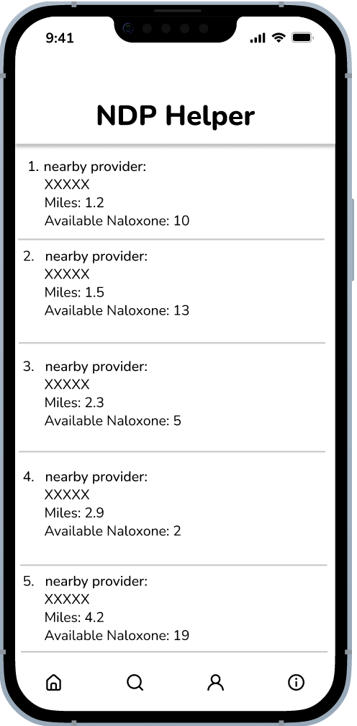
User: Residents

Slide 7
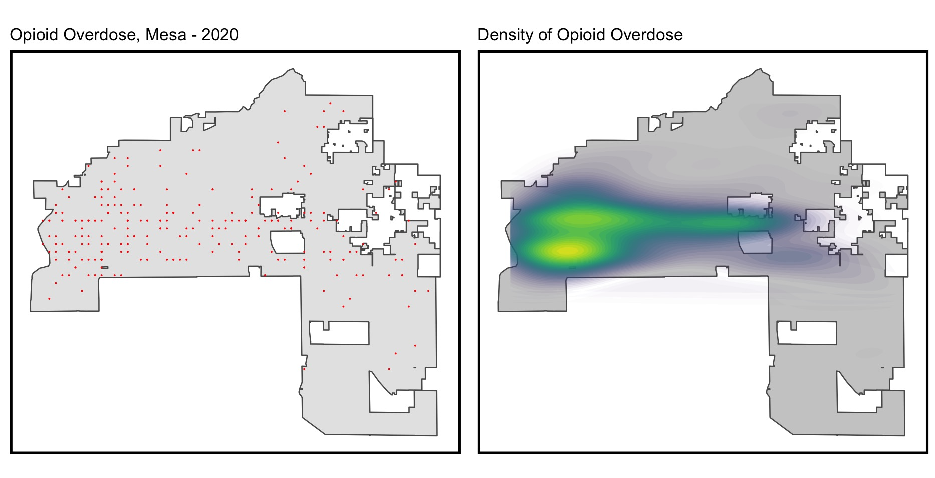
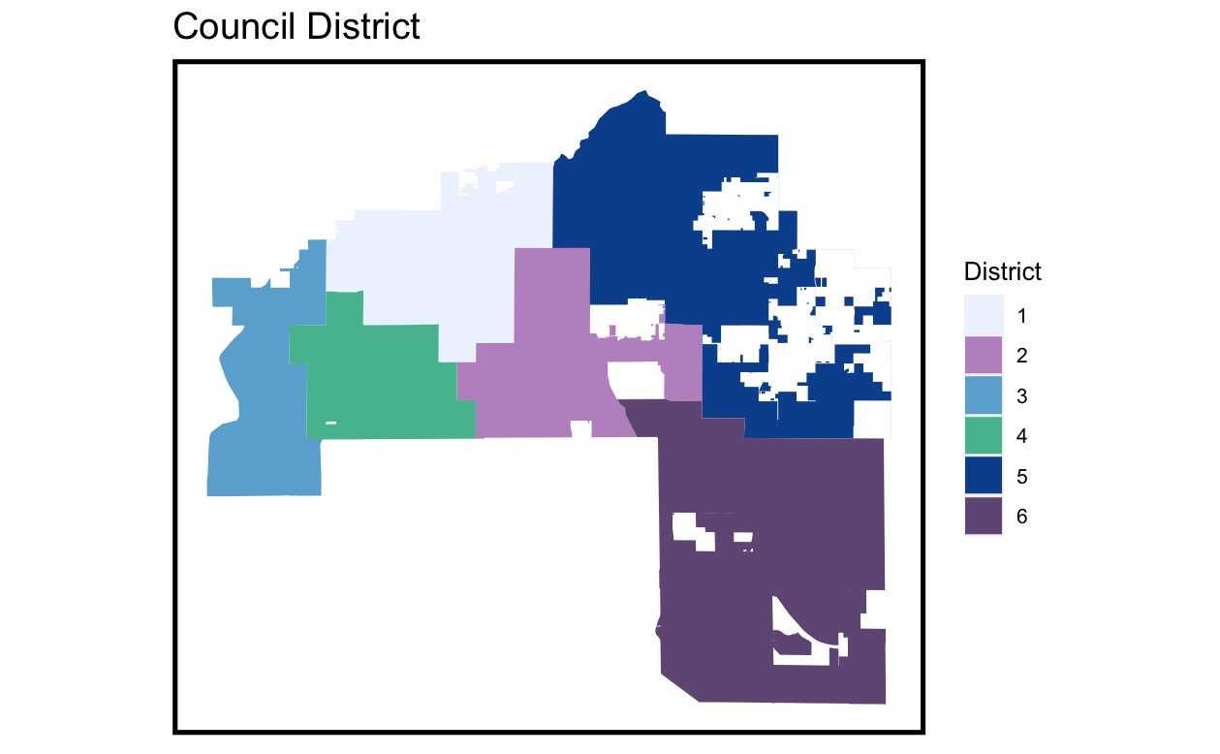
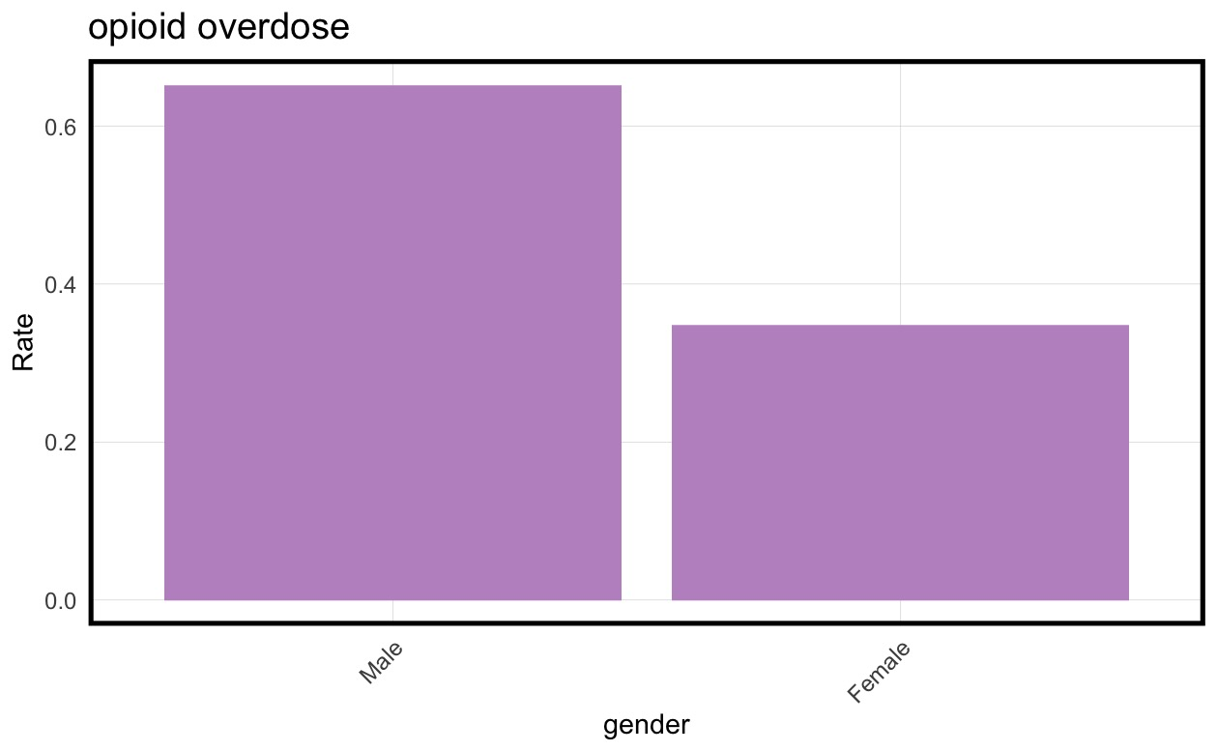
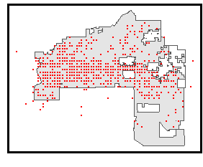
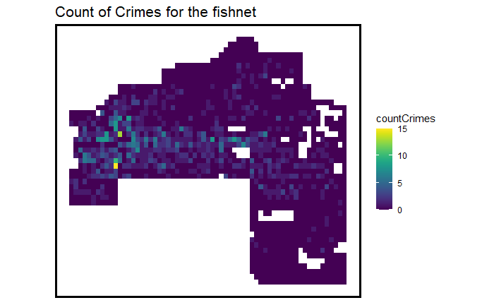
Data Exploration
Overdose in Mesa 2020
01
02
Overdose data & count map - all

Slide 8
Data for Machine Learning
Dependent Variable
02
01
Independent Variable
Heroin Overdose in 2020
Risk Factors:
Un_Sheltered“,”Trans_graffiti”, Plc_incidence", "Plc_dispatch", "Code_violation”
Amenities:
"Park", "Light", "Rail_station"
Fishnet
ACS data:
"pctWhite", "pctBachelors", "pctPoverty", "MedHHInc", "MedRent", "Familyincome"

Slide 9
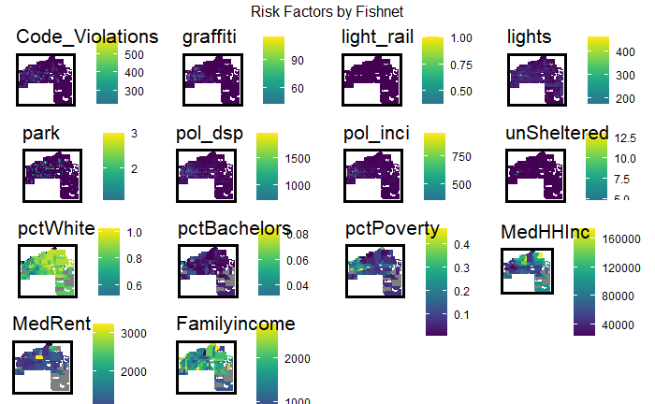
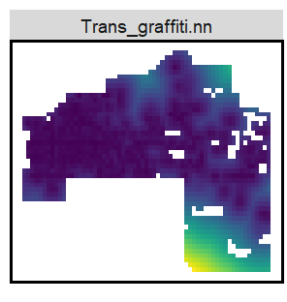
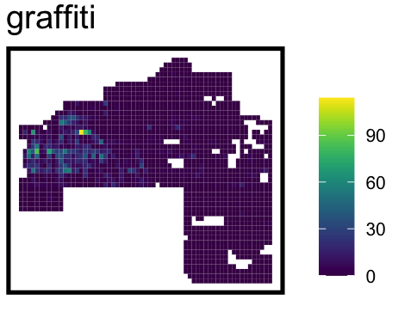
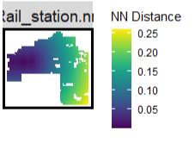
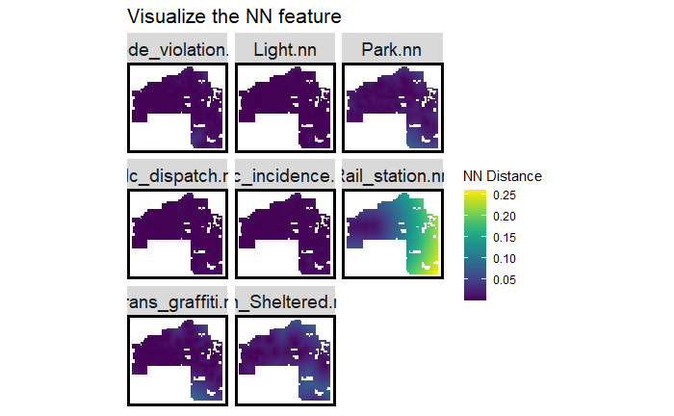
Engineering Features
Risk Factors:
nn_function
Amenities:
nn_function
ACS data:
Connect to Fishnet

Slide 10
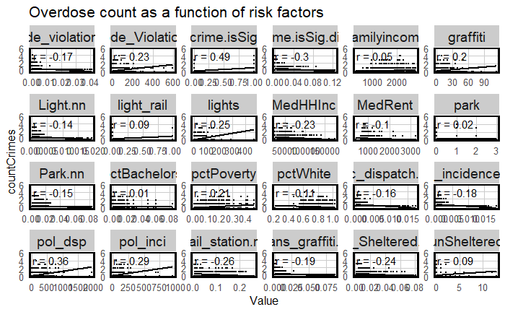
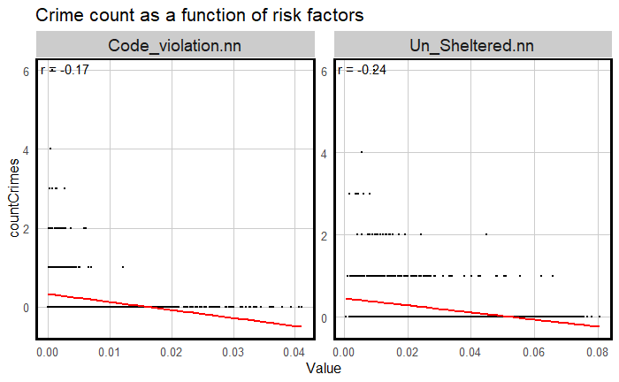
Geospatial risk modeling
We will use geospatial risk model which is a regression model, Predictions from these models are interpreted as ‘the FORECAST RISK /opportunity of that event occurring here’.
The goal is to borrow the experience from places where crime is OBSERVED and test whether that experience generalizes to places that MAY BE AT RISK, even if few events are reported.

Slide 11
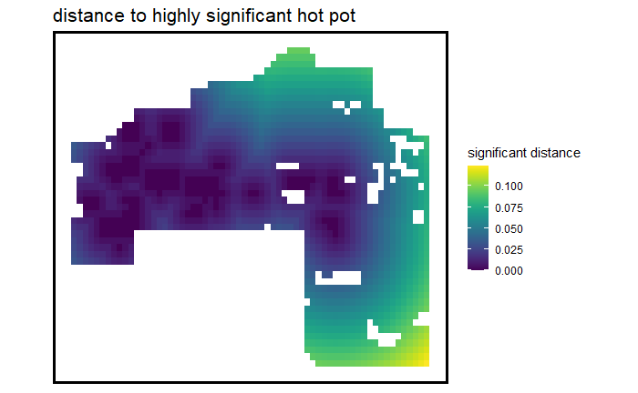
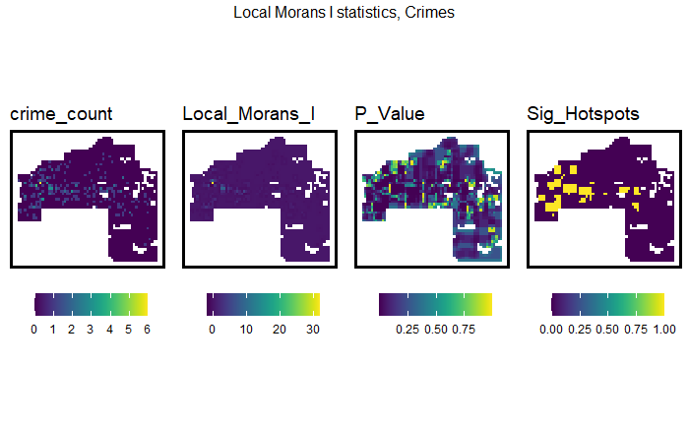
Spatial Process： Moran’ I
Local Moran’s I-related

Slide 12
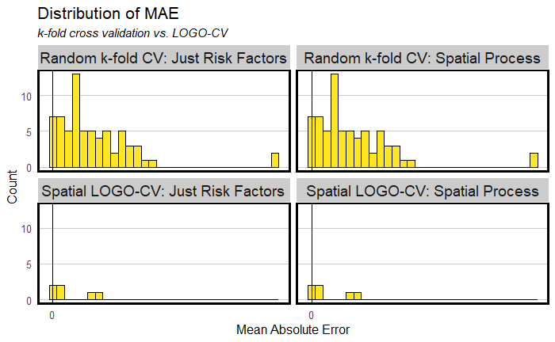
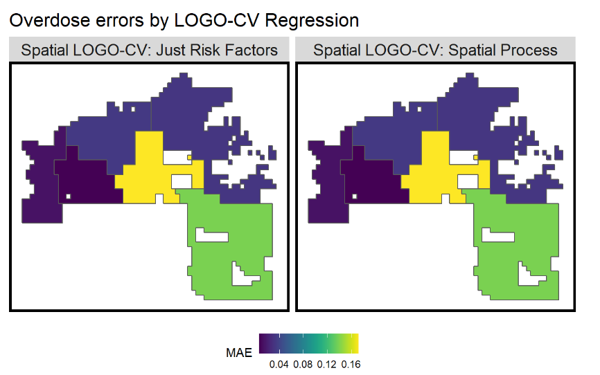
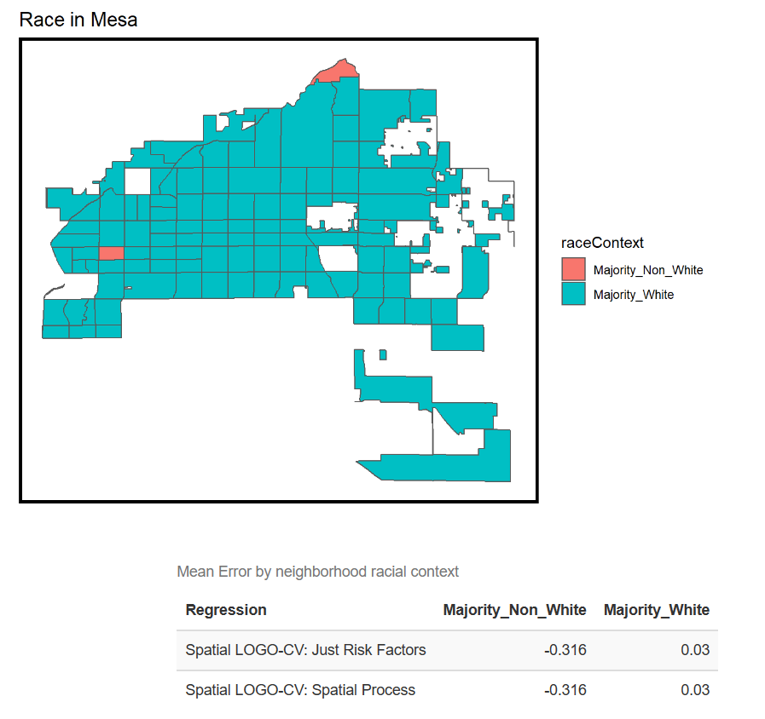
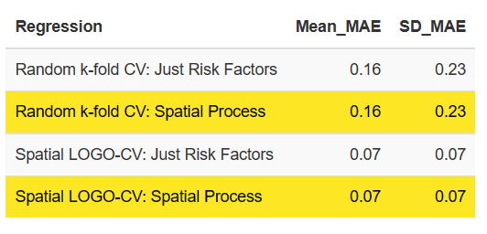
Spatial Process : CV, Accuracy & Generalizability
Accuracy
Generalizability

Slide 13
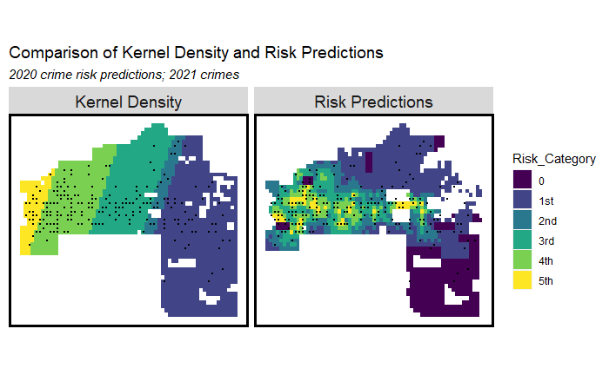
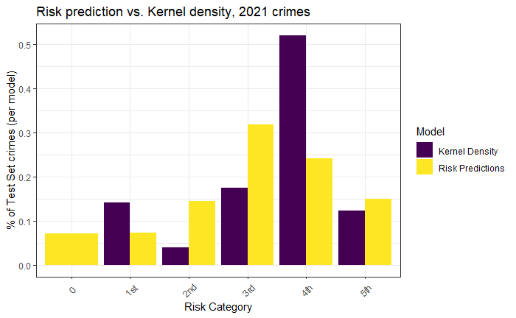
Results

Slide 14
Bias & Conclusion
Bias:
Conclusion: Useful but need more improvement.
Reported Bias: We used the reported heroin overdose data. However, more crimes are ‘reported’, and more risk is predicted. Some areas may simply have more reports of heroin overdoses due to more surveillance, rather than a high number of heroin overdoses in the area itself.
Observation Bias: heroin overdose are often unobserved because somebody overdosing on heroin is frequently not arrested or sent to hospital - we only observe the event when there is an incident or a police presence.
Improvement:
More factors:
such as hospitals and schools
More overdose services by prediction：
We recommend, based on the prediction map, distributing more naloxone to syringe services programs, substance Use Treatment, substance use prevention coalitions, recovery meetings, recovery housing, library, health department, food bank…

