Slide 1
Module 3 Project
An Exploration of Congressional Voting Behaviour
Kyle Hayes
Ramin Ostad
Last Update: Aug 2019

Slide 2
Key Questions:
High Level Objective: Explore voting patterns among members of Congress over time to understand what factors impact abstain votes and yes/no votes
Questions Phase I:
Abstain votes
Are candidates of either party more likely to abstain from voting?
Are members of either chamber more likely to abstain?
Yes Votes
Are candidates of either party more likely to vote Yes?
Are candidates of either party, within the House, more likely to vote Yes?
Are candidates of either party, within the Senate, more likely to vote Yes?
Based on these questions, we will formulate next step questions to further understand voting behaviour

Slide 3
Methodology:
Data Source: ProPublica.org API
Range: January, 1993 to present
Methodology:
Determined percentage by dividing vote categories (yay, abstain) for each party against total party members present
Compared lists of percentage sample means
Two-sided t-test, alpha = .05

Slide 4
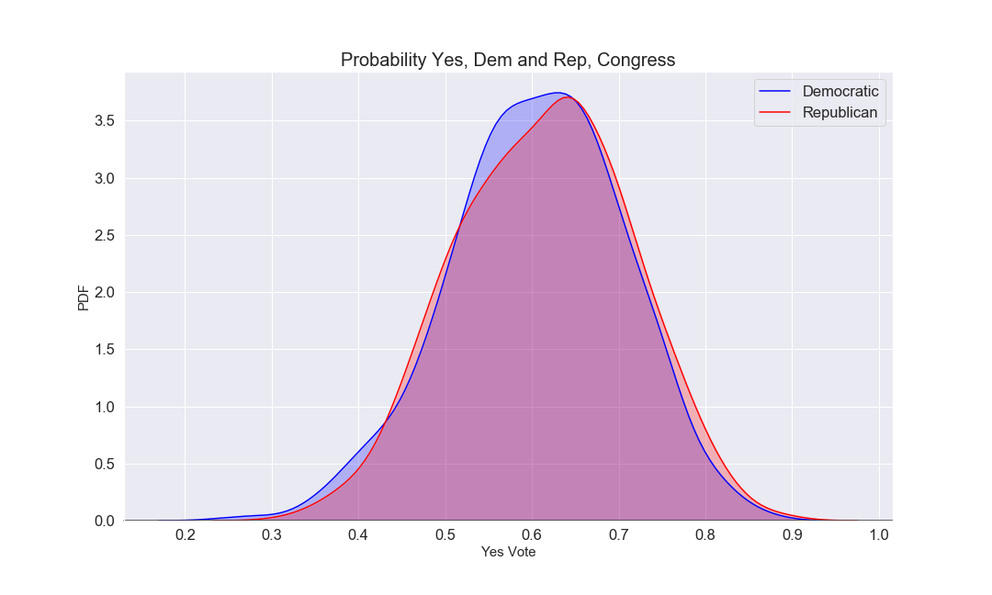
Probability Yes - Democrat and Republican - Congress
Do not reject H₀ that Dem and Rep have the same prob(yes) in Congress since 1992
p-value | 0.0472
effect (d) | 0.0888
power | 0.5100
Notes:
Source: Admissions training presentation and FAQ (July 2019)

Slide 5
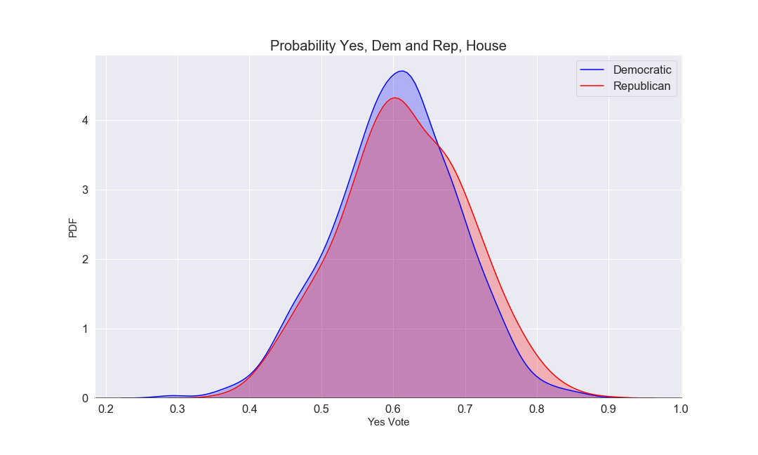
Probability Yes - Democrat and Republican - House
Reject H₀ that Dem and Rep have the same prob(yes) in House since 1992
p-value | 0.6974
effect (d) | 0.0173
power | 0.0674
Notes:
Source: Admissions training presentation and FAQ (July 2019)

Slide 6
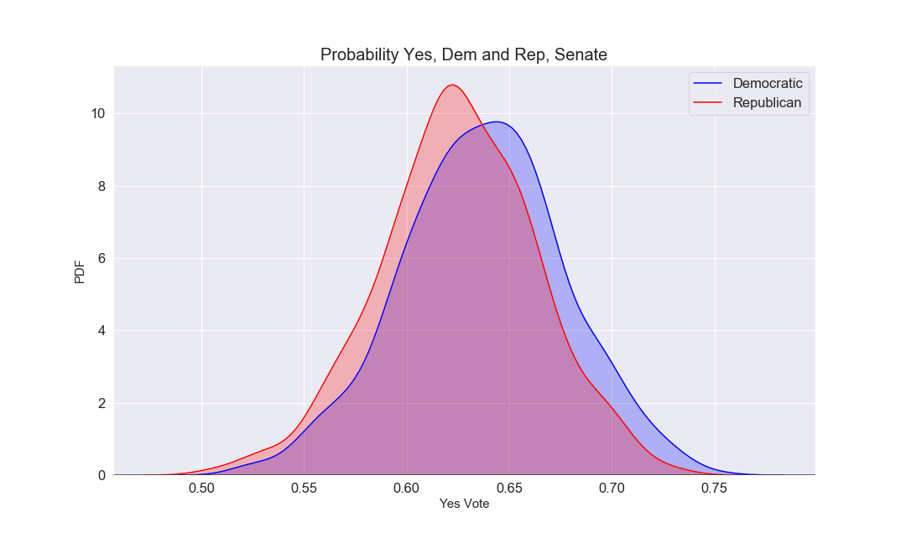
Probability Yes - Democrat and Republican - Senate
Reject that H₀ that Dem and Rep have the same prob(yes) in Senate since 1992
p-value | 0.7622
Effect (d) | 0.0135
power | 0.0605
Notes:
Source: Admissions training presentation and FAQ (July 2019)

Slide 7
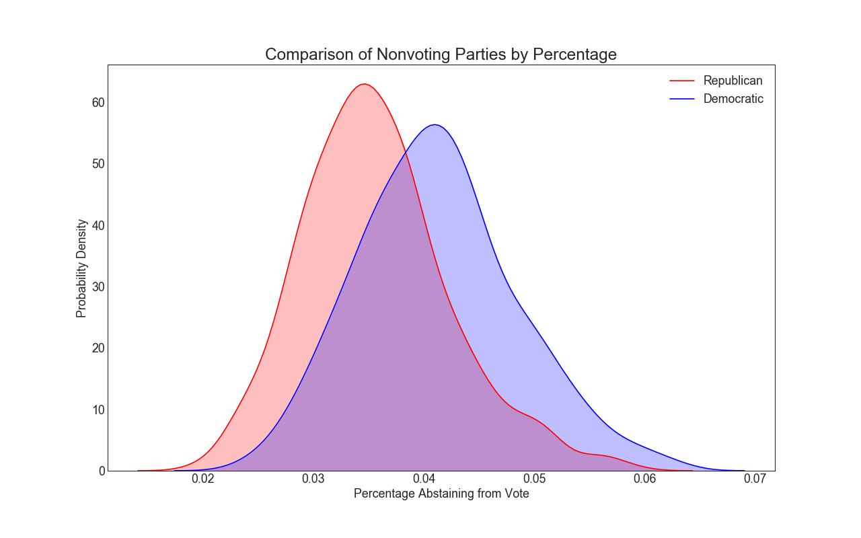
Probability Abstain - Democrat and Republican - Congress
Reject H₀ that Dem and Rep have the same prob(abstain) in Congress since ‘92
p-value | 1.72e-34
Effect (d) | 0.805
power | 1.0
Notes:
Source: Admissions training presentation and FAQ (July 2019)

Slide 8
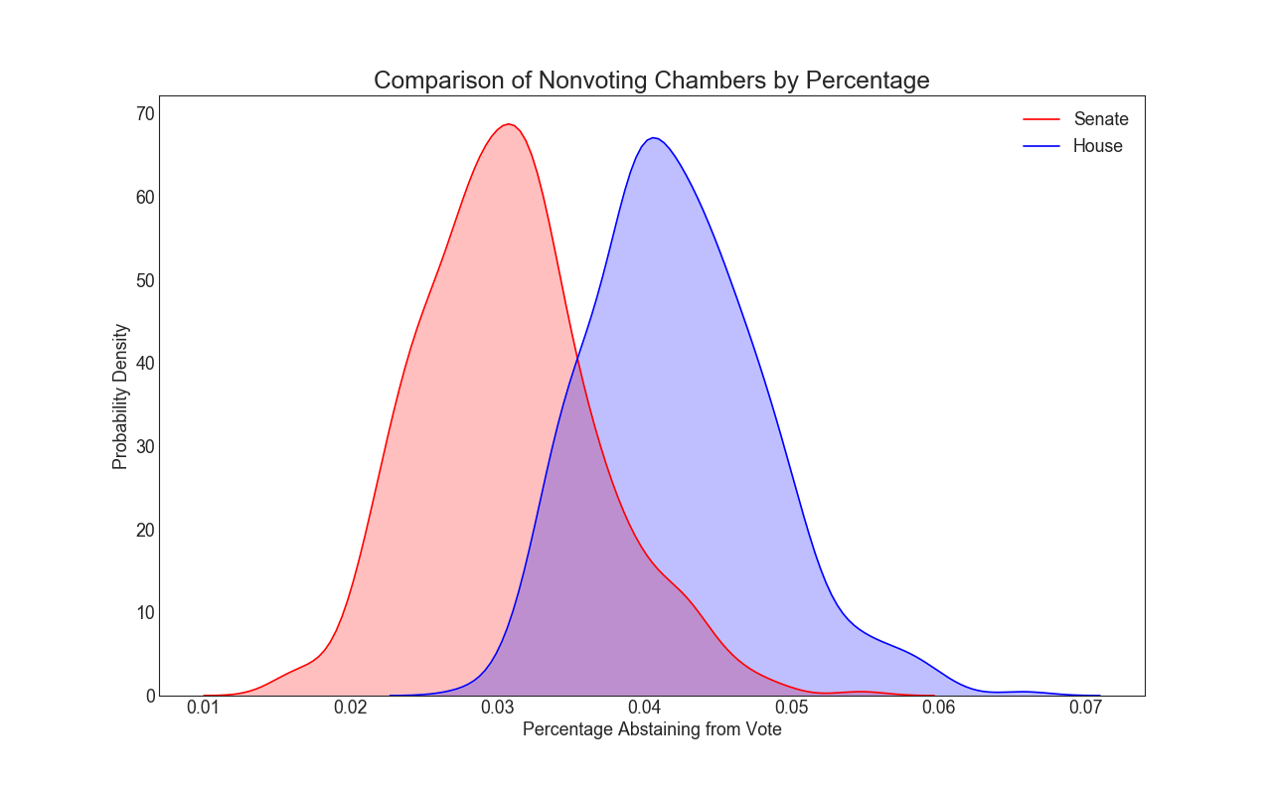
Probability Abstain - Senate and House
Reject H₀ that Senate and House have the same prob(abstain) in Congress since ‘92
p-value | 3.1e-148
Effect (d) | 1.96
power | 1.0
Notes:
Source: Admissions training presentation and FAQ (July 2019)

Slide 9
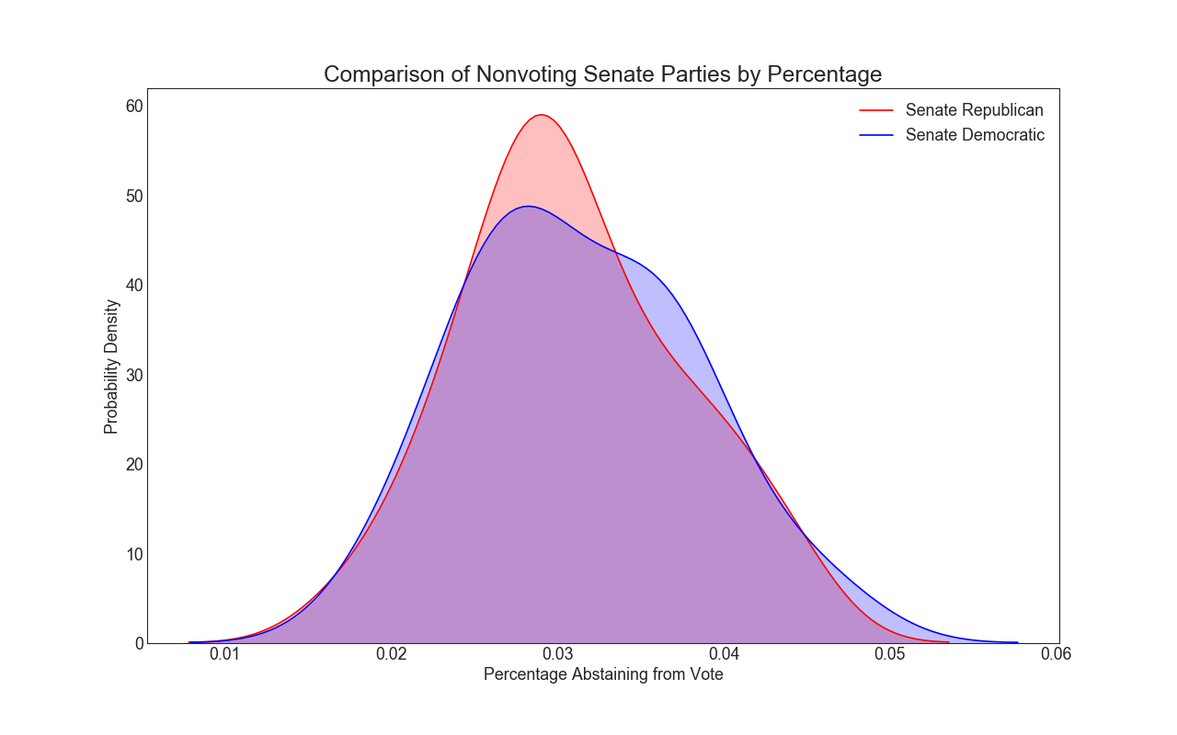
Probability Abstain - Senate Republicans and Democrats
Fail to Reject H₀ that Senate parties have different prob(abstain) since ‘92
p-value | .63
Effect (d) | -
power | -
Notes:
Source: Admissions training presentation and FAQ (July 2019)

Slide 10
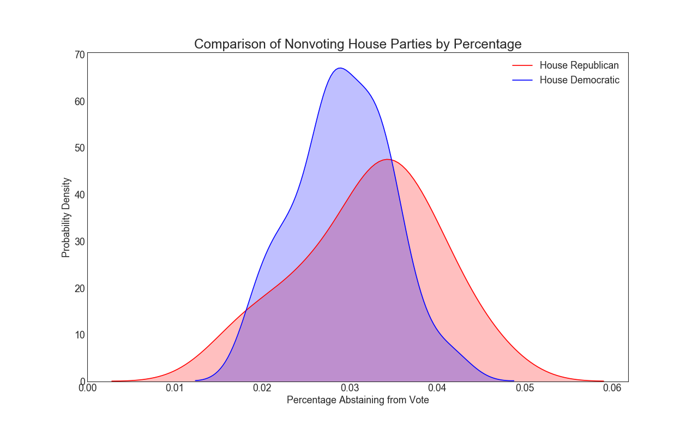
Probability Abstain - House Republicans and Democrats
Fail to Reject H₀ that House parties have different prob(abstain) since ‘92
p-value | 1.11e-07
Effect (d) | 1.56
power | 1.0
Notes:
Source: Admissions training presentation and FAQ (July 2019)

Slide 11
Recommendations & Limitations

Slide 12
Further Research and Next Steps
Further Research:
Our current research points out areas that are and are not significant. Key findings are that major differences between parties are not seen in the probability yes between parties.
Both Democrats and House Members were most likely to abstain from voting.
The house Republicans had the largest variance in abstain votes.
Next Step Questions
Does Party in Power of Chamber impact voting?
Does topic of bill impact votes?
How has votes changed over time?
Does the type of motion impact votes?

Slide 13

Thank You!

