Slide 1

MANUFACTURING ANALYTICS
PROJECT: P1068 ​

Slide 2
INTRODUCTION
Domain:
Manufacture
Business Problem: The manufacturing process is producing inconsistent quality. This leads to increased waste, higher rework costs, and reduced operational efficiency.
Goal:To improve manufacturing quality and consistency by identifying and addressing the root causes across different areas, reducing waste and rework, increasing usable output, enhancing overall production efficiency .

Slide 3
DATA OVERVIEW
File:
Manufactured analytics. Xlsx
Size:
6431 rows across 64 columns
Key columns:
Manufactured Qty, Processed Qty, Produced Qty, Rejected Qty, Wastage Percentage,Doc date .
Aggregation:
Total Manufactured Qty , Total Processed Qty , Total Rejected Qty , Total Wastage Qty

Slide 4
OBJECTIVES : KPI
Manufactured Qty
Processed Qty
Rejected Qty
Wastage Qty
Employee Wise Rejected Qty
Department Wise Rejected Qty
Machine Wise Rejected Qty
Production Comparison trend

Slide 5
PROCESS
Insight Extraction
Visualization (Power BI)
KPI Creation
Data Transformation
Data Cleaning
Data Collection

Slide 6
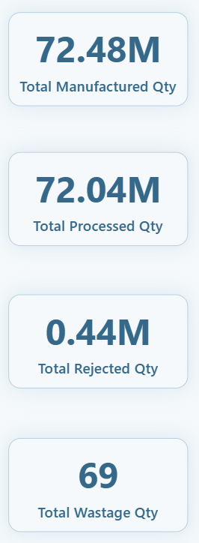
ANALYSIS 1
A strong output of 72M units reflects highly efficient and consistently stable manufacturing operations.
An impressive 72.04M units processed qty showcases exceptional throughput and well-optimized production flow.
A minimal rejection volume of 0.44M highlights effective quality control and reliable process performance.
With only 69 units wasted, the process demonstrates outstanding material efficiency and precision.

Slide 7
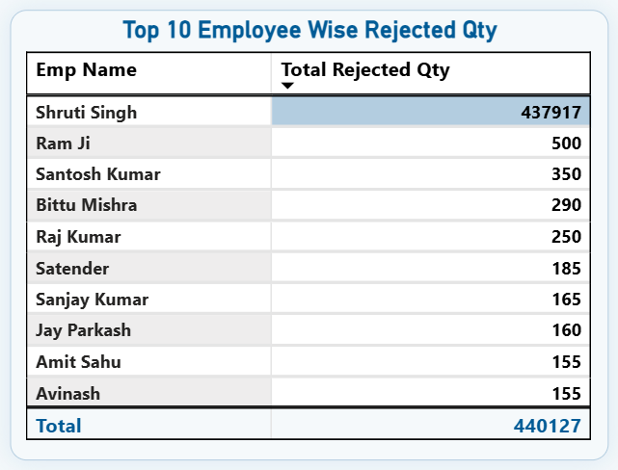
ANALYSIS 2
EMPLOYEE WISE REJECTED QUANTITY
The employees contributing the highest volume of rejected units. Shruti Singh shows a significantly higher rejection count compared to others, indicating a potential skill, process adherence, or workload imbalance issue.
Need for targeted training, process review, or quality monitoring to reduce overall rejection rates.

Slide 8
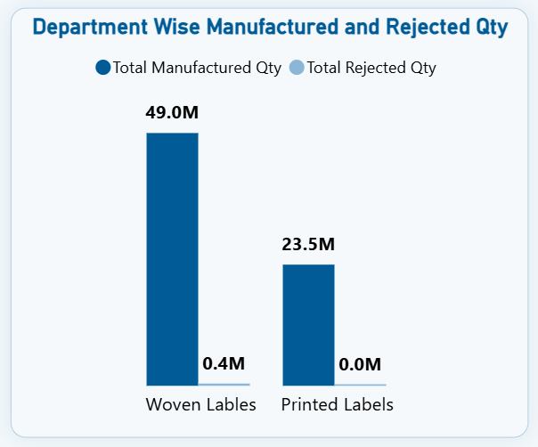
ANALYSIS 3
DEPARTMENT WISE REJECTED QUANTITY
Woven Labels department leads in production output but also contributes the majority of total rejections, indicating higher complexity or quality challenges in this segment.
Printed Labels, on the other hand, shows minimal defects, reflecting more stable or efficient processes. These insights can guide department-level process improvement strategies.

Slide 9
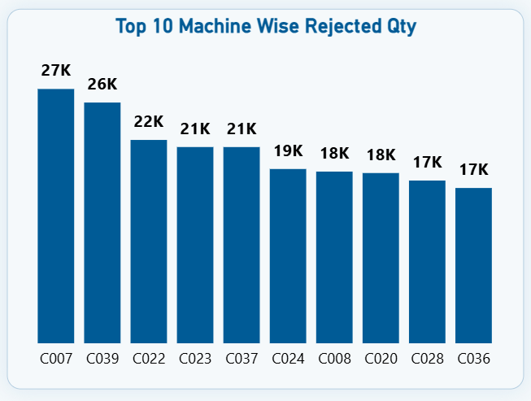
ANALYSIS 4
MACHINE WISE REJECTED QUANTITY
Top 10 machines show rejects ranging from 27K to 17K. C007 and C039 lead with the highest rejections, followed by C022, C023, and C037 (21–22K). Remaining machines fall between 17–19K. Overall, the top 10 machines show significant variation and highlight key focus areas for reducing total rejects.

Slide 10
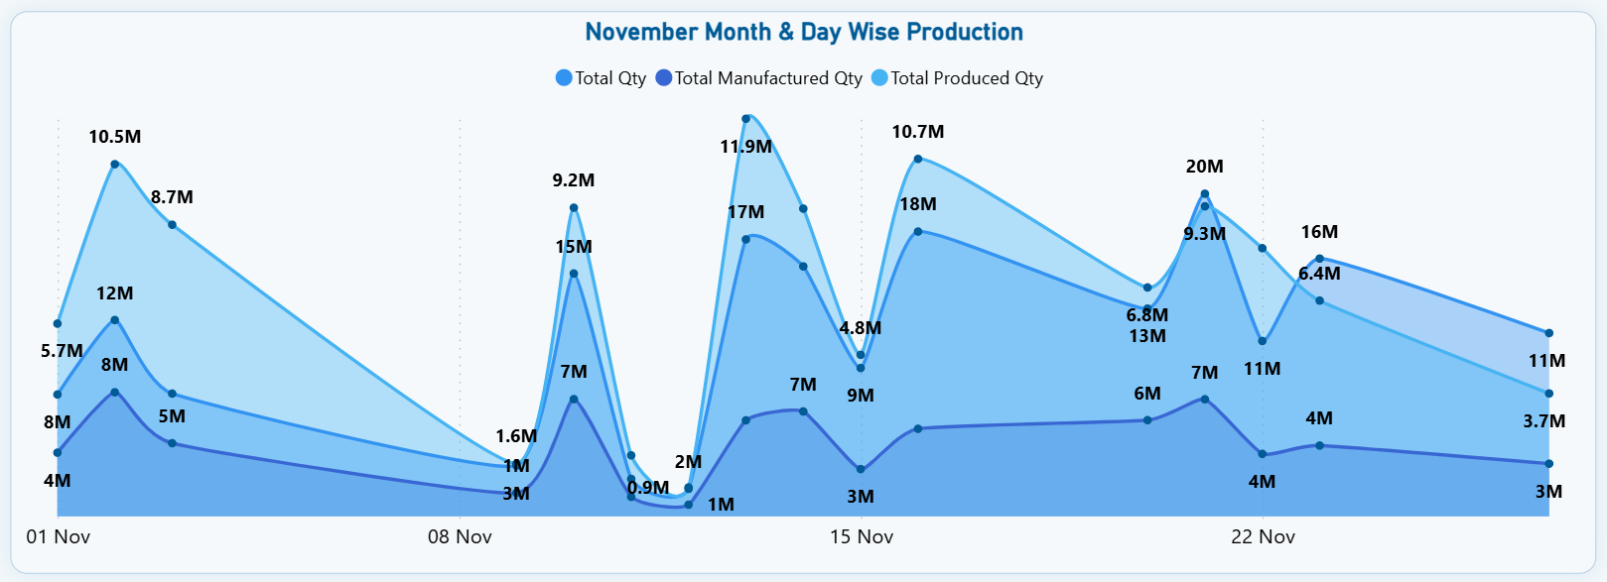
ANALYSIS 5
PRODUCTION COMPARISON TREND
Production shows sharp fluctuations across November. Peak outputs occurred on 1st (10.5M), 14th (11.9M), and 21st (10.7M), while significant drops happened around 7th–8th and 28th Nov. Manufactured Qty and Produced Qty follow the same pattern, indicating consistent process flow but unstable daily performance. Overall trend shows strong peaks followed by sudden dips — suggesting machine downtime, material issues, or shift variations.

Slide 11
Recommendations
Maintenance and calibration check: For high-reject machines, schedule maintenance or inspect them.
Train staff: Based on operator performance data, identify knowledge gaps, re-train
Set targets & continuous improvement plan: Aim to reduce reject rate from over next quarter, monitor weekly. Use dashboard to track progress publicly within teams.
Institute root-cause tracking and feedback loops: Whenever rejects occur, capture defect type , cause , corrective action, feed that back to operators, maintenance teams, and management.

Slide 12
INSIGHTS
Total manufactured quantity : 72.48 M units.
Total processed quantity: 72.04 M so most manufactured units are processed.
Total rejected quantity: 0.44 M units.
Total Wastage Qty : 69 relatively small compared to totals.
A breakdown of rejections by employee shows one outlier one employee with 437,917 rejects far above others with 500, 350.
Top 10 machine-wise rejected qty: shows some machines with high reject counts like “C007” at 27k rejects, then others 26k, 22k.
Department wise rejected shows that Woven Labels produces a very large share of total output but also results in the bulk of rejects where as Printed labels has much lower rejects relative to its output.
overall reject rate is low about 0.6% of total production, the rejects are highly concentrated in a few machines and a very few employees.

Slide 13
CONCLUSION
Overall production performance remained strong, but quality-related issues need focused attention.
The majority of rejections were concentrated in a few machines and operators, making corrective actions easier to target.
Enhancing training, strengthening machine maintenance, and improving planning can significantly reduce rejections.
With targeted improvements, the company can further stabilize production and improve operational efficiency.

Slide 14
CHALLENGES
Cleaning and preparing the data took more effort than expected. We had to identify essential columns and create accurate calculated fields using formulas.
Understanding the dataset was a key challenge. We spent time learning what each column represented and how they connected to the KPIs.
Building the dashboard required several refinements. Choosing suitable visuals and arranging them clearly took multiple iterations.

Slide 15
LEARNINGS
Gained strong skills in data cleaning and transformation using Excel and MySQL.
Improved Power BI skills for creating KPIs, visuals, and interactive dashboards.
Understood the importance of data standardization and documentation.
Enhanced teamwork, communication, and problem-solving during real project challenges.

Slide 16
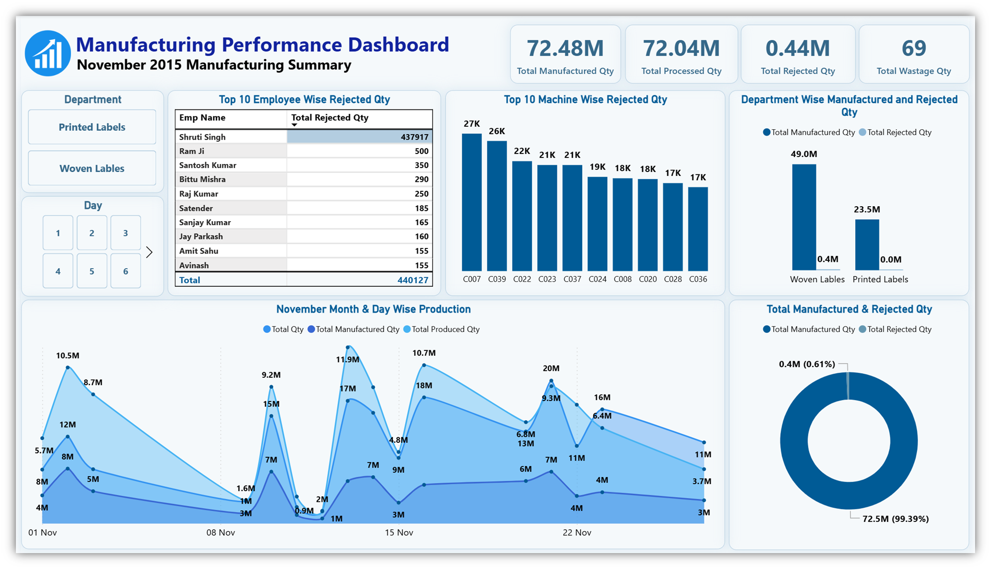

Slide 17
Thank You

