Slide 1
Clinic Patients Record Analysis

Slide 2
Agenda
1. Project Overview
2. Dataset Structure
3. Key KPIs
4. Patient Demographics
5. Appointment Analysis
6. Insights & Findings
7. Recommendations
8. Conclusion

Slide 3
Project Overview
This analysis provides insights into clinic patient records, including patient demographics, appointment behavior, and overall clinic performance.

Slide 4
Dataset Structure
user_id
clinic_name
clinic_email
date_of_birth
doctor_gender
user_created_at
registration_id
patient_full_name
patient_gender
patient_date_of_birth
age text clinic_id
appointment_created_at
doctor_name_clinic
Continent/country_name/region

Slide 5
Key KPIs
• Total Patients
• Total Appointments
• Total Doctors
• Male vs Female Patients
• Patients by Age Group
• Patients by Clinic
• Appointments by Clinic
• Average Patient Age
• Country / Region Distribution

Slide 6
Patient Demographics Insights
• Gender distribution
• Patient Age Distribution
• Clinic Performance by Location
• Doctor Performance
• Region / Country distribution

Slide 7
Appointment Analysis
• Appointments
• Peak appointment times
• Repeat patient visits
• Clinic performance comparison
• Appointment Distribution by Gender
• Appointment Patterns by Doctor

Slide 8
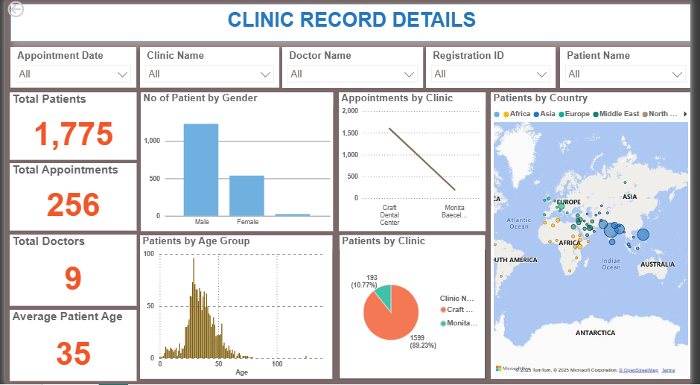
Complete Power BI Dashboard Overview

Slide 9
Key Insights
• Majority age group visiting the clinic
• Gender ratio of patients
• Highest performing clinic/doctor
• Clinic operations during peak appointment dates.

Slide 10
Recommendations
• Improve clinic operations during peak appointment dates
• Increase staff on high appointment days
• Enhance digital appointment system
• Follow-up reminders for patients

Slide 11
Conclusion
This clinic patient analysis provides key insights to improve patient care, optimize appointment scheduling, and enhance clinic performance.

