Slide 1
College Student Details Report
Role: Data Analyst

Slide 2
Summary
This report analyzes college student data using Power BI based on student name, college, and department. It highlights top colleges and popular departments using interactive visuals.

Slide 3
Methodology
• Data collection and validation
• Data cleaning and standardization
• Data modeling in Power BI
• Visual creation and analysis

Slide 4
Content – Graph Details
This Power BI dashboard provides an interactive overview of college student details, enabling analysis of student distribution across colleges, courses, and individual students.
Slicers (College, Course, Student Name):
Allow dynamic filtering of the entire report for focused analysis.
Count of Students by Course (Bar Chart):
Shows student enrollment across courses, helping identify high- and low-demand programs.
Top 5 Courses (Donut Chart):
Highlights the most popular courses based on student count and percentage share.
Top 5 Colleges (Bar Chart):
Compares colleges by student enrollment to identify leading institutions.
KPI Cards:
Display key metrics including Total Colleges, Total Courses, and Total Students for a quick summary.
Student Details Table:
Provides record-level information (College, Course, Student Name) and updates dynamically based on filters.

Slide 5
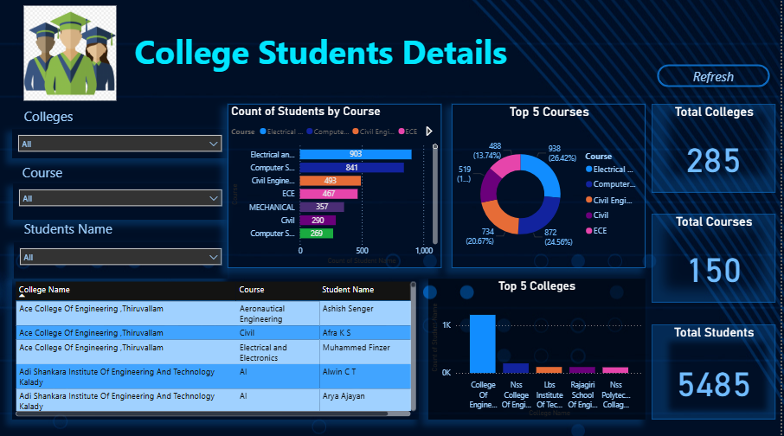

Slide 6
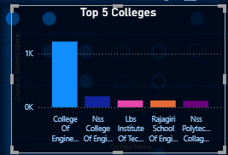
Top 5 Colleges – Student Enrollment Analysis
This bar chart displays the Top 5 colleges based on student enrollment. The height of each bar represents the total number of students enrolled in each institution.
One college clearly dominates student enrollment.
Other colleges show relatively balanced but lower student counts.
The analysis helps in comparing institutional popularity and capacity.
Useful for academic planning, benchmarking, and resource allocation.

Slide 7
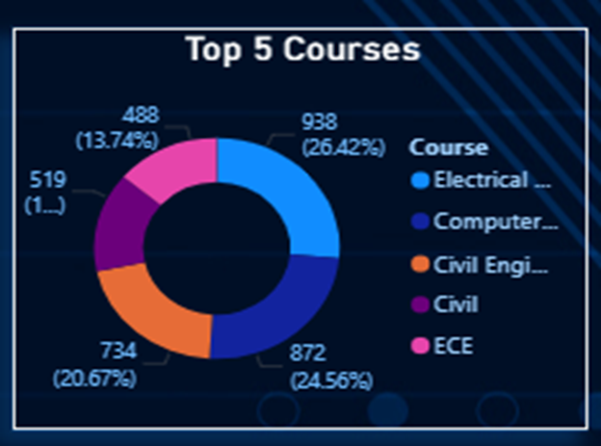
Top 5 Courses – Student Enrollment Analysis
This chart illustrates the distribution of students across the top five courses based on enrollment.
The donut chart highlights both the student count and the percentage share for each course.
Computer-related courses dominate student preferences
Engineering disciplines show strong and balanced demand
The insights support effective course planning and resource allocation

Slide 8
Suggestions / Recommendations
• Improve planning for high-enrollment colleges
• Promote less popular departments
• Maintain consistent data entry
• Extend analysis with more attributes

Slide 9
Conclusion
The report provides clear insights into student distribution and supports data-driven academic decision-making.

Slide 10
Name: Rumaisa kk
Company Name: Doctosmart Enterprises Pvt Ltd

