Slide 1

Rapido Ride Analytics Report
Role: Data Analyst
Prepared by: Rumaisa KK
Company: Doctosmart Enterprises Pvt Ltd
This report presents data-driven insights into ride
demand and operational performance.
Reporting Period: December 2023

Slide 2
Executive Summary
183K+ rides analyzed for December 2023, providing a comprehensive view of platform usage and customer behavior.
Demand peaks during morning and evening commute hours, while afternoon periods contribute the highest overall ride volume.
Electric bikes show steady adoption, highlighting growth potential for sustainable mobility.
Average ride duration of ~14 minutes indicates primary usage for short, urban trips.
Low cancellation rate (1.19%) reflects strong operational efficiency.
Ride demand is concentrated across a small number of high-demand start locations, supporting location-based planning.
Insights enable data-driven decisions for capacity planning, pricing strategy, and optimization.

Slide 3
Methodology
Data Collection Raw ride data was sourced from structured Excel files containing ride, time, location, and customer attributes. This ensured complete coverage of operational data for the analysis period.
Data Cleaning & Standardization The dataset was cleaned by removing duplicates, handling missing or inconsistent values, and standardizing date, time, and location formats to ensure data accuracy and consistency.
Feature Engineering Additional analytical fields were derived, including ride duration, distance, time-based attributes, and categorical groupings to support deeper insights.
KPI Calculation & Data Modeling Key performance indicators such as total rides, average ride duration, completion rate, cancellation rate, and peak-time metrics were calculated using SQL and DAX within Power BI, ensuring scalable and reusable measures.
Visualization & Insight Generation Interactive dashboards were developed in Power BI using KPI cards, trend charts, distribution visuals, and slicers, enabling stakeholders to explore data dynamically and derive actionable insights.

Slide 4
Data Preparation & Feature Engineering
Original Dataset (Raw Fields)
The initial dataset contained raw operational fields such as:
Order ID, Vehicle
Start Time, End Time, Duration
Start & End Locations with Location IDs
Latitude & Longitude
Customer Type
These fields captured transaction-level ride data, but were not sufficient for advanced time-based and performance analysis.

Slide 5
Derived Columns for Advanced Analysis
To enable deeper insights, additional columns were created and grouped as follows:
1. Ride Identification & Status
Ride_ID, Ride_Type,Ride_Status,User_Type
➡ Enabled accurate ride tracking, de-duplication, and cancellation analysis..
2. Time-Based Analysis Columns
Start_Date, Start_Time, End_Time,Ride_Date, Ride_Hours,Day_of_Week,
Time_Period (Morning / Afternoon / Evening / Night),Peak_Time_Flag
➡ Enabled hourly trends, peak vs off-peak analysis, and weekday demand patterns.
3. Duration & Distance Metrics
Ride_Duration_Min, Duration_Category (Short / Medium / Long),
Distance (calculated using latitude & longitude)
➡ Enabled trip efficiency analysis and distance-based ride behavior insights.
4. Location & Station Mapping
Start_Location, End_Location,Start_Station_ID, End_Station_ID,Duplicate ID handling columns
➡ Enabled location-based demand analysis and identification of high-traffic zones.

Slide 6
SQL-Based Data Analysis
Role of SQL in This Analysis
After data cleaning and preprocessing, SQL was used to perform structured data analysis and validation before visualization.
SQL was applied for:
• Filtering and excluding invalid or incomplete records • Aggregating ride data across time periods (hour, day, peak vs off-peak) • Calculating key metrics such as total rides, average ride duration, and cancellation counts • Segmenting data by ride type, user type, and location • Validating KPI results before loading data into Power BI
Business Value of SQL Analysis
Using SQL ensured:
• Accurate and consistent KPI calculations • Efficient handling of large datasets • Reliable data foundation for Power BI dashboards • Reduced calculation complexity at the visualization layer

Slide 7
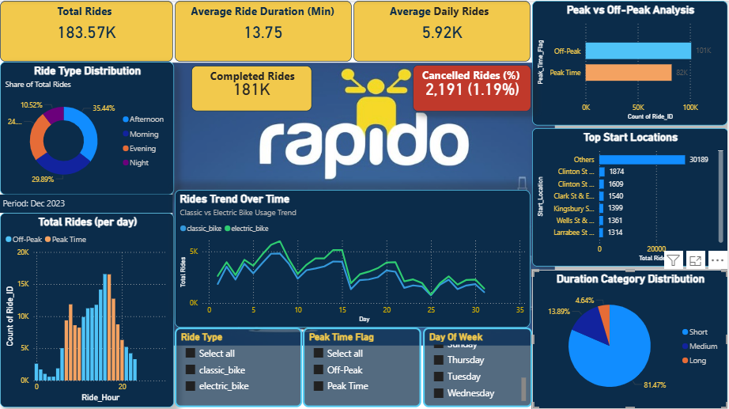
Power BI Dashboard Overview

Slide 8
This dashboard provides a comprehensive view of Rapido ride activity for December 2023, focusing on ride volume, time-based demand, ride types, cancellations, and location insights. It helps stakeholders quickly understand operational performance and customer behavior
1. KPI Cards (Top Section)
Total Rides
Average Ride Duration
Average Daily Rides
Completed Rides
Cancelled Rides
2. Peak vs Off-Peak Analysis (Bar Chart)
3. Ride Type Distribution (Donut Chart)
4. Total Rides per Day (Hourly Analysis – Column Chart)
5. Rides Trend Over Time (Line Chart)
6. Top Start Locations (Horizontal Bar Chart)
7. Duration Category Distribution (Pie Chart)
8. Interactive Filters (Slicers)

Slide 9
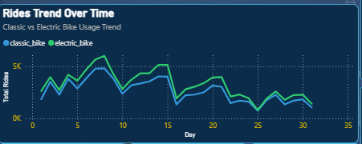
Ride Trend Over Time
This line chart presents a comparative analysis of Classic Bike and Electric Bike ride volumes over the selected time period.
Classic bikes consistently account for the majority of rides, indicating strong and stable customer preference for traditional bike services. Electric bikes, while contributing a smaller share, demonstrate steady and consistent adoption, reflecting gradual customer acceptance of sustainable mobility options.
Overall, the trend highlights a balanced demand pattern, with clear opportunities to further expand electric bike usage through targeted initiatives and operational support.

Slide 10
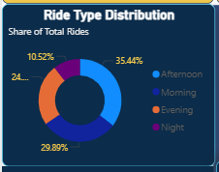
Ride Type Distribution
This donut chart illustrates the distribution of total rides across different time periods—morning, afternoon, evening, and night.
The analysis indicates that afternoon and morning hours contribute the largest share of ride activity, reflecting strong demand during core working and commuting periods. Evening rides maintain a moderate volume, while night-time usage remains comparatively lower.
These insights support time-based resource planning, enabling optimized bike allocation and workforce scheduling during high-demand periods.

Slide 11
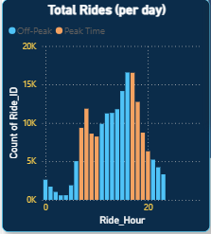
Hourly Ride Distribution
This bar chart illustrates the distribution of ride volume by hour, segmented into Peak and Off-Peak periods.
The analysis reveals distinct demand spikes during morning and evening hours, aligning with typical commuting patterns. Ride volumes taper off during late-night and early-morning hours, indicating lower demand during these periods.
These insights enable effective driver allocation, capacity planning, and surge management, ensuring optimal service levels during high-demand time windows.

Slide 12
Recommendations & Expected Business Impact
1. Strengthen Capacity During Peak Hours
Recommendation: Increase driver and vehicle availability during identified peak time windows.
Expected Business Impact:
Reduced customer wait times
Higher ride completion rates
Improved customer satisfaction and retention
2. Accelerate Electric Bike Adoption
Recommendation: Promote electric bike usage through incentives, targeted campaigns, and strategic deployment.
Expected Business Impact:
Lower operational fuel costs
Enhanced sustainability and brand perception
Diversified fleet with long-term cost efficiency

Slide 13
3. Optimize High-Demand Locations
Recommendation: Prioritize bike allocation and operational focus in high-traffic start locations.
Expected Business Impact:
Improved ride availability in critical areas
Higher utilization rates per vehicle
More efficient resource distribution
4. Implement Data-Driven Dynamic Pricing
Recommendation: Apply dynamic pricing strategies based on peak demand insights.
Expected Business Impact:
Better demand balancing during peak hours
Increased revenue per ride
Optimized supply-demand alignment

Slide 14
Conclusion
• The Power BI analysis delivers clear, actionable insights into ride demand patterns, usage trends, and operational performance.
• The findings enable data-driven decision-making, supporting improved resource allocation, demand management, and service optimization.
• Overall, this analysis provides a scalable analytical framework that supports continuous performance monitoring and informed business growth.

Slide 15
Key Takeaway
This analysis demonstrates how structured data preparation, robust KPI modeling, and interactive visualization transform raw operational data into actionable business insights.
By leveraging SQL for data analysis and Power BI for visualization, the dashboard enables stakeholders to:
Monitor operational performance effectively → Real-time visibility into ride volume, efficiency, and service stability
Anticipate demand patterns with confidence → Proactive identification of peak hours and usage trends for better planning
Support informed, data-driven strategic decisions → Reliable insights that guide pricing, capacity, and growth strategies

Slide 16
Thank You & Q&A
Thank you for your time and attention.
I’m happy to take your questions.
Rumaisa KK Data Analyst Doctosmart Enterprises Pvt Ltd

