Slide 1
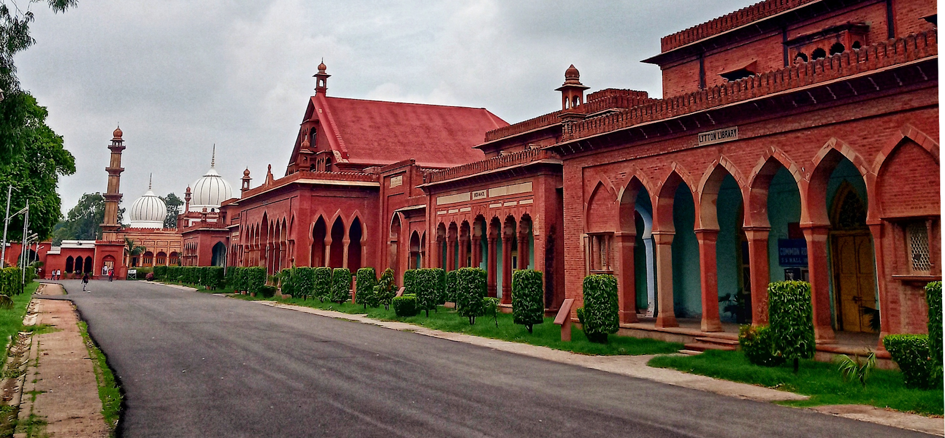
ALIGARH MUSLIM UNIVERSITY
A M U
MAGAZINE
Rich Legacy
Academic Programs
Campus Life
Campus Heritage
Innovation & Research
A walk through history and tradition.
Driving change through knowledge.
Student Voice
Feature Story
Ideas, perspectives and expectations.
AMU SHAPING LEADERS SINCE 1875

