Slide 1
Week 6: Data Models
Big Data Exercise Session
Weixuan Yuan
Fall 2023

Slide 2
Plan for today
Recap
Dremel paper
Exercise06 and Quiz06
Jsoniq tutorial 4-5

Slide 3
Data model VS syntax
Syntax: how the data is encoded as texts/bits
Data model: the logical view of the data, hidden from the physical storage
CSV - tables
JSON, XML - trees

Slide 4
Information set
Information items: nodes of the abstract tree
JSON: strings, numbers, booleans, nulls (atomic, leaves); objects, arrays (structured, interemediate nodes)
XML:
Document (root, has the top-level element as its child)
Element (has child elements, attributes, characters as children)
Attribute (leaf)
Character (leaf)

Slide 5
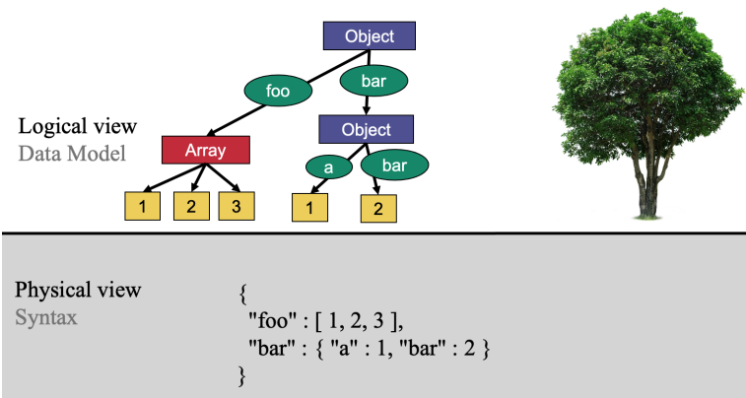
Conversion between syntax and data model
JSON:
Serialization: from data model to syntax

Slide 6
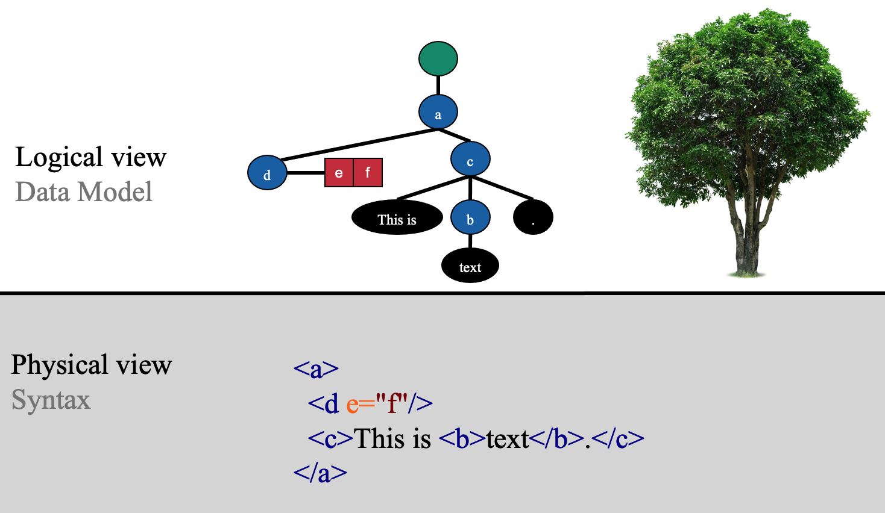
Conversion between syntax and data model
XML:
Serialization: from data model to syntax

Slide 7
Validation
Well-formed vs valid (against a specific schema)
What we usually do: have a schema -> validate a collection of (well-formed) documents against the schema
Schemas we look at in the course: JSound, JSON schema, XML schema

Slide 8
Validation: type system
Atomic types (leaves of the tree data model): strings, integers, decimals, floating-point numbers, datatimes, durations, binary data, null
Logical value space vs lexical value space
e.g. dates vs all strings of the form YYYY-MM-DD
Structured types: lists, records, maps, sets, XML elements
Cardinalities: exactly once(usually implicit), optional(?), any(*), at least once(+)

Slide 9
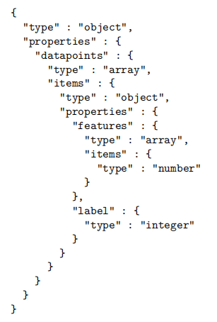
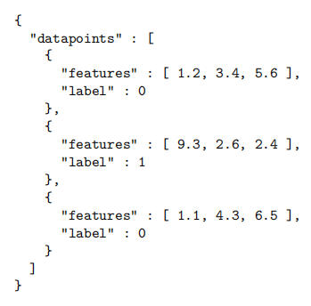
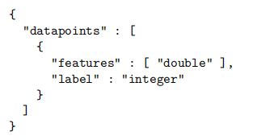
JSON document JSound JSON schema

Slide 10
Miscellaneous (JSound and JSON schema)
For both JSound and JSON schema, the presence of a key is optional by default. To require the presence of a key:
JSound: exclamation mark (e.g. "!name" : "string")
JSON schema: “required” property (e.g. "required" : [ "name", "first" ])
Open vs close: allowing additional keys or not.
By default, JSound is closed; JSON schema is open.

Slide 11
XML schema
General pattern: first define a type, then
<xs:element name="name" type="theTypeYouJustDefined"/>
You can also work with anonymous types, i.e. declaring the type inside
<xs:element name="name"/>
Simple types, complex types (complex content, simple content, empty content, mixed content)
Attribute declaration

Slide 12
DataFrames
If a collection of documents is valid against a “good” schema, we call it DataFrames. Requirements on the schema:
Close (no additional attributes allowed)
Requiring specific types for object/array values

Slide 13
Dremel
Dremel is a scalable, interactive ad-hoc query system for analysis of read-only nested data.
Dremel paper: store and query

Slide 14
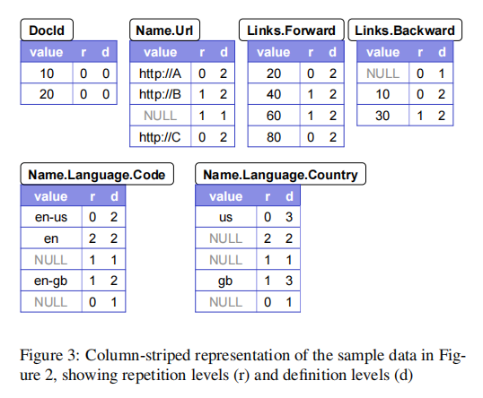
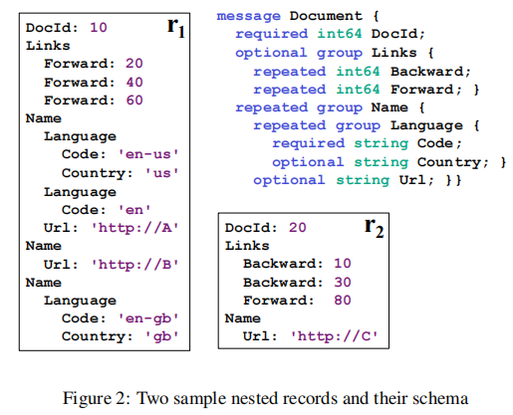
Dremel
Columnar storage: we only store the schema and the column-striped representation.
Definition level and repetition level: to losslessly represent the original records

Slide 15
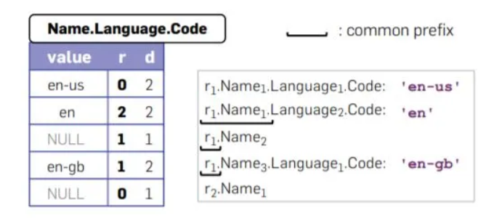
Dremel: repetition level
Repetition level: at what repeated field in the field’s path the value has repeated.
Range of repetition levels: between 0 and the number of repeated fields in the path

Slide 16
Dremel: definition level
Definition level: how many fields in path that could be undefined (because they are optional or repeated) are actually present
Range of definition levels: between 0 and the number of repeated or optional fields in the full path

