Slide 1
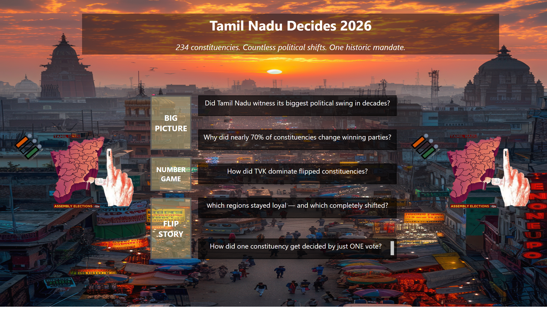
Home
Notes:
textbox
No alt text provided
textbox
No alt text provided
textbox
No alt text provided
textbox
No alt text provided
textbox
No alt text provided
textbox
No alt text provided
actionButton
No alt text provided
actionButton
No alt text provided
actionButton
No alt text provided
image
No alt text provided
image
No alt text provided

Slide 2
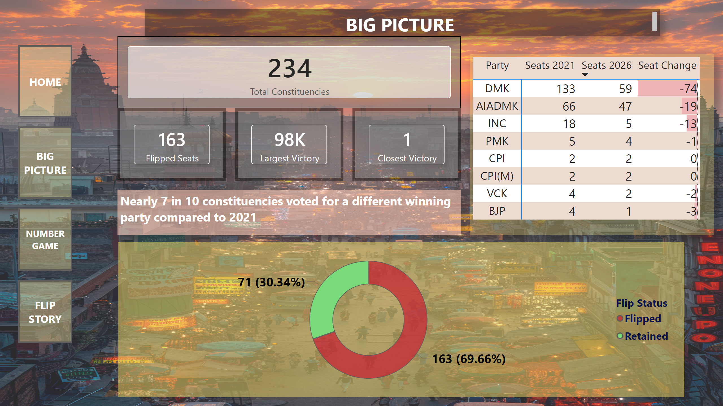
Big Picture
Notes:
cardVisual
No alt text provided
pivotTable
No alt text provided
textbox
No alt text provided
donutChart
No alt text provided
cardVisual
No alt text provided
cardVisual
No alt text provided
cardVisual
No alt text provided
actionButton
No alt text provided
actionButton
No alt text provided
actionButton
No alt text provided
actionButton
No alt text provided
textbox
No alt text provided

Slide 3
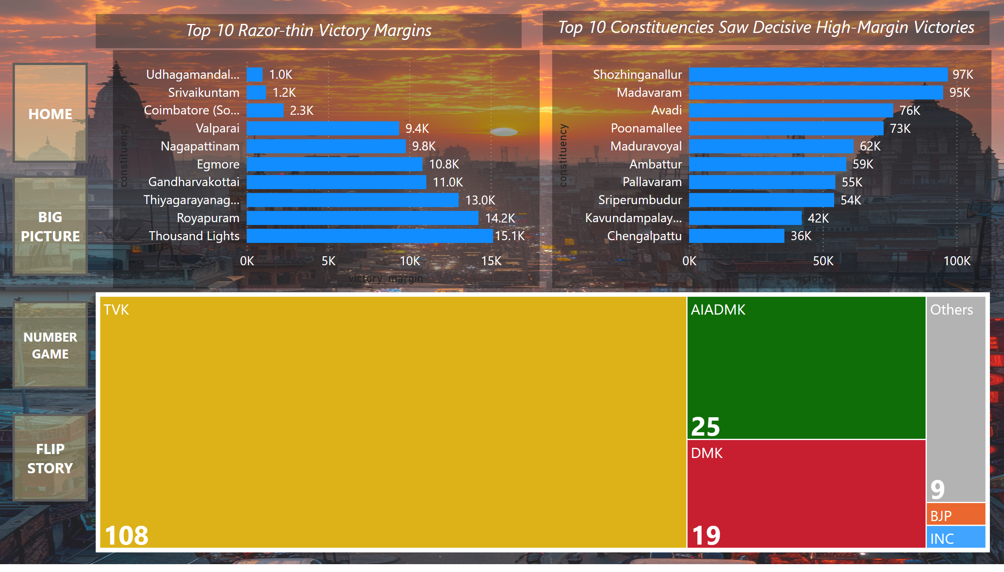
Number Game
Notes:
clusteredBarChart
No alt text provided
treemap
No alt text provided
textbox
No alt text provided
clusteredBarChart
No alt text provided
textbox
No alt text provided
actionButton
No alt text provided
actionButton
No alt text provided
actionButton
No alt text provided
actionButton
No alt text provided

Slide 4
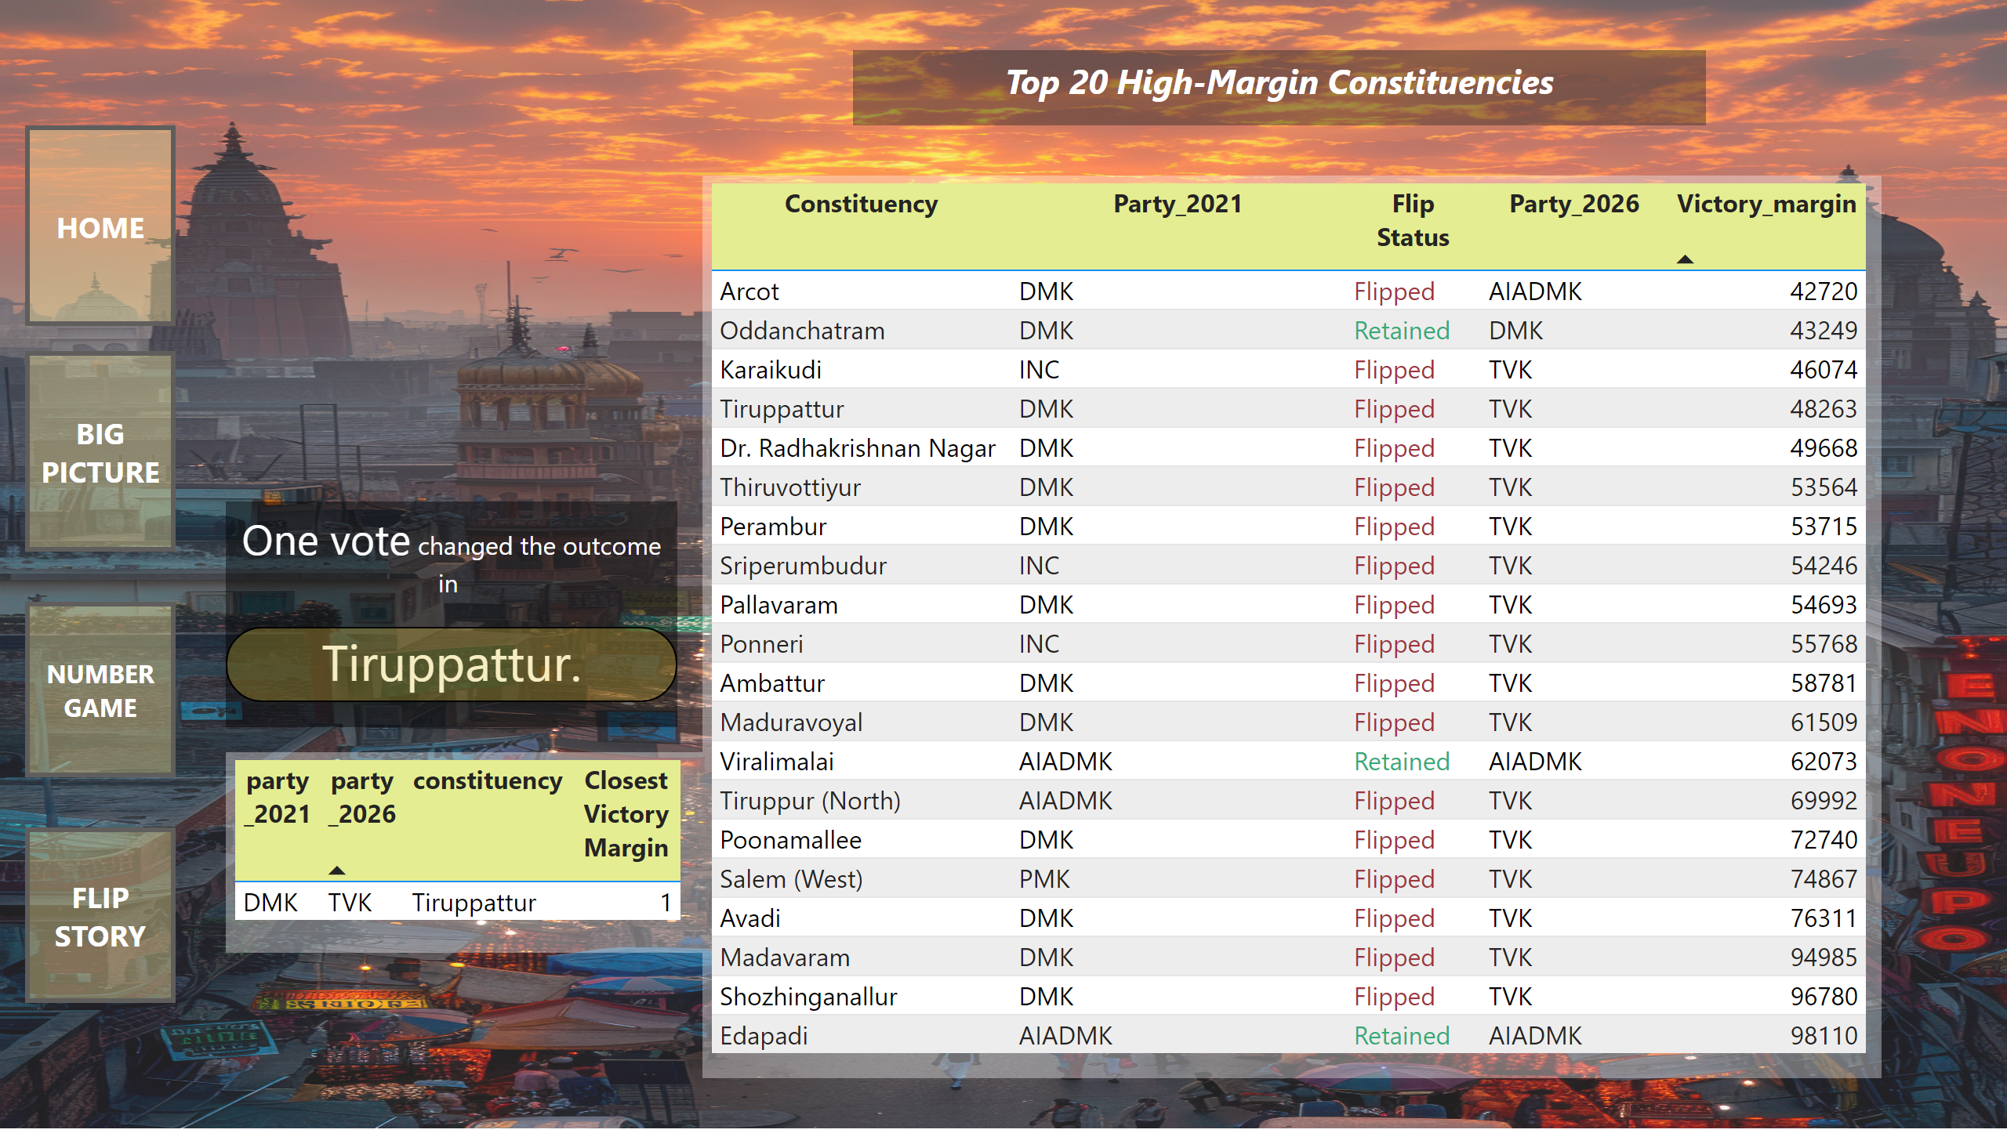
Flip Story
Notes:
tableEx
No alt text provided
textbox
No alt text provided
textbox
No alt text provided
textbox
No alt text provided
actionButton
No alt text provided
actionButton
No alt text provided
actionButton
No alt text provided
actionButton
No alt text provided
tableEx
No alt text provided

