Slide 1
RAGNER :
Improving LLMs performance using RAG and NER
Team 21
Rumit Gore (234101045) Rahul Agarkar (234101041)
Jay Khinchi (234101020)
(MTech CSE)

Slide 2
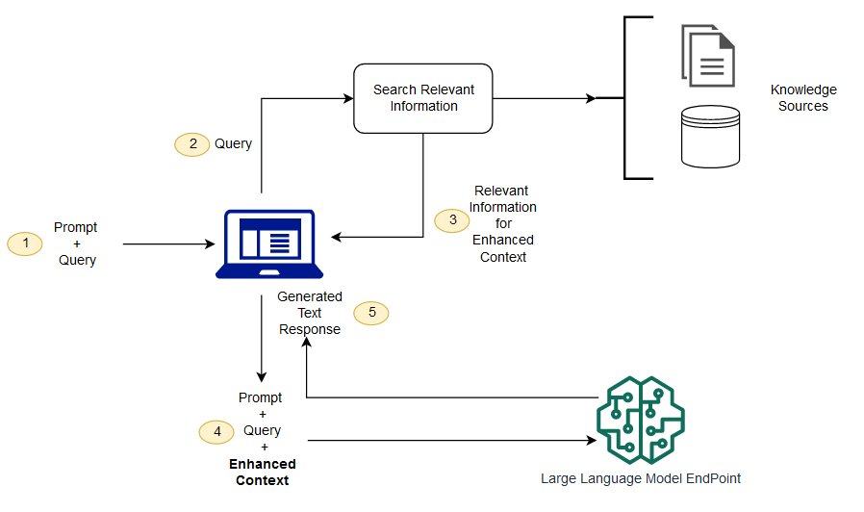
What is RAG (Retrieval Augmented Generation)

Slide 3
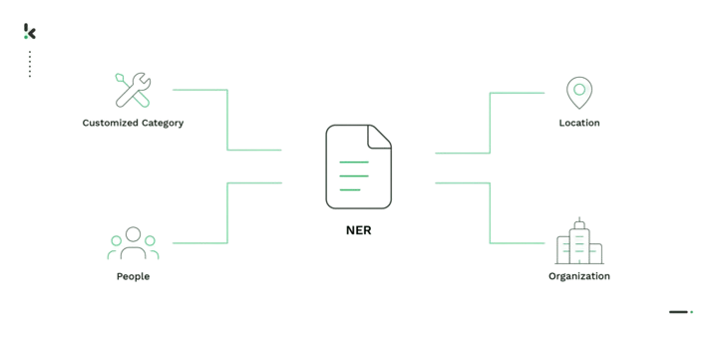
What is NER (Name Entity Recognition)

Slide 4
Normal Life

Slide 5
QUERY related to latest AGI launched by AI4Bharat
LLM trained till 2023 has no idea about it
Absurd response

Slide 6
Mentos Life

Slide 7
Using RAG
Vector Database containing info about AI4Bharat
QUERY related to latest AGI launched by AI4Bharat
LLM trained till 2023 has no idea about it
Correct response

Slide 8
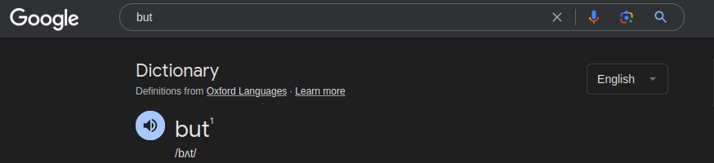
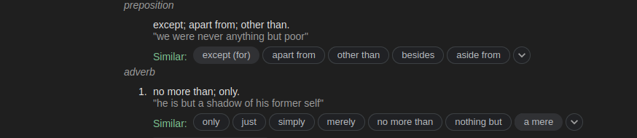

Slide 9
What if the AGI is called LAXMI.
The LLM might confuse it with the goddess Laxmi,
And say ‘JAI MATA DI’.

Slide 10
Using NER
Vector Database containing info about AI4Bharat
Pretrained NER model knowing Laxmi is an AGI
QUERY related to latest AGI launched by AI4Bharat
LLM trained till 2023 has no idea about it
Better Response

Slide 11
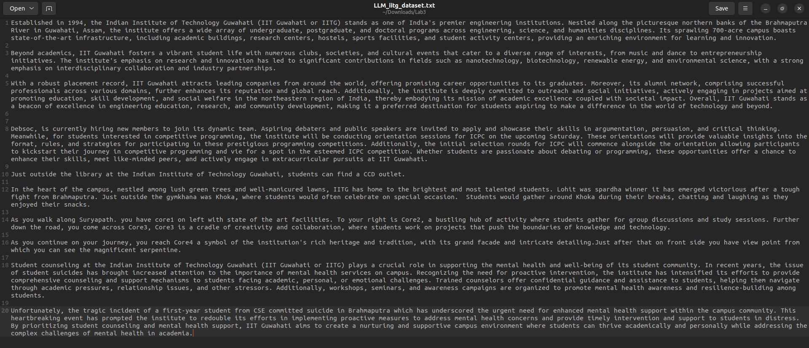
Example - Sample text in context to IITG

Slide 12
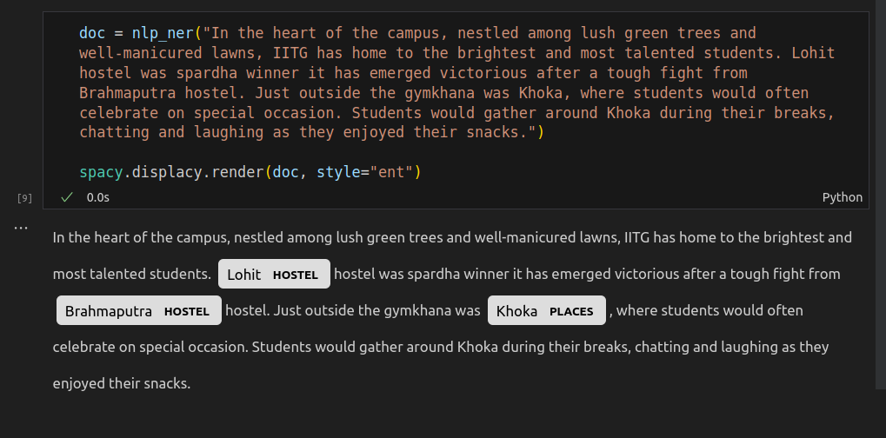
NER Annotations

Slide 13
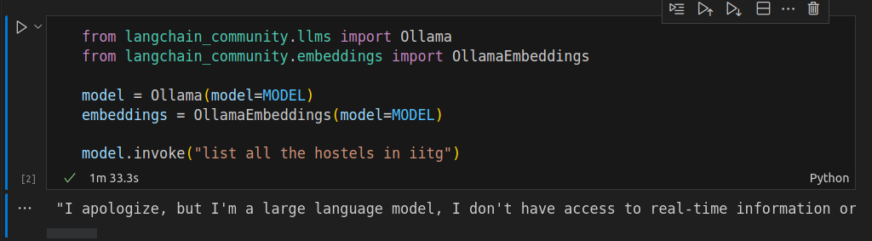
Normal LLM Response

Slide 14
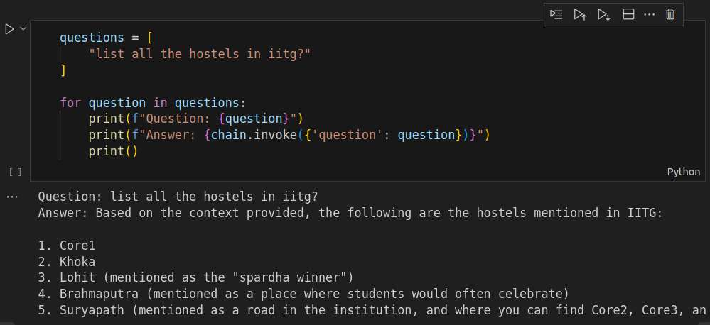
Response with RAG

Slide 15
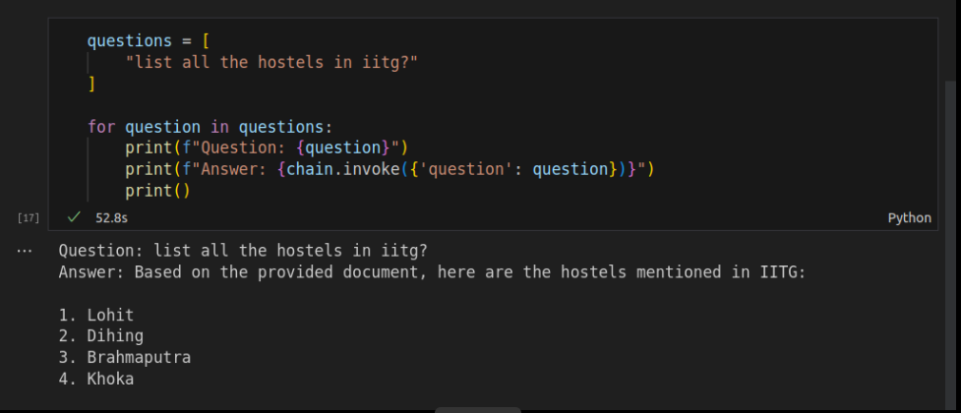
Response with RAG and NER

Slide 16
Demo
https://www.youtube.com/watch?v=XfAbEvzZ5vc
(Youtube Demo Link)

Slide 17
Challenges
Frequent Changes in libraries
No resources
Dataset issues
Specific input output formats of Models
Less Computation power

Slide 18
Resources Used
VS Code
Google Colab
Local LLM used using Ollama (llama2)
Embeddings using Ollama Embeddings
Langchain
Prompt Template
Document Loader
DocArrayInMemorySearch to form vector database
Chaining (context, question, prompt, model, parser)
Spacy for NER
Spacy NER Annotator for annotations
Streamlit for Frontend
nltk library for accuracy comparison
rake_nltk library for finding keywords

Slide 19
Data
For RAG
Any data can be uploaded.
The data can be of formal pdf, csv or JSON.
Langchain is used to load and process the data.
For NER
Custom made dataset is used.
The organisation can train the NER model as per their needs.
Generic dataset can also be used.

Slide 20
Conclusion
This is Novel idea with a promising future uses.
By combining the strengths of RAG for context-aware generation and NER for accurate entity recognition, you can create a more powerful and contextually relevant language model tailored to your specific use case.
And LLM used with RAG gives good results, but when combined with NER gives better results.

Slide 21
Thank You.

