Slide 1
FIRST PRE-DEFENSE / 24 OCT 2026
Business Management
& CRM Platform
with an Embedded AI Assistant
Aitzhan Iliyas / Aibek Galmbekov / Daniil Khvan
Supervisor: Gulnur Shuteyeva
Astana IT University · Software Engineering · SE-2417

Slide 2
PROBLEM DEFINITION
Why this project?
An engineering hypothesis that will be checked with real service-business users
Fragmented client data
Unlinked follow-ups
Customer profiles and inquiries may be stored in disconnected spreadsheets or tools.
Deals, task assignments and service appointments can lose shared context.
Booking conflicts
Uncontrolled AI actions
Parallel scheduling needs a consistent server-side rule to prevent overlaps.
Language-generated suggestions need permission checks and explicit confirmation.
RESEARCH STATUS
These are hypotheses; authentic interviews/client evidence have not yet been supplied.
BUSINESS MANAGEMENT + CRM / AITU SOFTWARE ENGINEERING
02

Slide 3
PRODUCT CONCEPT
One coherent service-business workflow
Trace a client request through the organization, from intake to reporting
01
›
02
›
03
›
04
›
05
›
06
Inquiry
Client
Deal
Task
Booking
Report
AI assistant: draft → show exact changes → confirm → enforce server rules
First design assumption: one service business, staff-facing web app; no customer mobile app in the MVP.
BUSINESS MANAGEMENT + CRM / AITU SOFTWARE ENGINEERING
03

Slide 4
FUNCTIONAL SCOPE
Planned MVP: six connected capabilities
01
02
03
Clients & notes
Deal pipeline
Tasks
Create, search and update customer records.
Track opportunities, stages and owners.
Assign follow-up work and due dates.
04
05
06
Service bookings
Reports
AI assistant
Select staff and reject conflicting time slots.
Summarize counts and process outcomes.
Prepare typed drafts; confirm safe actions.
BUSINESS MANAGEMENT + CRM / AITU SOFTWARE ENGINEERING
04

Slide 5
SCOPE BOUNDARIES
A strict MVP keeps the project achievable
IN SCOPE
OUT OF SCOPE
✓
Role-based staff access
−
Payroll, accounting, payment processing
✓
Clients, deals, tasks and appointments
−
Full multi-branch ERP and mobile apps
✓
Basic reports and activity history
−
Autonomous customer messaging
✓
AI action preview and confirmation
−
Unreviewed AI database writes
✓
Transactional booking constraints
−
Enterprise-scale rollout commitments
BUSINESS MANAGEMENT + CRM / AITU SOFTWARE ENGINEERING
05

Slide 6
EVIDENCE OF RELEVANCE
Validation: document real user needs
University requirement: 3–5 discussions or one substantive real-client agreement
01
02
03
04
Recruit
Discuss
Record
Validate
Owners, managers, scheduling staff
Current tools, delays, conflicts and exceptions
Consent, dated notes, anonymized quotations
Distinguish observed needs from our hypotheses
NOT YET VERIFIED
Templates prepared; real interviews or client confirmation must be collected by the team.
BUSINESS MANAGEMENT + CRM / AITU SOFTWARE ENGINEERING
06

Slide 7
LITERATURE REVIEW
13 scholarly publications inform the design
12 publications (2021–24) plus one foundational reference (2020)
Customer workflows
Tool-using models
AI in marketing and service
ReAct, Toolformer, ToolLLM, API-Bank
Huang & Rust · Ferraro et al.
Yao · Schick · Qin · Li
Failures & security
Controlled implementation
Prompt injection, lost context, evaluation
Augmented models, feedback, retrieval
Greshake · Liu · AgentBench
Mialon · Shinn · Lewis · Wei
BUSINESS MANAGEMENT + CRM / AITU SOFTWARE ENGINEERING
07

Slide 8
EXISTING-SYSTEM COMPARISON
Existing systems: compare, do not dismiss
Four vendors assessed against nine documented criteria
HubSpot
Broad CRM, sales, meeting and AI functionality
Our engineering focus
01
End-to-end traceability
Zoho CRM
CRM and Zia intelligent-assistance features
A request, task and booking are linked.
02
Testable constraints
Pipedrive
Pipeline and activity scheduling, with conflict avoidance
No accepted overlapping confirmed bookings.
03
Auditable AI actions
Draft, approval and server-side checks.
Bitrix24
CRM + tasks, calendars, analytics and CoPilot
BUSINESS MANAGEMENT + CRM / AITU SOFTWARE ENGINEERING
08

Slide 9
TECHNOLOGY COMPARISON
Technology decisions: compare the alternatives
Selections are justified design proposals, not benchmark results
Backend
Go
NestJS · Spring Boot
Storage
PostgreSQL
MySQL · MongoDB
API
REST + OpenAPI
GraphQL · gRPC
Frontend
React + TypeScript
Vue · Angular
AI operations
Typed proposal + review
Rule-based · direct LLM execution¹
¹ Direct model-to-database execution considered and rejected for security; not a proposed implementation.
BUSINESS MANAGEMENT + CRM / AITU SOFTWARE ENGINEERING
09

Slide 10
SPECIFICATION
Requirements are measurable
22 functional requirements + 12 non-functional requirements with priorities and acceptance criteria
FR-07
Book service
A valid free slot persists with staff, service and client links.
FR-08
Prevent collisions
Concurrent overlapping confirmations never create two accepted bookings.
FR-12
AI proposal
Natural-language request produces a preview; database is unchanged.
FR-14
Confirm AI action
Revalidate role and business rules before any mutation.
NFR-01
Authorization
All protected operations deny unauthorized changes.
BUSINESS MANAGEMENT + CRM / AITU SOFTWARE ENGINEERING
10

Slide 11
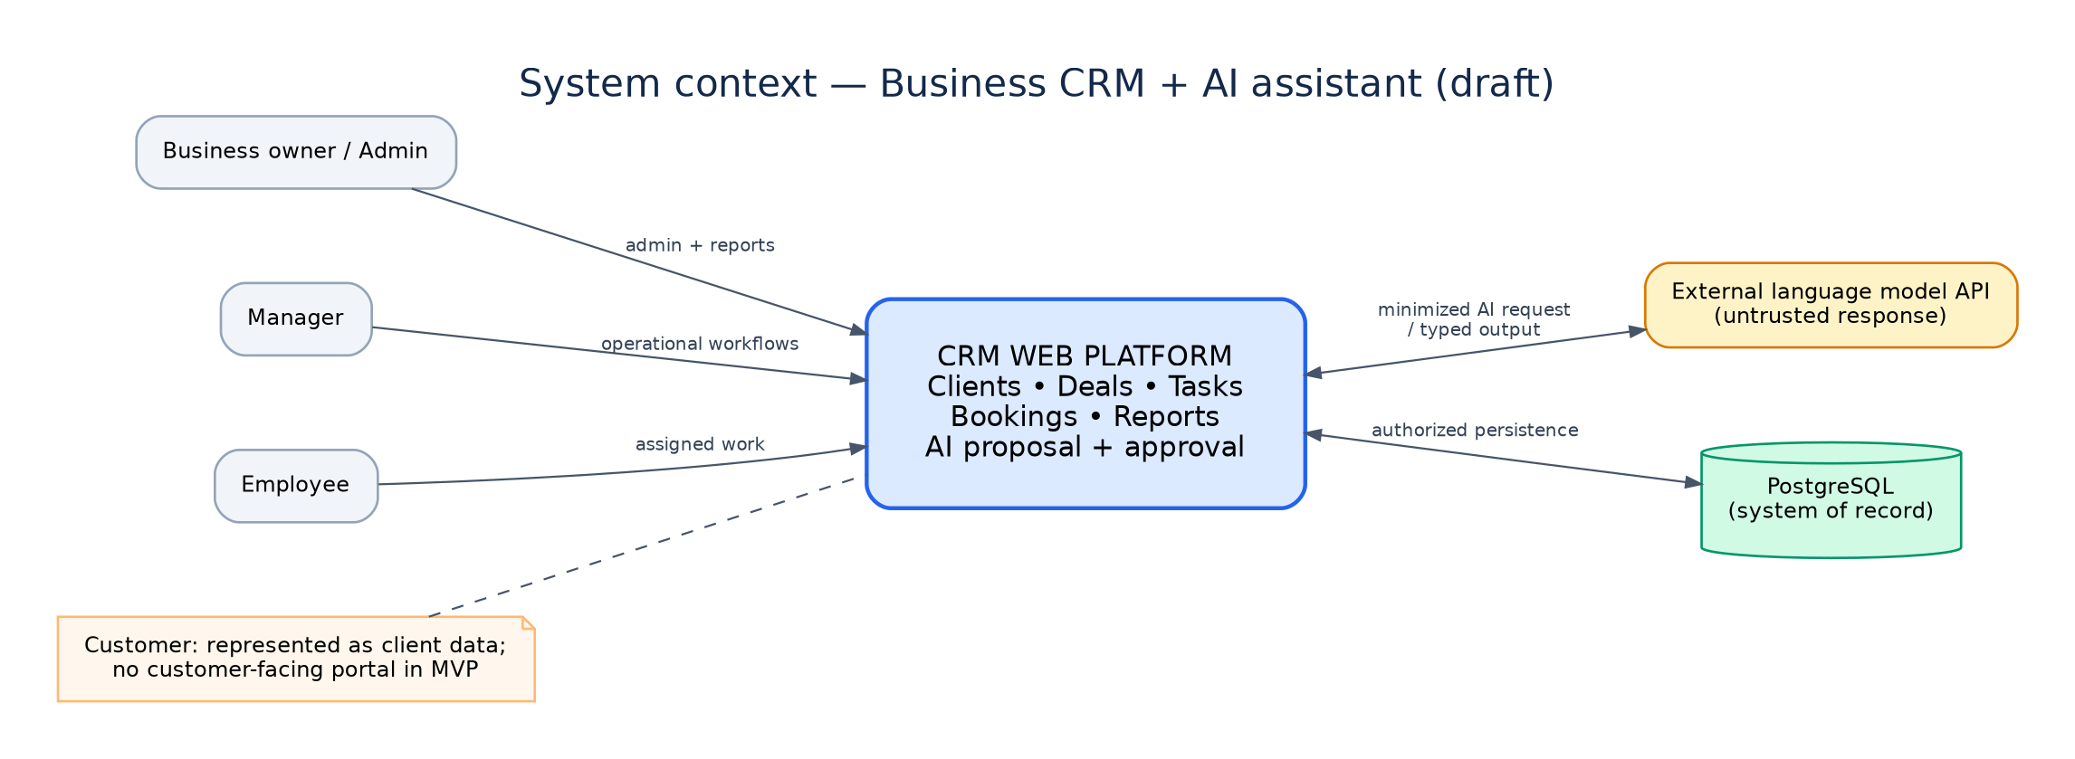
ARCHITECTURE · VIEW 1
System context: users and external boundary
Human users and model provider do not bypass the application API
BUSINESS MANAGEMENT + CRM / AITU SOFTWARE ENGINEERING
11

Slide 12
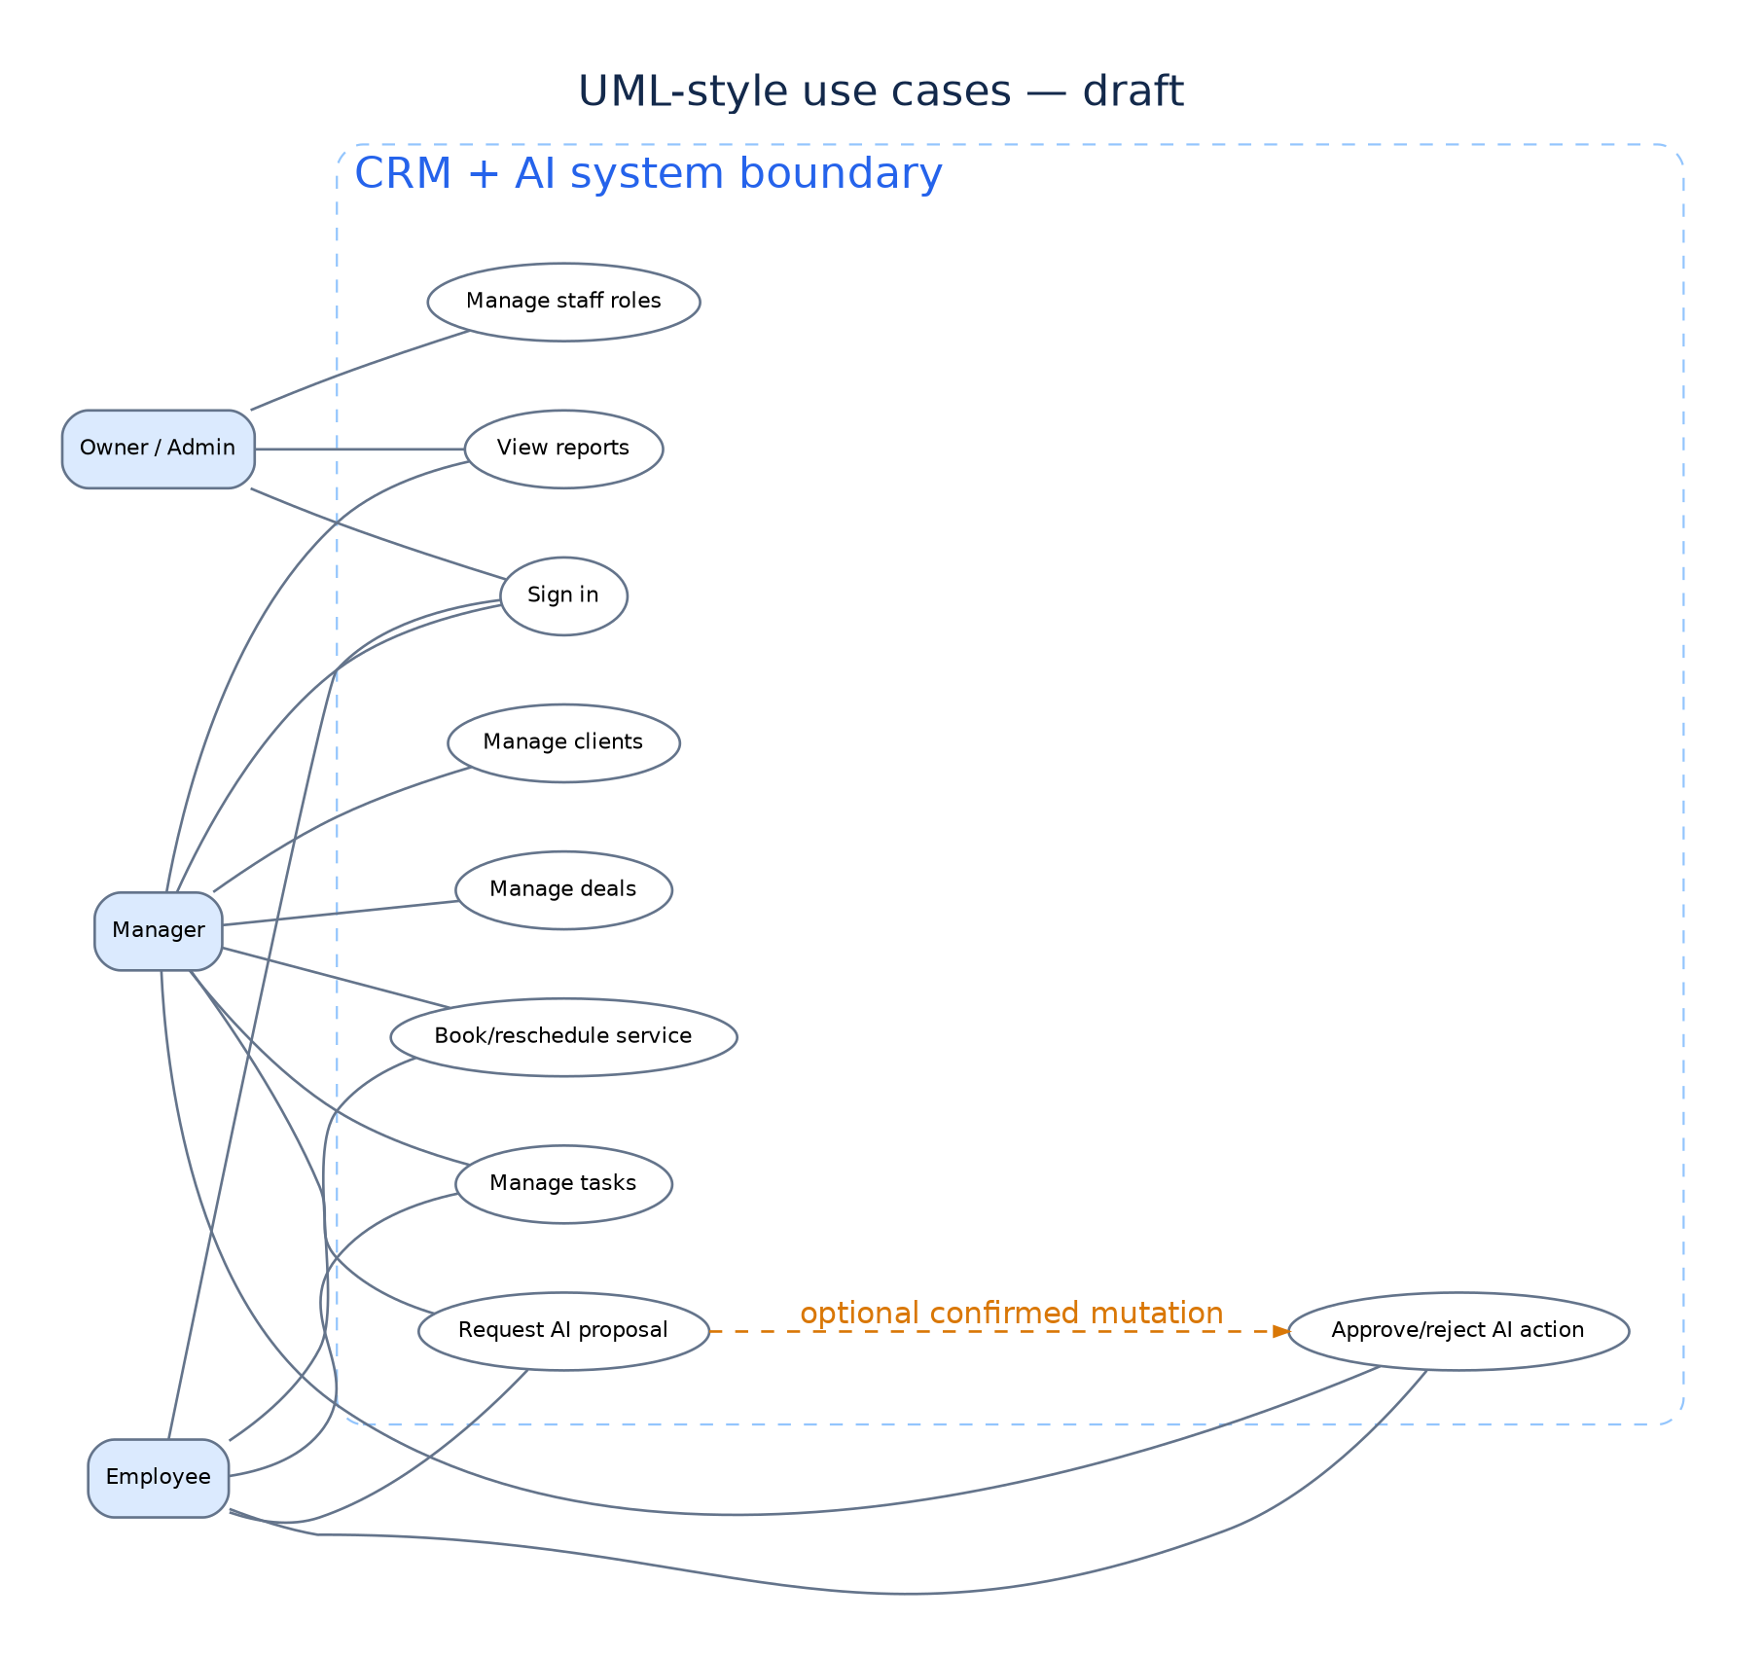
ARCHITECTURE · VIEW 2
Use cases: human-owned workflows
Editable UML (.puml) and Graphviz sources are included
Owner / Admin
Access and governance
Manager / Employee
CRM, tasks and bookings
AI Assistant
Proposal only, not authorization
BUSINESS MANAGEMENT + CRM / AITU SOFTWARE ENGINEERING
12

Slide 13
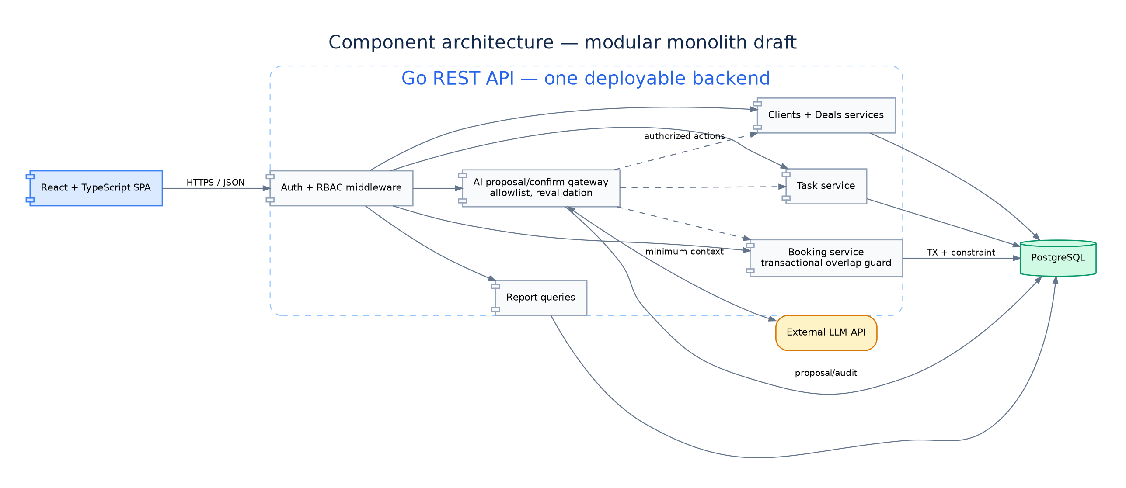
ARCHITECTURE · VIEW 3
Modular monolith with guarded AI integration
One API, shared business rules and a transactional PostgreSQL persistence layer
BUSINESS MANAGEMENT + CRM / AITU SOFTWARE ENGINEERING
13

Slide 14
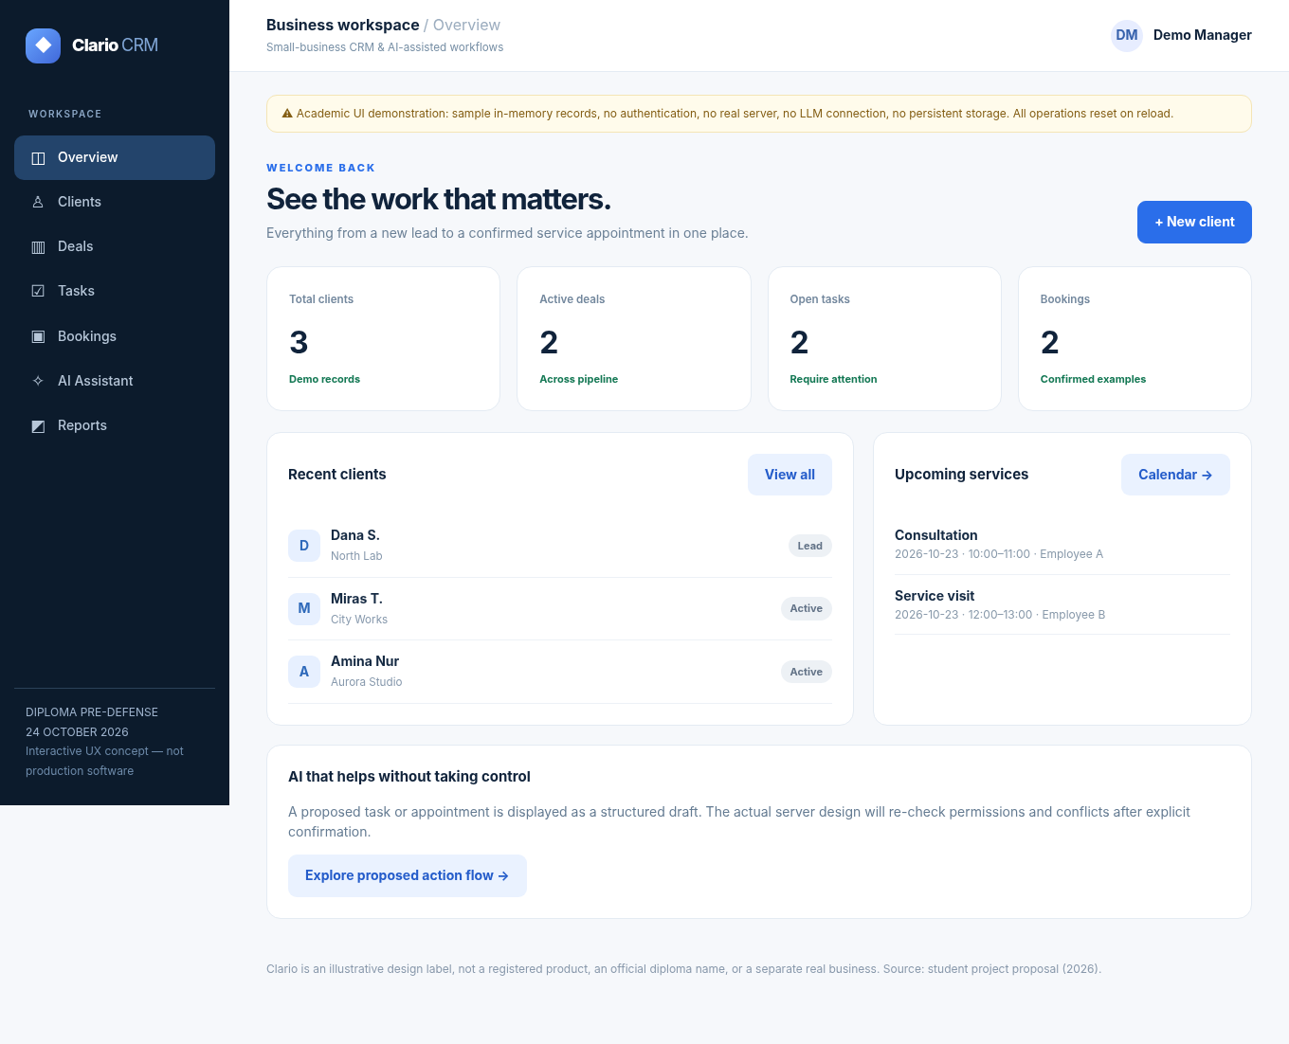
UX / PROTOTYPE
A clickable prototype demonstrates key journeys
Standalone browser demo, using synthetic records and local in-memory state
Navigate
Overview, clients, deals, tasks, bookings
Create demo records
Inputs and tables update locally
AI draft
Visible proposal requires user approval
BUSINESS MANAGEMENT + CRM / AITU SOFTWARE ENGINEERING
14

Slide 15
AI SAFETY DESIGN
AI is an assistant, not an administrator
The language model never receives database credentials or general-purpose execution rights
01
02
03
04
05
Intent
›
Draft
›
Review
›
Gate
›
Commit
User asks for action
Structured typed proposal
User inspects changes
Auth + schema + invariants
Approved state mutation
Any failed permission, invalid data or collision → REJECT; no write
BUSINESS MANAGEMENT + CRM / AITU SOFTWARE ENGINEERING
15

Slide 16
VERIFICATION PLAN
Evaluation compares outcomes—not promises
All thresholds are proposed targets; there are no real test results yet
0
0
≥85%
≥70
≥20%
overlapping confirmed bookings
unauthorized state mutations
correct AI proposals
SUS score target
median time improvement target
Concurrency test
Negative-role & AI corpus
100 annotated requests
Guided usability sessions
Against recorded manual baseline
Baseline: actual customer workflow or documented separate spreadsheet + calendar process; record setup and timing.
BUSINESS MANAGEMENT + CRM / AITU SOFTWARE ENGINEERING
16

Slide 17
PROJECT MANAGEMENT
Team accountability and project workflow
Every meaningful task belongs to an owner, has acceptance criteria and links to Git evidence
A
Aitzhan Iliyas
A
Aibek Galmbekov
D
Daniil Khvan
Backend + AI
Frontend
QA
API, schema, data invariants, guarded actions
Views, UX flows, validation and integration
Test strategy, cases, defect and safety checks
YouTrack task → feature branch → commit / PR → review → acceptance → tag
This process is prepared as a plan; real URLs, commit history, reviews and approvals still need to be supplied.
BUSINESS MANAGEMENT + CRM / AITU SOFTWARE ENGINEERING
17

Slide 18
SUBMISSION STATUS
Pre-defense readiness: prepared vs outstanding
Transparent evidence tracking is required for an academically defensible submission
PREPARED IN THE PACKAGE
NEEDS REAL PARTICIPATION
✓
Research review: 13 academic sources
!
3–5 real user interviews or client signoff
✓
4 competitors × 9 criteria
!
Supervisor review and change records
✓
5 technology decisions × 3 options
!
Repository and actual YouTrack project links
✓
Requirements, 3 diagrams and prototype
!
Independent team commits and code reviews
✓
Test plan, risks and backlog templates
!
Reviewed first-stage Git tag
BUSINESS MANAGEMENT + CRM / AITU SOFTWARE ENGINEERING
18

Slide 19
Thank you
Questions & feedback
Development of a Business Management and CRM Platform
with an Embedded AI Assistant

