Slide 1

Big data Introduction

Slide 2
Agenda
What are the characteristics of Big data
Generic concepts related to Datawarehouse platform
Why traditional Datawarehouse platform are not consider suitable for Big data analytics
Understanding the vast world of Big data platform
Benefit of Hadoop file system and other cloud storage
Mastering the concept of Parallel distributed Computing framework
Component failure and recoveries
Demystifying the Map Reduce

Slide 3
What is BigData?
Big data is a phrase, used to describe a huge amountof both structured and unstructured data that is so large that it’s practically impossible to store, process and access using tradition techniques
Following are the characterises exhibits by Big data
Massive Volume
Lots of unstructured data
Not possible to store this process using traditional RDBMS and ETL tools

Slide 4



Three Vs of Bigdata
Volume : Terabytes and petabytes (and even exabytes) of data
Velocity : Data flows into an organization at increasing rates
Variety : Any type of structured, Semi structured and unstructured data

Slide 5


Why Volume is increasing?
Volume increasing exponentially with different Media format
Lots of sensor, IOT and social media data

Slide 6




Why Velocity is increasing?
Rate at which data is coming in
Rate at which data needs to be analyzed
Speed of processing should be faster than arrival of new data
2.7 billion LIKES/day
400 million tweets/day

Slide 7
Why Variety is increasing?
Variety of data needs to be collected to perform advance analytics
These data can from various sources such as RDBMS
Application generated data and log file
XML, JSON,CSV,TSV , Text file and Binary data stored on file systems

Slide 8

Structured data has predefined schema such as field name and data type
CSV file with header
Records from data bases
Unstructured data don’t have predefined schema
Text file with column names
Audio Video
Images

Slide 9
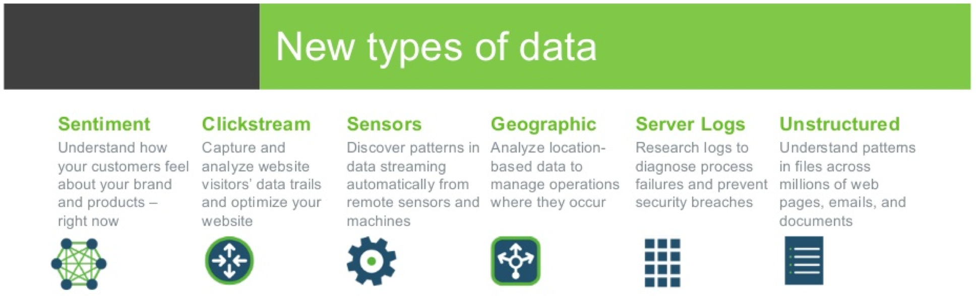
Common Types of Big Data?
The advent of social medium, IOT devices and business-to-business transactions are introducing new file types and formats

Slide 10
Big Data Analytics
Process of collecting, organizing and analyzing large amounts of data to gain insight
Information and Data as Assets
Improve decision making
Enhance performance
To be competitive
To be two steps ahead of the competition
Derive insights and drive growth

Slide 11
What is Data Warehouse?
A Data Warehouse is a central location where consolidated data from multiple locations are stored.
The end user accesses it whenever he needs some information.
Data Warehouse is not loaded every time when new data is generated.
There are timelines determined by the business as to when a Data Warehouse needs to be loaded – daily, monthly, once in a quarter etc.

Slide 12
Dimension Table?
The objects of the subject are called Dimensions.
The tables that describe the dimensions involved are called dimension tables.
Dividing a data warehouse project into dimensions, provides structured information for reporting purpose.
e-commerce Company
Customer |  |  | Product |  |  | Date
ID | Name | Address | ID | Name | Type | Order date | Shipment date | Delivery date
Subject
Dimensions
Attributes

Slide 13
What are Facts?
A fact is a measure that can be summed, averaged or manipulated. If a fact is manipulated, it has to be a measure that makes a business sense.
A dimension is linked to a fact.
A fact table contains 2 kinds of data – a dimension key and a measure.
Fact Table
Dimension
Product
Dimension
Product_ID
Dimension key
Number of units sold
Measure

Slide 14
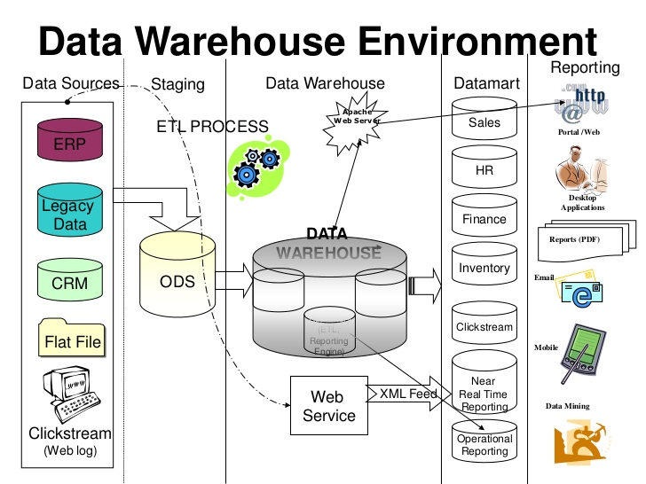

Slide 15
Star Schema
A star schema is the simplest of all the data warehouse schemas.
The dimensions are not normalized; Fact has keys from every dimension.
Performance of the Star schema is good, but cost of storage is high
Dealer
Dealer_ID
Location_ID
Country_ID
Dealer_NM
Dealer_CNTCT
Date Dim
Date_ID
Year
Month
Quarter
Date
FACT
Dealer_ID
Model_ID
Branch_ID
Date_ID
Units_Sold
Revenue
Branch Dim
Branch _ID
Name
Address
Country
Product
Product_ID
Product_Name
Model_ID
Variant_ID

Slide 16
Snowflake Schema?
Snow flaking is where we normalize the dimension tables of a star schema.
In Snow Flake schema, Dimensions are normalized
Query performance not so good as joins are more
Location
Location_ID
Region
Dealer
Dealer_ID
Location_ID
Country_ID
Dealer_NM
Dealer_CNTCT
Country
Country_ID
Country_Name
FACT
Dealer_ID
Product_ID
Date_ID
Units_Sold
Revenue
Date Dim
Date_ID
Year
Month
Quarter
Date
Variant
Variant_ID
Variant_Type
Product
Product_ID
Product_Name
Variant_ID

Slide 17
Limitations of traditional data warehouse
Not Possible to store huge data (Big Data)
No Flexible schema
Not suitable for storing un-structured data
Limited scalability
Takes huge time to perform ETL activity and load data into warehouse
Not suitable for doing advance machine learning and AI
Very expensive to develop, deploy and maintain the system

Slide 18

What is Dake Lake?
A data lake is a centralized platform where all kinds of data can be stored at any scale.
In Data lake, we store data in original form
Data lakes are cluster of inexpensive and scalable commodity hardware.
Unlike databases, A data lake works on a schema-on-read concept.
Data scientists can access, prepare, and analyze data faster and with more accuracy using data lakes.
This massive amount of data available in data lake can help companies to perform sentiment analysis or fraud detection.

Slide 19
Data Lake Vs Data Warehouse
Characteristics | Data Warehouse | Data Lake
Data | Relational from transactional systems, operational databases, and line of business applications | Non-relational and relational from IoT devices, web sites, mobile apps, social media, and corporate applications
Schema | Designed prior to the DW implementation (schema-on-write) | Written at the time of analysis (schema-on-read)
Price/Performance | Fastest query results using higher cost storage | Query results getting faster using low-cost commodity storage
Data Quality | Highly curated data | Any data that may or may not be curated (ie. raw data)
Users | Business analysts | Data scientists, Data developers, and Business analysts (using curated data)
Analytics | Batch reporting, BI and visualizations | Machine Learning, Predictive analytics, data discovery and profiling

Slide 20
Bigdata can be stored only on distributed platforms such as
Distributed file systems
Distributed data bases
Distributed Messaging queue or PubSub platform
Distributed Search Engines
Not only for storage even for processing we shall need distributed and parallel computing framework to process such data
Map Reduce
Spark

Slide 21



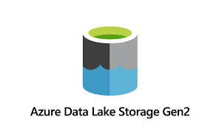
Storing Big data in file systems
Big data can be stored in following file system platforms
Distributed file system such as HDFS, AWS S3, Azure data lake gen(ADLS Gen2) and GCS
These platforms are storing big data for analytics use cases as ETL Processing, Reporting, Machine learning and AI
However, these platform will not be suitable if you want to perform CRUD(Create, Retrieve, Update and Delete) operation frequently

Slide 22
Benefits of storing Big data in file systems
Big block size of 64 or 128 MB
Bigger blocks enable reading more data in lesser disk IO Operations
Replication helps these platforms to provide read scalability and data availability

Slide 23

Apache Hadoop's MapReduce and HDFS components were inspired by Google papers on MapReduce and Google File System
Doug Cutting and Mike Cafarella, were the authors of these paper that were published in October 2003

Slide 24
What is HDFS?
Distributed
Highly fault tolerant
Runs on low-cost commodity hardware

Slide 25

HDFS Architecture
Architecture
Master of HDFS
Runs the NameNode daemon
Coordinates the data storage function
Does not store any data
1 GB
NameNode
Node 1
Node 2
Node 3
Node 4
Node 5
DataNode
DataNode
DataNode
DataNode
DataNode
Node 6
Node 7
Node 8
Node 9
Node 10
DataNode
DataNode
DataNode
DataNode
DataNode

Slide 26
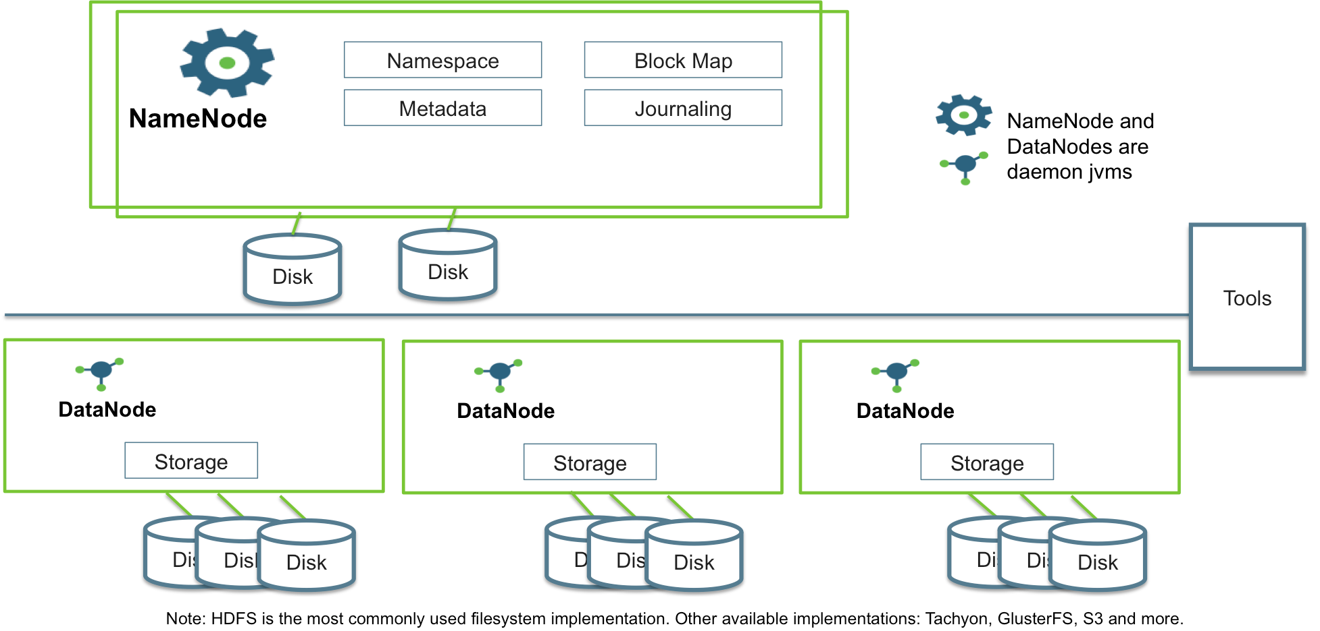
HDFS Process

Slide 27
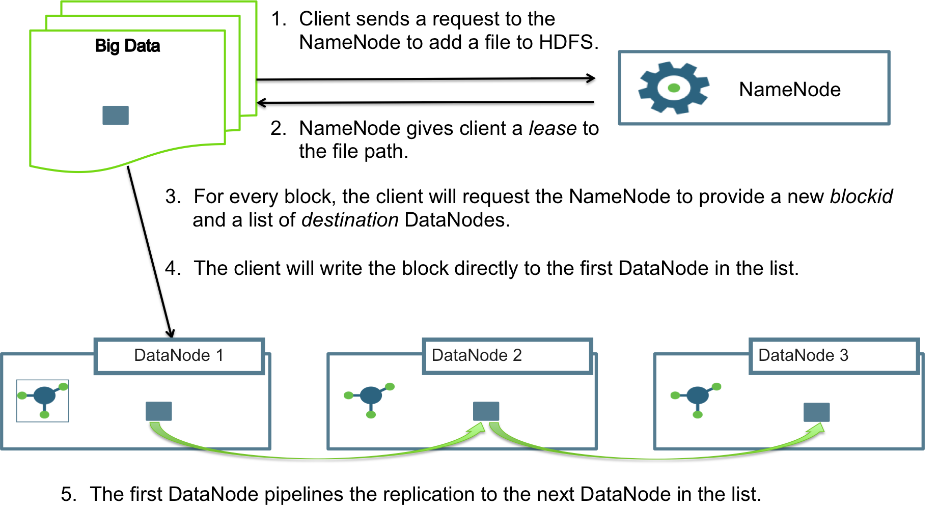
HDFS Write path

Slide 28
Component Failure & Recovery in HDFS
NameNode Failure and Recovery
If Namenode process goes down, then HDFS metadata will not be available
In absence of metadata, client will be unable to read HDFS data
Namenode High availability(HA) configuration is designed to handle this
In Namenode HA configuration , one of the Namenode will be configured as standby
For HA configuration zookeeper is required
Zookeeper permots standby Namenode to Active Namenode if Namenode is not available
DataNode Failure and Recovery
If DataNode process goes down, then some of HDFS blocks will not be available
If replication factor is set to 3 then 2 more datanodes will have same block stored
But what if all the 3 datanodes goes down in one shot?
Rack awareness, if configured will help in this scenario

Slide 29
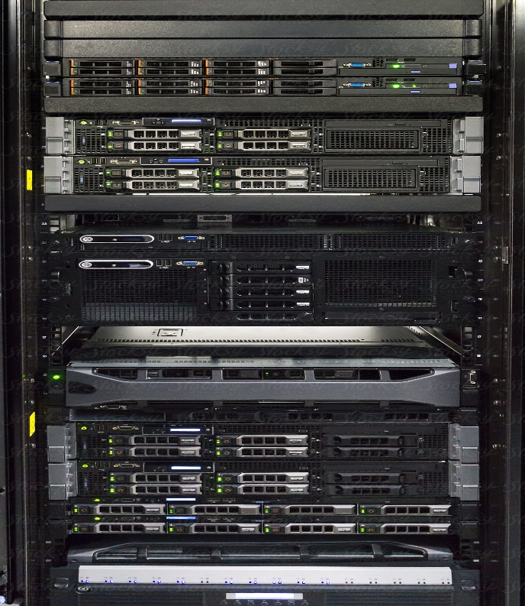
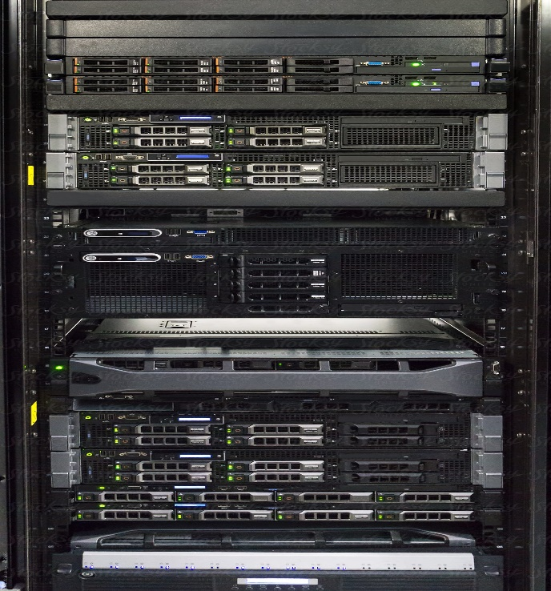
Rack Awareness
Once Rack awareness is configured then Namenode will make sure block gets replicated across the racks
In below image, two copies of block A and B are stored on rack RC1 and one copy on rack RC2
DataNode1: Rack RC1
DataNode4: RC2
A
DataNode2: RC1
DataNode5: RC2
A
B
DataNode4: RC1
DataNode6: RC2
B
A
B

Slide 30
What is YARN
YARN allocates resources to run any application inside Hadoop cluster
Its full form is Yet Another Resource Negotiator
It is an Operating System of Hadoop Cluster
Part of core Hadoop
Multi-node cluster has an aggregate pool of compute resources
CPU and memory like resources that an operating system would manage

Slide 31
YARN Bird’s Eye View
ResourceManager (master)
Application management
Scheduling
Security
NodeManager (worker)
Provides resources to lease
Memory, cpu
Container is unit of processing
ApplicationMaster manages jobs
JobHistory Server/Application Timeline Server
Job history preserved in HDFS

Slide 32
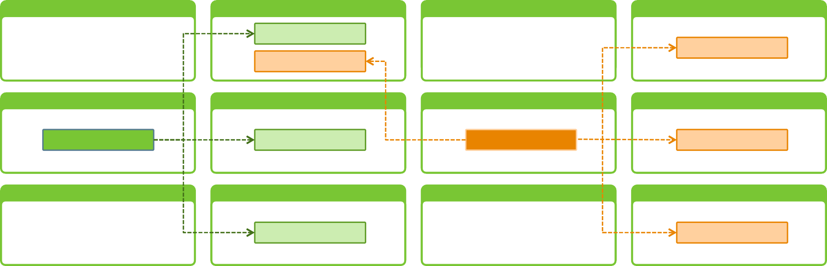
YARN Architecture
ResourceManager
Scheduler
NodeManager
NodeManager
NodeManager
NodeManager
Container _{1.1}
Container _{2.1}
Container _{2.4}
NodeManager
NodeManager
NodeManager
NodeManager
AM ₁
Container _{1.2}
AM₂
Container _{2.2}
NodeManager
NodeManager
NodeManager
NodeManager
Container _{1.3}
Container _{2.3}

Slide 33





5 Key Benefits of YARN
Scale
Improved Programing models and Services
Agility
Improved Cluster Utilization
Beyond JAVA

Slide 34
Components of YARN
ResourceManager
Global resource scheduler
Hierarchical queues
NodeManager
Per-machine agent
Manages the life-cycle of container
Container resource monitoring
ApplicationMaster
Per-application
Manages application scheduling and task execution
E.g. MapReduce Application Master
ResourceManager
Job Queues
Scheduler
Node Manager
Container
Container
Application Master

Slide 35
NodeManager
Daemon process on same machine as DataNode process
Container management
Driven by authorized ApplicationMaster requests
Start/stop/cleanup containers
Container sizes are determined by ApplicationMasters
Node-level resource management
Memory and CPU as resources

Slide 36
Resource Manager
ApplicationsManager
ApplicationMaster launch
Publishing resource capabilities to ApplicationMaster
Scheduling
Capacity Scheduler (default)
Hierarchical
Liveliness Monitoring
NodeManager & ApplicationMasters
Expects a heartbeat from a NodeManager within 10 minutes
Heartbeats sent by NodeManagers every 1 second by default
Expects a heartbeat from an ApplicationMaster within 10 minutes

Slide 37
Application Master
There will single Application Master per YARN Application
App Master will be parent of all the containers of the application(Job)
App Master will be initiated by Resource Manager
Every App Master will have unique application Id
App Master runs on the Data Node machine

Slide 38
Component Failure & Recovery in YARN (1/2)
Container Failure
Exceptions are propagated back to the ApplicationMaster
ApplicationMaster and NodeManager are responsible for restart or reschedule
ApplicationMaster will request new container(s) from ResourceManager
ApplicationMaster Failure
It can recover the state of the running containers and completed containers from the failed ApplicationMaster
ResourceManager will start a new instance of the master running in a new container managed by a NodeManager

Slide 39
Component Failure Recovery in YARN(2/2)
NodeManager Failure
Removed from ResourceManager’s pool of available nodes
ApplicationMaster and containers running on the failed NodeManager can be recovered as described above
ApplicationMasters can blacklist NodeManagers
ResourceManager Failure
Failover to standby ResourceManager or manually brought up by an administrator
Recovers from saved state stored by ZooKeeper
Cannot recover resource requests

Slide 40
Types of nodes in Hadoop Cluster
Master Nodes:
On these nodes master components of HDFS and YARN are installed
Namenode and Resource Manager process are master nodes
Management Nodes:
On these nodes, mostly management software are installed
Ambari/Cloudera manager , WebCat Server, Zookeeper and JobHistory Server
Workers Nodes:
On workers nodes, Datanode, NodeManager and other process runs
Client Nodes:
Software such as hive, Spark client , MRClient are installed
Edge Nodes:
Different data ingestion tools such as Flume, Sqoop and Kafka are installed

Slide 41
Hadoop Cluster Layout
Master-1
Namenode-Active
Master-2
Namenode Standby
Master-3
ResourceManager-Active
Master-4
ResourceManager-
Standby
Management1
Ambari/Cloudera Manager
Management 2
Hmaster, Oozie
Worker-3
Datanode, NodeManager, RegionServer
Worker-4
Datanode, NodeManager, RegionServer
Worker-1
Datanode, NodeManager, RegionServer
Worerk-2
Worker-2
Datanode, NodeManager, RegionServer
Client Node
Hive, MRClinet,SparkClient
Edge Node-1
Sqoop, Flume,Kafka
Edge Node2-Sqoop,Flume,Kafka

Slide 42
Hadoop As Data Lake
Data Source
Data Ingestion Layer
Database
Hive
HDFS
Impala/Presto
Query Layer
Processed Data
MapReduce/Spark
Files
Raw Data
Social media

Slide 43
Data Ingestion Layer
APP
WEB-HDFS
Oracle
Sqoop
JDBC
Import
Flume/NIFI
FTP Server
MiniNIFI
HDFS
Socail media
Kafka
Kafka Connect

Slide 44
Inside Hadoop Platform
MPP: Tez, Impala,Drill, Presto: Interactive/Adhoc query
HBase
Phoenix
Oozie
Ambari
Spark: MR++,RDD: Tranformation/Action: DF/DS: Spark-SQL, ML/DL,GraphX
Hive: MR,Spark,Tez
MetaStore: MySQL,Postgres
MR: Java
HDFS: Flat file, SequenceFile, ORC, Parquet, AVRO , Compress(LZO,Snappy,BZO) Encrypt

Slide 45
Roles of Hadoop Ecosystem Components
Storage
HDFS which is file system of Hadoop
Hbase , a NoSQL database of Hadoop
Kafka, a streaming platform for storing messages
Processing
MapReduce
Apache Spark
MPP Query engine
Impala
Presto
Tez
Data Ingestion
Flume
Sqoop
NIFI

Slide 46
Data Ingestion : Apache Sqoop
Apache SQOOP is a tool designed to support bulk export and import of data into HDFS from RDBMS, enterprise data warehouses, and NoSQL systems.
Sqoop has connectors for working with a range of popular relational databases, including MySQL, PostgreSQL, Oracle, SQL Server, and DB2.
Each of these connectors knows how to interact with its associated RDBMS

Slide 47
Sqoop Features
Import a single table
Import the complete database
Import selected tables
Import selected columns from a particular table
Filter out certain rows from certain tables, etc by using the query option
Sqoop uses MapReduce(map only) job to fetch data from an RDBMS and stores that on HDFS.

Slide 48
Data Ingestion : Apache Flume
Apache Flume is a data ingestion tool to ingest data from remote servers
It collects , aggregate and direct stream into HDFS
Flume works with different data sources to process and send data to defined destinations including HDFS
Channel
Source
Sink
Destination

Slide 49
Hadoop 3.0 new features
More Than Two NameNodes Supported
Support for erasure encoding in HDFS
Support for Opportunistic Containers and Distributed Scheduling
Intra-datanode balancer
Filesystem Connector Support
JDK 8.0 is the Minimum JAVA Version Supported by Hadoop 3.x

Slide 50

Let us perform some hands-on
Understanding HDFS commands
Executing MR Job
Verifying the results
Exploring MR Job history page

Slide 51
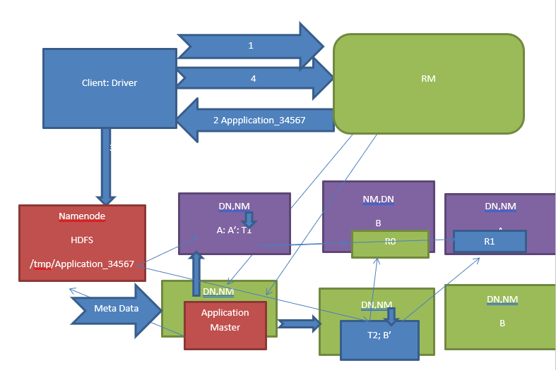
Execution Flow of YARN Application

Slide 52
MR Execution Flow (1/4)
Submit the request to resource manager by the job object created in the client JVM. Note: Client JVM will be created in the client node of the hadoop cluster
Then application manager of the resource manager will check whether application is a valid YARN application or not , and if it is a valid then generated a unique YARN application id
Job object inside the Driver process , using this unique id, creates a staging folder /tmp/applciation_2731 and copies all the jar, script, .sql and dependencies.
Job object inside the Driver process, again submit the request to the resource manager

Slide 53
MR Execution Flow (2/4)
Resource manager selects one of the data node(based on the availability of the resources CPU 1 core, 1 GB RAM) where Application master image will be copied
Then resource manager will instruct NM of the respective node(server) to start the image . once image is started it will be called as App Master container
App master wants to break the job into n tasks for this he will connect with the namenode and get metadata(blocks, locations) for the input folder specided while running the job

Slide 54
MR Execution Flow (3/4)
App master in order to create N no of tasks, first it needs to find out number of input split with the help of InputFormatClasses . Input classes consider the data split and make the record logically complete in order to decide the no of splits
Application master will decide the task assignment and request the resource manager to allocate the containers .
Once resources are allocated then application master will request the respective NM to start the container using those resources. Once container is started mapper process will start in that container

Slide 55
MR Execution Flow (4/4)
Mapper task runs map method implemented in the Mapper java class.
Once mapper is over then sorting shuffling will take place . As part of this phase, Hash partitioning will write the data (key value pair) into n part-m-* files here n depends upon no of reducer set in the application
These part files will be copied to respective reducers which will perform merge sort to combine multiple values of the given key into list of values
List of values and key will be fed into reduce method of Reducer class
Output of the reducer will be stored in HDFS

Slide 56































































Lifecycle of a YARN Application
☺
1 Client submits application request
2
Response with ApplicationID
ResourceManager
Scheduler
ApplicationsManager
ApplicationMasterService
3
Application Submission Context
5
Get Capabilities
(ApplicationId, queue, application name, application type, AM resource, priority) 4
+
Container Launch Context
(launch commands, LocalResource, delegation tokens)
Start ApplicationMaster
6
Req/Rec Containers
NodeManager 1
NodeManager 2
Container
Container
Container r
Job
Map2
Container
Container
Job
Map4
Container
Container
Container
ApplicationMaster MR Job
Job
Map3
Job
Map5
Job
Map6
Job
Reducer1
Free
Capacity
Job
Map1
Free
Capacity
NodeManager 3
7
Container Launch Requests
NodeManager 4
Free Capacity
Container Job Map7 | Container Job Map8 | Container Job Map9 | Container Job Map10 | Container Job Reducer2
Free Capacity

Slide 57
MapReduce Introduction

Slide 58
How does MapReduce work?

Slide 59
How does MapReduce work?
Mapper Phase
InputSplits
Map Output
Reducer Phase
Reduce Tasks
Reduce Output

Slide 60
How does MapReduce work?
Mapper Phase
MapReduce
InputSplits
Mapper Tasks
Map Output List
Reducer Phase
Reduce Tasks
Reduce Output

Slide 61
MapReduce
How does MapReduce work?
Mapper Phase
InputSplits
Mapper Tasks
Map Output List
Reducer Phase
Reduce Tasks
Reduce Output

Slide 62
MapReduce
How does MapReduce work?
Mapper Phase
InputSplits
Mapper Tasks
Map Output List
Reducer Phase
Reduce Tasks
Reduce Output

Slide 63
MapReduce
How does MapReduce work?
Mapper Phase
InputSplits
Mapper Tasks
Map Output List
Reducer Phase
Reduce Tasks
Reduce Output

Slide 64
MapReduce
How does MapReduce work?
Mapper Phase
InputSplits
Mapper Tasks
Map Output List
Reducer Phase
Reduce Tasks
Reduce Output

Slide 65
MapReduce
How does MapReduce work?
Mapper Phase
InputSplits
Mapper Tasks
Map Output List
Reducer Phase
Reduce Tasks
Reduce Output

Slide 66
MapReduce
How does MapReduce work?
Mapper Phase
InputSplits
Mapper Tasks
Map Output List
Reducer Phase
Reduce Tasks
Reduce Output

Slide 67
MapReduce
Hadoop MapReduce
Input
Splitting
Map
Map Output
Shuffling
Reduce
Result
<Hadoop, 1>
<Hive, 1>
<Spark, 1>
<Spark, 1>
<Spark 1>
<Spark, 1>
<1, Hadoop Hive Spark
>
Hadoop Hive Spark
Hbase Hive Spark
Spark Hive Hbase
<Spark, (1,1,1)>
<Hadoop, 1>
<Spark, 3>
<Hadoop, 1>
<2, Hbase Hive Spark
>
<Hbaser, 1>
<Hive 1>
<Spark, 1>
<Hadoop, 1>
<Hive, 1>
<Hive, 1>
<Hive,1>
<Hive, (1,1,1)>
<Hbase, (1,1)>
<Spark, 1>
<Hive, 1>
<Hbase, 1>
<Hive, 3>
<Hbase, 2>
<3, Spark Hive Hbase
>
<Hbase,1>
<Hbase,1>

Slide 68
MapReduce
Hadoop MapReduce
Input
Splitting
Map
Map Output
Shuffling
Reduce
Result
<Hadoop, 1>
<Hive, 1>
<Spark, 1>
<Spark, 1>
<Spark 1>
<Spark, 1>
<1, Hadoop Hive Spark
>
Hadoop Hive Spark
Hbase Hive Spark
Spark Hive Hbase
<Spark, (1,1,1)>
<Hadoop, 1>
<Spark, 3>
<Hadoop, 1>
<2, Hbase Hive Spark
>
<Hbaser, 1>
<Hive 1>
<Spark, 1>
<Hadoop, 1>
<Hive, 1>
<Hive, 1>
<Hive,1>
<Hive, (1,1,1)>
<Hbase, (1,1)>
<Spark, 1>
<Hive, 1>
<Hbase, 1>
<Hive, 3>
<Hbase, 2>
<3, Spark Hive Hbase
>
<Hbase,1>
<Hbase,1>

Slide 69
MapReduce
Hadoop MapReduce
Input
Splitting
Map
Map Output
Shuffling
Reduce
Result
<Hadoop, 1>
<Hive, 1>
<Spark, 1>
<Spark, 1>
<Spark 1>
<Spark, 1>
<1, Hadoop Hive Spark
>
Hadoop Hive Spark
Hbase Hive Spark
Spark Hive Hbase
<Spark, (1,1,1)>
<Hadoop, 1>
<Spark, 3>
<Hadoop, 1>
<2, Hbase Hive Spark
>
<Hbaser, 1>
<Hive 1>
<Spark, 1>
<Hadoop, 1>
<Hive, 1>
<Hive, 1>
<Hive,1>
<Hive, (1,1,1)>
<Hbase, (1,1)>
<Spark, 1>
<Hive, 1>
<Hbase, 1>
<Hive, 3>
<Hbase, 2>
<3, Spark Hive Hbase
>
<Hbase,1>
<Hbase,1>

Slide 70
MapReduce
Hadoop MapReduce
Input
Splitting
Map
Map Output
Shuffling
Reduce
Result
<Hadoop, 1>
<Hive, 1>
<Spark, 1>
<Spark, 1>
<Spark 1>
<Spark, 1>
<1, Hadoop Hive Spark
>
Hadoop Hive Spark
Hbase Hive Spark
Spark Hive Hbase
<Spark, (1,1,1)>
<Hadoop, 1>
<Spark, 3>
<Hadoop, 1>
<2, Hbase Hive Spark
>
<Hbaser, 1>
<Hive 1>
<Spark, 1>
<Hadoop, 1>
<Hive, 1>
<Hive, 1>
<Hive,1>
<Hive, (1,1,1)>
<Hbase, (1,1)>
<Spark, 1>
<Hive, 1>
<Hbase, 1>
<Hive, 3>
<Hbase, 2>
<3, Spark Hive Hbase
>
<Hbase,1>
<Hbase,1>

Slide 71
MapReduce
Hadoop MapReduce
Input
Splitting
Map
Map Output
Shuffling
Reduce
Result
<Hadoop, 1>
<Hive, 1>
<Spark, 1>
<Spark, 1>
<Spark 1>
<Spark, 1>
<1, Hadoop Hive Spark
>
Hadoop Hive Spark
Hbase Hive Spark
Spark Hive Hbase
<Spark, (1,1,1)>
<Hadoop, 1>
<Spark, 3>
<Hadoop, 1>
<2, Hbase Hive Spark
>
<Hbaser, 1>
<Hive 1>
<Spark, 1>
<Hadoop, 1>
<Queen, 1>
<Queen, 1>
<Hive, (1,1,1)>
<Hbase, (1,1)>
<Spark, 1>
<Hive, 1>
<Hbase, 1>
<Hive, 3>
<Hbase, 2>
<3, Spark Hive Hbase
>
<Hbase,1>
<Hbase,1>

Slide 72
MapReduce
Hadoop MapReduce
Input
Splitting
Map
Map Output
Shuffling
Reduce
Result
<Hadoop, 1>
<Hive, 1>
<Spark, 1>
<Spark, 1>
<Spark 1>
<Spark, 1>
<1, Hadoop Hive Spark
>
Hadoop Hive Spark
Hbase Hive Spark
Spark Hive Hbase
<Spark, (1,1,1)>
<Hadoop, 1>
<Spark, 3>
<Hadoop, 1>
<2, Hbase Hive Spark
>
<Hbaser, 1>
<Hive 1>
<Spark, 1>
<Hadoop, 1>
<Queen, 1>
<Queen, 1>
<Hive, (1,1,1)>
<Hbase, (1,1)>
<Spark, 1>
<Hive, 1>
<Hbase, 1>
<Hive, 3>
<Hbase, 2>
<3, Spark Hive Hbase
>
<Hbase,1>
<Hbase,1>

Slide 73
MapReduce
Hadoop MapReduce
Input
Splitting
Map
Map Output
Shuffling
Reduce
Result
<Hadoop, 1>
<Hive, 1>
<Spark, 1>
<Spark, 1>
<Spark 1>
<Spark, 1>
<1, Hadoop Hive Spark
>
Hadoop Hive Spark
Hbase Hive Spark
Spark Hive Hbase
<Spark, (1,1,1)>
<Hadoop, 1>
<Spark, 3>
<Hadoop, 1>
<2, Hbase Hive Spark
>
<Hbaser, 1>
<Hive 1>
<Spark, 1>
<Hadoop, 1>
<Queen, 1>
<Queen, 1>
<Hive, (1,1,1)>
<Hbase, (1,1)>
<Spark, 1>
<Hive, 1>
<Hbase, 1>
<Hive, 3>
<Hbase, 2>
<3, Spark Hive Hbase
>
<Hbase,1>
<Hbase,1>

Slide 74
MapReduce
Hadoop MapReduce
Input
Splitting
Map
Map Output
Shuffling
Reduce
Result
<Hadoop, 1>
<Hive, 1>
<Spark, 1>
<Spark, 1>
<Spark 1>
<Spark, 1>
<1, Hadoop Hive Spark
>
Hadoop Hive Spark
Hbase Hive Spark
Spark Hive Hbase
<Spark, (1,1,1)>
<Hadoop, 1>
<Spark, 3>
<Hadoop, 1>
<2, Hbase Hive Spark
>
<Hbaser, 1>
<Hive 1>
<Spark, 1>
<Hadoop, 1>
<Queen, 1>
<Queen, 1>
<Hive, (1,1,1)>
<Hbase, (1,1)>
<Spark, 1>
<Hive, 1>
<Hbase, 1>
<Hive, 3>
<Hbase, 2>
<3, Spark Hive Hbase
>
<Hbase,1>
<Hbase,1>

Slide 75
MapReduce
Hadoop MapReduce
Input
Splitting
Map
Map Output
Shuffling
Reduce
Result
<Hadoop, 1>
<Hive, 1>
<Spark, 1>
<Spark, 1>
<Spark 1>
<Spark, 1>
<1, Hadoop Hive Spark
>
Hadoop Hive Spark
Hbase Hive Spark
Spark Hive Hbase
<Spark, (1,1,1)>
<Hadoop, 1>
<Spark, 3>
<Hadoop, 1>
<2, Hbase Hive Spark
>
<Hbaser, 1>
<Hive 1>
<Spark, 1>
<Hadoop, 1>
<Hive, 1>
<Hive, 1>
<Hive,1>
<Hive, (1,1,1)>
<Hbase, (1,1)>
<Spark, 1>
<Hive, 1>
<Hbase, 1>
<Hive, 3>
<Hbase, 2>
<3, Spark Hive Hbase
>
<Hbase,1>
<Hbase,1>

Slide 76
MapReduce
Hadoop MapReduce
Input
Splitting
Map
Map Output
Shuffling
Reduce
Result
<Hadoop, 1>
<Hive, 1>
<Spark, 1>
<Spark, 1>
<Spark 1>
<Spark, 1>
Import data into HDFS
<1, Hadoop Hive Spark
>
Hadoop Hive Spark
Hbase Hive Spark
Spark Hive Hbase
<Spark, (1,1,1)>
<Hadoop, 1>
<Spark, 3>
<Hadoop, 1>
<2, Hbase Hive Spark
>
<Hbaser, 1>
<Hive 1>
<Spark, 1>
<Hadoop, 1>
<Hive, 1>
<Hive, 1>
<Hive,1>
<Hive, (1,1,1)>
<Hbase, (1,1)>
<Spark, 1>
<Hive, 1>
<Hbase, 1>
<Hive, 3>
<Hbase, 2>
<3, Spark Hive Hbase
>
<Hbase,1>
<Hbase,1>

Slide 77
MapReduce
Hadoop MapReduce
Input
Splitting
Map
Map Output
Shuffling
Reduce
Result
<Hadoop, 1>
<Hive, 1>
<Spark, 1>
<Spark, 1>
<Spark 1>
<Spark, 1>
Import data into HDFS
Specify input folder and InputFormatClass to use
<1, Hadoop Hive Spark
>
Hadoop Hive Spark
Hbase Hive Spark
Spark Hive Hbase
<Spark, (1,1,1)>
<Hadoop, 1>
<Spark, 3>
<Hadoop, 1>
<2, Hbase Hive Spark
>
<Hbaser, 1>
<Hive 1>
<Spark, 1>
<Hadoop, 1>
<Hive, 1>
<Hive, 1>
<Hive,1>
<Hive, (1,1,1)>
<Hbase, (1,1)>
<Spark, 1>
<Hive, 1>
<Hbase, 1>
<Hive, 3>
<Hbase, 2>
<3, Spark Hive Hbase
>
<Hbase,1>
<Hbase,1>

Slide 78
MapReduce
Hadoop MapReduce – Roles: User vs. Framework
Input
Splitting
Map
Map Output
Shuffling
Reduce
Result
Load data into HDFS
Create ‘Input Splits’
Specify Path & Input Format
<Hadoop, 1>
<Hive, 1>
<Spark, 1>
<Spark, 1>
<Spark 1>
<Spark, 1>
<1, Hadoop Hive Spark
>
>
Hadoop Hive Spark
Hbase Hive Spark
Spark Hive Hbase
<Spark, (1,1,1)>
<Hadoop, 1>
<Spark, 3>
<Hadoop, 1>
<2, Hbase Hive Spark
>
<Hbaser, 1>
<Hive 1>
<Spark, 1>
<Hadoop, 1>
<Hive, 1>
<Hive, 1>
<Hive,1>
<Hive, (1,1,1)>
<Hbase, (1,1)>
<Spark, 1>
<Hive, 1>
<Hbase, 1>
<Hive, 3>
<Hbase, 2>
<3, Spark Hive Hbase
>
<Hbase,1>
<Hbase,1>

Slide 79
MapReduce
Hadoop MapReduce – Roles: User vs. Framework
Input
Splitting
Map
Map Output
Shuffling
Reduce
Result
Load data into HDFS
Create ‘Input Splits’
Specify Path & Input Format
Create individual Records
<Hadoop, 1>
<Hive, 1>
<Spark, 1>
<Spark, 1>
<Spark 1>
<Spark, 1>
<1, Hadoop Hive Spark
>
Hadoop Hive Spark
Hbase Hive Spark
Spark Hive Hbase
<Spark, (1,1,1)>
<Hadoop, 1>
<Spark, 3>
<Hadoop, 1>
<2, Hbase Hive Spark
>
<Hbaser, 1>
<Hive 1>
<Spark, 1>
<Hadoop, 1>
<Hive, 1>
<Hive, 1>
<Hive,1>
<Hive, (1,1,1)>
<Hbase, (1,1)>
<Spark, 1>
<Hive, 1>
<Hbase, 1>
<Hive, 3>
<Hbase, 2>
<3, Spark Hive Hbase
>
<Hbase,1>
<Hbase,1 >

Slide 80
MapReduce
Hadoop MapReduce – Roles: User vs. Framework
Input
Splitting
Map
Map Output
Shuffling
Reduce
Result
Load data into HDFS
Create ‘Input Splits’
Specify Path & Input Format
Create individual Records
<Hadoop, 1>
<Hive, 1>
<Spark, 1>
<Spark, 1>
<Spark 1>
<Spark, 1>
<1, Hadoop Hive Spark
>
Hadoop Hive Spark
Hbase Hive Spark
Spark Hive Hbase
<Spark, (1,1,1)>
<Hadoop, 1>
<Spark, 3>
<Hadoop, 1>
<2, Hbase Hive Spark
>
<Hbaser, 1>
<Hive 1>
<Spark, 1>
<Hadoop, 1>
<Hive, 1>
<Hive, 1>
<Hive,1>
<Hive, (1,1,1)>
<Hbase, (1,1)>
<Spark, 1>
<Hive, 1>
<Hbase, 1>
>
<Hive, 3>
<Hbase, 2>
<3, Spark Hive Hbase
>
<Hbase,1>
<Hbase,1>

Slide 81
MapReduce
Hadoop MapReduce – Roles: User vs. Framework
Input
Splitting
Map
Map Output
Shuffling
Reduce
Result
Load data into HDFS
Create ‘Input Splits’
Specify Path & Input Format
Create individual Records
User Defined Logic
In Mapper’s map()
<Hadoop, 1>
<Hive, 1>
<Spark, 1>
<Spark, 1>
<Spark 1>
<Spark, 1>
<1, Hadoop Hive Spark
>
Hadoop Hive Spark
Hbase Hive Spark
Spark Hive Hbase
<Spark, (1,1,1)>
<Hadoop, 1>
>
<Spark, 3>
<Hadoop, 1>
<2, Hbase Hive Spark
>
<Hbaser, 1>
<Hive 1>
<Spark, 1>
<Hadoop, 1>
<Hive, 1>
<Hive, 1>
<Hive,1>
<Hive, (1,1,1)>
<Hbase, (1,1)>
<Spark, 1>
<Hive, 1>
<Hbase, 1>
<Hive, 3>
<Hbase, 2>
<3, Spark Hive Hbase
>
<Hbase,1>
<Hbase,1>

Slide 82
MapReduce
Hadoop MapReduce – Roles: User vs. Framework
Input
Splitting
Map
Map Output
Shuffling
Reduce
Result
Load data into HDFS
Create ‘Input Splits’
Specify Path & Input Format
Create individual Records
User Defined Logic
In Mapper’s map()
<Hadoop, 1>
<Hive, 1>
<Spark, 1>
<Spark, 1>
<Spark 1>
<Spark, 1>
<1, Hadoop Hive Spark
>
Hadoop Hive Spark
Hbase Hive Spark
Spark Hive Hbase
<Spark, (1,1,1)>
<Hadoop, 1>
>
<Spark, 3>
<Hadoop, 1>
<2, Hbase Hive Spark
>
<Hbaser, 1>
<Hive 1>
<Spark, 1>
<Hadoop, 1>
<Hive, 1>
<Hive, 1>
<Hive,1>
<Hive, (1,1,1)>
<Hbase, (1,1)>
<Spark, 1>
<Hive, 1>
<Hbase, 1>
<Hive, 3>
<Hbase, 2>
<3, Spark Hive Hbase
>
<Hbase,1>
<Hbase,1>

Slide 83
MapReduce
Hadoop MapReduce – Roles: User vs. Framework
Input
Splitting
Map
Map Output
Shuffling
Reduce
Result
Load data into HDFS
Create ‘Input Splits’
Specify Path & Input Format
Create individual Records
User Defined Logic
In Mapper’s map()
<Hadoop, 1>
<Hive, 1>
<Spark, 1>
<Spark, 1>
<Spark 1>
<Spark, 1>
<1, Hadoop Hive Spark
>
Hadoop Hive Spark
Hbase Hive Spark
Spark Hive Hbase
<Spark, (1,1,1)>
<Hadoop, 1>
<Spark, 3>
<Hadoop, 1>
<2, Hbase Hive Spark
>
<Hbaser, 1>
<Hive 1>
<Spark, 1>
<Hadoop, 1>
<Hive, 1>
<Hive, 1>
<Hive,1>
<Hive, (1,1,1)>
<Hbase, (1,1)>
<Spark, 1>
<Hive, 1>
<Hbase, 1>
<Hive, 3>
<Hbase, 2>
<3, Spark Hive Hbase
>
<Hbase,1>
<Hbase,1>

Slide 84
MapReduce
Hadoop MapReduce – Roles: User vs. Framework
Input
Splitting
Map
Map Output
Shuffling
Reduce
Result
Load data into HDFS
Create ‘Input Splits’
User Defined Logic in
Reducer’s reduce
Specify Path & Input Format
Create individual Records
User Defined Logic
In Mapper’s map()
<Spark, 1>
<Spark 1>
<Spark, 1>
<1, King Queen King>
<Hadoop, 1>
<Hive, 1>
<Spark, 1>
Hadoop Hive Spark
Hbase Hive Spark
Spark Hive Hbase
<Spark, (1,1,1)>
<Hadoop, 1>
<Spark, 3>
<Hadoop, 1>
<2, Hbase Hive Spark
>
<Hbaser, 1>
<Hive 1>
<Spark, 1>
<Hadoop, 1>
<Hive, 1>
<Hive, 1>
<Hive,1>
<Hive, (1,1,1)>
<Hbase, (1,1)>
<Spark, 1>
<Hive, 1>
<Hbase, 1>
<Hive, 3>
<Hbase, 2>
<3, Spark Hive Hbase
>
<Hbase,1>
<Hbase,1>

Slide 85
MapReduce
Hadoop MapReduce – Roles: User vs. Framework
Input
Splitting
Map
Map Output
Shuffling
Reduce
Result
Load data into HDFS
Create ‘Input Splits’
User Defined Logic in
Reducer’s reduce
Specify Path & Input Format
Create individual Records
User Defined Logic
In Mapper’s map()
<Hadoop, 1>
<Hive, 1>
<Spark, 1>
<Spark, 1>
<Spark 1>
<Spark, 1>
<1, Hadoop Hive Spark
>
Hadoop Hive Spark
Hbase Hive Spark
Spark Hive Hbase
<Spark, (1,1,1)>
<Hadoop, 1>
<Spark, 3>
<Hadoop, 1>
<2, Hbase Hive Spark
>
<Hbaser, 1>
<Hive 1>
<Spark, 1>
<Hadoop, 1>
<Hive, 1>
<Hive, 1>
<Hive,1>
<Hive, (1,1,1)>
<Hbase, (1,1)>
<Spark, 1>
<Hive, 1>
<Hbase, 1>
>
<Hive, 3>
<Hbase, 2>
<3, Spark Hive Hbase
>
<Hbase,1>
<Hbase,1 >

Slide 86
MapReduce
Hadoop MapReduce – Roles: User vs. Framework
Input
Splitting
Map
Map Output
Shuffling
Reduce
Result
Load data into HDFS
Create ‘Input Splits’
User Defined Logic
In Mapper’s map()
Specify Path & Output format
Specify Path & Input Format
Create individual Records
User Defined Logic in
Reducer’s reduce()
<Hadoop, 1>
<Hive, 1>
<Spark, 1>
<Spark, 1>
<Spark 1>
<Spark, 1>
<1, Hadoop Hive Spark
>
Hadoop Hive Spark
Hbase Hive Spark
Spark Hive Hbase
<Spark, (1,1,1)>
<Hadoop, 1>
<Spark, 3>
<Hadoop, 1>
<2, Hbase Hive Spark
>
<Hbaser, 1>
<Hive 1>
<Spark, 1>
<Hadoop, 1>
<Hive, 1>
<Hive, 1>
<Hive,1>
<Hive, (1,1,1)>
<Hbase, (1,1)>
<Spark, 1>
<Hive, 1>
<Hbase, 1>
<Hive, 3>
<Hbase, 2>
<3, Spark Hive Hbase
>
<Hbase,1>
<Hbase,1 >

Slide 87
MapReduce
Hadoop MapReduce – Roles: User vs. Framework
Input
Splitting
Map
Map Output
Shuffling
Reduce
Result
Load data into HDFS
Create ‘Input Splits’
Specify Path & Output format
Specify Path & Input Format
Create individual Records
User Defined Logic
In Mapper’s map()
User Defined Logic in
Reducer’s reduce()
<Hadoop, 1>
<Hive, 1>
<Spark, 1>
<Spark, 1>
<Spark 1>
<Spark, 1>
<1, Hadoop Hive Spark
>
Hadoop Hive Spark
Hbase Hive Spark
Spark Hive Hbase
<Spark, (1,1,1)>
<Hadoop, 1>
<Spark, 3>
<Hadoop, 1>
<2, Hbase Hive Spark
>
<Hbaser, 1>
<Hive 1>
<Spark, 1>
<Hadoop, 1>
<Hive, 1>
<Hive, 1>
<Hive,1>
<Hive, (1,1,1)>
<Hbase, (1,1)>
<Spark, 1>
<Hive, 1>
<Hbase, 1>
<Hive, 3>
<Hbase, 2>
<3, Spark Hive Hbase
>
<Hbase,1>
<Hbase,1 >

Slide 88
MapReduce
Hadoop MapReduce – Roles: User vs. Framework
Input
Splitting
Map
Map Output
Shuffling
Reduce
Result
Load data into HDFS
Create ‘Input Splits’
User Defined Logic
In Mapper’s map()
Specify Path & Output format
Specify Path & Input Format
Create individual Records
User Defined Logic in
Reducer’s reduce()
<Hadoop, 1>
<Hive, 1>
<Spark, 1>
<Spark, 1>
<Spark 1>
<Spark, 1>
<1, Hadoop Hive Spark
>
Replication, Rack Awareness etc.
Hadoop Hive Spark
Hbase Hive Spark
Spark Hive Hbase
<Spark, (1,1,1)>
<Hadoop, 1>
<Spark, 3>
<Hadoop, 1>
<2, Hbase Hive Spark
>
<Hbaser, 1>
<Hive 1>
<Spark, 1>
<Hadoop, 1>
<Hive, 1>
<Hive, 1>
<Hive,1>
<Hive, (1,1,1)>
<Hbase, (1,1)>
<Spark, 1>
<Hive, 1>
<Hbase, 1>
<Hive, 3>
<Hbase, 2>
<3, Spark Hive Hbase
>
<Hbase,1>
<Hbase,1 >

Slide 89
MapReduce
Hadoop MapReduce – Roles: User vs. Framework
Input
Splitting
Map
Map Output
Shuffling
Reduce
Result
Load data into HDFS
Create ‘Input Splits’
User Defined Logic
In Mapper’s map()
Specify Path & Output format
Specify Path & Input Format
Create individual Records
User Defined Logic in
Reducer’s reduce()
<Hadoop, 1>
<Hive, 1>
<Spark, 1>
<Spark, 1>
<Spark 1>
<Spark, 1>
<1, Hadoop Hive Spark
>
Replication, Rack Awareness etc.
Hadoop Hive Spark
Hbase Hive Spark
Spark Hive Hbase
<Spark, (1,1,1)>
<Hadoop, 1>
<Spark, 3>
<Hadoop, 1>
<2, Hbase Hive Spark
>
<Hbaser, 1>
<Hive 1>
<Spark, 1>
<Hadoop, 1>
<Hive, 1>
<Hive, 1>
<Hive,1>
<Hive, (1,1,1)>
<Hbase, (1,1)>
<Spark, 1>
<Hive, 1>
<Hbase, 1>
<Hive, 3>
<Hbase, 2>
<3, Spark Hive Hbase
>
<Hbase,1>
<Hbase,1 >

Slide 90
MR Job can contain either map reduce both or just mappers
No of Mappers in the Job depends upon the input split
No of reducer in the Job needs to be set by the developer
By default, no of reducer in the Job is just one
Otherwise , recommended value of the reducers in the job is ¼ of mappers tasks
Each Map and Reduce task is separate container of JVM
By default , Map and reduce JVM have 1 GB Memory and 1 CPU core

Slide 91
Driver is the process which runs inside the Application Master JVM
Each Mapper are Reducer tasks are being run as separate JVM by the Node Manager
Each task can be executed maximum 4 times
Each task is being assigned by Application Master to specific Node Manager
InputFormat class is Java class which has intelligence of making the record complete

Slide 92
MapReduce
MapReduce Execution Framework

Slide 93
MapReduce
MapReduce Execution Framework
Mapper Process

Slide 94
MapReduce
MapReduce Execution Framework
Mapper Process
Reduce Process

Slide 95
MapReduce
MapReduce Execution Framework
Mapper Process
Driver
Reduce Process

Slide 96
MapReduce
MapReduce Execution Framework
Input HDFS File - inputFile.txt
Mapper Process
Driver
Reduce Process

Slide 97
MapReduce
MapReduce Execution Framework
Input HDFS File - inputFile.txt
Block A
Block B
Block C
Mapper Process
Driver
Reduce Process

Slide 98
MapReduce
MapReduce Execution Framework
Input HDFS File - inputFile.txt
Block A
Block B
Block C
InputFormat
Mapper Process
Driver
Reduce Process

Slide 99
MapReduce
MapReduce Execution Framework
Input HDFS File - inputFile.txt
Block A
Block B
Block C
Input Split 1
InputFormat
Mapper Process
Driver
Reduce Process

Slide 100
MapReduce
MapReduce Execution Framework
Input HDFS File - inputFile.txt
Block A
Block B
Block C
Input Split 1
Input Split 2
Input Split 3
Input Split 4
InputFormat
Mapper Process
Driver
Reduce Process

Slide 101
MapReduce
MapReduce Execution Framework
Input HDFS File - inputFile.txt
Block A
Block B
Block C
Calculates
Input Split 1
Input Split 2
Input Split 3
Input Split 4
InputFormat
Mapper Process
Driver
Reduce Process

Slide 102
MapReduce
MapReduce Execution Framework
Input HDFS File - inputFile.txt
Block A
Block B
Block C
Calculates
Input Split 1
Input Split 2
Input Split 3
Input Split 4
InputFormat
Mapper Process
Mapper Process
Driver
Reduce Process

Slide 103
MapReduce
MapReduce Execution Framework
Input HDFS File - inputFile.txt
Block A
Block B
Block C
Calculates
Input Split 1
Input Split 2
Input Split 3
Input Split 4
InputFormat
Mapper Process
Mapper Process
Driver
Reduce Process

Slide 104
MapReduce
MapReduce Execution Framework
Input HDFS File - inputFile.txt
Block A
Block B
Block C
Calculates
Input Split 1
Input Split 2
Input Split 3
Input Split 4
InputFormat
Mapper Process
Mapper Process
Record Reader
Record Reader
Driver
Reduce Process

Slide 105
MapReduce
MapReduce Execution Framework
Input HDFS File - inputFile.txt
Block A
Block B
Block C
Calculates
Input Split 1
Input Split 2
Input Split 3
Input Split 4
Reads
Reads
InputFormat
Mapper Process
Mapper Process
Record Reader
Record Reader
Driver
Reduce Process

Slide 106
MapReduce
MapReduce Execution Framework
Input HDFS File - inputFile.txt
Block A
Block B
Block C
Calculates
Input Split 1
Input Split 2
Input Split 3
Input Split 4
Reads
Reads
InputFormat
Mapper Process
Mapper Process
Defines
Record Reader
Record Reader
Driver
Reduce Process

Slide 107
MapReduce
MapReduce Execution Framework
Input HDFS File - inputFile.txt
Block A
Block B
Block C
Calculates
Input Split 1
Input Split 2
Input Split 3
Input Split 4
Reads
Reads
InputFormat
Mapper Process
Mapper Process
Defines
Record Reader
Record Reader
Passes <K,V> pairs
Passes <K,V> pairs
Driver
Reduce Process

Slide 108
MapReduce
MapReduce Execution Framework
Input HDFS File - inputFile.txt
Block A
Block B
Block C
Calculates
Input Split 1
Input Split 2
Input Split 3
Input Split 4
Reads
Reads
InputFormat
Mapper Process
Mapper Process
Defines
Record Reader
Record Reader
Passes <K,V> pairs
Passes <K,V> pairs
Mapper
Mapper
Driver
Reduce Process

Slide 109
MapReduce
MapReduce Execution Framework
Input HDFS File - inputFile.txt
Block A
Block B
Block C
Calculates
Input Split 1
Input Split 2
Input Split 3
Input Split 4
Reads
Reads
InputFormat
Mapper Process
Mapper Process
Defines
Record Reader
Record Reader
Passes <K,V> pairs
Passes <K,V> pairs
Mapper
Mapper
Driver
<K, V> pairs
<K, V> pairs
Reduce Process

Slide 110
MapReduce
MapReduce Execution Framework
Input HDFS File - inputFile.txt
Block A
Block B
Block C
Calculates
Input Split 1
Input Split 2
Input Split 3
Input Split 4
Reads
Reads
InputFormat
Mapper Process
Mapper Process
Defines
Record Reader
Record Reader
Passes <K,V> pairs
Passes <K,V> pairs
Mapper
Mapper
Driver
<K, V> pairs
<K, V> pairs
Reduce Process
Reduce Process

Slide 111
MapReduce
MapReduce Execution Framework
Input HDFS File - inputFile.txt
Block A
Block B
Block C
Calculates
Input Split 1
Input Split 2
Input Split 3
Input Split 4
Reads
Reads
InputFormat
Mapper Process
Mapper Process
Defines
Record Reader
Record Reader
Passes <K,V> pairs
Passes <K,V> pairs
Mapper
Mapper
Driver
<K, V> pairs
<K, V> pairs
Reduce Process
Reduce Process

Slide 112
MapReduce
MapReduce Execution Framework
Input HDFS File - inputFile.txt
Block A
Block B
Block C
Calculates
Input Split 1
Input Split 2
Input Split 3
Input Split 4
Reads
Reads
InputFormat
Mapper Process
Mapper Process
Defines
Record Reader
Record Reader
Passes <K,V> pairs
Passes <K,V> pairs
Mapper
Mapper
Driver
<K, V> pairs
<K, V> pairs
Reduce Process
Reduce Process

Slide 113
MapReduce
MapReduce Execution Framework
Input HDFS File - inputFile.txt
Block A
Block B
Block C
Calculates
Input Split 1
Input Split 2
Input Split 3
Input Split 4
Reads
Reads
InputFormat
Mapper Process
Mapper Process
Defines
Record Reader
Record Reader
Passes <K,V> pairs
Passes <K,V> pairs
Mapper
Mapper
Driver
<K, V> pairs
<K, V> pairs
Reduce Process
Shuffle
Reduce Process

Slide 114
MapReduce
MapReduce Execution Framework
Input HDFS File - inputFile.txt
Block A
Block B
Block C
Calculates
Input Split 1
Input Split 2
Input Split 3
Input Split 4
Reads
Reads
InputFormat
Mapper Process
Mapper Process
Defines
Record Reader
Record Reader
Passes <K,V> pairs
Passes <K,V> pairs
Mapper
Mapper
Driver
<K, V> pairs
<K, V> pairs
Reduce Process
Partition
Shuffle
Reduce Process

Slide 115
MapReduce
MapReduce Execution Framework
Input HDFS File - inputFile.txt
Block A
Block B
Block C
Calculates
Input Split 1
Input Split 2
Input Split 3
Input Split 4
Reads
Reads
InputFormat
Mapper Process
Mapper Process
Defines
Record Reader
Record Reader
Passes <K,V> pairs
Passes <K,V> pairs
Mapper
Mapper
Driver
<K, V> pairs
<K, V> pairs
Reduce Process
Partition
Shuffle
Reduce Process
Sort

Slide 116
MapReduce
MapReduce Execution Framework
Input HDFS File - inputFile.txt
Block A
Block B
Block C
Calculates
Input Split 1
Input Split 2
Input Split 3
Input Split 4
Reads
Reads
InputFormat
Mapper Process
Mapper Process
Defines
Record Reader
Record Reader
Passes <K,V> pairs
Passes <K,V> pairs
Mapper
Mapper
Driver
<K, V> pairs
<K, V> pairs
Reduce Process
Partition
Shuffle
Reduce Process
Sort

Slide 117
MapReduce
MapReduce Execution Framework
Input HDFS File - inputFile.txt
Block A
Block B
Block C
Calculates
Input Split 1
Input Split 2
Input Split 3
Input Split 4
Reads
Reads
InputFormat
Mapper Process
Mapper Process
Defines
Record Reader
Record Reader
Passes <K,V> pairs
Passes <K,V> pairs
Mapper
Mapper
Driver
<K, V> pairs
<K, V> pairs
Reduce Process
Partition
Shuffle
Reduce Process
Sort
Reducer
Reducer

Slide 118
MapReduce
MapReduce Execution Framework
Input HDFS File - inputFile.txt
Block A
Block B
Block C
Calculates
Input Split 1
Input Split 2
Input Split 3
Input Split 4
Reads
Reads
InputFormat
Mapper Process
Mapper Process
Defines
Record Reader
Record Reader
Passes <K,V> pairs
Passes <K,V> pairs
Mapper
Mapper
Driver
<K, V> pairs
<K, V> pairs
Reduce Process
Partition
Shuffle
Reduce Process
Sort
Reducer
Reducer
Passes <K,V> pairs
Passes <K,V> pairs

Slide 119
MapReduce
MapReduce Execution Framework
Input HDFS File - inputFile.txt
Block A
Block B
Block C
Calculates
Input Split 1
Input Split 2
Input Split 3
Input Split 4
Reads
Reads
InputFormat
Mapper Process
Mapper Process
Defines
Record Reader
Record Reader
Passes <K,V> pairs
Passes <K,V> pairs
Mapper
Mapper
Driver
<K, V> pairs
<K, V> pairs
Reduce Process
Partition
Shuffle
Reduce Process
Sort
Reducer
Reducer
OutputFormat
Passes <K,V> pairs
Passes <K,V> pairs

Slide 120
MapReduce
MapReduce Execution Framework
Input HDFS File - inputFile.txt
Block A
Block B
Block C
Calculates
Input Split 1
Input Split 2
Input Split 3
Input Split 4
Reads
Reads
InputFormat
Mapper Process
Mapper Process
Defines
Record Reader
Record Reader
Passes <K,V> pairs
Passes <K,V> pairs
Mapper
Mapper
Driver
<K, V> pairs
<K, V> pairs
Reduce Process
Partition
Shuffle
Reduce Process
Sort
Reducer
Reducer
OutputFormat
Passes <K,V> pairs
Passes <K,V> pairs
Defines
Output Data
Output Data

Slide 121
MapReduce
MapReduce Execution Framework
Input HDFS File - inputFile.txt
Block A
Block B
Block C
Calculates
Input Split 1
Input Split 2
Input Split 3
Input Split 4
Reads
Reads
InputFormat
Mapper Process
Mapper Process
Defines
Record Reader
Record Reader
Passes <K,V> pairs
Passes <K,V> pairs
Mapper
Mapper
Driver
<K, V> pairs
<K, V> pairs
Reduce Process
Partition
Shuffle
Reduce Process
Sort
Reducer
Reducer
OutputFormat
Passes <K,V> pairs
Passes <K,V> pairs
Defines
Writer
Writer
Defines
Output Data
Output Data

Slide 122
MapReduce
MapReduce Execution Framework
Input HDFS File - inputFile.txt
Block A
Block B
Block C
Calculates
Input Split 1
Input Split 2
Input Split 3
Input Split 4
Reads
Reads
InputFormat
Mapper Process
Mapper Process
Defines
Record Reader
Record Reader
Passes <K,V> pairs
Passes <K,V> pairs
Mapper
Mapper
Driver
<K, V> pairs
<K, V> pairs
Reduce Process
Partition
Shuffle
Reduce Process
Sort
Reducer
Reducer
OutputFormat
Passes <K,V> pairs
Passes <K,V> pairs
Defines
Writer
Writer
Defines
Output Data
Output Data

Slide 123
MapReduce
MapReduce Execution Framework
Input HDFS File - inputFile.txt
Block A
Block B
Block C
Calculates
Input Split 1
Input Split 2
Input Split 3
Input Split 4
Reads
Reads
InputFormat
Mapper Process
Mapper Process
Defines
Record Reader
Record Reader
Passes <K,V> pairs
Passes <K,V> pairs
Mapper
Mapper
Driver
<K, V> pairs
<K, V> pairs
Reduce Process
Partition
Shuffle
Reduce Process
Sort
Reducer
Reducer
OutputFormat
Passes <K,V> pairs
Passes <K,V> pairs
Defines
Writer
Writer
Defines
Writes
Writes
Output Data
Output Data

Slide 124
MapReduce
MapReduce Execution Framework
Input HDFS File - inputFile.txt
Block A
Block B
Block C
Calculates
Input Split 1
Input Split 2
Input Split 3
Input Split 4
Reads
Reads
InputFormat
Mapper Process
Mapper Process
Defines
Record Reader
Record Reader
Passes <K,V> pairs
Passes <K,V> pairs
Defines
Mapper
Mapper
Driver
<K, V> pairs
<K, V> pairs
Reduce Process
Partition
Shuffle
Reduce Process
Sort
Reducer
Reducer
OutputFormat
Passes <K,V> pairs
Passes <K,V> pairs
Defines
Writer
Writer
Defines
Writes
Writes
Output Data
Output Data

Slide 125
MapReduce
MapReduce Execution Framework
Input HDFS File - inputFile.txt
Block A
Block B
Block C
Calculates
Input Split 1
Input Split 2
Input Split 3
Input Split 4
Reads
Reads
InputFormat
Mapper Process
Mapper Process
Defines
Record Reader
Record Reader
Passes <K,V> pairs
Passes <K,V> pairs
Defines
Mapper
Mapper
Driver
<K, V> pairs
<K, V> pairs
Defines
Partition
Shuffle
Reduce Process
Sort
Reduce Process
Reducer
Reducer
OutputFormat
Passes <K,V> pairs
Passes <K,V> pairs
Defines
Writer
Writer
Defines
Writes
Writes
Output Data
Output Data

Slide 126
MapReduce
MapReduce Execution Framework
Input HDFS File - inputFile.txt
Block A
Block B
Block C
Calculates
Input Split 1
Input Split 2
Input Split 3
Input Split 4
Reads
Reads
InputFormat
Mapper Process
Mapper Process
Defines
Record Reader
Record Reader
Passes <K,V> pairs
Passes <K,V> pairs
Defines
Mapper
Mapper
Driver
Defines
<K, V> pairs
<K, V> pairs
Defines
Partition
Shuffle
Reduce Process
Sort
Reduce Process
Reducer
Reducer
OutputFormat
Passes <K,V> pairs
Passes <K,V> pairs
Defines
Writer
Writer
Defines
Writes
Writes
Output Data
Output Data

Slide 127
MapReduce
MapReduce Execution Framework
Input HDFS File - inputFile.txt
Block A
Block B
Block C
Calculates
Input Split 1
Input Split 2
Input Split 3
Input Split 4
Reads
Reads
InputFormat
Mapper Process
Mapper Process
Defines
Record Reader
Record Reader
Passes <K,V> pairs
Passes <K,V> pairs
Defines
Mapper
Mapper
Driver
Defines
<K, V> pairs
<K, V> pairs
Defines
Defines
Partition
Shuffle
Reduce Process
Reduce Process
Sort
Reducer
Reducer
OutputFormat
Passes <K,V> pairs
Passes <K,V> pairs
Defines
Writer
Writer
Defines
Writes
Writes
Output Data
Output Data

Slide 128
MR Job can contain either map reduce both or just mappers
No of Mappers in the Job depends upon the input split
No of reducer in the Job needs to be set by the developer
By default, no of reducer in the Job is just one
Otherwise , recommended value of the reducers in the job is ¼ of mappers tasks
Each Map and Reduce task is separate container of JVM
By default , Map and reduce JVM have 1 GB Memory and 1 CPU core

Slide 129
Thank You

