Slide 1
Design and Evaluation of an n8n-Based Workflow-to-Action Architecture
for IoT-Style Fan Control
PC-hosted n8n, Python middleware, and Raspberry Pi middleware validation
Research questions
RQ1: How accurately does the deterministic workflow produce expected fan actions?
RQ2: How accurately does the agent-enhanced workflow produce contract-valid action output?
RQ3: What latency, resource, and deployment behavior is observed locally and in Pi middleware validation?
Yacoub Dawli
DT099G Bachelor Thesis
Mid Sweden University

Slide 2
The simple idea
Temperature
input
n8n
decision
Python
middleware
Simulated fan
action
→
→
→
fan_on / fan_off
The fan is the test case. The architecture around the action is the thesis.

Slide 3
Why this matters
A workflow can do more than move data.
It can trigger actions.
Decision
Action side
Evidence
What chose fan_on or fan_off?
Where was the action handled?
What result was recorded?
The thesis evaluates this workflow-to-action chain.

Slide 4
Focused final scope
Final scope
Broad original direction
narrowed to
• one temperature-to-fan scenario
• more devices
→
• self-hosted n8n
• more workflows
• Python middleware
• more deployment options
• deterministic + agent workflow
• CSV evidence + Raspberry Pi middleware validation
Goal: one complete and measurable workflow-to-action chain.

Slide 5
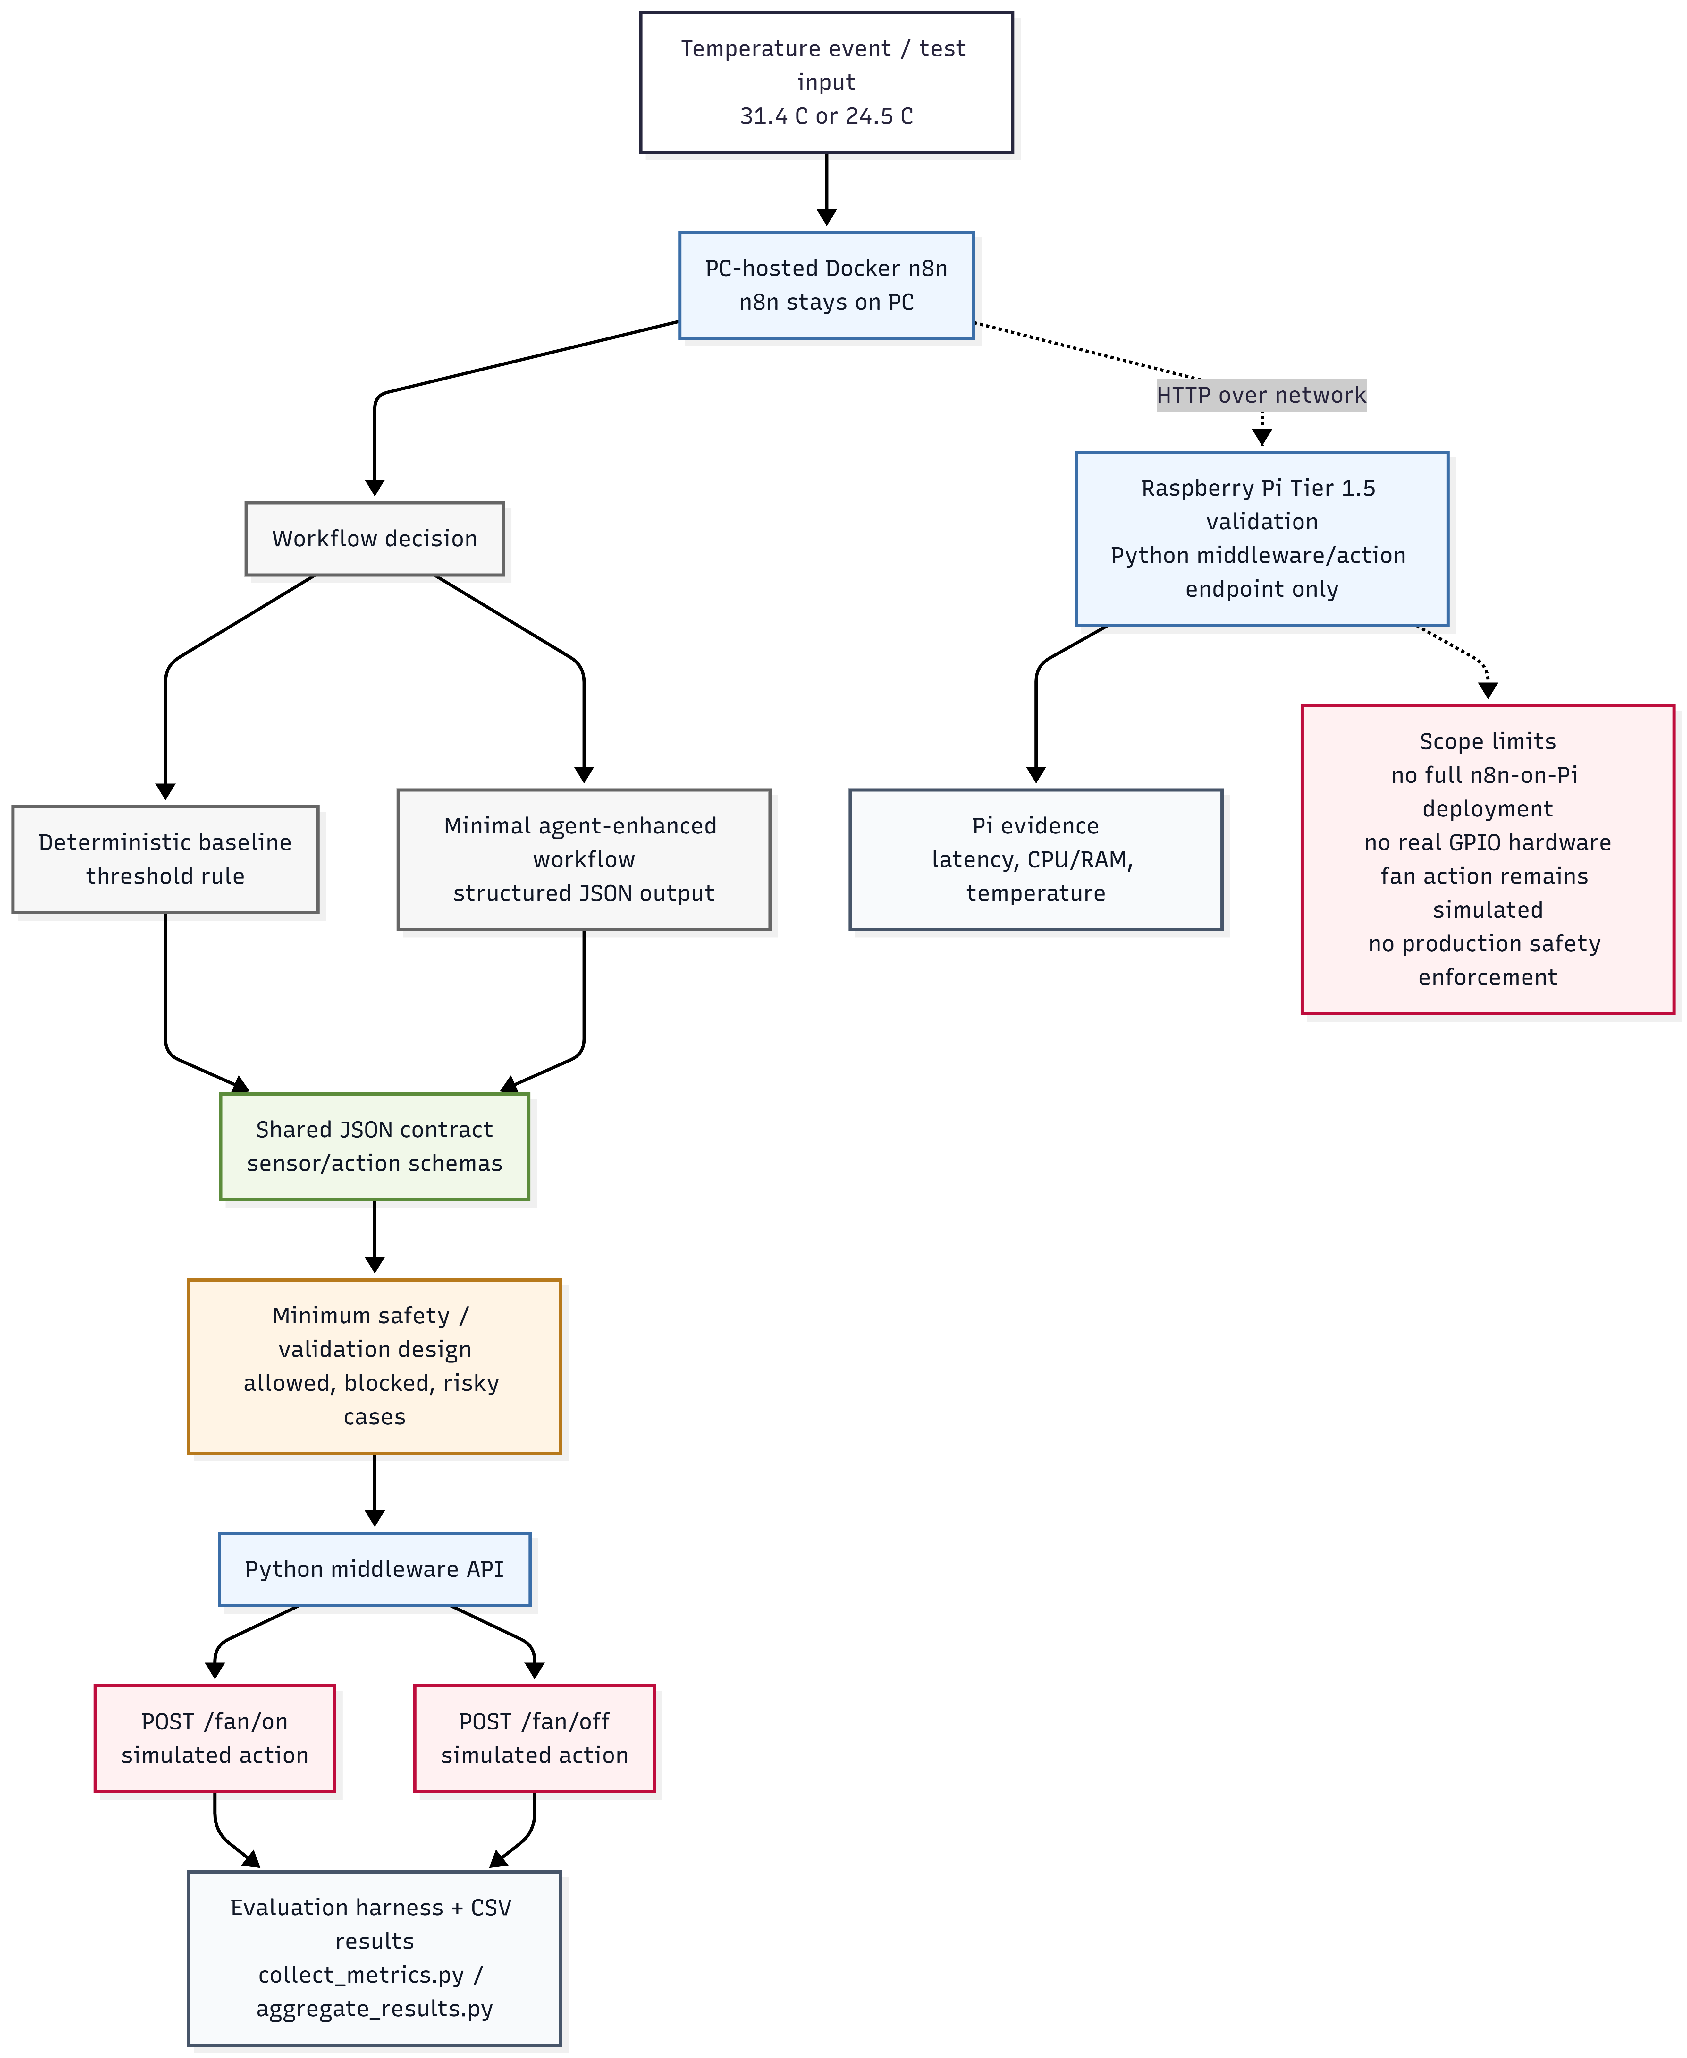
Final system overview
Mock temperature input → n8n workflow → Python middleware → simulated fan state →
recorded evidence
This is the main workflow-to-action chain evaluated in the thesis.

Slide 6
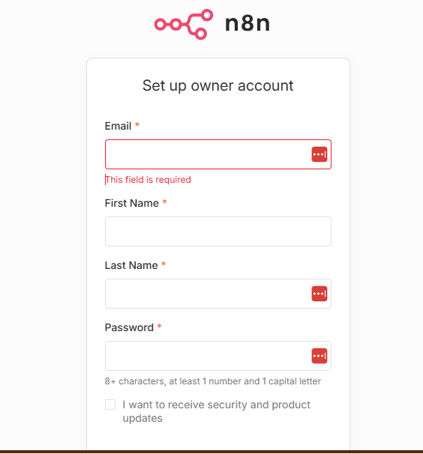
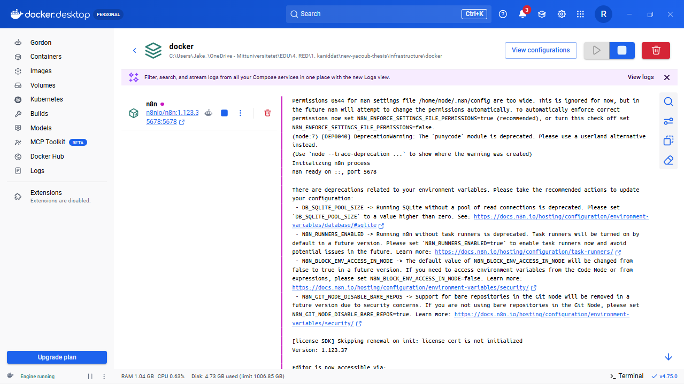
n8n and Docker
• n8n runs locally through Docker
• Docker Compose starts the workflow environment
n8n at localhost:5678
• n8n opens at localhost:5678
Docker Compose
Docker was the practical way to run n8n locally.

Slide 7
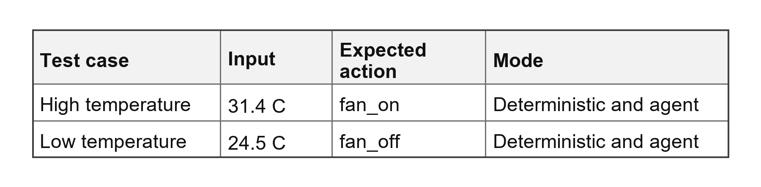
Temperature input as a mock sensor event
The temperature is manually sent as a mock sensor event.
It imitates what a real sensor could send later.
No real thermometer/GPIO sensor is used in the core evaluation.
Example mock sensor event
{
"sensor_id": "temp_01",
"type": "temperature",
"value": 31.4,
"unit": "C",
"timestamp": "..."
}
sent to n8n
->
The mock sensor provides the input. n8n makes the decision.

Slide 8
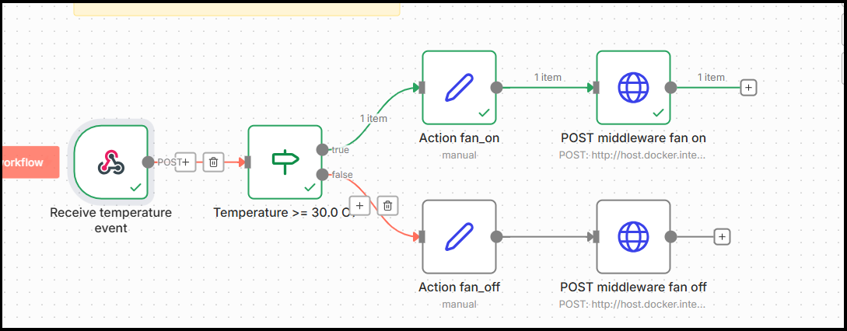
Deterministic workflow
Baseline rule:
1. IF node checks temperature
2. High temperature -> fan_on
3. Low temperature -> fan_off
n8n IF node decides the path.
No AI-Agent is used in this baseline.
The deterministic workflow gives a stable baseline for comparison.

Slide 9
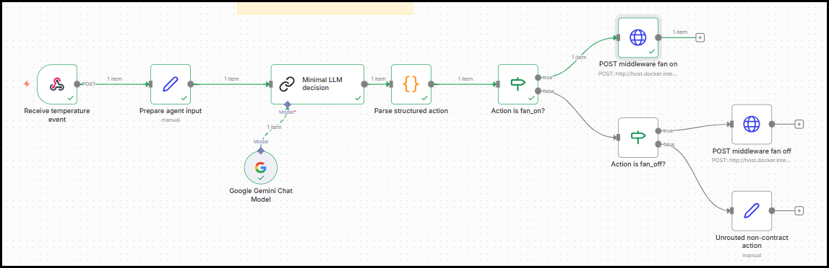
Agent-enhanced workflow
Agent path:
temperature event -> LLM step
-> structured action
Example structured output
{
"action_id": "fan_on",
"target": "fan_1"
}
1. LLM step
2. Structured action output
3. Sent forward to middleware
The threshold does not need AI.
The point is to test structured agent output in the same workflow-to-action setup.

Slide 10
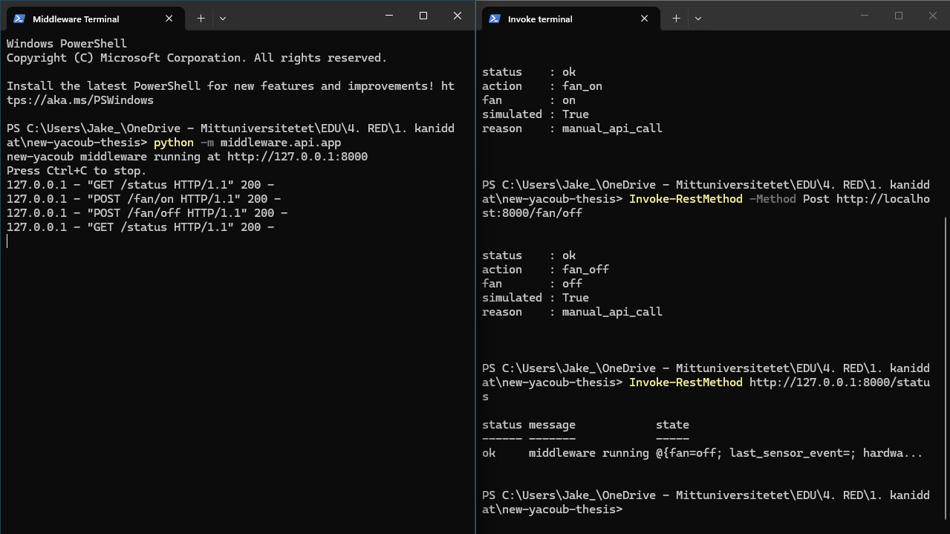
Python middleware and simulated fan
n8n decides. Python handles the action.
n8n decision
to
Python middleware
to
simulated fan state
Endpoints
POST /fan/on
POST /fan/off
GET /status
The Python middleware does not decide the temperature rule. n8n decides the action before calling the middleware.
n8n decides. Python handles the action. GET /status shows the result.

Slide 11
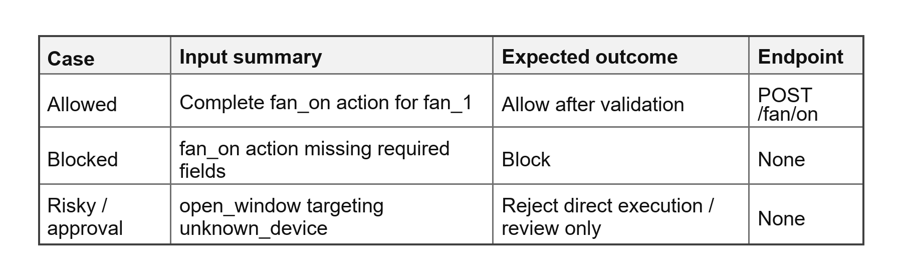
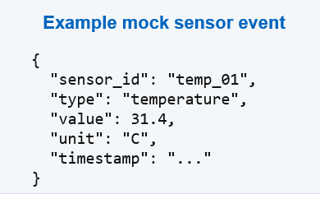
Contracts and safety design
Shared contracts
Safety layer
Runtime
expected message format
documented allowed / blocked cases
narrow fan_on / fan_off surface
This is documented validation design, not full runtime enforcement.
Full runtime schema validation and HITL approval were left as future work.

Slide 12
Evaluation setup
Proof-of-concept evidence,
not a broad benchmark.
Checks expected behavior in controlled cases.
Controlled test cases
Evidence recorded
31.4 C -> expected fan_on
- selected action
24.5 C -> expected fan_off
- success / failure
- latency observations
- resource observations
The evaluation checks whether the
workflow-to-action chain behaves as
expected.
The goal is measurable proof-of-concept evidence.

Slide 13
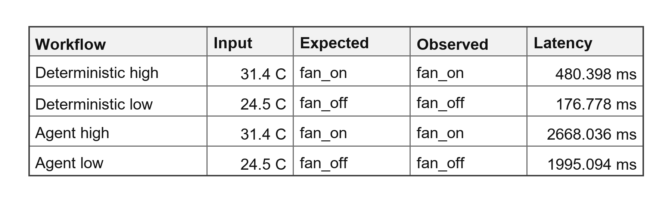
Local results
Both local workflow paths produced the expected action.
The agent-enhanced path had higher latency observations.
Latency observations,
not a statistical benchmark.
High temperature -> fan_on
Low temperature -> fan_off
Structured action output
Higher agent latency
Local workflow-to-action chain worked and produced recorded evidence.

Slide 14
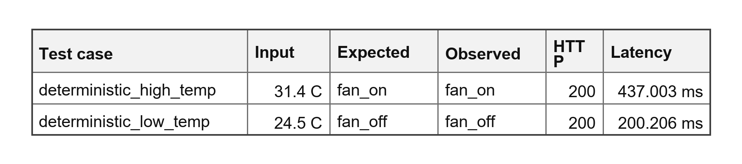
Raspberry Pi validation
PC-hosted n8n
workflow stayed on PC
Network call
HTTP action request
Raspberry Pi middleware
Python action endpoint
->
->
This validates the action endpoint on separate hardware, not full n8n-on-Pi deployment.
Pi validation results
single-run proof-of-concept observations
31.4 C -> fan_on 24.5 C -> fan_off
Separate-hardware action endpoint validation, not full n8n-on-Pi deployment.

Slide 15

Societal contribution
The fan is a controlled proxy. The real value is the event -> validation -> action pattern.
Responsible automation needs boundaries and evidence.
Event
input signal
->
Workflow decision
chosen action
->
Validation boundary
contract check
->
Middleware action
endpoint call
->
Recorded evidence
result trace
Broader relevance
Smart buildings
Industrial monitoring
Environmental sensing
Health / environment
ventilation, heating, lighting
alerts and controlled responses
air quality, humidity, water level
traceable notifications, approved actions
Possible future use cases, not operational deployment.
The exciting part is not the fan.
It is the responsible structure around future event-driven systems.

Slide 16
Conclusion and limitations
A complete workflow-to-action proof of concept was built and evaluated.
RQ1: How accurately does the deterministic workflow produce expected fan actions?
RQ2: How accurately does the agent-enhanced workflow produce contract-valid action output?
RQ3: What latency, resource, and deployment behavior is observed locally and in Pi middleware validation?
What was shown
Limitations
- n8n selected actions from temperature input
- deterministic and agent paths produced expected actions
- Python middleware handled the simulated fan action
- Raspberry Pi validation showed separate-hardware action endpoint behavior
- evidence was recorded
- simulated fan
- small number of test cases
- single-run latency observations
- safety layer mainly documented design
- full runtime schema validation and HITL approval remain future work
The contribution is the measured structure around the fan action, not the fan itself.

