Slide 1

Mid Sweden University
– a centre of knowledge and creativity

Slide 2

Mid Sweden University works for
Openness, kinship and diversity
Lifelong learning
Sustainable development
Education in close collaboration with working life
Distance learning at the forefront
High quality research
Close co-operation with the surrounding community
Notes:
• The fact that Mid Sweden University offers higher education at home contributes to more people having the opportunity to choose to study, without having to move. This in turn contributes to us in the region getting an increased proportion of skilled labor. • With the investment in the University of Children, Mid Sweden University establishes contact at an early age and can then arouse curiosity for higher studies and research.

Slide 3
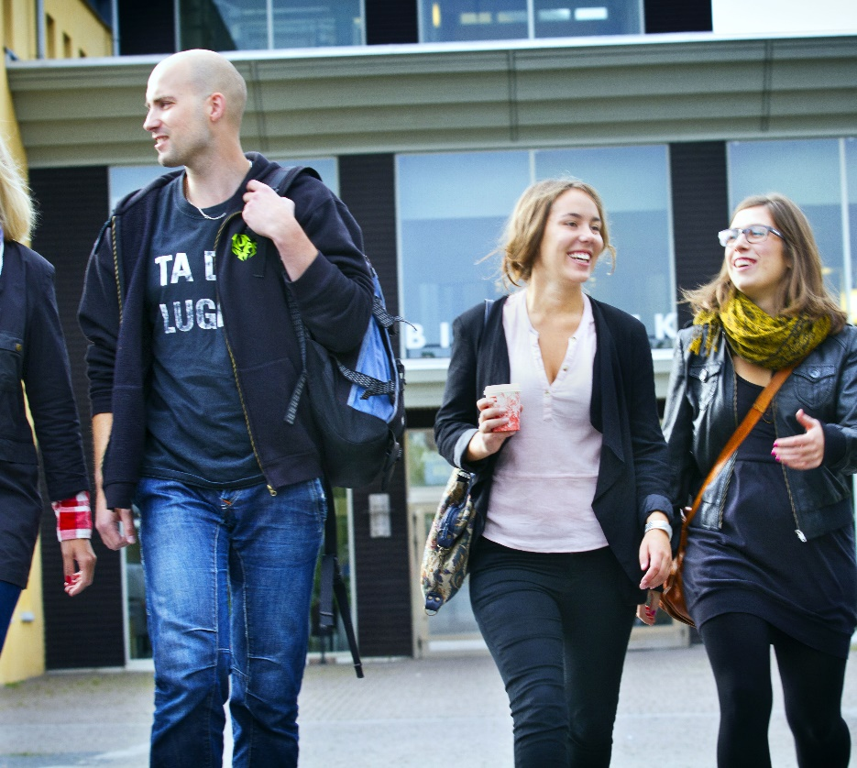
The university’s contribution to the region
A population increase of about 39,000 people in the last 30 years 84% of the students from Jämtland or Västernorrland counties remain in the region three years after graduation
Half of the total number of students remain in the region five years after graduation 85% of the students have a job one year after graduation
Notes:
• Mid Sweden University contributes to immigration and rejuvenation - half of those who graduated from Mid Sweden University remain in the region five years after graduation. The figure is higher compared to the reference universities. • Mid Sweden University reduces emigration - 84% of the students recruited from Jämtland and Västernorrland counties remain in the region three years after graduation. The figure is higher compared to the reference universities. • Studies at Mid Sweden University provide jobs - 85% are established in the labor market one year after graduation. • The investment in increased working life connection yields results - the proportion of alumni who have a weak or uncertain position in the labor market has decreased steadily since 2010
Source: SWECO 2020

Slide 4
Facts about Mid Sweden University

Slide 5
Mid Sweden University in numbers
27 619 students
480 courses
60 Bachelor’s programmes
40 Master’s programmes
1 260 employees
125 professors
Turnover just over SEK 1,25 billion
Notes:
Mid Sweden University in numbers
Number of students is based on the calendar year 2025 and includes both grant-rounding and non-grant-rounding students, rounded figure
27 619 students
480 courses
60 Bachelor’s programmes
40 Master’s programmes
1 260 employees
125 professors
Turnover just over SEK 1,25 billion

Slide 6
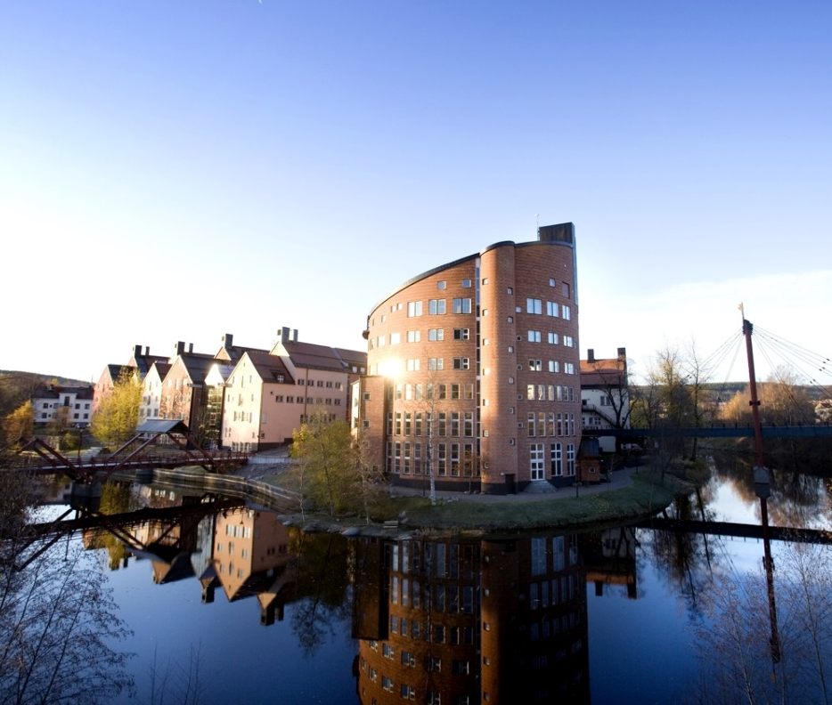
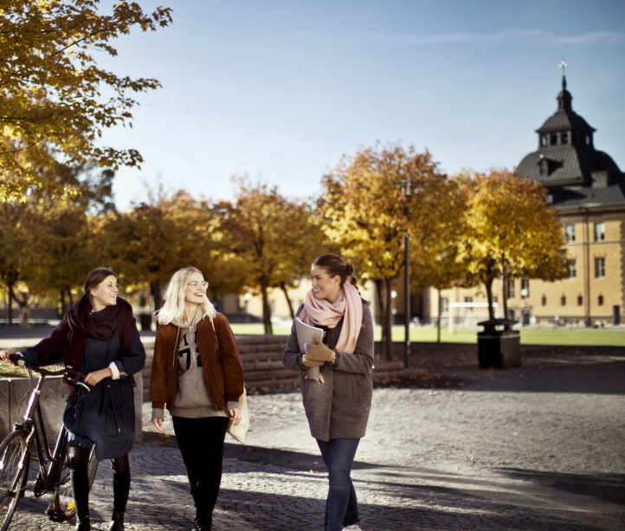
Two campuses
Campus Sundsvall
Campus Östersund

Slide 7
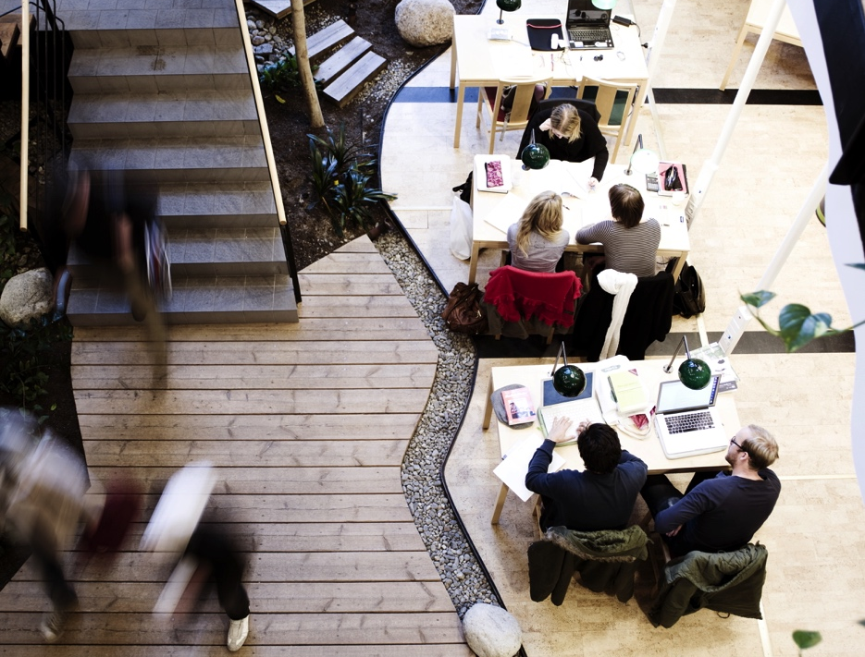
The University Library in numbers 2021
The university library is the heart of the university. It plays a crucial role in supporting and promoting learning, research and the dissemination of knowledge within both the university and society at large. Here you can both find and create knowledge and get tools for learning and success.
Notes:
Mid Sweden University has its own libraries in Sundsvall and Östersund. The university library offers services to students, employees and the general public.
Year 2021
· 707 916 usages/downloads of e-articles / section e-books
· 34 054 lending of printed books
· 92 883 visits to the library premises (during pandemic)
· 3 551 participants in the University Library’s teaching / supervision
The University Library’s mission is to offer library services and learning support. The learning support includes making literature available, supporting information competence in the education and offering an inspiring study environment for students. In addition, there is a growing publishing support activity aimed at researchers. The library also has the function of a workplace library for all employees at the university and is open to the public.

Slide 8
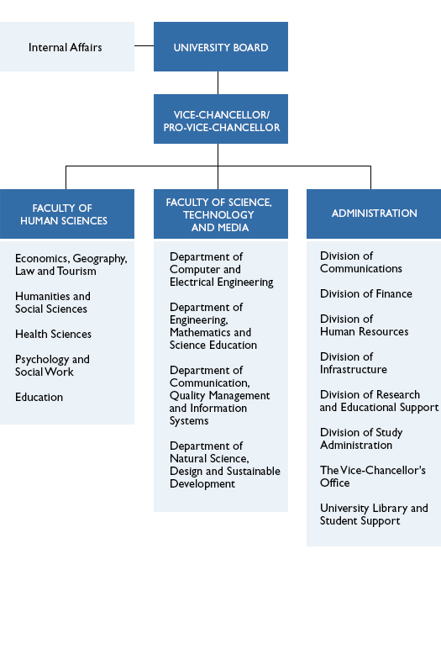
Organisation

Slide 9
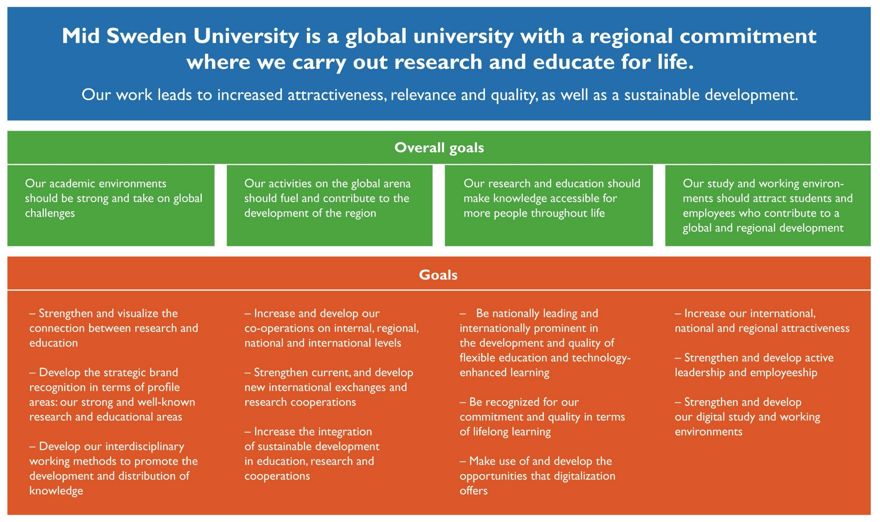
Strategy and vision
Notes:
Mid Sweden University's board decided in 2018 on a strategy for the period 2019-2023.
The strategy gives the business the conditions to plan and implement activities that contribute to common goals. Four general concepts have been identified which describe what Mid Sweden University wants to strengthen and what effects we want to achieve.
• Sustainable development - what we do must work not only today but also in the future. Our educations and our research must be consistently oriented towards building a resource-efficient, equal, gender-equal and sustainable society. We must actively and visibly contribute to the UN's global goals, in order to also contribute to a better future. We will strengthen the sustainability culture among Mid Sweden University's staff and students.
• Relevance - our educations and our research must be in demand because they take their natural starting point in societal processes. We will work interdisciplinary and with a connection to the outside world where we see our surroundings as a resource. We must benefit from and contribute to the development of our environment, both in the public sector and in business and civil society.
• Quality - everything we do must be permeated by high ambitions and recognized quality with knowledge development as a guiding star, whatever form it may take.
• Attractiveness - we must be a university that is noticeable and visible. Our youth, our ambitions and our flexibility are our strengths. We will expand and strengthen our networks and collaborations, and our recruitment will be even more clearly directed towards international contexts.

Slide 10

Vision
Mid Sweden University is a global university with regional involvement where we research and educate for life.
Our work leads to strengthened attractiveness, relevance and quality as well as to sustainable development.
Notes:
Figures 10–11 are enlargements of the vision and goals presented in Figure 9.

Slide 11

Overall goals
• Our academic environments are strong and address global challenges
• Our operations in the global arena drive and contribute to regional development
• Our research and education make knowledge available to more people throughout their lives
• Our study and work environment attracts students and employees who contribute to global and regional development
Notes:
Figures 10–11 are enlargements of the vision and goals presented in Figure 9.

Slide 12

Together we realize opportunities
At Mid Sweden University, we create an environment that makes it possible for students and researchers to achieve their goals together with us.
Effects we want now:
Sustainable Development
Social relevance
Recognized quality
Attractiveness through flexibility, strong collaborations and internationalization
Notes:
Four general concepts have been identified which describe what Mid Sweden University wants to strengthen and what effects we want to achieve.
• Sustainable development - what we do must work not only today but also in the future. Our educations and our research must be consistently oriented towards building a resource-efficient, equal, gender-equal and sustainable society. We must actively and visibly contribute to the UN's global goals, in order to also contribute to a better future. We will strengthen the sustainability culture among Mid Sweden University's staff and students.
• Relevance - our educations and our research must be in demand because they take their natural starting point in societal processes. We will work interdisciplinary and with a connection to the outside world where we see our surroundings as a resource. We must benefit from and contribute to the development of our environment, both in the public sector and in business and civil society.
• Quality - everything we do must be permeated by high ambitions and recognized quality with knowledge development as a guiding star, whatever form it may take.
• Attractiveness - we must be a university that is noticeable and visible. Our youth, our ambitions and our flexibility are our strengths. We will expand and strengthen our networks and collaborations, and our recruitment will be even more clearly directed towards international contexts.

Slide 13
Wide range of programmes and courses

Slide 14
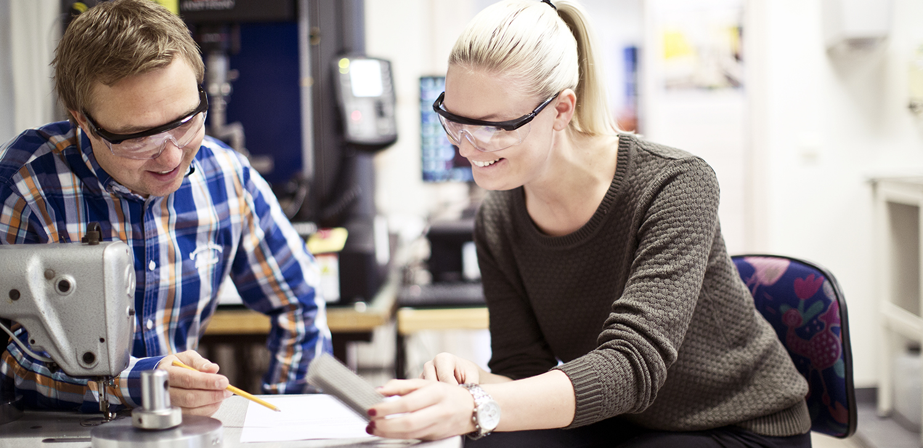
Attractive courses and programmes of high quality – for lifelong learning
Notes:
Offer courses and programmes that:
are attractive and of high quality
we are able to recruit students to
are conducted in close collaboration with working life
offer a clear educational focus
are connected to research
Our education should be characterized by:
educational awareness
closeness
flexible type of instruction
international study environment
critical thinking and acquiring knowledge individually as key concepts

Slide 15
The distribution of students between the two campuses
A total number of about 25 000 students (2025)
Campus Sundsvall, 2,506
Campus Östersund, 2,431
The rest of the students take web-based courses without campus lessons.
Notes:
Number of individuals on the teaching forms Campus and Distance, 2025
Mid Sweden University has a total of approximately 25,000 students (calendar year 2025, including summer courses and non-grant-based programs)
Sundsvall, 2,506 (2025) - individuals studying on campus (distance education with meetings on campus is not included in this figure).
Östersund, 2,431 (2025) - individuals studying on campus (distance education with meetings on campus is not included in this figure).
Summer courses:

Slide 17
Where do the students come from?
Mid Sweden University recruits many students from Stockholm, Västra Götaland, Skåne, and Uppsala. New students, autumn semester 2025: 14.5 % of the university’s new students come from Jämtland and Västernorrland – 5.5% from Jämtland and 9% from Västernorrland. Almost half, 45%, come from the metropolitan regions. The remaining 43.5% come from other parts of the country.
Notes:
The most common recruitment area for new students at Mid Sweden University is, as for many other higher education institutions, Stockholm County.
During the 2025 academic year, recruitment from the counties where the university’s campuses are located – Västernorrland and Jämtland – accounted for just under 15% of all new students.
Source: LISA

Slide 18
Programmes at Mid Sweden University
Access programme
Behavioural Sciences programmes
Master of science engineering programmes
Economy programmes
Sports programmes
Engineering programmes
Computer programmes
Programmes in Fine, Applied and Performing arts
Teacher Training programmes
Media programmes
Environment and Natural Sciences programmes
Programme in Psychology
Social Sciences programmes
Programme in Social Work
Languages and Humanities programmes
Tourism programmes
Health Sciences programmes

Slide 19

Closeness to new knowledge by means of collaboration
Business councils
Field studies
Study visits
Internship and degree projects
Mentor programmes
Participation in networks and conferences
Innovation support
Miun Innovation supports student entrepreneurship
Notes:
All students at Mid Sweden University have the opportunity to receive advice on issues of idea development and entrepreneurship at Miun Innovation. It is part of the university's investment in working life and support for students' entry into the labor market.

Slide 20
Useful research of high quality

Slide 21
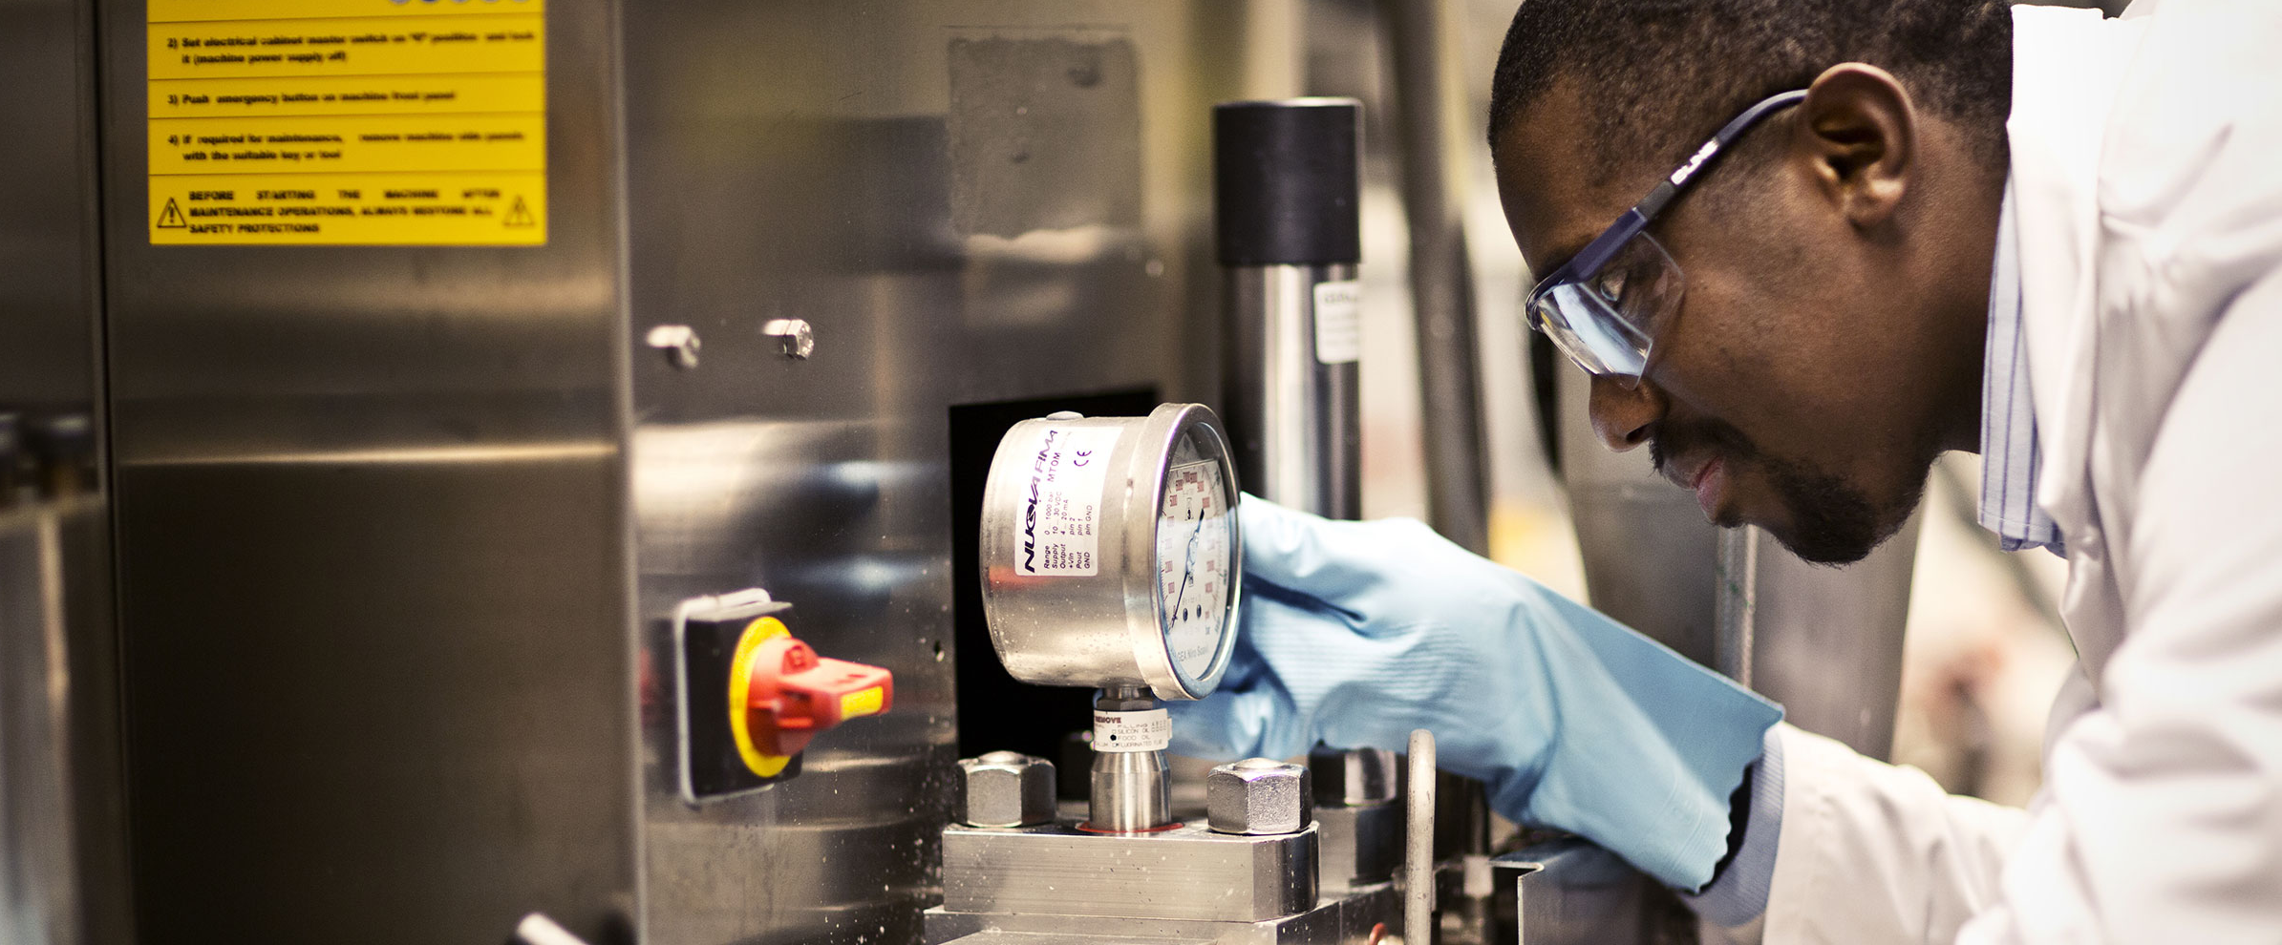
Research of high academic quality relevant to the surrounding society
Notes:
Aims according to the research strategy:
• Strengthen and make visible the connection between research and education
• Develop profiled, strong and well-known research and education areas
• Develop our disciplinary approaches to promote knowledge development and dissemination
• Increase and develop our collaboration internally, regionally, nationally and internationally
• Strengthen existing and develop new international exchanges and research collaborations
• Increase the integration of sustainable development in education, research and collaboration

Slide 22
Development of research 2005–2024
Notes:
Dark blue curve: Government researchfunding (SEK Million)
Orange curve: PhD Students (number)
Light blue curve: External funding for research (SEK Million)
Red curve: Professors (number)

Slide 23
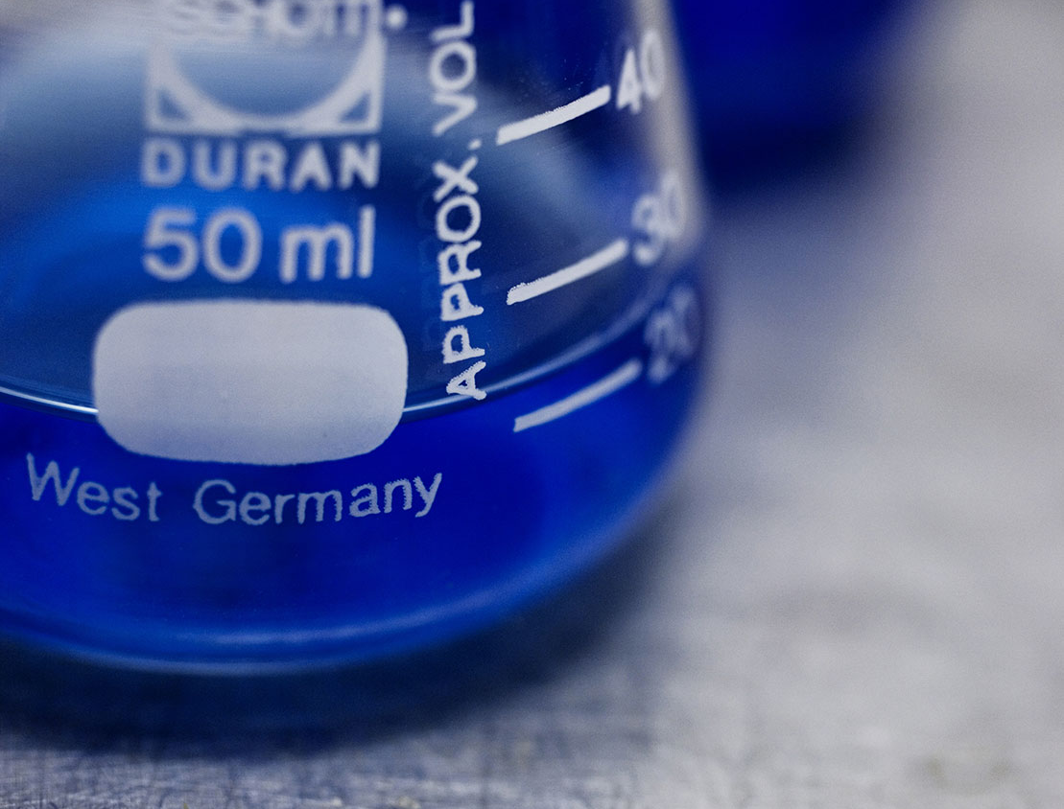
Research at Mid Sweden University
is partly organized in research centres and partly in subject research and research groups
is, to a great extent, conducted and made use of in direct collaboration with external partners
has a clear connection to first-cycle programmes and courses
Notes:
The center formations are arenas for collaboration and spearheads in their research areas. A forum is a university-wide and multidisciplinary work unit that serves as a meeting place for researchers and stakeholders.

Slide 24
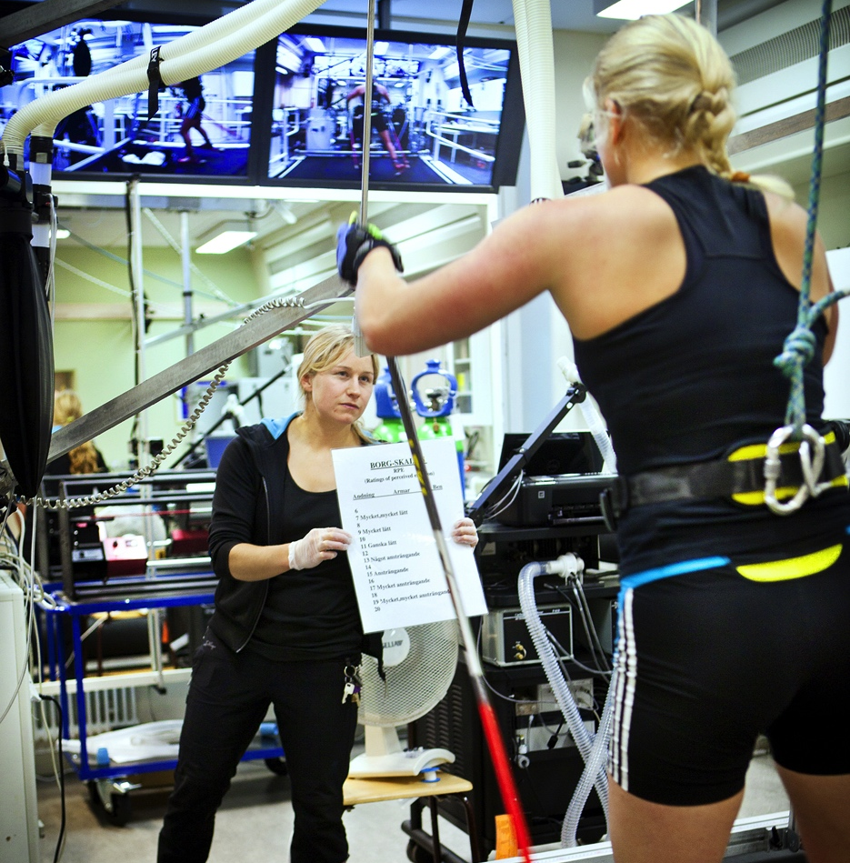
Profiled research areas
Mid Sweden University has eight different research centres. Several of them are world leading within their fields of research.
The centres also works as platforms for cooperation with financiers and other parties.

Slide 25
Research centres
CER – conducts industry-oriented research on economic relations of individuals and companies in the banking, insurance, pension, audit and real estate industries
DEMICOM – conducts research on democracy and communication in the digital community
ETOUR – develops and communicates scientific knowledge about tourism and travel
FSCN – conducts world-leading research in collaboration with the industry in subprocesses from forest to paper, biomaterial and new products

Slide 26
Research centres
NVC – research in winter sports/skiing, performance and health
RCR – develops and communicates knowledge about risk, crisis and security
Sports Tech Research Centre – research in sports technology and products for outdoor and sports activities as well as products meeting the demands of people with disabilities
STC – develops sensor-based systems and services in electronics and computer science with a focus on industrial IT and digital services

Slide 27
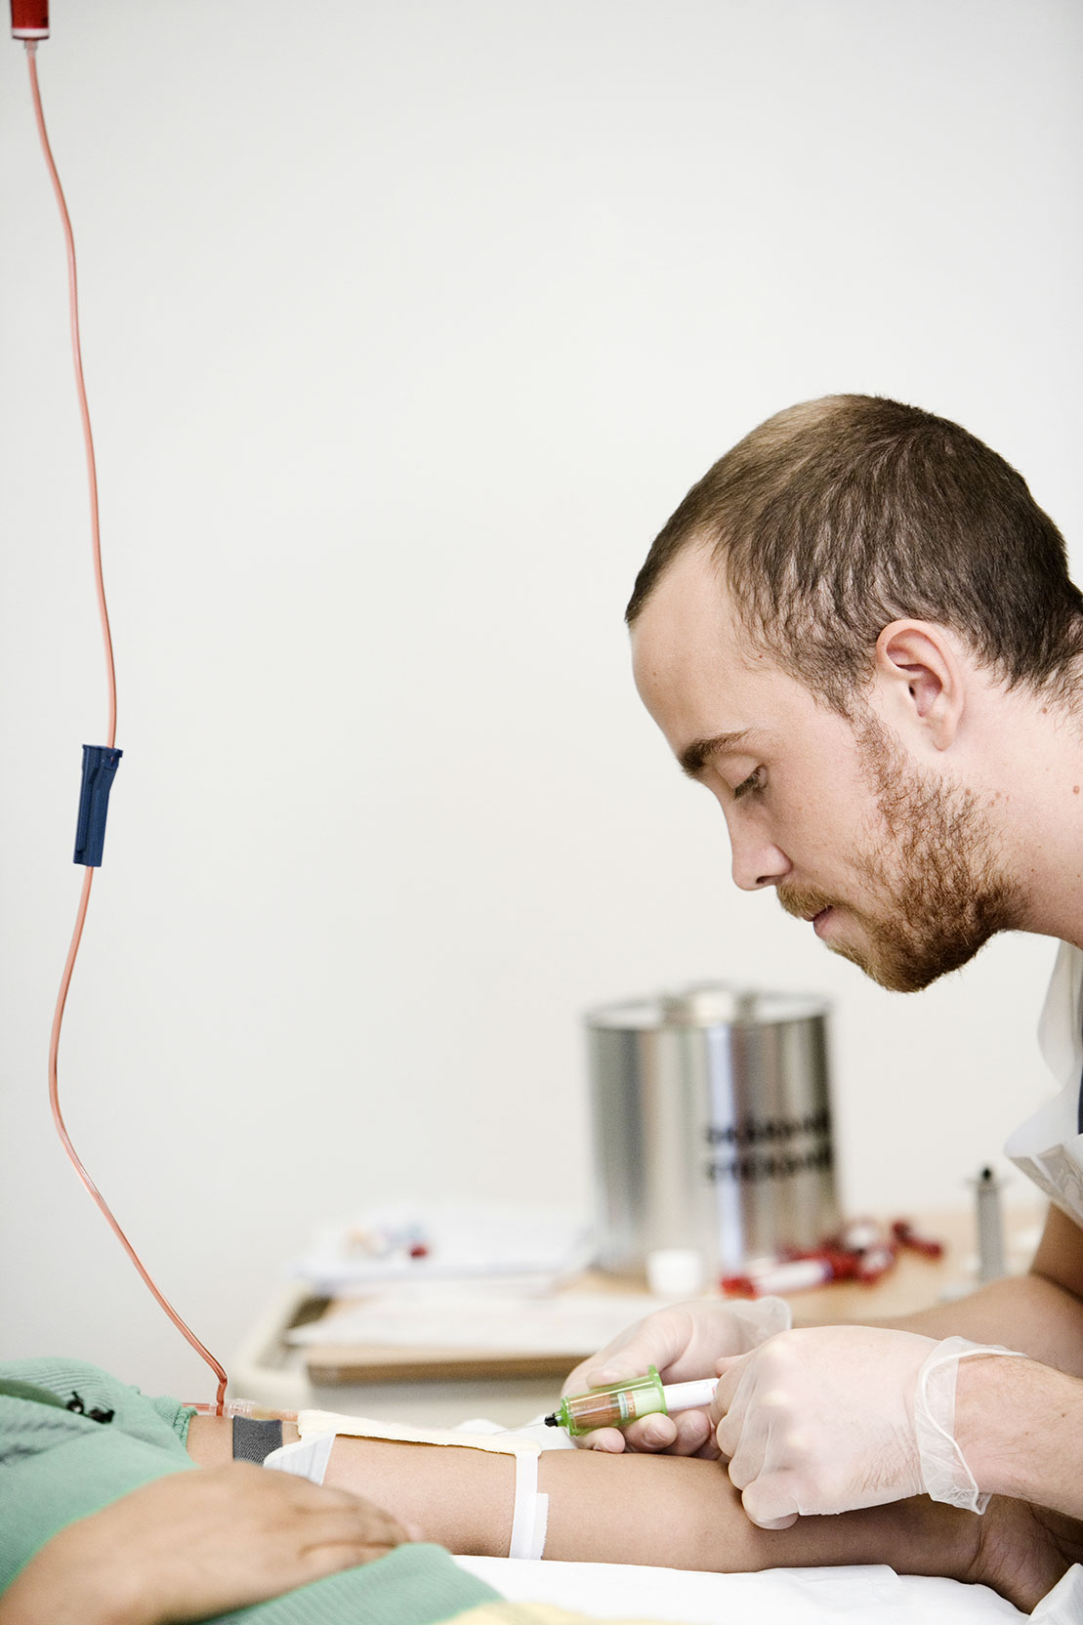
Subject research
Research connected to big and important first-cycle educational areas
A great part of subject research deals with the welfare sector, for example school, care and nursing
Notes:
Subject research
Within Mid Sweden University, research is conducted in all scientific areas. This leads to a broad range of research projects and qualified researchers. One example is research related to big and important first-cycle educational areas. Since most researchers also teach, first-and second-cycle students get a natural insight into and a connection to the research conducted at Mid Sweden University in a certain subject.

Slide 28

Utilization of research
Innovation support for researchers
Commercialization of research and knowledge
Mid Sweden University is part of an innovation office commissioned by the state - the innovation office Fyrklövern

Slide 29
Contact Phone +46 10 142 80 00 E-mail kontakt@miun.se Web miun.se

