Slide 1

AI journey planner + transaction engine
morrovia
Turn travel intent
into booked trips.
A lean, founder-led travel product that helps people build confident routes, then monetises hotels, flights, activities and trip essentials at the exact decision moment.
Revenue + funding pitch deck
morrovia
01

Slide 2

Planning leaks value
Travellers arrive with intent, but the buying journey is scattered across search, maps, blogs, spreadsheets and booking sites.
1
2
3
Fragmented decisions
Low confidence
Lost transaction moment
Routes, stays, flights and activities are planned in different places.
People struggle to know if the sequence, duration and logistics actually work.
Most planners hand users away before the booking decisions are made.
Morrovia’s opportunity is to keep the traveller inside one decision flow until the trip becomes bookable.
morrovia
02

Slide 3
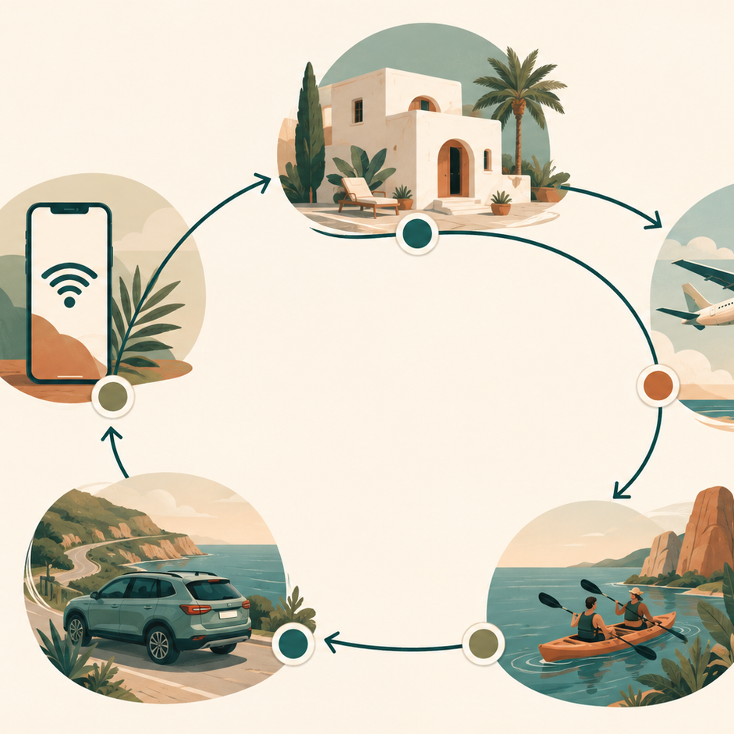
Morrovia sits inside the decision
Not another travel blog. A planner that moves users from idea to route to specific booking actions.
01
Start with intent
“I have 2 weeks in Japan and China.”
02
Build the trip
Dates, route, pace, interests and trade-offs.
03
Make it bookable
Hotels, flights, activities and essentials appear at the right moment.
The commercial model works because recommendations are contextual: the user already needs to book the next part of the journey.
morrovia
03

Slide 4
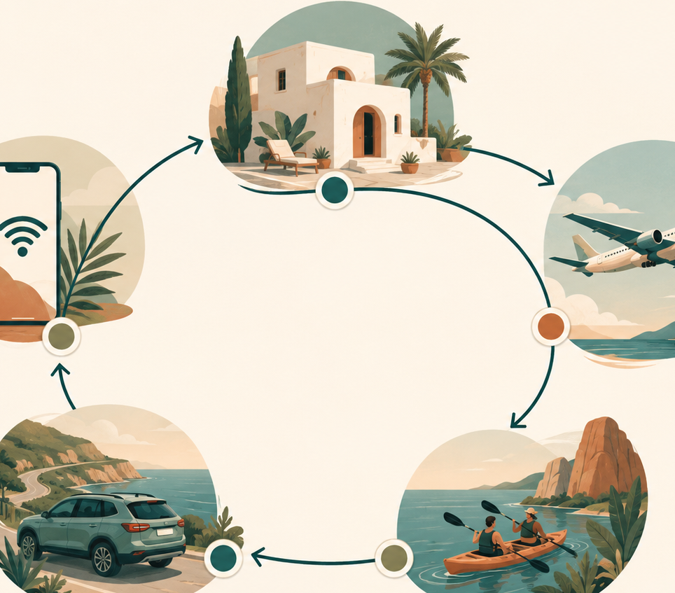
The revenue stack is the trip
A single holiday contains multiple commercial decisions. Morrovia can monetise the sequence without feeling like ads.
Accommodation
Core booking moment
£40
Flights
Before route locks
£10
Activities
Inside each day
£10–15
Car rental
Only where useful
£4–6
eSIM + transport
Preparation layer
£2–5
Blended value per completed trip: ~£70.50 before paid products.
morrovia
04

Slide 5

Per-trip economics become meaningful
The Year-1 model uses conservative affiliate assumptions plus a lightweight paid trip product.
~£70.50
+ £14.99
affiliate revenue per completed trip
optional Morrovia Trip Pass
Accom
£40
Flights
£10
Activities
£12
Car
£5
Other
£3.5
Working assumptions only. Real performance depends on traffic quality, affiliate acceptance, basket size and conversion.
morrovia
05

Slide 6
The three metrics that matter
Morrovia’s revenue model should be explained through three simple levers: qualified planners, booking conversion and average affiliate income.
MAUs
Booking conversion
Avg. affiliate income
1,000
12%
£70
qualified active planners / month
planners who complete bookings via Morrovia
per completed monetised trip
MAUs × booking conversion × average affiliate income × 12 = annualised revenue
Year 1 model: 1,000 MAUs × 12% booking conversion × £70 × 12 = ~£100.8k ARR.
Important: at 10% conversion, 1,000 MAUs is ~£84k ARR. The £100k target assumes roughly 12% conversion or a small amount of direct Trip Pass revenue.
morrovia
06

Slide 7
The growth targets are simple
The deck should anchor around MAUs, booking conversion and average affiliate income — not generic traffic.
Milestone
MAUs
Booking conv.
Avg. income
Annualised revenue
Year 1
1,000
12%
£70
£100k ARR
Year 2
5,000
12%
£75
£540k ARR
Year 3
10,000
12%
£70
£1.0m ARR
Year 3 target: 10,000 qualified planners/month × 12% conversion × £70 = ~£84k/month, or ~£1.0m ARR.
The major investor question becomes: can Morrovia reach 10k high-intent planners/month and maintain ~12% booking conversion?
morrovia
07

Slide 8
Funding: validation capital, not a big pre-seed
With no founder salaries in Year 1, Morrovia can be tested cheaply before raising serious growth capital.
£5k
£10k
£20k
Founder-funded launch
Angel buffer
Full validation push
MVP, analytics, basic APIs, first organic/social tests.
More creator tests, paid acquisition signal, faster learning.
Enough room to actively chase the Year-1 £100k run-rate.
Raise only enough to learn: can we acquire qualified planners, convert bookings and prove £50–£70+ revenue per monetised trip?
morrovia
08

Slide 9
Minimum viable budget
Spend only against proof. Keep most cash back until a channel shows signal.
AI, maps, hosting, software
£1–2k
Validation milestones
Analytics, testing, research
£0.5–1k
•
MVP live
•
100+ monetised trips
Creators + content experiments
£1–3k
•
measured revenue/trip
Paid acquisition tests
£1.5–5k
•
repeatable acquisition signal
Admin, company, legal/accounting
£0.5–1k
•
path to 1,000 planners/mo
The next raise should be based on evidence, not the idea.
morrovia
09

Slide 10

A small team with distinct lanes
More hands increase the odds of success — as long as roles are complementary and equity is earned through contribution.
Founder
Growth lead
Strategic angel
Product, design, product engineering, strategy
Sales, social, partnerships, creator distribution
Capital, investor network, commercial guidance
Product / AI advisor
Technical advisor
AI direction, prioritisation, team/product thinking
Architecture, code review, hard integrations
Team philosophy: do not minimise the team. Minimise unnecessary dilution.
morrovia
10

Slide 11
Equity framework: protect the cap table
Before traction, outside equity should stay small, specific and mostly vested.
<10%
3–6%
15%
target outside founder ownership before traction
likely externally allocated initially
hard ceiling unless co-founder calibre
Strategic angel
2–5% total, with contribution equity vesting
Product / AI advisor
0.25–1.5% depending on actual involvement
Technical advisor
0.1–0.5% unless they become core builder
Other advisors
keep combined pool under ~1% initially
Rule: pay extra equity for specific ongoing contribution, not availability or goodwill.
morrovia
11

Slide 12
Clean company setup
Keep Morrovia separate from the existing contracting Ltd before investment, IP and affiliate contracts build up.
Old UK Ltd
Keep as personal contracting vehicle. Do not mix client income with startup shareholders.
New Morrovia Ltd
Owns product, code, brand, domain, affiliate accounts and investment.
Remote-first setup
Incorporate online, use registered office, open business banking such as Revolut Business.
SEIS-ready path
Issue new shares directly from Morrovia Ltd if angel investment proceeds.
Clean entity. Clean IP. Clean cap table. Cleaner angel conversation.
morrovia
12

Slide 13
morrovia
A travel planner with a transaction engine underneath.
The near-term ask is intentionally small: launch, prove conversion and raise only when the data deserves it.
01
Launch MVP
02
Validate revenue
route builder, saved trips and trip pages
hotels, flights, activities and Trip Pass
03
Prove distribution
04
Decide next raise
1,000 MAUs at ~12% conversion
bootstrap, angel extension or seed
morrovia.com

