Slide 1

The Path-Finding Algorithm A*
Cavelli Rosario Francesco
Cerra Michele
Colotti Manuel Enrique
System and Device Programming

Slide 2

Contents
1- Introduction
2- Benchmark Graphs
3- Design
4- Implementation
5- Plots
6- Experimental Results

Slide 3
Contents
1- Introduction
2- Benchmark Graphs
3- Design
4- Implementation
5- Plots
6- Experimental Results

Slide 4

Introduction
A* ALGORITHM
A* is a widely used best-first informed algorithm for traversing Graphs and finding optimal-cost paths. It extends Dijkstra’s algorithm by introducing the concept of Heuristic Function which plays a key role in making more optimal decisions at each step by estimating the distance between a given node and the destination.
The project was developed using the C language on a Unix-like environment and implements several versions of this algorithm, both sequential and parallel ones, with the goal of testing one against the other and getting a final result that summarizes their overall performances.

Slide 5
Contents
1- Introduction
2- Benchmark Graphs
3- Design
4- Implementation
5- Plots
6- Experimental Results

Slide 6

BENCHMARK GRAPHS
FILES CONTENT
Each file contains a benchmark Graph with a number of Vertices progressively growing from a few hundreds of thousands up to almost 30 millions.
All the file we used for developing and testing our different versions of the A* algorithms represent a portion of the road network of the United States of America.
Smallest files contain Graphs created considering a small urban or metropolitan area, while the biggest files contains the road network of different states and even of the whole Country.

Slide 7
BENCHMARK GRAPHS
FILE STRUCTURE
To reduce the memory needed we decide to store all graphs in binary files.
Each file is organized in 3 main parts:
First part: Number of vertices
  First 4 bytes contain the amount of vertices the graph is made of.
Second Part: Nodes list
  A list of all nodes and their characteristics follows. Each vertex is characterized by a pair of coordinates, stored using two float numbers.
Third part: Edges list
  Last part consists of a list of all edges. Each edge is represented as a pair of node indexes (int
  4 Bytes) plus the weight of the edge (float 4 Bytes)

Slide 8
BENCHMARK GRAPHS
FILE GENERATION
Since graph files we are using have a specific format, we implemented an additional feature that allows us to obtain binary files of the format described in the previous section by merging 2 ASCII files containing all information.
The program retrieves the paths of the sources files (one containing information about vertices and the other with information about edges), creates the final binary file and then starts merging the nodes list file with the one containing the edges list.

Slide 9
BENCHMARK GRAPHS
FILE LOADING
We created 2 different version of the function that is in charge of loading a graph file: one complete this
task in a sequential fashion, the other in a parallel one.
Sequential loading: read first the nodes and then the edges.
Parallel loading: it receives the number of threads N to be used. N/2 threads start reading all vertices, while the other N/2 threads read all edges.

Slide 10
Contents
1- Introduction
2- Benchmark Graphs
3- Design
4- Implementation
5- Plots
6- Experimental Results

Slide 11

DESIGN
DESIGN FOCUS
The main design choices concern the organization of the following data structures.
Graph
Symbol Table
Priority Queue
Queue

Slide 12
DESIGN
GRAPH
It is implemented as a semi-ADT.
The main data structure is a C structure in Graph.h containing:
The number of vertices.
The number of edges.
An array of adjacency lists, one for each vertex. Each list’s node contains a vertex id and the weigth of the edge connecting them.
A Symbol Table
A sentinel node that marks the end of each list.
A mutex used to lock the entire array of lists while loading the graph.

Slide 13
DESIGN
SIMBOL TABLE
Nodes in the graph are identified by a number starting from 0, and each node is characterized by a state having different feature.
The mapping from node to state is done by a symbol table of states, in our case the coordinates of the point in the map, that could be (latitude, longitude) or (x, y).
The ST is an ADT with dynamic array of Coordinates that expand itself if the max size is reached with the power of 2 method.
During the parallel load, concurrent accesses are protected by using a mutex, contained within the C structure representing the symbol table.

Slide 14
DESIGN
PRIORITY QUEUE
Very important data structure on which we rely for the execution of each variant of A*.
The priority queue is implemented as a min-heap of Items; each item contains two values identifying: the index of the node represented by the item, and as priority an estimate of the cost of the whole path that would be obtained by passing by that node Fscore.

Slide 15
DESIGN
QUEUE
The implementation of Distributed A* requires a data structure for the sending of the newly generated state/node to the processor/thread that owns it. This send must be asynchronous and non-blocking, in order to avoid synchronization overhead.
For this reason we designed an ADT Queue FIFO, a half-duplex linked list queue of HItems with pointers to head and tail.
Each element in a queue is of type Hitem. This etherogeneus data type represents a message and contains:
Index of the node to expand
Priority of the node, that is the cost found to reach it
Index of its father node
identifier of the owner-thread
Pointer to the next message in queue.

Slide 16
Contents
1- Introduction
2- Benchmark Graphs
3- Design
4- Implementation
5- Plots
6- Experimental Results

Slide 17

implementation
HEURISTICS
An heuristc h(n) is a function that gives an estimate of the cost of the path from one node n to the target t node.
The heuristics that we implemented are the followings:
Dijkstra Emulator4
Euclidean Distance
Haversine formula
  It determines the great-circle distance in meters between two points on a sphere given their longitude and latitude

Slide 18
implementation
HEURISTICS
The A* versions that we succesfully implemented are the followings:
Sequential A*
Simple Parallel A* (SPA*)
Hash Distributed A* (HDA*)

Slide 19
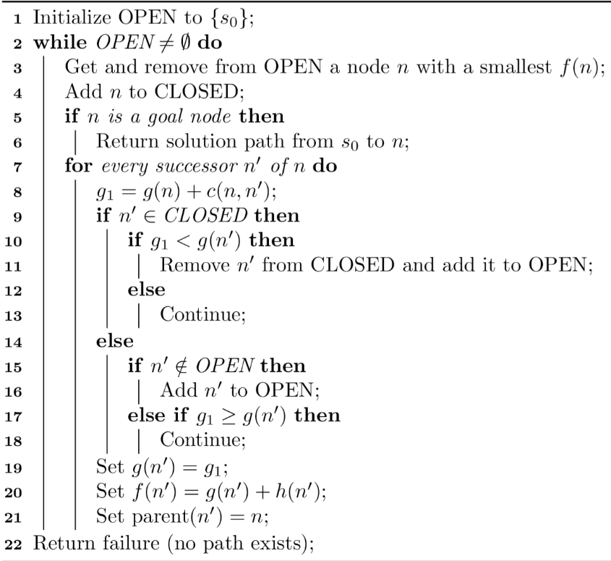
implementation
SEQUENTIAL A*
The first algorithm that we have implemented is a sequential version of A*, which works in the following way:

Slide 20
implementation
SINGLE PARALLEL A*
The first concurrent A* version that we have implemented is Single Parallel A* (SPA) which exploits thread level parallelism in order to find the best path.
We implemented it in two versions: in the first version we have used a single mutual exclusion to lock all the shared data structures, while in the second one we proceeded using a mutex for each single node of the graph.

Slide 21
implementation
HASH FUNCTIONS
To implement Hash-Based Decentralized A* (HDA*) we needed to use an hash function capable of dispatching nodes extracted from the openSet, to a precise thread/processor.
The hash functions that we are using for HDA* are:
Multiplicative Hashing
Zobrist Hashing (Tabular Hashing)
Abstract State Zobrist Hashing
Abstract Feature Zobrist Hashing
where on 4 Bytes

Slide 22
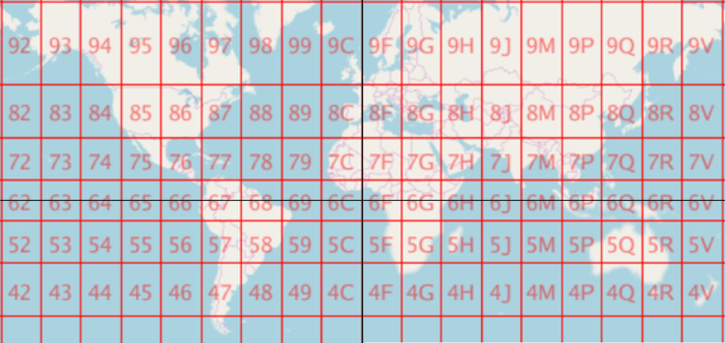
implementation
ABSTRACT FUNCTION
To implement Abstract Zobrist Hashing we had to implement an Abstract function.
An abstract function is a feature projection function, which is a many-to-one mapping from each raw feature
to an abstract feature.
In our implementation we used an approximation of the Open Location Code.

Slide 23
implementation
HASH DECENTRALIZED A*
The last concurrent version of A* is HDA*, the latter was implemented in two different variants:
HDA* with Master, in this version a pool of slave threads communicate with each other through the master.
HDA* without Master, here instead slaves can communicate directly with each other even though there is still a master thread whose only duty is to check the termination condition.

Slide 24
Contents
1- Introduction
2- Benchmark Graphs
3- Design
4- Implementation
5- Plots
6- Experimental Results

Slide 25

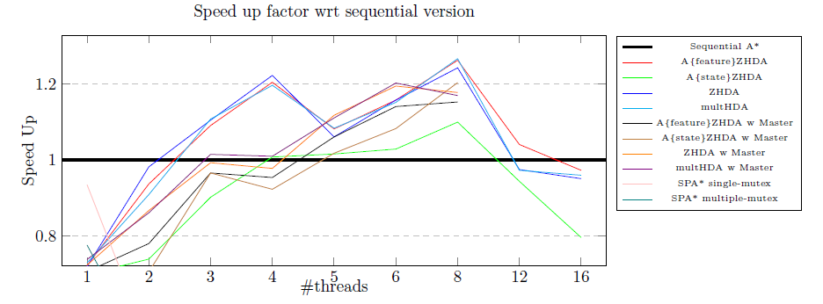
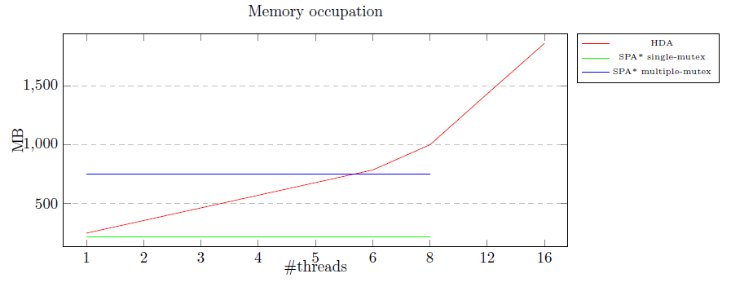
PLOTS
CENTRAL USA nodes: 14M edges: 34M

Slide 26
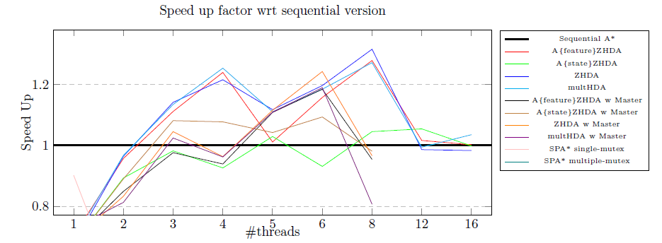
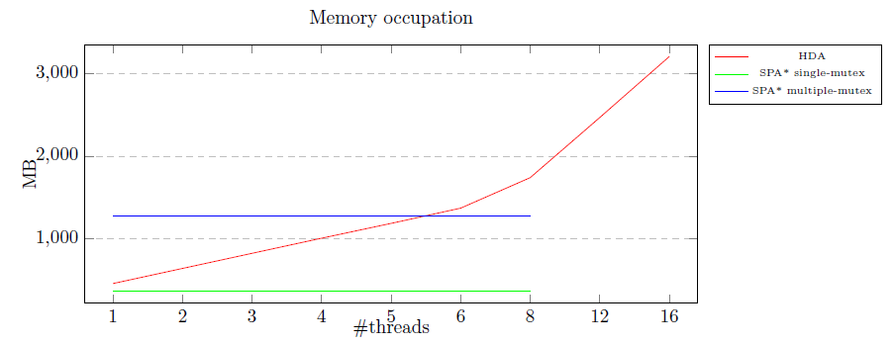
PLOTS
CENTRAL USA nodes: 24M edges: 58M

Slide 27
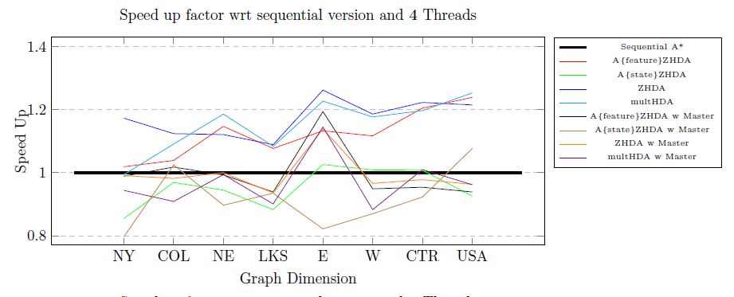
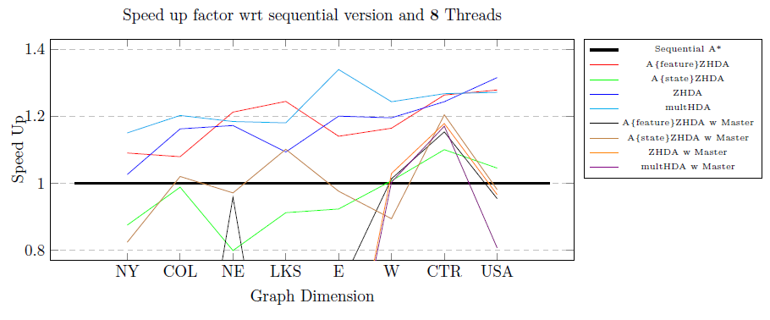
PLOTS
GRAPH DIMENSIONS COMPARISONS

Slide 28
Contents
1- Introduction
2- Benchmark Graphs
3- Design
4- Implementation
5- Plots
6- Experimental Results

Slide 29

EXPERIMENTAL RESULTS
CONCLUSIONS
In general we can say that the Speed Up increases with the increasing of the number of nodes in the graph.
Summarising the best algorithms are:
multHDA*
A{feature}ZHDA*
ZHDA*
, with 6 and 8 threads.
These algorithms always give a speed up in our tests using 4, 6 and 8 threads.

Slide 30
Thank you

