Slide 1


AngularJS
Giuseppe Mandato, Frontend Developer – Esis S.r.l
Open Source Web Application Framework (by Google).
KEYWORDS:
Client-side single page application
MVC – Model View Controller
User Interface => Declarative Programming
Business Logic => Imperative Programming
AJAX – JSON Web Server
Data Binding
Dependency Injection
Testability
GETTING STARTED:
Install Chrome
Install LiveReload / Install ng-inspector
$ git clone https://github.com/hitmands/angular-course.git
$ npm install
$ bower install
$ grunt release
$ grunt watch
$ node server.js
http://it.linkedin.com/in/giuseppemandato - g.mandato@esis-italia.com
1
Notes:
----- Note riunione (24/03/15 18:04) -----
Introduction

Slide 2
Concepts
Giuseppe Mandato, Frontend Developer – Esis S.r.l
Client Side
Single Page
Application
CLIENT SIDE APPLICATION:
It describes an application that doesn’t depend from the server (really, from the technologies used in the server).
WELCOME TO HTML5 PUSHSTATE API
SINGLE PAGE APPLICATION:
Also called SPA, describes a system that serves the whole application in a one, once loaded, page.
All static resources (css, scripts, templates) are served at the first GET request.
All dynamic resources (Domain-Model, ecc.) are served with AJAX.
app.get(‘*’, function(req, res) {
return res.sendFile( ‘index.html’ );
});

Slide 3
Concepts
Giuseppe Mandato, Frontend Developer – Esis S.r.l
M
V
C
S
MV*:
Originally introduced in server-side contexts, MVC – and its variations – is a Design Pattern that allows you to decouple the model from its rappresentation.
MODEL
DOMAIN MODEL
CONTROLLER
VIEW MODEL
VIEW
USER

Slide 4
Concepts
Giuseppe Mandato, Frontend Developer – Esis S.r.l
M
V
C
S
MV*:
Originally introduced in server-side contexts, MVC – and its variations – is a Design Pattern that allows you to decouple the model from its rappresentation.
MODEL
DOMAIN MODEL
CONTROLLER
SERVICES: VIEW-LESS BUSINESS LOGIC
VIEW MODEL
VIEW
USER

Slide 5
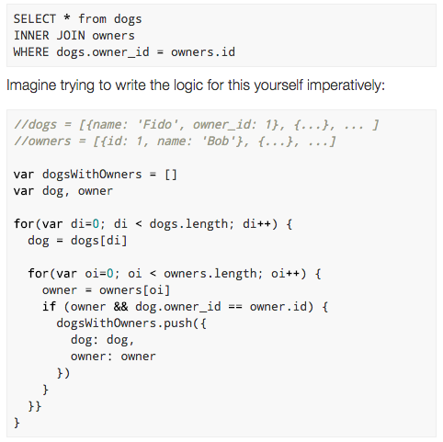
Concepts
Giuseppe Mandato, Frontend Developer – Esis S.r.l
Declarative
Imperative
Programming
ANGULARJS uses a Declarative approach when we have to build User Interfaces and uses Imperative approach when we have to do/add Business Logic.
ASK WHAT INSTEAD OF HOW
--Probably the best side of AngularJS--
--Probably the best side of AngularJS--

Slide 6
Concepts
Giuseppe Mandato, Frontend Developer – Esis S.r.l
Declarative
Imperative
Programming
ANGULARJS uses a Declarative approach when we have to build User Interfaces and uses Imperative approach when we have to do/add Business Logic.
UI? ASK WHAT INSTEAD OF HOW
<find-god where=“universe” />

Slide 7
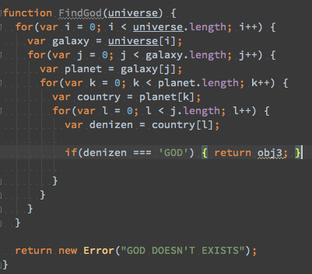

Concepts
Giuseppe Mandato, Frontend Developer – Esis S.r.l
Declarative
Imperative
Programming
ANGULARJS uses a Declarative approach when we have to build User Interfaces and uses Imperative approach when we have to do/add Business Logic.
BL?

Slide 8
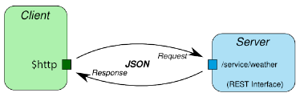

Concepts
Giuseppe Mandato, Frontend Developer – Esis S.r.l
AJAX
RESTFUL
JSON SERVERS
In a client-side web application the server doesn’t have to build user interfaces, this is that the client have to do!
The server should only process AJAX requests and respond, when is possible, with a json formatted result.

Slide 9
Concepts
Giuseppe Mandato, Frontend Developer – Esis S.r.l
DATA BINDING
Normally there are two types of data-binding aka ONE-WAY and TWO-WAY data binding.
…is the synchronization process of data between the model and the view components
MODEL
TEMPLATE
VIEW
ONE-WAY, or ONE-TIME MERGE question: ..if a change occurs?

Slide 10
Concepts
Giuseppe Mandato, Frontend Developer – Esis S.r.l
DATA BINDING
Normally there are two types of data-binding aka ONE-WAY and TWO-WAY data binding.
…is the synchronization process of data between the model and the view components
reflection
MODEL
VIEW
Compilation
propagation
Any changes of the view updates the model and any changes of the model updates the view. AUTOMATICALLY.
TEMPLATE
NOTE: The MODEL is the single-source-of-truth, the view is a projection-only model.

Slide 11
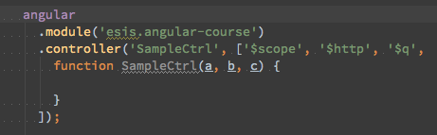
Concepts
Giuseppe Mandato, Frontend Developer – Esis S.r.l
DEPENDENCY INJECTION
A Software Design Pattern that allows to declare – and then retrieve – the needed dependencies at the software to work…
Generally:
Dependent
A system for the dependencies declaration
Injector
DECLARE THE DEPENDENCIES:
AS FUNCTION PARAMETERS [No in ng-strict-di]
USE THE $INJECT PROPERTY
USE THE ARRAY ANNOTATION SYSTEM
AngularJS DI implementation is very easy to understand:

Slide 12
Concepts
Giuseppe Mandato, Frontend Developer – Esis S.r.l
TESTING/TESTABILITY
This is NO-PART of this course… but…
Some useful information:
AngularJS DI gives you the possibility to mock everything, such as $http requests for example, so… you don’t have reason to avoid testing!
SEE:
ngMock and ngMockE2E modules
KarmaJS, Jasmine/Protractor, PhantomJS tools.
https://docs.angularjs.org/guide/unit-testing
https://docs.angularjs.org/guide/e2e-testing

Slide 13
Overview
Giuseppe Mandato, Frontend Developer – Esis S.r.l
The Angular Object:
NG
jqLite
/
$q
Utils
Module
and something else…
https://docs.angularjs.org/api

Slide 14
Overview
Giuseppe Mandato, Frontend Developer – Esis S.r.l
NG
THE CORE MODULE
Loaded by default, the NG module provides the basic components, such as services, directives, ecc., that allows the application to work.
… $http, ng-model, $scope …
https://docs.angularjs.org/api/ng

Slide 15
Overview
Giuseppe Mandato, Frontend Developer – Esis S.r.l
jqLite
$q
angular.element
Is a subset of jQuery, called jQuery Lite, it wraps a DOM Element into a jQuery Object.
Useful to manipulate the DOM in a crossbrowser way.
If jQuery exists, angular.element becomes a jQuery alias.
$q
A lightweight implementation of Kris Kowal’s Q. Based on Promises Design Pattern, this service helps you to work with asynchronously tasks.
If you want to work with AngularJS, you need to know Promises (ES6 – Specification).
https://docs.angularjs.org/api/ng/function/angular.element
https://docs.angularjs.org/api/ng/service/$q

Slide 16
Overview
Giuseppe Mandato, Frontend Developer – Esis S.r.l
Utils
angular[…]
A set of utilities that we can use in a wide variety of contexts…
angular.isString(); angular.foreach(); angular.fromJson(); angular.extend(); angular.equals(); angular.noop; angular.uppercase()
https://docs.angularjs.org/api/[…]

Slide 17
Bootstrap Process
Giuseppe Mandato, Frontend Developer – Esis S.r.l
Request URI
angularjs.js download
DomContentLoaded
Locating ngApp Directive (the root element)
$injector Configuration
Application Ready to work

Slide 18
Overview
Giuseppe Mandato, Frontend Developer – Esis S.r.l
Module
angular.module
The most famous angular method, returns module. All modules that should be available to an application must be registered in this way.
angular.module(name, requires[, configFn]);
angular.module(name);
https://docs.angularjs.org/api/ng/function/angular.module

Slide 19
Overview
Giuseppe Mandato, Frontend Developer – Esis S.r.l
Routing Definition; Services Configuration;
Services Decoration;
…
angular.module
…works as a jQuery-like getter&setter and is a container for all application parts that gives you the access for:
Configs
Providers
Constants
$injector Configuration
Services
Values
Factories
Providers[$get]
$inject Instance
Filters
Directives
Application Init
$rootScope Ready
Run[nners]
Scope[s]
Controllers
Views
Binding on:
DOM Events – MODEL - ROUTING

Slide 20
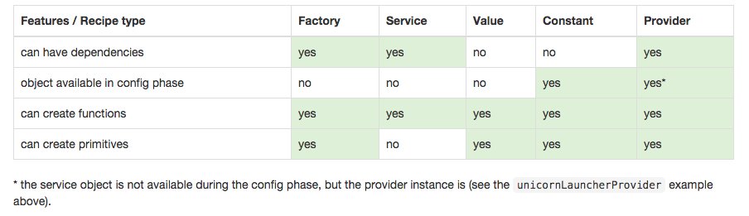
In-depth
Giuseppe Mandato, Frontend Developer – Esis S.r.l
All components registered by the $provide Object are Providers.
Normally, in AngularJS, all providers are singletone in order to work with the
dependency Injection.
Constants / Providers / Services / Factories / Values
--Yes, all you need is provider[s]--
Notes:
Open Listing: ./src/slides/snippets/1-angular.module.js

Slide 21
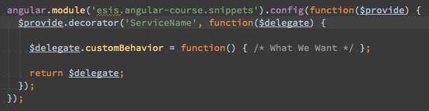
In-depth
Giuseppe Mandato, Frontend Developer – Esis S.r.l
All components registered by the $provide Object are Providers.
Normally, in AngularJS, all providers are singletone in order to work with the
dependency Injection.
All Providers, except Constants and Provider Instances, are interceptable by a SERVICE DECORATOR.
The DECORATOR PATTERN can be used to extend (decorate) the functionality of a certain object statically,
or in some cases at run-time […] Wikipedia
Some of the built-in Services
$http | $window, $document, $anchorScroll | $controller
$log | $rootScope, $locale | $filter
$interval, $timeout | $q, $exceptionHandler | $compile, $parse, […]
Notes:
Open Listing: ./src/slides/snippets/1-angular.module.js

Slide 22
In-depth
Giuseppe Mandato, Frontend Developer – Esis S.r.l
SCOPES: A hierarchical structure (context) where the model is stored and the view-expressions are evaluated.
Can Emit/Listen Events: $broadcast/$emit/$on/$$listeners
Can Watch Expressions/Properties: $watch, $watchCollection
Can Propagate model-changes to the view: $apply
Can Trigger the digest loop: $digest
Can be Nested and Isolated to ereditate/limit their ambit: $new
Can be Destroyed: $destroy
Each angular application can have only-one $rootScope (the scope of the whole application and belongs to the ng-app element).
Each Controller generates a new Scope instance, Each directive, where specified, can generate a new (Child/Isolate) Scope.
NOTE:
in AngularJS the Scope object is a normal javascript object: Methods and Properties are added with the dot-notation and are exposed to view in a transparent way, like this:
The singletone nature of the $rootScope makes it available via DI
$rootScope
$broadcast →
$scope.$parent / $scope.$root →
$scope
← $scope.$parent
$scope
←
$emit →
←Attributes / Events / Watchers →
←
$scope
$scope
isolated
https://github.com/angular/angular.js/wiki/Understanding-Scopes
Notes:
Open Listing: ./src/slides/snippets/1-angular.module.js

Slide 23
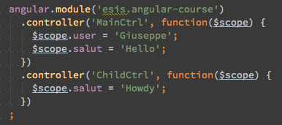
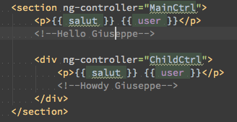

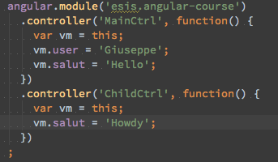
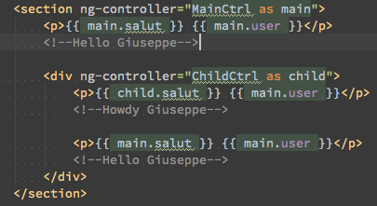
In-depth
Giuseppe Mandato, Frontend Developer – Esis S.r.l
Controller: A javascript Constructor (called via new operator) used to add/modify the scope behavior. Can be attached to the DOM via ng-controller directive. Each Controller creates a new injectable child scope.
A best way to build angularjs controllers is:
…to make sure that it contains only the necessary business logic needed by its view-portion.
Each UI-element of the view should have its controller. All UI-elements should be children of the route-controller.
Everything that doesn’t belong to it should be encasulate in a service. The controller have to transform the domain-model into view-model (and vice versa) only.
Use the controller-as syntax when is possible.
Be careful to inheritance and to the closure.
https://docs.angularjs.org/guide/controller
Notes:
Open Listing: ./src/slides/snippets/1-angular.module.js

Slide 24
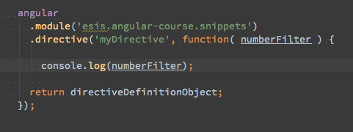
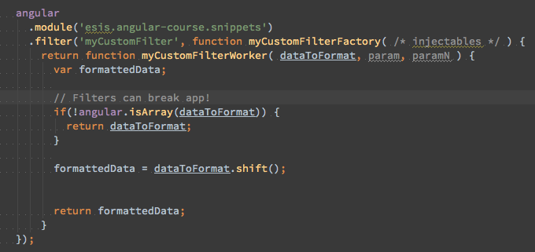
In-depth
Giuseppe Mandato, Frontend Developer – Esis S.r.l
Filters: A javascript Factory Function that returns a Worker Function. Useful when we have to format data for displaying to the user. Injectable via DI with the Filter suffix. The Value to format is the first argument, ever. All filters are exposed to views.
https://docs.angularjs.org/guide/filter
Notes:
Open Listing: ./src/slides/snippets/1-angular.module.js

Slide 25
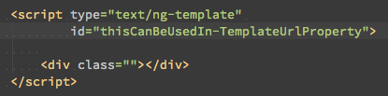

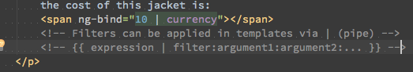
In-depth
Giuseppe Mandato, Frontend Developer – Esis S.r.l
Templates are HTML SNIPPETS with specific AngularJS ELEMENTS and ATTRIBUTES. Are Dynamically loadable and are cache-able via $templateCache service!
Expressions are javascript-like expressions, normally wrapped by curly braces or inside a ng-bind, ng-bind-html directives. All Angular-expressions don’t generate errors/exceptions. They don’t support any type of control flow and isn’t possibile to declare functions inside them.
NOTE: UNLIKE JAVASCRIPT DOES, ANGULARJS-EXPRESSION ARE EVALUATED ON THE SCOPE CONTEXT.
Template/Expressions and DATA-BINDING:
ONE-WAY BINDING | TWO-WAY BINDING | ONE-TIME BINDING
{{ expression }}, ng-bind … | ng-model=“expression” | {{ ::expression }} , ng-bind …
https://docs.angularjs.org/guide/templates - https://docs.angularjs.org/guide/expression
Notes:
Open Listing: ./src/slides/snippets/1-angular.module.js

Slide 26
In-depth
Giuseppe Mandato, Frontend Developer – Esis S.r.l
Directives are markers (element, attribute, class, comment) on a specific DOM ELEMENT. These markers, when normalized, tell to the $compile what kind of behaviour attach to that DOM ELEMENT...
NORMALIZATION: The process of namespace stripping or dash-delimited to camelCase converting (In order to be html-validator friendly, we can prefix an angular marker with the: data-, x-, ecc.).
COMPILATION: Is the recursive process of dom-traversing. It is divided in two phases: Compile (a function executed with the raw-template) and Link (a instance function executed when the template is linked with the scope).
DECLARATION: via module.directive: nameAsCamelCase, factory function that returns a DIRECTIVE DEFINITION OBJECT or POST LINK function.
NOTES: The ng namespace is reserved for angular built-in directives. Considering that the HTML-Language is case-insensitive angular uses the camelCaseToDashDelimited Syntax to register directives.
COMPONENT | BEHAVIOUR | Ie7-friendly | DOM LIMITED API
Restricted by Element | Restricted by Attribute | Restricted by class name | Restricted by comment
E | A | C | M
<my-dir /> | <div my-dir> </div> | <div class=“my-dir”></div> | <!-- directive: my-dir -->
Notes:
Open Listing: ./src/slides/snippets/1-angular.module.js

Slide 27
In-depth
Giuseppe Mandato, Frontend Developer – Esis S.r.l
Tanks for all. LET’S GO, OPEN THE PROJECT
Notes:
Open Listing: ./src/slides/snippets/1-angular.module.js

