Slide 1
Soldering station 2023
Runar Jans

Slide 2
Table of contents
Introduction
Materials and methods
Results
Conclusion

Slide 3
Introduction
The subject “Project ontwerpen”
Schedule
Background information

Slide 4
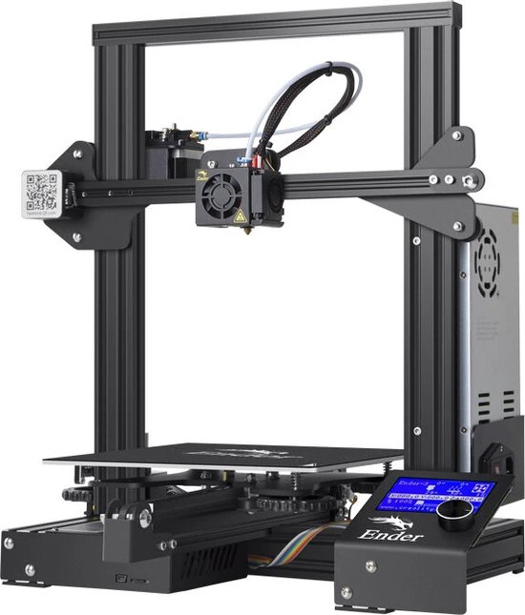
Materials and methods
Software
Hardware

Slide 5


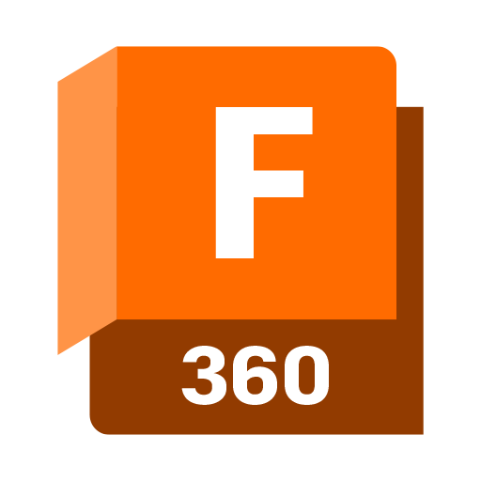
Software
PCB design
Case design

Slide 6

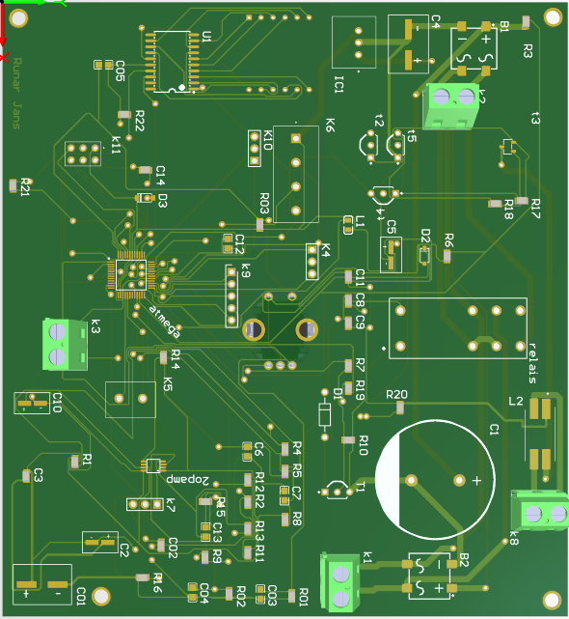
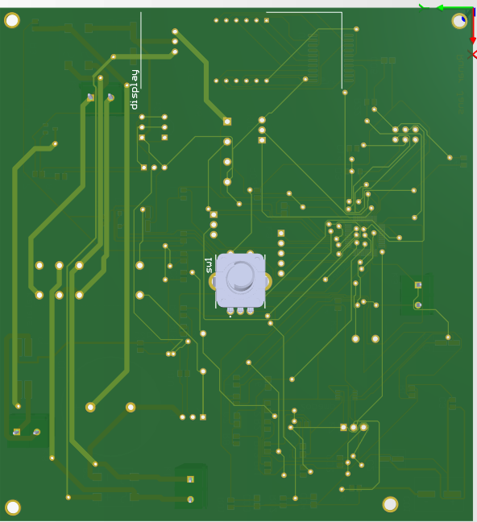
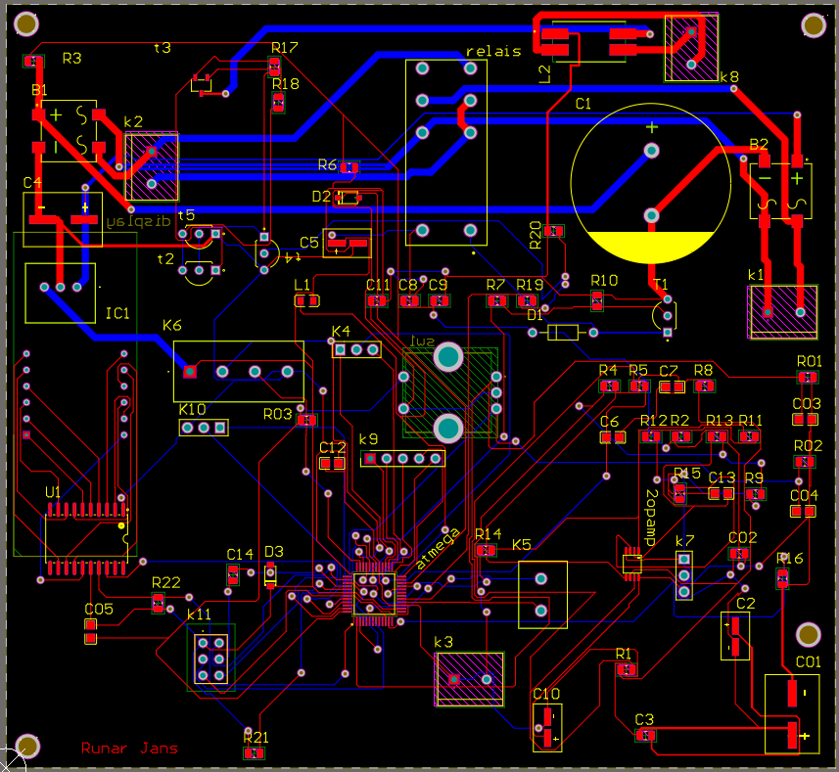
Software
Altium PCB

Slide 7
Hardware
3D-printer
PCB
Components

Slide 8
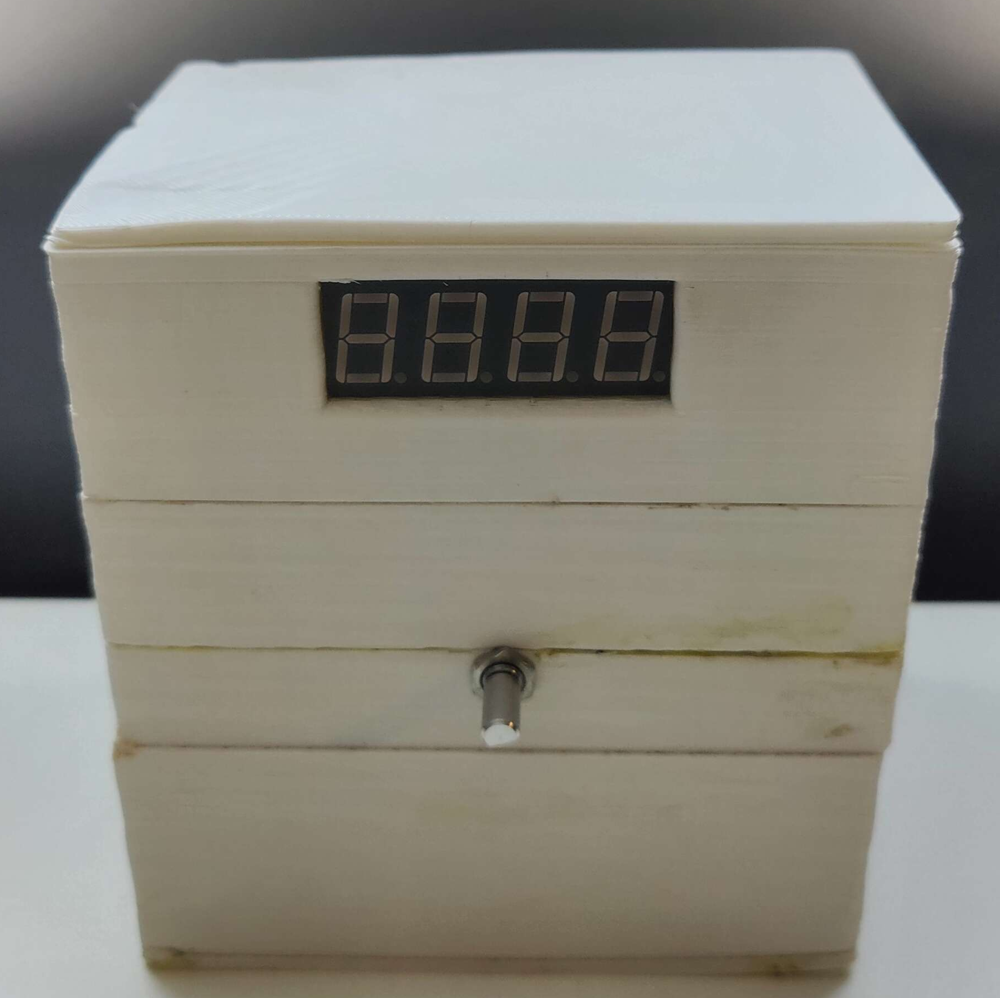
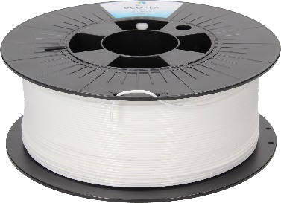
Hardware
What is a 3D-printer?
Why use a 3D printer?

Slide 9
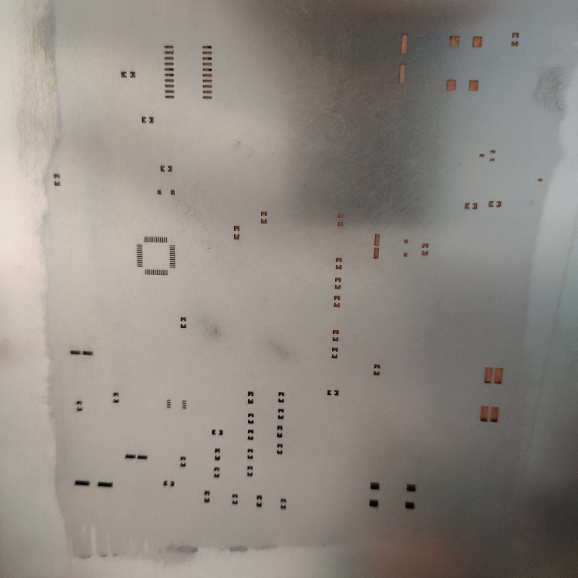
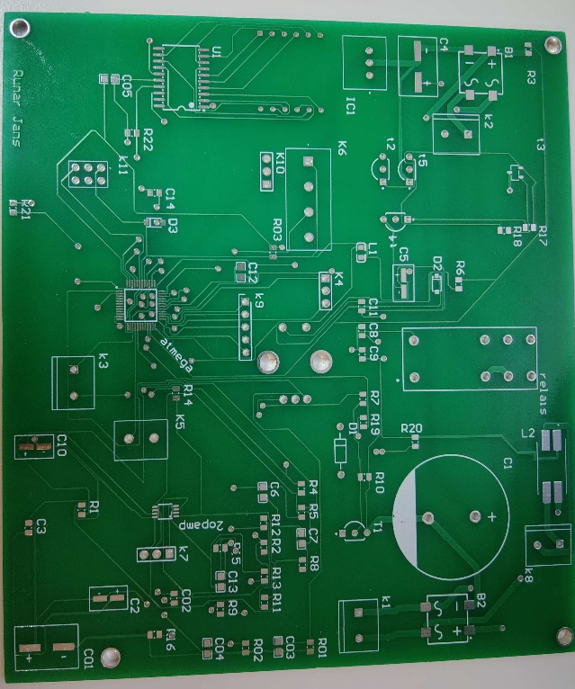
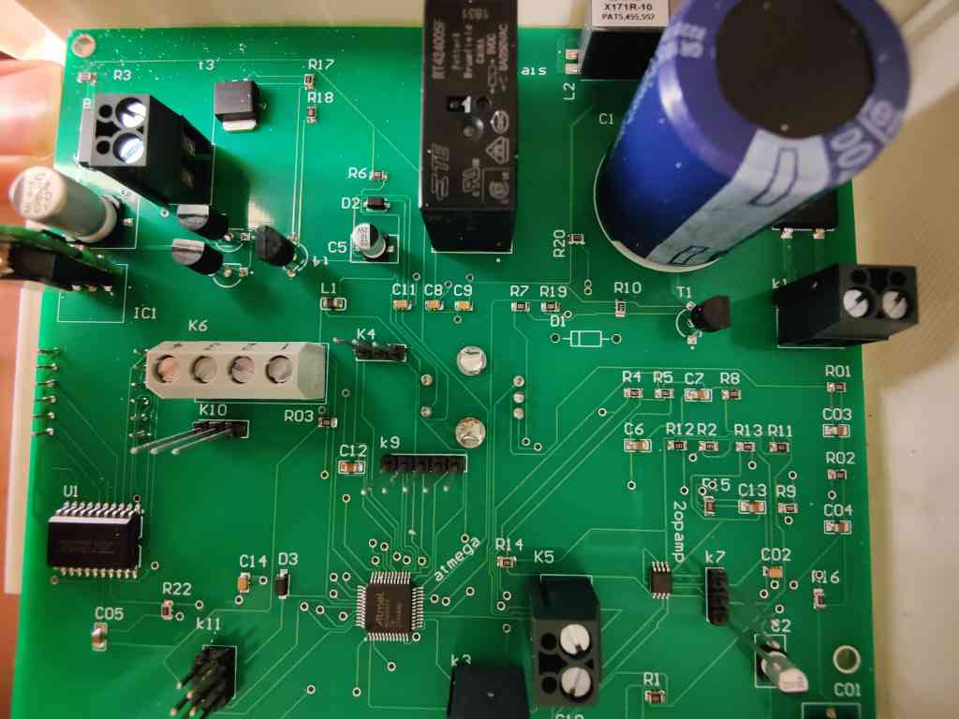
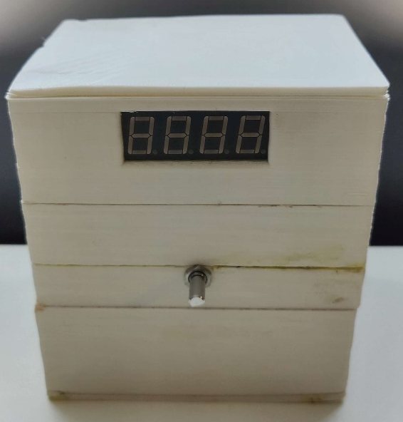

Hardware
What is a PCB?
Manufacturer
Stencil and paste

Slide 10
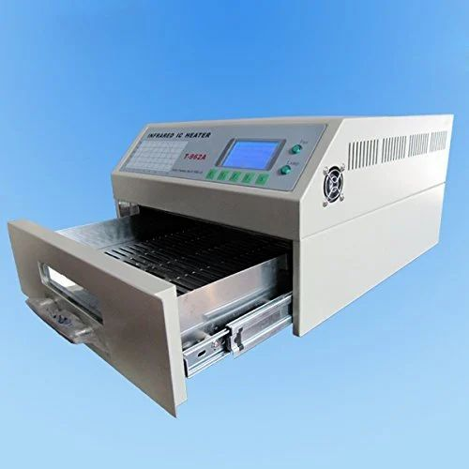
Hardware
Soldering process

Slide 11
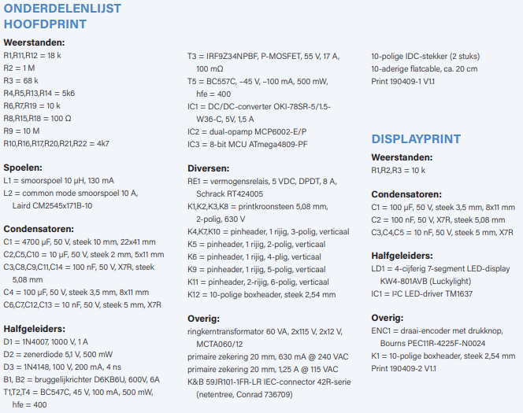
Hardware
Elektor component list
Group order
SMD

Slide 12
Results
End result
Problems

Slide 13

End result
Not finished
Money spend
What I learned

Slide 14
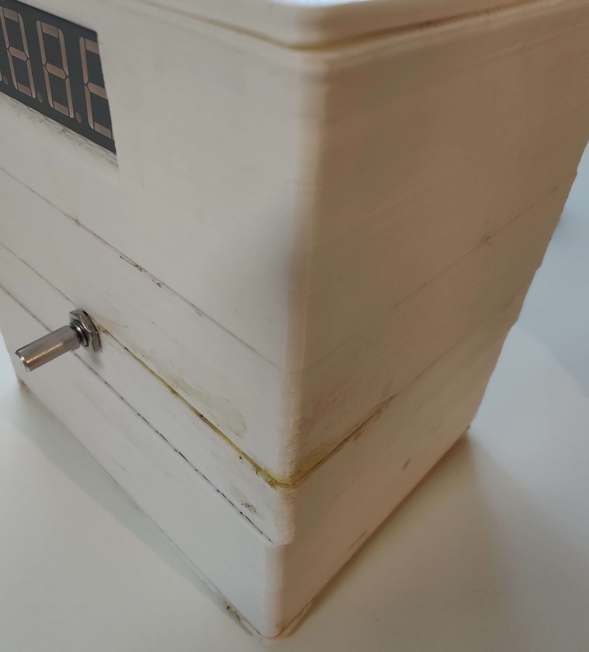
Problems
Lack of time
Altium
Case
Desired operation

Slide 15
Conclusion
3D-printing
Components
Software

Slide 16
Thank you!
Questions or comments?

