Slide 1
Soldering station 2023
1
Runar Jans

Slide 2
Table of contents
2
Introduction
Materials and methods
Results
Conclusion

Slide 3
Introduction
3
The subject “Project ontwerpen”
Schedule
Background information

Slide 4
Materials and methods
4
Software
Hardware

Slide 5


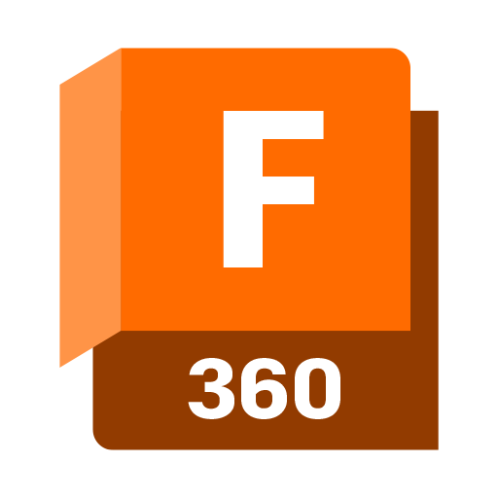
Software
5
PCB design
Case design

Slide 6

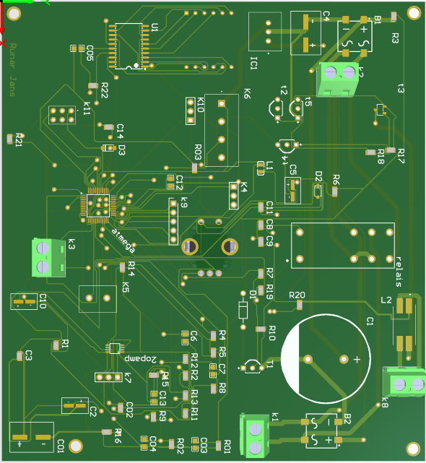
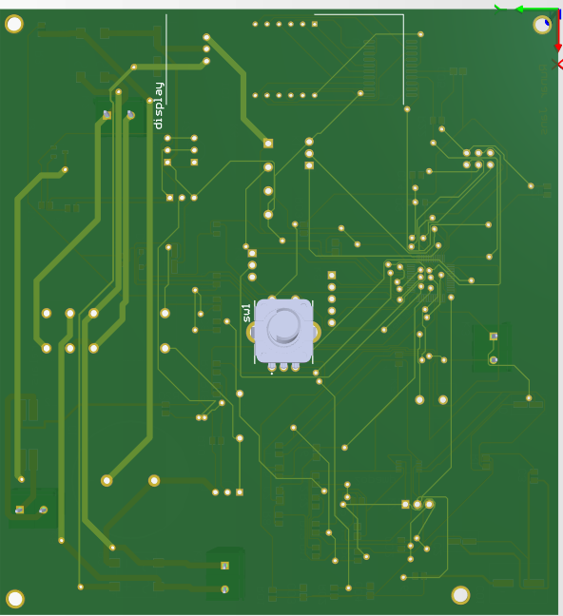
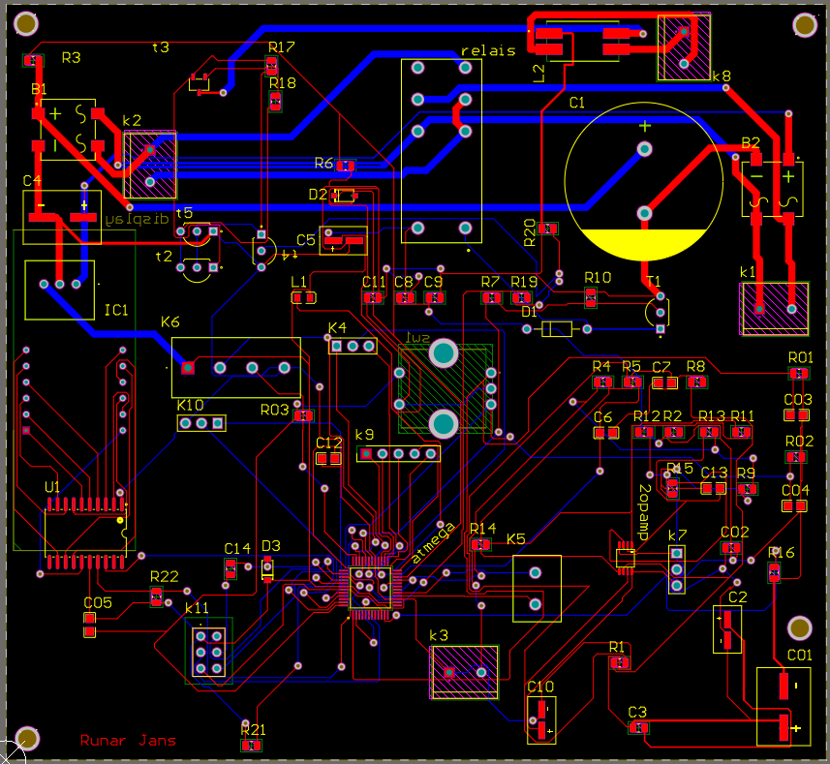
Software
6
Altium PCB

Slide 7
Hardware
7
3D-printer
PCB
Components

Slide 8
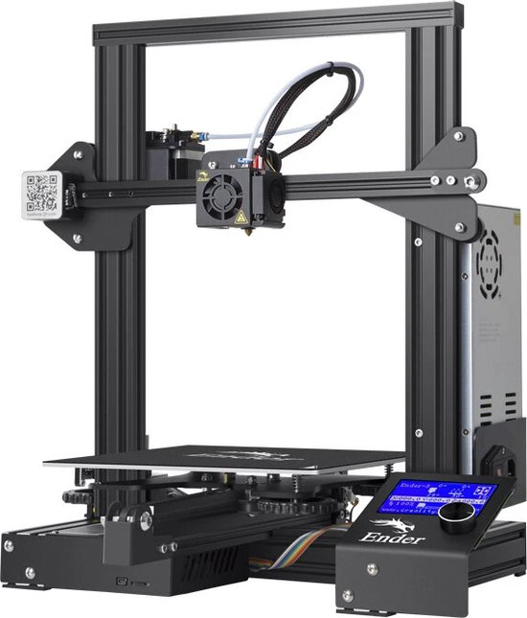
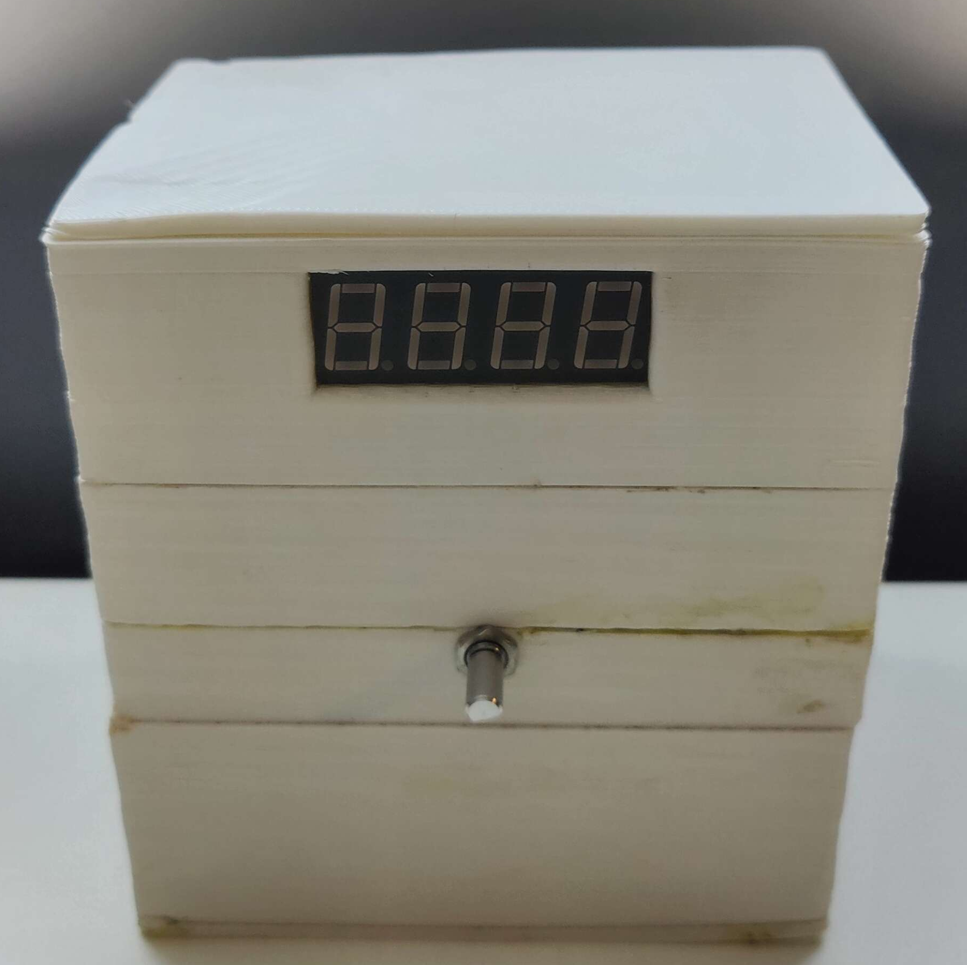
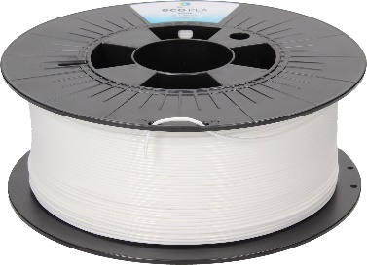
Hardware
8
What is a 3D-printer?
Why use a 3D printer?

Slide 9
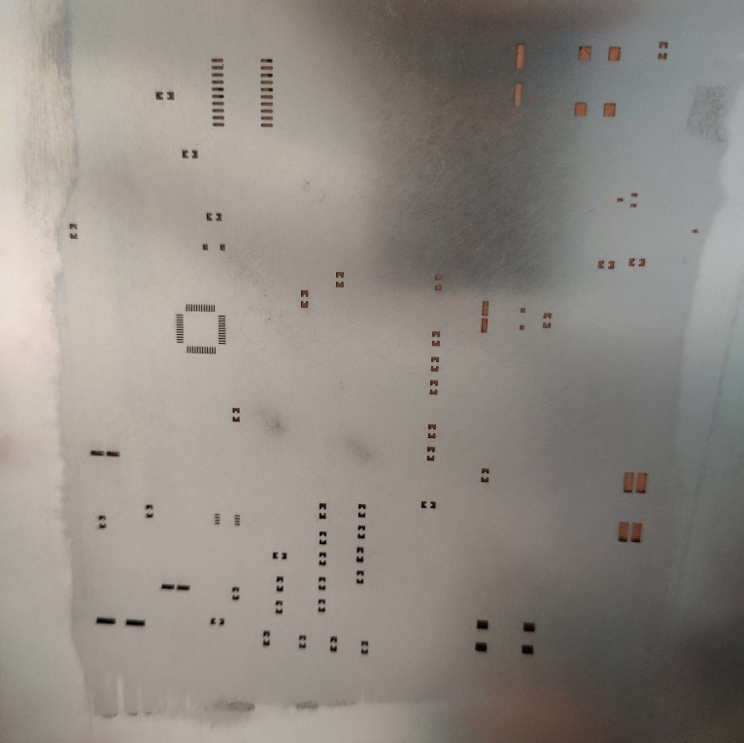
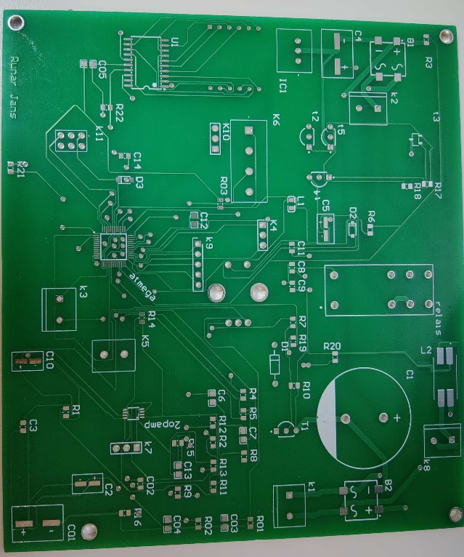
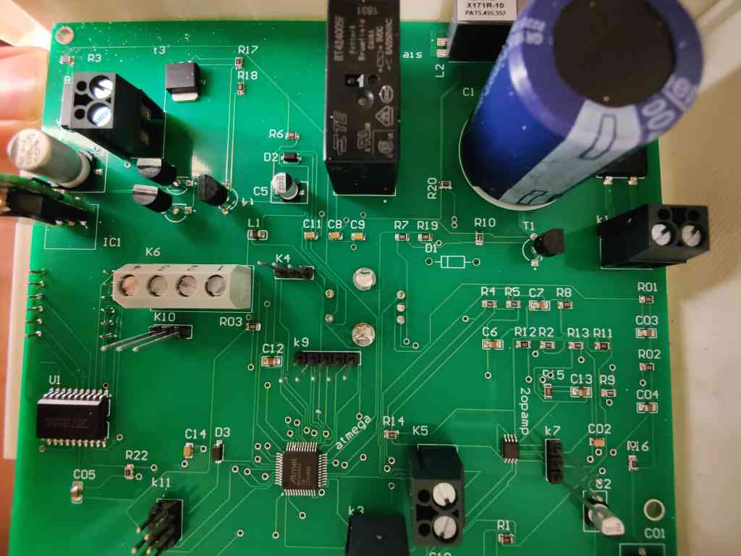
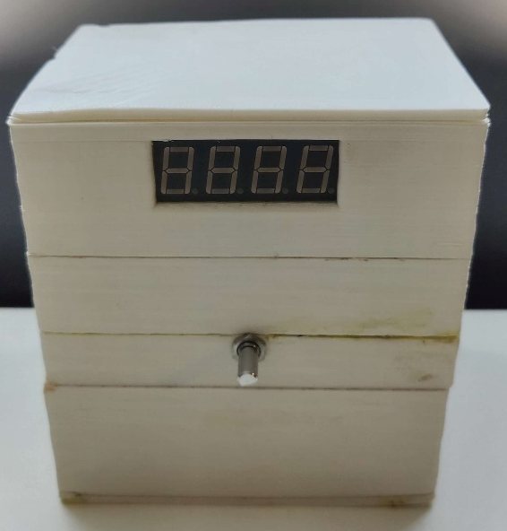

Hardware
9
What is a PCB?
Manufacturer

Slide 10
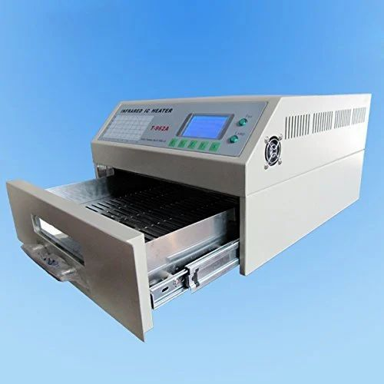
Hardware
10
Soldering process

Slide 11
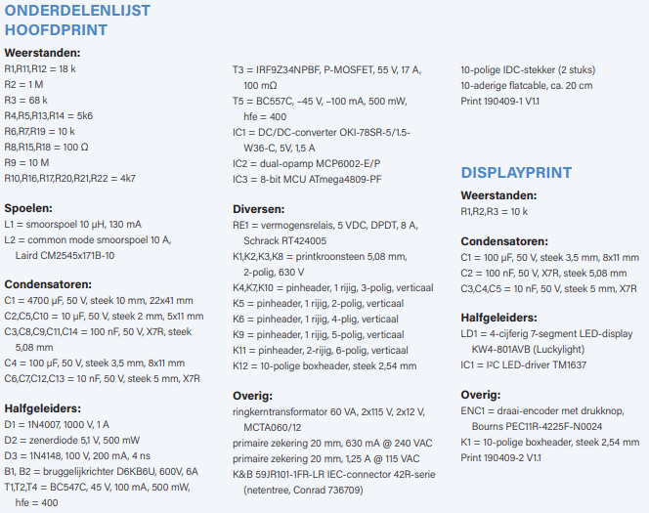
Hardware
11
Elektor component list
Group order
SMD

Slide 12
Results
12
End result
Problems

Slide 13

End result
13
Not finished
Money spend
What I learned

Slide 14
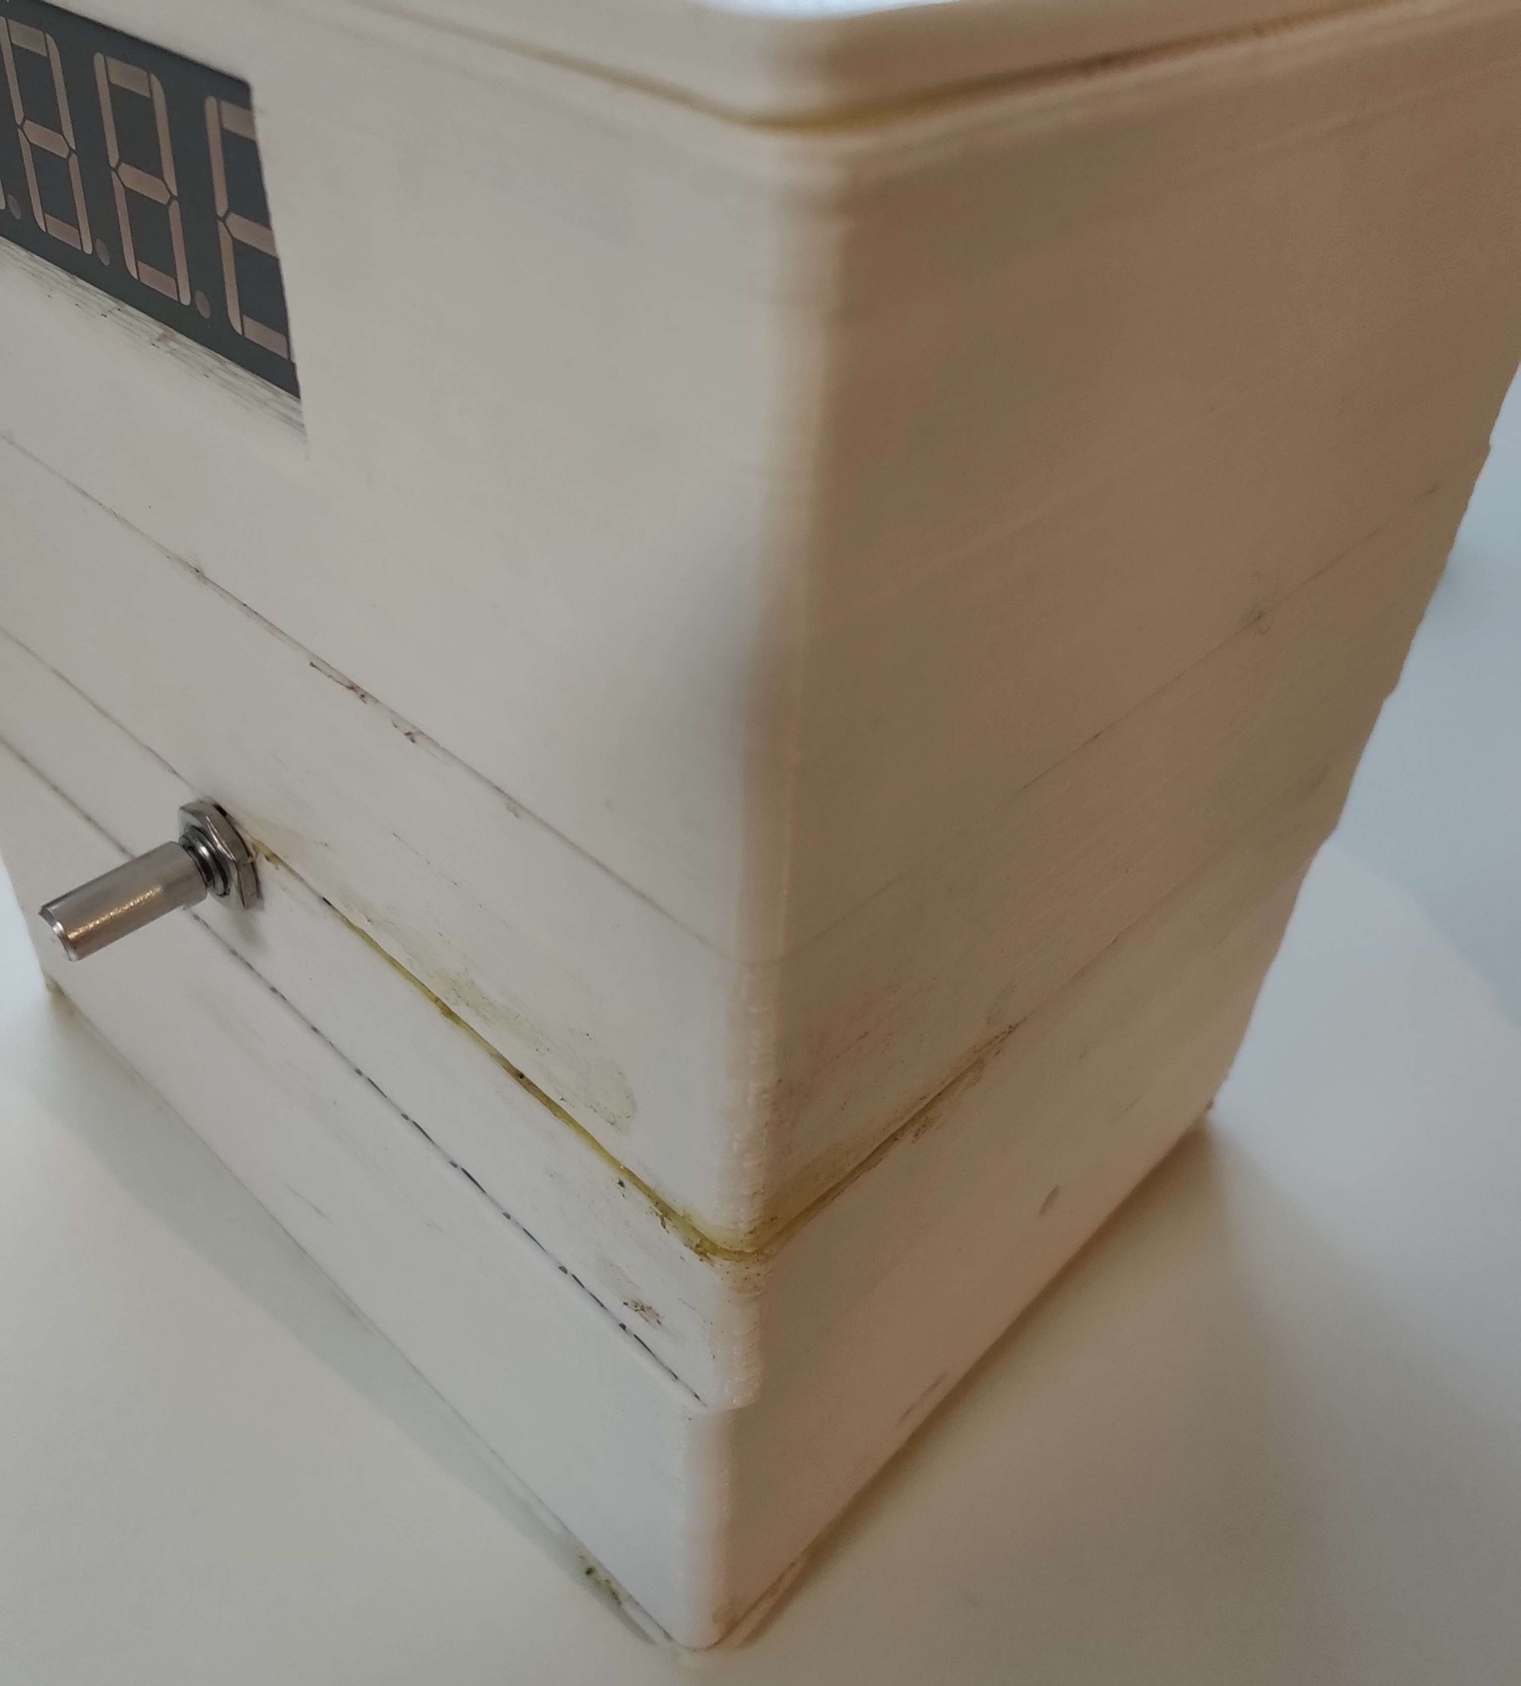
Problems
Lack of time
Altium
Case
Desired operation
14

Slide 15
Conclusion
15
3D-printing
Components
Software
Time management

Slide 16
Thank you!
16
Questions or comments?
Notes:
feel free to ask questions or provide any comments

