Slide 1
Arcitecture

Slide 2
Database
Problems:
Two bars with same name in different towns
How to store pictures
What GPS capability should we have
Different closing times different days
Bar
BarName | GPS_X | GPS_Y | OpenTime | CloseTime | Description | Picture/s
Bar46 | 33.123 | -12.153 | 1600 | 0 | Its a bar | (...)
Filters
Food | RealAle | Club | Allows Dogs | Welsh | Family Friendly | DukeBox | Quiz

Slide 3
Database
Towns
TownName
Aberystwyth
BarsInTown
Town | BarName
Aberystwyth | Bar46

Slide 4
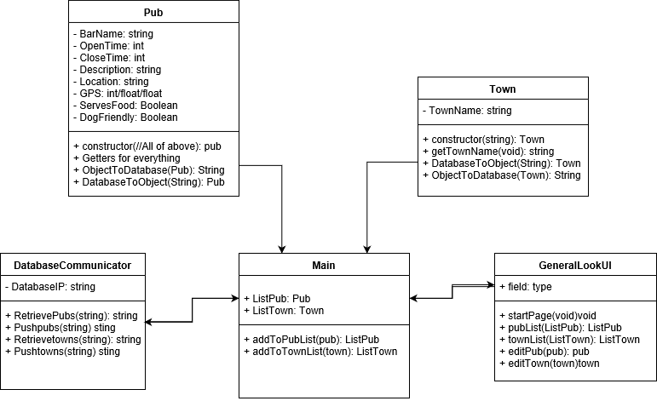
Diagram Desktop

Slide 5
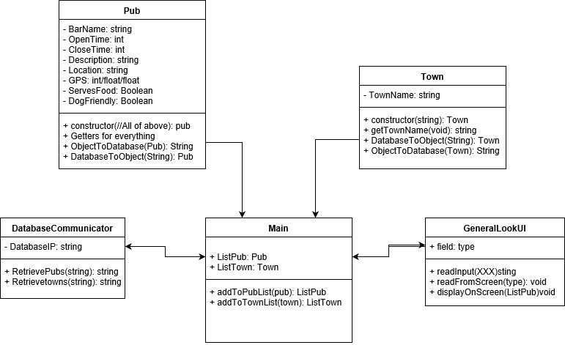
Diagram Phone

