Slide 1
Issues System Overview

Slide 2
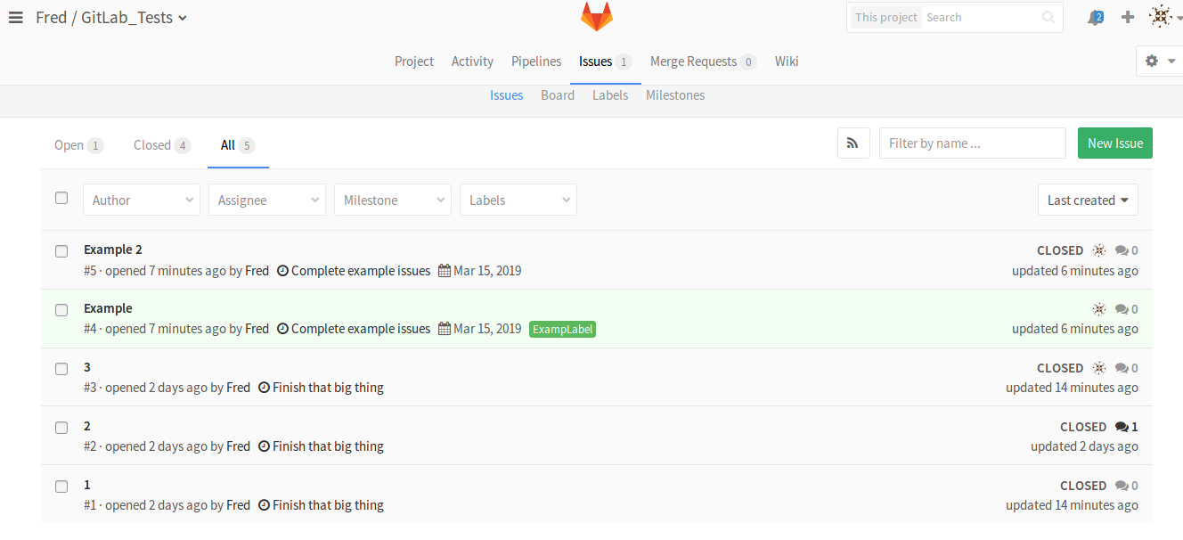
Issues
A noticeboard for impending changes/additions
Can be assigned to one person or nobody
Can have due dates
Can comment on and rate issues for feedback

Slide 3
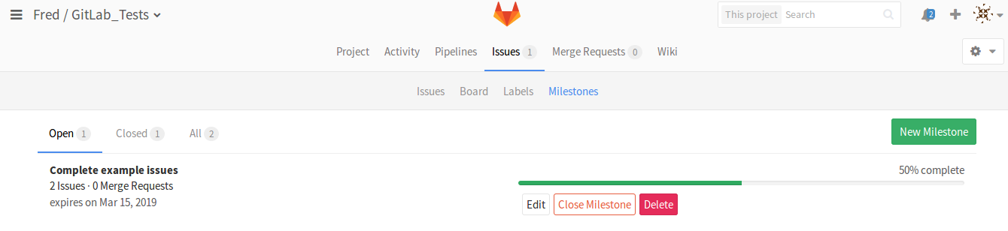
Milestones
Used to group issues related to the same goal together
Provides a progress bar to roughly measure closeness to completion
Progress bar fills with every closed issue with that milestone

Slide 4
Labels
A tagging system for issues
Use to categorise issues that are similar in nature (eg. “Bug”, “Feature”, “In Progress”), not similar in goal

Slide 5
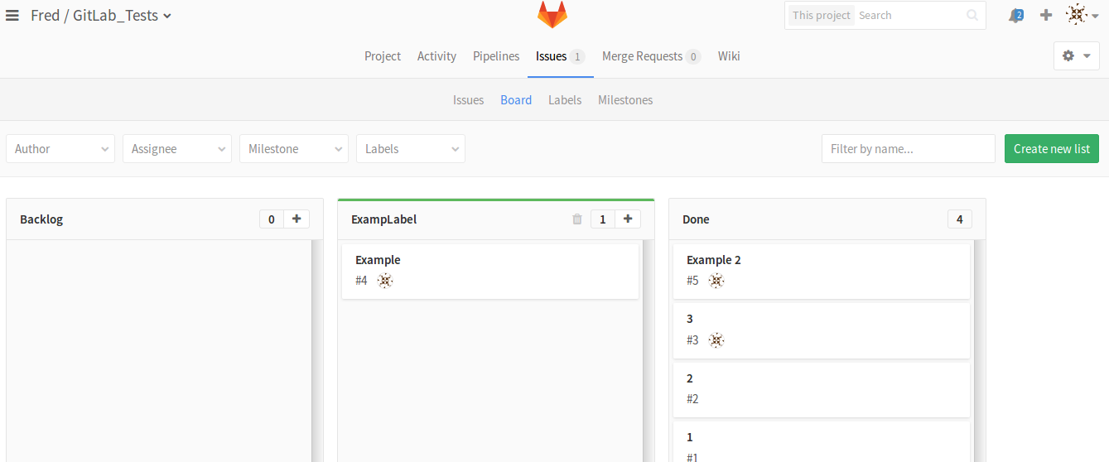
Boards
Used to visualise issues based on their labels
For best results, mainly use boards based off of progress-themed labels (i.e. “To Do”, “Doing”, “Reviewing”)

Slide 6
IMPORTANT RULES TO FOLLOW
Do not close issues related to spec. document updates; just move them to “Reviewing”
Always communicate with others working on the same file/directory/milestone as you before committing anything
If you commit something related to an issue, your commit message must refer to the issue’s number

Slide 7
Extra QA Manager Stuff
Must oversee issues in the “Reviewing” board by checking the updates, arranging any further review meetings, and submitting the document as “Released”
Ensure everybody is using the issues system appropriately
Ensure that additional tests are created to check that updates to the software are working as intended

