Slide 1

GitGroup
A Web Based Software Development Management System
Runbo ZHAO, Jingyu BAO, Xuying CAO, Chengxiang YIN
Advisor: Edmund S. Yu Course: CSE 682 Software Engineering

Slide 2

www.gitgroup2018.com
GitGroup is deployed on Heroku.

Slide 3

Overall Description
Product
GitGroup is not only designed for programmer but also for people who has less development experience such as project manager, project members…
What is GitGroup
GitGroup is a web-based GitHub Application. It is a project management platform that allows everyone on your team to communicate with the developers.
it is easy to create an Agile workflow for your team with a kanban board. GitGroup's seamless integration with GitHub keeps all of your GitHub Issue data in sync across both platforms in real time.

Slide 4
Interface Requirement
Bulma
Thu style of GitGroup UI must be clean and easy to use. The CSS framework GitGroup choose is Bulma. It is a beautiful, lightweight and stylish CSS framework. and its grid is fully built with flexbox. Achieving flexible layout with same-size columns is as simple as adding .column class to HTML element. Furthermore, Bulma has some GitHub design style component like panel. It
can be easy reuse to build GitGroup project lists.

Slide 5
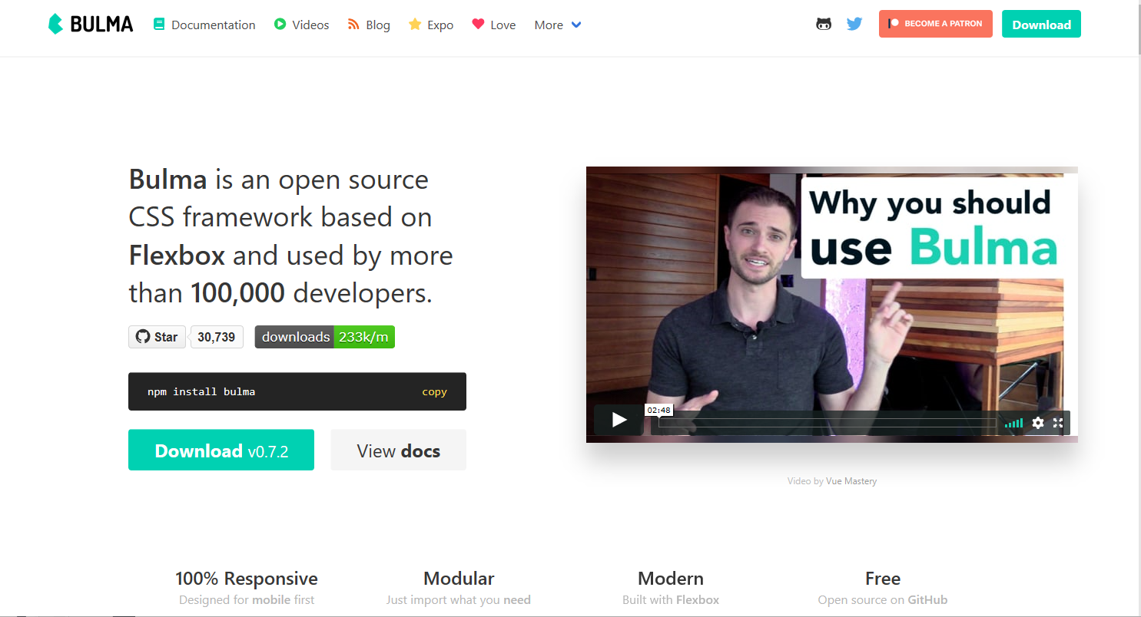
Interface Requirement
Bulma

Slide 6
System Architecture

Slide 7
System Architecture

Slide 8
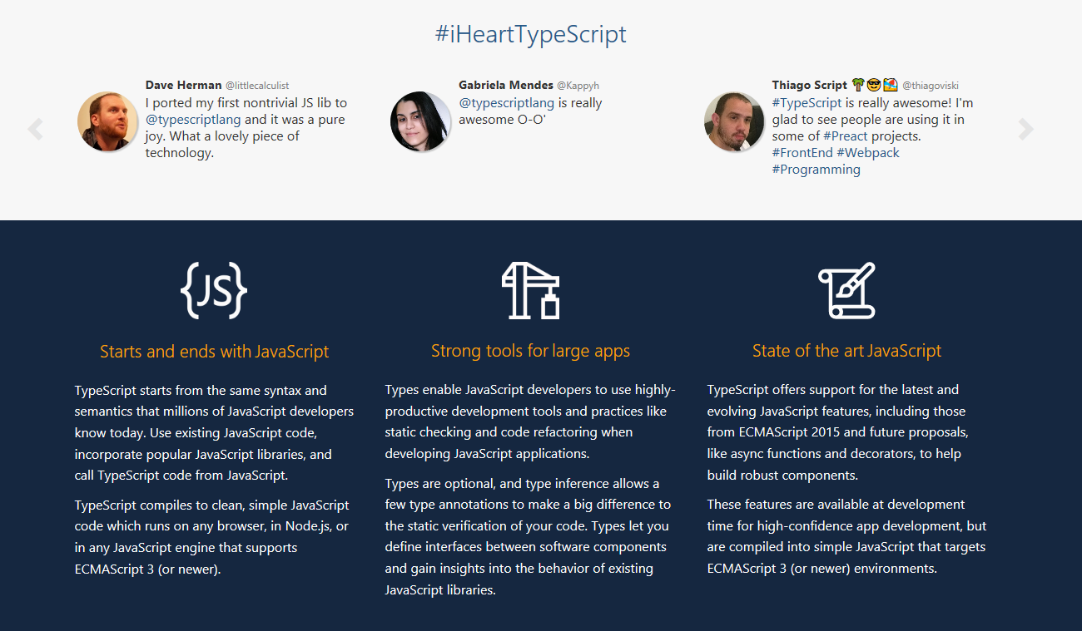
System Architecture
TypeScript

Slide 9
System Architecture
TypeScript
TypeScript is an open-source programming language developed and maintained by Microsoft. It is a strict syntactical superset of JavaScript, and adds optional static typing to the language. TypeScript is used to develop GitGroup because its strong Object-Oriented-Programming features. TypeScript is designed for development of large applications and transcompiles to JavaScript. As TypeScript is a superset of JavaScript, existing JavaScript programs are also valid TypeScript programs. TypeScript may be used to develop JavaScript applications for both client-side and server-side (Node.js) execution.

Slide 10
CONTENTS
01
02
03
04
05
GitHub OAuth
Project
Overview
Kanban
Future

Slide 11
GitHub OAuth

Slide 12
GitHub OAuth
What Are GitHub OAuth?
GitHub Apps are first-class actors within GitHub. A GitHub App acts on its own behalf, taking actions via the API directly using its own identity, which means you don’t need to maintain a bot or service account as a separate user.
GitHub Apps can be installed directly on organizations and user accounts and granted access to specific repositories. They come with built-in webhooks and narrow, specific permissions. When you set up for your GitHub App, you can select the repositories you want it to access. Some key ideas when creating GitHub Apps

Slide 13
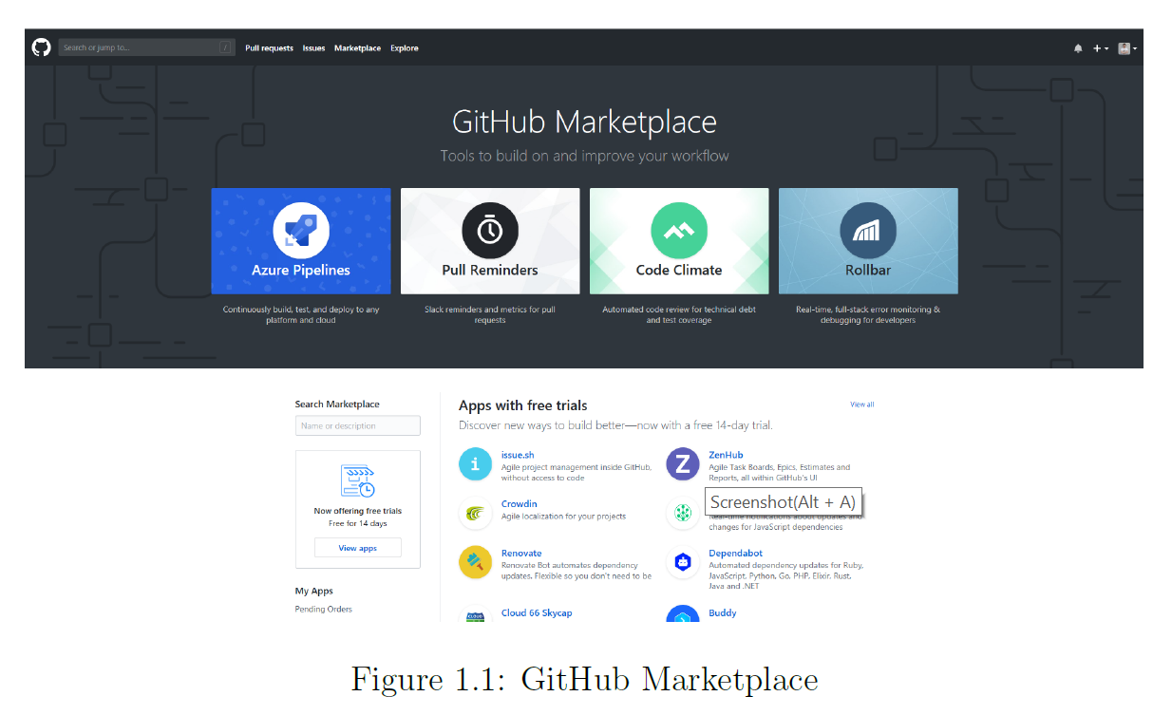
GitHub OAuth
What Are GitHub OAuth?

Slide 14
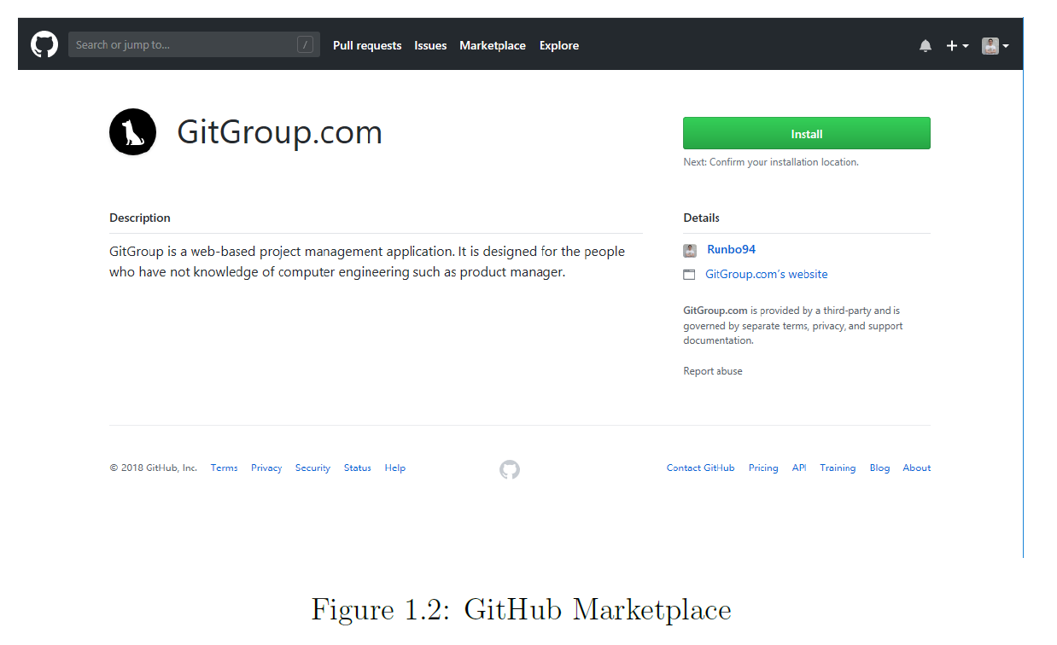
GitHub OAuth
What Are GitHub OAuth?

Slide 15
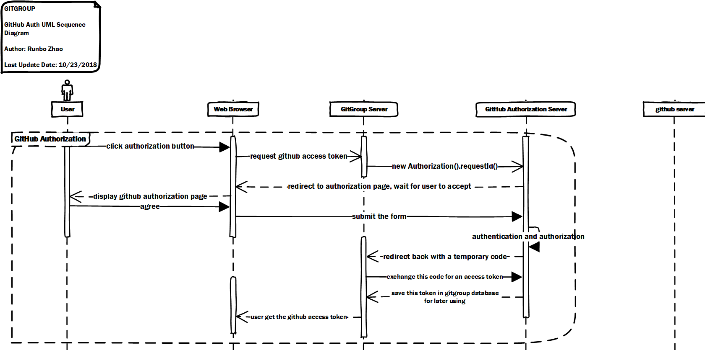
GitHub OAuth
What Are GitHub OAuth?

Slide 16
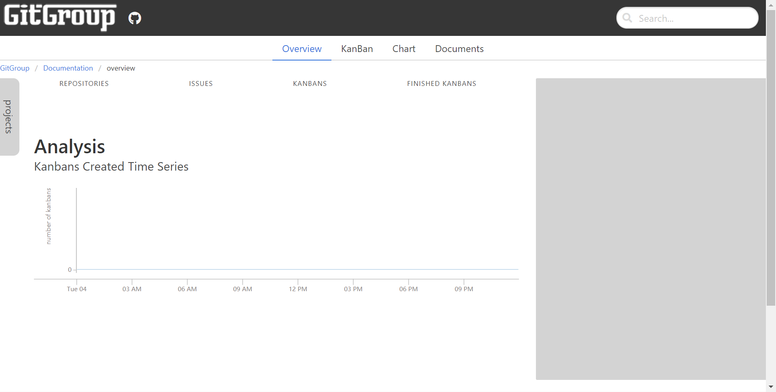
GitGroup OAuth
What Are GitHub OAuth?
Click the auth button, users are redirected to request their GitHub identity.

Slide 17
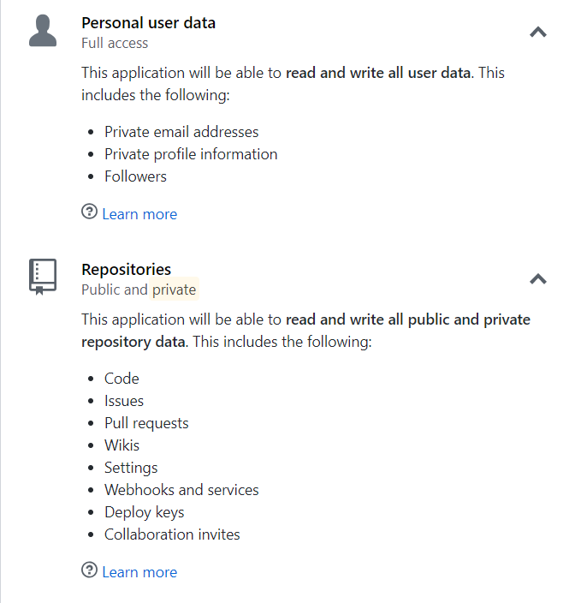
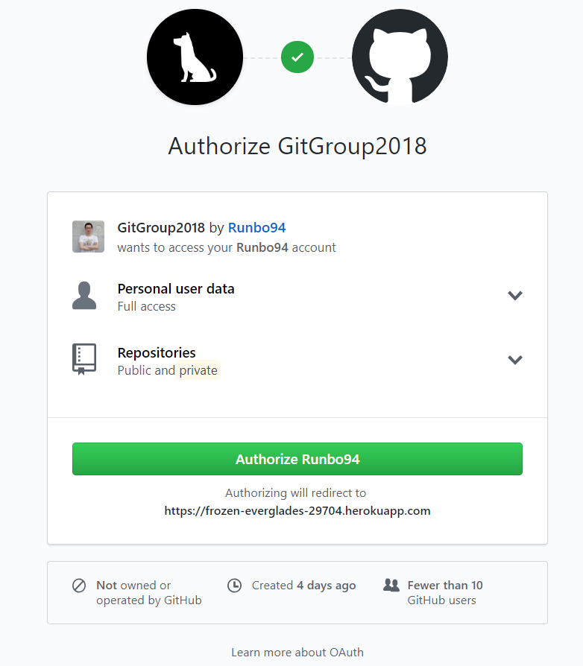
GitGroup OAuth
What Are GitHub OAuth?
the list of scopes attached to the token that were granted by the user
Click Authorize.

Slide 18
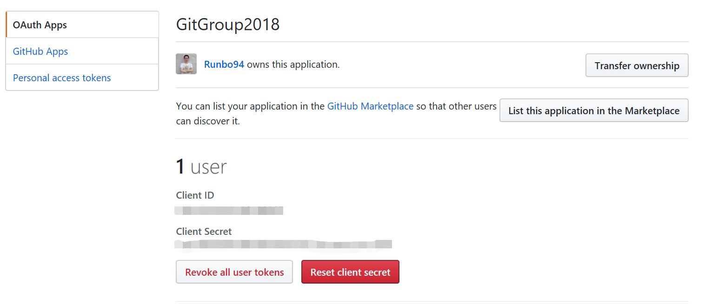
GitGroup OAuth
What Are GitHub OAuth?
Auth records in GitHub

Slide 19
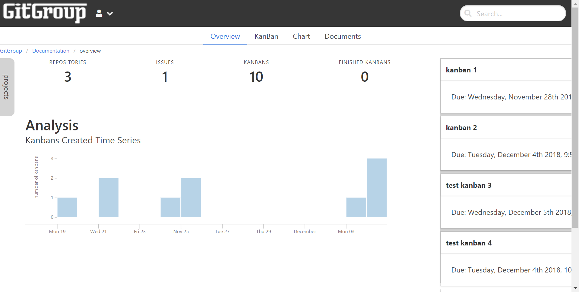
GitGroup OAuth
Personal Information
What Are GitHub OAuth?

Slide 20
Project

Slide 21
Project
What Is Project In GitGroup?
Projects are the highest level containers in GitGroup. You attach one or more data sources (GitHub Repositories) to a Project and that defines what information you can manage within the Project.

Slide 22
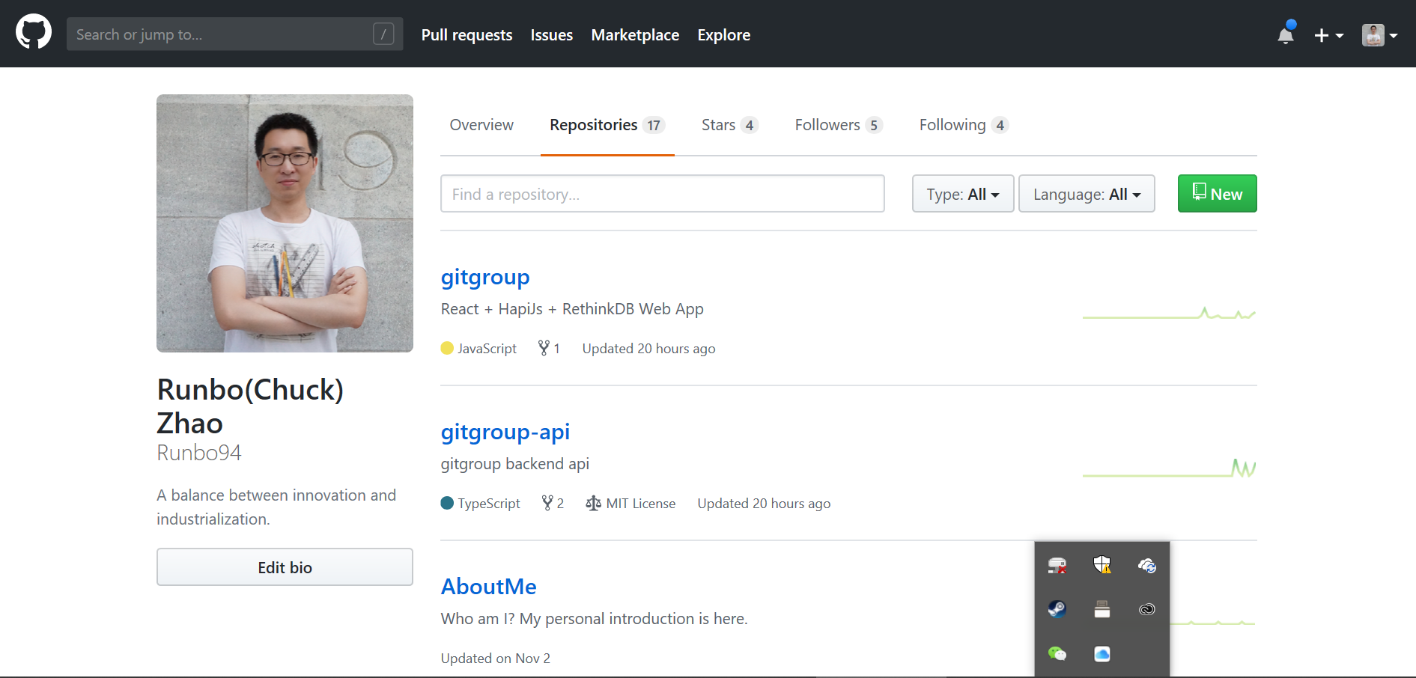

Project
What Is Project In GitGroup?
Repositories in GitHub

Slide 23
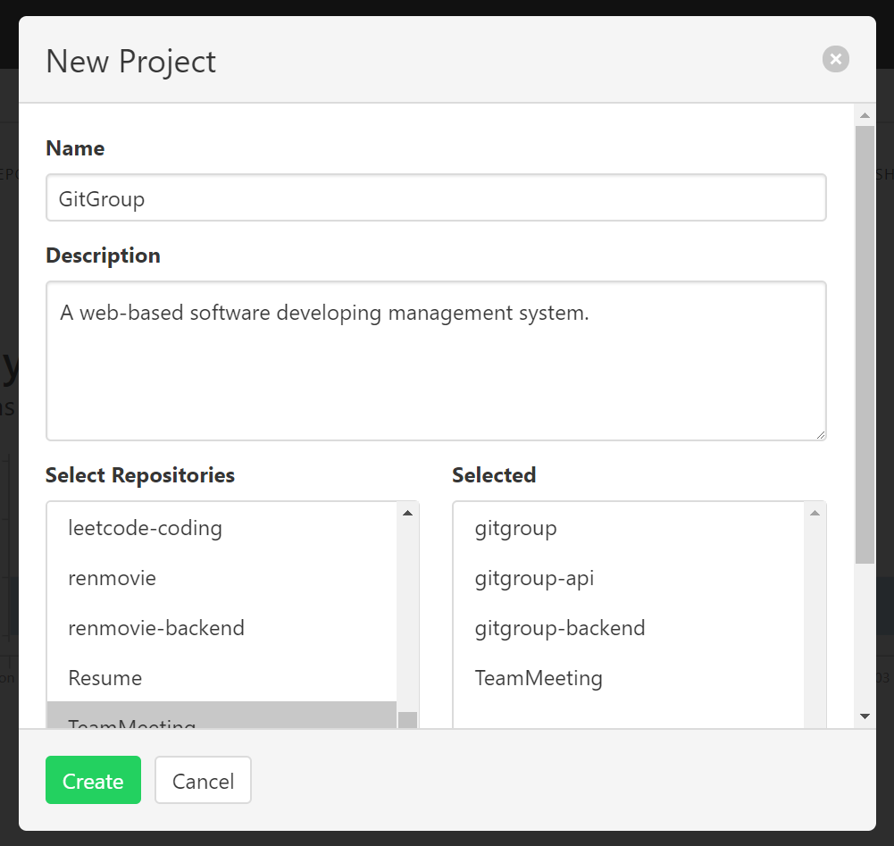
Project
Create New Project In GitGroup?
Project name
Project Description
Select Repositories in the GitHub

Slide 24
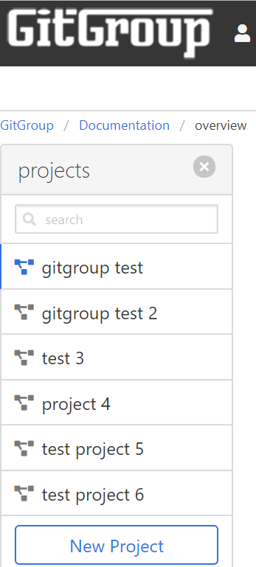
Project
List All Projects In GitGroup?
List all projects you have created.

Slide 25
Overall Description
Product Functions - KanBan
The Kanban board which is similar to projects board in the GitHub. In the Kanban board, there are several columns represent different stage of the development process. You can customize your own stage. Every column contains issue card imported from the GitHub, and you can easily drug them among the columns. If you drug it to the Done column. The issue in the GitHub will be automatically closed.

Slide 26
Overall Description
Product Functions - Analytics
GitGroup offers a variety of Agile charts and analytics to help you keep track of how your team is doing. Both owner and collaborators can view these charts.
Burndown and Burnup Charts
Throughput Chart
Users Throughput Chart
Velocity Chart

Slide 27
Overall Description
Product Functions - Chat
GitGroup offers chat room for users to communication. There are two types of chat. One is global chat which is used to communicate friends directly. Another is in-team chat which is used to communicate among the team members.

Slide 28
CSS
{…}
Overview

Slide 29
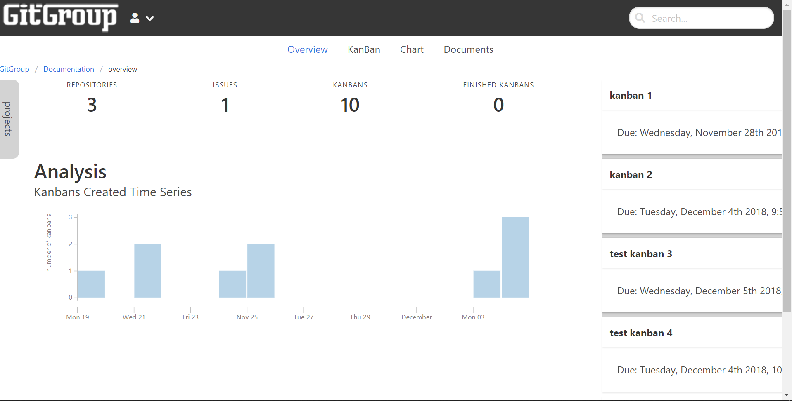
Overview
The time series of the creation of kanbans
Open projects list.
The number of repositories, issues, kanbans, finished kanbans
All the Kanbans and their due days

Slide 30
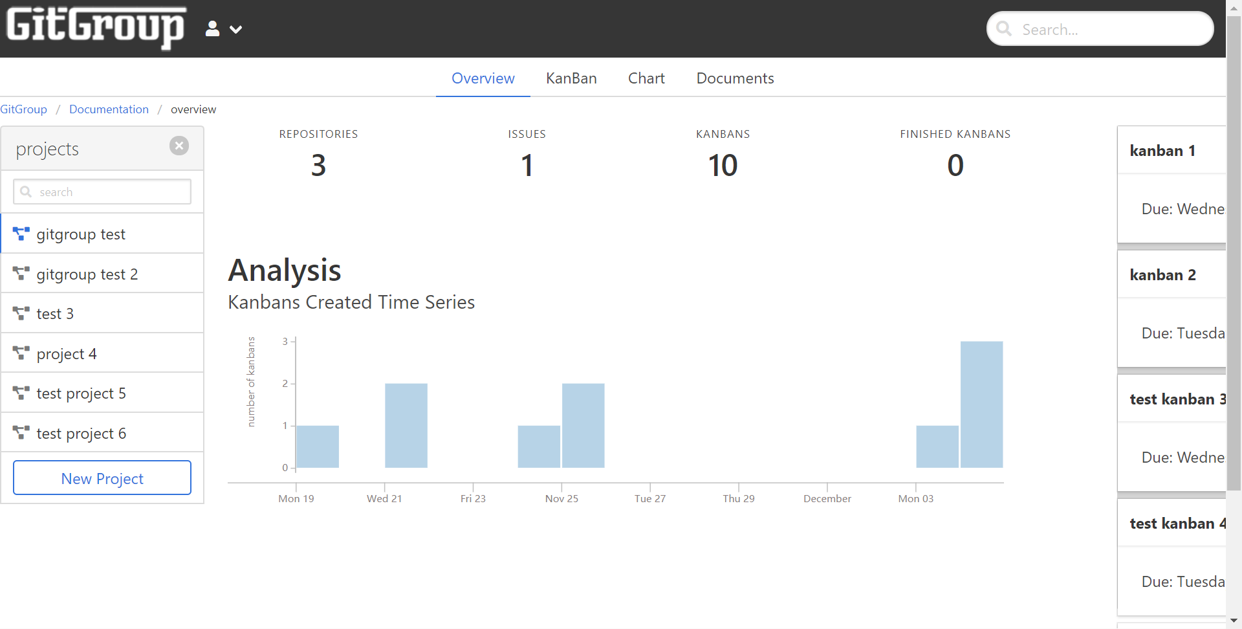
Overview
Projects List

Slide 31
Kanban

Slide 32
Kanban
What Is Kanban?
The Kanban board is set of columns that allow you to track the progress of tasks as they move through your workflow.

Slide 33
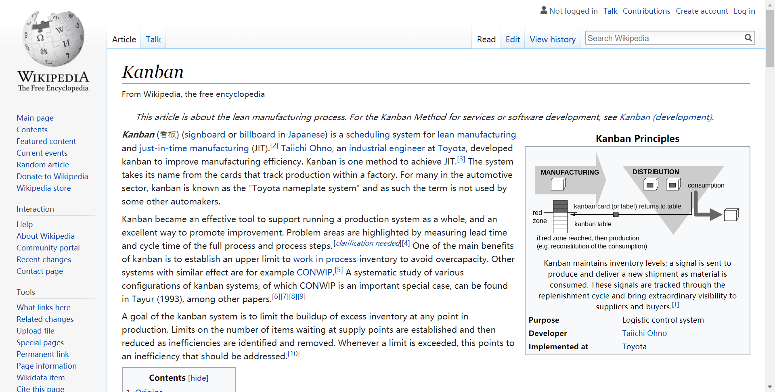
Kanban
What Is Kanban?

Slide 34
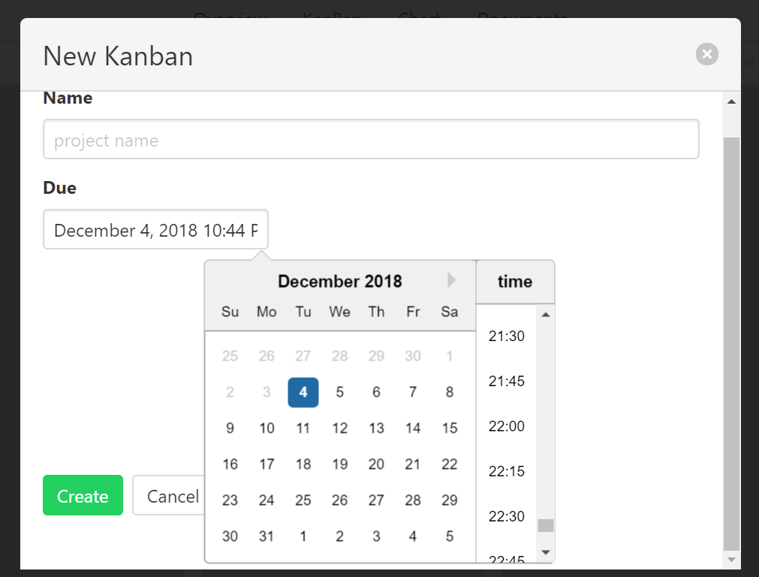
Kanban
How to Create A New Kanban?
The Kanban Name
The Time Picker

Slide 35
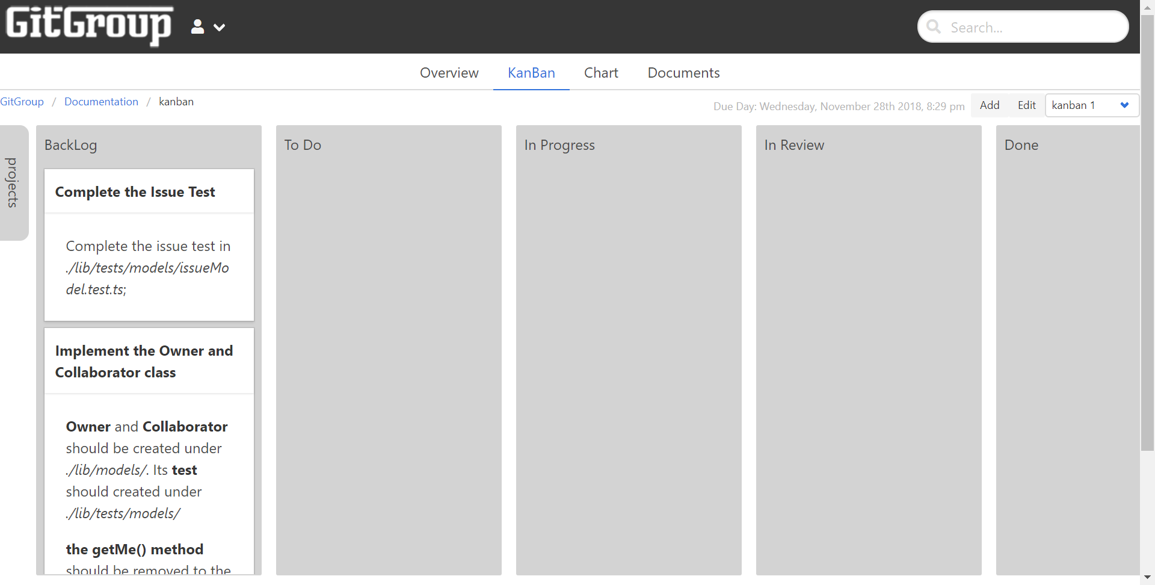
Kanban
What Is Issue?
All the Cards in the BackLog are from GitHub Issues.

Slide 36
Kanban
What Is Issue?
Issues are a great way to keep track of tasks, enhancements, and bugs for your projects. They’re kind of like email—except they can be shared and discussed with the rest of your team. Most software projects have a bug tracker of some kind. GitHub’s tracker is called Issues, and has its own section in every repository.

Slide 37
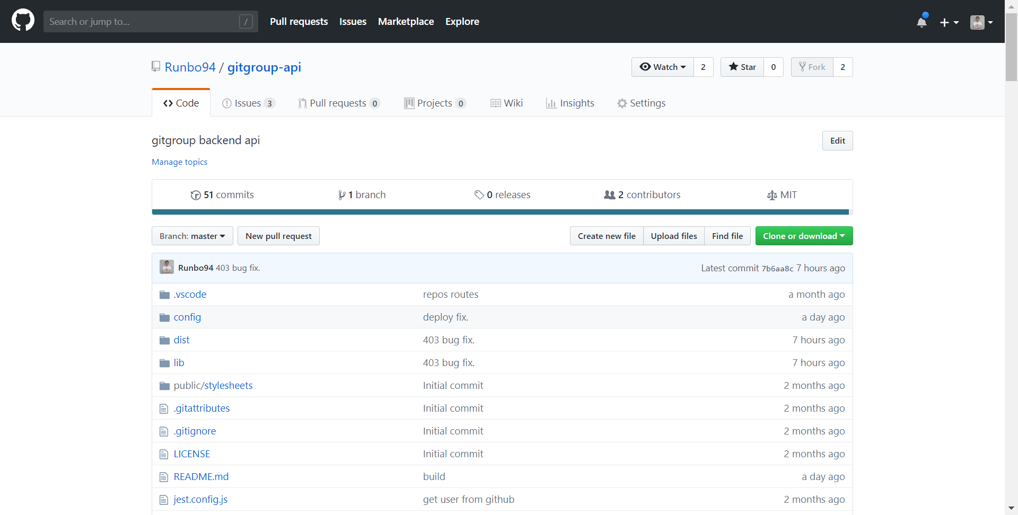
Kanban
How to Create a New Issue In GitHub?
Click here

Slide 38
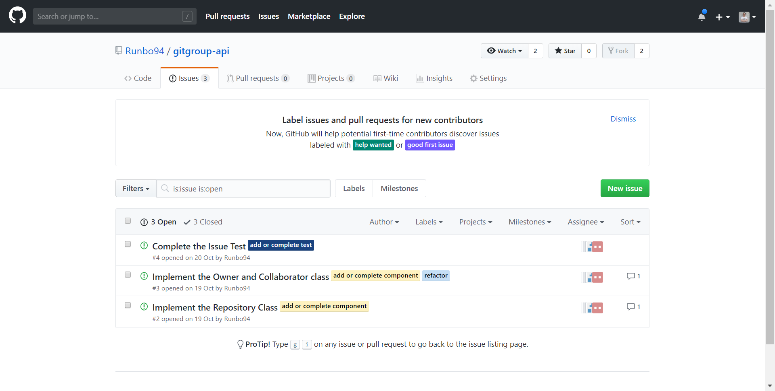
Kanban
How to Create a New Issue In GitHub?

Slide 39
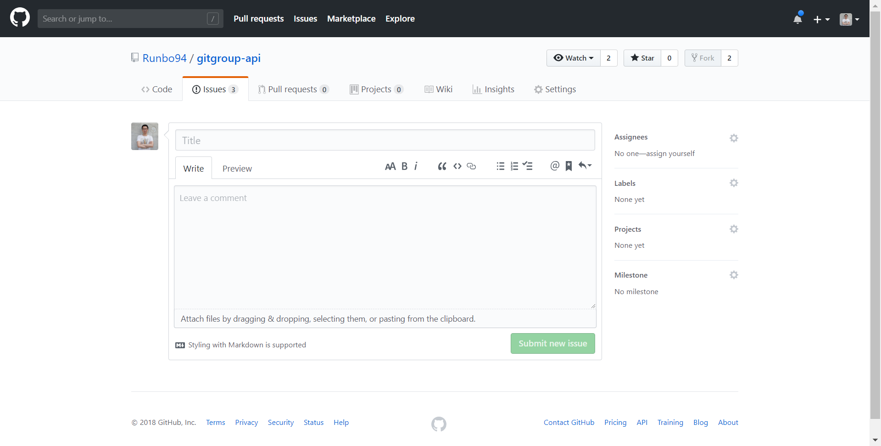
Kanban
How to Create a New Issue In GitHub?
Issue Title
Issue Body

Slide 40
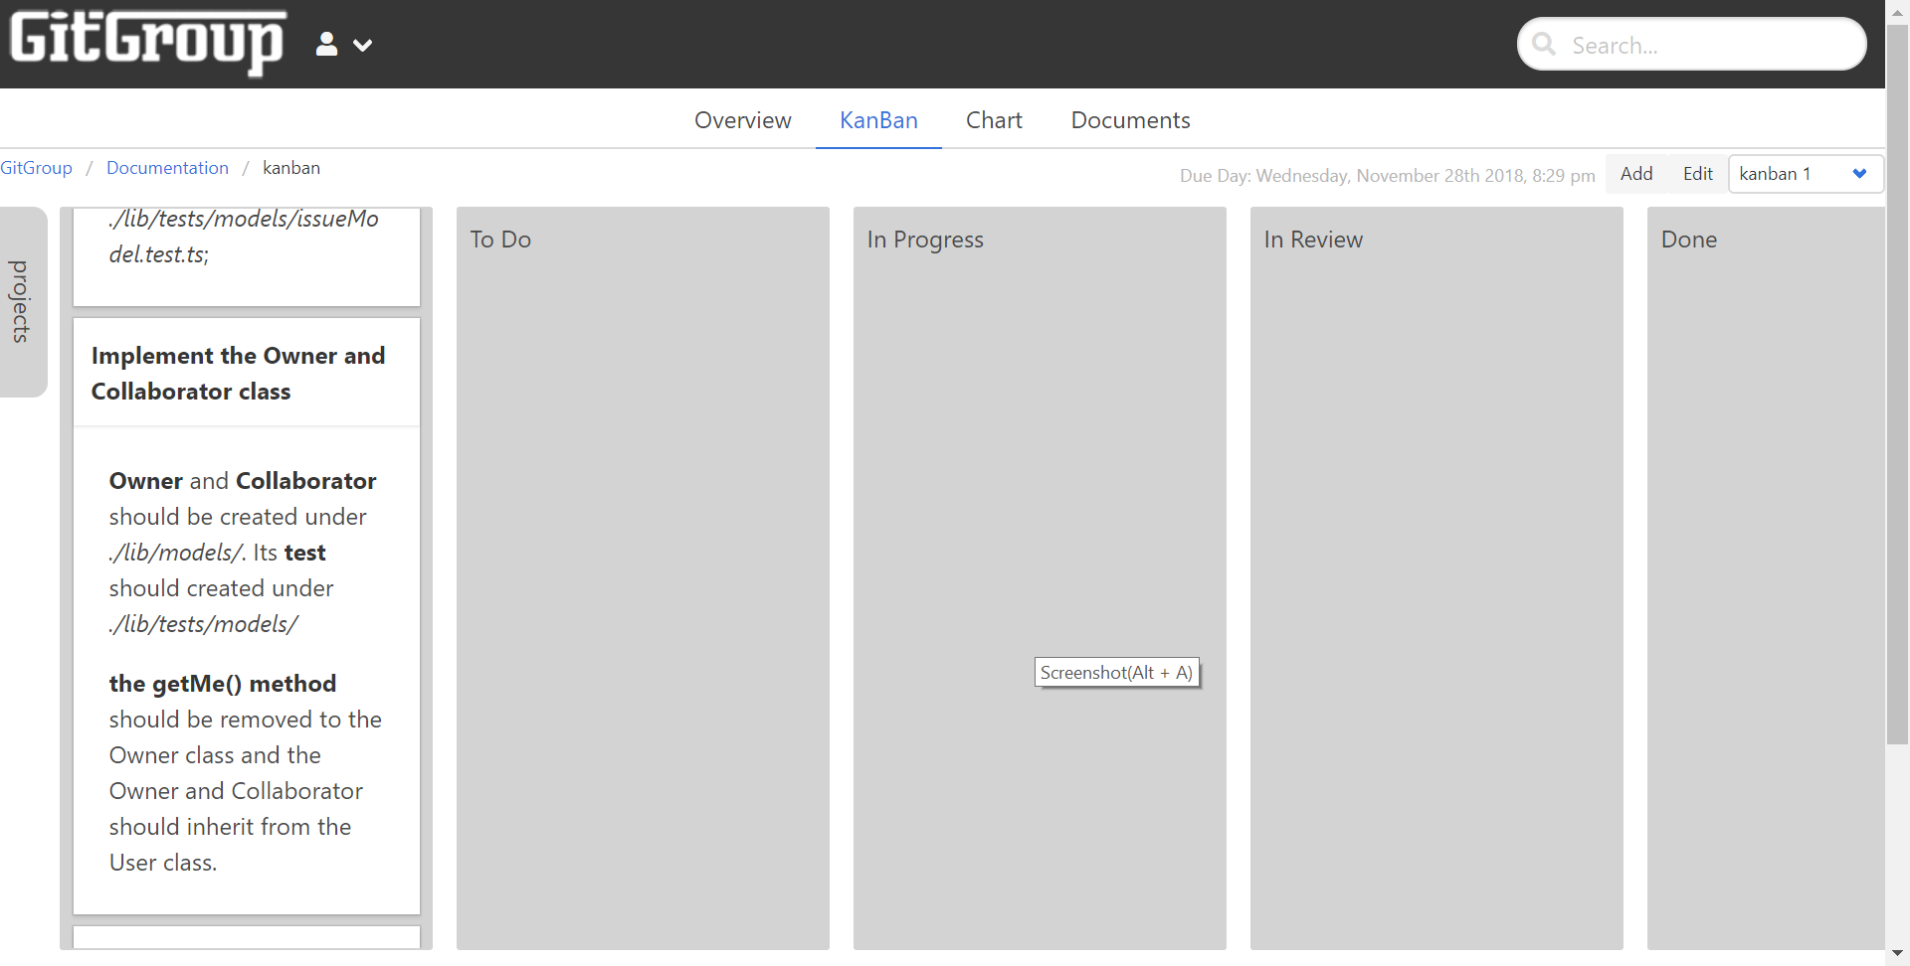
Kanban
Kanban Card
All the Open Issues in the GitHub will appear here. Support Markdown text.

Slide 41
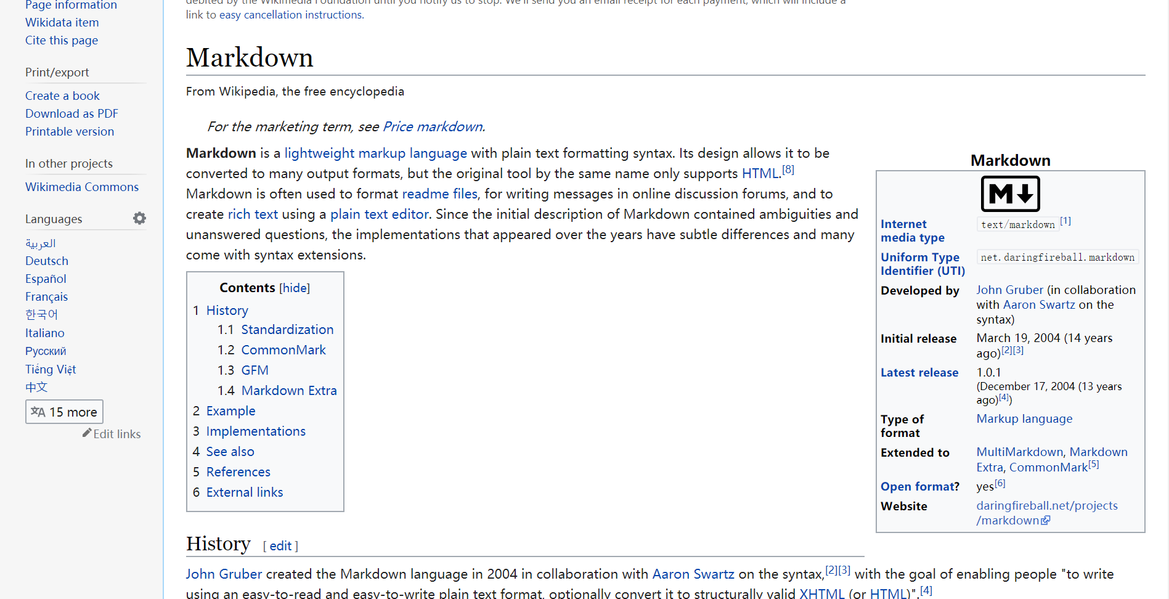
Kanban
What is Markdown?

Slide 42
Kanban
Auto Open And Close.
Cards that are moved into the Done column on GitGroup will be automatically closed and cards closed via GitHub will be automatically moved into the Done column.

Slide 43
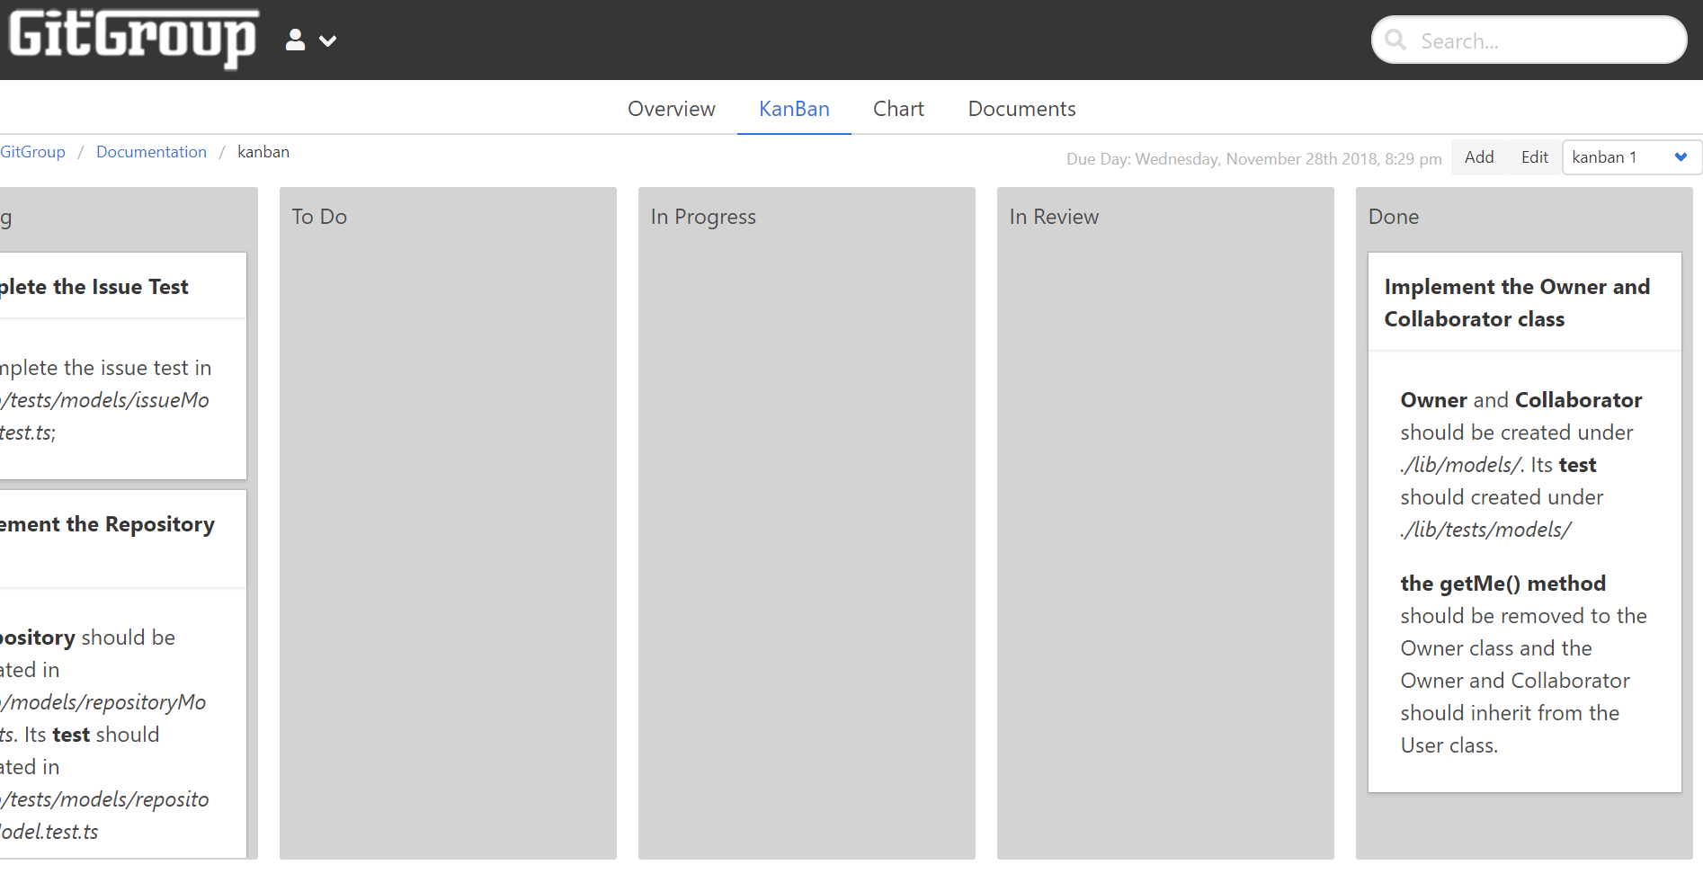
Kanban
Auto Open And Close.

Slide 44
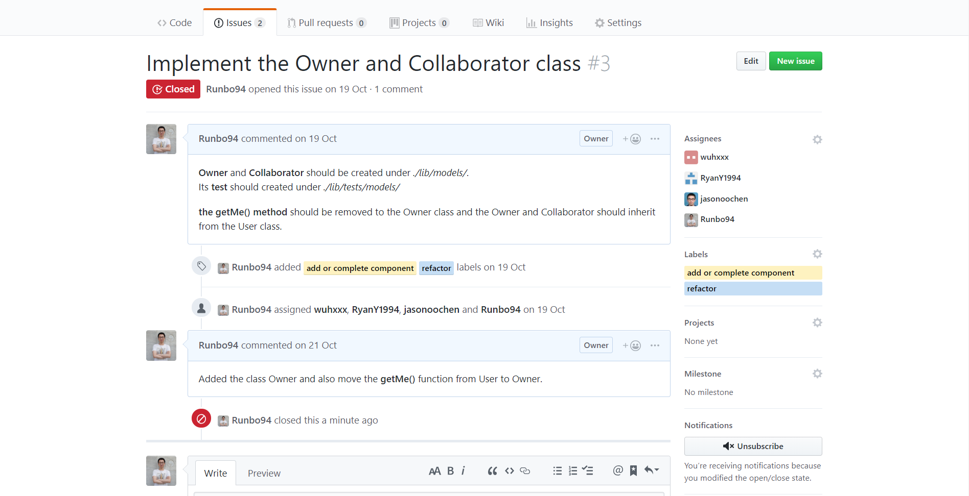
Kanban
Auto Open And Close.

Slide 45
Future

Slide 46
Future
More charts
Burndown and Burnup Charts
A Burnup chart tracks how much work has been completed during the Sprint. Burnup charts have three lines, Goal, Closed Points/Cards, and Ideal Closed Points/Cards. The Goal line allows you to easily see when new work is added to a sprint. Similar to the Burndown Ideal line, the Burnup ideal line marks how much work should have been closed in order to ensure all of the work in your Sprint is completed on time. The Closed line shows the total number of points or cards closed that have been closed.
Both Burndown and Burnup charts can be ltered by source and can be set to exclude
weekends in the Ideal line calculation. They can also display data using point totals or card totals.

Slide 47
Future
More charts
Throughput Chart
The Throughput chart shows you how much work your team is completing everyday. The chart is a stacked bar chart with each segment representing the work done on each of your sources. Throughput charts can help you spot changes in your team's productivity or workflow. GitGroup’s Throughput chart has many lters that allow you dig into the details of what work is being completed everyday.
The Throughput chart can be iteratered by card type, source, assignee, epic, label, milestone and sprint. You can also adjust the date range displayed. Data can be presented as point totals or card totals.

Slide 48
Future
More charts
Users Throughput Chart
The Users Throughput chart tracks how much is being done by each team member weekly. Like the Throughput chart, the Users throughput chart allows you to track how eciently your team is working and spot potential problems in your team members' workows. The Users Throughput chart also oers a rich set of lters. The chart can be displayed as a stacked area chart or stacked bar chart.
The Users Throughput chart can be ltered by source, assignee, label, milestone and sprint. You can also adjust the date range displayed. Data can be presented as point totals or card totals.

Slide 49
Future
More charts
Velocity Chart
If you are using Sprints, you can track how much work your team is getting done per sprint with the Velocity chart. The Velocity chart is a stacked bar chart showing how many cards or points were closed during each sprint in the selected date range. Each section of the bars represents one of your sources. The Velocity chart allows you to see potential problems in your team's eciency as well as providing a way to predict how much work your team will be able to accomplish in future sprints.
The Velocity chart can be ltered by source and label. You can also adjust the date range displayed. Data can be presented as point totals or card totals.

Slide 50
THANK YOU FOR WATCHING

