Slide 1

GitGroup
A Web Based Software Development Management System
Runbo ZHAO, Jingyu BAO, Xuying CAO, Chengxiang YIN
Advisor: Edmund S. Yu Course: CSE 682 Software Engineering

Slide 2
CONTENTS
01
02
03
04
05
06
Introduction
Description
Interface(UI)
Requirement
System
Models
System
Architecture

Slide 3
Introduction

Slide 4
Introduction
What Are GitHub Apps?
GitHub Apps are first-class actors within GitHub. A GitHub App acts on its own behalf, taking actions via the API directly using its own identity, which means you don’t need to maintain a bot or service account as a separate user.
GitHub Apps can be installed directly on organizations and user accounts and granted access to specific repositories. They come with built-in webhooks and narrow, specific permissions. When you set up for your GitHub App, you can select the repositories you want it to access. Some key ideas when creating GitHub Apps

Slide 5
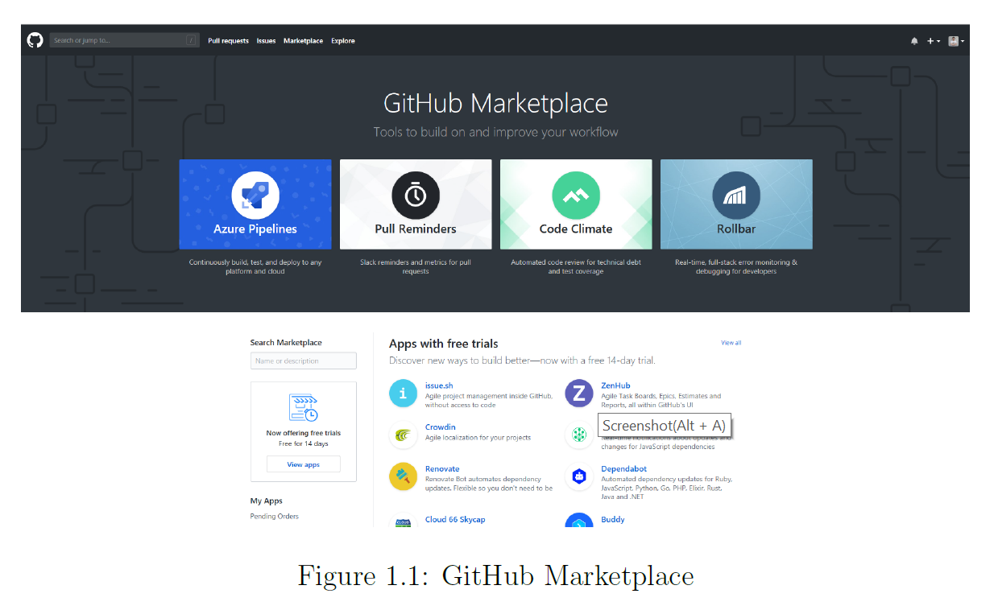
Introduction
What Are GitHub Apps?

Slide 6
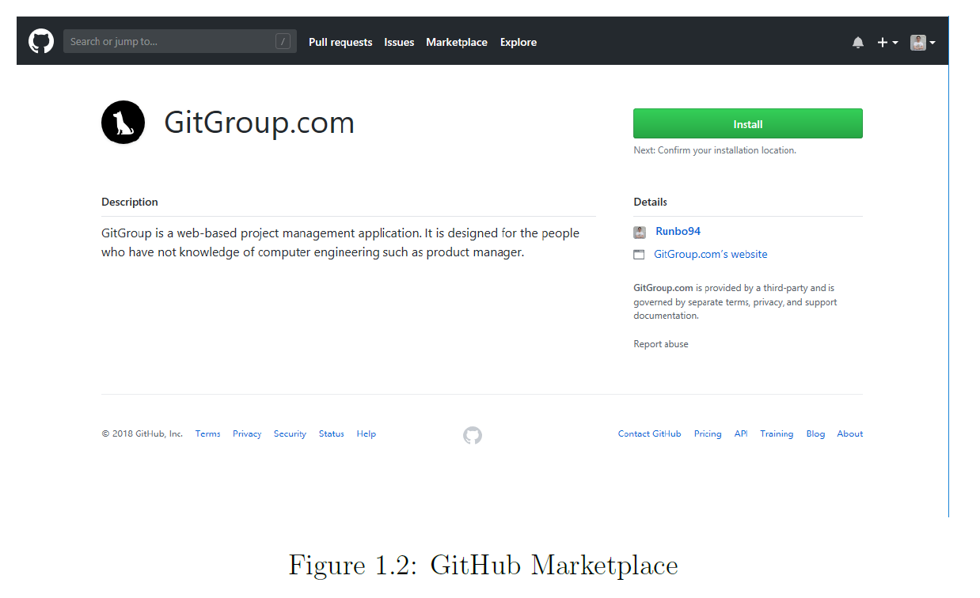
Introduction
What Are GitHub Apps?

Slide 7
Overall Description

Slide 8

Overall Description
Product
GitGroup is not only designed for programmer but also for people who has less development experience such as project manager, project members…
What is GitGroup
GitGroup is a web-based GitHub Application. It is a project management platform that allows everyone on your team to communicate with the developers.
it is easy to create an Agile workflow for your team with a kanban board. GitGroup's seamless integration with GitHub keeps all of your GitHub Issue data in sync across both platforms in real time.

Slide 9
Overall Description
Product Functions - KanBan
The Kanban board which is similar to projects board in the GitHub. In the Kanban board, there are several columns represent different stage of the development process. You can customize your own stage. Every column contains issue card imported from the GitHub, and you can easily drug them among the columns. If you drug it to the Done column. The issue in the GitHub will be automatically closed.

Slide 10
Overall Description
Product Functions - Analytics
GitGroup offers a variety of Agile charts and analytics to help you keep track of how your team is doing. Both owner and collaborators can view these charts.
Burndown and Burnup Charts
Throughput Chart
Users Throughput Chart
Velocity Chart

Slide 11
Overall Description
Product Functions - Chat
GitGroup offers chat room for users to communication. There are two types of chat. One is global chat which is used to communicate friends directly. Another is in-team chat which is used to communicate among the team members.

Slide 12
CSS
{…}
Interface Requirement

Slide 13
Interface Requirement
Bulma
Thu style of GitGroup UI must be clean and easy to use. The CSS framework GitGroup choose is Bulma. It is a beautiful, lightweight and stylish CSS framework. and its grid is fully built with flexbox. Achieving flexible layout with same-size columns is as simple as adding .column class to HTML element. Furthermore, Bulma has some GitHub design style component like panel. It
can be easy reuse to build GitGroup project lists.

Slide 14
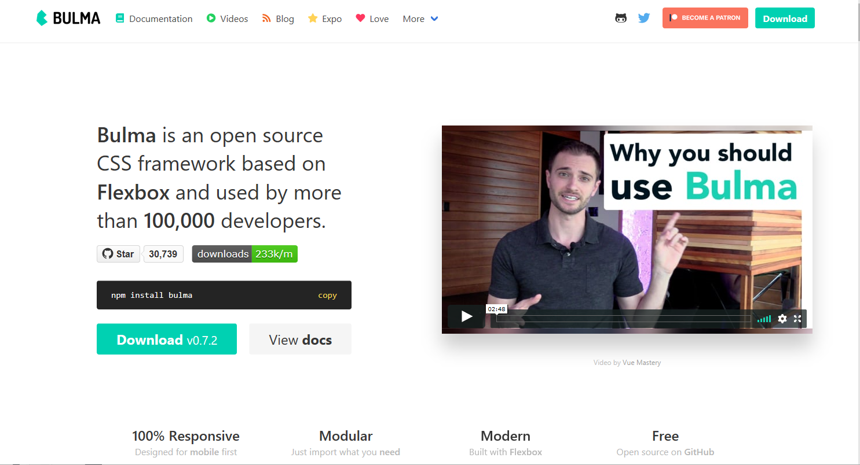
Interface Requirement
Bulma

Slide 15
Interface Requirement
UI Design
The overview is the home page of GitGroup. Because our design aim is ease and simple, all
the important information should display on this main page. The main navigation bar shows the personal information. and the second navigation bar is used for navigate among the Overview, Kanban, Chart and Documentation page.

Slide 16
Interface Requirement
UI Design
The next line is the tool bar, all the tool button should be here. Specially, the left side in this line is the bread crumb which is used to improve the navigation experience. The most important part is the workspace which is divided into 3 parts.
The left side bar is the Project list where users can search, choose, edit, add and remove project.
The combination of the project list and second navigation bar, which is called two-dimension
navigation, is stronger, more accurate.

Slide 17
Interface Requirement
UI Design
The middle part of workspace is user's current status, and it is shown as some diagrams and
charts.
The right side bar is all the to-do things including cards which are close to deadline, message and
meeting log.

Slide 18
Interface Requirement
UI Design
The Kanban board is set of columns that allow you to track the progress of tasks as they move
through your workflow. The GitGroup Kanban board default columns are Inbox, Backlog, Ready, In Progress, In Review and Done. Cards that are newly added to the Workspace (such as when an issue is made on GitHub) will go into the Inbox column by default.

Slide 19
Interface Requirement
UI Design
The Kanban board is set of columns that allow you to track the progress of tasks as they move
through your workflow. The GitGroup Kanban board default columns are Inbox, Backlog, Ready, In Progress, In Review and Done. Cards that are newly added to the Workspace (such as when an issue is made on GitHub) will go into the Inbox column by default.

Slide 20
Interface Requirement
UI Design
Cards that are moved into the Done column on GitGroup will be automatically closed and cards closed via GitHub will be automatically moved into the Done column. And the right top of Kanban board shows the due day of this KanBan.

Slide 21
Interface Requirement
UI Design
The Chart UI is easy and understandable. The main part shows different charts and you can
change them via buttons on the tool bar.

Slide 22
Requirement

Slide 23
Requirement
Functional User Requirement
UR-1 User shall be able to create a new project and new team in GitGroup.
UR-2 User shall be able to manage GitHub repositories and team members like add or remove repositories and members.
UR-3 User shall be able to use Kanban board to organize issues by dragging issue cards among several columns representing different stage of the development processes.
UR-4 User shall be able to analysis the development duration, quality and the team work situation of the project by using a variety of agile charts and analytics. also manage tasks like suggesting a new idea or tracking a bug.
UR-5 User shall be able to organize an online meeting group chat, schedule and record the conference within the team or the global scope.

Slide 24
Requirement
Non-Functional User Requirement
UR-6 The application shall be able to make GitHub easy to use, especially friendly for the person who has little development experience such as product manager.
UR-7 The application shall be quickly restored to operational status after a failure occurs.
UR-8 The app shall be reliable to uses with no downtime.
UR-9 The application shall be able to provide maximum security against malicious attack.

Slide 25
Requirement
User Interfaces (Functional System Requirements)
UI-1.1 Developers can create a new project and make a team with other developers.
UI-1.2 Developers can remove a project and collaborators of the project after checking if the project is empty.
UI-2.1 Developers can manage their team by inviting to or removing collaborators from their projects.
UI-2.2 Developers can manage their repositories by adding or removing repositories of their projects.

Slide 26
Requirement
User Interfaces (Functional System Requirements)
UI-3.1 Developers can classify issues by different stages of development process via putting them in different columns of Kanban board.
UI-3.2 Developers can add or remove a Kanban from their Kanban board.
UI-3.3 Developers can customize their own stage by editing column name except Done column.
UI-3.4 Developers can close issues by dragging it to the Done column, which will automatically close issues in the GitHub.

Slide 27
Requirement
User Interfaces (Functional System Requirements)
UI-4.1 Project manager can track the progress of their projects by burn down and burn up charts.
UI-4.2 Project manager can measure how much work a team can used in extreme Programming and Scrum from throughput chart.
UI-4.3 Project manager can analysis the velocity of project going from velocity chart.
UI-5.1 Team leader can organize an online meeting group chat within their team.
UI-5.2 Developers can organize an online meeting group chat within the global.
UI-5.3 Developers can receive a meeting notication from team leader.
UI-5.4 Developers can set an alarm for notifying the coming events on a conference schedule form.
UI-5.5 Developers shall be able to record content of meeting on a meeting notebook.

Slide 28
Requirement
Non-Functional System Requirement
NF-6.1 The user shall be able to use all the app functions without any kind of training. The average number of questions call about how to use app shall not exceed 10 per day.
NF-6.2 The app shall be available for any kind of mobile device and PC.
NF-7.1 When an fail occurs, the warning block shall display on the application window, and the page shall be navigated to the previous page or authorization page.
NF-8.1 The app shall be available to all users during whole day (Mon-Sun, 00:00 00:00)
NF-9.1 The app shall not expose contact information to other users.
NF-9.2 The app should minimize the amount of personally identifying information (PII) that it collects.

Slide 29
System Models

Slide 30
System Models
Use Case Diagram

Slide 31
System Models
State Diagram

Slide 32
System Models
State Diagram

Slide 33
System Models
Activity Diagram

Slide 34
System Models
Sequence Diagram

Slide 35
System Models
Sequence Diagram – GitHub Authorization
GitGroup acts on behalf of a user, it performs user-to-server requests. These requests must be authorized with a user's access token. User-to-server requests include requesting data for a user, like determining which repositories to display to a particular user. These requests also include
actions triggered by a user, like running a build, in order to identifying and authorizing users on GitGroup, it must identify GitHub users when they visit GitGroup using OAuth. When GitGroup user click authorization button they are redirected to request his/her GitHub
identity.

Slide 36
System Models
Sequence Diagram – GitHub Authorization
The web browser will send a request for GitHub access token to GitGroup server, and GitGroup server redirected to request a GitHub identity to GitHub Authorization Server. Then GitHub redirects back to GitGroup authorization page, wait for user to accept. After user accept the request, web server submit the agree form to GitHub authorization server, and GitHub redirects back with a temporary code in a code parameter as well as the state GitGroup server provided in the previous step in a state parameter.

Slide 37
System Models
Sequence Diagram – GitHub Authorization
If the states don’t match, the request was created by a third party and the process should be aborted. GitGroup exchange this code for an
access token, then save this token in GitGroup database for later using and user get the GitHub access token.
When user request data with access token, user are directed to request data related to the GitHub protected data, and GitGroup server request to access GitHub user protected resource and handle GitHub resource, do business logic and re-package the resource. At last GitGroup return data to web server, web server visualize the data and display it to user.

Slide 38
System Models
Sequence Diagram – GitHub Authorization
Once user request data without access token or with wrong access token which means GitGroup cannot access GitHub user protected resource. After GitHub reject the access, GitGroup server return authorization fail information to user. User will request data successfully only if user request correct GitHub access token.

Slide 39
System Models
Class Diagram

Slide 40
System Architecture

Slide 41
System Architecture

Slide 42
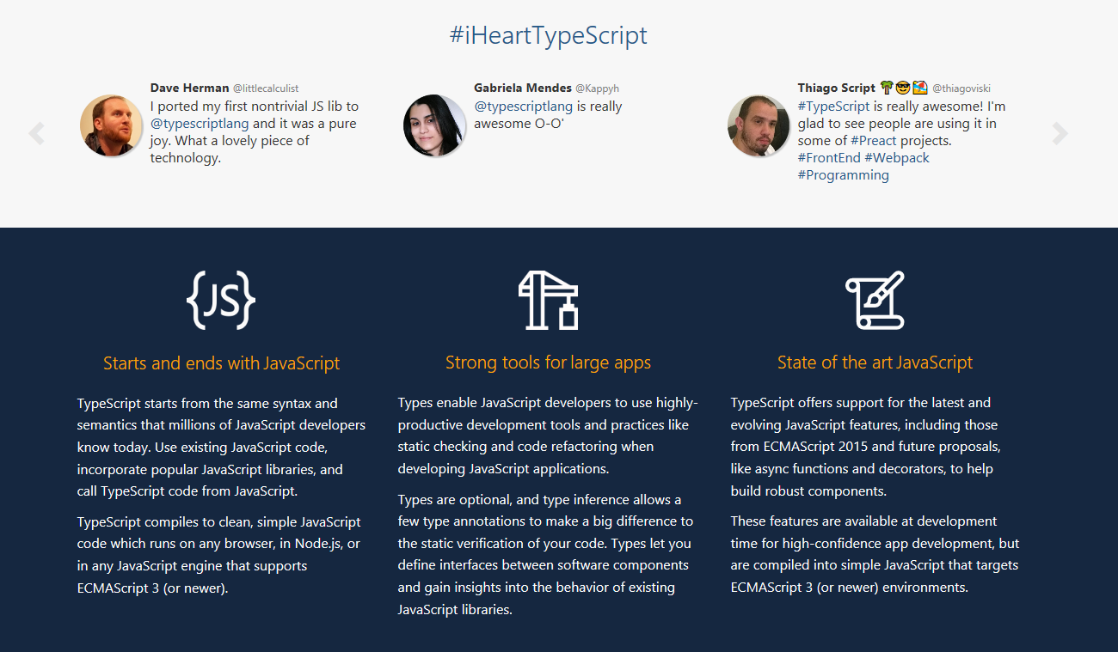
System Architecture
TypeScript

Slide 43
System Architecture
TypeScript
TypeScript is an open-source programming language developed and maintained by Microsoft. It is a strict syntactical superset of JavaScript, and adds optional static typing to the language. TypeScript is used to develop GitGroup because its strong Object-Oriented-Programming features. TypeScript is designed for development of large applications and transcompiles to JavaScript. As TypeScript is a superset of JavaScript, existing JavaScript programs are also valid TypeScript programs. TypeScript may be used to develop JavaScript applications for both client-side and server-side (Node.js) execution.

Slide 44
THANK YOU FOR WATCHING

