Slide 1
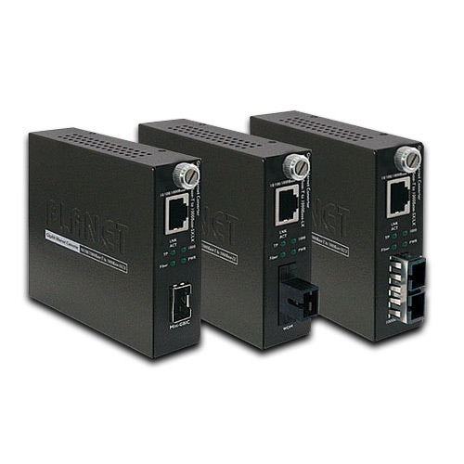
GST-80X Series
Card Type Managed
10/100/1000BASE-T to 1000BASE-SX/LX Smart Media Converter
Model:
GST-802 (SX(SC,MM) -220m/550m)
GST-802S (LX(SC,SM) -10km)
GST-805A LX/SX(-distance depends on SFP module
GST-806A15 LX(WDM) -TX:1310nm-15km
GST-806B15 LX(WDM) -TX:1550nm-15km
GST-806A60 LX(WDM) -TX:1310nm-60km
GST-806B60 LX(WDM) -TX:1550nm-60km
Port Type:
Fast media converter
Gigabit media converter
Type:
Card Type
Stand alone

Slide 2
Series:
Unmanaged Converters
Managed Converters
PoE Converter
Industrial Converter
Chassis

Slide 3
Overview
To provide an easy use yet powerful solution for FTTX applications, PLANET has released a new 10/100/1000Base-T to 1000Base-SX/LX Smart Media Converter, GST-80x series, featuring plug & play and smart media conversion functions. Distance Extension with High Performance and Steady Network Communication PLANET GST-80x Smart Gigabit Media Converter series extends communication distance with highly Gigabit performance via fiber optical cable. The GST-80x series provides media conversion between 10/100/1000Base-T and 1000Base-SX/LX interfaces such as multi-mode LC/SC connectors (220m / 550m), single-mode LC/SC connectors (10/20/30/40/50/70/120km) and single fiber connectors (WDM,15/60km) for various fiber optic applications.
Enhanced Smart Management Features The GST-80x series provides auto MDI/MDI-X on its TP port and the DIP switch to configure the available smart functions including the auto-negotiation / force for fiber interface and Link Pass-through function (LLCF/LLR). The Link Loss Carry Forward (LLCF) function works with Link Loss Return (LLR) to diagnose network connections. Also, the LLR function can immediately alarm network administrator the media link issue and provide efficient solution to monitoring the entire network. Easy Installation The GST-80x series allows two segments to connect easily. The Smart Media Converter can be used as a standalone unit when powered by its DC adapter or used as a slide-in module to PLANET 19-inch managed 16-slot media converter chassis (MC-1610MR / MC-1610MR48). When working with the Managed media converter chassis, the GST-80x is able to be managed and its status can be monitored through the local RS-232 console and remote web interface.

Slide 4
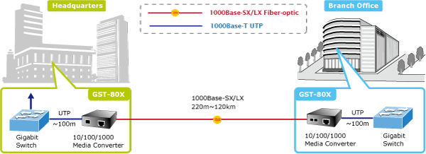
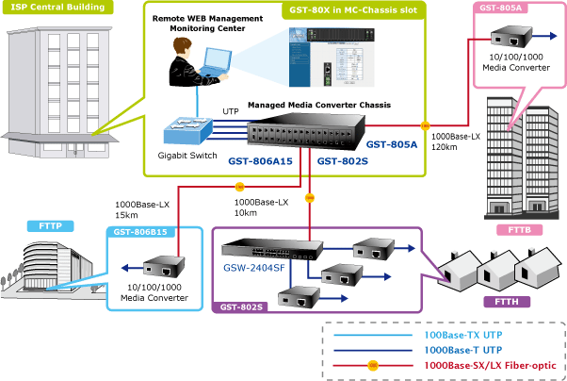
Application
Fiber-Optic Networking for ISP, Enterprise, and Home PLANET GST-80x provides advanced media conversion technology -- 10/100/1000Base-T and 1000Base-SX/LX interfaces to fulfill different kinds of demands as the current network grows and expands. The GST-80x provides diverse fiber connect type options for different network applications. It is very flexible for the GST-80x to work as a standalone device or be installed in the central management media converter chassis for centralized management. When working with the management media converter chassis, the GST-80x is hot swappable to avoid network downtime. The GST-80x is the ideal solution to building a network solution of FTTH (Fiber to the Home) or FTTC (Fiber to the Curb), and FTTB (Fiber to the Building) for ISPs, campuses and enterprises.

Slide 5
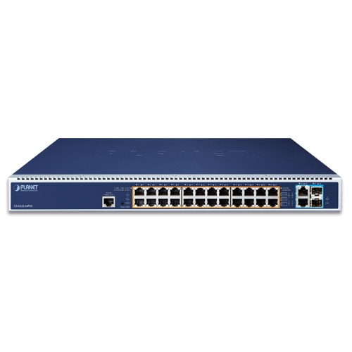
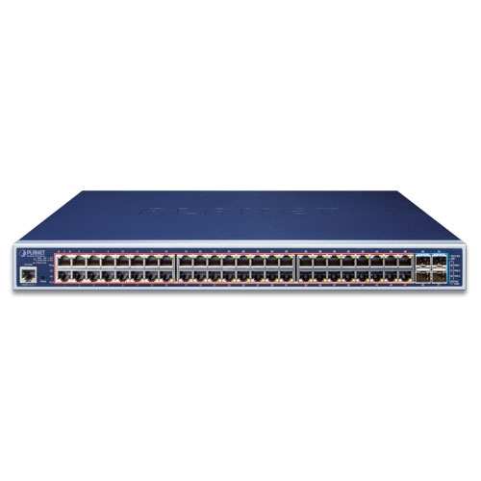
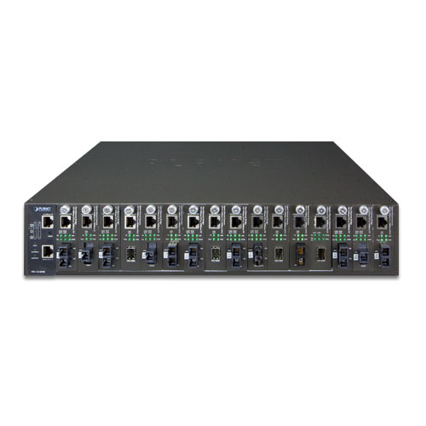
Network Connectivity Hybridge Cabling
Cat6 Patch Cord RJ45 to RJ45 1M
Cat6 Patch Cord RJ45 to RJ45 1M
GST-802 / GST-802S
Chassis MC-1610MR / MC-1610MR48
Chassis MC-1610MR / MC-1610MR48
L3 48-Port 10/100/1000T 802.3at PoE + 4-Port 10G SFP+ Managed Switch
L3 24-Port 10/100/1000T 802.3bt PoE + 2-Port 10GBASE-T + 2-Port 10G SFP+ Managed Switch with Dual Modular Power Supply Slots
Patch Cord SC-SC, SM 9/125um, Duplex, 3M

Slide 6
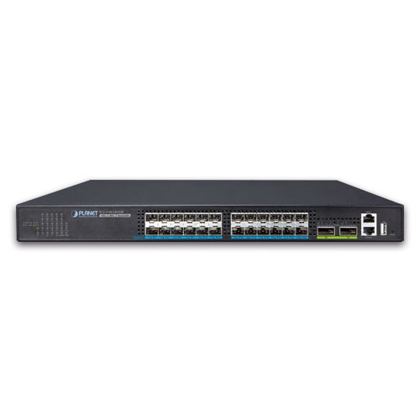
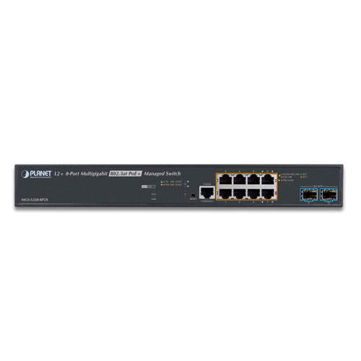
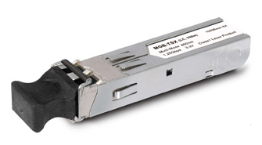
Network Connectivity Hybridge Cabling
Cat6 Patch Cord RJ45 to RJ45 1M
Cat6 Patch Cord RJ45 to RJ45 1M
GST-805A/GST-806A15
GST-806B15/GST-806A60/GST-806B60
Chassis MC-1610MR / MC-1610MR48
Chassis MC-1610MR / MC-1610MR48
MGB-Series Transceiver
Layer 2+ 24-Port 10G SFP+ + 2-Port 40G QSFP+ Stackable Managed Switch
L2+ 8-Port 2.5G 802.3at PoE + 2-Port 1G/10G SFP+ Managed Multigigabit Switch
Patch Cord LC-LC, SM 9/125um, Duplex, 3M

Slide 7
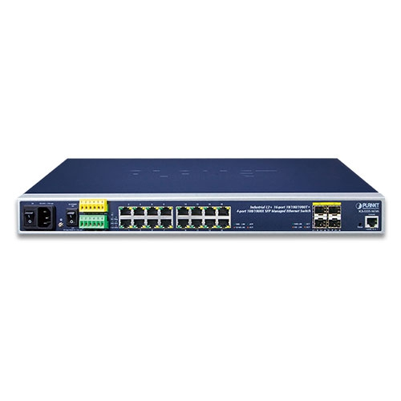
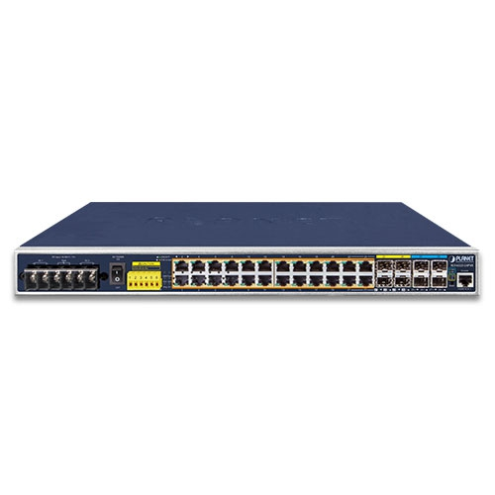
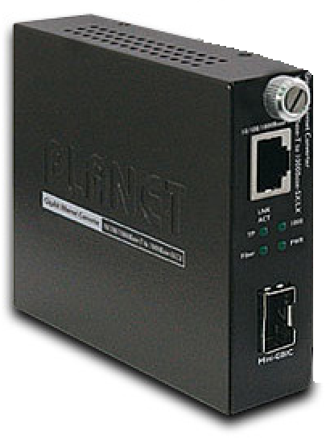
Network Connectivity Extending Distrance
Cat6 Patch Cord RJ45 to RJ45 1M
Cat6 Patch Cord RJ45 to RJ45 1M
GST-802 / GST-802S
MGB-Series Transceiver
Industrial L2+ 16-Port 10/100/1000T + 4-Port 100/1000X SFP Managed Ethernet Switch
Industrial L3 24-Port 10/100/1000T 802.3at PoE + 4-Port 10G SFP+ Managed Ethernet Switch
Patch Cord LC-LC, SM 9/125um, Duplex, M

Slide 8
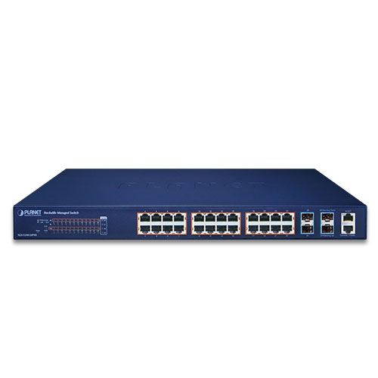
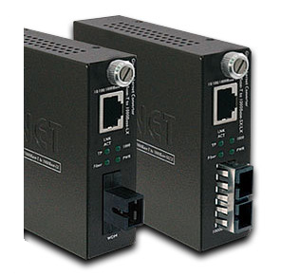
Network Connectivity Extending Distrance
Cat6 Patch Cord RJ45 to RJ45 1M
Cat6 Patch Cord RJ45 to RJ45 1M
GST-805A/GST-806A15
GST-806B15/GST-806A60/GST-806B60
MGB-Series Transceiver
Layer 2+ 24-Port 10G SFP+ + 2-Port 40G QSFP+ Stackable Managed Switch
Layer 2+ 24-Port 10/100/1000T 802.3at PoE + 4-Port 10G SFP+ Stackable Managed Switch
Patch Cord SC-SC, SM 9/125um, Duplex, 10M

Slide 9
Network Connectivity Sever to Fiber Connect
Cat6 Patch Cord RJ45 to RJ45 1M
GST-802 / GST-802S
Industrial L2+ 16-Port 10/100/1000T + 4-Port 100/1000X SFP Managed Ethernet Switch
MGB-Series Transceiver
Industrial L3 24-Port 10/100/1000T 802.3at PoE + 4-Port 10G SFP+ Managed Ethernet Switch
Patch Cord LC-LC, SM 9/125um, Duplex, 10M

Slide 10
Network Connectivity Sever to Fiber Connect
Cat6 Patch Cord RJ45 to RJ45 1M
GST-805A/GST-806A15
GST-806B15/GST-806A60/GST-806B60
Layer 2+ 24-Port 10G SFP+ + 2-Port 40G QSFP+ Stackable Managed Switch
MGB-Series Transceiver
Layer 2+ 24-Port 10/100/1000T 802.3at PoE + 4-Port 10G SFP+ Stackable Managed Switch
Patch Cord SC-LC, SM 9/125um, Duplex, 10Km

Slide 11
Item Spotlight
1x 10/100/1000Base-T Auto-Negotiation RJ45 port Supporting Auto-MDI/MDIX
1x 1000Base-SX/LX port with LC/SC/WDM connector supporting multi-mode or single-mode fiber optic cable
Maximum Transmission Distance Depends on the Inserted Modules
Auto-negotiation of Half-Duplex / Full-Duplex Transfer Mode
LEDs Indicate Ethernet and Fiber Link Status at a Glance
Plug-and-play, Support 1U 16 Slots Chassis & Stand-alone Use
Complies with IEEE 802.3 10Base-T, IEEE 802.3u 100Base-TX, IEEE 802.3ab 1000Base-T, IEEE 802.3z 1000Base-SX/LX Ethernet Standard

Slide 12
Feature
Standards: - Complies with IEEE 802.3 10Base-T, IEEE 802.3u 100Base-TX, IEEE 802.3ab 1000Base-T, IEEE 802.3z 1000Base-SX/LX Ethernet Standard • Interface: - One 10/100/1000Base-T port with RJ-45 connector - One 1000Base-SX/LX port with LC/SC/WDM connector supporting multi-mode or single-mode fiber optic cable - Auto-negotiation and Auto-MDI / MDI-X for 10/100/1000Base-T port • Layer 2 Features: - Back-pressure and IEEE 802.3x compliant flow control and full wire-speed forwarding rate - 9K Jumbo Frame size supported - Link Loss Return (LLR) switch on each fiber optic to aid in troubleshooting remote network connections - Link Loss Carry Forward (LLCF) work with LLR in diagnosing network connections • Smart Management: - Provides DIP switch for fiber (Auto-negotiation / Manual) and LFP function(Disable / Enable) setting - Manageable through Managed Media Converter Chassis System (MC-1600MR/MC-1610MR series) - Bandwidth control / TS-1000 OAM / IEEE 802.3ah OAM / Loop Back Test function provided with MC-1610MR / MC-1610MR48 Managed Media Converter Chassis System • Hardware: - Used as a stand-alone device or work with Managed Media Converter Chassis for up to 16 converter with redundant power supply for optional expansion use - LED indicators for converter status - Choice of fiber-connector from SC, LC, WDM, multi-mode / single-mode fiber / 1000Base-SX / LX mini GBIC module - EMI standards complies with FCC, CE class A

Slide 13
Related Porduct
MC-1610MR / MC-1610MR48 : 16-Slot Managed Media Converter Chassis with Redundant Power Supply System
ที่มา : https://www.planet.com.tw/en/product/gst-80x-series?c1=media-conversion&c2=gigabit-media-converter&c3=chassis-managed-gigabit-media-converter
Datasheet : https://www.planet.com.tw/storage/products/24466/C-GST-80x_s.pdf

