Slide 1
VR Project
Runcong LI
ZiXin Zou
Freder Sipile

Slide 2
Summary
Paint interaction
SFML interaction
Unity3D dynamic project
2

Slide 3
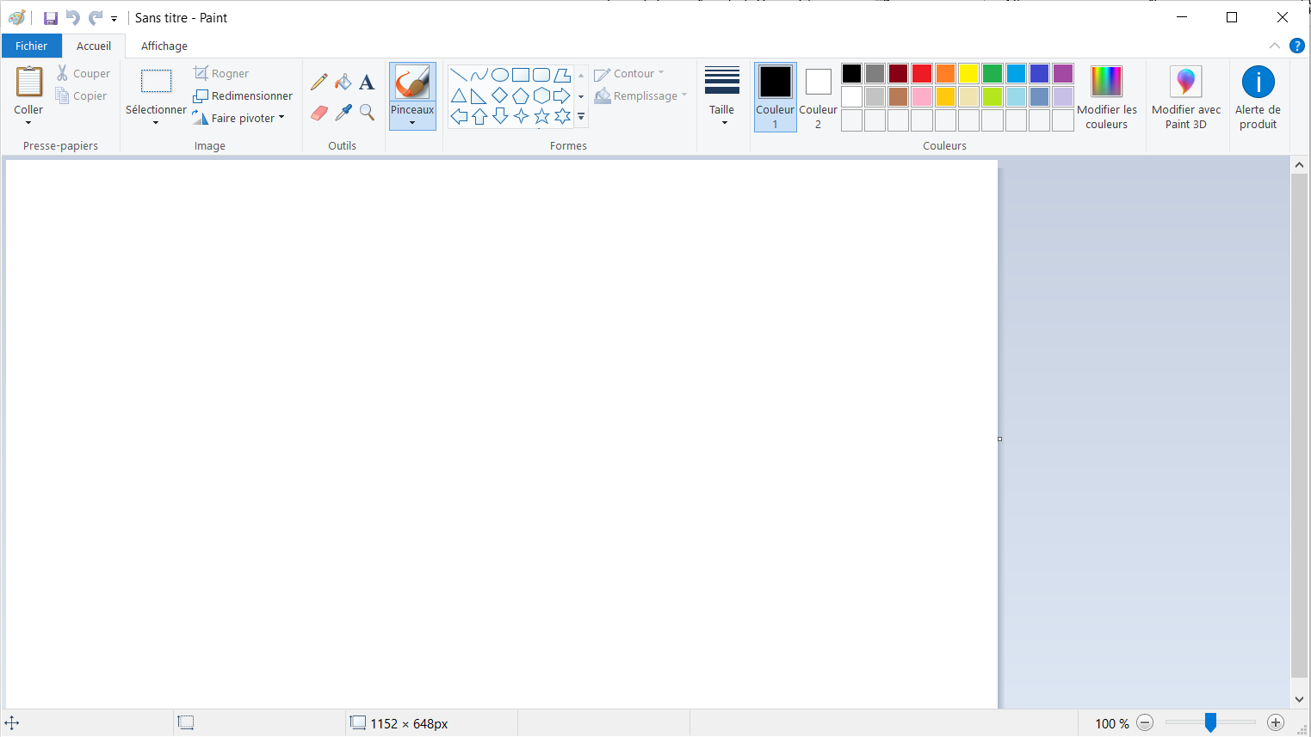
Paint interaction
Open & close paint by Clapping.
Draw by moving forward with your right hand and moving.
Retract the right hand, move the mouse but don't draw
3

Slide 4

SFML interaction
Change the colours
Raise or lower right hand
Change shape
Raise or lower left hand
Put a texture
Push forward with right hand
4

Slide 5
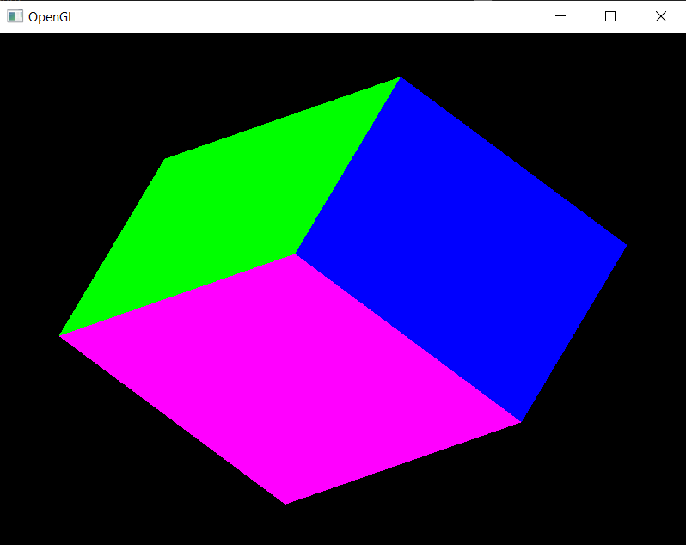
SFML with OpenGL
Change the rotation and colours
Raise or lower right hand
Put a texture on the cube
Raise or lower left hand
5

Slide 6
Unity3D dynamic project: Basketball Game
6

Slide 7
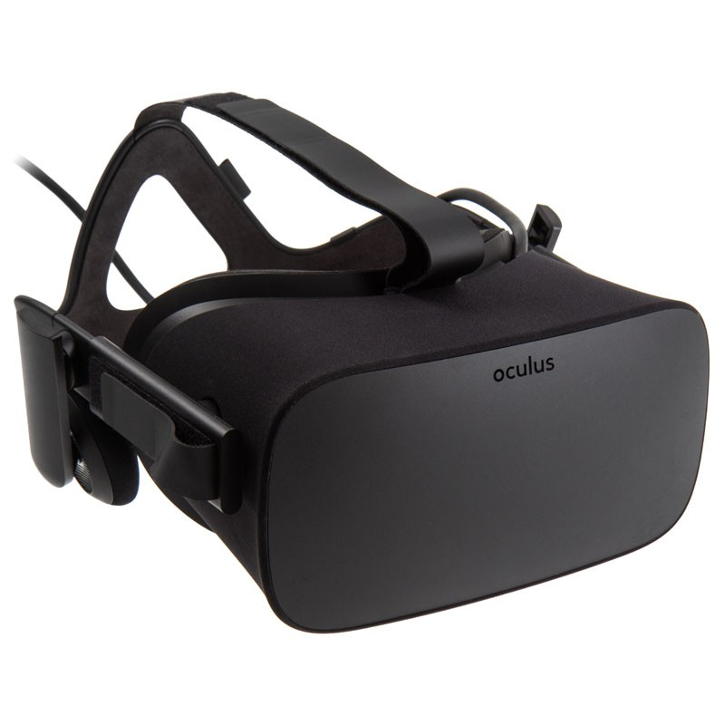

Technologies
Oculus Rift
Unity 3D
7

Slide 8
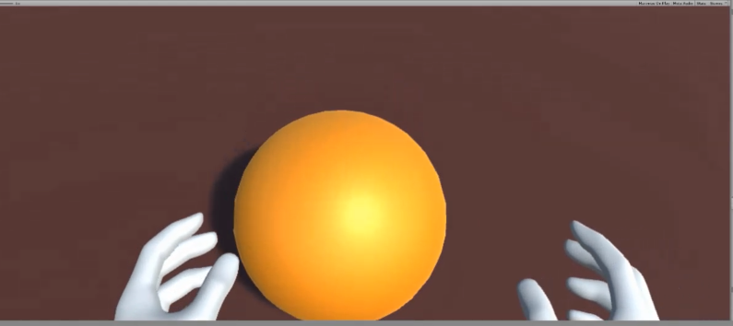
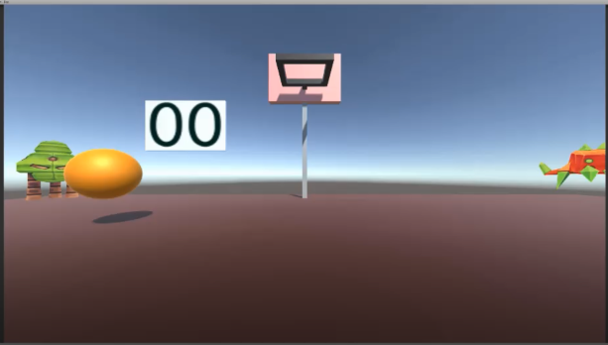
The goal of Game
- A Basketball Game in oculus rift
-
8

Slide 9
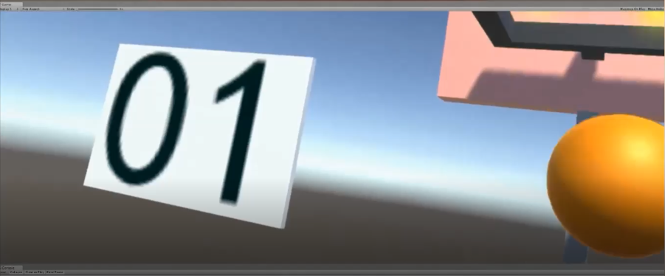
Players score by shooting
9

Slide 10
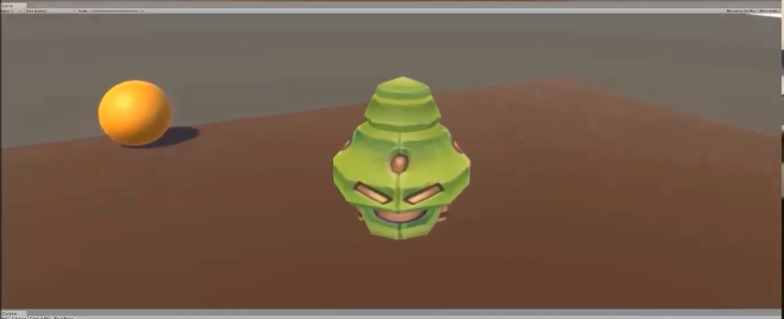
Players pitching to get a certain score of ghosts appear
10

Slide 11
Motion sickness
- The camera always follows the player's position movement without delay: let the user's rotation sense corresponds to the vision.
- Control movement speed, simple picture
-Action close to the real world
11

Slide 12
Bussiness Model
Key Partner: Oculus
Target Customer Segments: Game lovers with Oculus Rift
Distribution Channels:
Oculus App Shop
VR Experience Shop
Cost Structure:
Development cost
Revenue Model:
Game sales
Advertisement Income
12

Slide 13
Demonstration
13

