Slide 1

Mid-Term Defence
Design and Implementation of a Multi-Device DNN Collaborative Inference System at the Edge
Runcong Zhou
Computer Science

Slide 2







CONTENTS
1. Research Background & Objectives
2. System Design & Methodology
3. Progress & Preliminary Results
Remaining Work & Timeline

Slide 3



01
Research Background and Objectives

Slide 4


1. Research Background & Objectives
Pipeline and Distributed inference in multiple Devices
Device1
Device2
Device3
1
2
3
4
5
6
7
8
Device1
1
2
Device2
1
2
Device3
1
2
Device4
1
2
Time

Slide 5






1. Research Background & Objectives
Research Objective：
1. DNN Structure Visualization Visualize the hierarchical structure of deep neural network layers.
Visualization outcomes
7
8
Model 1
Model 2
Model 3
1
2
3
4
5
6
2. Virtual Device Configuration Configure multiple simulated edge devices with customizable computing capacity and bandwidth.
Model Information Current Layer Information
3. Model Partition Simulation Simulate collaborative inference by partitioning model layers across devices.
Simulated Device
Simulated Device
Simulated Device
Visualization Interface
4. Performance Evaluation Measure latency, throughput, and device utilization under different partition strategies.
Sectional Configuration

Slide 6
02
System Design and Methodology

Slide 7
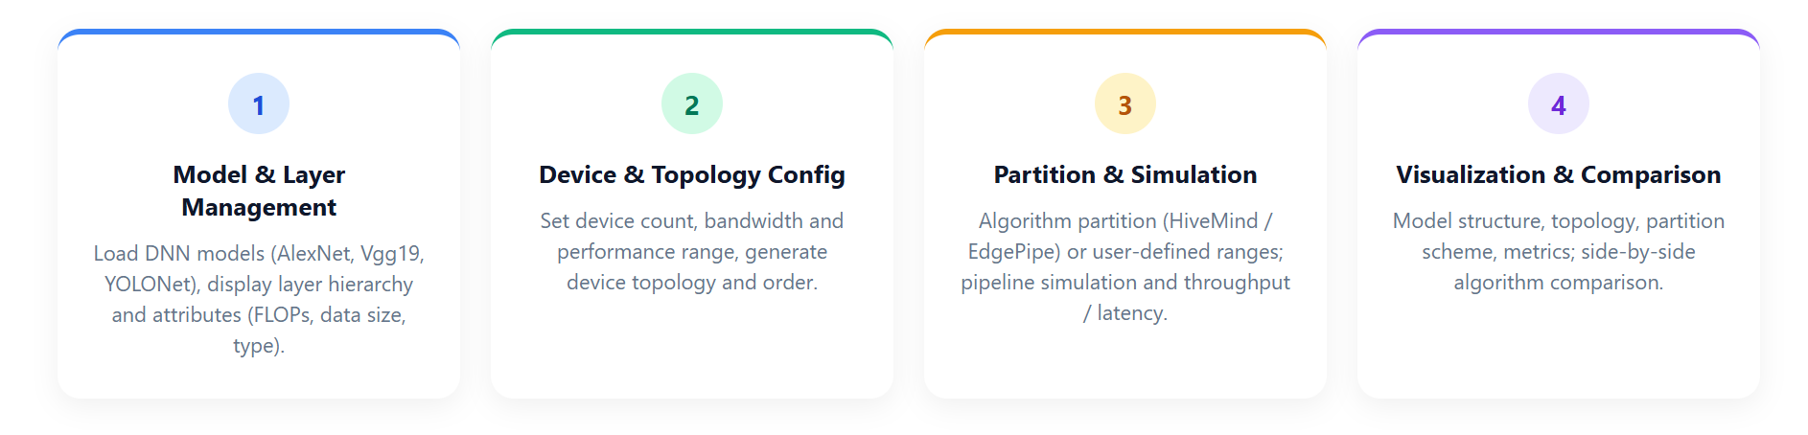
Main Function Modules
2. System Design & Methodology

Slide 8
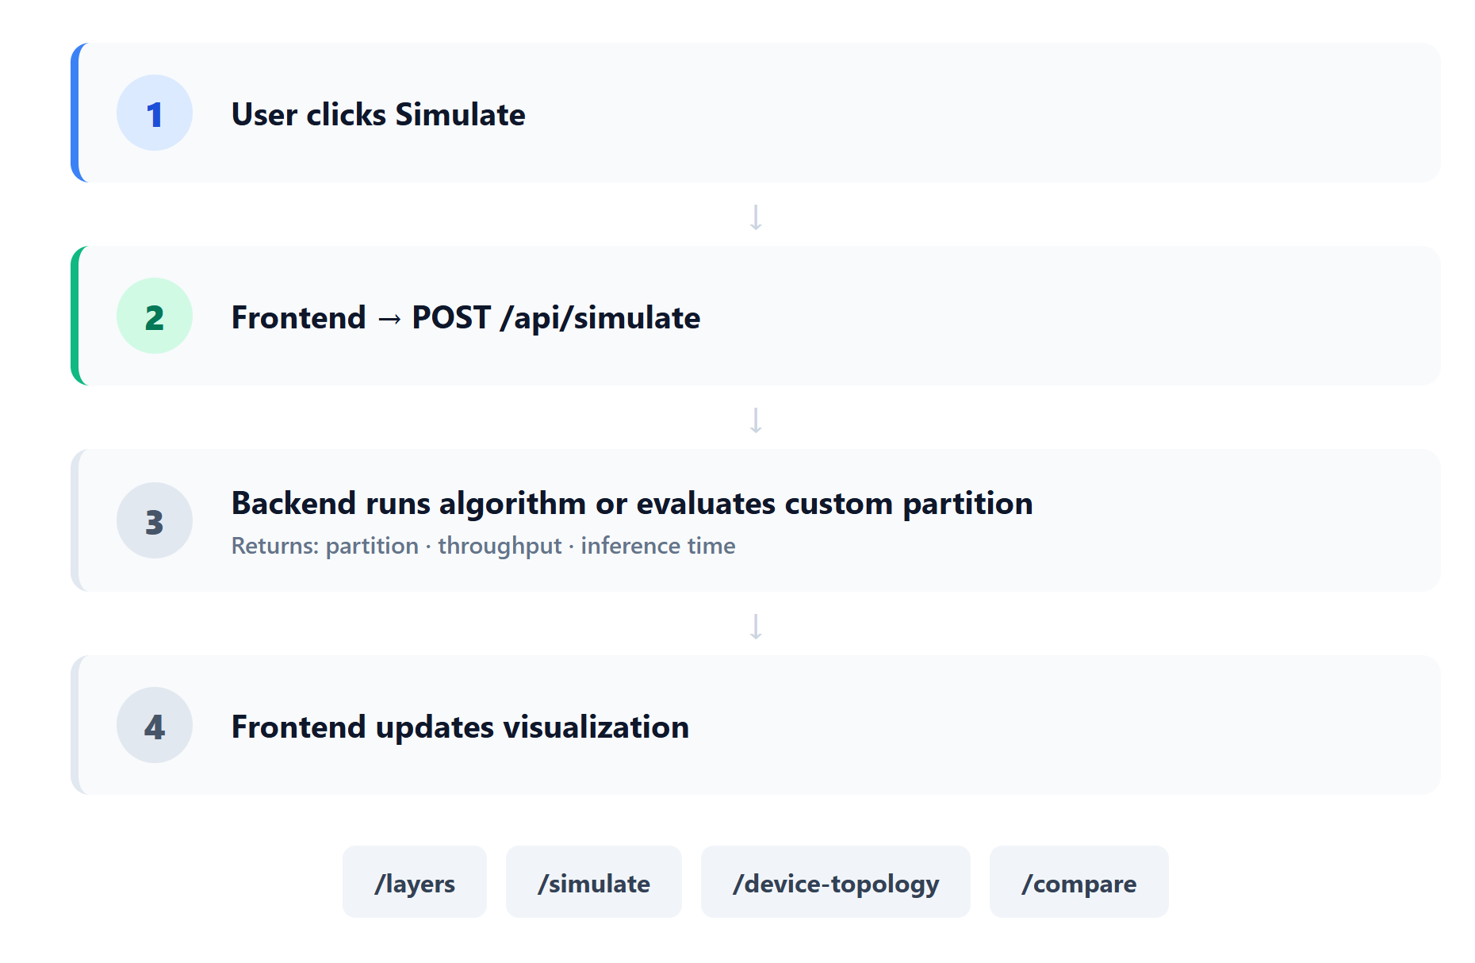
Background API & Simulation Flow
2. System Design & Methodology

Slide 9
03
Progress and Preliminary Results

Slide 10
Experiment Design
3.Progress & Preliminary Restults
Algorithms: HiveMind (min latency) vs EdgePipe (max throughput)
Variables:
Models (AlexNet, Vgg19, YOLONet, SqueezeNet)
Device count (3–6) ·
Bandwidth (10–60 MB/s)
Device performance (20–100 GFlops/s)
Metrics: Throughput (batches/s) · Inference time (s)
Setup: Same topology & seed for both algorithms

Slide 11
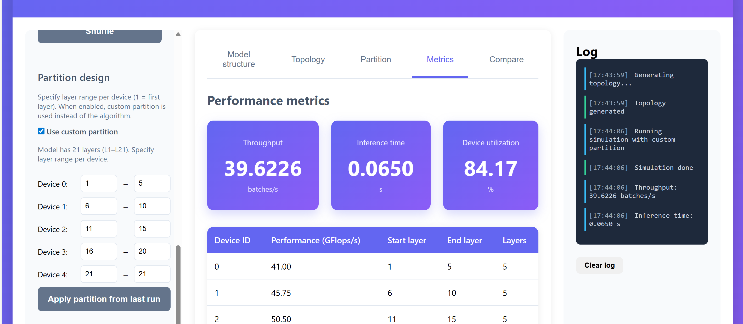
Platform Overview
3.Progress & Preliminary Restults
Left: model, device count, algorithm, bandwidth/performance, and optional custom partition.
Right: five tabs (model structure, topology, partition, metrics, algorithm comparison); run Simulate then switch tabs to view results.
The platform integrates model visualization, device simulation, and performance analysis in a unified interface.

Slide 12

Video Presentation
3.Progress & Preliminary Restults

Slide 13
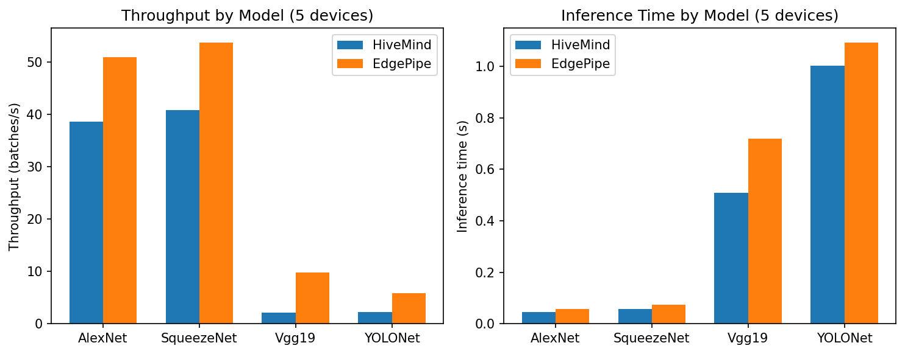
Model Comparison
3.Progress & Preliminary Restults
Figure1. Comparison of EdgePipe and HiveMind
EdgePipe has higher throughput; HiveMind has lower inference latency.

Slide 14
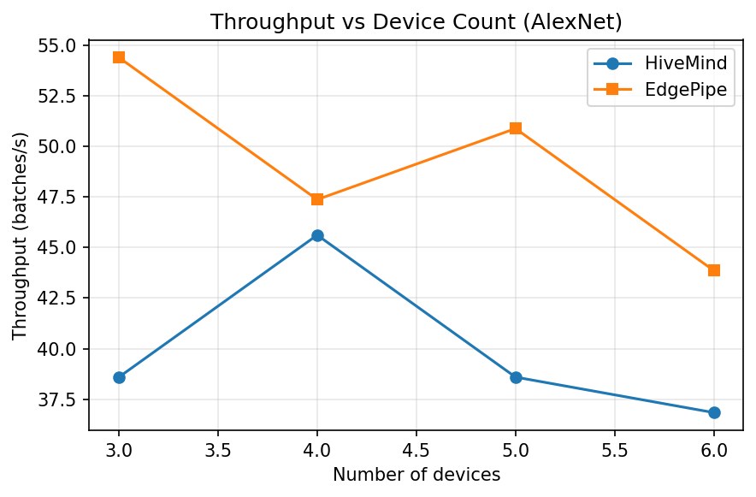
Impact of Device Count
3.Progress & Preliminary Restults
Figure 2. Throughput vs. device count
More devices do not always mean higher throughput. EdgePipe performs best with 3 devices, HiveMind with 4; beyond these points, adding devices hurts performance.

Slide 15
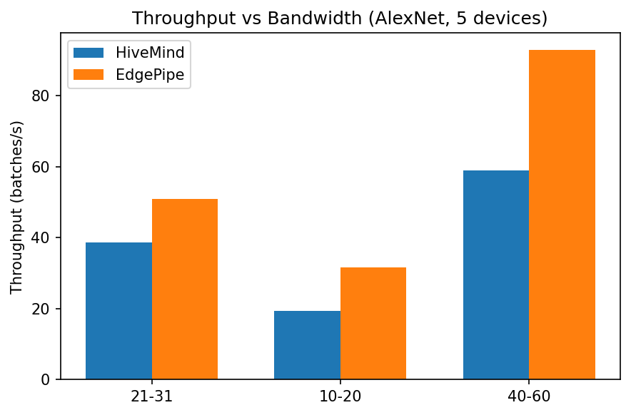
Impact of Bandwidth
3.Progress & Preliminary Restults
Figure 3. Throughput vs. inter-device bandwidth
Higher bandwidth improves throughput for both algorithms.

Slide 16
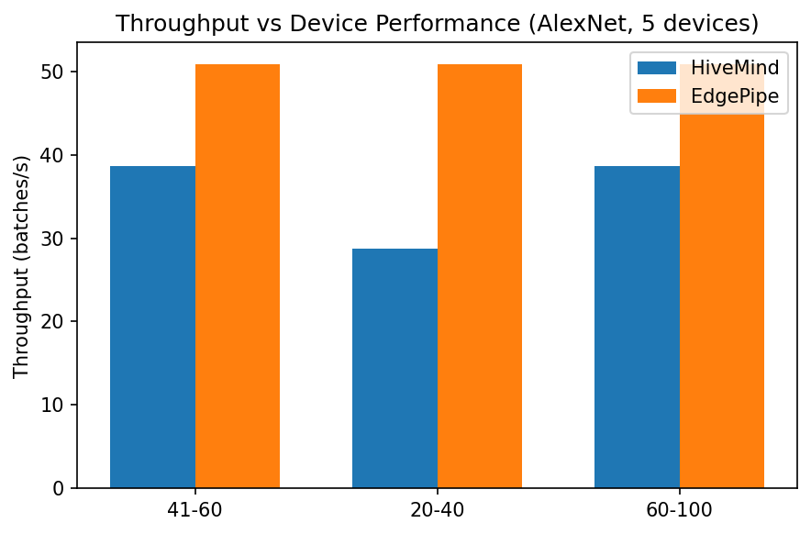
Impact of Device Performance
3.Progress & Preliminary Restults
Figure 4. Throughput vs. device performance
Higher device performance improves throughput.

Slide 17
Conclusions
3.Progress & Preliminary Restults
Throughput vs. latency: The two algorithms optimize different objectives; there is no single best choice across all scenarios.
Configuration matters: Performance depends on topology, bandwidth, and device count, not only on the algorithm.
Design implication: Choose the algorithm and configuration based on whether the system is throughput-bound or latency-bound.

Slide 18
04
Remaining Work and Timeline

Slide 19
4. Remaining Work and Timeline
Remaining Work
Algorithm: Joint optimization of partition and device ordering; explore hybrid strategies combining HiveMind and EdgePipe.
Evaluation: Ablation study (partition vs. ordering vs. bandwidth); scalability tests with more devices and larger models.
Platform: Add batch experiment export and communication-overhead visualization.
Thesis: Complete related work, refine methodology, and finalize discussion.

Slide 20
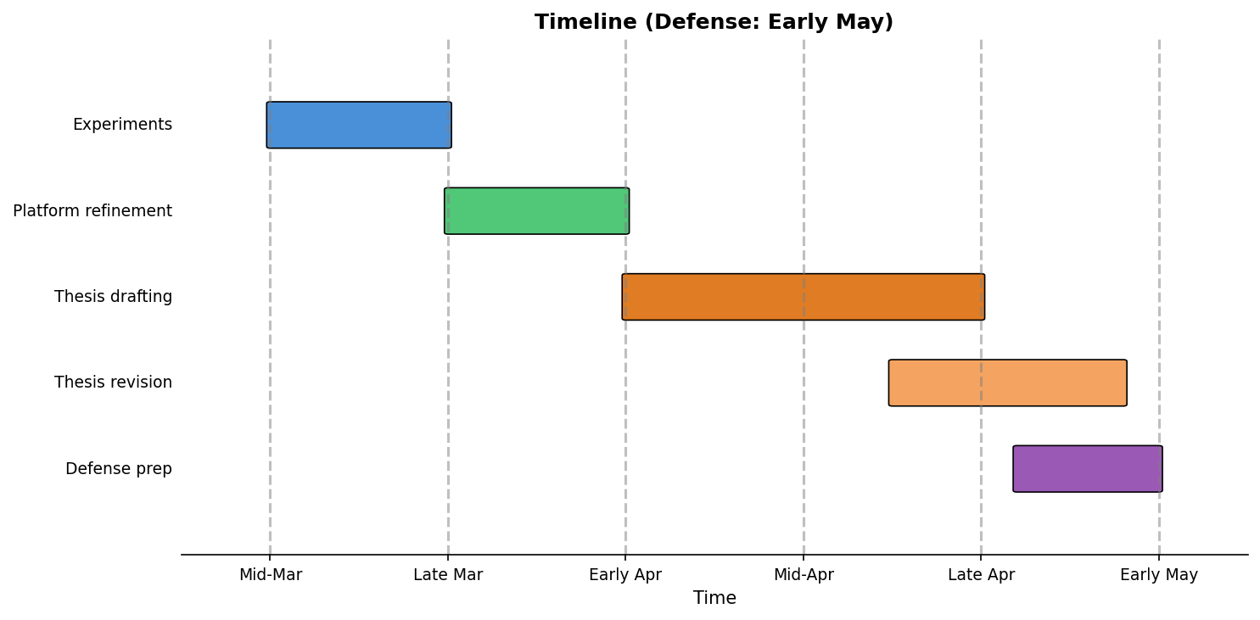
4. Remaining Work and Timeline

Slide 21
Reference
[1] P. Ren, X. Qiao, Y. Huang, L. Liu, C. Pu, and S. Dustdar, “A Survey on Collaborative DNN Inference for Edge Intelligence,” IEEE Transactions on Services Computing, 2022.
[2] Y. Hu, C. Imes, X. Zhao, S. Kundu, P. A. Beerel, S. P. Crago, and J. P. N. Walters, “Pipeline Parallelism for Inference on Heterogeneous Edge Computing,” arXiv preprint arXiv:2110.14895, 2021.
[3] Dai, P., Han, B., Li, K., Xu, X., Xing, H. and Liu, K. (2015) ‘Joint Optimization of Device Placement and Model Partitioning for Cooperative DNN Inference in Heterogeneous Edge Computing’, IEEE Transactions on Services Computing, 14(8), pp. 1–15.
[4] Y. Kang, J. Hauswald, C. Gao, A. Rovinski, T. Mudge, J. Mars, and L. Tang, “Neurosurgeon: Collaborative intelligence between the cloud and mobile edge,” ACM SIGARCH Computer Architecture News, vol. 45, no. 1, pp. 615–629, 2017.
[5] Z. Zhou, X. Chen, E. Li, L. Zeng, K. Luo, and J. Zhang, “Edge intelligence: Paving the last mile of artificial intelligence with edge computing,” Proceedings of the IEEE, vol. 107, no. 8, pp. 1738–1762, 2019.
[6] D. Narayanan, A. Harlap, A. Phanishayee, V. Seshadri, N. R. Devanur, G. R. Ganger, P. B. Gibbons, and M. Zaharia, “PipeDream: Generalized pipeline parallelism for DNN training,” in Proceedings of the 27th ACM Symposium on Operating Systems Principles (SOSP), 2019.
[7] Y. Huang et al., “GPipe: Efficient training of giant neural networks using pipeline parallelism,” NeurIPS, 2019.
[8] A. Vaswani, N. Shazeer, N. Parmar, J. Uszkoreit, L. Jones, A. N. Gomez, Ł. Kaiser, and I. Polosukhin, “Attention is all you need,” in Advances in Neural Information Processing Systems, 2017.
[9] Z. Zhao, K. M. Barijough, and A. Gerstlauer, “DeepThings: Distributed adaptive deep learning inference on resource-constrained IoT edge clusters,” IEEE Transactions on Computer-Aided Design of Integrated Circuits and Systems, vol. 37, no. 11, pp. 2348–2359, 2018.
[10] S. Teerapittayanon, B. McDanel, and H.-T. Kung, “BranchyNet: Fast inference via early exiting from deep neural networks,” in 23rd International Conference on Pattern Recognition (ICPR), 2016.
[11] M. Satyanarayanan, “The emergence of edge computing,” Computer, vol. 50, no. 1, pp. 30–39, 2017.
[12] E. Li, L. Zeng, Z. Zhou, and X. Chen, “Boomerang: On-demand cooperative deep neural network inference for edge intelligence on the industrial internet of things,” IEEE Network, vol. 33, no. 5, pp. 96–103, 2019.
[13] Y. Mao, C. You, J. Zhang, K. Huang, and K. B. Letaief, “A survey on mobile edge computing: The communication perspective,” IEEE Communications Surveys & Tutorials, vol. 19, no. 4, pp. 2322–2358, 2017.
[14] L. Zhou, M. H. Samavatian, A. Bacha, S. Majumdar, and R. Teodorescu, “Adaptive parallel execution of deep neural networks on heterogeneous edge devices,” in Proceedings of the 4th ACM/IEEE Symposium on Edge Computing (SEC), 2019.

Slide 22


Thanks For Listening
2022-CS
Runcong Zhou

