Slide 1

Short Term Synaptic Plasticity Misha Tsodyks Henry Markram (EPFL) Yun Wang (Tufts) Klaus Pawelzik (Bremen) Wu Si (Peking University) Omri Barak (Technion) Gianluigi Mongillo (Paris V) Mi Yuanyuan (Institute of Basic Medical Sciences, Beijing) Misha Katkov (WIS)

Slide 2
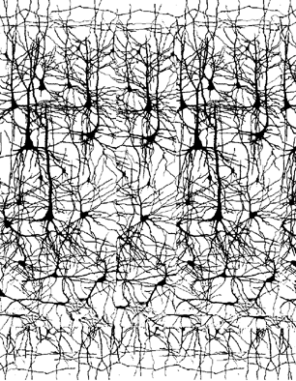
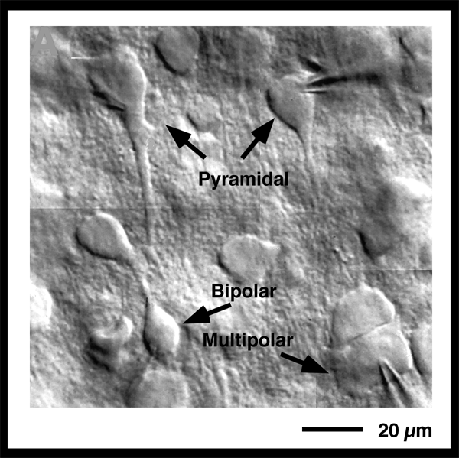
Multineuron Recording

Slide 3
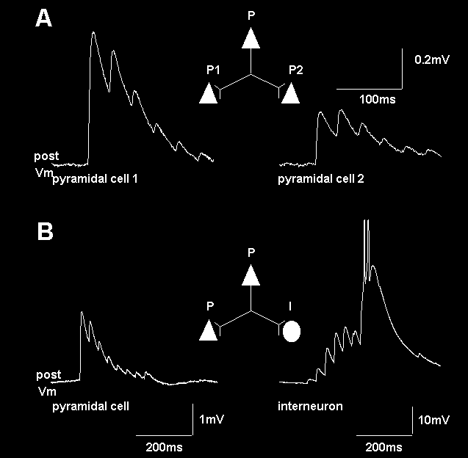
Markram, Wang & Tsodyks PNAS 1998

Slide 4
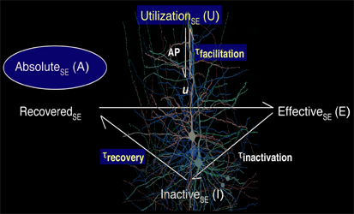
A Phenomenological Approach to Dynamic Synaptic Transmission
4 Key Synaptic Parameters
Absolute strength
Probability of release
Depression time constant
Facilitation time constant
2 Synaptic Variables
Resources available (x)
Release probability (u)
Markram, Wang & Tsodyks PNAS 1998

Slide 5
A Phenomenological Approach to Dynamic Synaptic Transmission
4 Key Synaptic Parameters
Absolute strength
Probability of release
Depression time constant
Facilitation time constant
2 Synaptic Variables
Resources available (x)
Release probability (u)
Markram, Wang & Tsodyks PNAS 1998

Slide 6
Phenomenological model of synaptic depression
( )

Slide 7
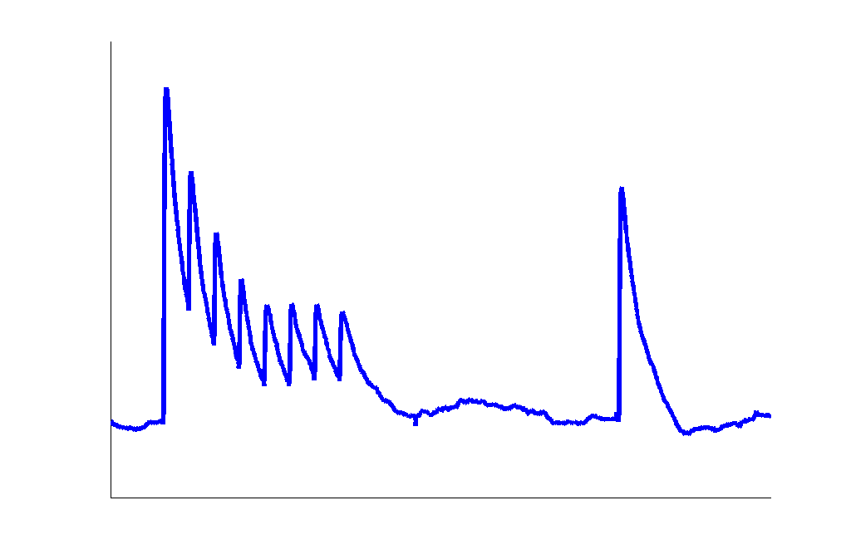
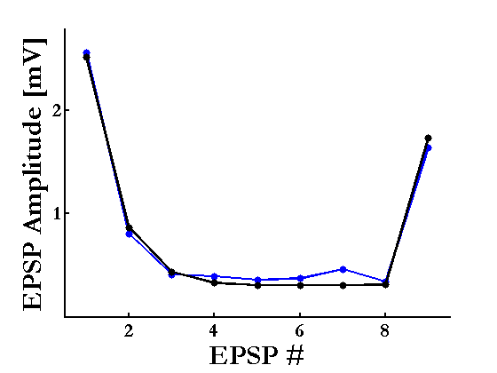
The fitting process (deterministic model)

Slide 8
Frequency-dependence of post-synaptic response

Slide 9
Frequency-dependence of post-synaptic response

Slide 10
Frequency-dependence of post-synaptic response

Slide 11
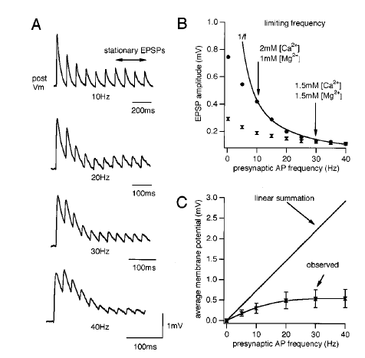
The 1/f Law of Release
Tsodyks & Markram, PNAS 1997

Slide 12
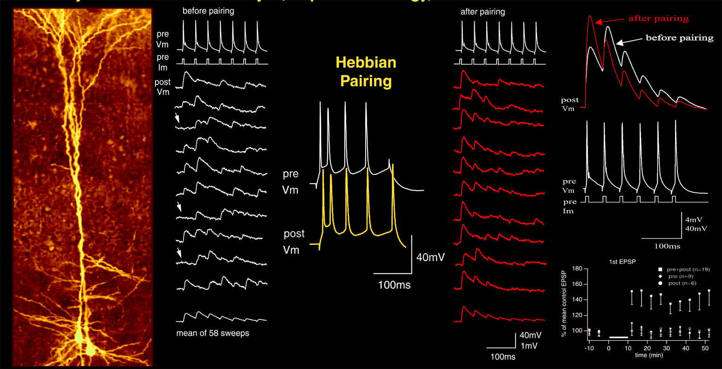
Redistribution of Synaptic Efficacy (Markram & Tsodyks, Nature 96)

Slide 13
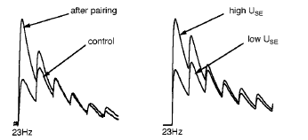
Redistribution of Synaptic Efficacy
high u
low u

Slide 14
Population signal
E(t)
Tsodyks, Pawelzik & Markram, Neural Computation 1998

Slide 15
Population signal (Poisson spike trains)
E(t): time-dependent firing rate
Tsodyks, Pawelzik & Markram, Neural Computation 1998

Slide 16
Population signal

Slide 17
Steady-state signal:

Slide 18
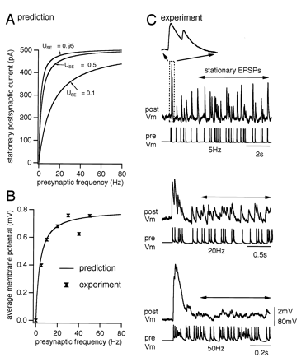
Tsodyks & Markram, PNAS 1997

Slide 19
Time-dependent signal
‘High-pass filtering’ of the input rate

Slide 20
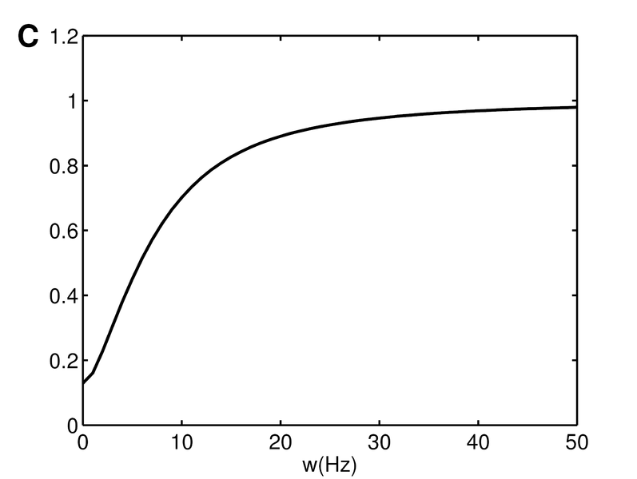
High-pass filtering of the input rate
amplitude
Tsodyks and Wu (2013), Scholarpedia

Slide 21
Synchronous change in pre-synaptic rates

Slide 22
Synchronous change in pre-synaptic rates

Slide 23
Synchronous change in pre-synaptic rates
(Weber’s law)
Abbott et al, Science 1997

Slide 24
