Slide 1
NDX Data Dash boarding From Yahoo! Finance API to Tableau
By Rundong Gao

Slide 2


4th year Bachelor of Computer Science Candidate
at University of Waterloo
Double Majors in Honors Computer Science and
Honors Applied Mathematics

Slide 3
Today I will…
Present my answers to 4 questions with Tableau about Nasdaq-100 index.
Explain the technologies and design of behind it. How it was achieve?
One additional feature.
Retrospective

Slide 4
4 Questions I will answer today:
What are the top 10 stocks whose prices changes most in Q3 2014?
What are the top 3 sectors (industry) that has the maximum number of stocks who change prices over 30% in first half of 2014?
How much each sector contributed to the total market cap and volume of NDX-100?
How did trading volume influence AAPL stock price?

Slide 5
TECHNOLOGIES:
Tableau Desktop, Tableau Online
AWS RDS, AWS EC2
Yahoo! Finance API
Ruby
Postgres DB

Slide 6
NDX_100 database

Slide 7
From Yahoo! Finance API to Tableau

Slide 8
One step further…
static historical data:
doesn’t change, update or refresh

Slide 9
What our data is no long static?
Data need frequent update.
What if we want the NDX-100 data from the beginning of 2016 till Yesterday?

Slide 10
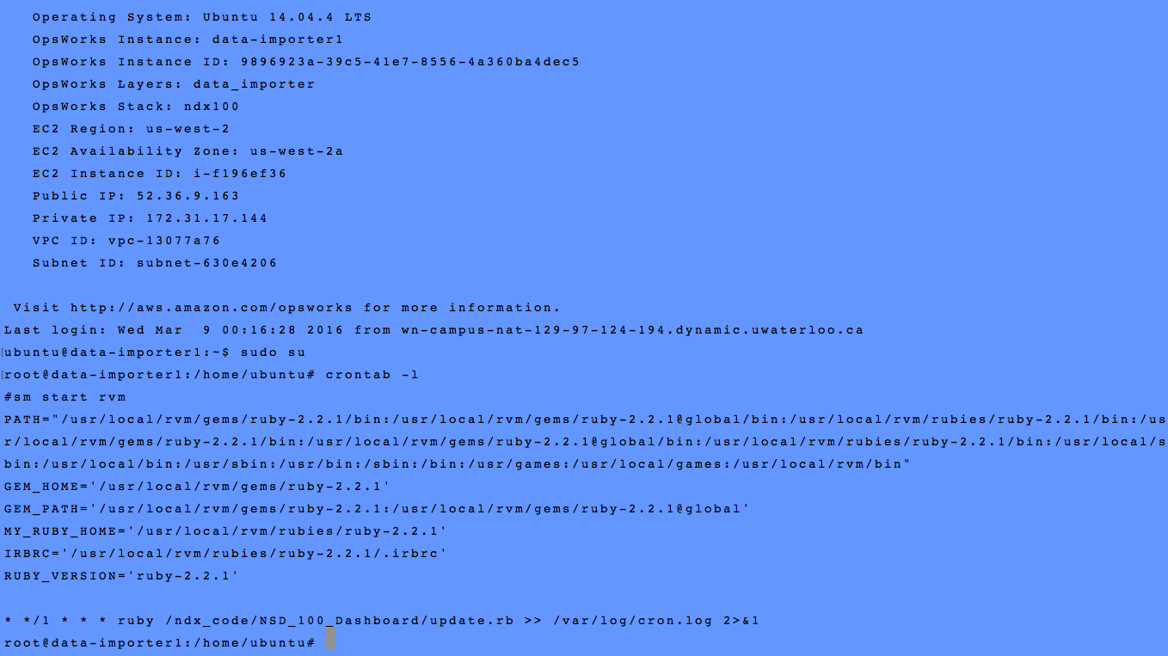
A Linux Server on AWS EC2 checking update every hour using crontab

Slide 11
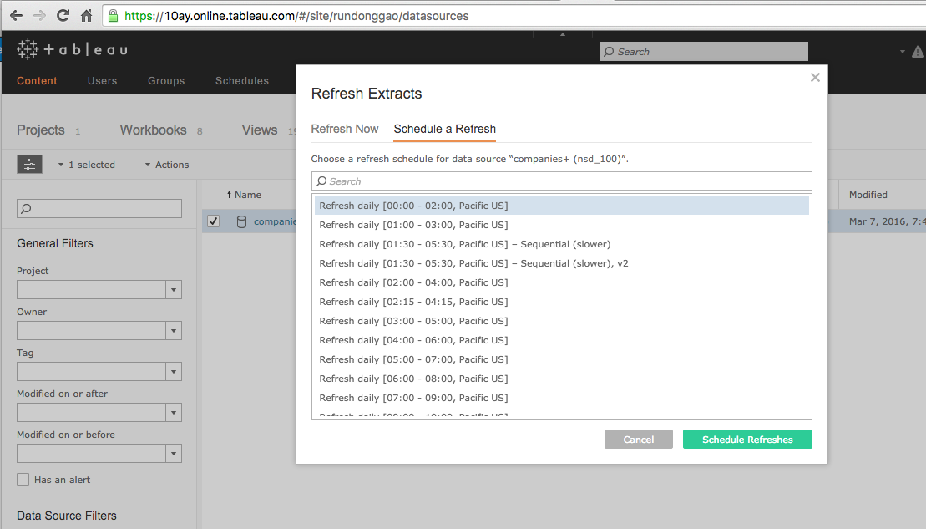
And a data source extraction from tableau Online

Slide 12
What I did well?
I learned Tableau and Yahoo! Finance API!
Especially Tableau!!!
I moved everything to cloud!
I set a system to refresh data!

Slide 13
What I could do better
Unit test
Better documentation
Expand this case study out side NDX-100

Slide 14
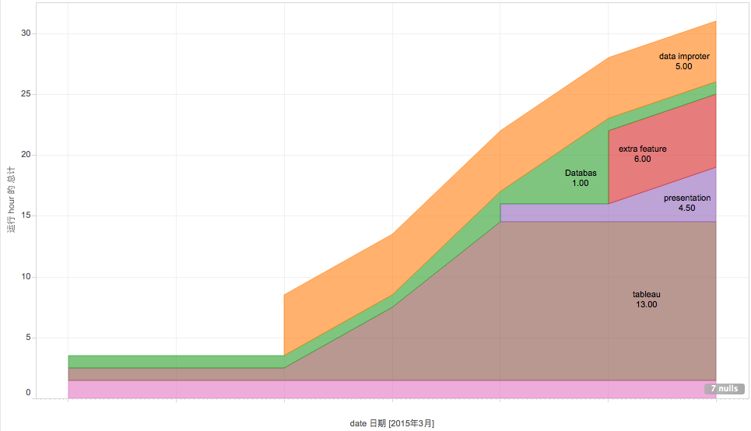
How many hours did I use?

Slide 15
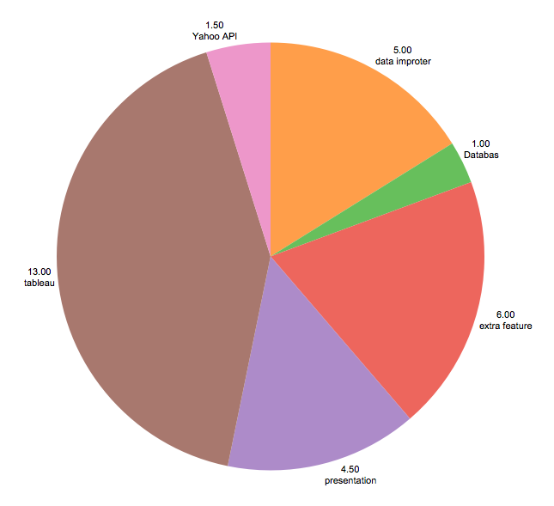
How many hours did I use?

Slide 16
My source code and all related files can be found at : https://github.com/RundongGao/NSD_100_Dashboard
URLs for tableau workbooks:
https://10ay.online.tableau.com/t/rundonggao/views/Q3_most_changed/MostChangedinQ32014?:embed=y&:showShareOptions=true&:display_count=no&:showVizHome=no
https://10ay.online.tableau.com/t/rundonggao/views/booming_stock_1st_hf/BOOMINGStocksin1stHY2014?:embed=y&:showShareOptions=true&:display_count=no&:showVizHome=no
https://10ay.online.tableau.com/t/rundonggao/views/Contribution_in_Martet_Cap_and_Volume/Story1?:embed=y&:showShareOptions=true&:display_count=no&:showVizHome=no
https://10ay.online.tableau.com/t/rundonggao/views/Volume_vs_Stock_Price/Story1?:embed=y&:showShareOptions=true&:display_count=no&:showVizHome=no
https://10ay.online.tableau.com/t/rundonggao/views/OHLC_2016/Sheet1?:embed=y&:showShareOptions=true&:display_count=no&:showVizHome=no

Slide 17
Thank you for your time :D

Slide 18
Comments and Questions?

